Slide 1
Longline Electronic Reporting and Monitoring
Pacific Islands Fisheries Science Center
3rd meeting of the WCPFC E-reporting and E-monitoring Working Group
6 August 2018

Slide 2
Benefits of Electronic Reporting
145 longline vessels based in Hawaii or California
15 longline vessels based in American Samoa
Benefits to monitoring: | Benefits to the industry: | Benefits to both:
Real-time data submissions reduce processing time needed for paper forms Reduce the number of paper forms processed through PIFSC/JIMAR (>20,000 forms per year) | Ease of use and efficiency Review form similar to current paper form Data are secure and encrypted end-to-end | Improved timeliness for bigeye tuna quota tracking in the WCPFC and IATTC Convention areas Improved location accuracy (GPS locations pulled from VMS)
Notes:
-Cuts back on resources in fisheries monitoring both in paper and labor
-Even with processing at the end of a trip, the processing time of data entry is removed
-The quicker the data is received and processed, the more accurate the projection is as far as when the fishery will close
-Saves time for captains rather then having to legibly fill out their logsheet

Slide 3
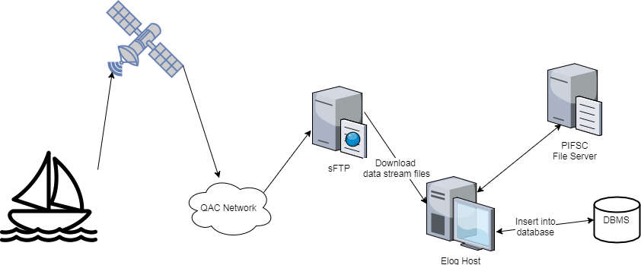
Overview
Data entered on Android device
E-forms sent via VMS unit using Iridium satellite communications
Transmission confirmation from satellite
Re-transmit feature
Encrypted end-to-end (from tablet to NOAA server)

Slide 4
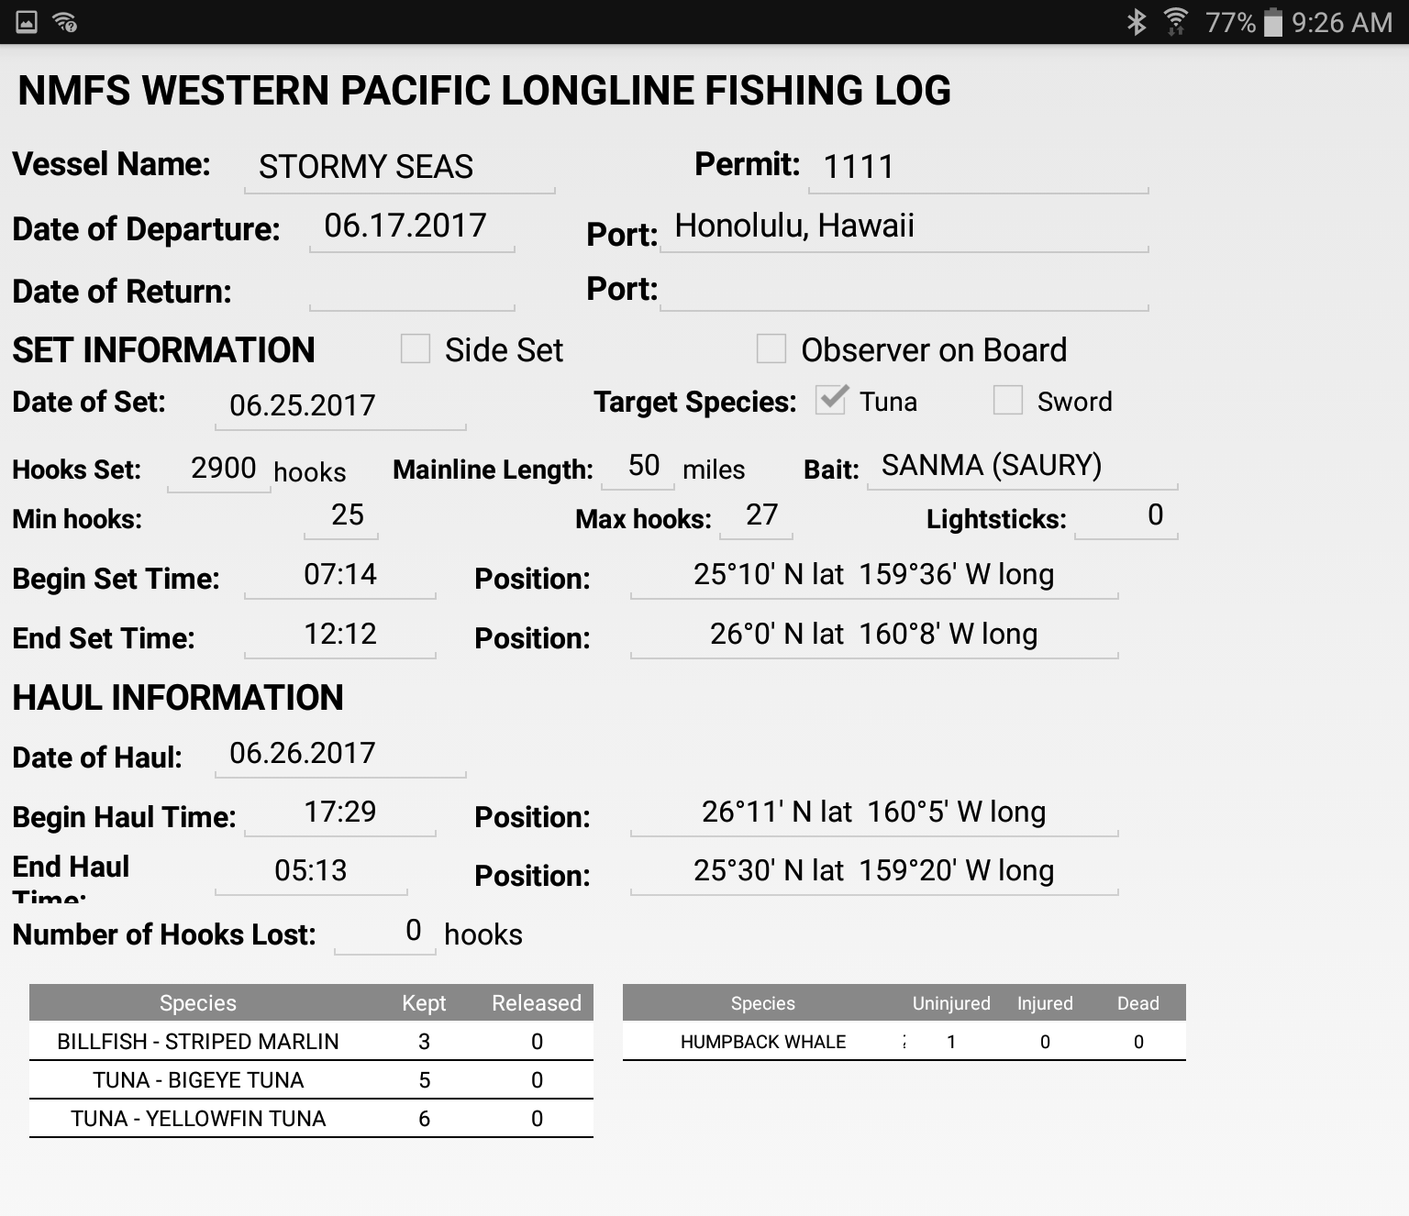
Feature – Set Review Screen
Similar look to the paper logsheet
Easy to read

Slide 5
Feature – Trip Catch Summary Screen
Previous trip summaries of kept and released counts by species
Requested by captains

Slide 6
ER Challenges
12 vessels are equipped with tablets to continue at-sea beta testing, maximum of 100 tablets
Timing - Vessels are out at sea for 2-3 weeks and in port for a few days
User/industry training
USA fishery with English, Korean and Vietnamese ethnic groups with differing computer knowledge
Tablet management for vessels that land fish in California
Encryption key management
Notes:
Ongoing
Outreach –
Finding captains/owners to test the new application
Training captains on the new application
Timing –
Captains not always at their vessel while in port
User feedback –
Talking to the captains and owners to how we can improve the app.

Slide 7
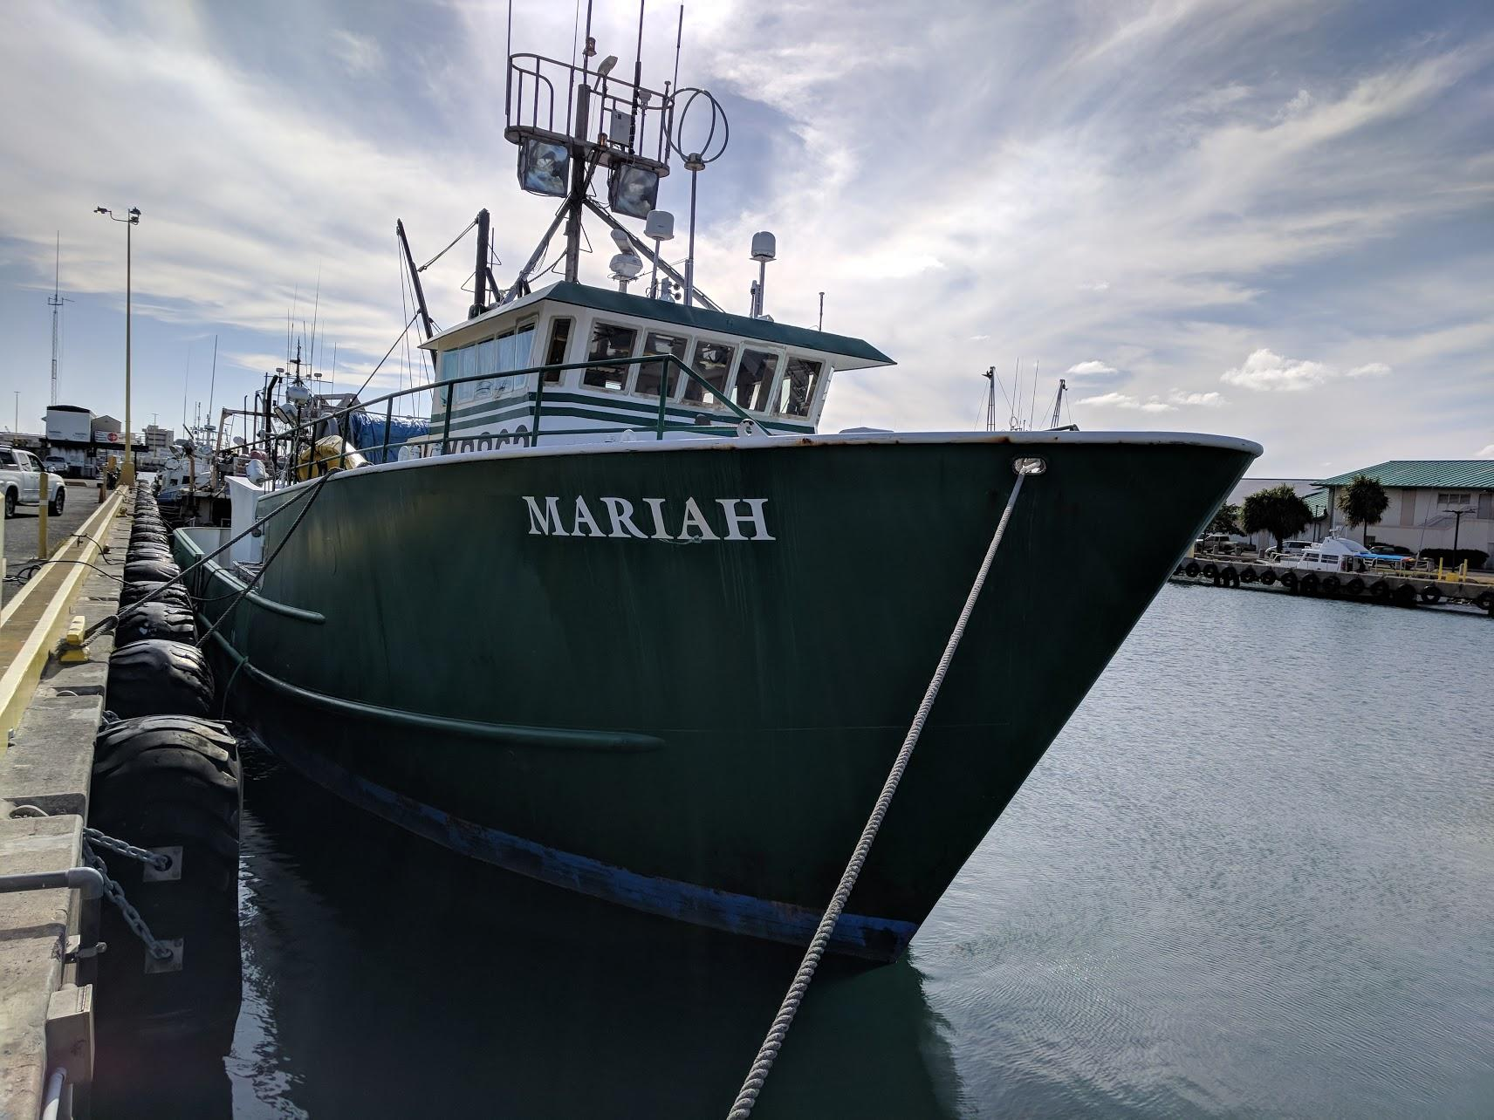
Longline EM Overview
7.5%
At-sea observer coverage –
100% shallow-set;
20% deep-set in Hawaii and A. Samoa
16 active installs in Hawaii
Systems maintained by Saltwater Inc.
Closed system, hard drives retrieved in Honolulu
Human review
Catch accounting objective
Comparing EM to Observer Data
50%
9.5%
66
U.S. Department of Commerce | National Oceanic and Atmospheric Administration | NOAA Fisheries | Page 7
Notes:
funding from within noaa
18 installs in 2017, one sank one is currently in selection for redeployment
Saltwater EM is our system maintenance provider and software developer
Systems are storing data locally on encrypted hard drives which are picked up from a centralized port in Honolulu
Footage from a reviewed trip is watched in its entirety by a human at 8x speed. We are using data for catch and bycatch (or discards) data as well as catch effort and these results are being compared to observer data to determine data gaps

Slide 8
Data Comparisons
7.5%
116 deployed trips
7.5% EM ‘coverage’
Observer data used as baseline
Review of 17 Trips
193 Deep-set hauls targeting Bigeye Tuna
~ 1800 Hours of footage reviewed in ~300 hours of active review
~6 hours of review maximum per day
QA/QC to take a break from review
50%
9.5%
66
U.S. Department of Commerce | National Oceanic and Atmospheric Administration | NOAA Fisheries | Page 8
Notes:
in 2017 we recorded 116 trips representing 7.5% em coverage
17 trips were then compared with observer data, in the slides ahead there is a metric called percent difference which is in reference how the EM data differs from observer data
Active video review only takes about 15% of deck time 1800 hours of fishing took only 300 hours to review
Review efforts were limited to 6 hours maximum per day to keep the reviewer from burning out. the reviewers would periodically take a viewing break to quality check the data

Slide 9
Retained and Discarded (bycatch) Catches - 193 Hauls
 | Observer Catch | EM Catch | Piece Difference | Percent Difference
Tunas | 4348 | 4320 | -28 | -0.6%
Billfishes | 595 | 591 | -4 | -0.7%
Sharks* | 1658 | 750 | -908 | -54.8%
Protected Species | 14 | 13 | -1 | -7.1%
All Species | 15450 | 13673 | -1777 | -11.5%
U.S. Department of Commerce | National Oceanic and Atmospheric Administration | NOAA Fisheries | Page 9
Notes:
Here are the over all figures for all retained and discarded species in comparison with observer data from the same trips. Over all 88.5 percent of all observed catch events were found during the EM review process. In this first year, a large data gap for discarded species was identified and is shown here by the large difference in shark detection. As part of the EM review protocol, species are only IDed based on characteristics seen in the footage, so while EM review could only identify half the sharks the observer saw, there were a large amount of unidentified catch events that were most likely sharks that never showed up on camera. There was also one protected species that was caught in a camera's blind spot and was therefore missed in the EM review.

Slide 10
Retained only Catched - 193 Hauls
 | Observer Kept | EM Kept | Piece Difference | Percent Difference
Tunas | 3862 | 3883 | +21 | +0.5%
Billfishes | 475 | 491 | +16 | +3.4%
Sharks | 3 | 3 | 0 | 0.0%
All Species | 6752 | 6769 | 17 | -0.3%
U.S. Department of Commerce | National Oceanic and Atmospheric Administration | NOAA Fisheries | Page 10
Notes:
As you can see here, the numbers for retained species are much better with only 1 species having a statistical difference from observer counts. if the animal is brought on deck, this early iteration of EM and the review process had no problem finding it.

Slide 11
Statistics for retained economically important species
 | Total Piece Difference | Percent Difference | P-Value | Statistically Different (P<0.05)
BET | -42 | -1.7% | 0.053 | No
YFT | 15 | 1.4% | 0.584 | No
Striped Marlin | -14 | 9.7% | 0.104 | No
Blue Marlin | 5 | 11.4% | 0.254 | No
Swordfish | 5 | 8.2% | 0.342 | No
U.S. Department of Commerce | National Oceanic and Atmospheric Administration | NOAA Fisheries | Page 11

Slide 12
Lessons from Hawaii
9 trips lost due to 2TB HDD failures
Smaller HDDs or SSDs are more resilient
1 trip lost when vessel sank (no transmission)
1 system failure due to user error
1 camera failure due to gaff strike
9 cameras identified with sub-standard image
Using IP cameras with adjustable focus
Automation development is improving quickly
VIAME - NMFS built open source machine learning toolkit
U.S. Department of Commerce | National Oceanic and Atmospheric Administration | NOAA Fisheries | Page 12
Notes:
About 7 percent of the trips from 2017 experienced a hard drive failure where the systems could no longer write data to the drives midtrip. In testing, smaller hard drives are proving to hold up better to at sea conditions
One of the downsides to storing data locally is that damage to a system or a hard drive leads to loss of all data during that trip. transmission of video for catch accounting is cost prohibitive at this time
The systems are not hard wired to electricity or sealed from the crew and are installed on active fishing vessels. During a trip, the crew is focused on fishing and may occasionally unintentionally contact system components, over the course of the year 1 system failed due to user error and 1 camera was broken by a gaff.
Some cameras presented a blurry image. Most of these cameras have now been fixed by the saltwater technician paying close attention to lighting conditions and precisely adjusting and affixing the focus knob inside the cameras to prevent the lens from moving out of focus.
And finally, I’d like to mention VIAME which is an open source computer vision tools to teach machine learning algorithms to count fish in the data, enabling human reviewers to help train the machines which in turn will help boos review efficiency

Slide 13
Next steps
Technical Report comparing observer and EM data
Project comparing video review times 4x, 8x & 16x
Consider video review for only protected species on a subset of trips to increase coverage
Volunteer program, then it will require regulatory action to amend the Council’s Fishery Ecosystem Pland to define the rules for EM use (when, where), redefine roles of EM and observers, identify data ownership, cost recovery etc.
U.S. Department of Commerce | National Oceanic and Atmospheric Administration | NOAA Fisheries | Page 13
Notes:
About 7 percent of the trips from 2017 experienced a hard drive failure where the systems could no longer write data to the drives midtrip. In testing, smaller hard drives are proving to hold up better to at sea conditions
One of the downsides to storing data locally is that damage to a system or a hard drive leads to loss of all data during that trip. transmission of video for catch accounting is cost prohibitive at this time
The systems are not hard wired to electricity or sealed from the crew and are installed on active fishing vessels. During a trip, the crew is focused on fishing and may occasionally unintentionally contact system components, over the course of the year 1 system failed due to user error and 1 camera was broken by a gaff.
Some cameras presented a blurry image. Most of these cameras have now been fixed by the saltwater technician paying close attention to lighting conditions and precisely adjusting and affixing the focus knob inside the cameras to prevent the lens from moving out of focus.
And finally, I’d like to mention VIAME which is an open source computer vision tools to teach machine learning algorithms to count fish in the data, enabling human reviewers to help train the machines which in turn will help boos review efficiency

