Slide 1
A Tuna CDS for the WCPFC --- based on FAO’s Best Practice Guidelines for Tuna CDS
Gilles Hosch – FAO/ABNJ
Tuna Market & Trade Specialist

Slide 2
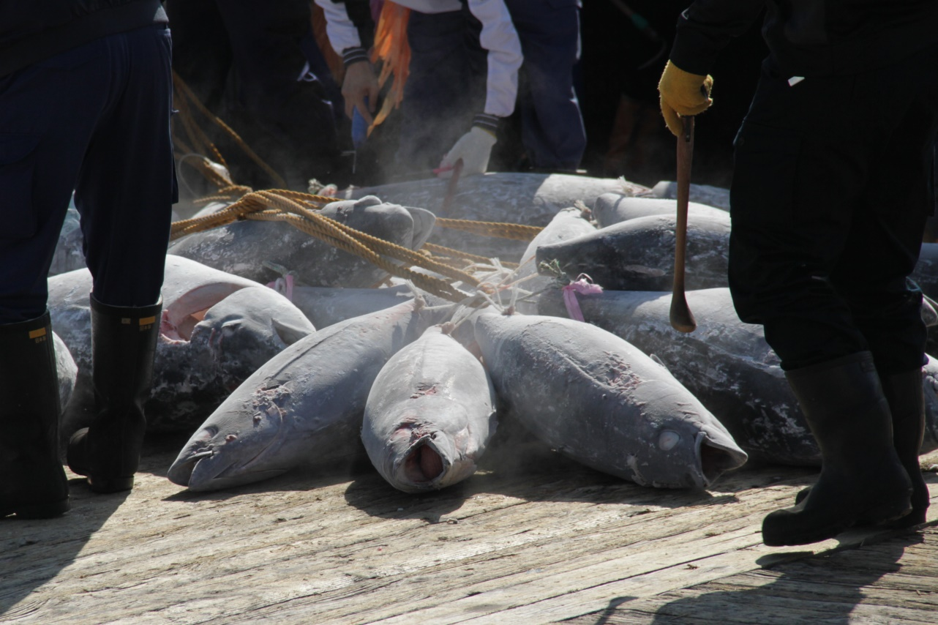
Objective of this session
Provide a first look at key WCPFC CDS system elements, based on previous IWG discussions and positions, and proposed CDS principles guiding FAOs work on CDS

Slide 3
Points covered
International CDS work
Existing CDS & key differences
CDS definition and objective
CDS mode of action / merits and limits
CDS traceability concept
CDS Scope and coverage
Roles of stakeholders
CDS standards
e-CDS data load & central / decentralised ops

Slide 4
Past and present CDS work
COFI
2002 FAO Expert Consultation produces list of data elements for catch certificates
KOBE
2007 & 2010 meetings & preliminary conclusions
Move from SDP to CDS / Cover species globally thru harmonised systems / use e-CDS / RFMO CDS > unilateral CDS / flag State certification insufficient
FAO/ABNJ
2014 Tuna CDS Best Practice Guidelines
COFI
2015 FAO Expert Consultation on Voluntary Guidelines for Catch Documentation Schemes

Slide 5
Existing CDS systems
 | year | e-CDS | central certificate registry | document system | verifiable traceability
CCAMLR | 2000 | yes | yes | CC + TC | yes
ICCAT | 2008 | yes * | yes | CC + TC | yes
CCSBT | 2010 | actively planning | yes | CC + TC | yes
EU | 2010 | no | no | CC (+ PS) | no

Slide 6
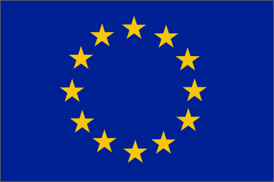
Two CDS models
Only catches traded to the EU – from any marine fishery worldwide – are covered and partially accounted for
Fishery A
PS
MARKET: single market State (MS)
Legend:
PS: Port and/or Processing State
MS: Market State
Fishery B
PS
MS
PS
Fishery C
PS
MS
PS
PS
Fishery D
PS
Fishery E
MS
PS
All product* through any and all port, processing and market State is covered and accounted for
FISHERY: single stock across its entire range
MS
PS
ICCAT
PS
MS
* domestic landings are exempted

Slide 7
What is a CDS?
Lack of a recognised international definition
A CDS is a global traceability system, hinging on a data and document system linking catch & trade data/certificates
A CC certifies a unit of legal catch, providing a validated document to the legal owner of fish
The CDS traces movement of the certified unit of catch from harvesting, through processing and international trade, into the end market

Slide 8
CDS objective
To combat IUU fishing…
through…
denying IUU fish market access. Only certified catch can be landed and traded.
2ary objectives are possible, but should not overburden the system

Slide 9
CDS – mode of action
Certificates have to be registered in a central certificate registry every step along the supply chain, in order to record links and volumes
In order to ensure only legally certified product is moving through the system, mass balance (volumes) needs to be monitored
Detected imbalances signal laundering of non-originating fish into certified supply streams and must lead to enforcement action
Central rule: LANDING or IMPORT ≥ EXPORT

Slide 10
Merits and limits of CDS
CDS GOOD:
underreporting and misreporting of catches by otherwise legal operators
denying landing opportunities for illegal catch in cooperating port States
denying laundering avenues for illegal catches in cooperating processing/market States
CDS NO GOOD:
Denying IUU operators access to rogue (non-cooperating) port and end-market States

Slide 11
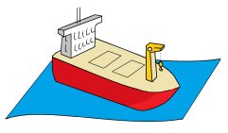
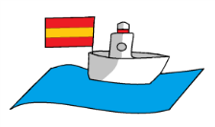
CDS traceability concept
landing
sales
splits
processing
distribution
consumption
export
import
sales
splits
processing
distribution
consumption
re-export
import
sales
splits
processing
distribution
consumption
(re-export)
National Traceability Laws
INTERNAL TRACEABILITY
COUNTRY A
COUNTRY B
COUNTRY C
EXTERNAL TRACEABILITY
reefer(s)
landing
export
import
re-export
import
etc.
RFMOCDS
Rules
fishing operation

Slide 12
Scope and coverage
How to get started on the CDS? Incrementally?
The commercial products and end-market perspective is most useful to answer question
“Lightmeat” tuna cans…mixed species
ALB generally not mixed as a commercial product (“whitemeat”)
Especially canning-grade tuna can be sourced from multiple gears (but sashimi grade also…)
Covering all tunas and all gears makes sense
Simplified regime for artisanal fisheries (EU)

Slide 13
Roles of stakeholders
Private sector – fishing operations
Initiate catch certificate / submit data
Responsible for truthfulness of submission
Provide validated CC to first buyers
Private sector – importers
Confirm receipt of importation and TC
Private sector – processors and traders
Initiate trade certificate / submit data
Responsible for truthfulness of submission
Provide validated TC to buyer (intl trade)

Slide 14
Roles of stakeholders
CA – flag State
Verify and validate submitted CCs (est. weight)
Investigate fraud / prosecute offenders
CA – port State
Verify existence of CC before landing is permitted
Verify and counter-validate submitted CCs (ver. weight)
Investigate fraud / prosecute offenders
CA – processing/market State
Verify and validate submitted TCs
Investigate mass balance anomalies / prosecute offenders

Slide 15
Roles of stakeholders
CA – coastal State
Object / block the validity of specific CCs based on catches obtained from its EEZ (on the basis of established infringements to national law)
may be implemented through a non-objection routine; i.e. as long as a coastal State does not object, it is in agreement with flag and port State validations and counter-validations
CCs ought to be blocked within a specified time limit following validation by the flag State

Slide 16
Roles of stakeholders
RFMO
CDS data monitoring and analysis
Preparation of agreed reconciliation reports
Engagement with CPCs and CNPCs on detected anomalies
Preparation of lists of detected and unresolved anomalies for the TCC
Active engagement with non-members of the supply chain to join the Commission as a full or cooperating non-member

Slide 17
Standards
The traceability standard must be defined:
capability to trace back to individual vessels and fishing trips
CDS: external (inter-country) traceability only
The validation standard must be defined:
What elements ought to be verified before validation? (risk analysis)
When is an operation deemed to be “IUU” and not eligible for a CC?
Does a settled fine/sanction/penalty make the catch re-eligible for certification?

Slide 18
Standards
The accreditation standard must be defined:
Only public authorities can perform the function of competent authority (CA)
[but delegation ought to remain an option – under the responsibility of the CA]
A notification procedure should be defined to identify these authorities / public record
The various State-level CAs – as applicable – have to be notified per CPC / CNPC (flag, port, coastal, processing/ market)

Slide 19
WCPFC e-CDS data load
Based on comparative calculations based on the EU, CCSBT and CCAMLR CDS…
RFMO | Tuna catch (volume) | Vessel operators (companies) | Processors/ Exporters | Importers | Total
IATTC | 13% | 2,600 | 910 | 3,250 | 6,760
ICCAT | 10% | 2,000 | 700 | 2,500 | 5,200
IOTC | 19% | 3,800 | 1,330 | 4,750 | 9,880
WCPFC | 58% | 11,600 | 4,060 | 14,500 | 30,160
Global | 100% | 20,000 | 7,000 | 25,000 | 52,000
RFMO | Tuna catch (relative) | Tuna catch (volume) | number of certificates
IATTC | 13% | 598,000 | 85,024
ICCAT | 10% | 460,000 | 65,403
IOTC | 19% | 874,000 | 124,265
WCPFC | 58% | 2,668,000 | 379,336
Global | 100% | 4,600,000 | 654,028

Slide 20
Decentralised CDS
Harmonising between RFMOs, while decentralising within?
Decentralised
50+ independent IT systems? Protocols?
Burden: developing, training, operating?
System uptime?
Inflexible for updates
Oversight: ???
Centralised
1 system
Burden: minimised
Uptime maximised
Rules and system updates simple
Oversight & monitoring: easy

Slide 21
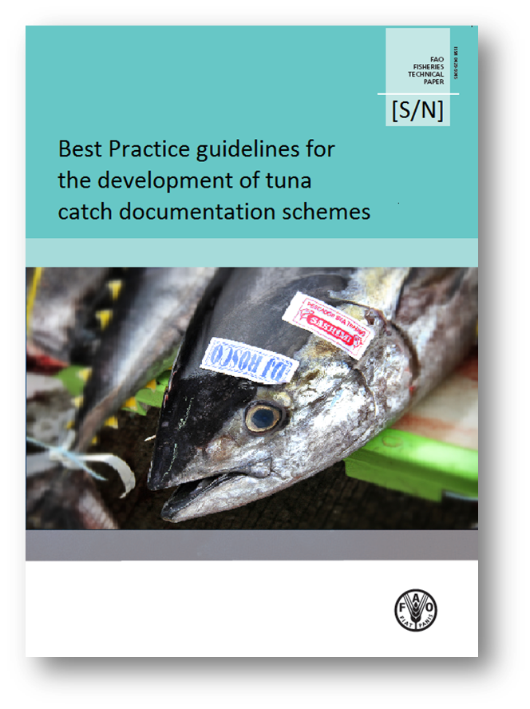
Thank You
e-mails:
gilles.hosch
@fao.org
hosch@pt.lu
Cell:
+352 621 752418
Skype:
hosch69

