Slide 1
Compatibility & consequences of alternative potential TRPs for the south Pacific albacore stock MOW3-WP/06 SPC, OFP MOW3 meeting, Apia, Samoa Friday 28th November 2014

Slide 3
Aims
Consequences of using ‘minimum’ south Pacific albacore biomass target reference point levels compatible with different levels of LRP risk;
Consequence of achieving the ‘default’ MSY reference point;
Examine candidate TRPs based upon fishery objectives such as catch rates, fishery profitability and MEY;
2010 catch rates
MEY, 10% ‘super profit’, & ‘break-even’ levels
Motivate discussion on the compatibility and acceptability of different candidate target levels, and the potential implications of those management options for the southern longline fishery.

Slide 4
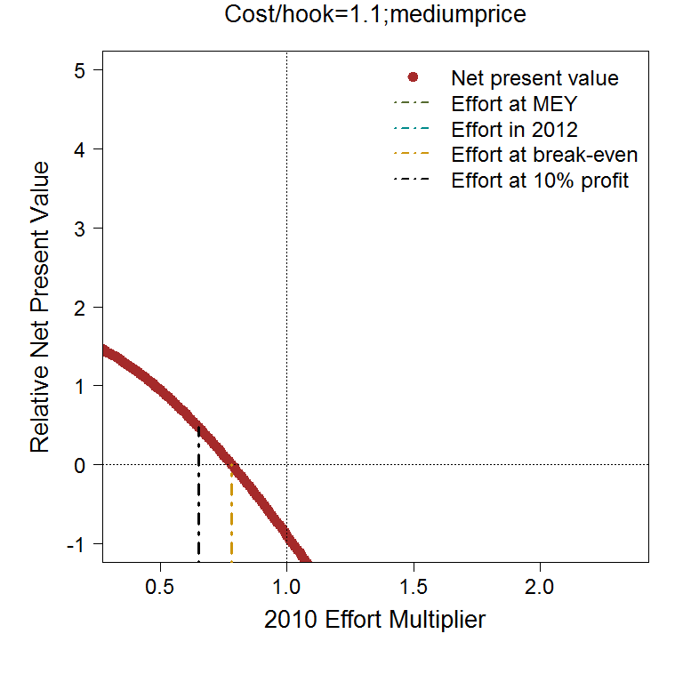
Approach
Required update and application of the ‘south Pacific albacore bio-economic model’ (Appendix 1 of the paper)
New financial information (lower fish prices)
Updated ‘bycatch’ level relationships
3 levels of fishing costs

Slide 5
Approach to examine TRPs
Stock projections from the 2012 assessment model
200 x 20 year stochastic projections
Using SC10 recommendations to capture uncertainty
Future effort within the longline fishery was scaled
Recruitment variability around the SRR
Identified LL fishing levels that achieved the various reference points examined on average
Examined the consequences for the south Pacific albacore stock, including
Average stock status and risk relative to the agreed LRP
Catch rates
etc

Slide 6
‘Minimum’ TRPs – risk analysis
5% risk
5% risk
Scalar | 3.8
Median SB/SB_{F0} | 0.38
Risk SB<LRP | 5%
VB/VB₂₀₁₀ | 46%

Slide 7
MSY
Scalar | 6.8
Median SB/SB_{F0} | 0.25
Risk SB<LRP | 34%
VB/VB₂₀₁₀ | 28%
Level = MSY

Slide 8
CPUE at 2010 levels
Scalar | 0.83
Median SB/SB_{F0} | 0.71
Risk SB<LRP | 0%
VB/VB₂₀₁₀ | 100%
Making money? | No

Slide 9
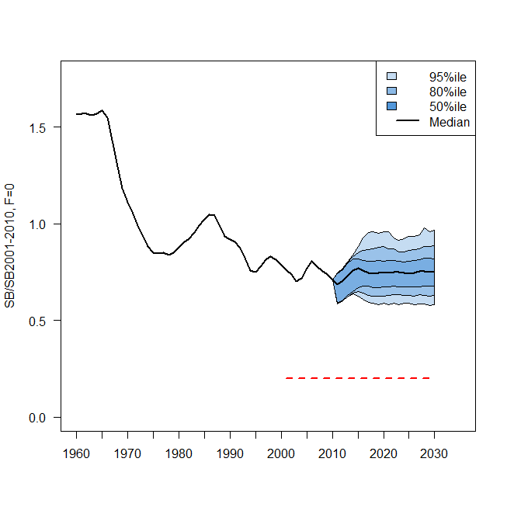
Economic TRP levels
’10% profit’ level
 | MEY | Breakeven | 10% profits
Scalar | <0.25 | 0.57-1.12 | 0.47-0.94
Median SB/SB_{F0} | 0.90 | 0.64-0.78 | 0.68-0.81
Risk SB<LRP | 0% | 0% | 0%
VB/VB₂₀₁₀ | 136% | 90-114% | 97-120%
Making money? | Max | Basic returns | Y (10%)
‘Medium’ price & cost scenario

Slide 10
Summary
MSY as a long term target implies a high risk of falling below the LRP (1 in 3 chance)
Recovering CPUE to 2010 levels is not enough to make profits in the fishery at current prices (i.e. 2010 CPUE is below levels needed to breakeven)
MEY as a target implies major reductions in effort to be achieved at current prices
Achieving a 10% profit within the fishery may be a more sensible target at current prices, but reductions from 2010 effort levels still required, of 6%-53% dependent on costs.
‘Breaking even’ (basic returns) generally required reductions in effort from 2010 levels (dependent upon prices and costs)

Slide 11
Discussion points
Confirmation of the need and rationale for a Harvest Strategy for southern LL fishery, including a TRP for SPA, that meets management objectives (e.g. economic, social and biological).
Do we want a TRP to maximize economic yield – or will it be necessary to trade off objectives and get a ‘pretty good’ economic yield?
How should we consider the differing economic performance of fleets when considering MEY‐based target reference points?
How best to further the development of a harvest strategy for the southern LL fishery (e.g. further bio-economic analyses) as part of the work of the Commission?

