Slide 1
Preliminary Yellowfin Outcomes Under The WCPFC Mixed Fishery Harvest Strategy Approach
WCPFC-SC22-2026-MI-WP-06
SPC-OFP

Slide 2
SC22 is invited to:
Endorse the approach outlined here to evaluate outcomes for yellowfin under the proposed WCPFC mixed fishery approach;
Note that under the adopted MPs for skipjack and South Pacific albacore, and potential MPs for bigeye tuna, yellowfin is expected to remain above the LRP with high probability;
Note that current management objective for yellowfin cannot be achieved for the range of bigeye TRPs currently under consideration;
Provide feedback on the information provided, and in particular, on the performance indicators used to demonstrate expected outcomes for yellowfin, and
Note that the evaluations presented here can be updated and resubmitted for BMW02.

Slide 3
Previous Work
There is no MP that explicitly considers the stock status of yellowfin and manages the associated fisheries.
Fisheries are primarily managed through the MPs of bigeye, skipjack, and South Pacific albacore.
In the absence of an agreed TRP for yellowfin, the evaluations are presented in relation to the default management objective of CMM 2025-02 of the average spawning biomass depletion ratio for the period 2012 to 2015.
Previous analyses to determine likely outcomes for bigeye and yellowfin tuna under the TT-CMM indicate it may not be possible to achieve current management objectives for bigeye and yellowfin simultaneously.

Slide 4
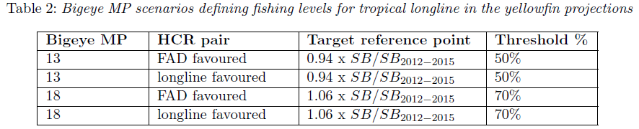
Projection Framework
Fishery specific effort levels were set consistent with the interim skipjack MP, the interim albacore MP and four illustrative MP scenarios from the bigeye evaluations.
Given the numerous aspects of the bigeye MP to still be agreed, evaluations were conducted for a reduced subset of MP designs to demonstrate stock outcomes under plausible yet contrasting MP options.

Slide 5
Projection Framework Continued
Fishery | MP | Details
Tropical purse seine fishery | Skipjack | Total future purse seine (FAD-associated and free-school) effort was fixed at 2012 levels.
Pole and line fishery | Skipjack | Effort was fixed at 2001-2004 average levels
Domestic fisheries of Vietnam, Indonesia and Philippines | Skipjack | Effort of the domestic fisheries was fixed at the 2016-2018 average level, including the fisheries operating in archipelagic waters
Southern longline fisheries | South Pacific Albacore | Effort fixed at a level consistent with South Pacific albacore achieving the TRP under the adopted South Pacific albacore MP (effort approximately 10% higher than 2019-2021 levels)
Northern longline fisheries | – | Effort fixed at the average effort of 2019-2021.
Tropical longline fisheries | Bigeye | Effort consistent with four illustrative bigeye MPs.

Slide 6
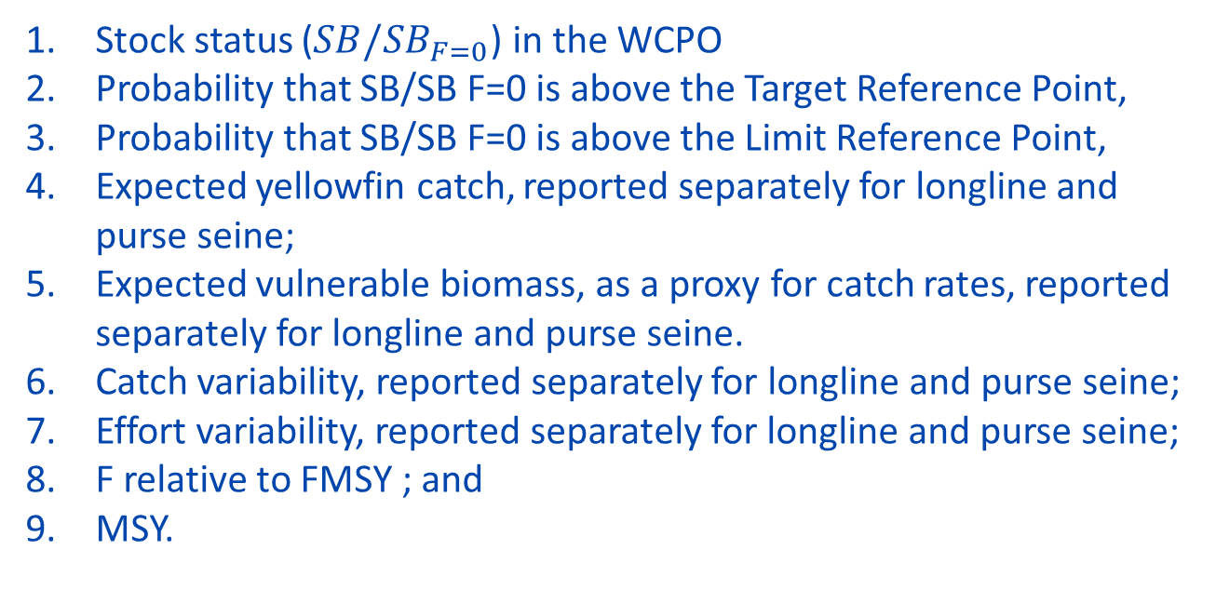
Performance Indicators
Stock status ($SB/SB_{F=0}$) in the WCPO
Probability that SB/SB F=0 is above the Target Reference Point,
Probability that SB/SB F=0 is above the Limit Reference Point,
Expected yellowfin catch, reported separately for longline and purse seine;
Expected vulnerable biomass, as a proxy for catch rates, reported separately for longline and purse seine.
Catch variability, reported separately for longline and purse seine;
Effort variability, reported separately for longline and purse seine;
F relative to FMSY ; and
MSY.

Slide 7

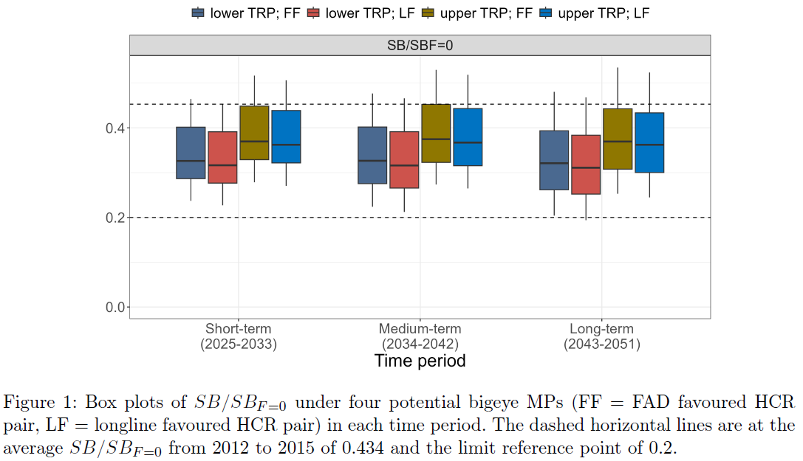
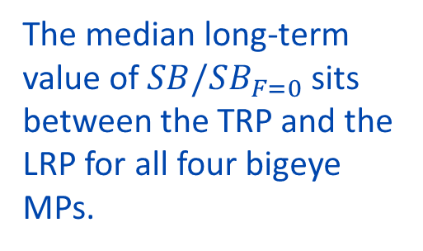
Results: Stock Status
The median long-term value of $SB/SB_{F=0}$sits between the TRP and the LRP for all four bigeye MPs.

Slide 8
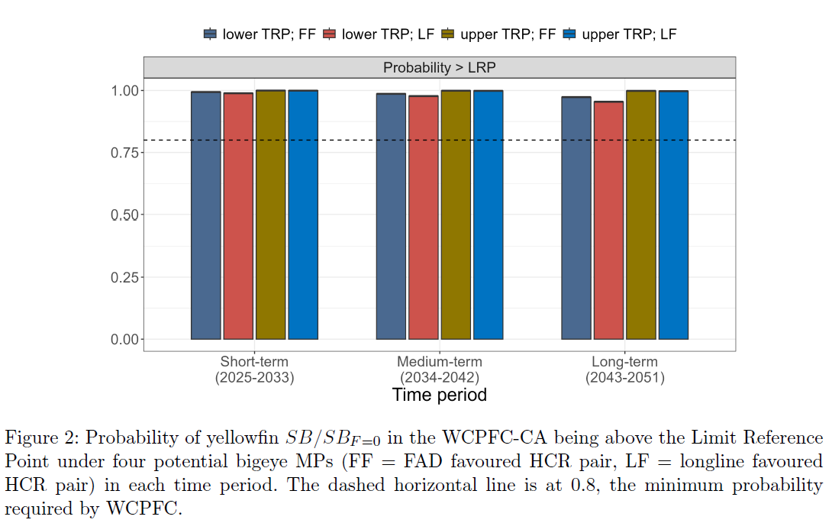
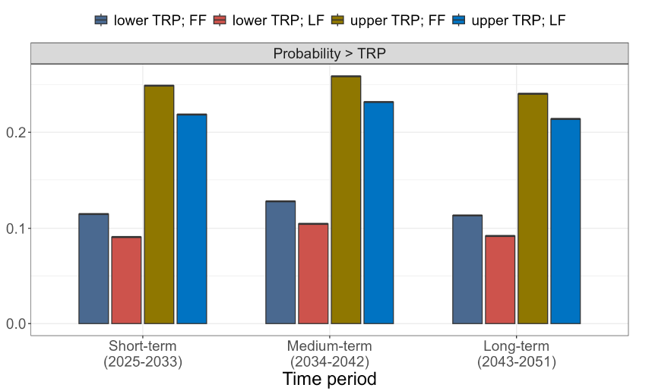
Results: LRP and TRP
The illustrative bigeye MPs resulted in a probability of being above
the LRP of at least 95% and above the TRP of between 9% and 25%.

Slide 9
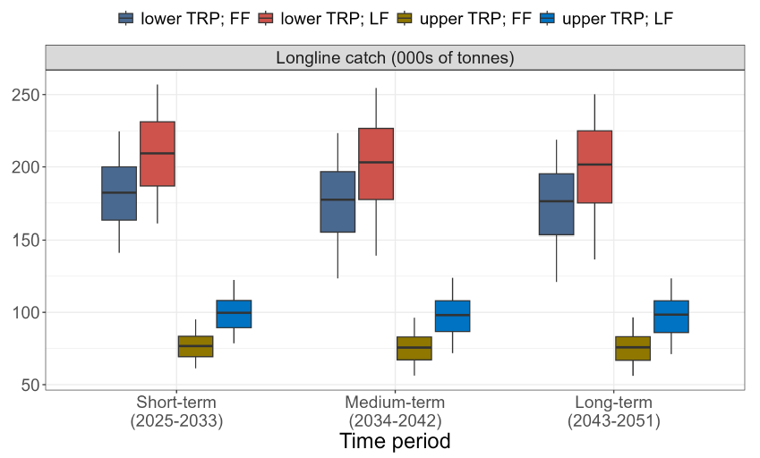
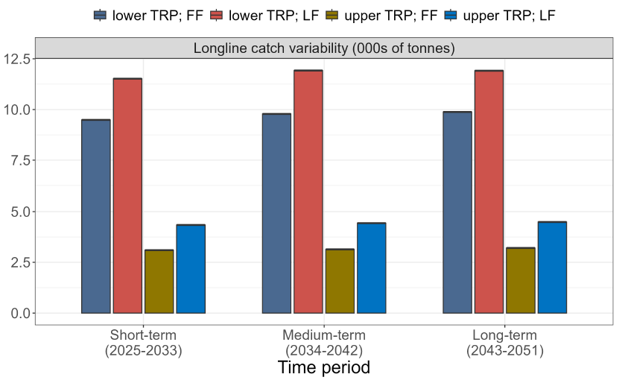
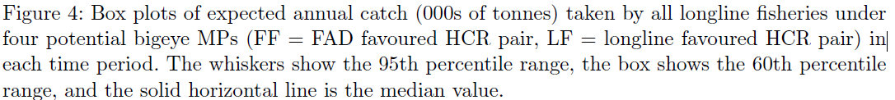
Results: Longline Catch and Catch Variability
Longline catches of yellowfin are significantly higher under the lower TRP MPs due to the increase in longline effort in order to reduce the bigeye stock.

Slide 10
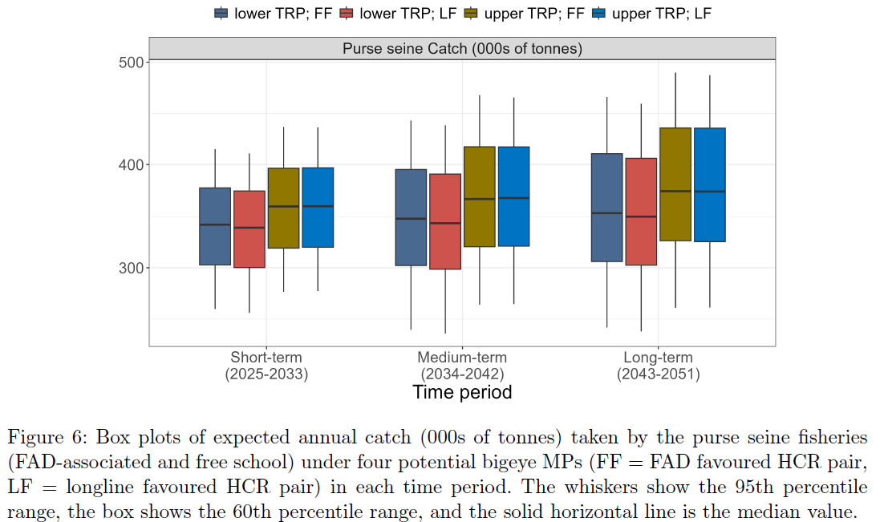
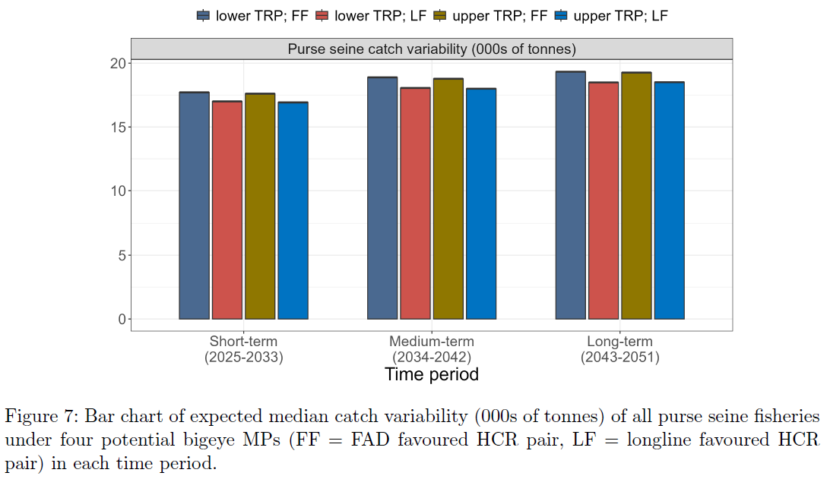
Results: Purse seine Catch and Catch Variability
There is little difference between the expected purse seine catches of yellowfin under the different bigeye MPs because purse seine effort was fixed at 2012 levels and there is relatively little change in the yellowfin vulnerable biomass for purse seine fisheries.

Slide 11
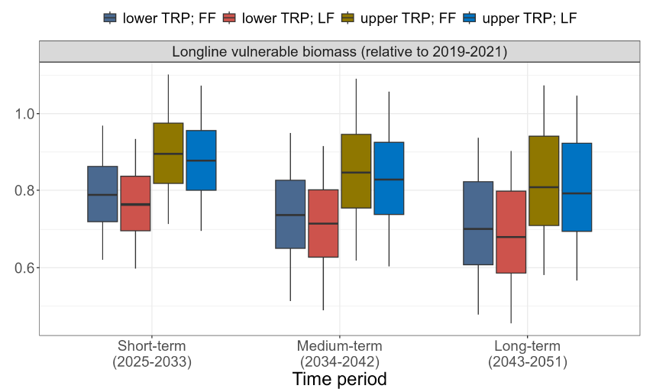
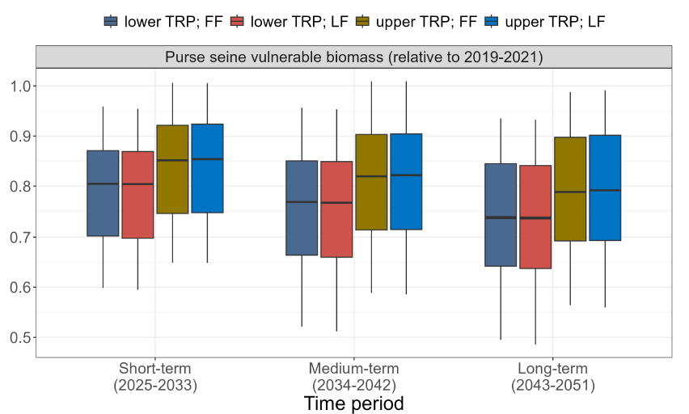
Results: Vulnerable Biomass
The expected future vulnerable biomass is lower than the 2019-2021 average level for both the longline fisheries managed through the bigeye MP and the purse seine fisheries.

Slide 12
Results Continued
Outcomes for yellowfin tuna show:
The stock of yellowfin tuna is expected to remain above the LRP with greater than 80% probability;
The management objective of maintaining the yellowfin stock around 2012-2015 average depletion levels cannot be met;
For longline fisheries, the choice of bigeye TRP had the greatest impact on expected catches of yellowfin, with longline or FAD favoured HCRs having lesser impact;
Catches of yellowfin in purse seine fisheries were more stable, but are slightly higher for the upper bigeye TRP option.

Slide 13
Further Work
Future evaluations of outcomes for yellowfin should include observed catches for the transient period where possible.
Performance indicators for effort variability and MSY are not yet available, pending ongoing development of the MSE framework but will be developed and presented for future analyses.

Slide 14
Conclusion
We invite SC22 to:
Endorse the approach outlined here to evaluate outcomes for yellowfin under the proposed WCPFC mixed fishery approach;
Note that under the adopted MPs for skipjack and South Pacific albacore, and potential MPs for bigeye tuna, yellowfin is expected to remain above the LRP with high probability;
Note that current management objective for yellowfin cannot be achieved for the range of bigeye TRPs currently under consideration;
Provide feedback on the information provided, and in particular, on the performance indicators used to demonstrate expected outcomes for yellowfin,
Note that the evaluations presented here can be updated and resubmitted for BMW02.
We gratefully acknowledge funding for this work from the New Zealand Ministry of Foreign Affairs and Trade (MFAT) funded project “Sustainable Pacific Fisheries”.

