Slide 1
Agenda Item 4
WCPO Bigeye TRPs
WCPFC BMW1
Online
SPC-OFP
20-21 May 2026

Slide 2
Introduction
WCPFC21 (summary report para 433-434) stated - Candidate BET TRPs are specified as follows:
  a) 2012-2015 average spawning biomass depletion (currently estimated at 34%SB_{F=0})
  b) 0.94 x 2012-2015 average spawning biomass depletion (currently estimated at 32%SB_{F=0})
  c) 1.06 x 2012-2015 average spawning biomass depletion (currently estimated at 36%SB_{F=0})
  [these] may in future be specified as threshold targets for which associated probabilities of being 'at or above' would need to be specified.
WCPFC22 maintained these three TRP levels

Slide 3
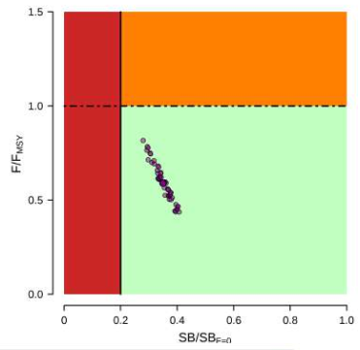
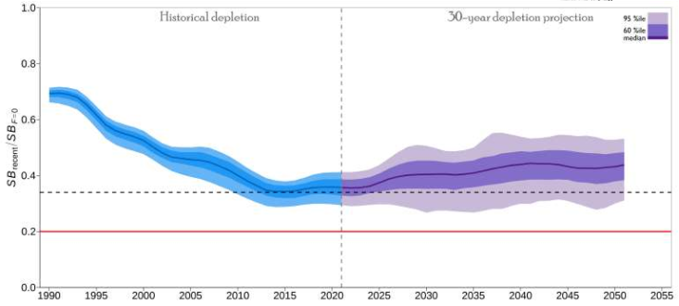
Status from 2023 assessment
‘Long term’ recruitment assumption
CAVEAT – based on the 2023 stock assessment, outcomes under agreed OMs may be different

Slide 4
Vulnerable biomass
BET: long-term recruitment |  | Bigeye vulnerable biomass (rel. 2019-2021 average)
Median depletion level (%SB_{F=0}) | Change in SB (%SB_{F=0}) from 2012-2015 average | ‘Tropical’ longline | ‘Southern’ longline
0.36 | +6% | Down ~38% | Up ~36%
0.34 | 0% | Down 44% | Up 32%
0.32 | -6% | Down 52% | Up 25%
WCPFC21-2024-31 Table 5 (BET long term recruitment)
CAVEAT – based on the 2023 stock assessment, outcomes under agreed OMs may be different (VB being considered as a PI)

Slide 5
Note
Candidate TRP levels are relatively close together
  Differences for some PIs across this range may be small

Slide 6
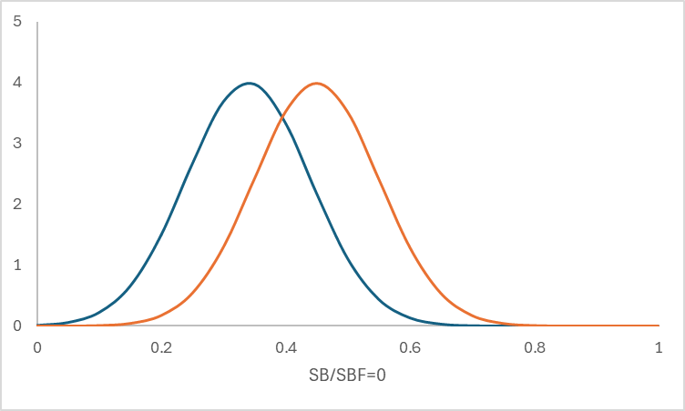
Threshold TRPs
‘Threshold’ TRPs
  ‘target’ achieved on average, ‘threshold’ to remain above with a specific probability
  Status of TRP needs manager’s clarification
    Specify the probability of being ‘at or above’
50% below,
50% above
70% above
TRP

Slide 7
BMW1
Decision points
  Whether the defined bigeye TRPs are actual targets or are to be considered as thresholds.
  If the bigeye TRPs are to be considered as thresholds, specify the probability that the spawning biomass depletion should be maintained above the thresholds.
For example:
  Threshold TRP with [at least] 70% probability of remaining above 34%SB_{F=0}

