Slide 1
WCPFC21 Climate Co-Leads Summary of Work
WCPFC21-2024-12 and WCPFC21-2024-12a

Slide 2
Climate change workplan and TORs for a CMM climate change vulnerability assessment
WCPFC21-2024-12
WCPFC21-2024-12b
The WCPFC Climate Change Workplan 2024 - 2027 describes tasks to be taken by the Commission and its SBs to address climate change impacts on WCPFC fisheries in the Convention Area.
The Terms of Reference for a CMM Climate Change Vulnerability Assessment define the Scope, Objectives, Rationale, Methodology, Timing, and Resources of the Assessment.

Slide 3
Updates to the WCPFC workplan following subsidiary body input
Action items in the workplan came from discussions at the Subsidiary Bodies and with SB Chairs.
The workplan now includes a table outlining ongoing and new activities and the following details:
Schedule
Activity
Project/link to SB workplan
Expected outcome
Overall link to advice to Commission (link to policy)
Responsible/Funds assigned-available?

Slide 4
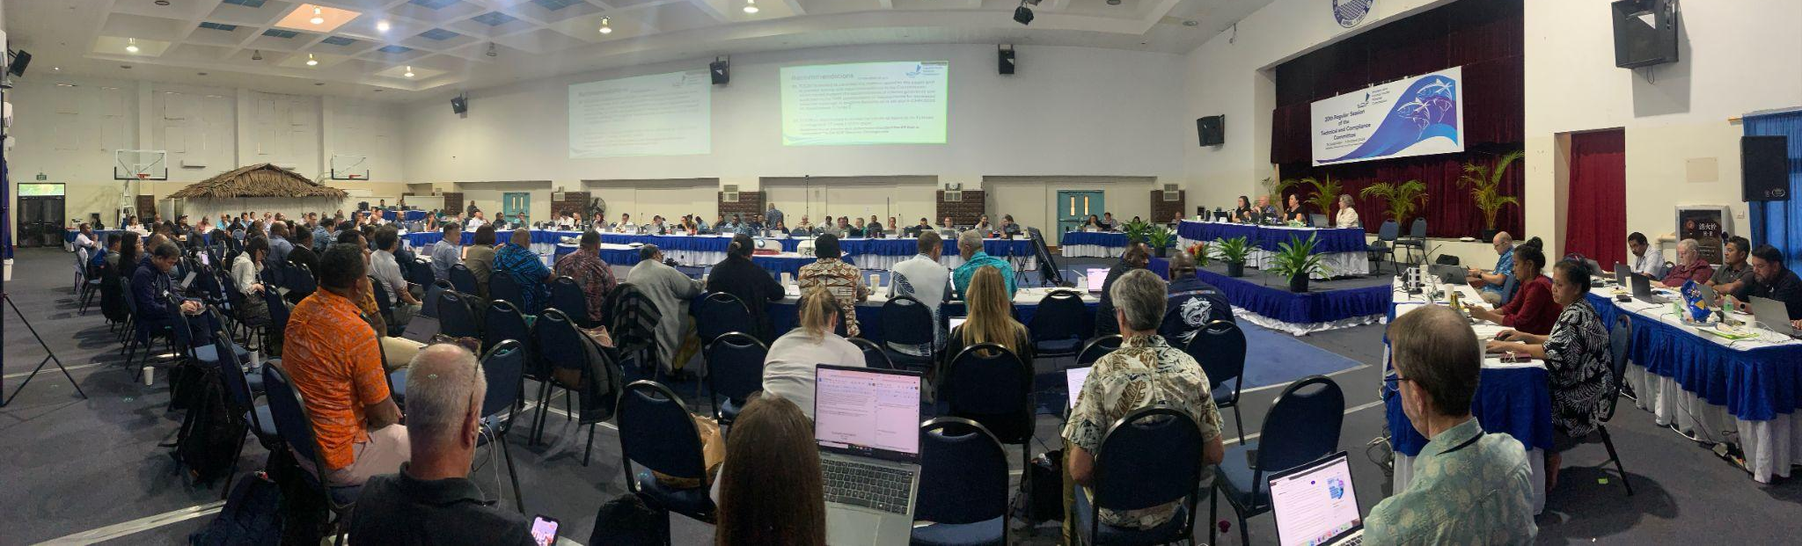
Co-leads integrated input from all subsidiary bodies into the updated TORs
WCPFC21-2024-12a now includes:
Language in response to NC20, SC20, and TCC20 outcomes
Clarifications related to terminology (“vulnerability” vs. “susceptibility”)

Slide 5
CMM Climate Change Vulnerability Assessment
The Assessment is intended to consider issues that are known climate change impacts and use that information to identify which CMMs might benefit from further discussion.
Additional descriptions in WCPFC21-12a and WCPFC21- 2024-13

Slide 6
Thank you/Kommol tata!

