Slide 1
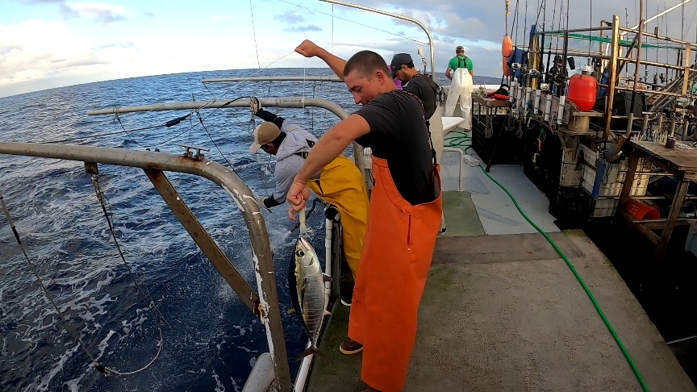
Pacific Tuna Tagging Project
WCPFC-SC20 2024
Fisheries and Ecosystem Monitoring and Analysis
SPC-OFP

Slide 2
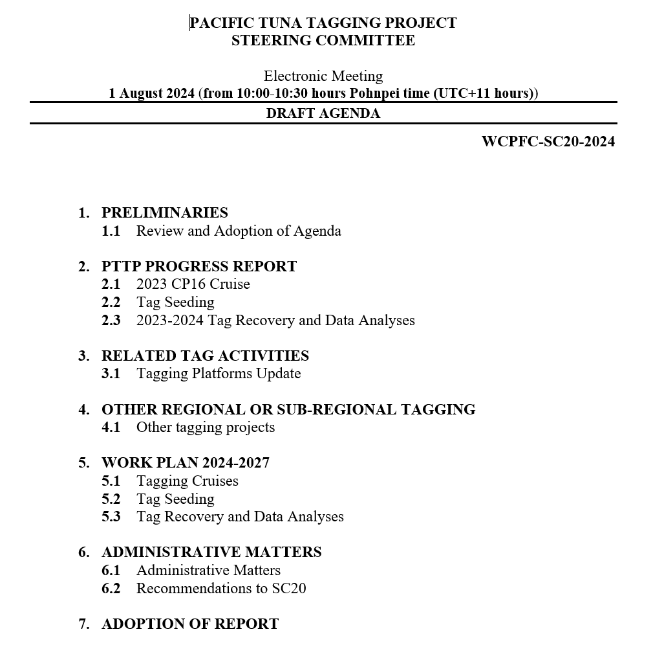
SC20 Pacific Tuna Tagging Project
The Pacific Tuna Tagging Project is a WCPFC project in place since 2006.
Its objective is to obtain data to support WCPO stock assessments, and to better understand the interactions between tropical tuna species and major fishing gears, and better interpret fisheries data.
Here, we provide a brief summary of:
Project 42: Pacific Tuna Tagging Project Report and Work-plan for 2024-2027 (SC20-RP-PTTP-01)
Project 42: Report of the Pacific Tuna Tagging Project Steering Committee (SC2-RP-PTTP-02)

Slide 3
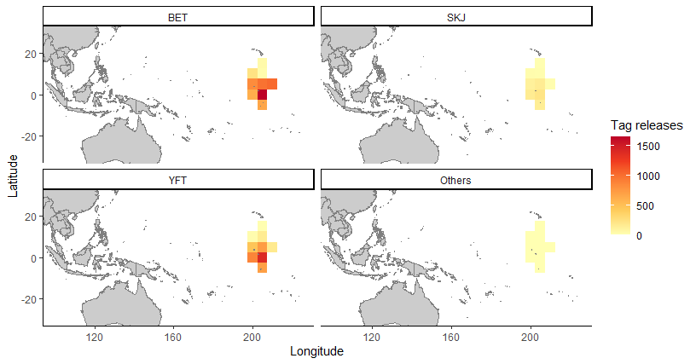
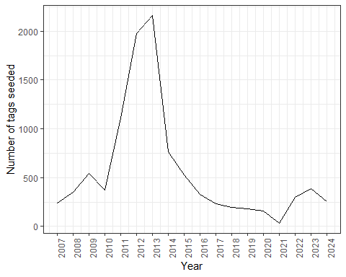
PTTP Activities 2023-2024
Wild Fish Tagging
Bigeye-focussed Central Pacific tagging cruise implemented
45-day cruise onboard Gutsy Lady 4, 16th Aug – 29th Sept 2023
11,319 tuna tagged (53% BET, 40% YFT, 7% SKJ)
76 industry drifting FADs visited, 1 TAO buoy
Biological samples taken from 306 individuals
Tag Seeding
Tag seeding is a critical method of informing tag reporting rates for WCPO stock assessments
Starting 2024 we are supporting a large increase in tag seeding
A 10-fold increase from recent years, spread across fleets and regions
Estimate reporting rates more comprehensively than in the past

Slide 4
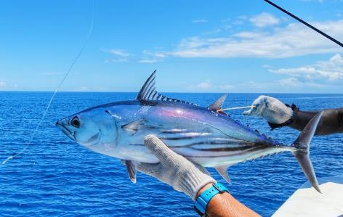
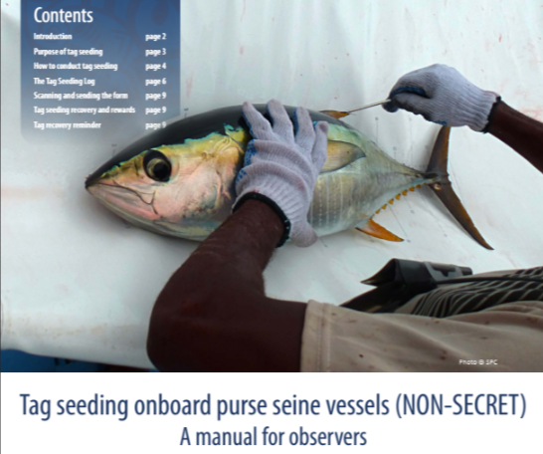
PTTP Workplan 2024-2027
Wild Fish Tagging
Scheduled 2024 skipjack-focussed cruise, contingent on planned refurbishment of F/V Soltai 105 in the Solomon Islands
Scheduled 2025 bigeye-focussed central Pacific cruise
Future research cruises are planned to utilise the Regional Fisheries Research Vessel, now at the recruitment of shipyard and management company stage
Further engagement with industry for access to drifting FADs to support research cruises
Tag Recovery and Analyses
Improved engagement and recovery across region in parallel to large-scale tag seeding
Supporting analyses for 2025 WCPO skipjack assessment: tagging effects, reporting rate estimation and tag mixing
Continued support for higher levels of tag seeding by ROPs

Slide 5
Recommendations to SC20
Note the critical importance of effective tag seeding for informing stock assessment and support the increased deployment and fleet coverage of tag seeding experiments through regional and national observer programmes.
Note the need for member participation and support in tag reporting as both wild and seeded tags continue to be found throughout the fishery.
Note and support the ongoing regional fisheries research vessel project.
Consider and support the PTTP work-plan for 2024-2027, and indicative budget presented here
Budget | 2021 | 2022 | 2023 | 2024 | 2025 | 2026 | 2027
Total | USD 1,433,875.00 | USD 1,402,880.00 | USD 1,450,000.00 | USD 1,450,000.00 | USD 1,475,000.00 | USD 1,475,000.00 | USD 1,475,000.00
WCPFC | USD 730,000.00 | USD 730,000.00 | USD 730,000.00 | USD 800,000.00 | USD 875,000.00 | USD 950,000.00 | USD 950,000.00
Republic of Korea | USD 166,000.00 | USD 166,000.00 | USD 166,000.00 | USD 166,000.00 | USD 166,000.00 | USD 166,000.00 | USD 166,000.00
SSP | USD 537,875.00 | USD 506,880.00 | USD 554,000.00 | USD 484,000.00 | USD 434,000.00 | USD 359,000.00 | USD 359,000.00
SSP% | 38% | 36% | 38% | 33% | 29% | 24% | 24%

