Slide 1
Pacific Marine Specimen Bank (Project 35b)
WCPFC-SC20 2024
Fisheries and Ecosystem Monitoring and Analysis
SPC - OFP

Slide 2
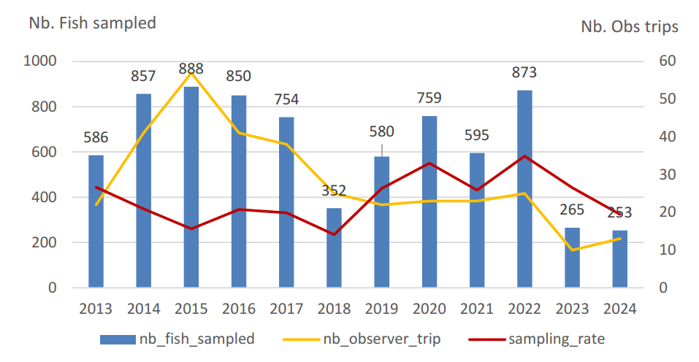
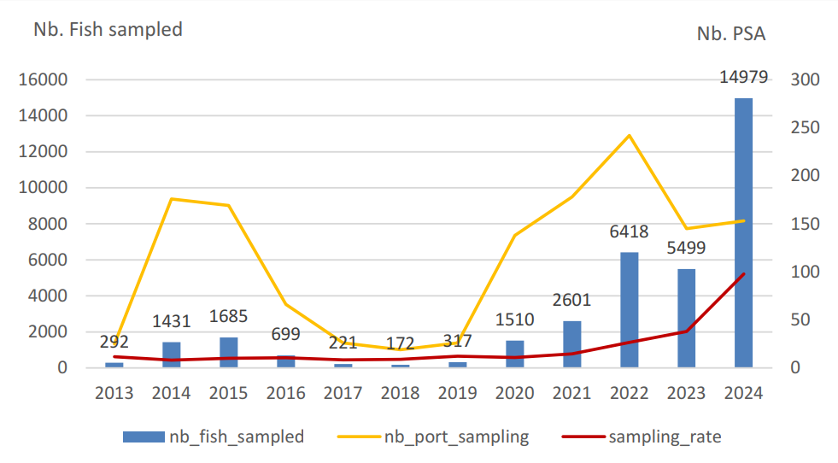
Since 2001 ~273,100 biological samples from ~101,000 individual animal specimens
Activities
SC20-RP-P35b-01 and SC20-RP-P35b-02
SAMPLING
July 2023-June 2024
~48,000 biological samples from ~16,700 individual animal specimens
Observer sampling
Port sampling

Slide 3
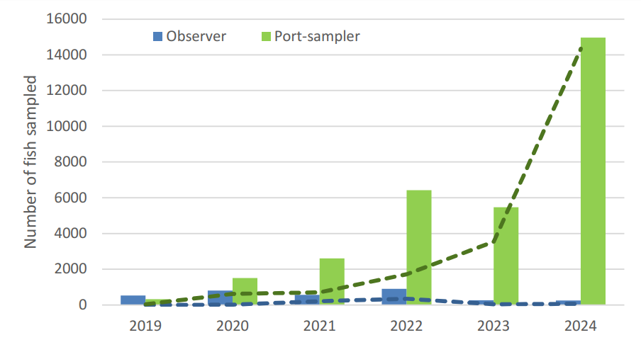
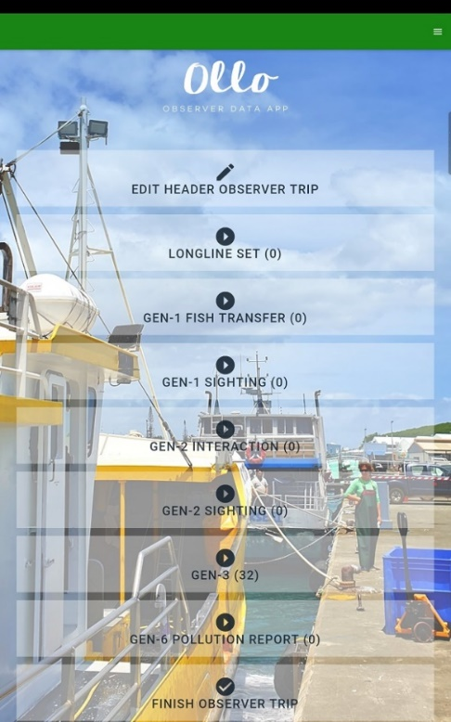
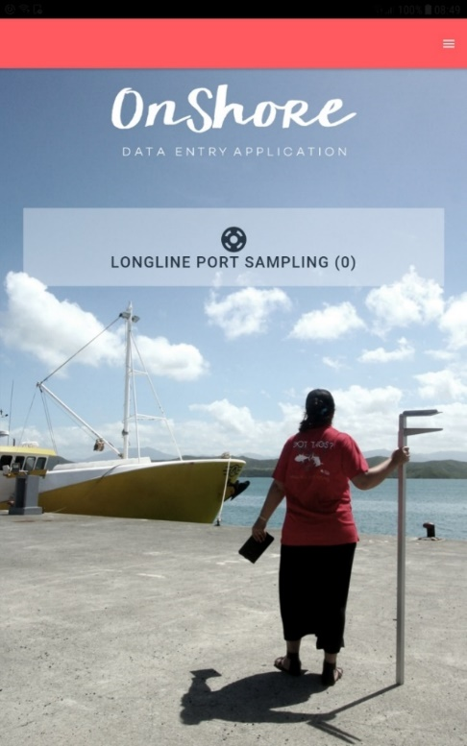
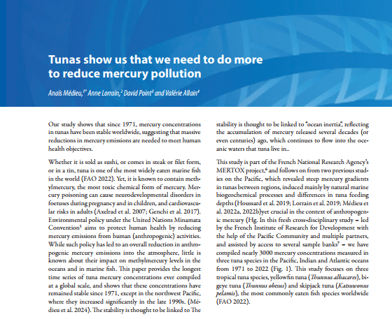
Activities
TRAINING
3 countries, 55 trainees
ELECTRONIC REPORTING
PMSB ACCESS AND OUTPUTS
42 projects using samples
9 articles published in Jul 2023-Jun 2024
Use of electronic reporting for biological sampling
https://www.spc.int/ofp/PacificSpecimenBank

Slide 4
Workplan and budget
Continue to document standard operating procedures for the PMSB
Continue improving training materials for biological sampling
Continue the development and enhancement of electronic recording ER apps and trainings
Continue the development of a WCPO-wide sampler network for the collection of tuna genetics samples
Completion of the construction of the wet laboratory extension and renovation of the taxonomy laboratory in Noumea
Transfer of Biodasys (PMSB database) to a web-based technology
Quality management system implementation based on ISO9001 standard
Improve the reporting of PMSB activities through PMSB website
Encourage the use of electronic reporting ER for biological sampling data collection
2024 budget: USD 107,373
Proposed 2025 budget: USD 109,520
Indicative 2026 budget: USD 111,711

Slide 5
Recommendations
We invite SC20 to:
Continue to support initiatives to increase rates of observer biological sampling, noting that this contribution is essential to the ongoing success of the WCPFC’s work
Incorporate the identified budget into the 2025 budget and the 2026 indicative budget, as development of the WCPFC PMSB is intended to be ongoing and is considered essential
Endorse change for Project 35b to report on the 12 months of the civil year (Jan-Dec) preceding SC, instead of reporting on the 12 months before SC (July-June) which would allow the provision of better-quality data in the SC report
Endorse that the workplan in section 4 of the report be pursued by the scientific services provider, in addition to standard duties associated with maintenance and operation of the WCPFC PMSB in 2024-2025

