Slide 1
Western Pacific East Asia Project
Lars Olsen– WPEA Project Manager
SC20 - Manila

Slide 2
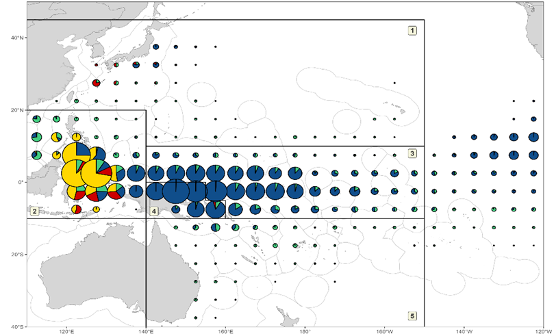
Why is WPEA work important?
Catch in this region represents around 30% of the annual catches of key tuna species in the WCPO
Including about 40% of the total yellowfin tuna catch in the WCPO
Data collection is incredibly challenging with many hundreds of ports and many thousands of vessels
Figure 1. Distribution of yellowfin tuna catch by gear, 1990–2023 (longline - green; pole-and-line - red; purse seine - blue; other fisheries - yellow). The five-region spatial stratification used in stock assessment is shown.

Slide 3
WPEA-Improved Tuna Monitoring (ITM)
Just finished WPEA-ITM which ran from January 2017 – June 2024
NZD 4.91 million over the period 2017-2023
Top up and extension to 2024 to make the total NZD 5.23 million
WCPFC and the WPEA countries of Indonesia, Philippines and Vietnam are very thankful for NZ support for this important work
Goal: To improve monitoring and management of tuna catches in Indonesia, Philippines and Vietnam and contribute to reduced IUU fishing
A summary of the final activities of this project are in paper SC20-RP-WPEA-01

Slide 4
Next Phase = WPEA – SPF
New project called WPEA – Sustainable Pacific Fisheries started in July 2024 and will run until June 2027
Again, generously supported by the government of New Zealand for the value of NZ 4.5 million
WPEA-SPF builds on the previous WPEA-ITM project
This Project focuses on building improved performance by Indonesia, Philippines and Viet Nam to meet their obligations to WCPFC requirements in the broader effort to combat illegal, unreported and unregulated (IUU) fishing, and the management of the western and central Pacific tuna stocks sustainably for wider benefits.
We will report on progress each year at WCPFC meetings

Slide 5
Recommendation to SC20
SC20 will note the successful completion of the WPEA-ITM project and beginning of the next phase of this work being the WPEA-SPF project.

