Slide 1
MI-WP-09 Evaluation of CMM 2023-01 (Tropical Tuna CMM) WCPFC SC20 Manila, Philippines
SPC-OFP 14-21 August 2024

Slide 2
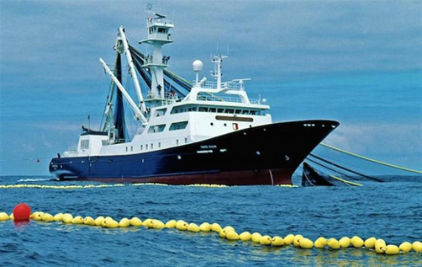
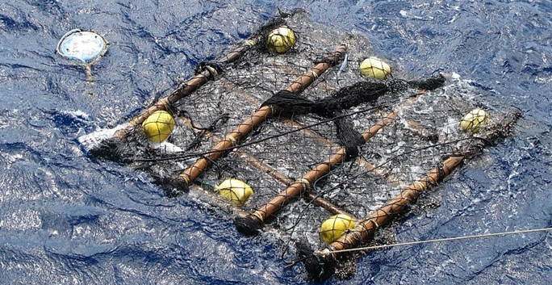
Content
CMM evaluation
Step 1: Develop alternative scenarios for future fishing levels possible under CMM2023-01
Step 2: Evaluate the consequences of each scenario for tropical tuna stocks, and compare to CMM2023-01 objectives
Presentation won’t cover additional analyses in appendices
Evaluated up to 2023 - when CMM 2021-01 in place
Evaluations from 2025 will include 2024 data.
Appendices are ~longer than the main paper – could do with rationalising…

Slide 3
CMM 2023-01
What’s new? Changes include:
Shorter FAD closure (by 50%)
Potential increases in Table 3 LL BET catch by flag, tied to observer coverage increases
KR 5% increase in 2024
TW 2% increase in 2024
Changes to LL limits in Table 3 (US)

Slide 4
CMM 2023-01 evaluation
Step 1: Scenarios to bracket potential futures under CMM 2023-01:
‘2019-2021 avg’ = recent conditions continue
‘Optimistic’ = incorporate shorter FAD closure period specified in CMM 2023-01, effort at 2019-21 levels; LL take limits or 2019-21 levels if lower
‘SKJ MP/Table 3’ = shorter FAD closure + 2012 effort levels; LL fleets indicating higher Table 3 catches achieve this
‘Fully utilised’ = all opportunities under the CMM maximised; 2012 PS effort as per skipjack MP, high seas FAD sets maximised, LL BET catch limits taken + Table 3 extras. NOTE: don’t assume Table 1 total levels – not seen in recent yrs.
Evaluated for BET (recent and long-term recruitment), YFT and SKJ
For YFT and SKJ, PS impact is primarily through the overall PS effort
For BET PS impact is primarily through the FAD set effort x effort change
For YFT – continue assuming BET LL catch scalars are applied to yellowfin

Slide 5
Evaluating stock impacts
30 yr projections off latest assessment model grids
BET run for the two recruitment scenarios (‘recent’ and ‘long term’)
Future PS effort and LL catch set at scenario levels (scaled off 2019-2021 levels)
Most domestic ID/PH/VN fisheries set at 2016-2018 average catch effort levels for yellowfin tuna evaluation
Outcomes presented:
‘equilibrium’ outcomes (depletion SB/SB_{F=0} and F/F_{MSY}) at end of 30 yr projection
Risk relative to LRP (and F_{MSY}) at end of 30 yr projection
‘Snapshot’ evolution of stock status (see Tables 6 & 8)

Slide 6
BET outcomes
Scenario |  | Scalars relative to 2019-2021 |  | Median SB₂₀₅₁/SB_{F=0} | Median SB₂₀₅₁/SB_{F=0} v SB₂₀₁₂₋₁₅/SB_{F=0} | Median F₂₀₄₇₋₂₀₅₀/F_{MSY} | Median ratio F₂₀₄₇₋₂₀₅₀/F_{MSY} v F₂₀₁₇₋₂₀/F_{MSY} | Risk (%)¹
Recruit | Fishing level | Purse seine | Longline |  |  |  |  | SB₂₀₅₁<LRP | F>F_{MSY} | F>F_{MSY}
Recent | 2019-21 avg | 1.00 | 1.00 | 0.46 | 1.35 | 0.57 | 0.97 | 0% | TBC | 26%
 | Optimistic | 1.19 | 1.00 | 0.43 | 1.27 | 0.62 | 1.05 | 0% | TBC | 29%
 | SKJ MP/Table 3 | 1.40 | 1.12 | 0.39 | 1.15 | 0.71 | 1.20 | 0% | TBC | 35%
 | Fully utilised | 1.43 | 1.67 | 0.30 | 0.88 | 1.05 | 1.78 | 3% | TBC | 52%
Long-term | 2019-21 avg | 1.00 | 1.00 | 0.43 | 1.26 | 0.79 | 1.34 | 0% | 38%
 | Optimistic | 1.19 | 1.00 | 0.41 | 1.19 | 0.89 | 1.51 | 0% | 44%
 | SKJ MP/Table 3 | 1.40 | 1.12 | 0.36 | 1.06 | 1.08 | 1.83 | 1% | 54%
 | Fully utilised | 1.43 | 1.67 | 0.27 | 0.79 | 1.57 | 2.66 | 30% | 72%
CMM objective SB₂₀₁₂₋₂₀₁₅/SB_{F=0} = 0.34

Slide 7
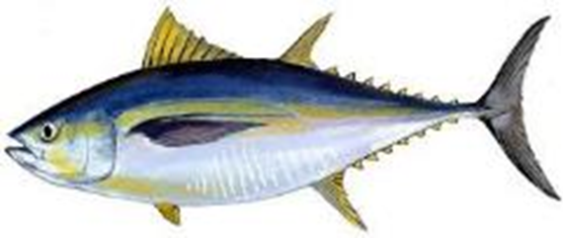
Fully utilised - Bigeye
Recent recruitment
Long term recruitment
Historic
Projected
Historic
Projected
2012-2015
2012-2015

Slide 8
YFT/SKJ outcomes
Stock | Fishing level | Scalars relative to 2019-2021 |  |  | Median SB₂₀₅₁/SB_{F=0} | Median SB₂₀₅₁/SB_{F=0} | Median SB₂₀₅₁/SB_{F=0} v SB₂₀₁₂₋₁₅/SB_{F=0} | Median F₂₀₄₇₋₂₀₅₀/F_{MSY} | Median ratio F₂₀₄₇₋₂₀₅₀/F_{MSY} v F₂₀₁₇₋₂₀/F_{MSY} | Risk (%)¹
Stock |  | Purse seine | Longline | Longline |  |  |  |  |  | SB₂₀₅₁<LRP | F>F_{MSY}
Yellowfin | 2019-21 avg | 1 | 1 | 1 | 0.41 |  | 0.93 | 0.57 | 1.14 | 0% | 0%
 | Optimistic | 1 | 1 |  | 0.41 |  | 0.93 | 0.57 | 1.14 | 0% | 0%
 | SKJ MP/Table 3 | 1.17 | 1.12 |  | 0.38 |  | 0.86 | 0.62 | 1.24 | 0% | 0%
 | Fully utilised | 1.17 | 1.67 | 1.66 | 0.34 |  | 0.77 | 0.67 | 1.34 | 2% | 2%
SB₂₀₁₂₋₂₀₁₅/SB_{F=0} = 0.44 |  |  |  |  |  |  | Median SB₂₀₅₁/SB_{F=0} v SB/SB_{F=0} = 0.50
Skipjack | 2019-21 avg | 1 |  | 1 |  | 0.53 | 1.07 | 0.31 | 0.97 | 0% | 0%
 | Optimistic | 1 |  | 1 |  | 0.53 | 1.07 | 0.31 | 0.97 | 0% | 0%
 | SKJ MP/Table 3 | 1.17 |  | 1.12 |  | 0.50 | 1.00 | 0.35 | 1.09 | 0% | 2%
 | Fully utilised | 1.17 |  | 1.67 |  | 0.50 | 1.00 | 0.35 | 1.09 | 0% | 2%
SKJ TRP: SB/SB_{F=0} = 0.50

Slide 9
Recent levels v expected under CMM
 | Average 2019-21 | 2021 | Scalar 2021 | 2022 | Scalar 2022 | 2023 | Scalar 2023
Purse seine effort (FAD sets)¹ | 15,878 | 17,408 | 1.10 | 18,447 | 1.16 | 16,609 | 1.05
Longline bigeye catch (mt) | 56,048 | 50,950 | 0.91 | 52,656 | 0.94 | 54,158 | 0.97
Longline yellowfin catch (mt) | 66,084 | 57,790 | 0.87 | 67,906 | 1.03 | 62,599 | 0.95
Fully utilised: LL = 1.67, FAD sets =1.43

Slide 10
Summary
Fully utilised CMM 2023-01 achieves objectives (skipjack MP TRP) for skipjack
Fully utilised CMM 2023-01 does not achieve objective (2012-2015) for bigeye under either recruitment scenario
No CMM 2023-01 scenario achieves objective (2012-2015) for yellowfin (caveat around assumption that yellowfin is scaled consistent with bigeye LL catch, YFT R2 effort based)

Slide 12
BET – time series snapshots
Scenario |  | Scalars relative to 2019-21 |  | Median SB₂₀₂₃₋₂₀₂₆/SB_{F=0} | Median SB₂₀₃₂₋₂₀₃₅/SB_{F=0} | Median SB₂₀₄₈₋₂₀₅₁/SB_{F=0} | Risk SB₂₀₂₆ < LRP | Risk SB₂₀₃₅ < LRP | Risk SB₂₀₅₁ < LRP
Recruitment | Fishing level | Purse seine | Longline
Recent | 2019-21 avg | 1.00 | 1.00 | 0.39 | 0.45 | 0.46 | 0% | 0% | 0%
 | Optimistic | 1.19 | 1.00 | 0.39 | 0.43 | 0.43 | 0% | 0% | 0%
 | SKJ MP/Table 3 | 1.40 | 1.12 | 0.36 | 0.40 | 0.39 | 0% | 0% | 0%
 | Fully utilised | 1.43 | 1.67 | 0.34 | 0.32 | 0.30 | 0% | 0% | 3%
Long-term | 2019-21 avg | 1.00 | 1.00 | 0.38 | 0.40 | 0.43 | 0% | 0% | 0%
 | Optimistic | 1.19 | 1.00 | 0.38 | 0.38 | 0.41 | 0% | 0% | 0%
 | SKJ MP/Table 3 | 1.40 | 1.12 | 0.36 | 0.35 | 0.36 | 0% | 0% | 1%
 | Fully utilised | 1.43 | 1.67 | 0.34 | 0.27 | 0.27 | 0% | 15% | 30%

Slide 13
YFT/SKJ time series snapshots
Scenario |  | Scalars relative to 2019-21 |  | Median SB₂₀₂₃₋₂₀₂₆/SB_{F=0} | Median SB₂₀₃₂₋₂₀₃₅/SB_{F=0} | Median SB₂₀₄₈₋₂₀₅₁/SB_{F=0} | Risk SB₂₀₂₆ < LRP | Risk SB₂₀₃₅ < LRP | Risk SB₂₀₅₁ < LRP
Stock | Fishing level | Purse seine¹ | Longline
Yellowfin | 2019-21 avg | 1.00 | 1.00 | 0.43 | 0.40 | 0.41 | 0% | 0% | 0%
 | Optimistic | 1.00 | 1.00 | 0.43 | 0.40 | 0.41 | 0% | 0% | 0%
 | SKJ MP/Table 3 | 1.17 | 1.12 | 0.43 | 0.37 | 0.38 | 0% | 0% | 0%
 | Fully utilised | 1.17 | 1.67 | 0.43 | 0.34 | 0.34 | 0% | 0% | 2%
Skipjack | 2019-21 avg | 1.00 | 1.00 | 0.50 | 0.54 | 0.53 | 0% | 0% | 0%
 | Optimistic | 1.00 | 1.00 | 0.50 | 0.54 | 0.53 | 0% | 0% | 0%
 | SKJ MP/Table 3 | 1.17 | 1.12 | 0.46 | 0.50 | 0.50 | 0% | 0% | 0%
 | Fully utilised | 1.17 | 1.67 | 0.46 | 0.50 | 0.50 | 0% | 0% | 0%

