Slide 1
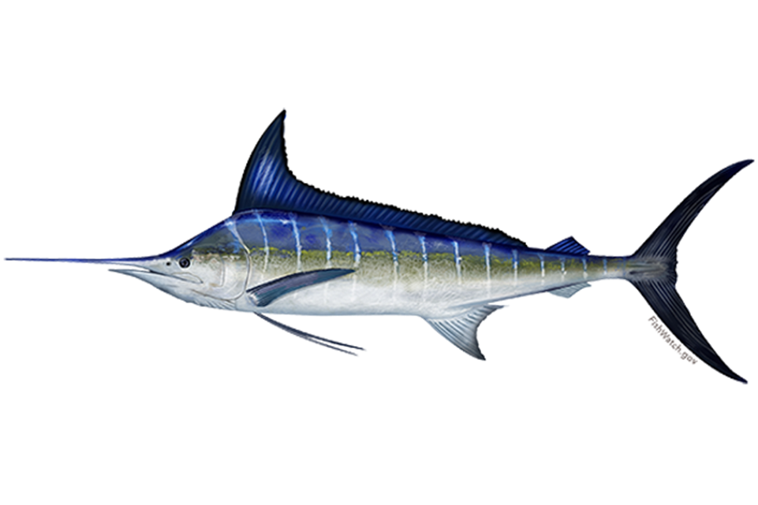
Stock assessment of striped marlin
(Kahikia audax)
in the southwest Pacific Ocean: 2024
WCPFC-SC20-2024 / SA-WP-03
August 2024
Manila, Philippines
C. Castillo Jordan¹, J. Day¹, T. Teears¹, N. Davies², J. Hampton¹,
S. McKechnie¹, A. Magnusson¹, T. Peatman³,
T. Vidal¹, P. Williams, P. Hamer¹
1 Oceanic Fisheries Programme, the Pacific Community
2 TeTakina Ltd
3 Private Consultant

Slide 2
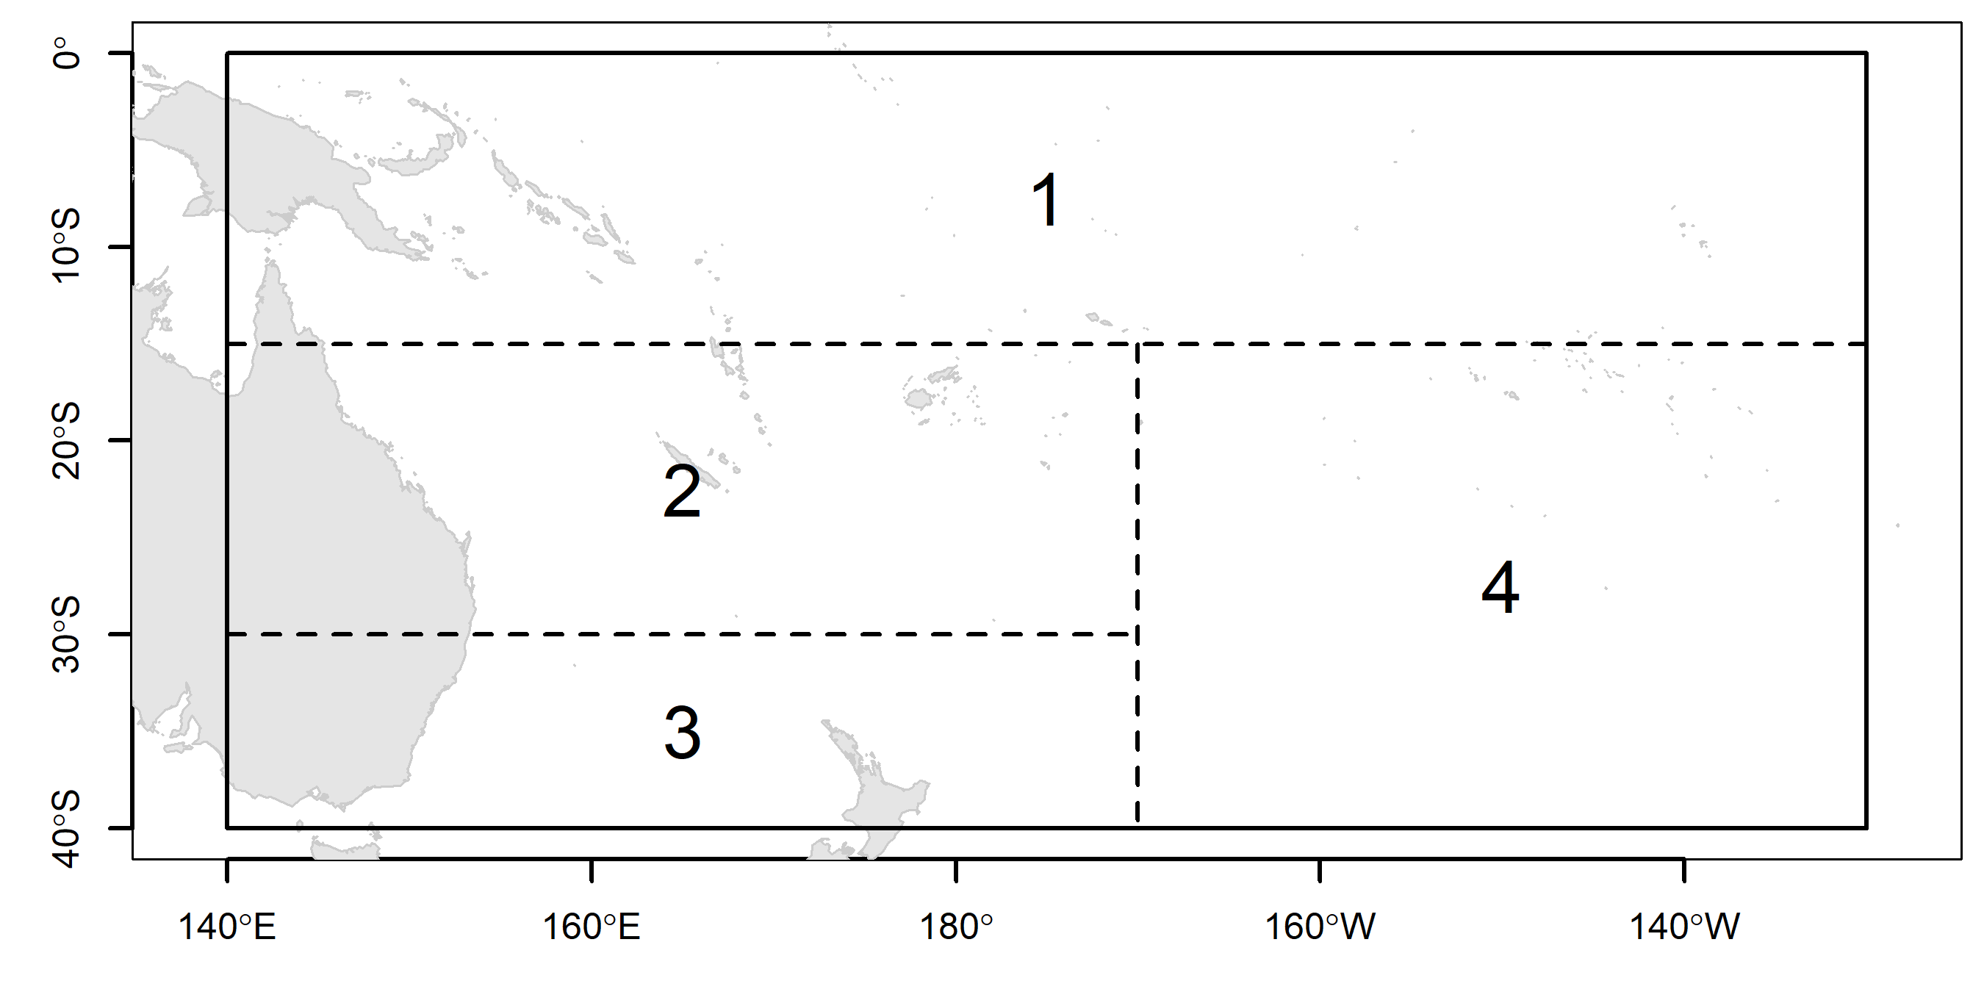
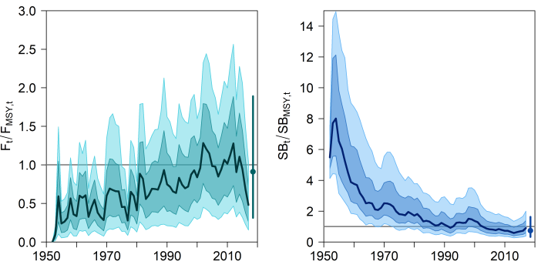
MLS 2019 in a nutshell (Ducharme-Barth et al. 2019)
Natural mortality (M) and steepness (h) contributed to the overall level of uncertainty in the assessment
 | Option 1 | Option 2 | Option 3
h | 0.65 | 0.8 | 0.95
Growth | Kopf et.al 2011 | Otolith age
M | 0.3 | 0.4 | 0.5
CPUE | JP 2 LL | TW 5 LL | AU 6 LL
Size freq (W/L) | 10/20 | 20/40 | 50/100
Rec CV | 0.2 | 0.5 | 2.2
Stock likely overfished, and close to be overfishing
 | Median | 10th %ile | 90th %ile
F_{recent} /F_{MSY} | 0.911 | 0.313 | 1.891
SB_{recent} /SB_{MSY} | 0.737 | 0.334 | 1.635
SB_{recent} /SB_{F=0} | 0.198 | 0.093 | 0.464

Slide 3
2024 MLS assessment – highlights and key changes
2024 stock assessment
Team working in different places
Main new changes
New MFCL 2.2.7.0 version
New growth and revise maturity by Farley et al 2021.
Model start in 1979
Catch conditioning method
M and h ensemble for uncertainty (priors)
Index fishery, sdmTMB, JPTW, vessel ID random effect
Input data reweighted by catch and CPUE
Francis size data weighting
Lorenzen M
Reduction in parameters from 2248 to 76
PDH

Slide 4
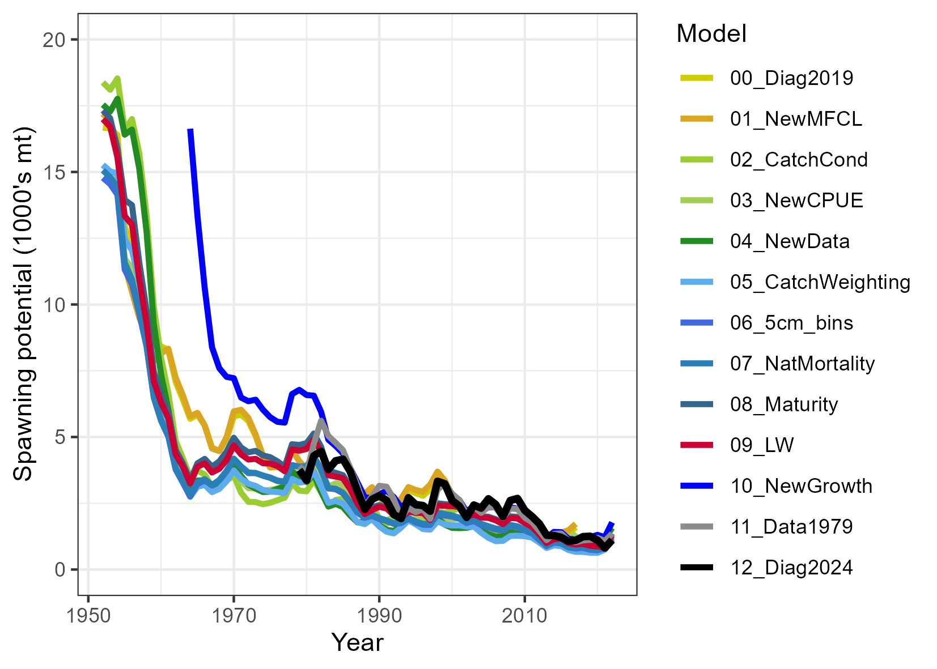
Diagnostic model development
00 = Diagnostic case 2019
01 = new MFCL
02 = Catch conditioning 2019
03 = New CPUE
04 = New Data until 2022
05 = Catch weighting
06 = 5 cm bins
07 = Lorenzen M
08 = New maturity
09 = New LW relationship
10 = New growth
11 = Data start in 1979
12 = Francis method, PDH, Diag.case 2024
Off the scale

Slide 5
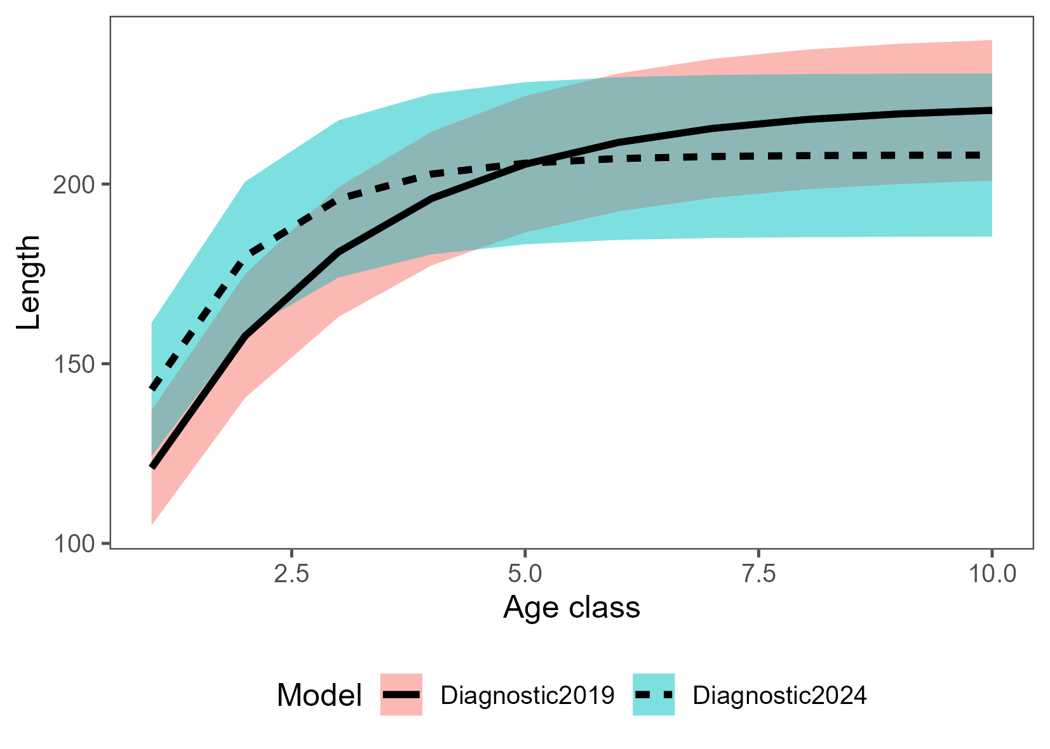
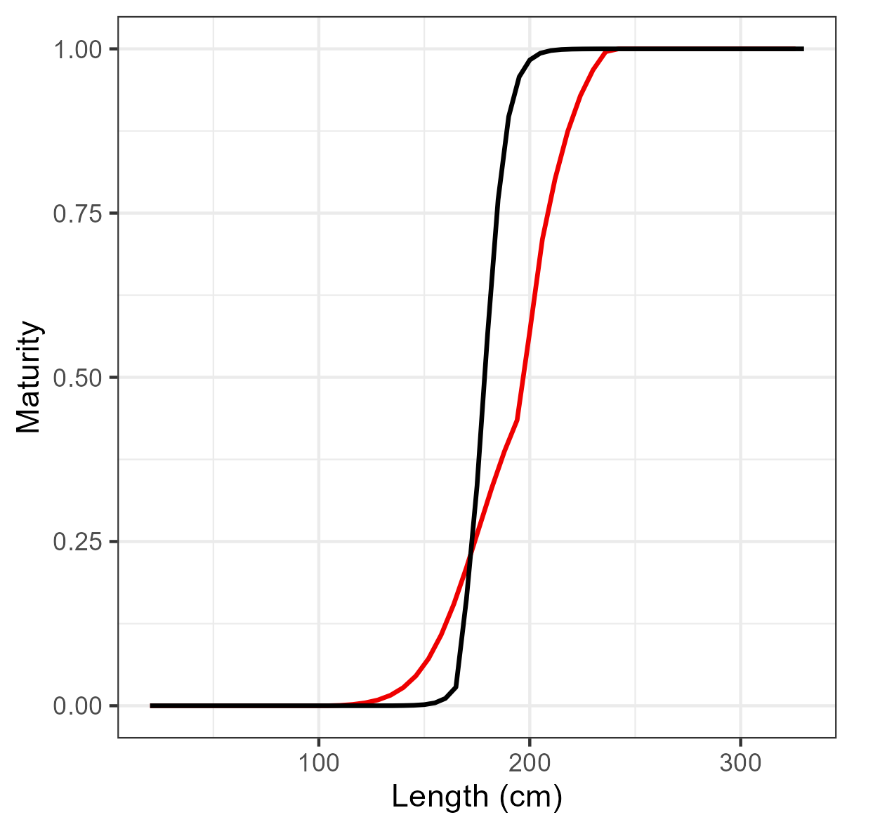
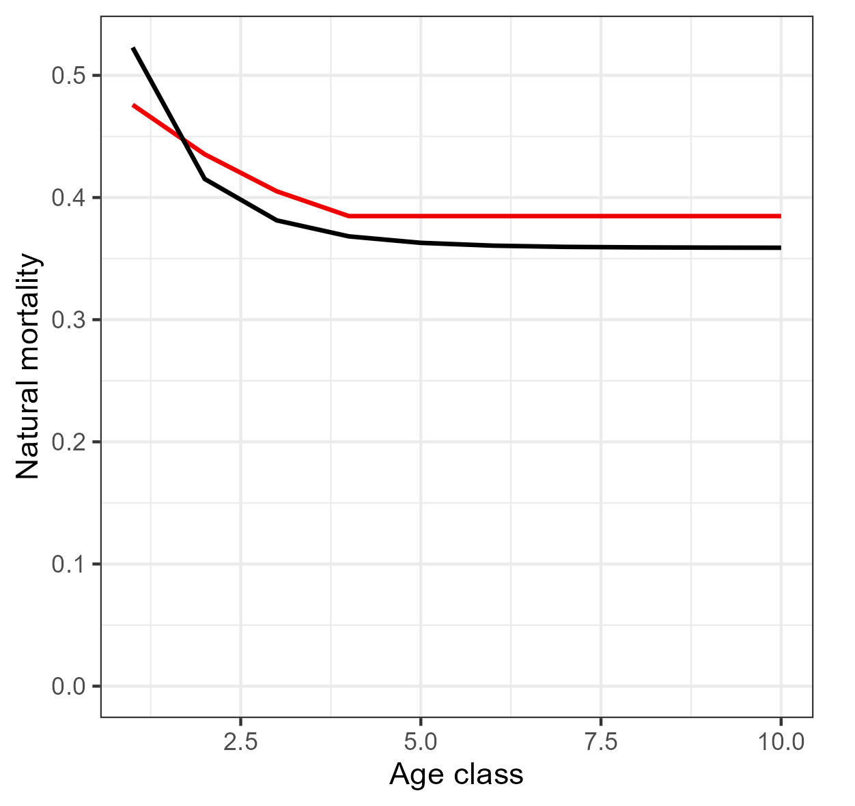
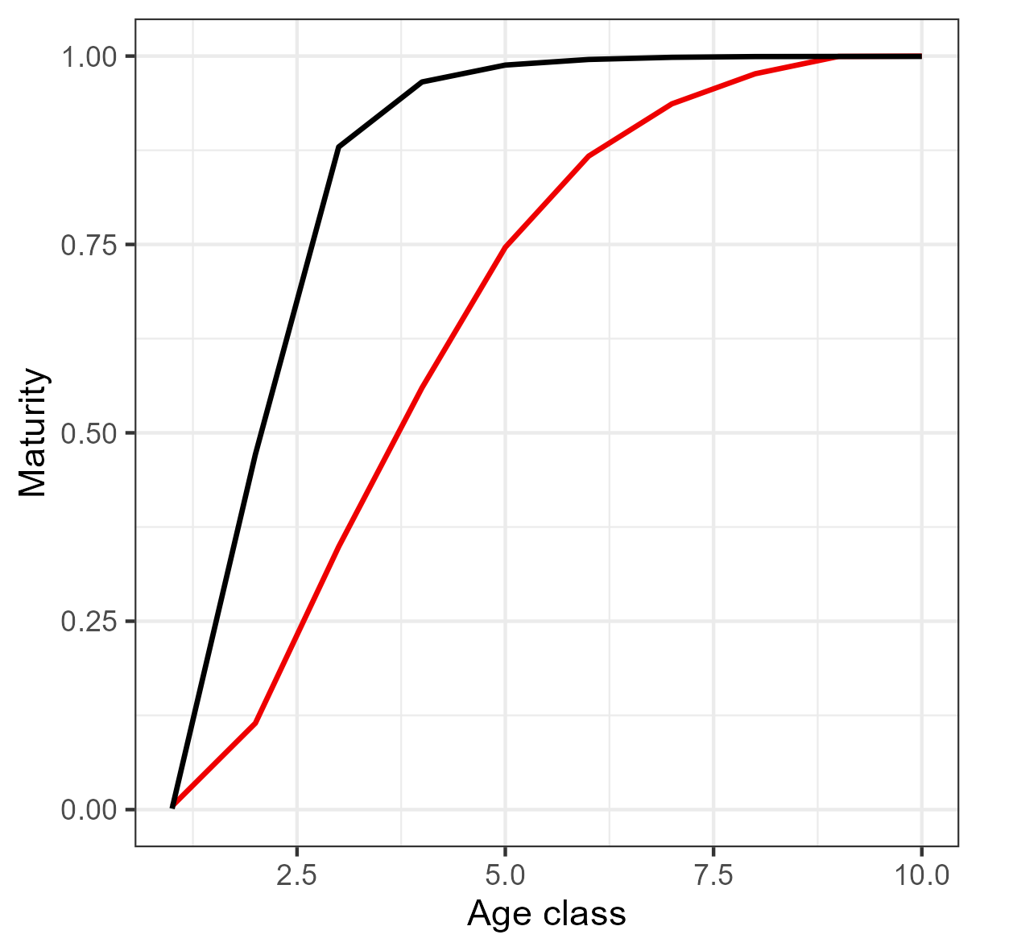

Updated biology (Csiro, Farley et al 2021)
Size-at-age
Maturity-at-length & age
Natural mortality-at-age

Slide 6
2024 diagnostic:
Diagnostics analysis
  Hessian
  Jitter
  ASPM
  Catch Curve
  Likelihood profiles
  “Piner” plots
  Retrospectives
Sensitivities
  Recruitment CV
  CPUE
  Initial conditions F
  M and h
Others (late model exploration)
  2019 subjective fix DW
  Removing 2022 07.LL.AU.3
  06.LL.AU.2 and 07.LL.AU.3
    Removing LF
    Similar DW 06 and 07
  NZ ODF request F12 and the weight frequency data in F6 and F7

Slide 7
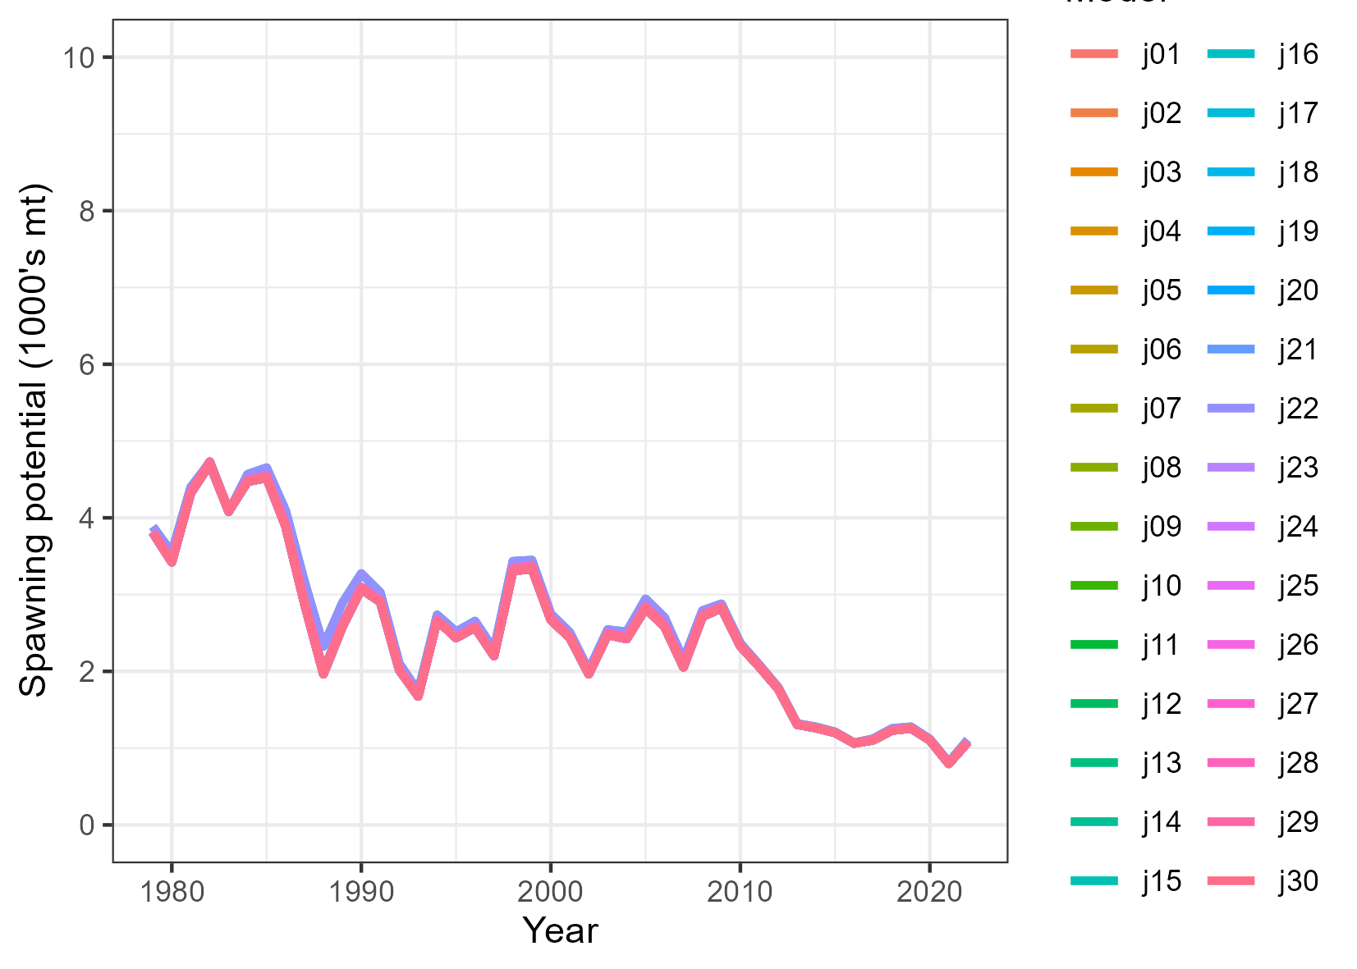
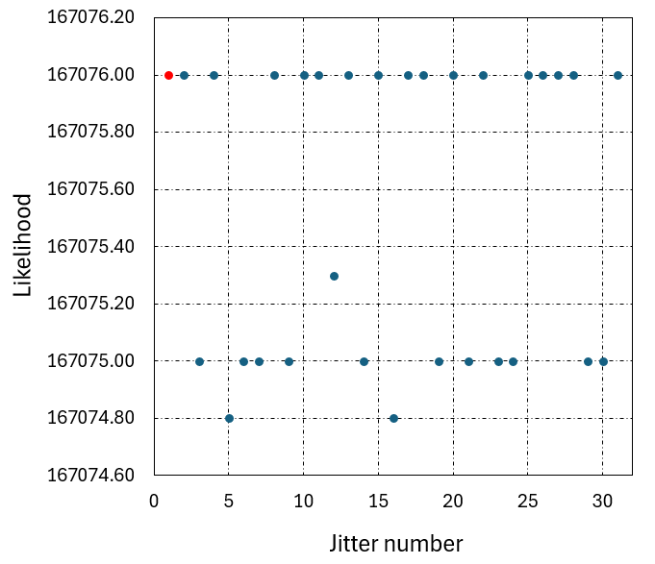
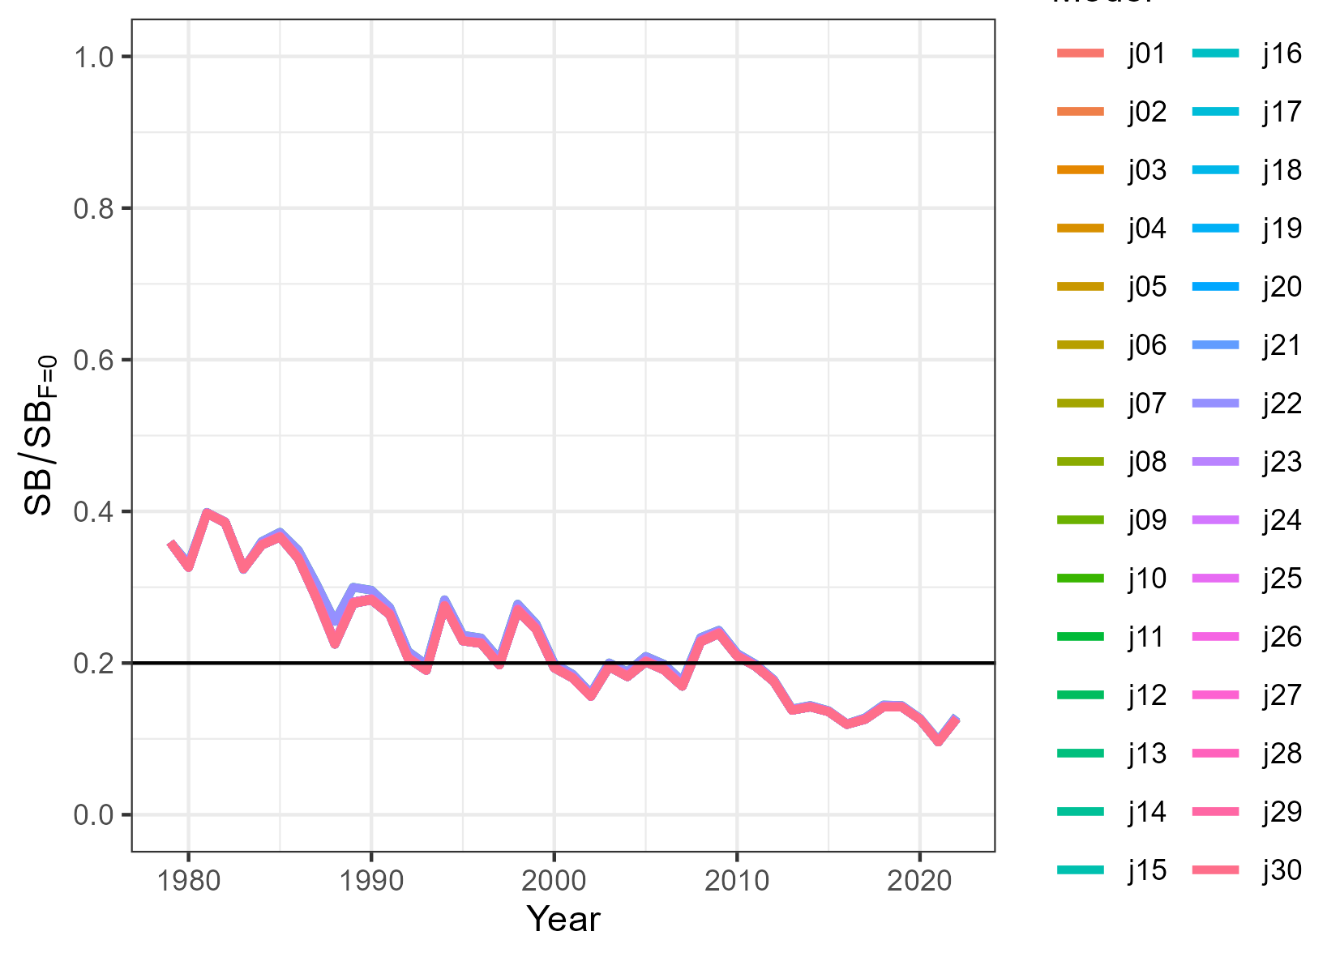
Convergence
Gradients E-05, PDH and pass jitter test

Slide 8
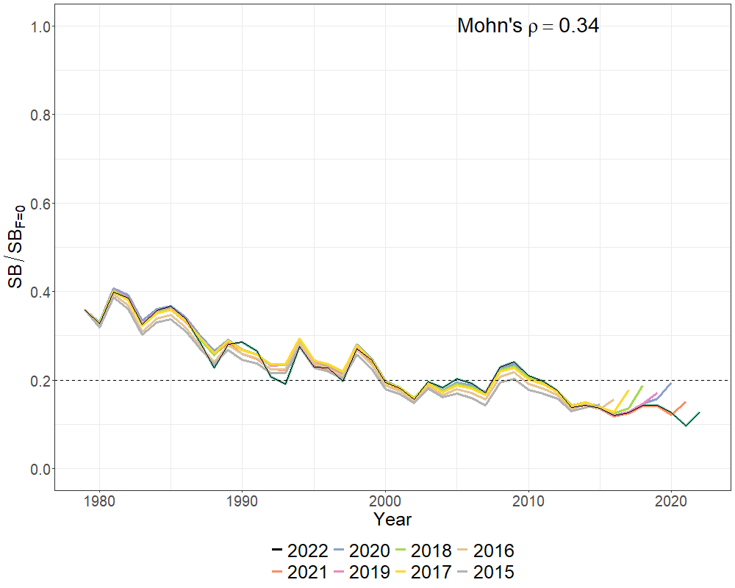
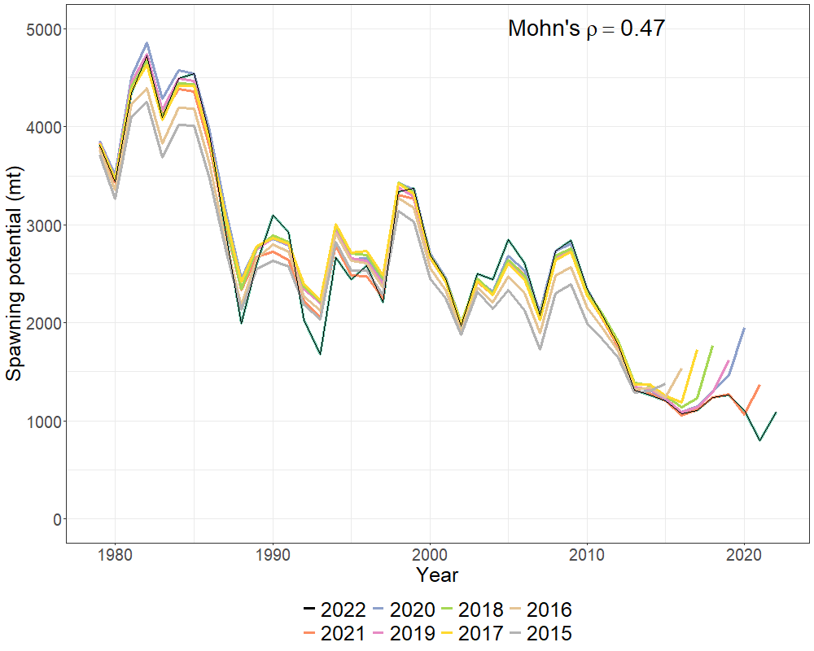
Retrospective analysis
Artificial kick up
Issue for projections
MFCL development work

Slide 9
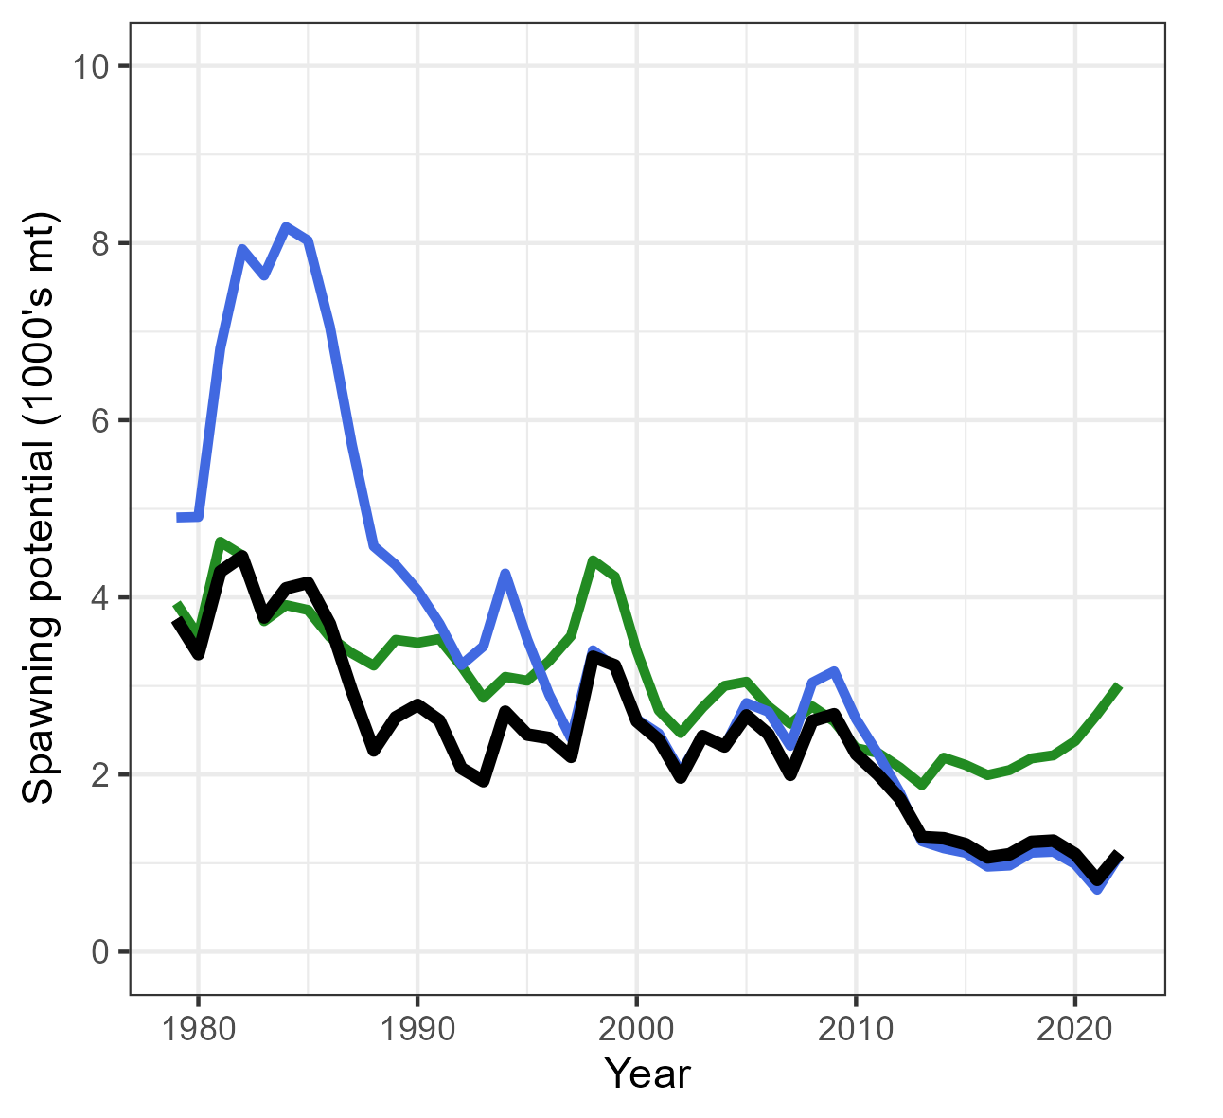
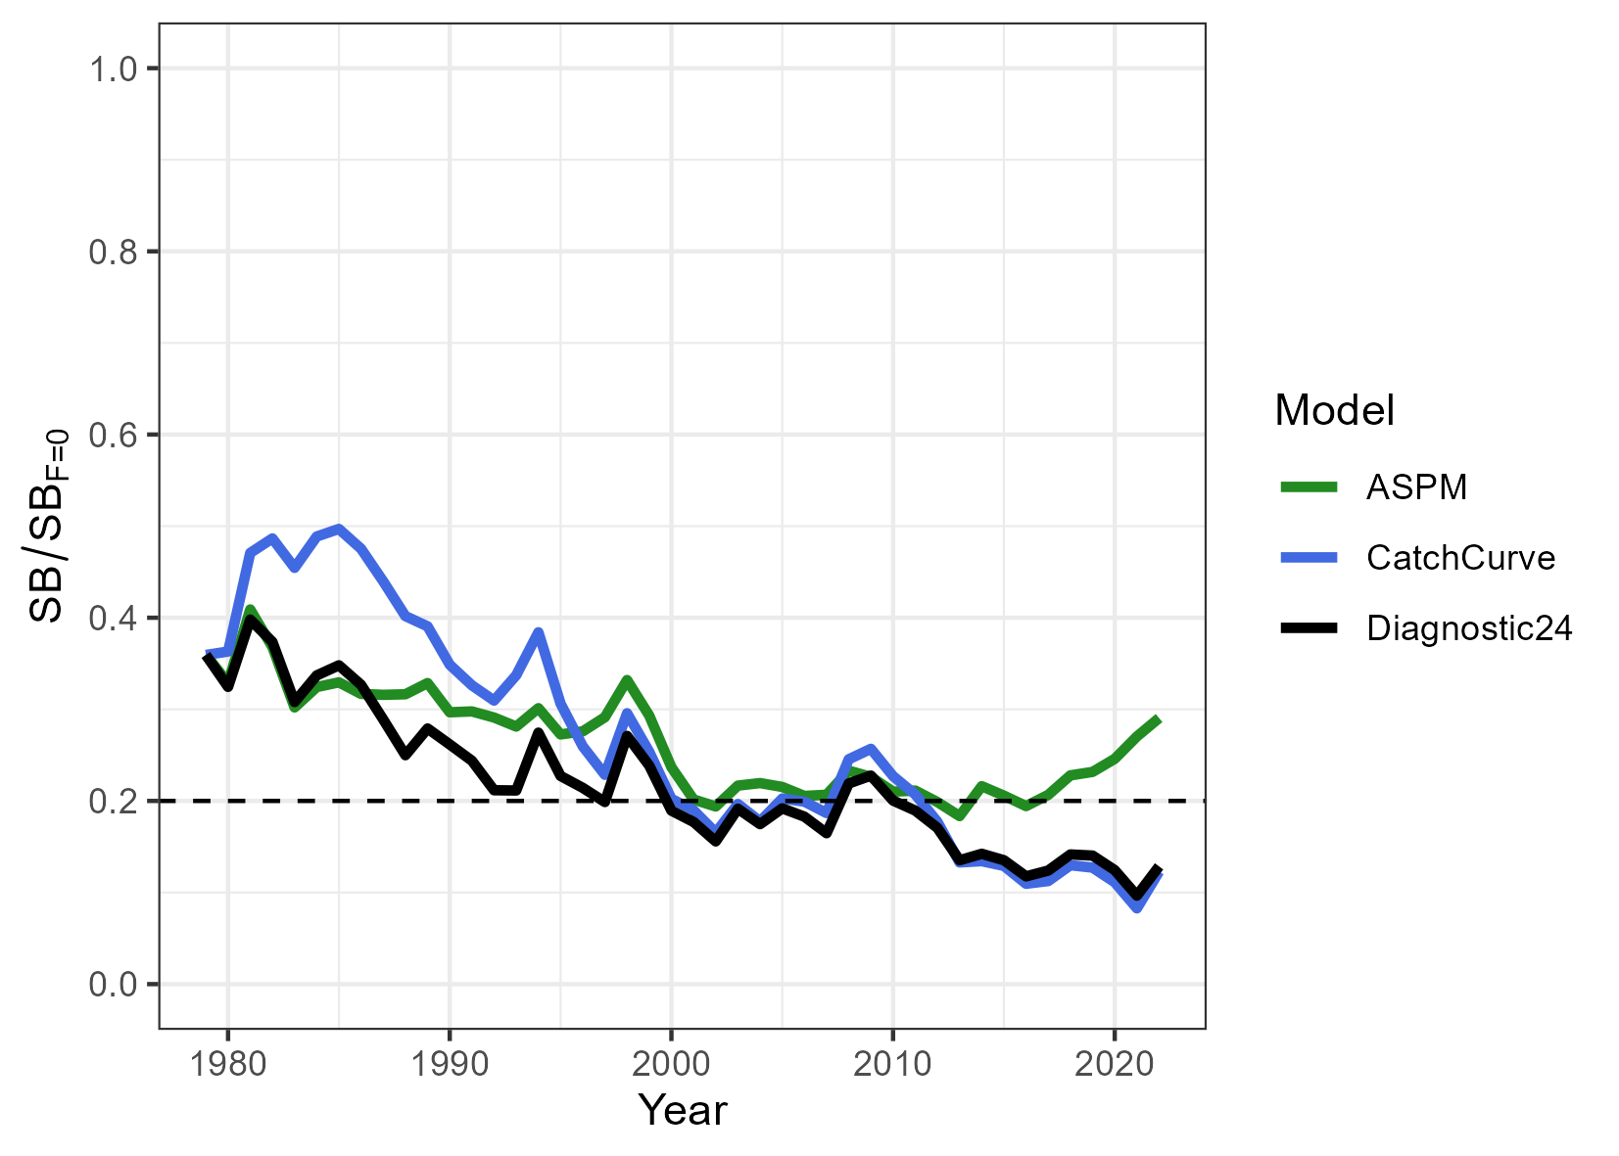
ASPM and Catch curve (extreme cases)
Different data components
ASPM = CPUE
Catch curve = size composition

Slide 10
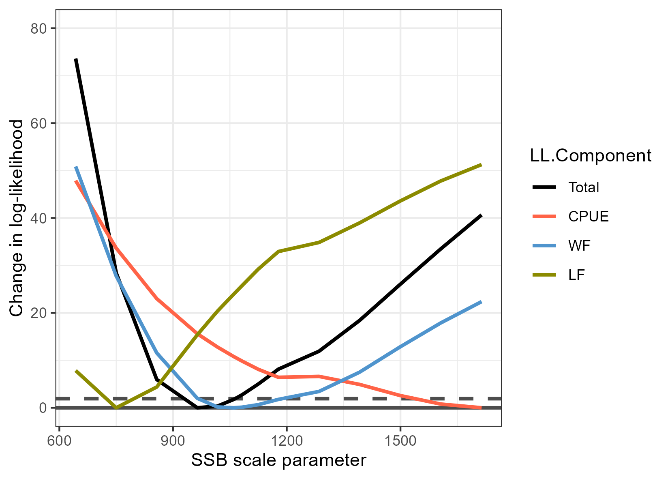
LL profile total
WF
LF
CPUE

Slide 11
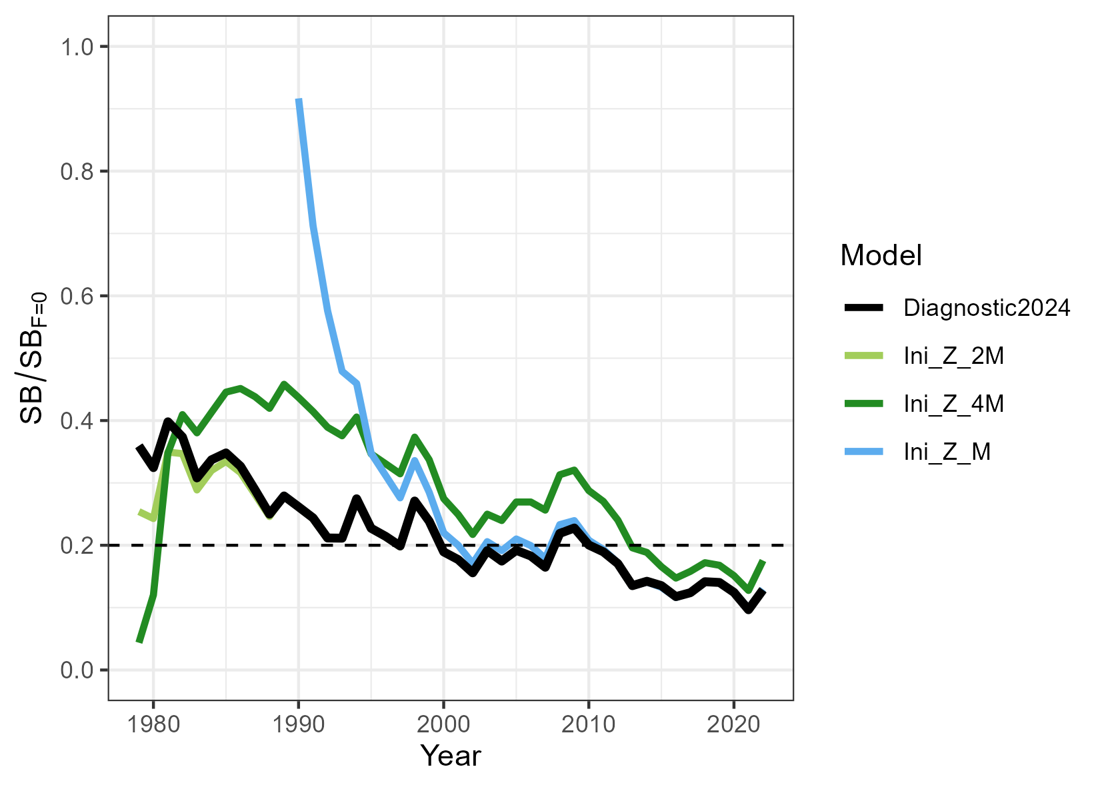
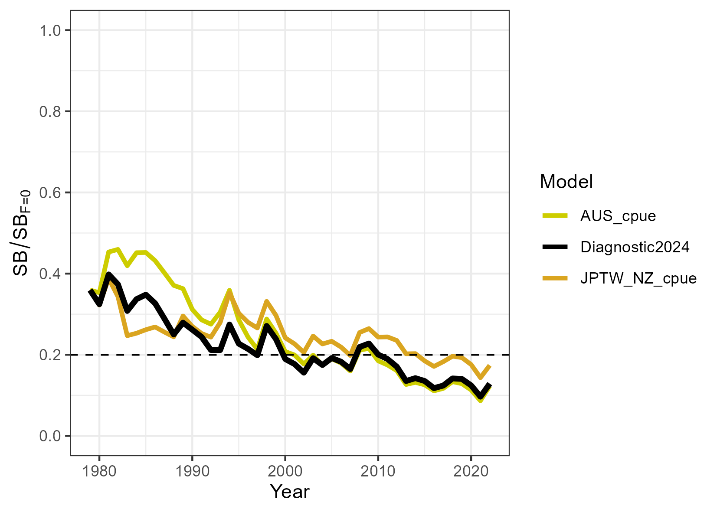
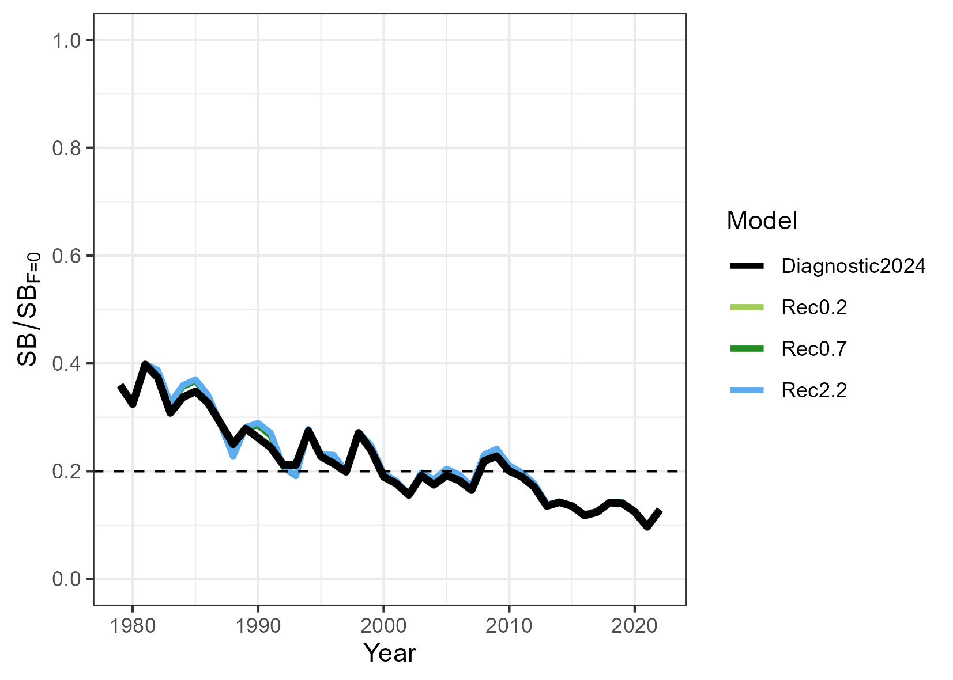
Sensitivities
Initial conditions
CPUEs
Rec CV
CPUEs
Ini condition
Recruitment penalty

Slide 12
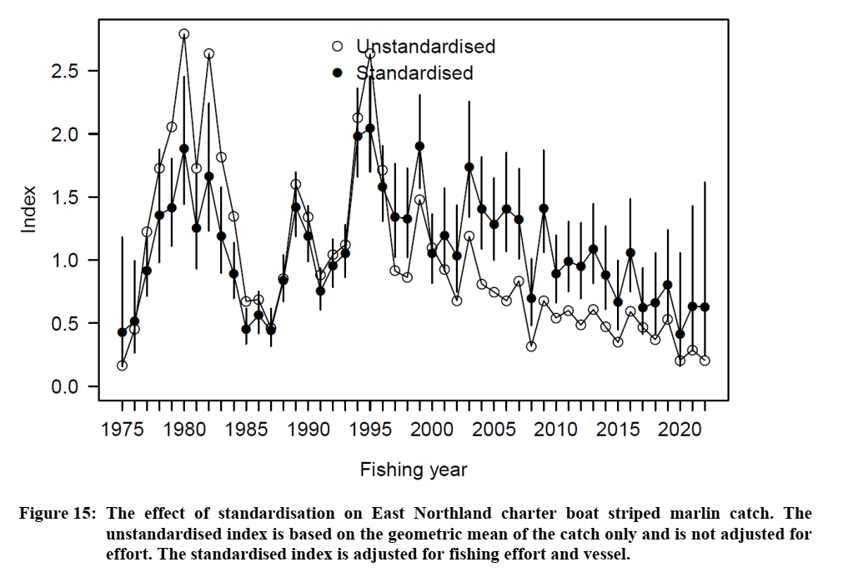
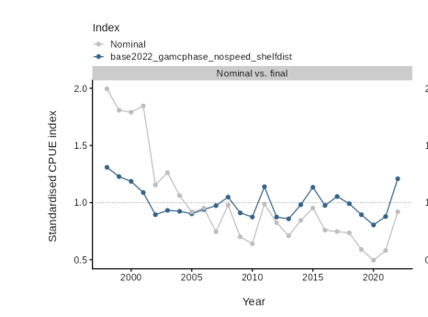
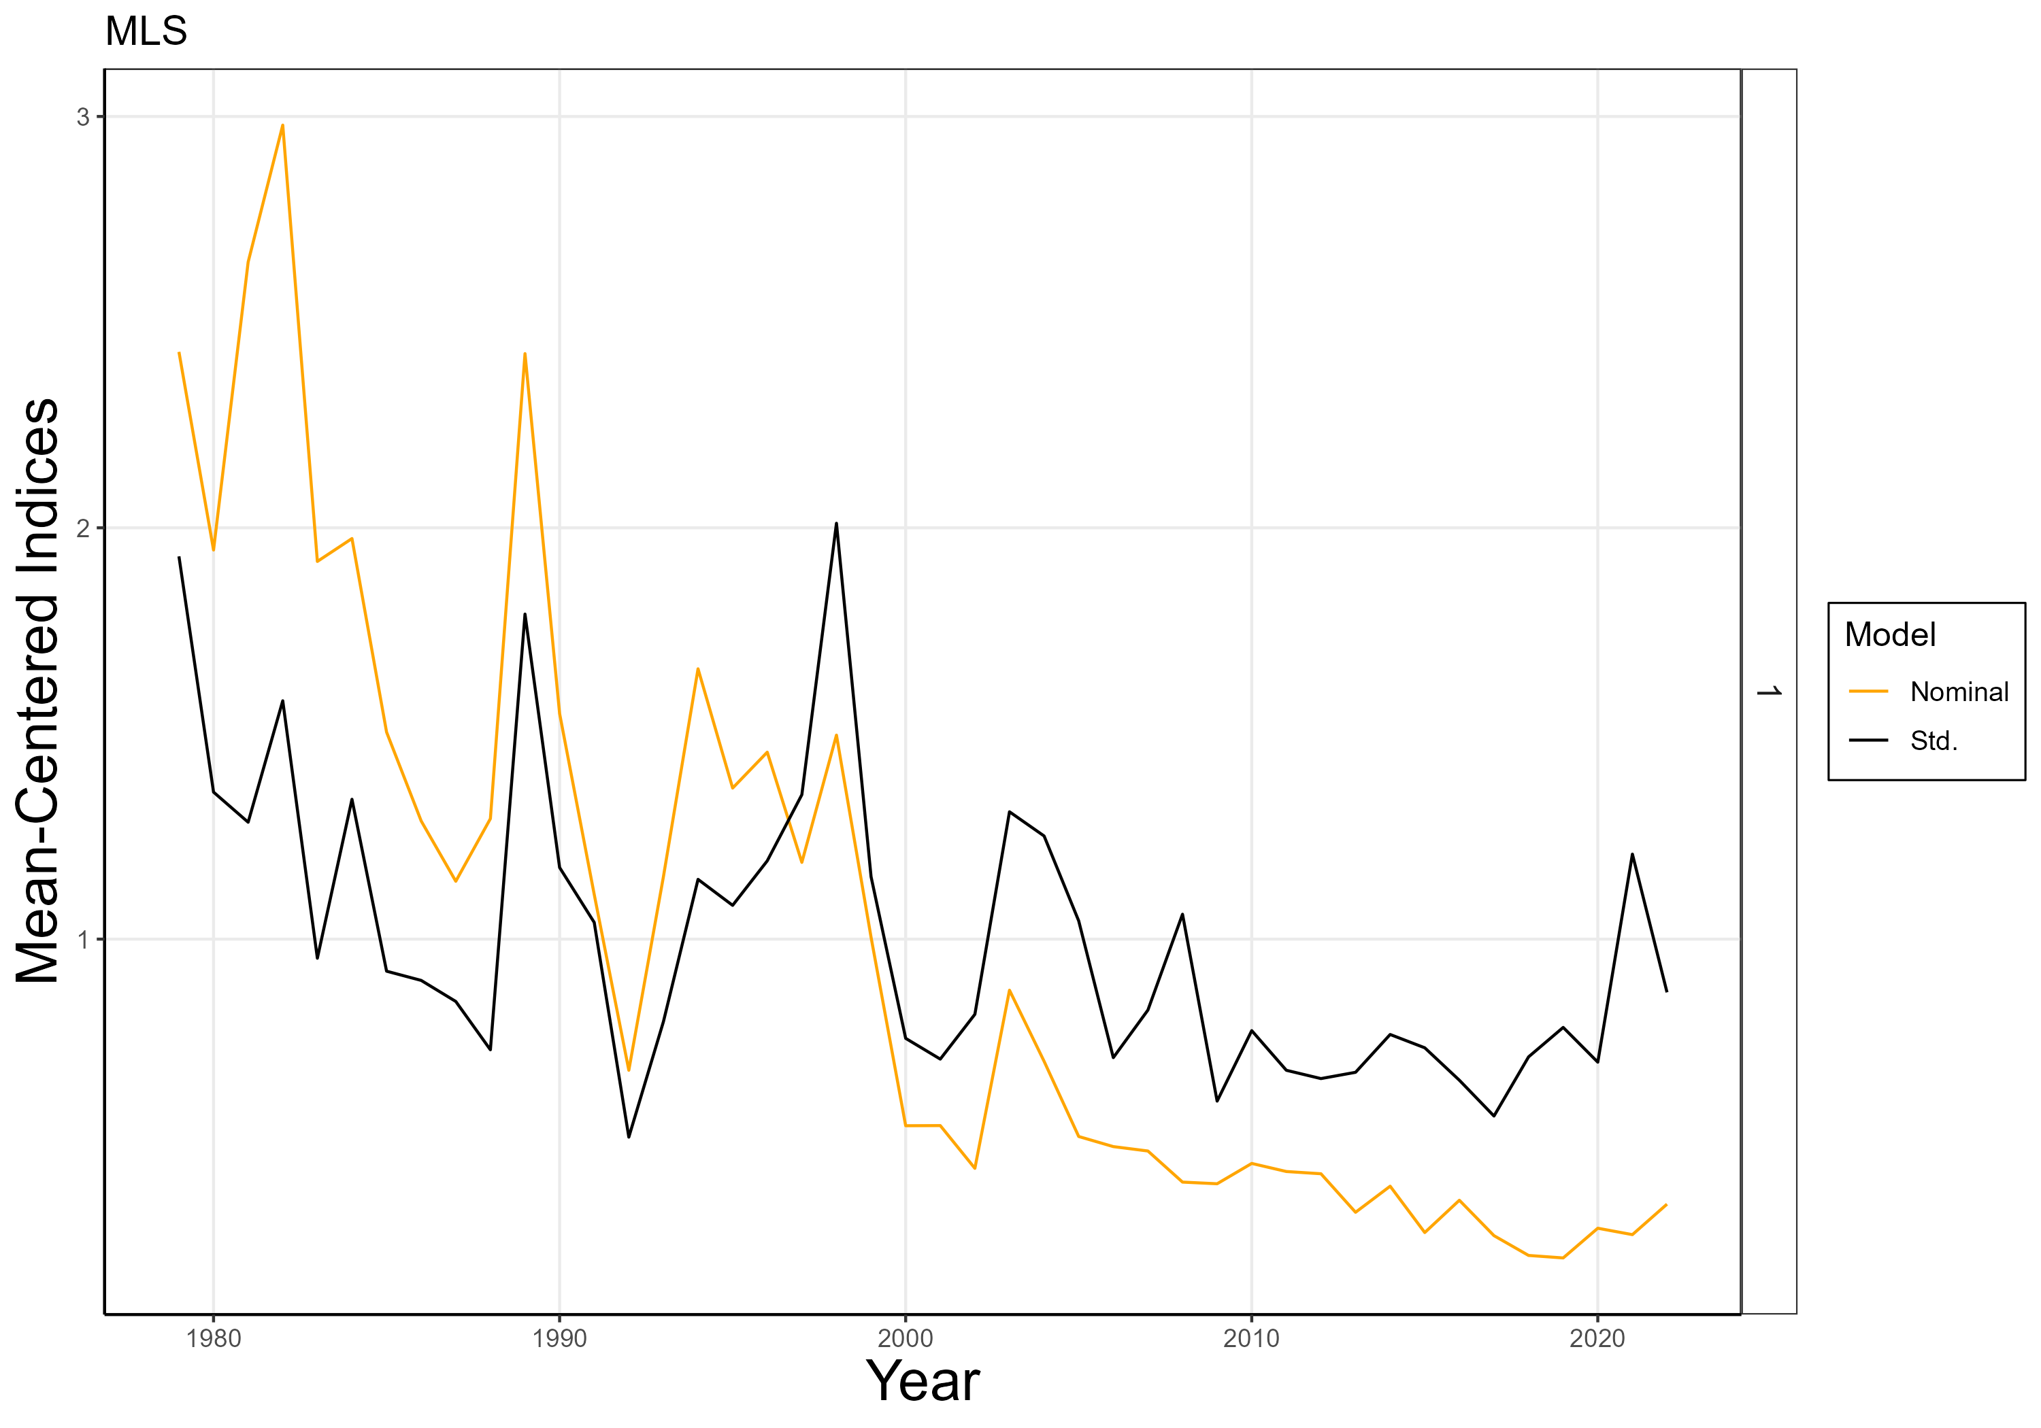
NZ charter boat
CPUE index
Sensitivities
Australian CPUE index
STD
NOM
2024 assessment
JP/TW CPUE index
Abundance indices
for striped marlin in the
southwest Pacific
STD
NOM

Slide 13
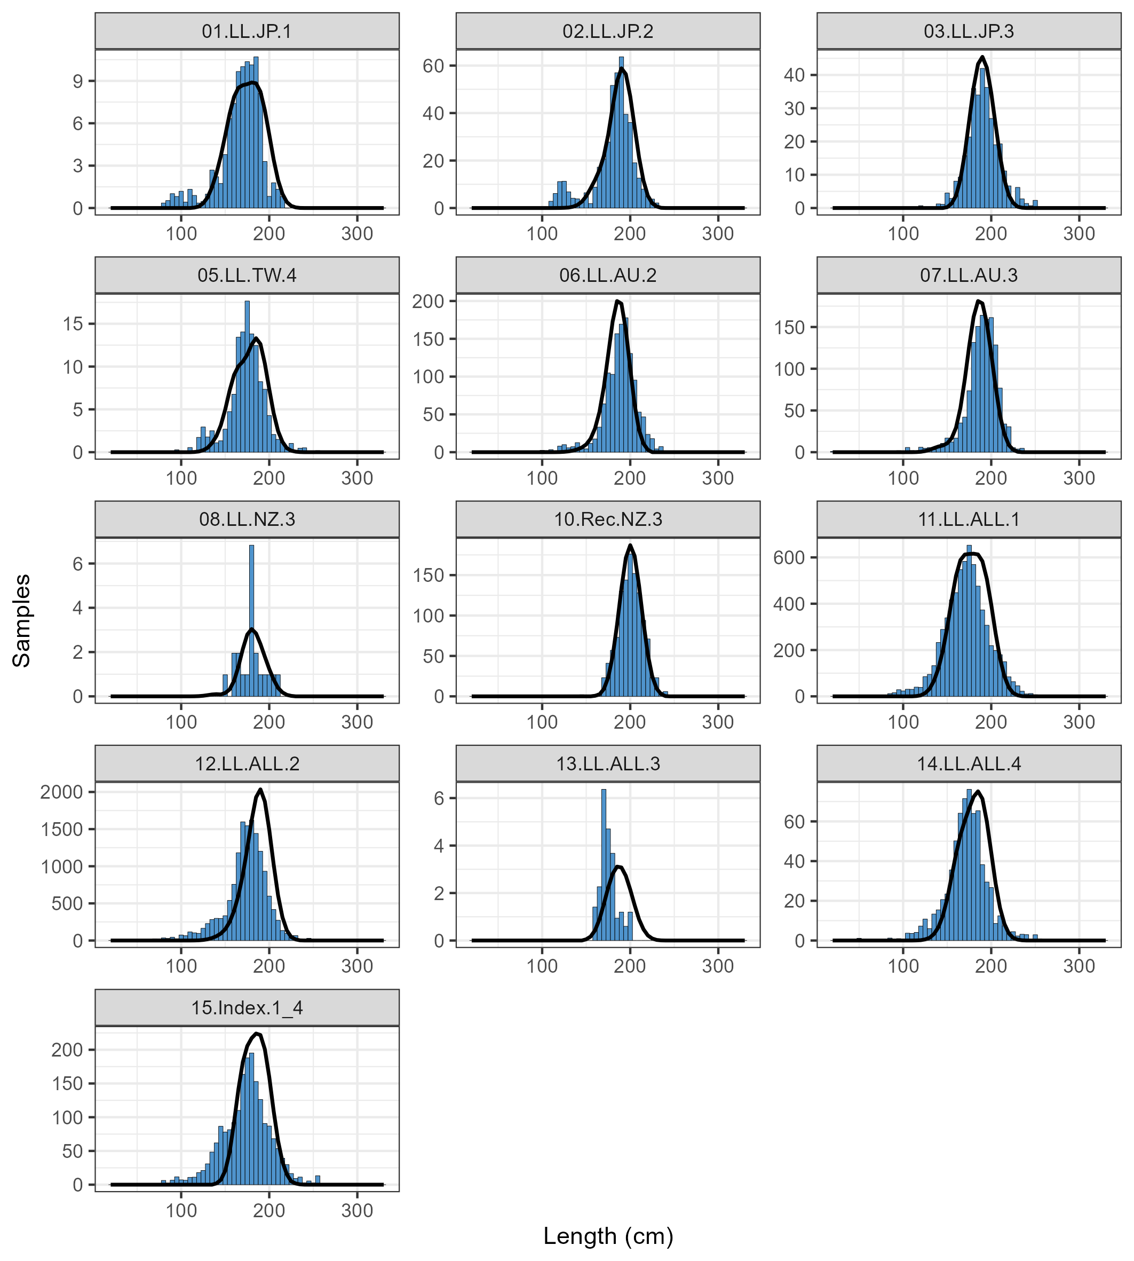
Issues arising
LF fits
CPUE

Slide 14
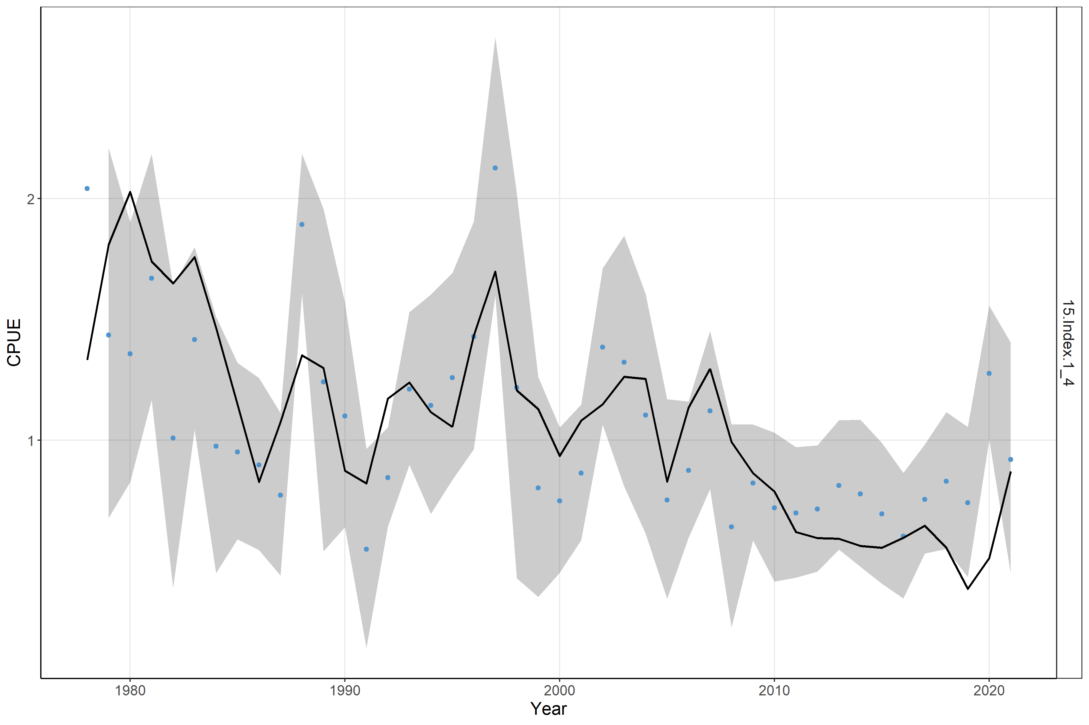
CPUE fit

Slide 15
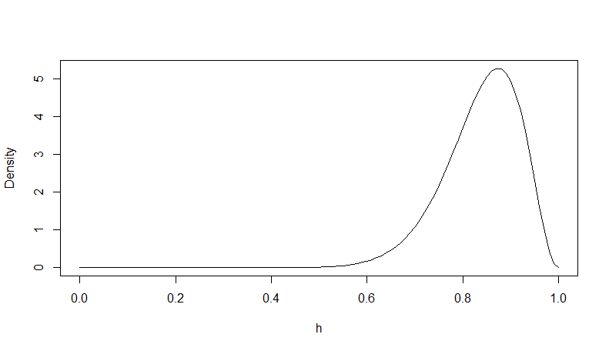
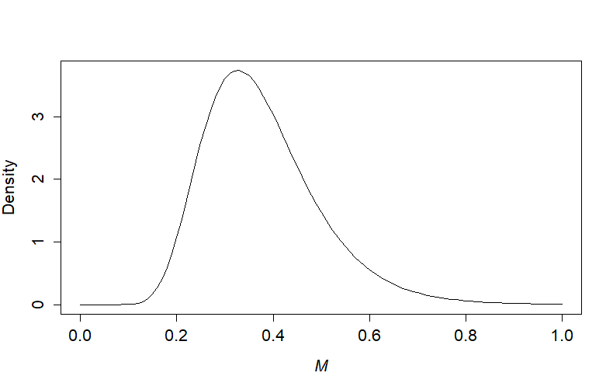
Ensemble models (priors)
h
M
Filtered by PDH

Slide 16
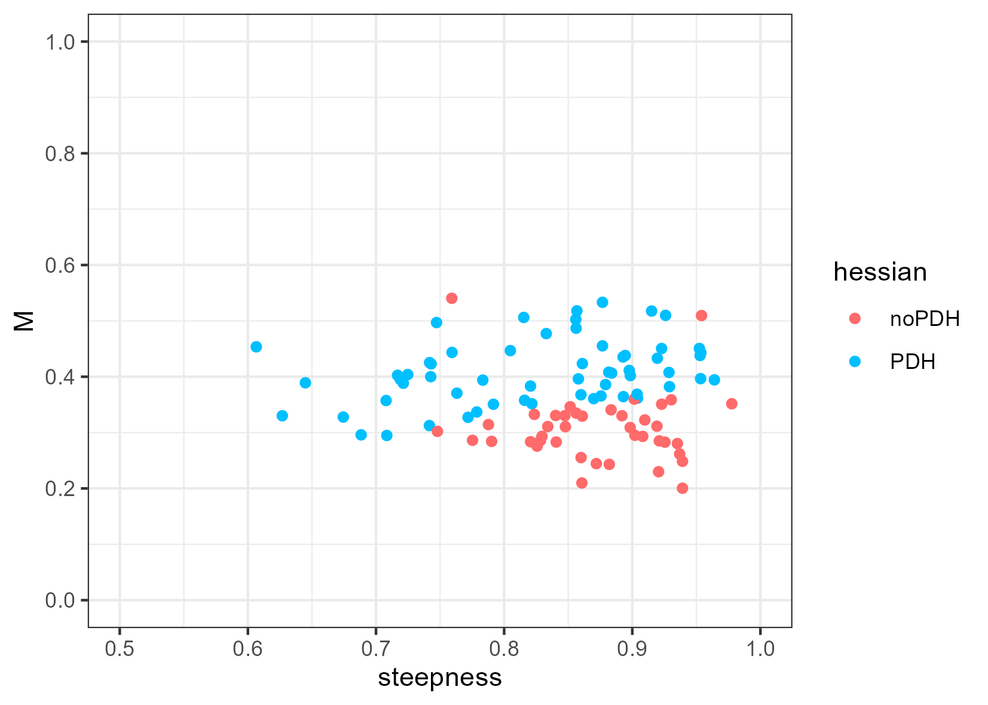
PDH filter
Less than 0.35 M
h greater than 0.75
59 pass the filter

Slide 17
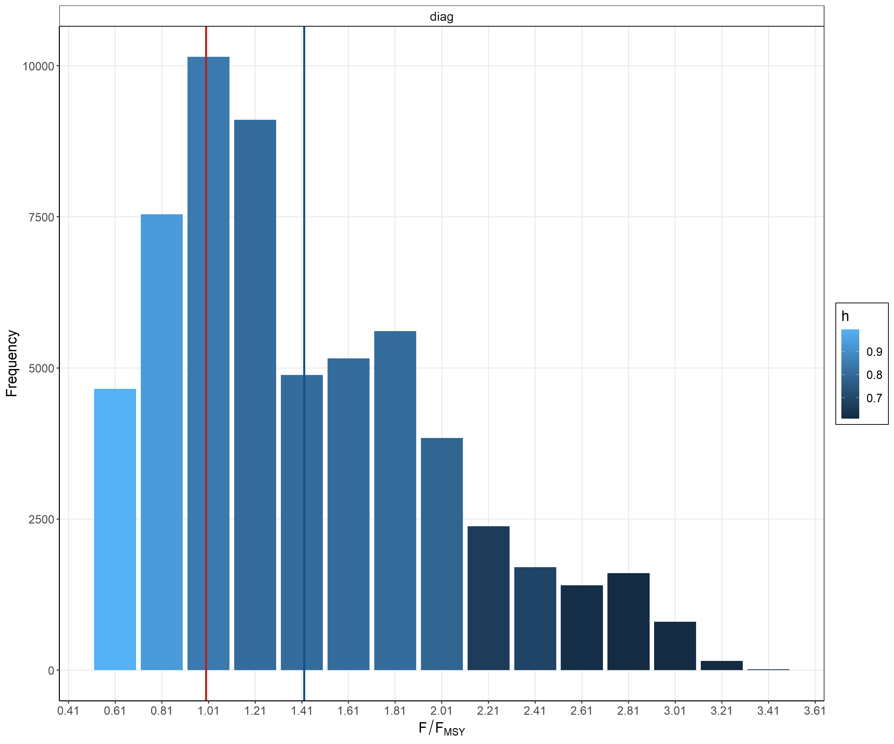
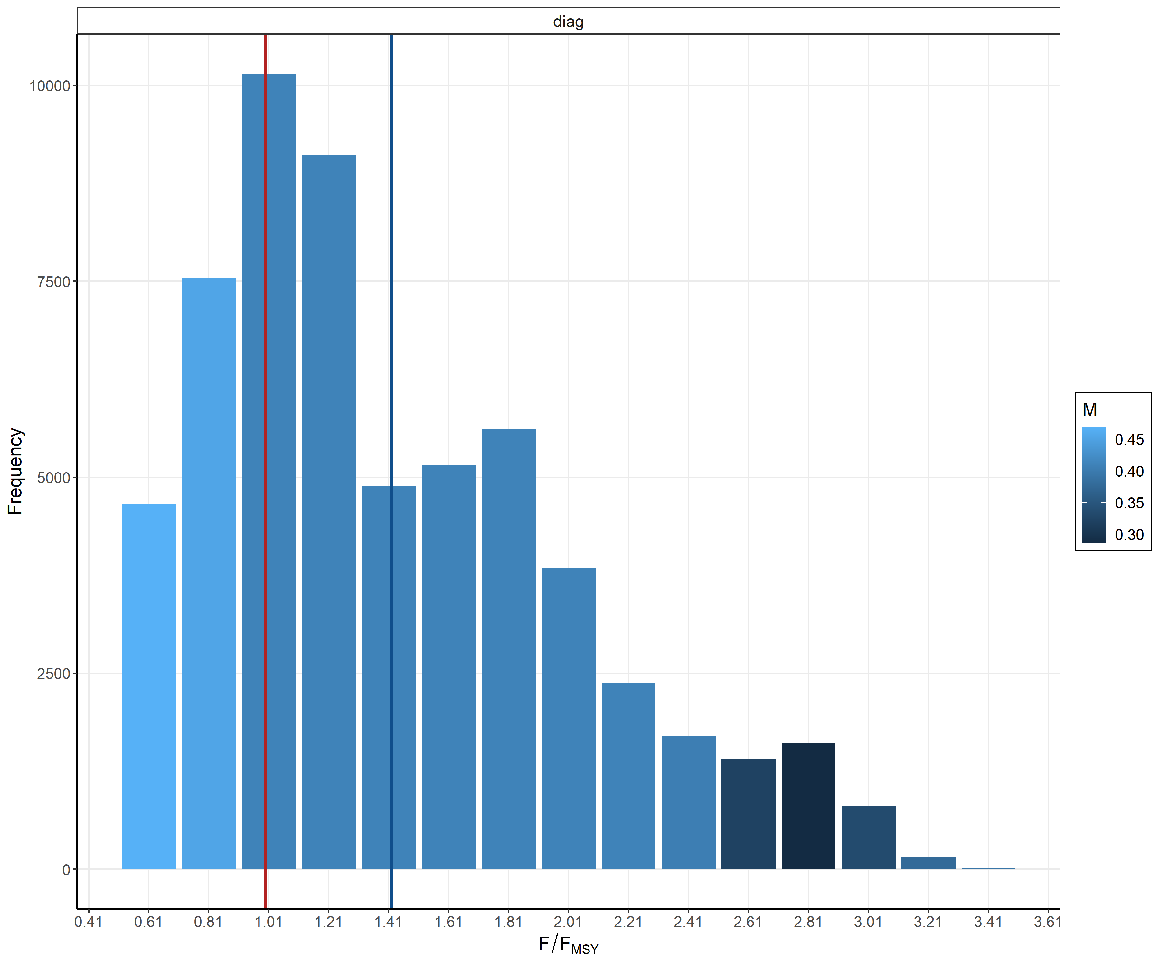
Model output – F/F_{MSY} across the range of h/M values
steepness
natural mortality
F=Fmsy
Mean

Slide 18
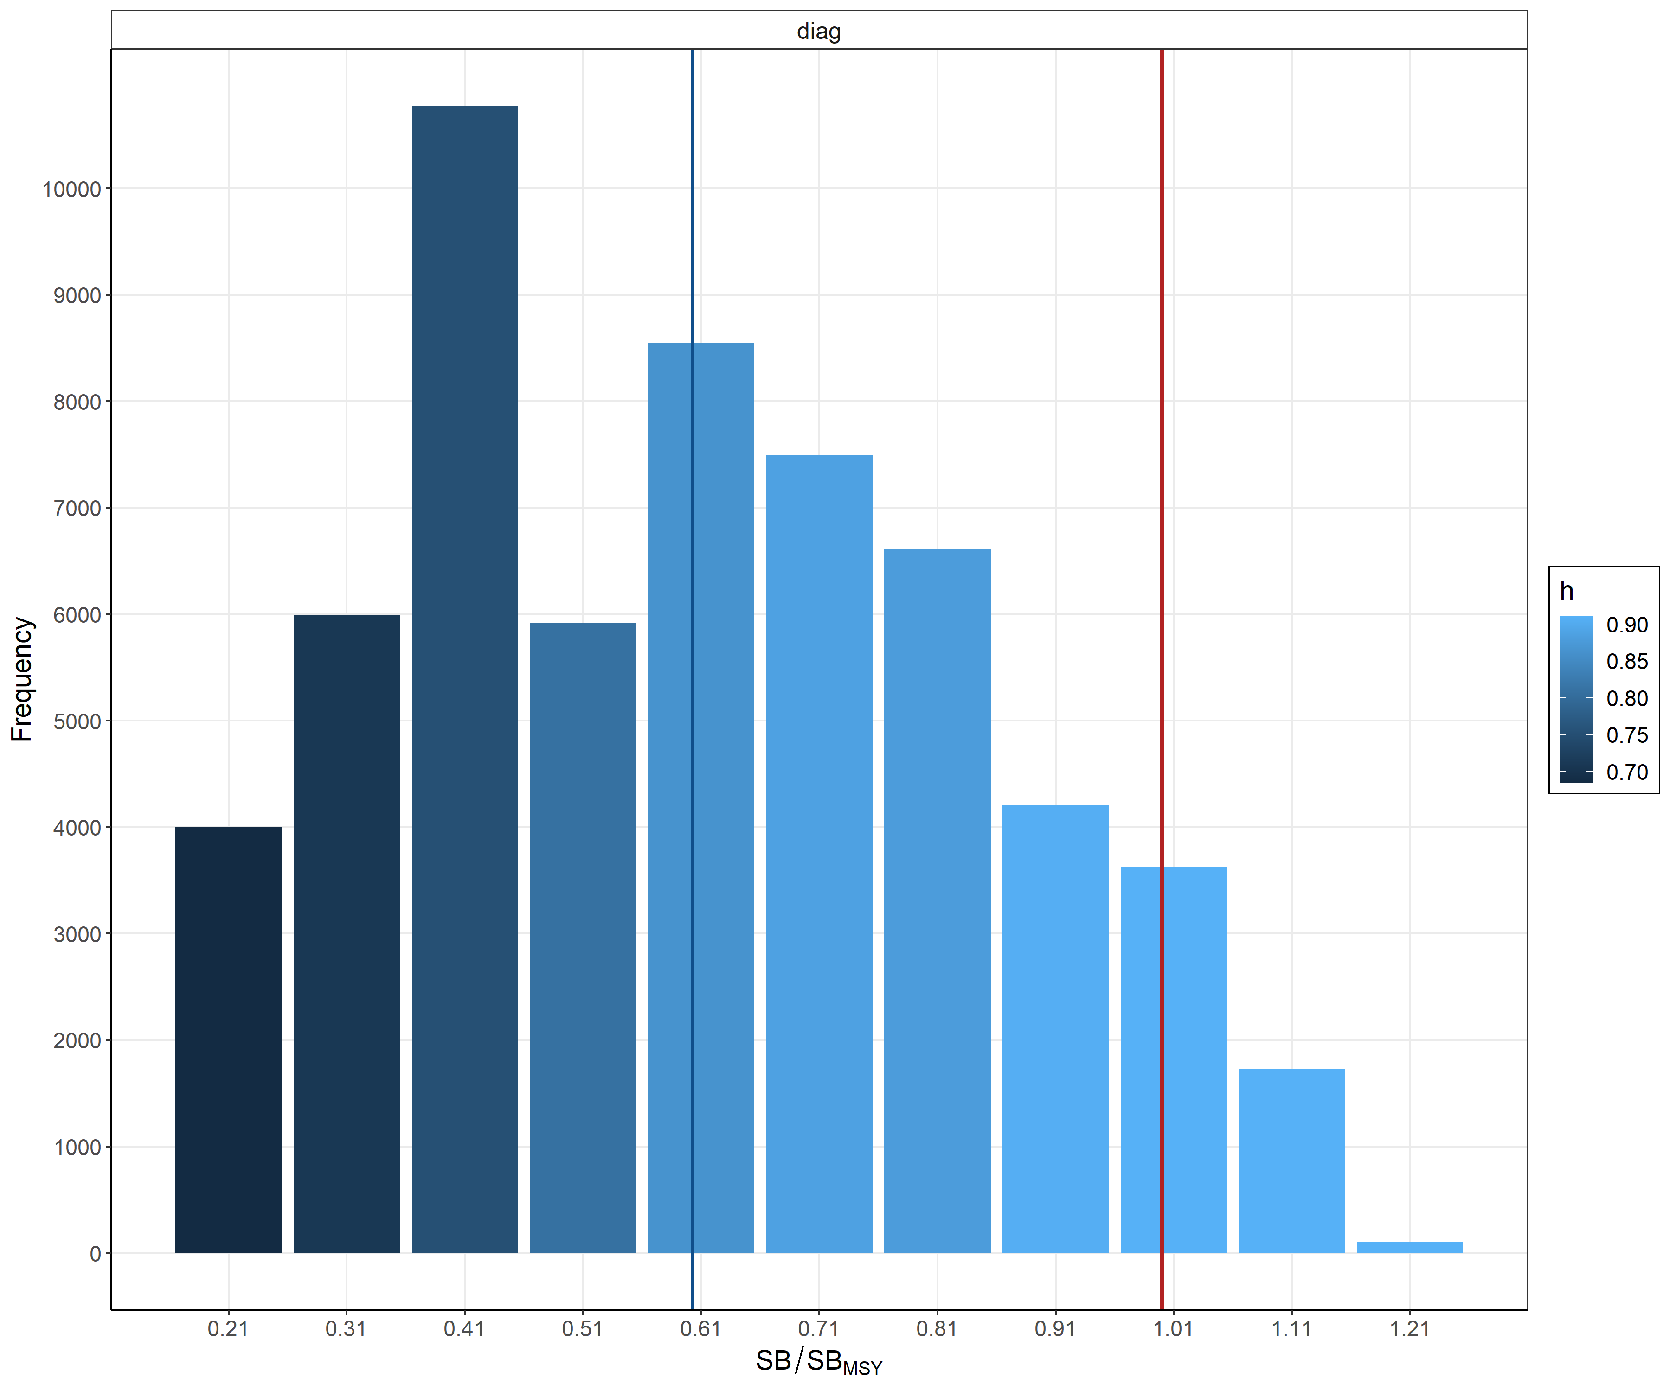
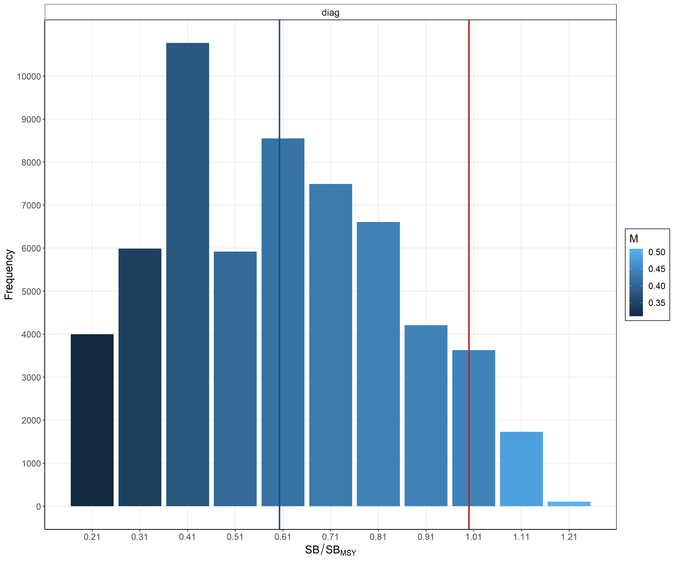
Model output – SBrecent/SBMSY across the range of h/M values
steepness
natural mortality
SB=SBmsy
Mean

Slide 19
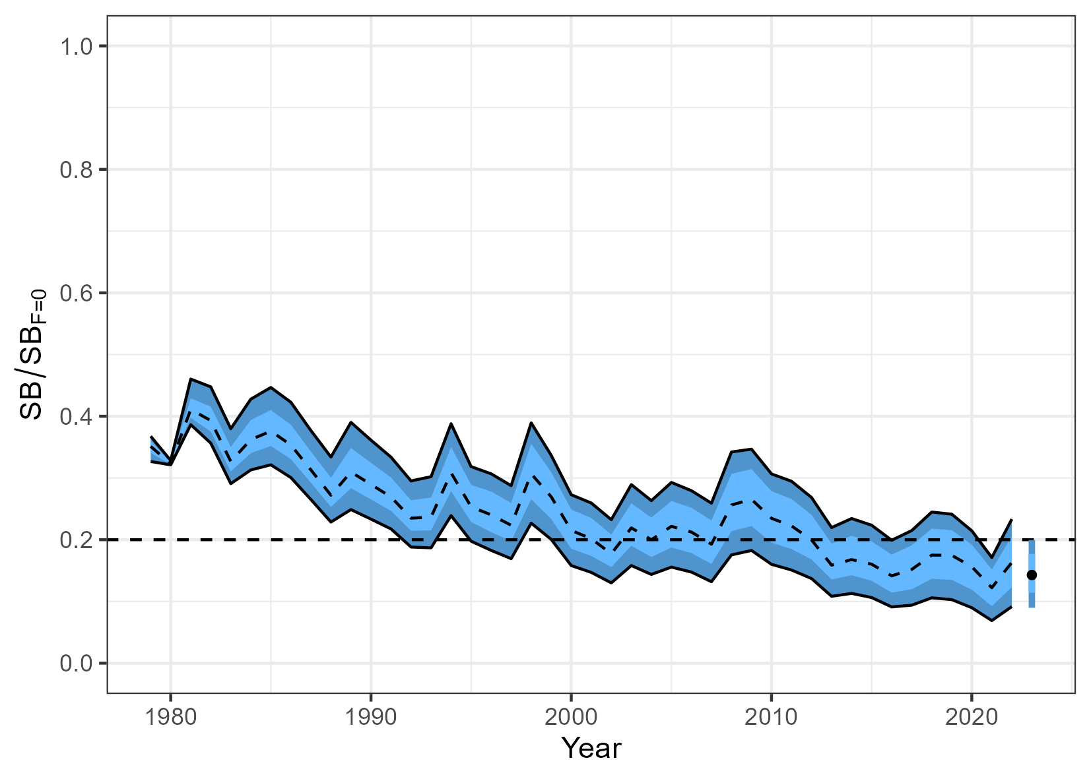
Depletion – all models
Just for interest
No depletion ref.points
for Billfishes
SB/SBF=0

Slide 20
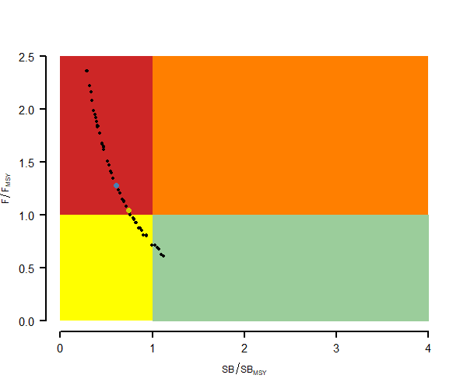
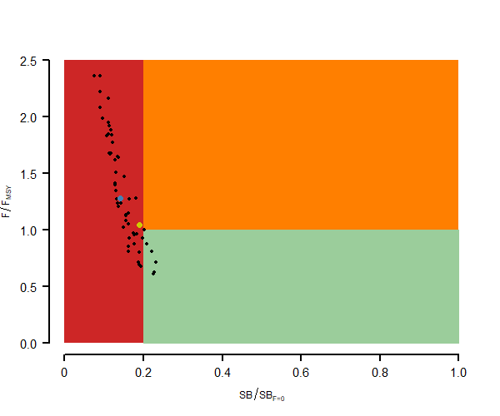



Kobe and Majuro plots
Kobe
recent
Majuro
Median
Overall median change by SB/SBMSY 0.60 (80th percentile 0.29 – 0.95)
Median F/FMSY= 1.21 (80th percentile 0.79-2.30)

Slide 21
Exploring some of the critical issues
Data conflict (LF and WF)
Poor CPUE fit
Different selectivity groups
Data weighting
Influential data from last two years (fleet 6 and 7)

Slide 22
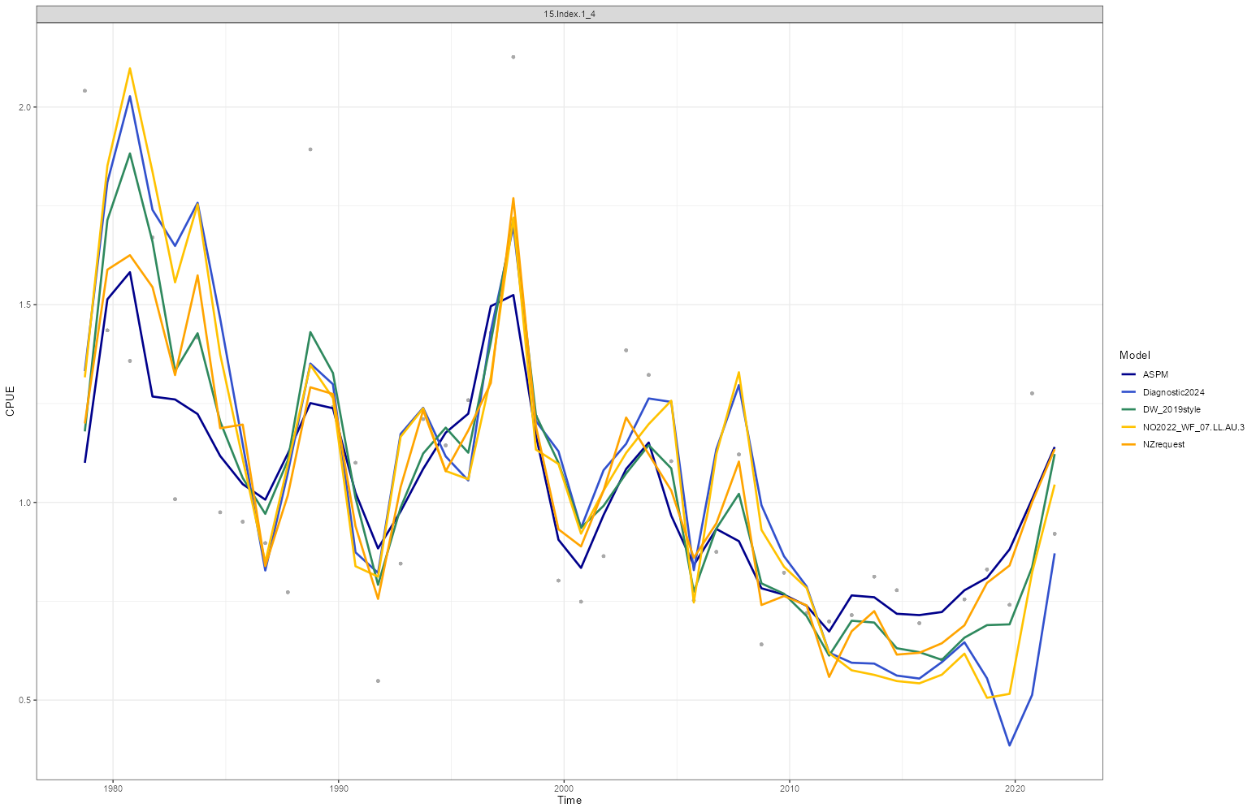
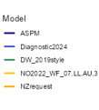

Slide 23
Recent exploration model issues
Best CPUE fit
Worst CPUE fit
The management values from the current model are biased towards pessimistic
Just diagnostic model
No full exploration (diagnostics)
NZ ODF request : Full down-weight 12.LL.ALL.2 LF, and 06.LL.AU.2 and 07.LL.AU.3 WF. Remove 52%LF and 67%WF

Slide 24
Concerns with the assessment in relation to management quantities (Rev2)
We have recognised some critical model issues late in the assessment process that would benefit from further work to improve the confidence in the management advice.
These concerns include poor fits to some of the size data and the under fit to CPUE in the recent time period, data conflicts and data weighting impacts, and the results of the ASPM and Catch Curve models.
Preliminary work to understand the implications of some of these issues suggest the current model estimates of stock status are likely biased towards more pessimistic management advice, the degree to which we cannot be certain without additional work.
We also very recently identified some concerns around some data inputs that need further understanding.
SC20 should consider the issues raised when evaluating whether the assessment results provide the best available science for management advice.

Slide 25
Recommendations for further work
Increase biology sampling (otoliths, tissues)
Age validation
Growth parameters across the Pacific
Increase collection of representative size comp.data
Environmental factor on recruitment
Review of the comp.data (length and weight)
Consider the issue of effective hook effort changes (reductions)
Priors investigation for ensemble models
Quarterly time step model to improve resolution
Use of alternative model platforms

Slide 26

To be continued? …

Slide 27
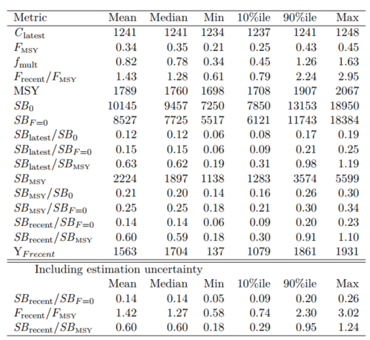
Summary of ref points

Slide 28
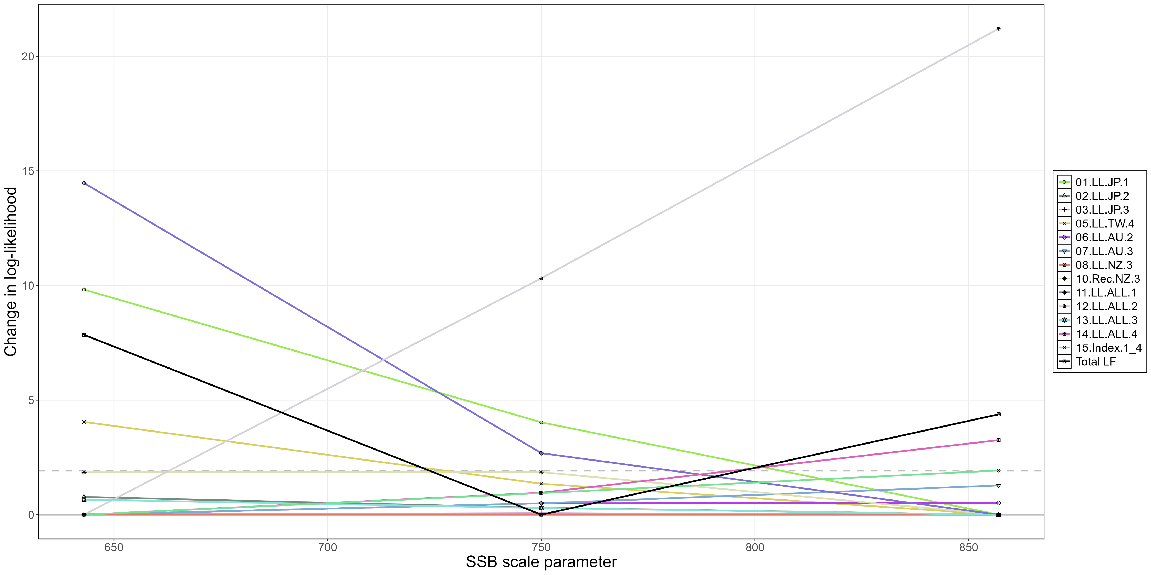
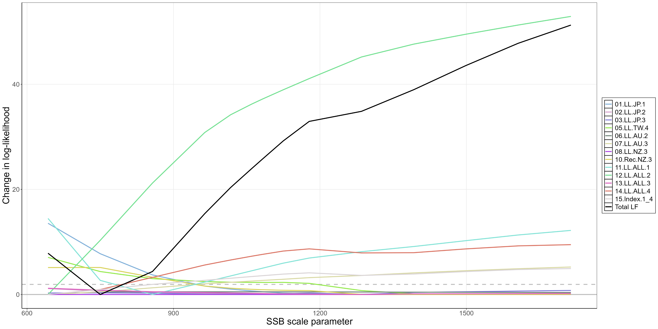
LF by fleet

Slide 29
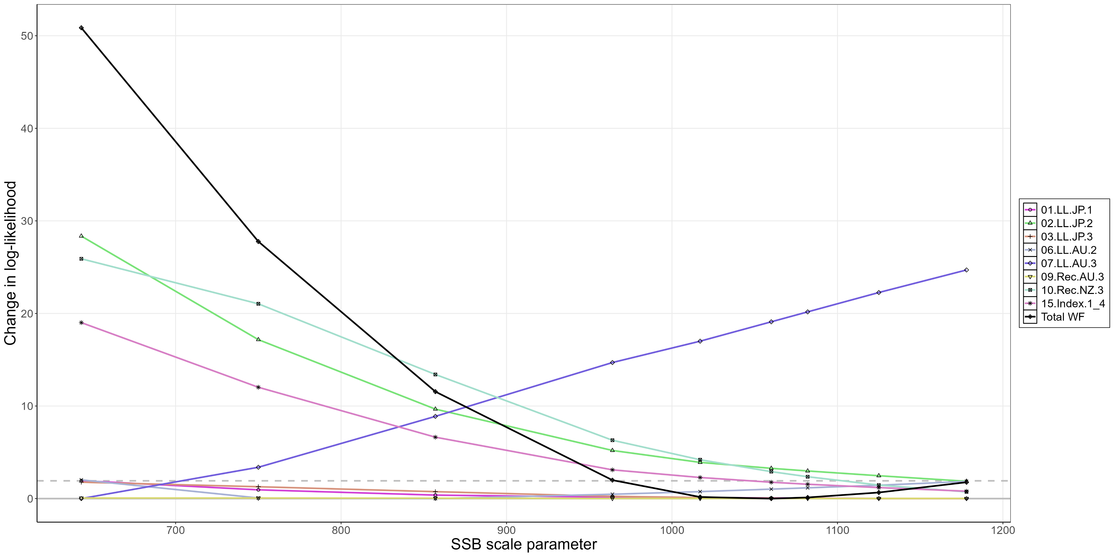
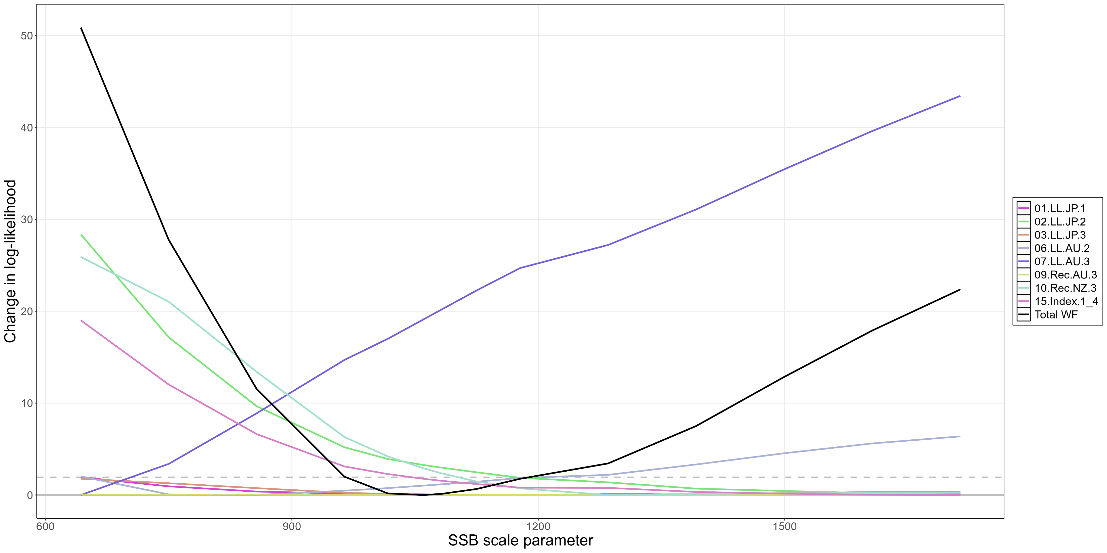
WF by fleet

Slide 30
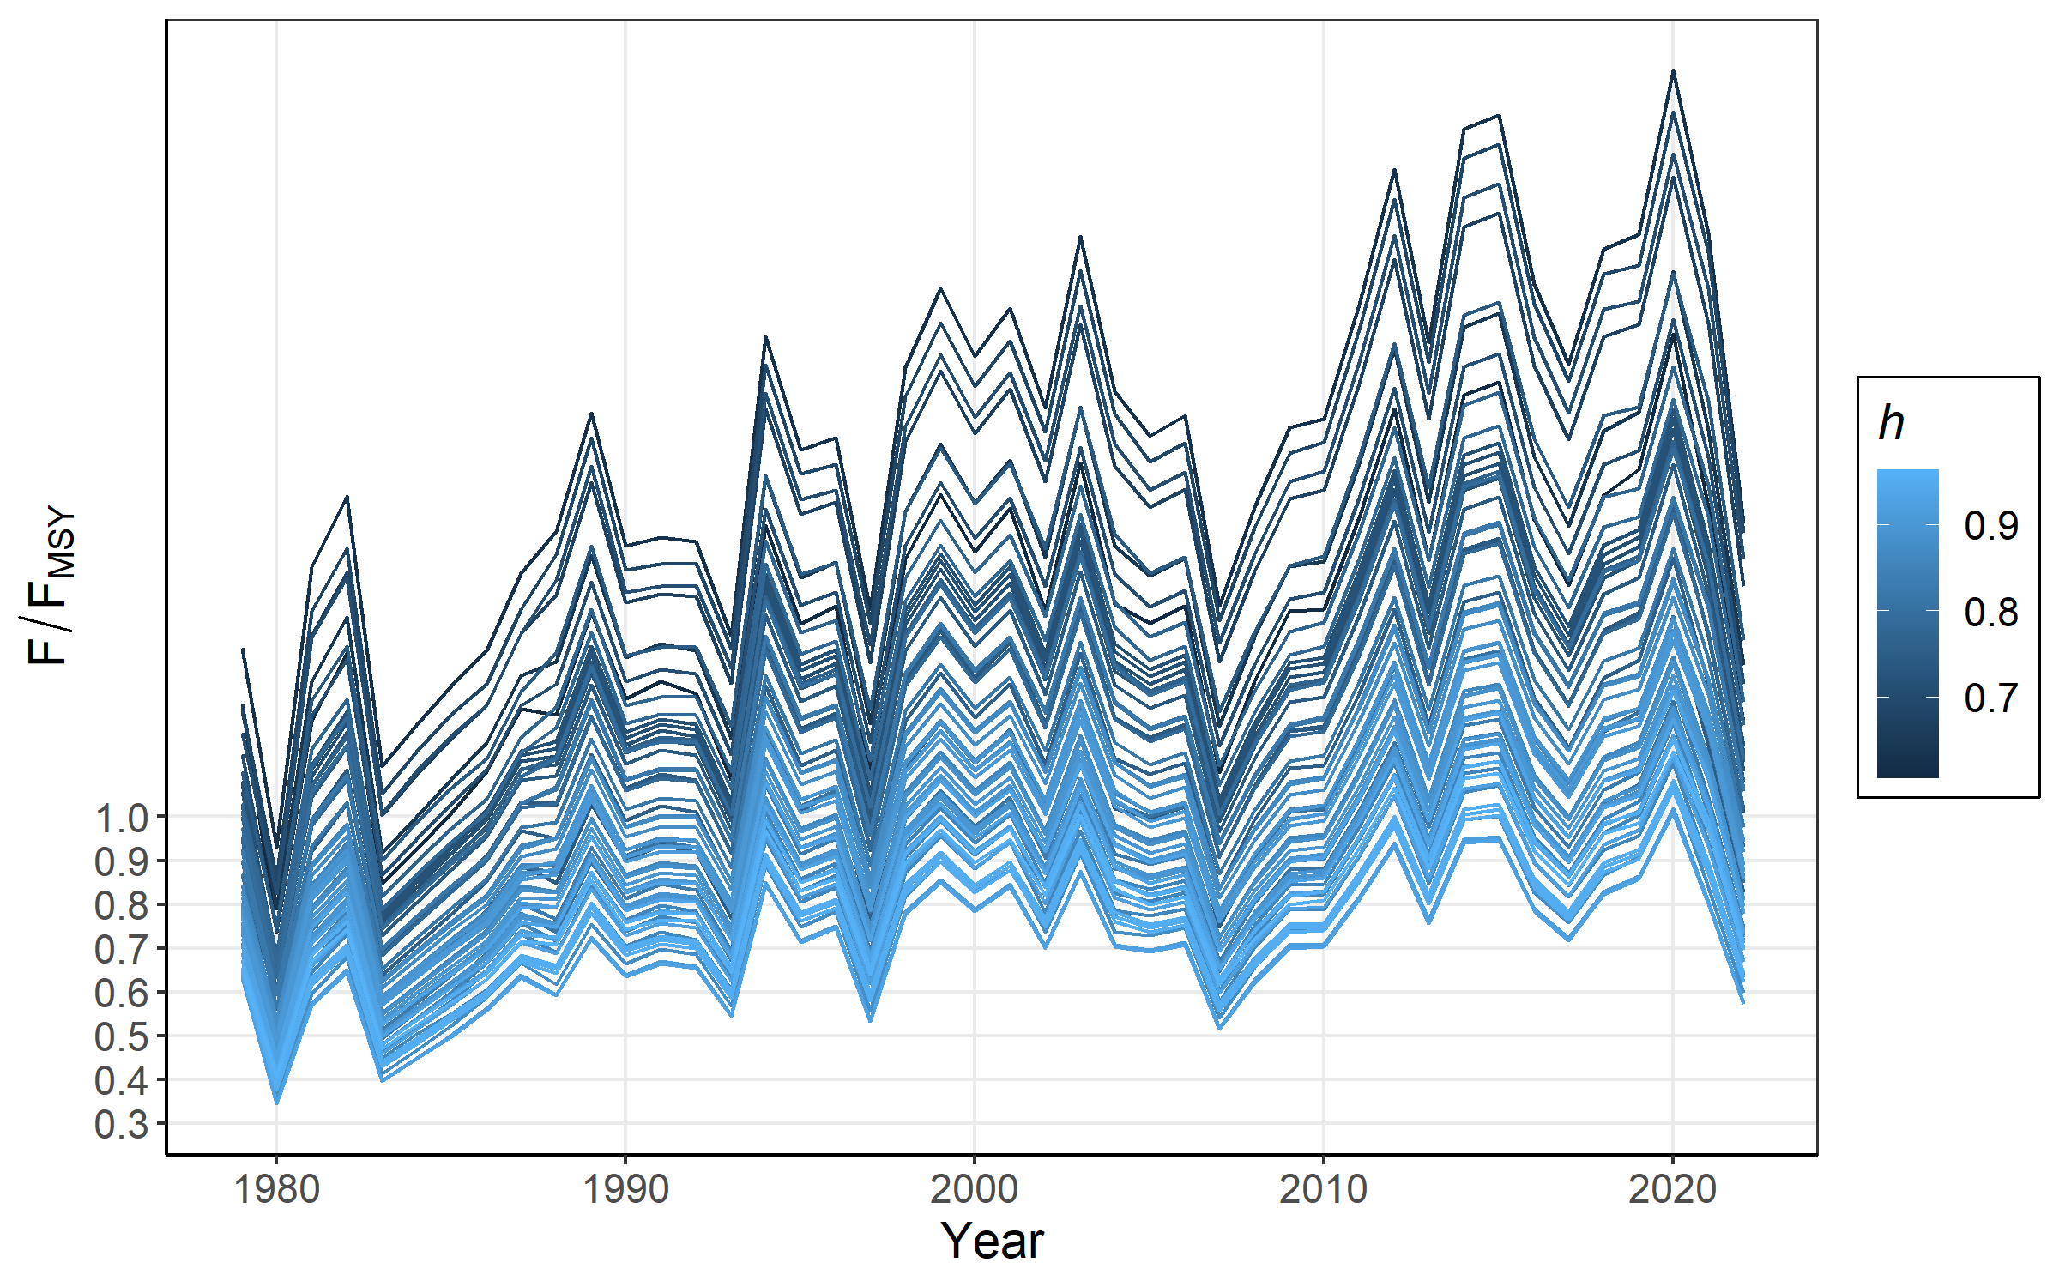
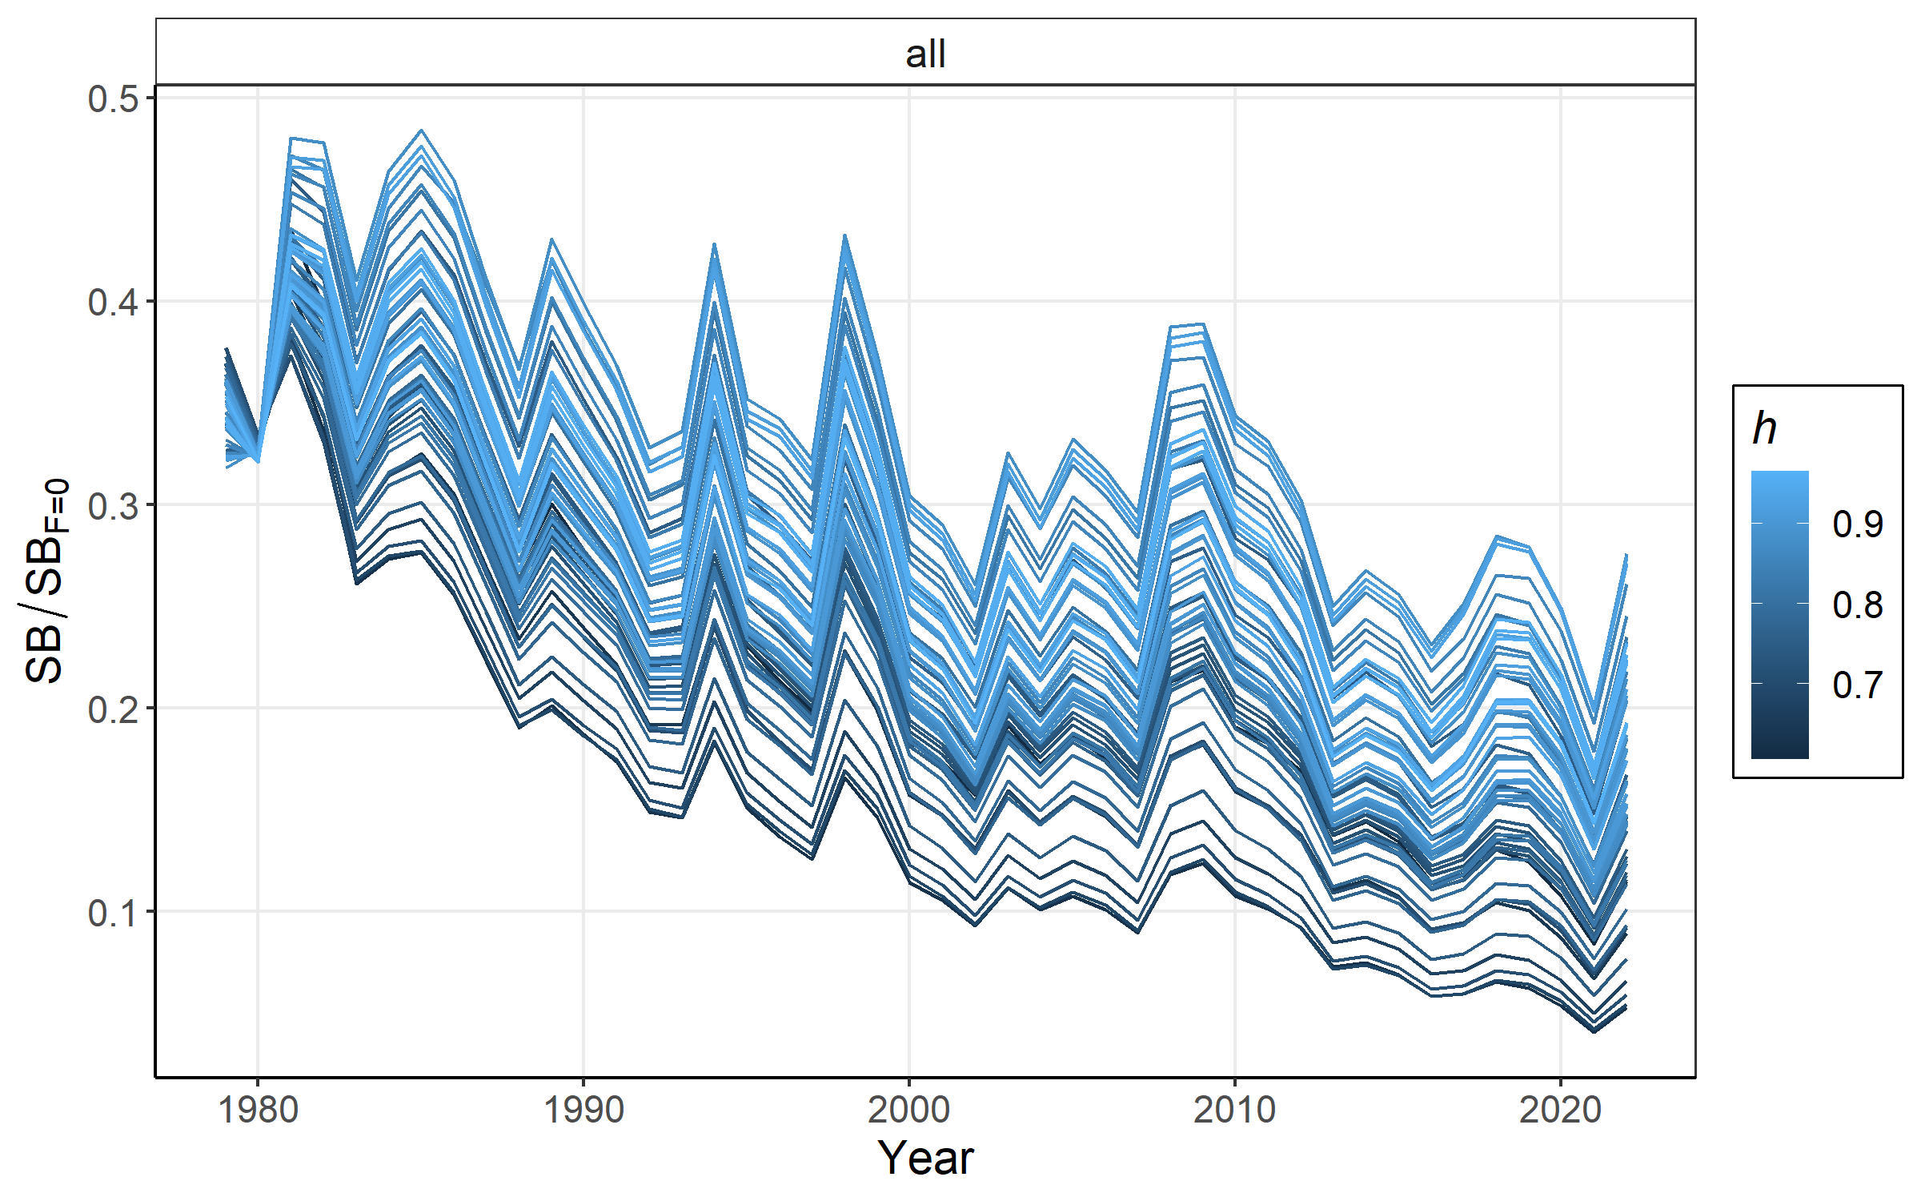
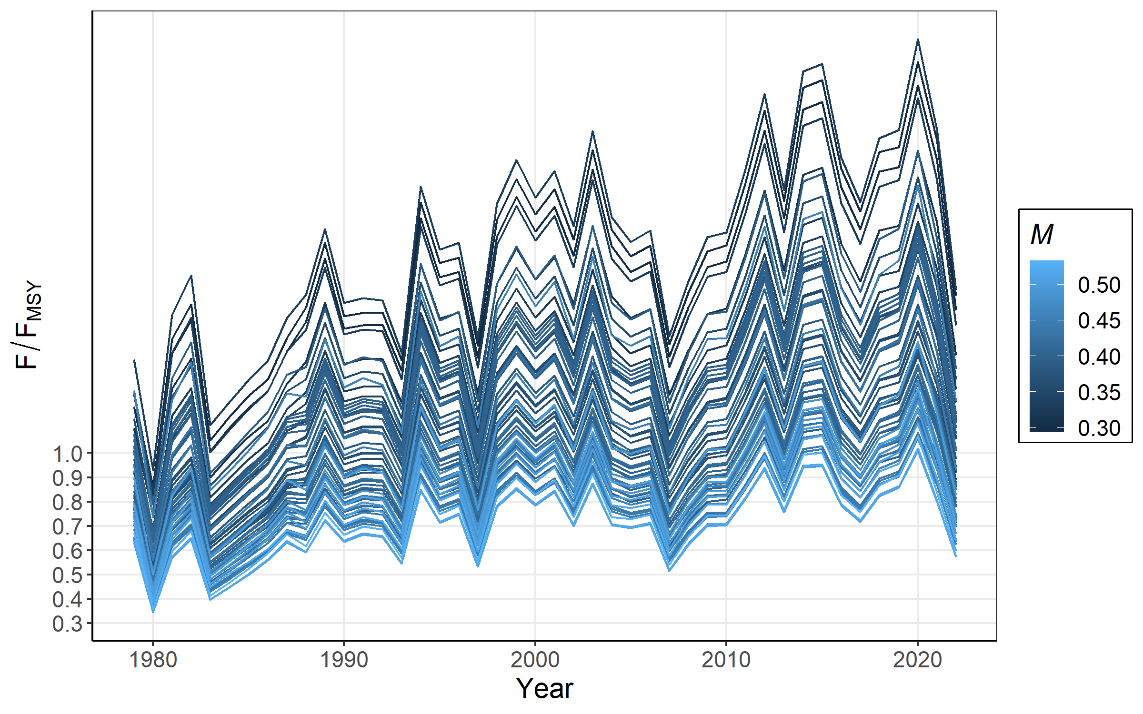
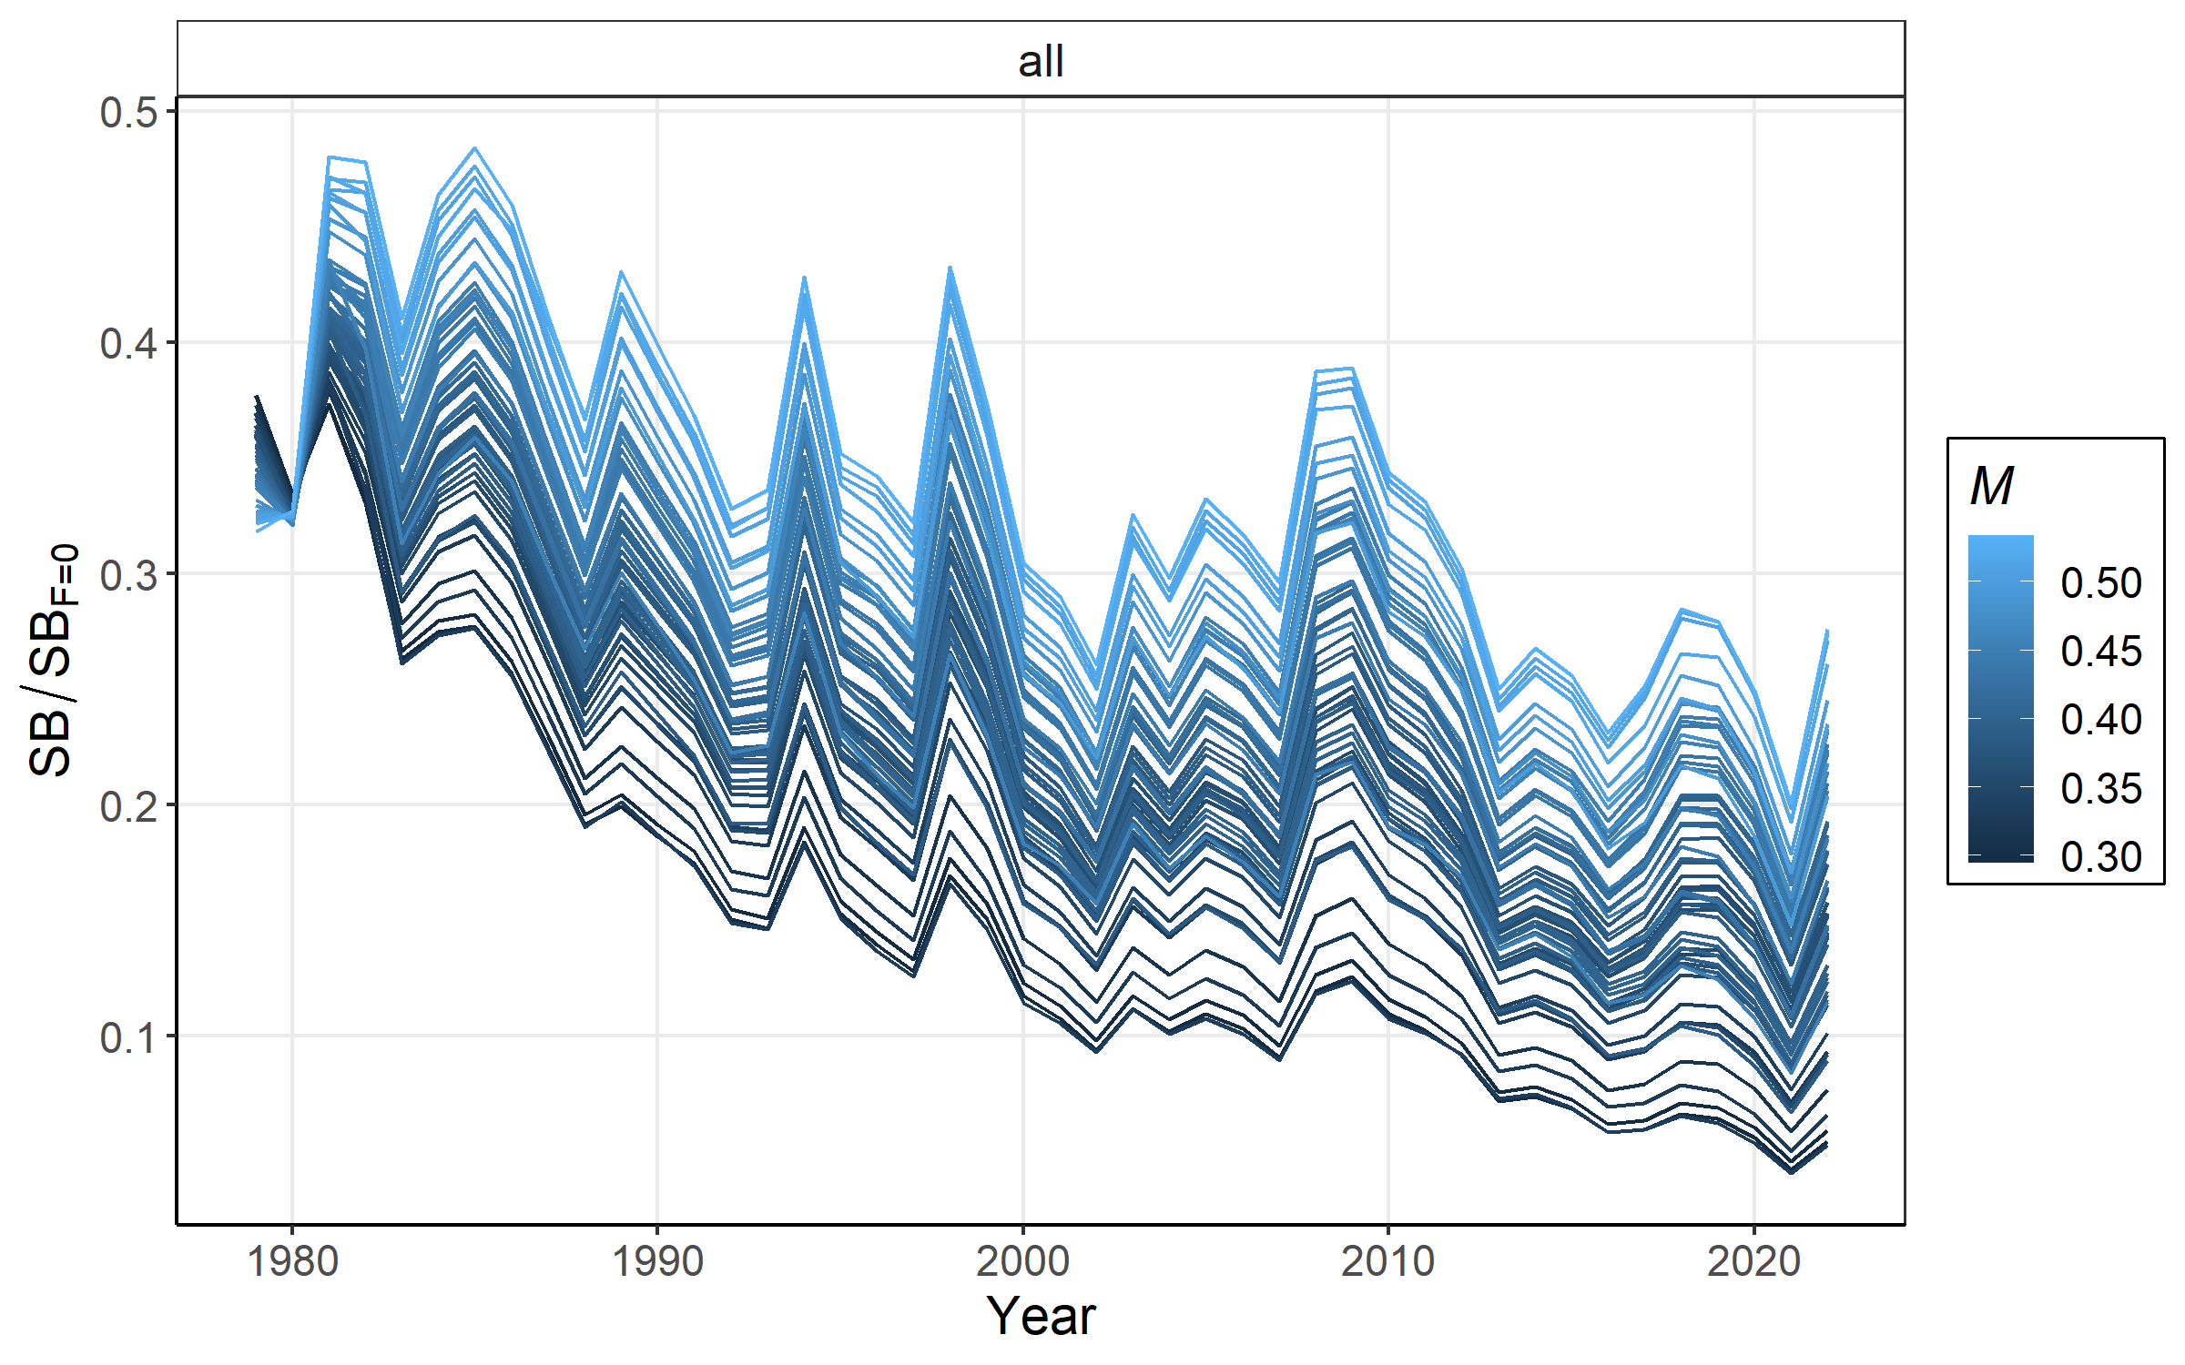
Model output – Ref pts across the range of h/M values
steepness
natural
mortality

Slide 31
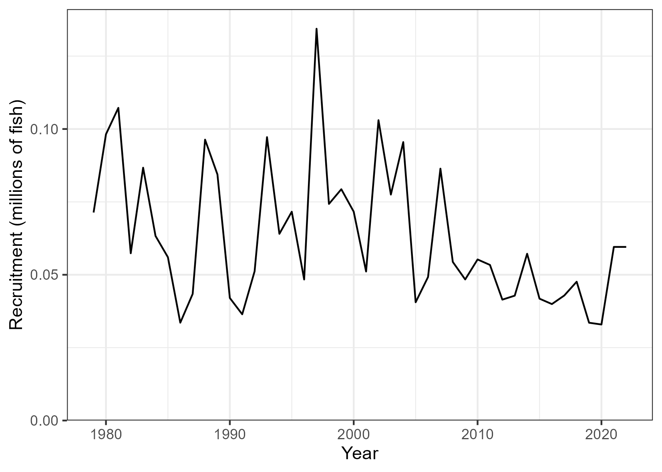

Slide 32
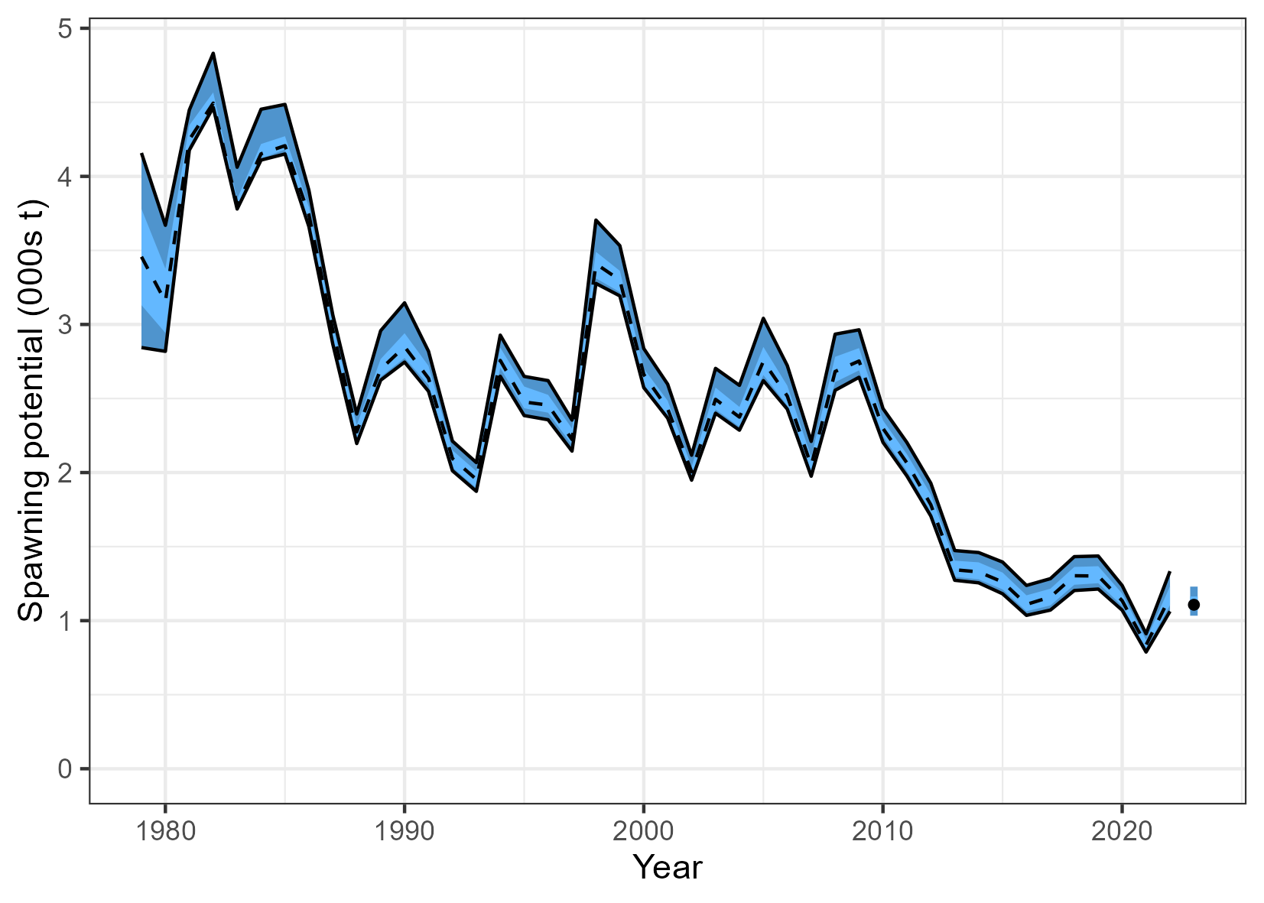
Model output – SBio and Depletion across the range of h/M values
Spawning potential
Depletion

Slide 33
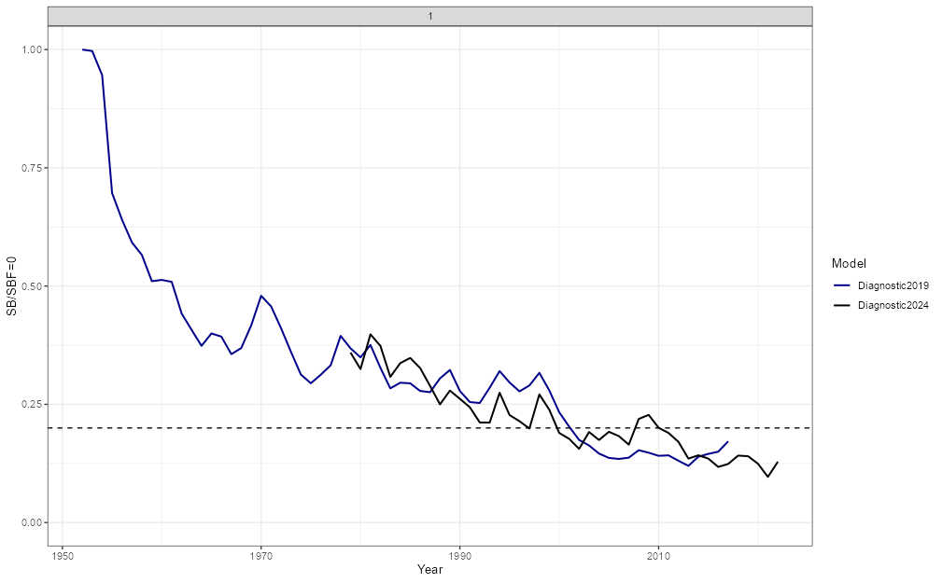
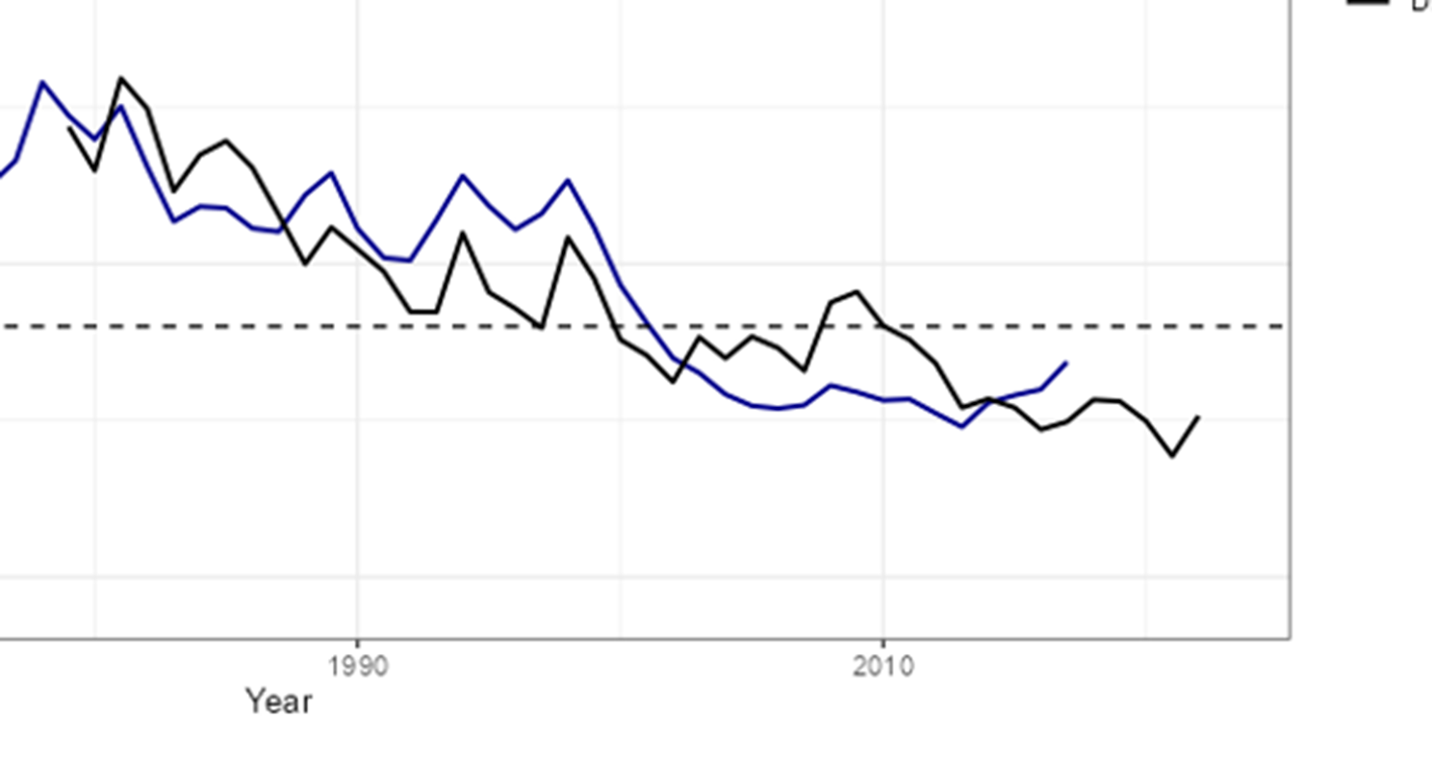

Slide 34
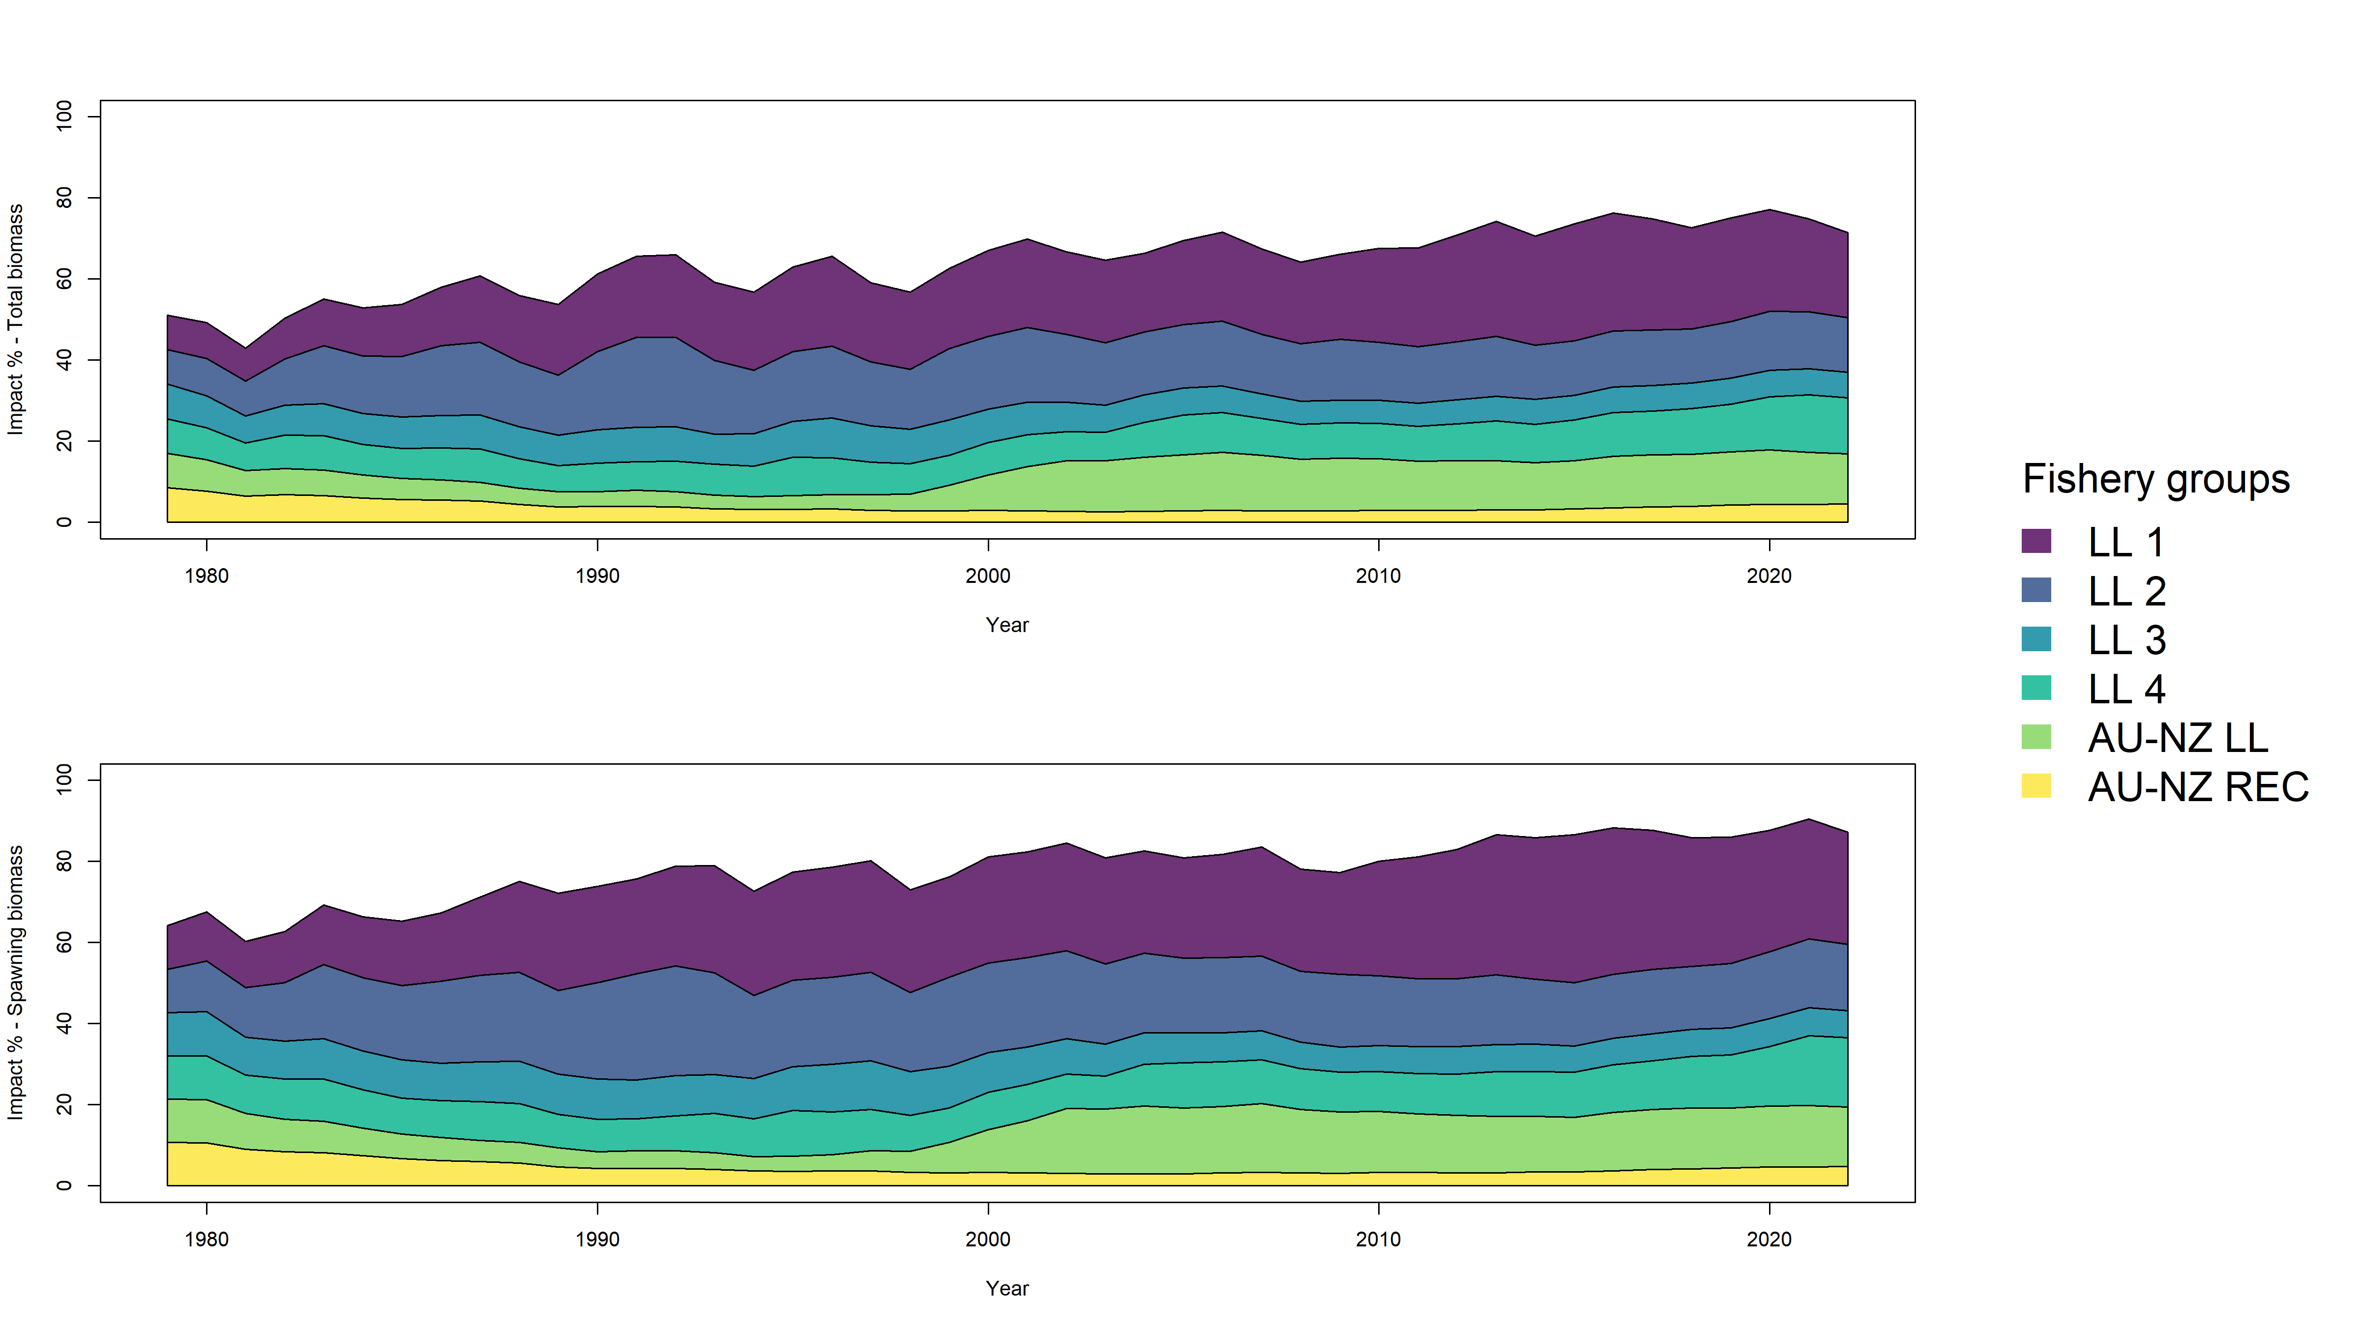
Fisheries impact

Slide 35


Slide 36

Diagnostic case using different data weighting

Slide 37

Diagnostic case 2024
No data for 07.LL.AU.03 in 2022

Slide 38


Slide 39


