Slide 1
Year 1: Catch history, CPUE and LFs for WCPO oceanic whitetip shark
(Carcharhinus longimanus)
Scientific Committee 20th Regular Session
SA-WP-11
Prepared by: Tyla Hill-Moana
Philipp Neubauer
Steve Brouwer
Kath Large
Date: August 2024

Slide 2
Overview:
Part 1: Potential inputs to OCS assessment 2025
Background
Methods for
catch reconstruction (CR),
CPUE, and
length compositions for potential use in assessment
Largely based on developments made in the context of other shark assessment

Slide 3
Background

Slide 4
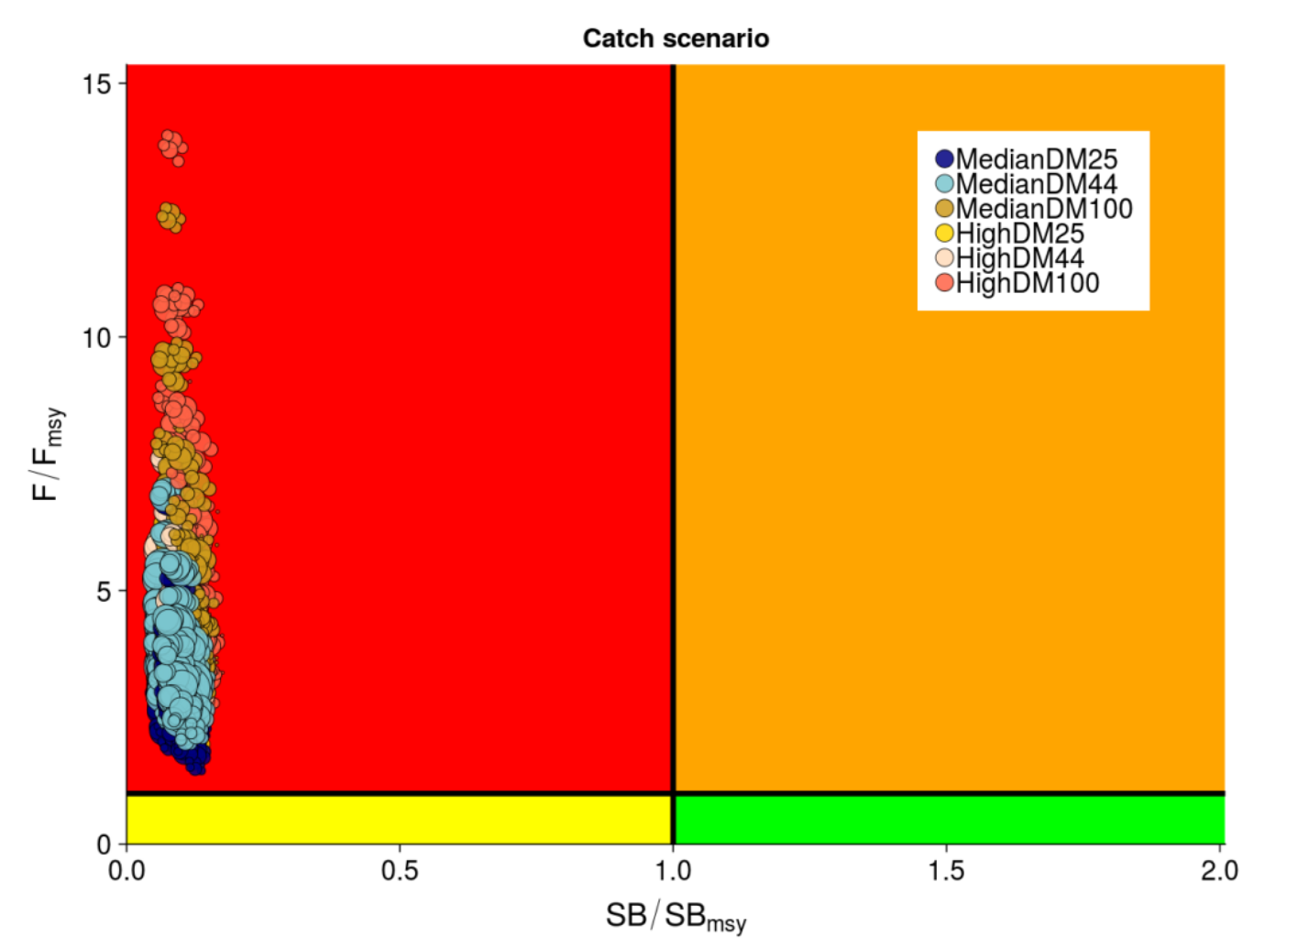
2. SC15 conclusions:
Previous stock assessments
Stock status: overfished and undergoing overfishing based on depletion and MSY-based reference points
Very slight recovery in stock biomass in the most recent years (2013-2016)
Few, if any, target fisheries
greatest impact from longline bycatch
lesser impact from purse seine
Notes:
Just notes:
Slight improvements to F-based reference points, could be a reflection of the CMM and looking survivability of sharks when caught and released
Catch scenarios account for DM < 100% very slight increasing in SB since 2013, but depletion remains very low.
Expected stock recovery to be slow after CMM, [so interesting to see trends after at least a decade of the CMM being in effect]
Despite all relative improvement in F-based RPs since 2013, F/F_{crash} > 1 indicate population should go extinct in the long-term
Put some of this somewhere in the slide before this??

Slide 5
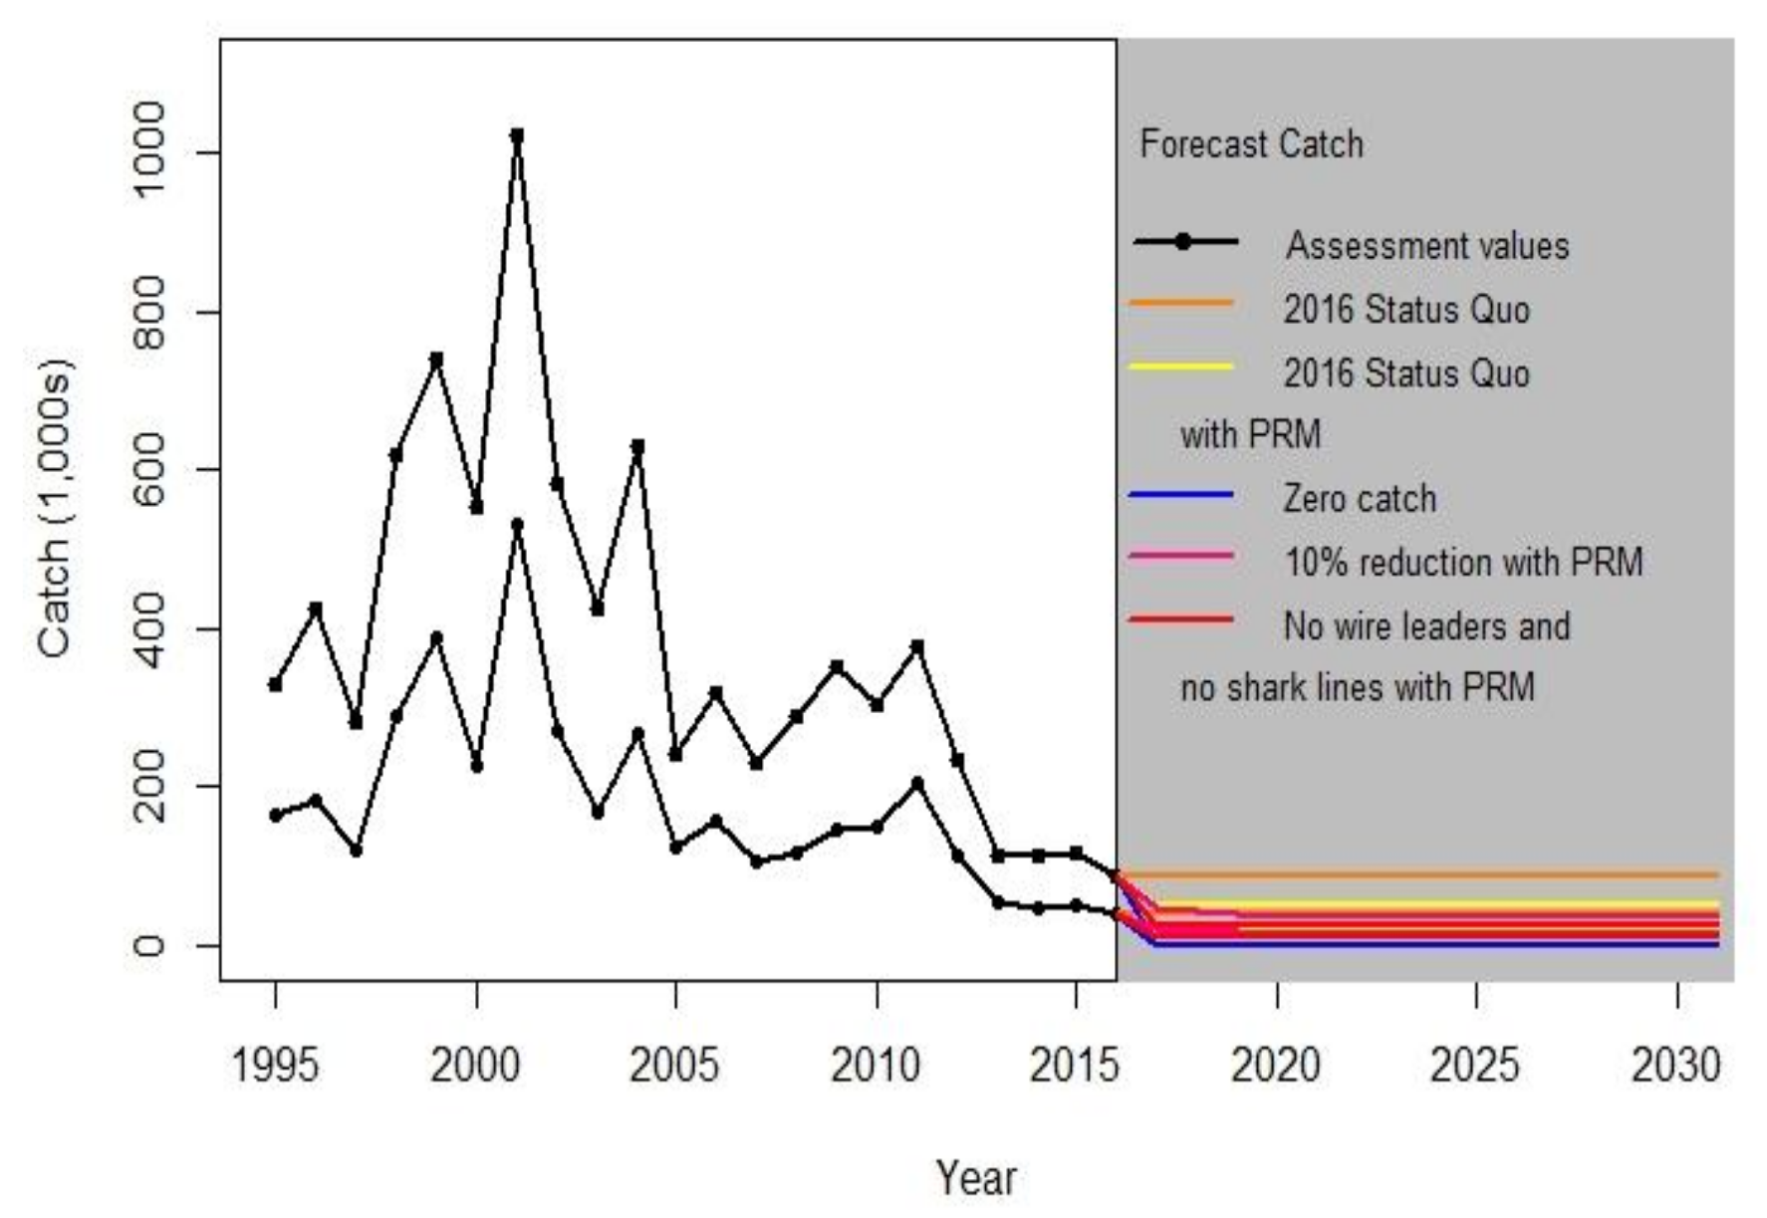
Future stock projections – Bigelow et al. (2022)
Stock projections
Considered five future catch scenarios forecasted within a 15 year window
2019 assessment values projected, with:
assumption 43.75% mortality (status quo)
status quo with updated estimates of handling & PRM (LL-retrieval M 19.2%, PRM (8%))
10% catch reduction (2017-2020) and updated estimates (LL-retrieval 19.2%, PRM 8%)
assumption of reduced mortality from gear-ban (41.2%) and updated estimates (LL-retrieval 19.2%, PRM (3%))
zero future catch
Notes:
Uses contemporary estimated mortality (longline retrieval, PRM, catch reduction, prohibition of write branchline and shark lines.
Forecast time period 2017-2031
OCS pop. projected to increase at moderate pace
Higher projected SB in 2031 relative to 2016

Slide 6
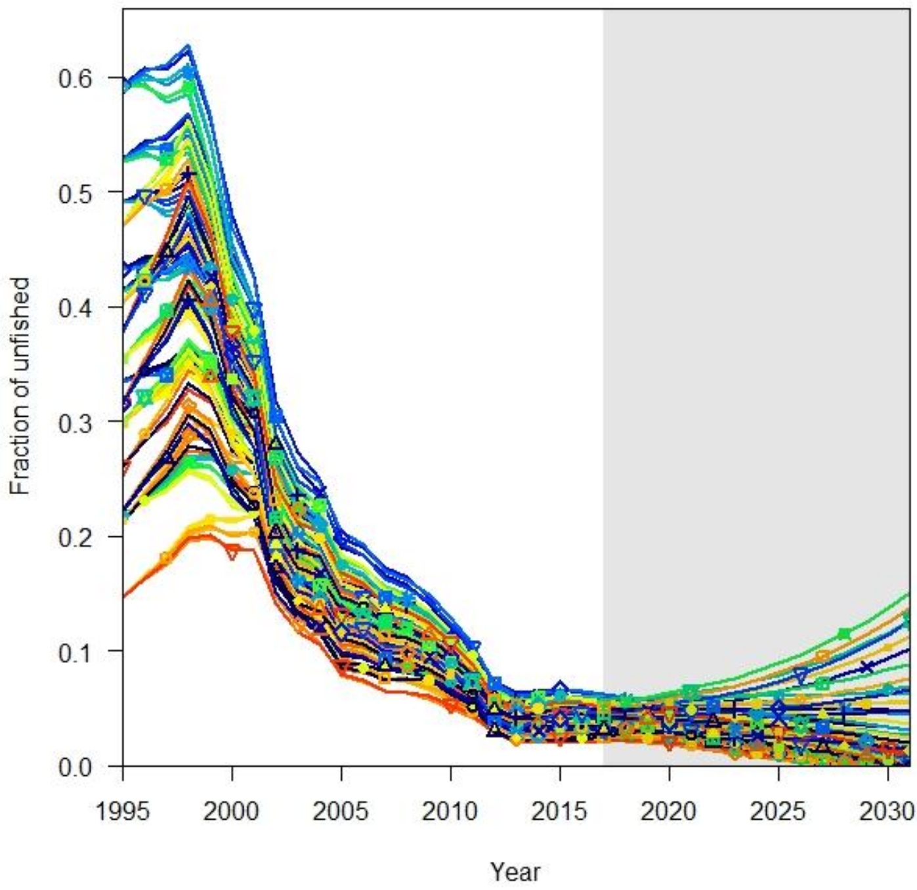
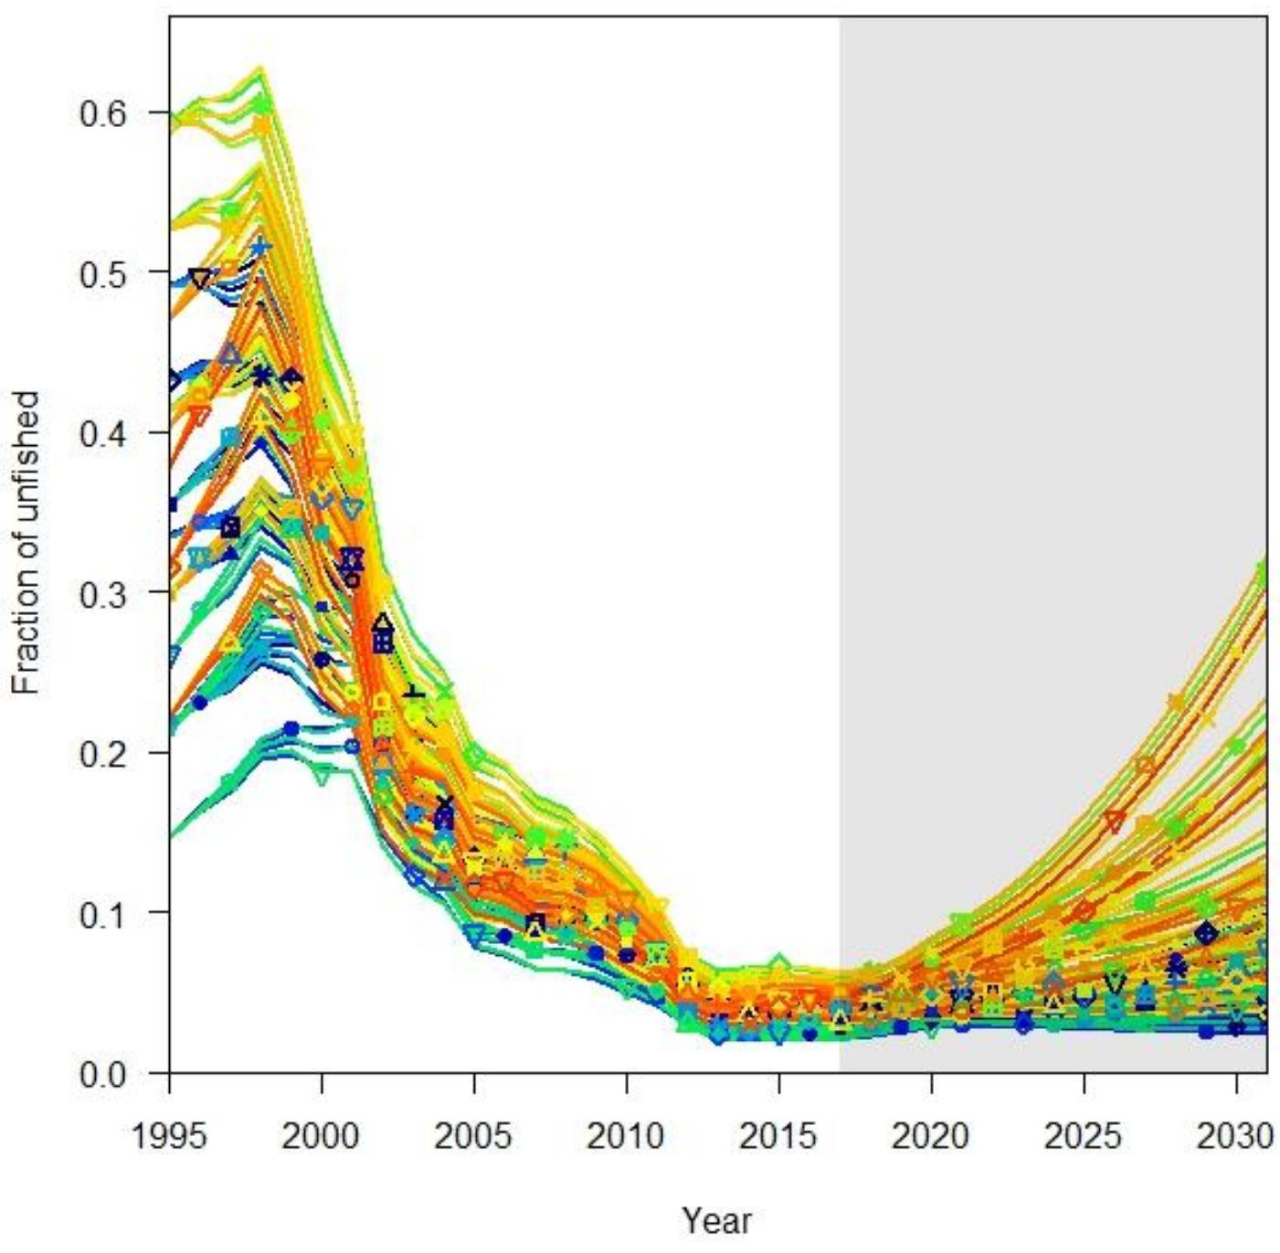
Future stock projections – Bigelow et al. (2022)
Stock projections
Population was projected to increase over the projection period under new mortality scenarios: higher projected SB in 2031 relative to 2016
Will need to consider appropriate catch scenarios for updated assessments;
New assessment may be able to provide insights into which scenarios are most likely.
2016 status quo
2016 with updated estimates
mean SB₂₀₃₁/SB_{F=0} = 0.015
mean SB₂₀₃₁/SB_{F=0} = 0.070

Slide 7
Stock, biology & length structure

Slide 8
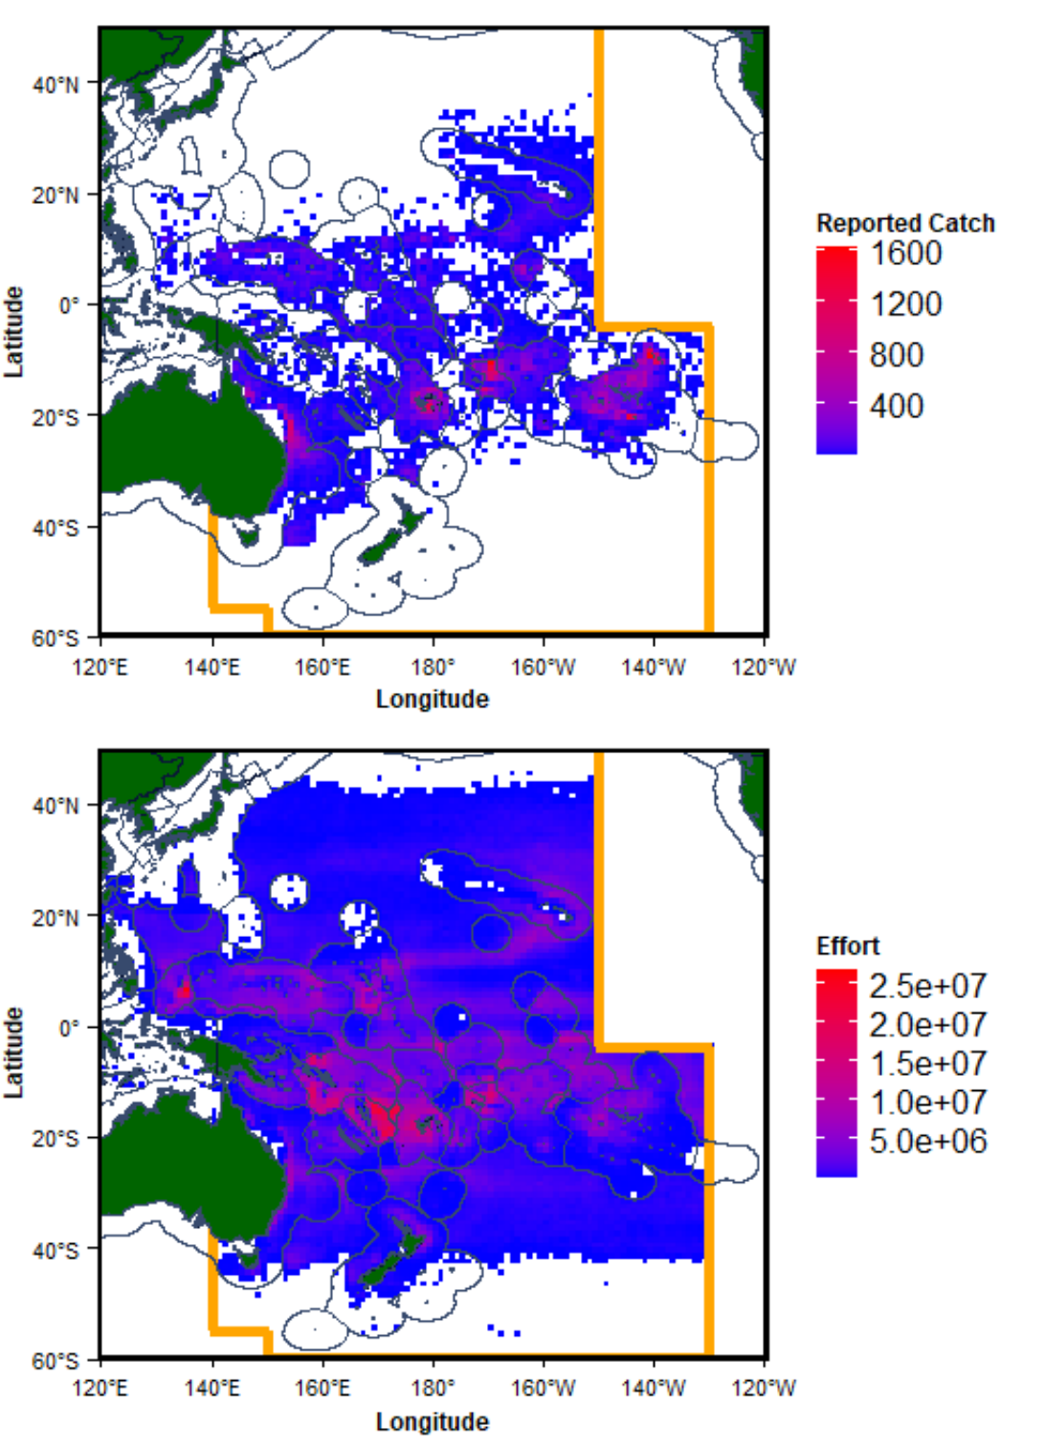
Fishery
Part 1: Potential inputs to OCS assessment 2025
Most reported LL catch is south of the equator to 25° South

Slide 9
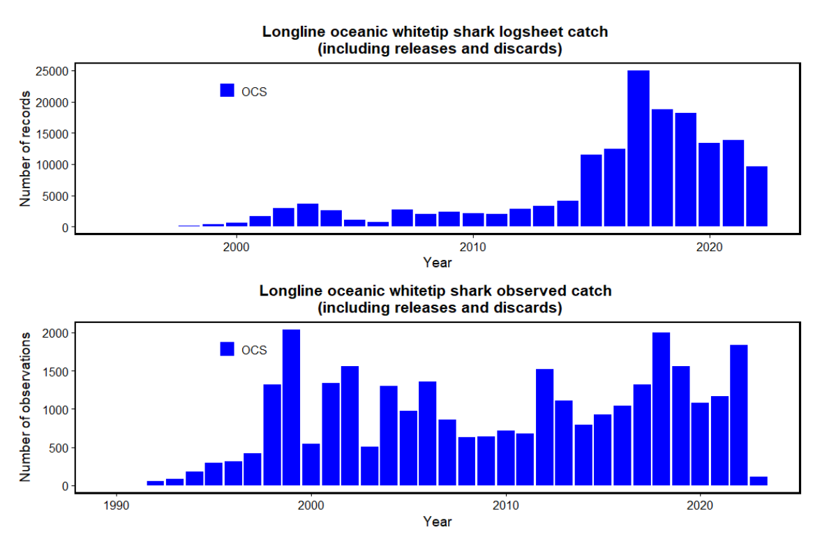
Fishery
Part 1: Potential inputs to OCS assessment 2025
Most reported LL catch is south of the equator to 25° South
Probably not well reported in the past

Slide 10
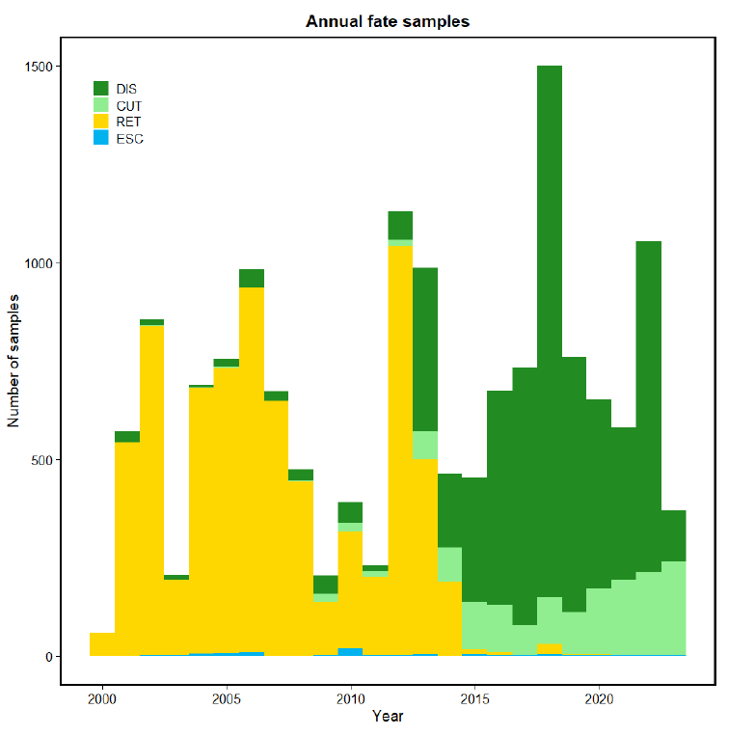
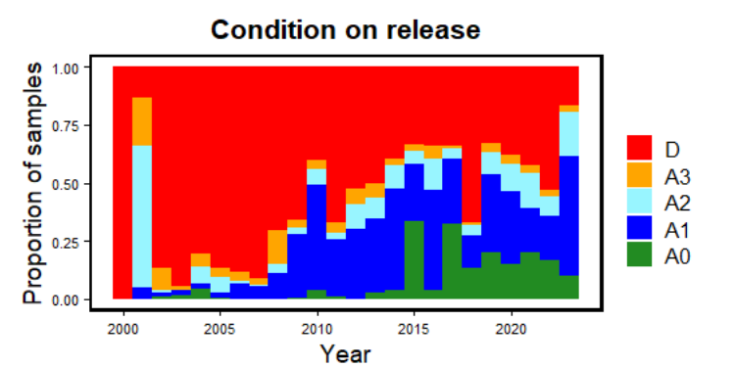
Fishery
Part 1: Potential inputs to OCS assessment 2025
Most reported LL catch is south of the equator to 25° South
Probably not well reported in the past
Increasingly cut free, near 100% non-retention in recent years
Still reasonably high handling mortality

Slide 11
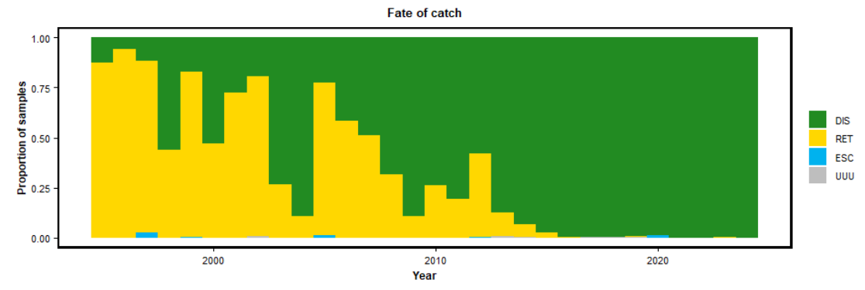
Fishery
Part 1: Potential inputs to OCS assessment 2025
Most reported LL catch is south of the equator to 25° South
Probably not well reported in the past
Increasingly cut free, near 100% non-retention in recent years
Still reasonably high handling mortality
Little PS catch; increasingly discarded in good condition.

Slide 12
Recent research on biology:
Part 1: Potential inputs to OCS assessment 2025
Growth (VB) | k = 0:103cm, L₀ = 82:9cm, Linf = 341:7cm k = 0:.085cm, L₀ = 64, Linf = 309.4 k = 0:045, L₀ = 99cm, Linf = 342:5cm | Seki et al. (1998) Joung et al. (2016) D’Alberto et al. (2017)
Litter size | 1–14 (mean: 6.2, n = 97) 10–11 (n = 2) | Seki et al. (1998) Joung et al. (2016)
Birth size | 55–77 cm (TL) 64cm Unobserved (99 cm TL modelled) | Seki et al. (1998) Joung et al. (2016) D’Alberto et al. (2017)
Maturity (TL) | Males: 167–195 cm; females: 175–189 cm Males: 194.4 cm; females: 193.4 cm Males: 193 cm; females: 224 cm | Seki et al. (1998) Joung et al. (2016) D’Alberto et al. (2017)
PRM | Bigelow K, Carvalho F. ( 2021a) – LL-mortality, Bigelow & Carvalho (2021b) – (Project 101), Hutchinson et al. (2022) – PRM sharks in LL-fisheries
Any suggestion on biology research for us to follow up?

Slide 13
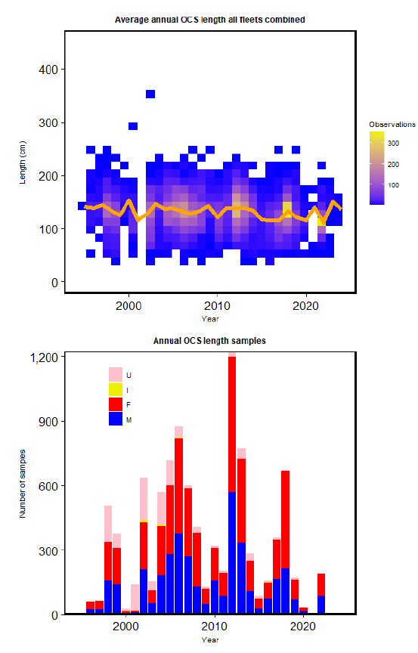
Stock structure
Part 1: Potential inputs to OCS assessment 2025
Reasonable amounts of length data from longline observers

Slide 14
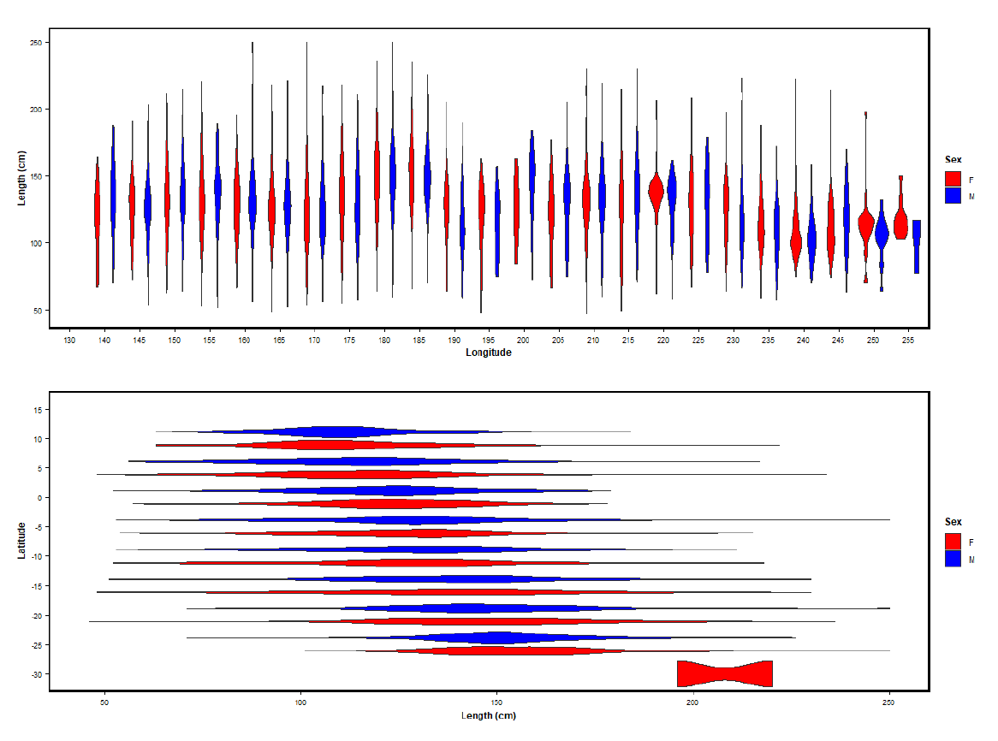
Stock structure
Part 1: Potential inputs to OCS assessment 2025
Reasonable amounts of length data from longline observers
Larger individuals south of equator

Slide 15
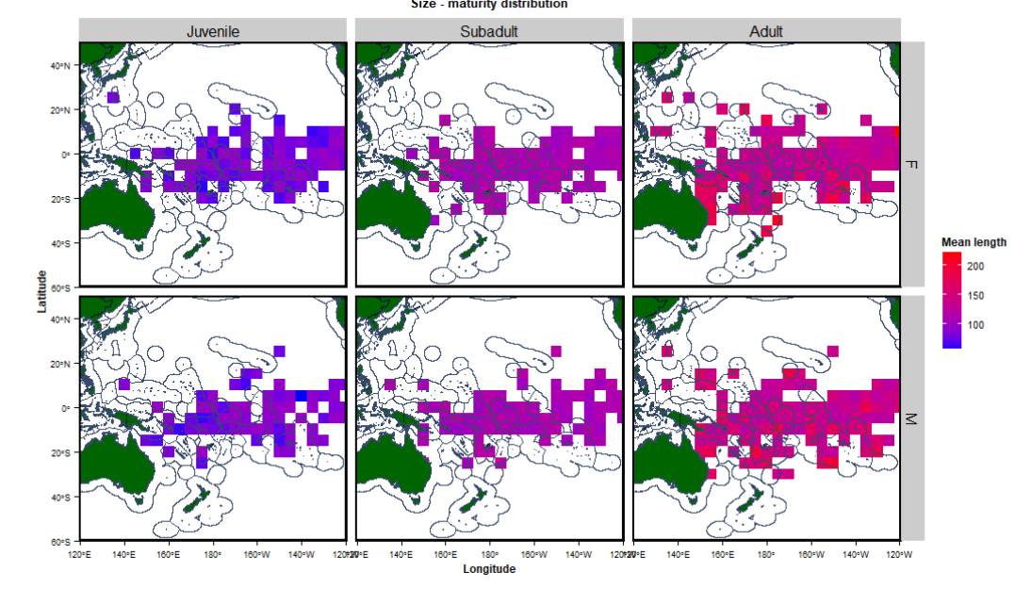
Stock structure
Part 1: Potential inputs to OCS assessment 2025
Reasonable amounts of length data from longline observers
Larger individuals south of equator
Unclear about underlying cause - no discernable patterns in maturity in space

Slide 16
Standardised length compositions

Slide 17
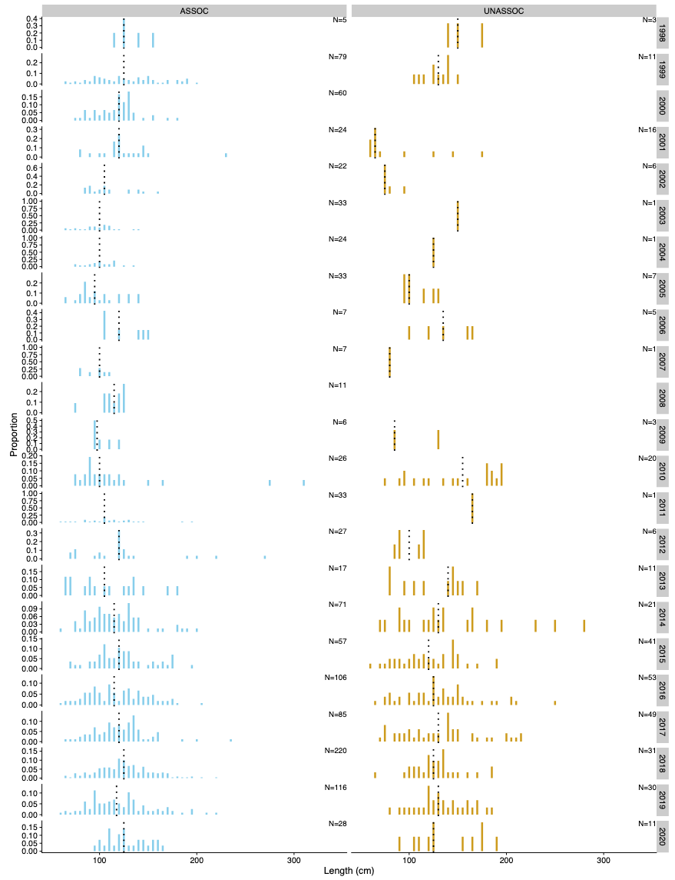
Length compositions
Part 1: Potential inputs to OCS assessment 2025
Only for longline. Low number of PS length samples, insufficient for models.

Slide 18
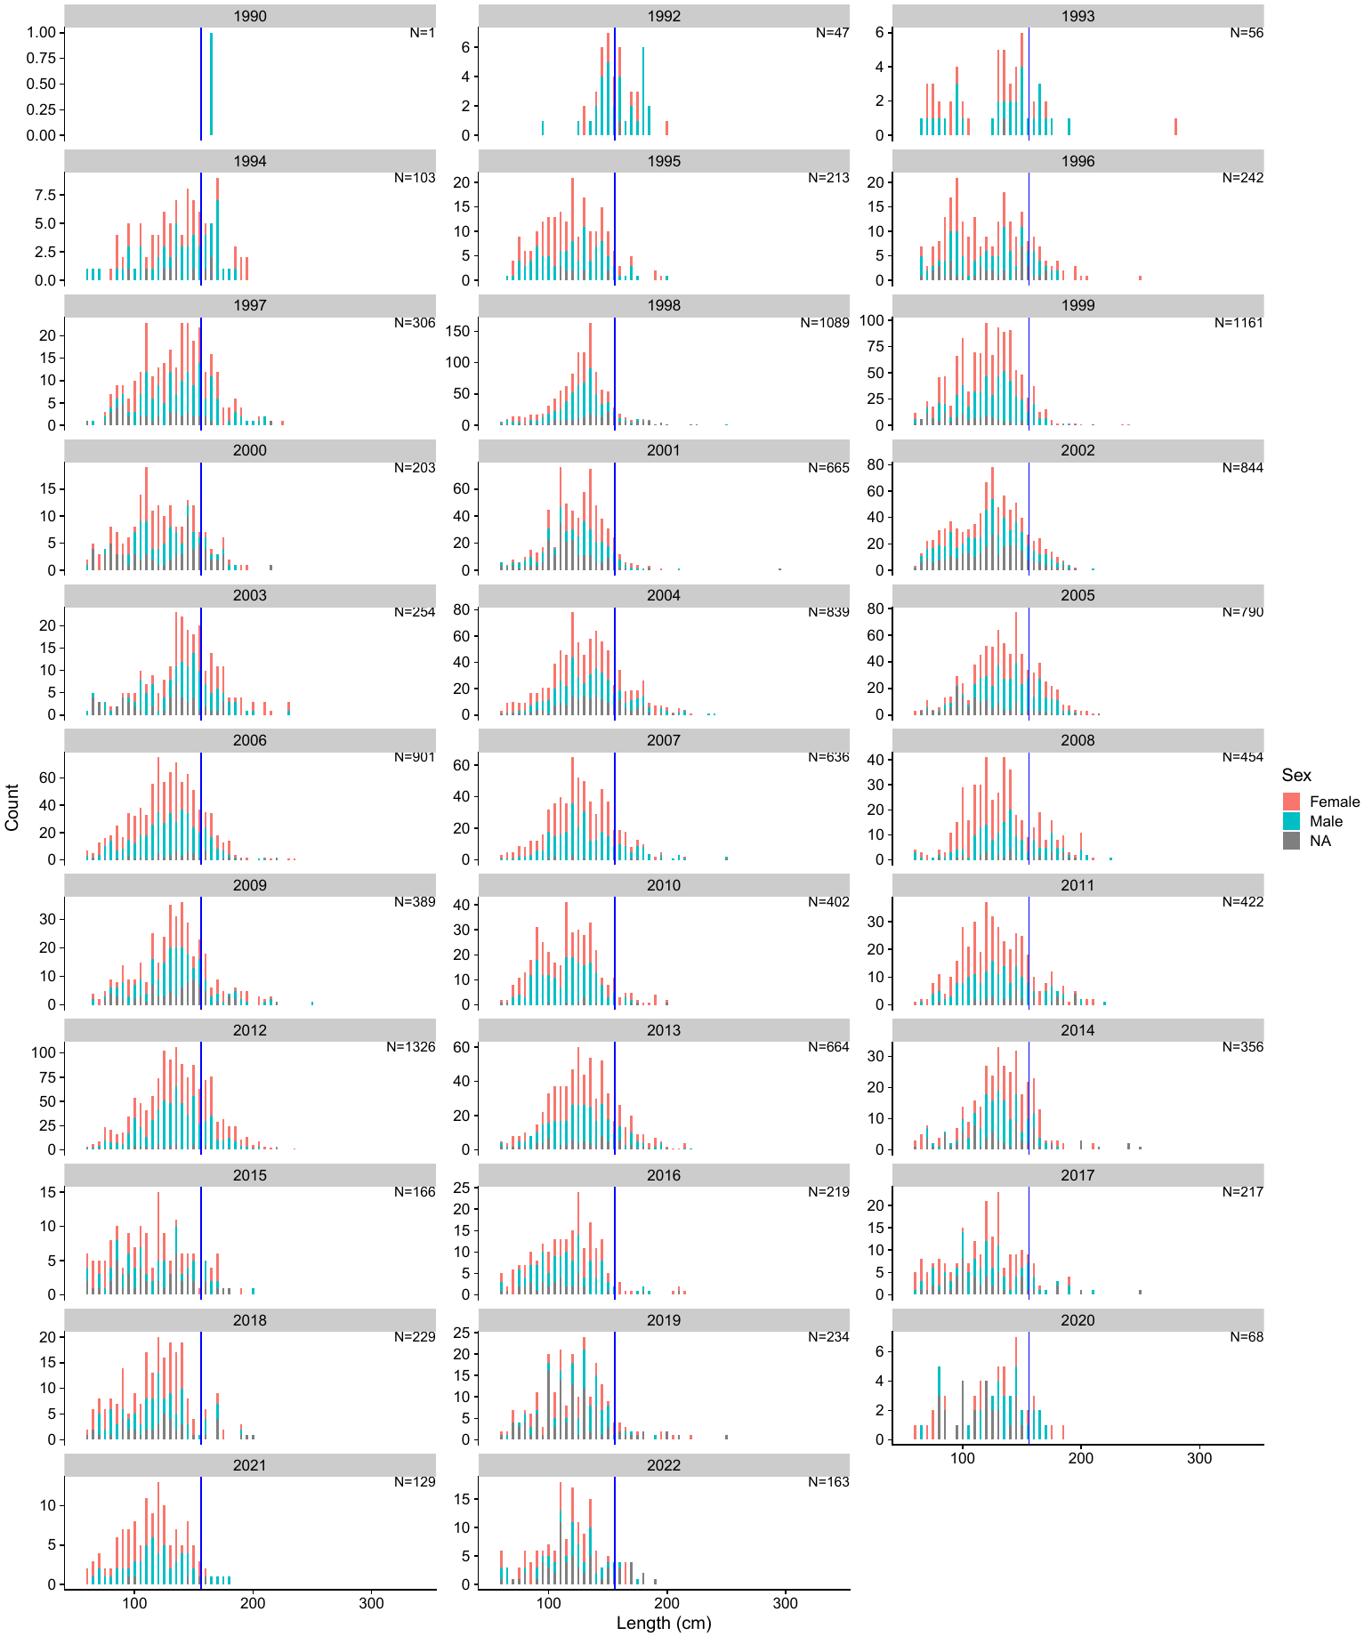
Length compositions
Part 1: Potential inputs to OCS assessment 2025
Only for longline. Low number of PS length samples, insufficient for models.

Slide 19
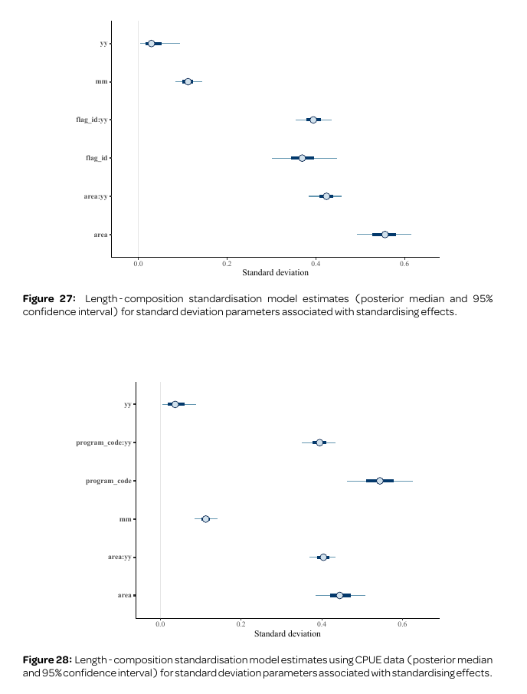
Length compositions
Part 1: Potential inputs to OCS assessment 2025
Only for longline. Low number of PS length samples, insufficient for models.
Model-based scaling of LFs for capture fisheries and indices
Scaling (prediction to total catch) for capture fisheries
Scaling by CPUE, using year effects only for index fisheries
Little/no year effect in both models: not needed to fit the data

Slide 20
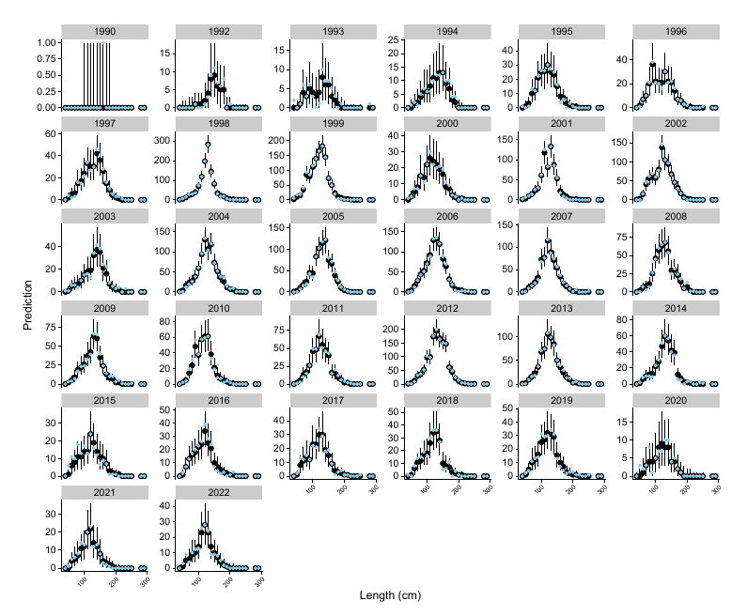
Length compositions
Part 1: Potential inputs to OCS assessment 2025
Only for longline. Low number of PS length samples, insufficient for models.
Model-based scaling of LFs for capture fisheries and indices
Scaling (prediction to total catch) for capture fisheries
Scaling by CPUE, using year effects only for index fisheries
Little/no year effect in both models: not needed to fit the data

Slide 21
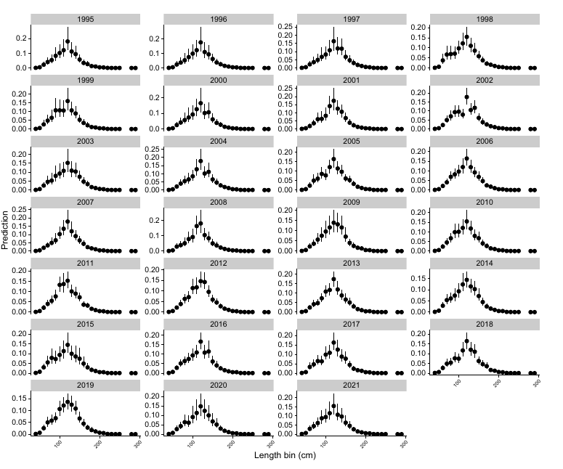
Scaled LFs
Part 1: Potential inputs to OCS assessment 2025
Little detectable change in length compositions over time across the WCPO
Contrasts with strong reductions in observed longline catch rates in late 1990s and early 2000s
Lack of detectable trends possibly due to low observer coverage

Slide 22
Catch reconstruction

Slide 23
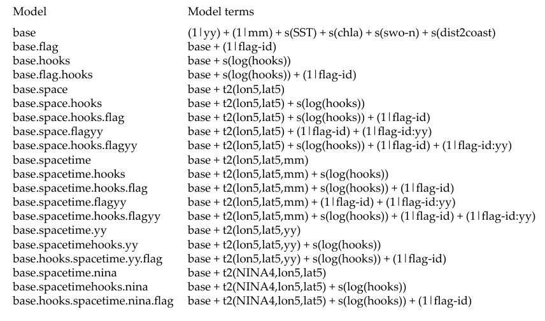
Approach
Part 1: Potential inputs to OCS assessment 2025
Series of GLMM models used for catch-reconstruction for PS and LL catches based on observed catch-rates
Multi-model predictions using model-based stacking
Estimates model weights based on leave-one-out prediction ability across strata

Slide 24
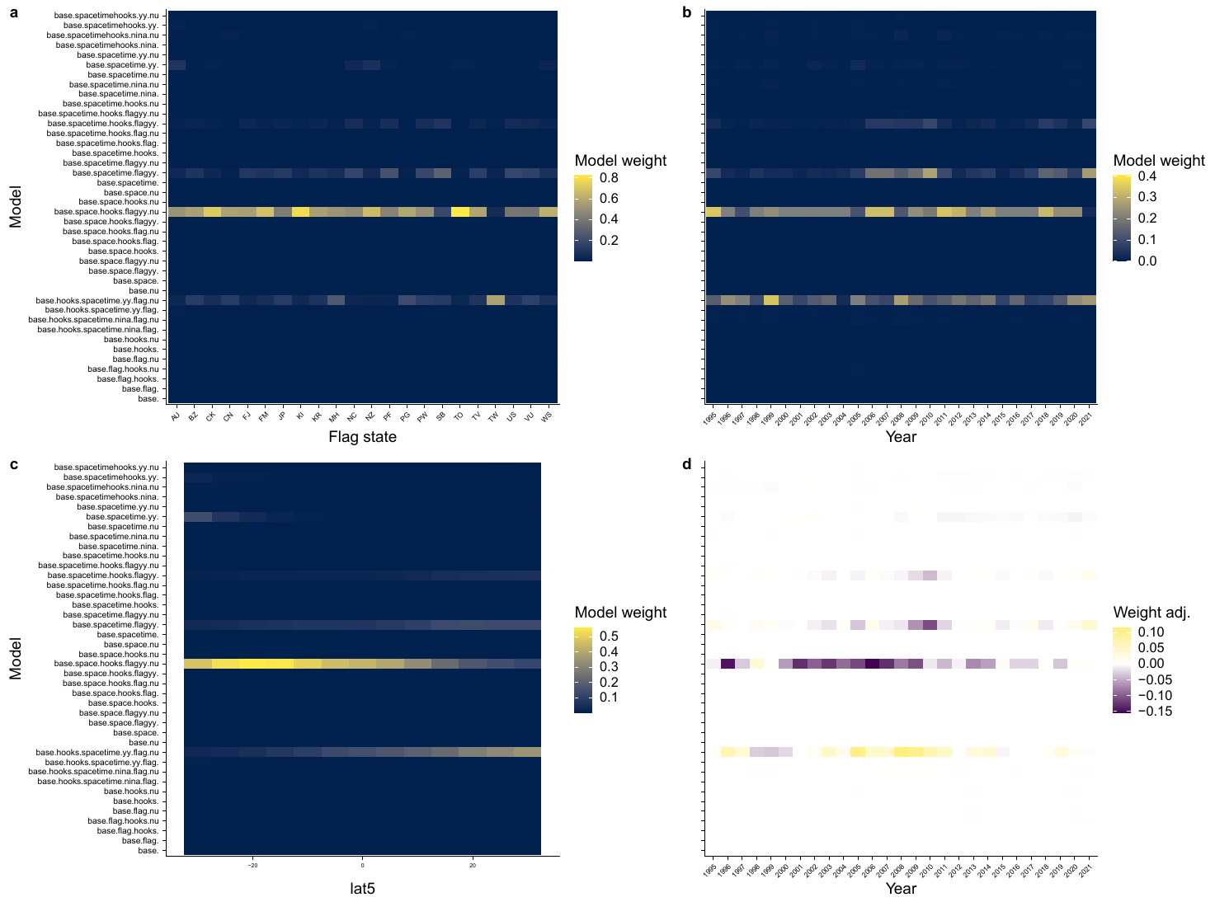
Model weighting
Part 1: Potential inputs to OCS assessment 2025
For longline:
model with flag-year interactions consistently best,
spatio-temporal model also having high weight.

Slide 25
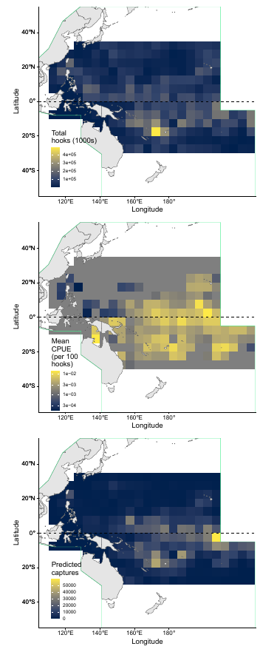
Longline
Part 1: Potential inputs to OCS assessment 2025
Effort and estimated interactions mostly in south-eastern equatorial Pacific.
CPUE relatively high throughout most of the Pacific (except for some north-western areas).
Unclear if low CPUE and estimated catch in north-western Pacific is due to local depletion or species distribution.

Slide 26
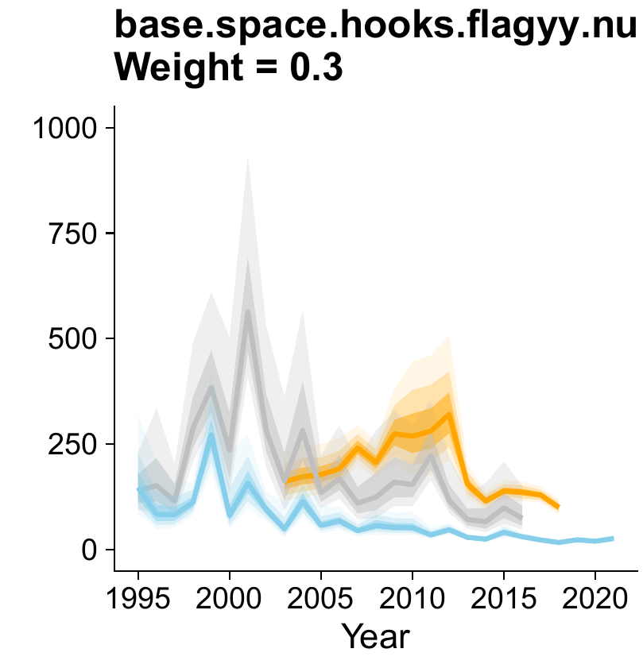
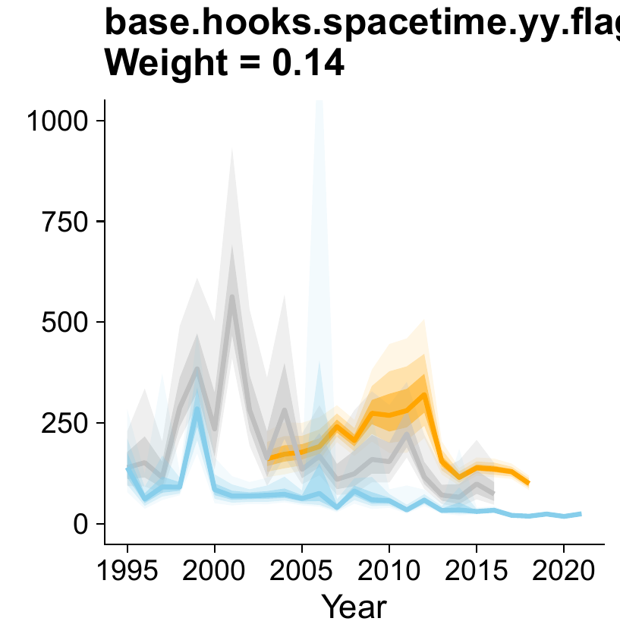
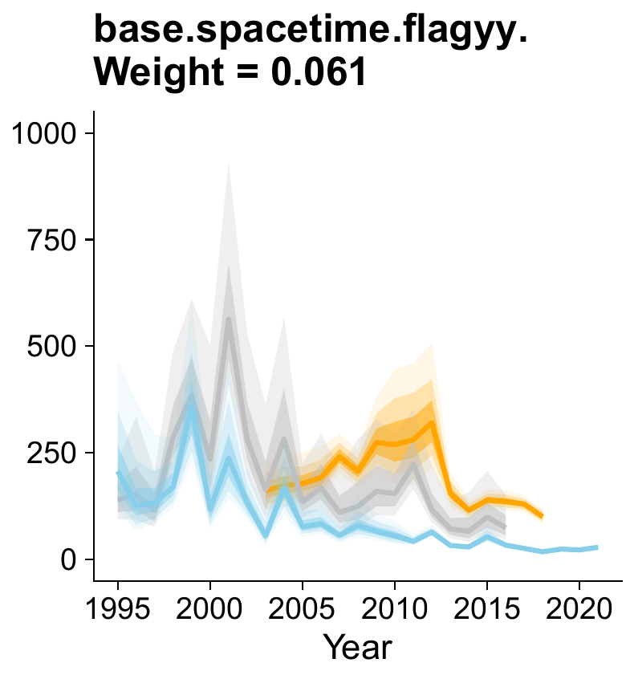
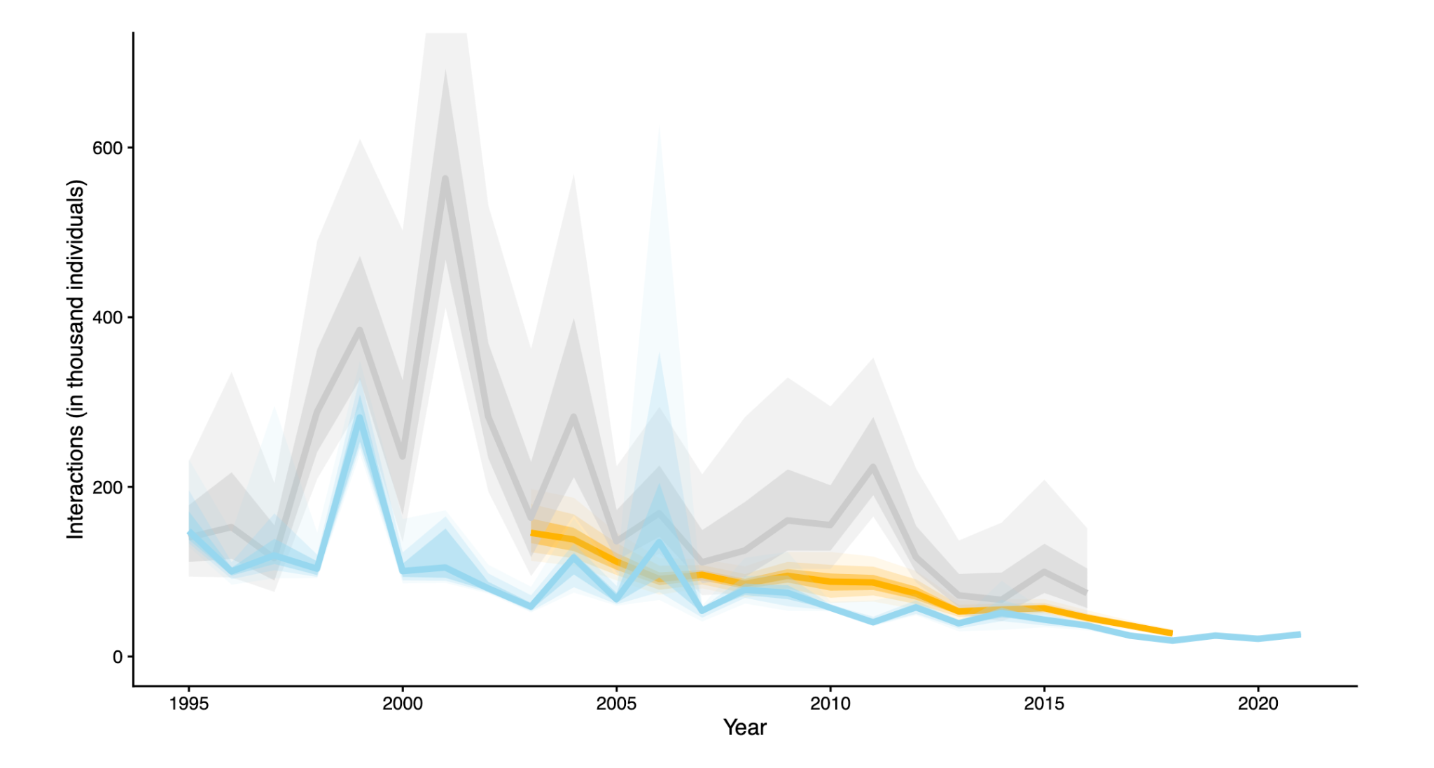
Longline
Part 1: Potential inputs to OCS assessment 2025
Estimated interactions declined since 1999 from ~200k to ~50k.
Comparable to predicted values from Peatman et al. (2018), but lower than those predicted by Tremblay-Boyer et al. (2019)
Trends associated with DW-fleets

Slide 27
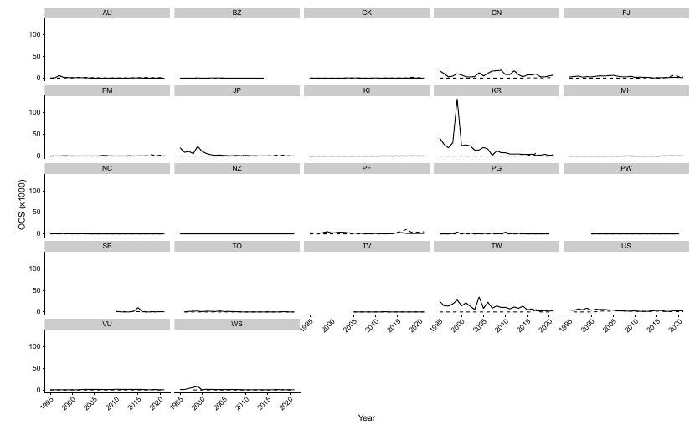
Longline
Part 1: Potential inputs to OCS assessment 2025
Estimated interactions declined since 1999 from ~200k to ~50k.
Comparable to predicted values from Peatman et al. (2018), but lower than those predicted by Tremblay-Boyer et al. (2019)
Trends associated with DW-fleets

Slide 28
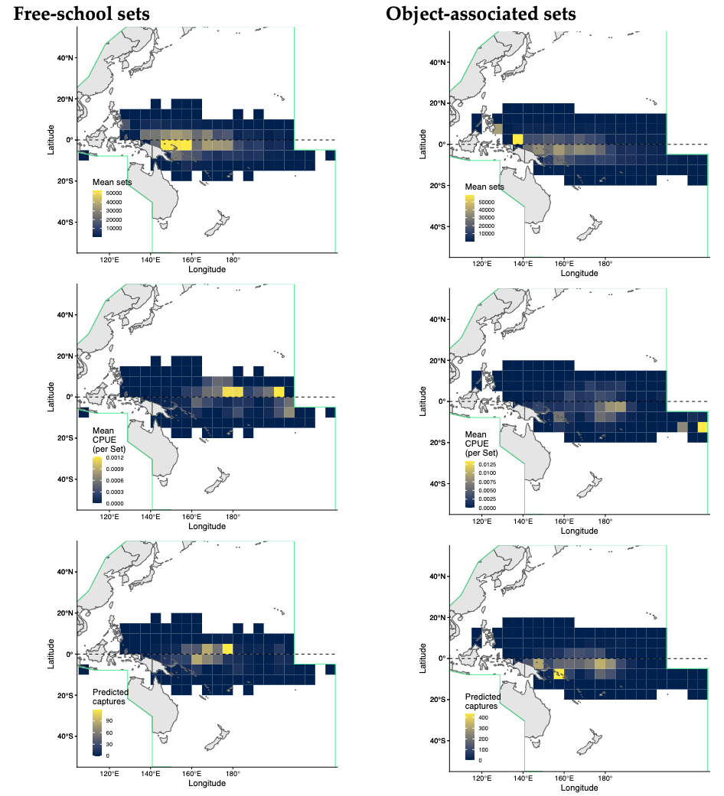
Purse-seine CR
Part 1: Potential inputs to OCS assessment 2025
Effort concentrated in the western equatorial Pacific for both set-types,
CPUE generally higher towards the central and eastern equatorial WCPO
Given effort distribution, most interactions are further east than areas of high CPUE

Slide 29
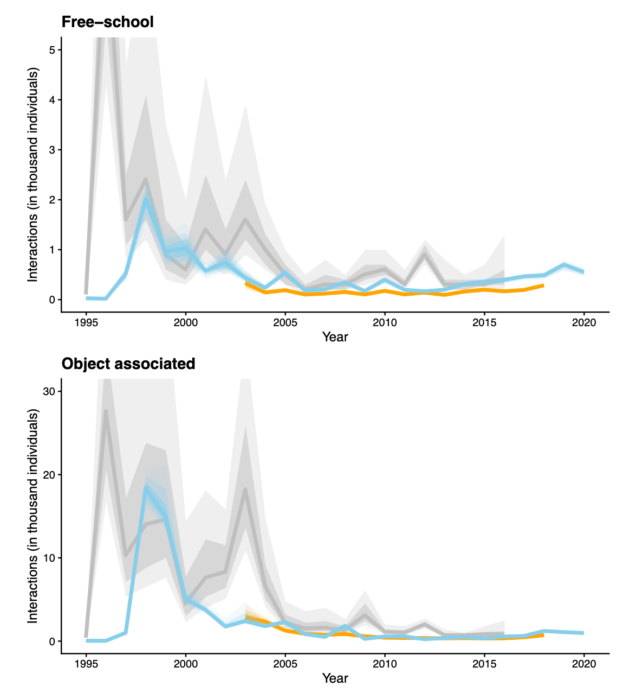
Purse-seine CR
Part 1: Potential inputs to OCS assessment 2025
For both set-types, estimated interactions declined since late 1990s and remain low.
Free-school, post-2010 predicted increase until recent times.

Slide 30
CPUE

Slide 31
Longline CPUE
Part 1: Potential inputs to OCS assessment 2025
Variables sequentially added to CPUE model
Most complex model standardised for ENSO variables
Models run across four sets of observer programs

Slide 32
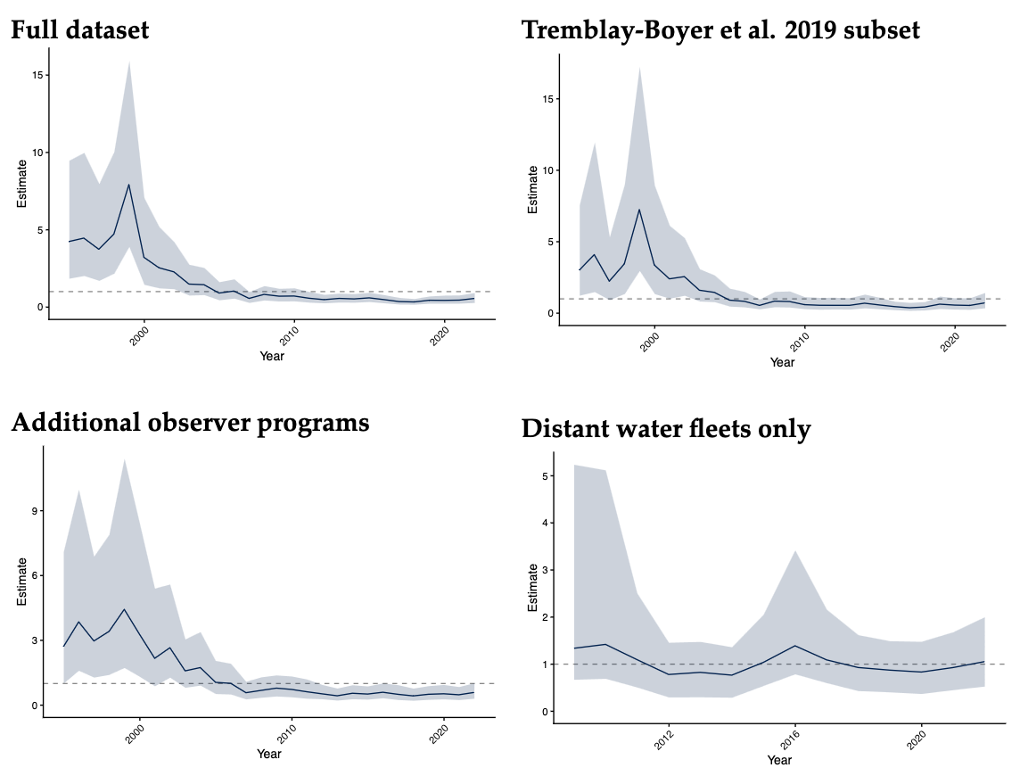
Longline CPUE
Part 1: Potential inputs to OCS assessment 2025
Similar trends for most indices, but different degrees of decline
Highly variable at the start, declined post-1999, flattens around 2008
High initial CPUE for full set and Tremblay-Boyer et al. 2019; lower index for additional-observer set

Slide 33
Longline
Part 1: Potential inputs to OCS assessment 2025
Tremblay-Boyer et al. 2019
Plotting by observer programme suggests single datapoint drives very high early peak catch rate; likely not correct
Alternative set of observer-programs appears more consistent.
Additional observer programs

Slide 34
Longline
Part 1: Potential inputs to OCS assessment 2025
Tremblay-Boyer et al. 2019
Plotting by observer programme suggests single datapoint drives very high early peak catch rate; likely not correct
Alternative set of observer-programs appears more consistent.
Additional observer programs

Slide 35
Purse-seine CPUE
Part 1: Potential inputs to OCS assessment 2025
Shorter time series, 2009 start-date - too few captures pre 2009
Different results by set-types: Relatively flat indices for free-school, standardisation effect by NINA4 covariate
Increasing index for associated sets, standardisation effect by observer program and less by NINA4 covariate

Slide 36
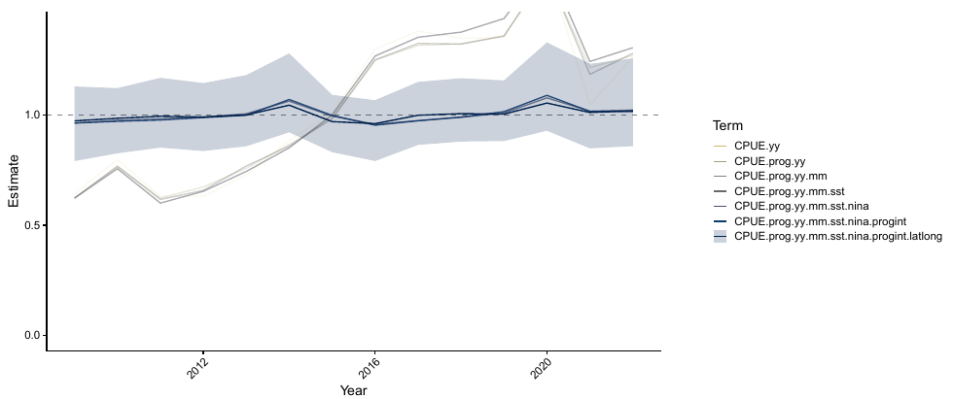
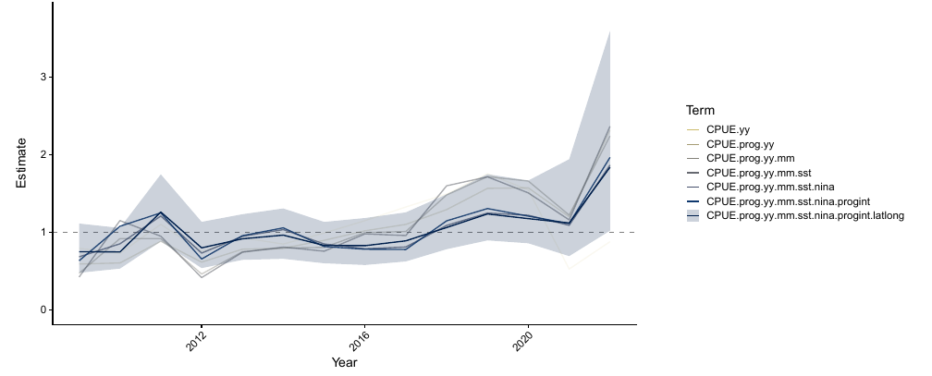
Purse-seine CPUE
Part 1: Potential inputs to OCS assessment 2025
Shorter time series, 2009 start-date - too few captures pre 2009
Different results by set-types: Relatively flat indices for free-school, standardisation effect by NINA4 covariate
Increasing index for associated sets, standardisation effect by observer program and less by NINA4 covariate

Slide 37
Purse-seine
Part 1: Potential inputs to OCS assessment 2025
Free-school sets
Object-associated sets

Slide 38
Preliminary findings

Slide 39
Recommendations
Part 1: Potential inputs to OCS assessment 2025
There are likely to be sufficient data and a sufficiently consistent signal in the different datasets, especially from longline, to conduct a stock assessment: We suggest that a fully integrated assessment could be attempted.
Alternative assessment methods (for example surplus production assessments) should be run in parallel with an integrated assessment.
Length-based or hybrid length-based spatial assessments provide an alternative approach that is independent of recent longline data, and allows for multi-model inference that can strengthen conclusions and potential management advice from an integrated approach.

Slide 40
Ngā mihi rā. Thank you for your input!

