Slide 1
20th Regular Session of the Scientific Committee
14-21 August 2024, Manila, Philippines
Progress Towards a Close-Kin-Mark-Recapture Application to South Pacific Albacore (Project 100c)
WCPFC-SC20-2024/SA-WP-09
SPC-OFP and CSIRO

Slide 2
1. Complete the foundational research needed for the application of CKMR methods to WCPFC stocks to reduce the uncertainty in stock assessments.
epigenetic ageing for south Pacific albacore and Pacific bigeye using existing validated otolith age.
  A calibrated epigenetic age model was developed for bigeye and yellowfin tuna in 2023 that covered ages ranging from 0.2 to 11 years and showed a high correlation between epigenetic methylation in muscle tissue and validated otolith age.
  The information is now being translated to a high-throughput platform in collaboration with Diversity Arrays Technology (DArT), Australia.
  Epigenetic age calibration of south Pacific albacore tuna will be undertaken once the technology is transferred to DArT.

Slide 3
1. Complete the foundational research needed for the application of CKMR methods to WCPFC stocks to reduce the uncertainty in stock assessments.
evaluation of radiocarbon otolith age validation of southwest Pacific swordfish and epigenetic age calibration.
  Radiocarbon age validation has commenced and 14C results from 13 swordfish otoliths are now in hand.
  Additional samples are available from the CSIRO archives; however, the search for samples from larger, potentially older specimens continues.
  Epigenetic age calibration can commence once radiocarbon age validation has been fully developed, given that sufficient high quality muscle tissue samples from “known age” fish are available.

Slide 4
1. Complete the foundational research needed for the application of CKMR methods to WCPFC stocks to reduce the uncertainty in stock assessments.
genome resequencing of south Pacific albacore and Pacific bigeye for enhanced detection of kin-pairs.
  Currently underway for a total of 36 individuals per species for albacore, bigeye, yellowfin and skipjack tuna.
  Sampling covers six locations across the Pacific region..

Slide 5
2. Complete CKMR feasibility and design study for South Pacific albacore. .
The design study has been updated (see Tremblay-Boyer et al. 2024 (SC20-SA-IP-24) and Appendix 1 for full details) and the target sample size revised to 36,000-84,000 tissue samples across three years.
Sampling feasibility studies and rollout to date indicate that achieving this target remains possible.
..

Slide 6
3. Complete CKMR scoping studies for Pacific bigeye and southwest Pacific swordfish.
The Pacific bigeye scoping study is now complete.
  Results indicate that between 60,000 and 100,000 tissue samples will be needed over a three-to-four-year period to achieve acceptable levels of precision (~15% CV) in estimates of abundance.
  A formal design study is recommended to provide more precise estimates.
The southwest Pacific swordfish scoping study has commenced and is expected to be completed before the end of 2024.

Slide 7
4. Develop and trial Standard Operating Procedures for the cost effective and reliable collection of tissue samples necessary for CKMR applications to WCPFC stocks.
A core standard operating procedure (SOP) has been developed that can be adapted to the diverse sampling scenarios encountered at key ports.
The core SOP has now been introduced to port samplers in Solomon Islands, New Caledonia, New Zealand, USA, Fiji, Tonga, Samoa, and French Polynesia via a new SPC-OFP training course. Samplers in FSM and RMI have also been trained
The first DNA quality control results are expected in August 2024 and will inform any refinements to the SOP that are required.

Slide 8
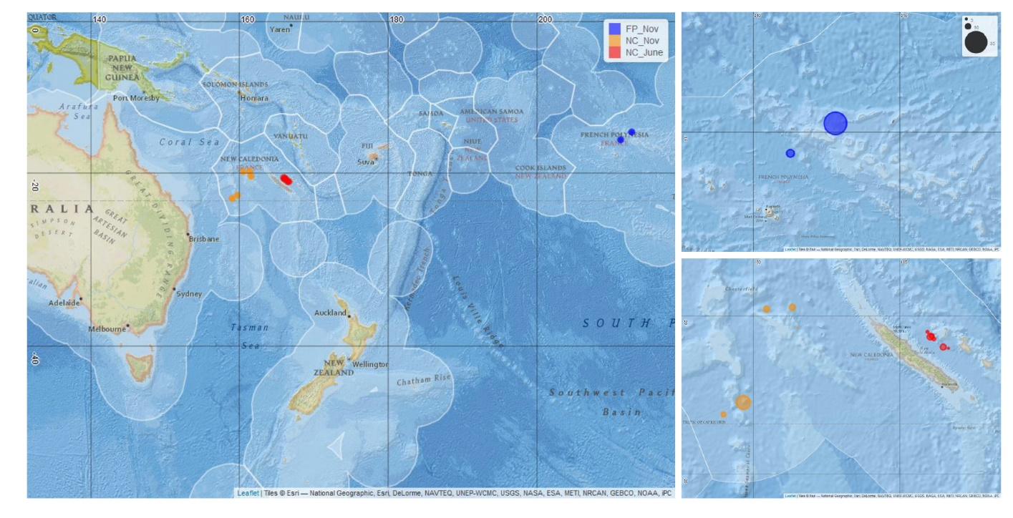
Sampling locations in FP and NC
5. Use trial samples to investigate and validate connectivity hypotheses via non-close-kin methods for south Pacific albacore in preparation for the 2024 stock assessment.
n = 55
n = 38
n = 55
Notes:
Muscle tissue and sagittal otoliths sampled from mature south Pacific ALB in French Polynesia and New Caledonia in the same month (November 2022).
An additional 38 mature individuals sampled in New Caledonia in June 2022.

Slide 9
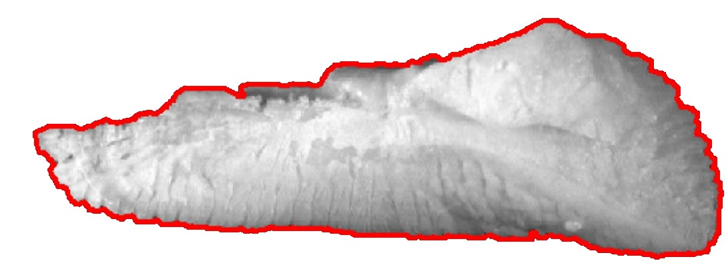
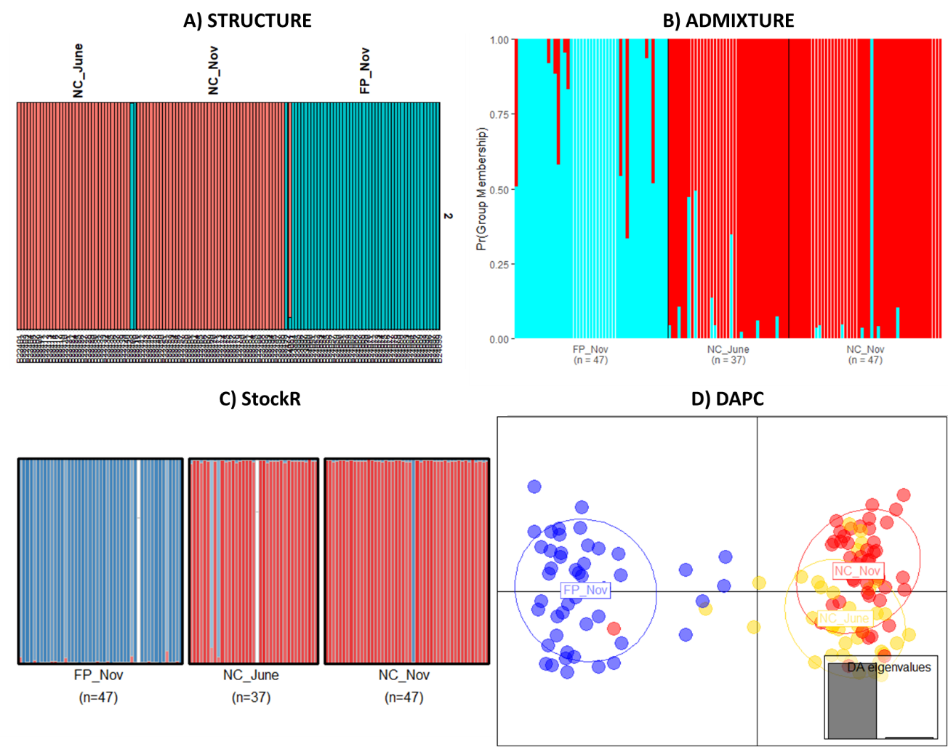
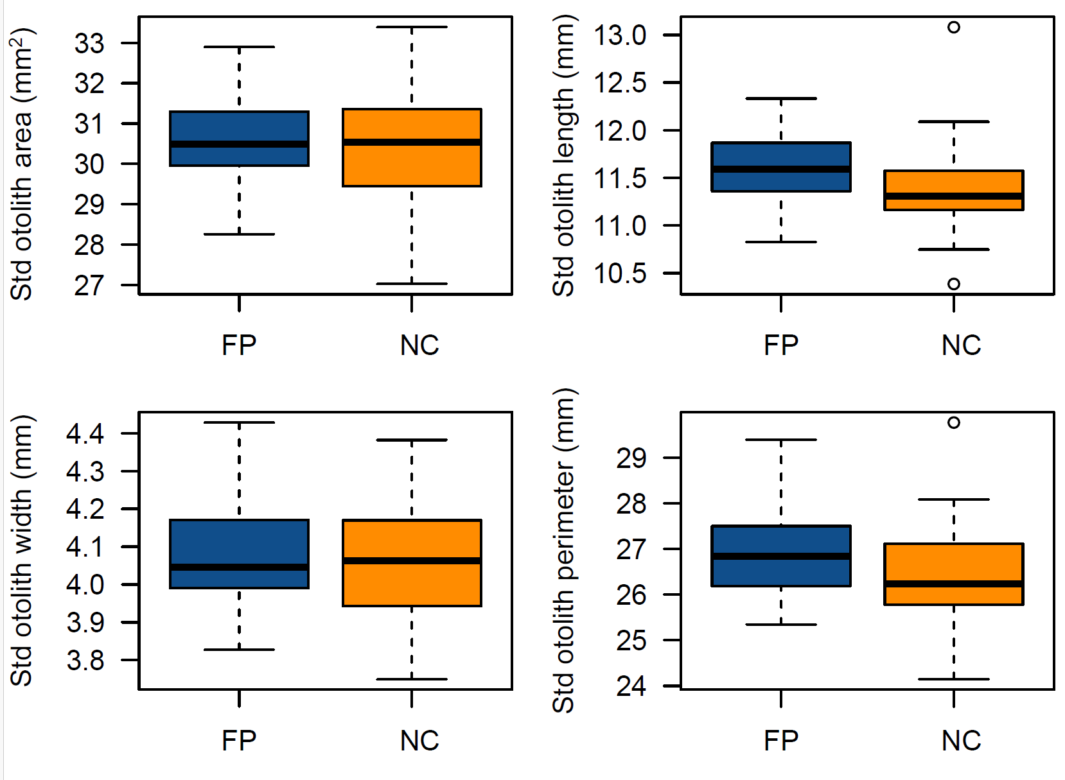
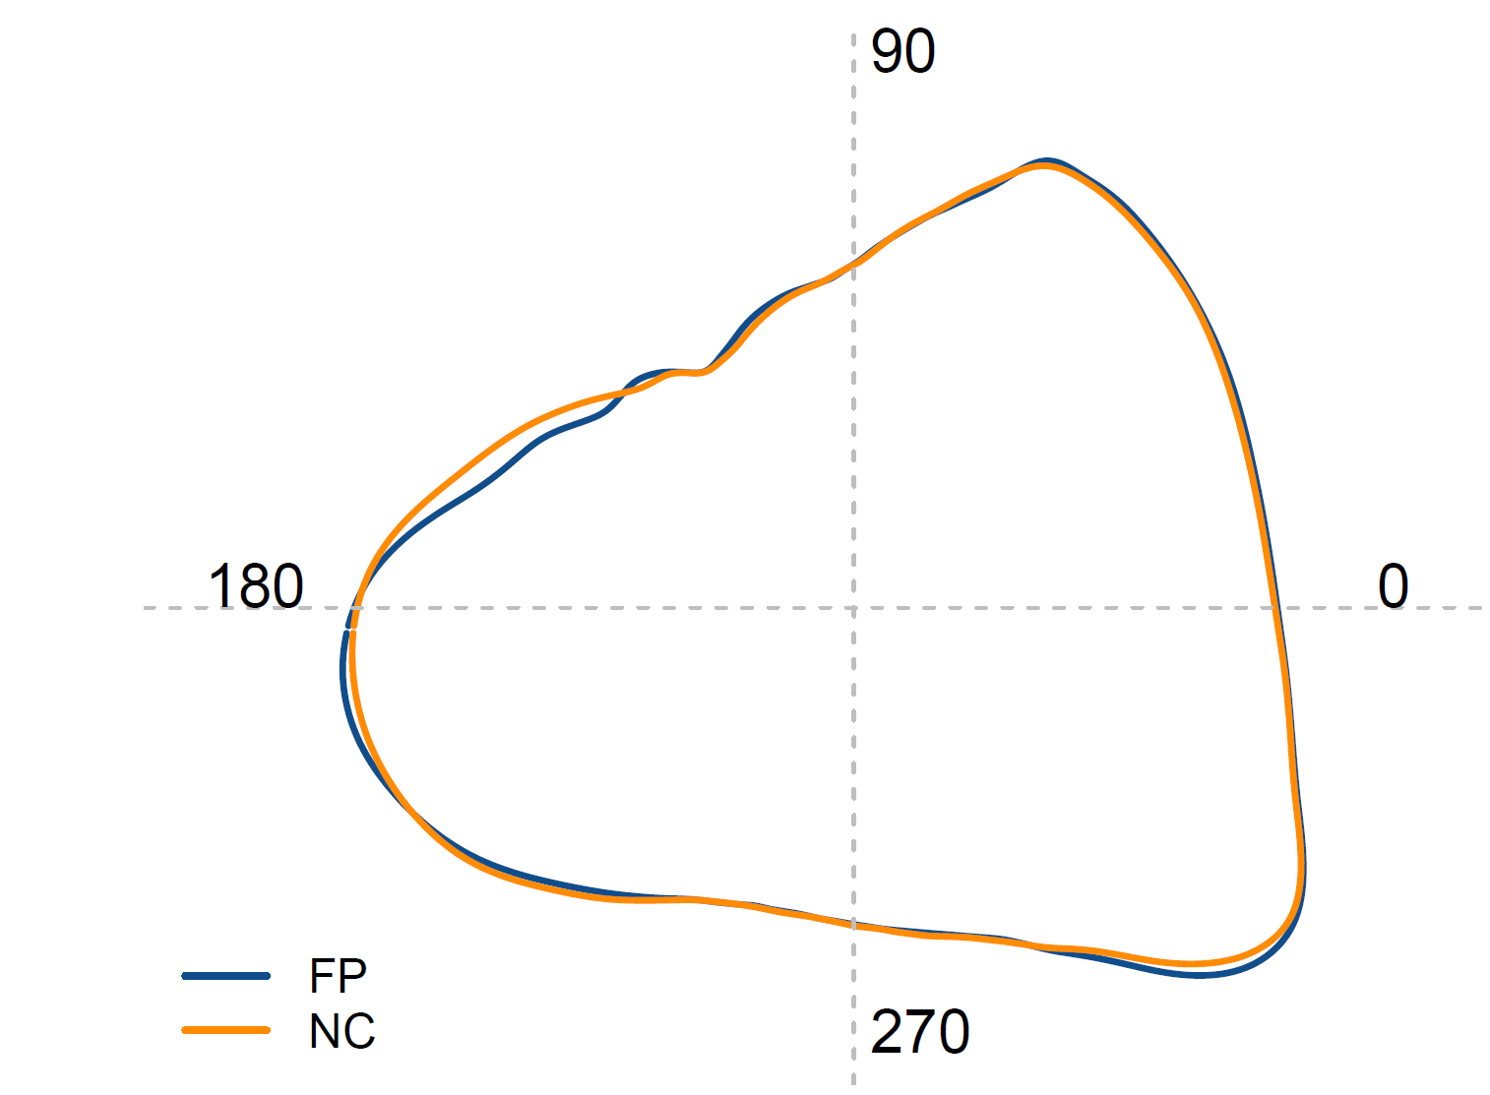
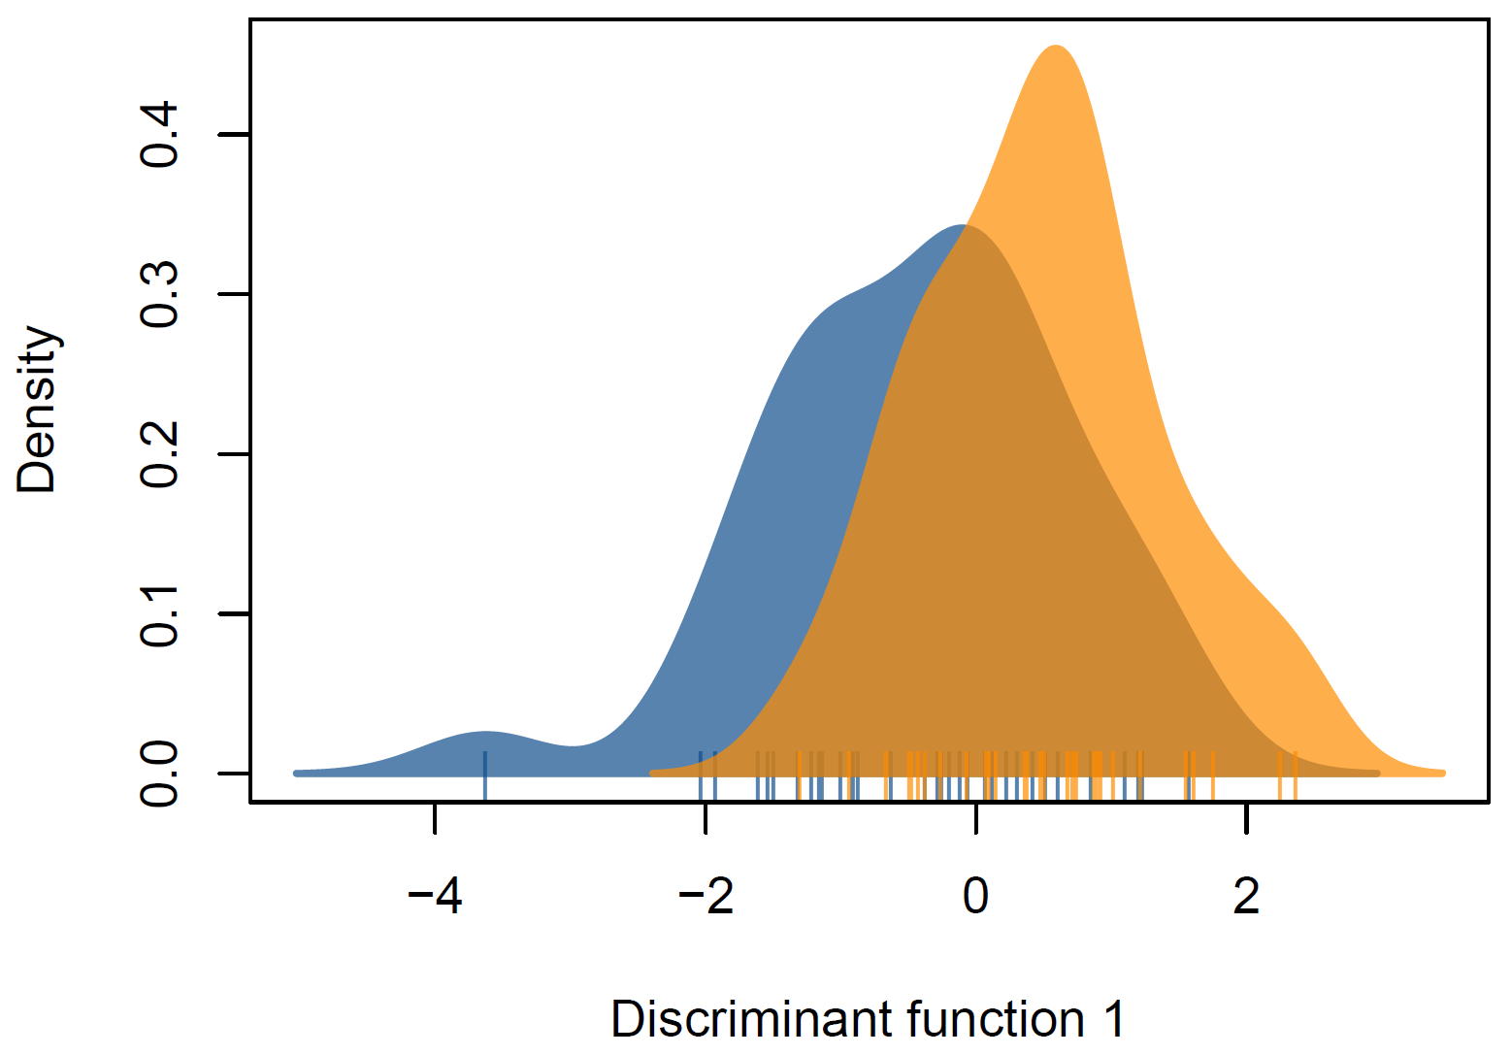
Genetics and otolith shape – FP vs. NC
Notes:
Analyses of genetic and otolith shape data both support the existence of population differentiation between French Polynesia and New Caledonia.
Furthermore, genetic data from the additional 38 individuals captured from New Caledonian waters in June 2022 indicate seasonal stability in the New Caledonian population genomic signature over at least a five-month period from June through November (2022).
Thus, seasonal variation cannot explain the genetic differentiation observed between fish collected from New Caledonia and French Polynesia.

Slide 10
5. Use trial samples to investigate and validate connectivity hypotheses via non-close-kin methods for south Pacific albacore in preparation for the 2024 stock assessment.
An analysis of genetic and otolith shape data (see Macdonald et al. 2024 (SC20-SA-IP-04) and Appendix 2 for full details) provides strong evidence of population differentiation between New Caledonia and French Polynesia.
These results align with modelled movement rate estimates used in the 2024 assessment, and together with other lines of evidence, lend support to the 2-region spatial structure adopted for the assessment.
Follow-up work and further sampling is recommended to help clarify the precise location of any longitudinal division in the south Pacific albacore stock.

Slide 11
6. Develop capacity within WCPFC to implement and evaluate CKMR applications to WCPFC stocks.
Six training events have been held in 2024 focused on SOP for port-based tissue sampling.
These have upskilled 59 port samplers, fisheries observers, government and industry staff from 13 countries.
In total, just over 11,000 tissue samples from south Pacific albacore have been collected since February 2023
SC20 may wish to start considering introducing capacity building for the analysis and interpretation of CKMR in stock assessment

Slide 12
KEY Recommendations
The SC is invited to:
Note progress on each activity to date.
Consider the scheduling of and resourcing for the inclusion of CKMR data in future stock assessments for south Pacific albacore, noting the demonstrated capacity of sampling teams now established throughout the region to achieve the updated target of 36,000-84,000 tissue samples over a three-year period.
Support the 2024 PAW recommendation for follow-up studies of south Pacific albacore population structure
  incorporates finer-scale, structured sampling across the WCPO and further east in the EPO
  combines empirical and modelled data from a variety of sources where available; and
  explores intrinsic and environmental mechanisms that might give rise to the observed population structure

