Slide 1
Western and Central Fisheries Commission
20th Regular Session of the Scientific Committee
This is the Teal Title Slide, you can swap to the
Blue 1 Title Slide or Blue2 Title Slide in the Layout menu
Stock assessment of shortfin mako shark in the North Pacific Ocean through 2022
ISC SHARK Working Group
August 16, 2024
Notes:
Overview of the terminology behind the main identifier.

Slide 2
Overview
Overview of the 2018 benchmark stock assessment
Conceptual model
Key data inputs
Modelling approach
  Stock Synthesis model
  Bayesian State-Space Surplus Production Model (BSPM)
2024 Assessment results
  Model fit & diagnostics
  Model ensemble
  Projections
Discussion

Slide 3
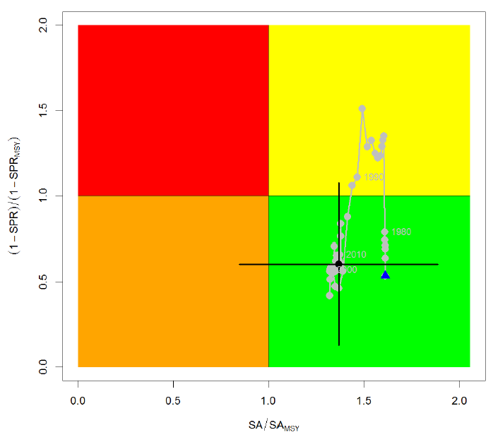

Overview of the 2018 stock assessment
Stock Synthesis 3.24U (ISC 2018)
SA₂₀₁₆ / SA_{MSY} = 1.36
$\frac{1−SPR_{2013−2015}}{1−SPR_{MSY}}$= 0.62
North Pacific Ocean (NPO) shortfin mako shark (SMA) was not experiencing overfishing and not overfished relative to MSY-based reference points

Slide 4
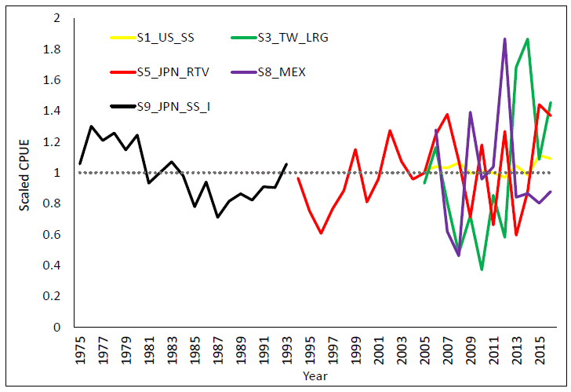
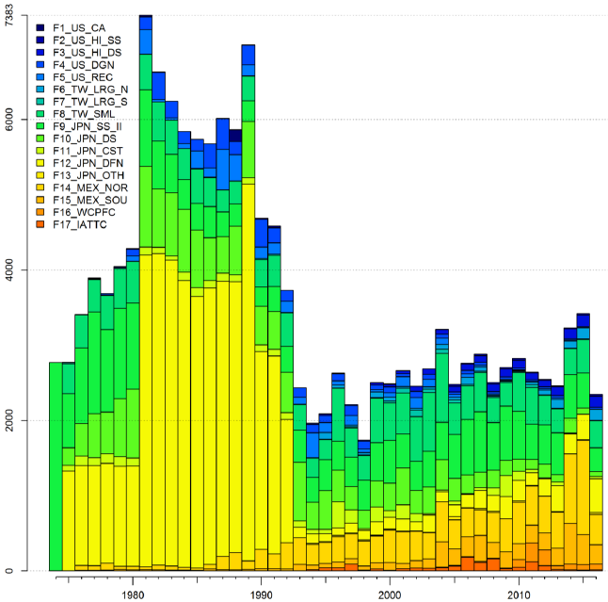
2018 stock assessment: background
Initially intended to begin the model in 1994 given the lack of species-specific catch/CPUE in the Japanese data for sharks prior to 1994
However, models beginning in 1994 were unable to converge to reasonable estimates

Slide 5
2018 stock assessment: background
Initially intended to begin the model in 1994 given the lack of species-specific catch/CPUE in the Japanese data for sharks prior to 1994
However, models beginning in 1994 were unable to converge to reasonable estimates
Subsequently, catches and a CPUE index were developed for the period 1975 – 1993 by applying catch ratios of SMA from 1994 – 1999 to total shark catches for 1975 – 1993.
The 2018 assessment was only able to achieve convergence following the inclusion of these data.

Slide 6
2018 stock assessment: background
Initially intended to begin the model in 1994 given the lack of species-specific catch/CPUE in the Japanese data for sharks prior to 1994
However, models beginning in 1994 were unable to converge to reasonable estimates
Subsequently, catches and a CPUE index were developed for the period 1975 – 1993 by applying catch ratios of SMA from 1994 – 1999 to total shark catches for 1975 – 1993.
The 2018 assessment was only able to achieve convergence following the inclusion of these data.
However, it is uncertain how representative these data are given that SMA represented a small proportion of shark catch, and that the majority of the shark catch is blue shark, which have different life history and fishery interactions.
?
?

Slide 7
Conceptual model
Population structure
Reproduction
Growth
Maximum age
Two online intersessional meetings of the ISC SHARKWG were held (May & June 2023) to review & summarize current understanding of SMA biology, life-history and fishery interactions, and explicitly define a conceptual model based on the recommendations of recent research.
Natural mortality
Movement dynamics
Environmental preferences
Fishery interactions
Minte-Vera et al., 2024. The use of conceptual models to structure stock assessments: A tool for collaboration and for “modelling what to model”. Fisheries Research

Slide 8
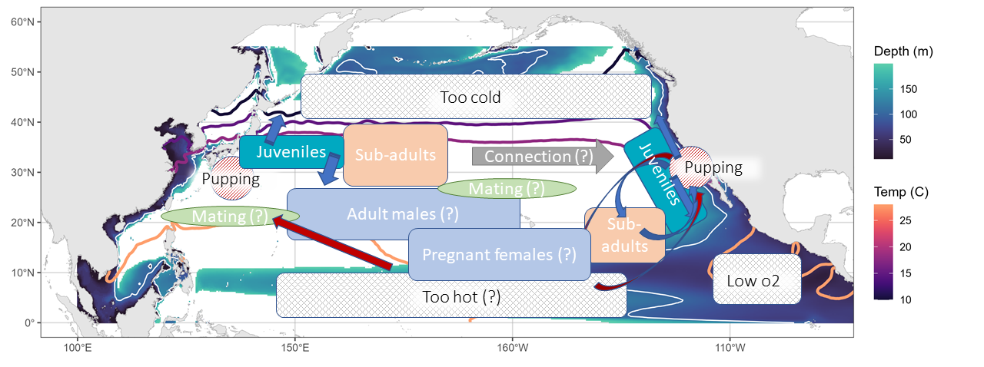
Conceptual model

Slide 9
Identified uncertainties
Key uncertainties were identified in developing the conceptual model:
Stock structure is unknown in the NPO. Multiple parturition sites raises the possibility that multiple stocks exist depending on the level of genetic exchange between sites
Biological uncertainties exist. The lack of observations for large females complicates the understanding of SMA biology with regards to maximum age, growth, reproduction and natural mortality.
Fisheries inputs are uncertain. Post-1994 catch is uncertain due to unknown levels of discard reporting in logbooks, pre-1994 catch is uncertain due to lack of species-specific data for sharks. No fishery indexes the entire spatial distribution or mature females.

Slide 10
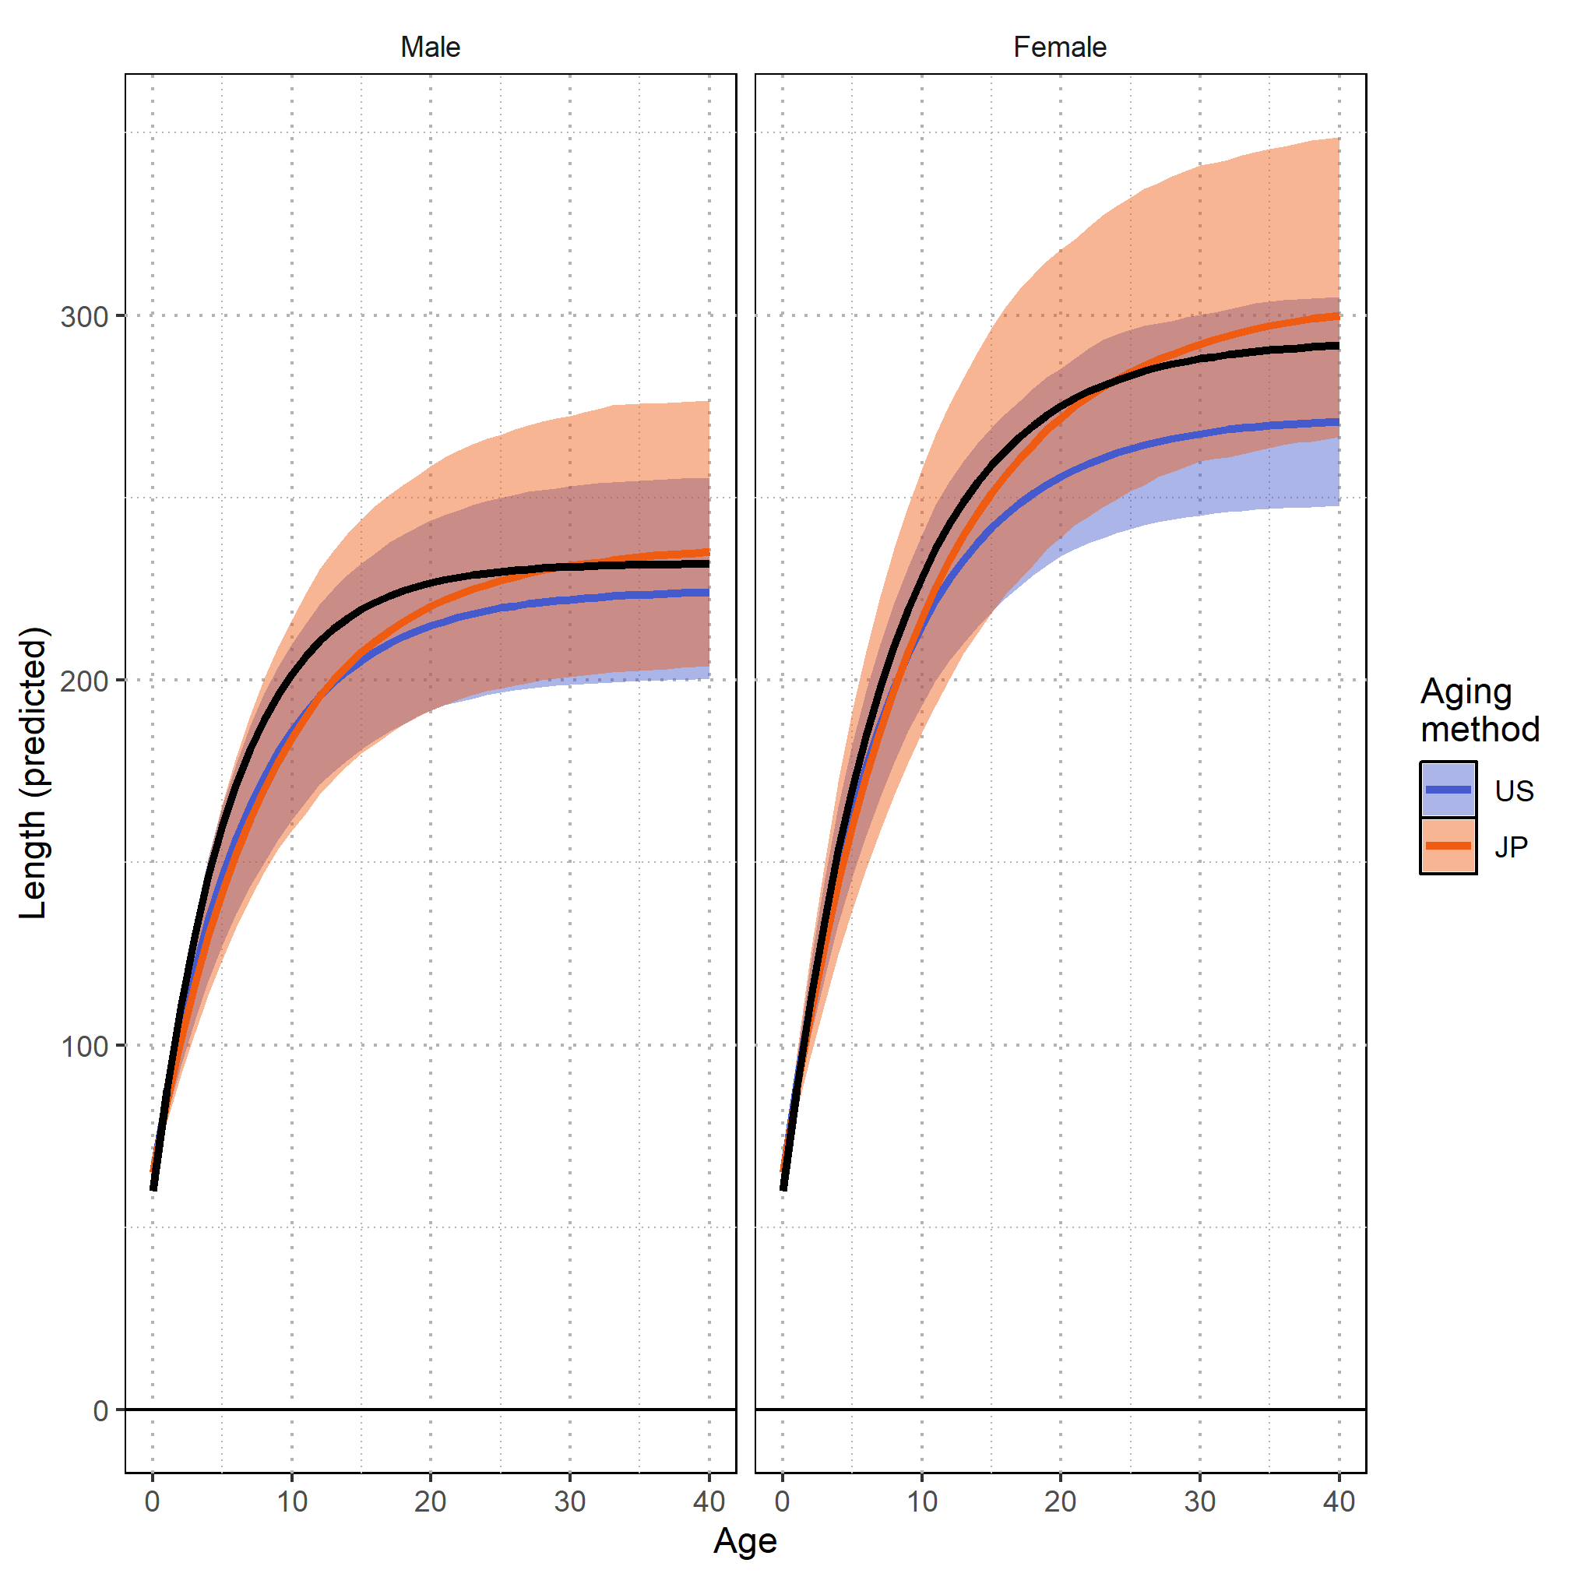
Biology and life-history
Biological assumptions were largely consistent with the 2018 assessment.
  Maximum age ~31 years
  Reproduction occurred every 2-3 years
  Female length @ 50% maturity ~233cm PCL
  Litter size either constant (~12) or a function of maternal length.
Growth curves were updated to account for methodological differences in determining age from vertebrae.
Adult levels of natural mortality were updated using a meta-analytic approach that considered empirical relationships with maximum age, age at maturity and growth.
  0.13 – 0.17 for females & 0.18 – 0.2 for males
2018 growth curve
2024 growth curve: US aging
2024 growth curve: JP aging

Slide 11
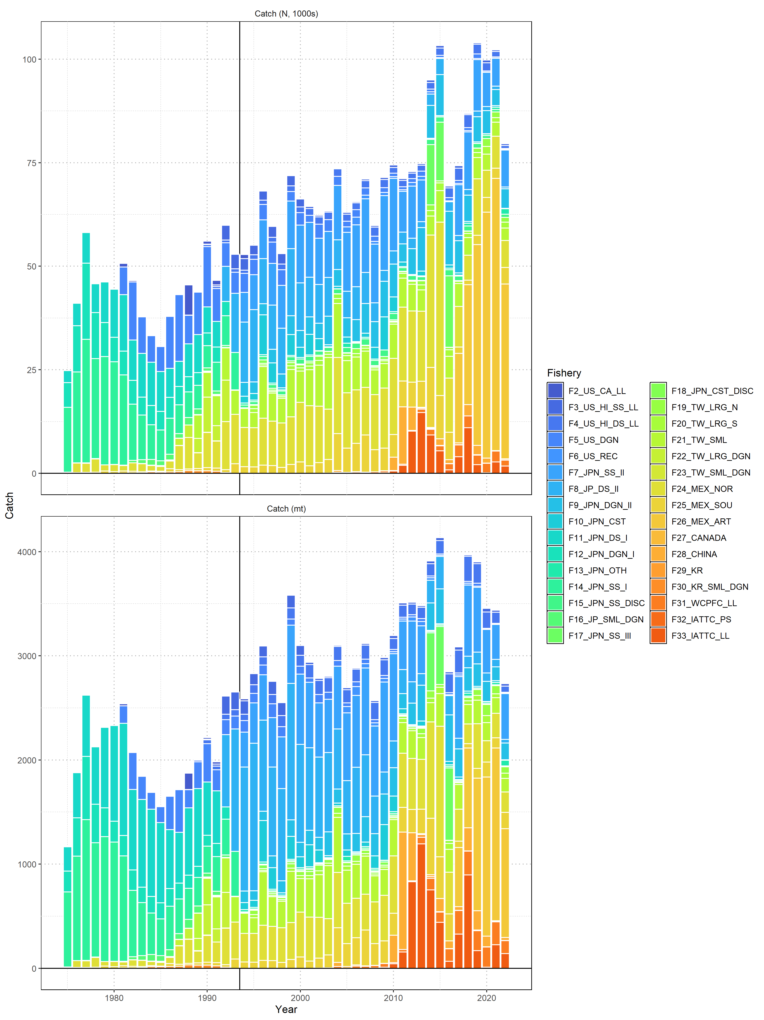
Fisheries
Large-scale fishery interactions have likely existed since the 1950s
Impacts from longline and high-seas driftnet fisheries may be significant but are highly uncertain prior to 1994 due to the lack of species-specific shark data
50k
1980
1994

Slide 12
Fisheries
100k
Large-scale fishery interactions have likely existed since the 1950s
Impacts from longline and high-seas driftnet fisheries may be significant but are highly uncertain prior to 1994 due to the lack of species-specific shark data
Post-1994 catches come predominantly from longline.
75k
1994
2020

Slide 13
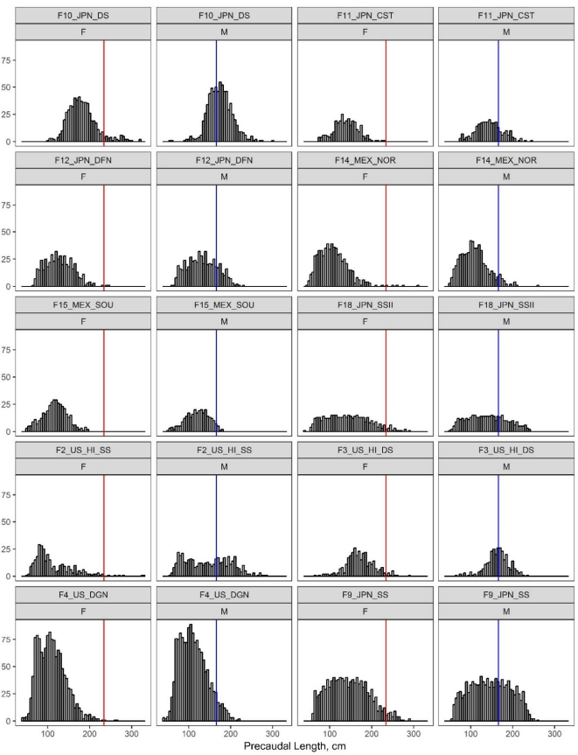
Size composition
Size composition data was available for a number of fisheries, and all lengths were converted to pre-caudal length (PCL)
Figure 4; ISC, 2018

Slide 14
Size composition
Size composition data was available for a number of fisheries, and all lengths were converted to pre-caudal length (PCL)
Very few fisheries were observed to interact with females larger than the length @ 50% maturity (~233 cm PCL)
The SHARKWG considered this to be evidence of strong dome-shaped selectivity rather than a sharp increase in female natural mortality post maturity.
Figure 4; ISC, 2018

Slide 15
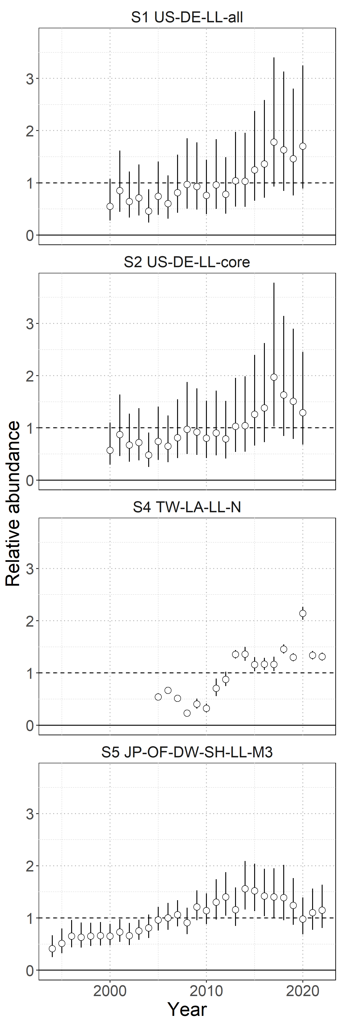
Standardized CPUE
The SHARKWG considered a number of indices and evaluated their representativeness based the data source, overlap with conceptual distribution of the stock, and appropriateness of the standardization model.

Slide 16
Standardized CPUE
The SHARKWG considered a number of indices and evaluated their representativeness based the data source, overlap with conceptual distribution of the stock, and appropriateness of the standardization model.
4 indices were identified as suitably representative:
  Q3 US Hawai’i deep set longline (all & core areas)

Slide 17
Standardized CPUE
The SHARKWG considered a number of indices and evaluated their representativeness based the data source, overlap with conceptual distribution of the stock, and appropriateness of the standardization model.
4 indices were identified as suitably representative:
  Q3 US Hawai’i deep set longline (all & core areas)
  Chinese-Taipei large scale longline north of 25 °N

Slide 18
Standardized CPUE
The SHARKWG considered a number of indices and evaluated their representativeness based the data source, overlap with conceptual distribution of the stock, and appropriateness of the standardization model.
4 indices were identified as suitably representative:
  Q3 US Hawai’i deep set longline (all & core areas)
  Chinese-Taipei large scale longline north of 25 °N
  Japanese shallow-set longline

Slide 19
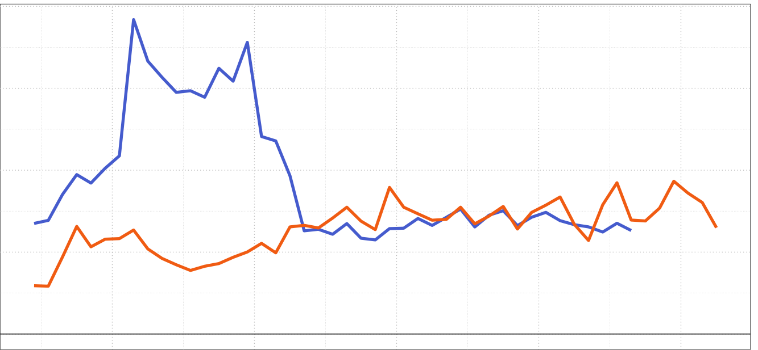
Modeling approach
Initial plans were to update the 2018 Stock Synthesis (SS3) model, and estimate stock status from 1975 – 2022.
Given the assumed biology, SS3 models were unable to reconcile increasing catch and CPUE post-1994 following the removal of the 1975 – 1993 index and revision of the high seas drift net catch (pre-1994).
The SHARKWG made a strategic pivot and developed a Bayesian state-space surplus production model (BSPM) to more efficiently account for key uncertainties and estimate stock status from 1994 – 2022.
1980
2000
2020
2018 assessment catch
Updated catch

Slide 20
Bayesian State-Space Surplus Production Model (BSPM)
BSPMs were developed and implemented using the STAN probabilistic programming language.
Briefly BSPMs are a simplified, age-aggregated representation of population dynamics where the key leading parameters are population carrying capacity (K), initial depletion (x₀), maximum intrinsic rate of increase (R_{Max}), and shape of the production function (n).
Fletcher-Schaefer hybrid; random-effects formulation

Slide 21

Bayesian State-Space Surplus Production Model (BSPM)
BSPMs were developed and implemented using the STAN probabilistic programming language.
Briefly BSPMs are a simplified, age-aggregated representation of population dynamics where the key leading parameters are population carrying capacity (K), initial depletion (x₀), maximum intrinsic rate of increase (R_{Max}), and shape of the production function (n).
Additional variance parameters related to process error $σ_{P}$, observation error $σ_{O}$, and fishing mortality variability $σ_{F}$ are also estimated.
Fletcher-Schaefer hybrid; random-effects formulation

Slide 22

Bayesian State-Space Surplus Production Model (BSPM)
BSPMs were developed and implemented using the STAN probabilistic programming language.
Briefly BSPMs are a simplified, age-aggregated representation of population dynamics where the key leading parameters are population carrying capacity (K), initial depletion (x₀), maximum intrinsic rate of increase (R_{Max}), and shape of the production function (n).
Additional variance parameters related to process error $σ_{P}$, observation error $σ_{O}$, and fishing mortality variability $σ_{F}$ are also estimated.
Informative priors were developed using numerical prior-pushforward simulations and filtering of simulated population trajectories.
Fletcher-Schaefer hybrid; random-effects formulation

Slide 23
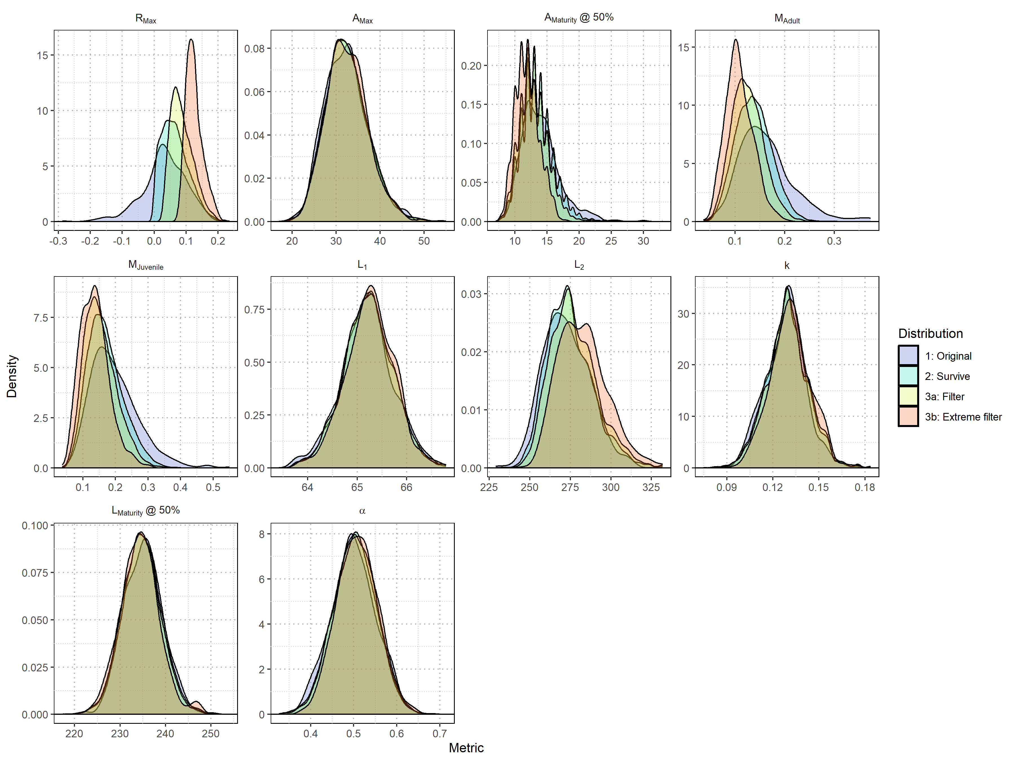
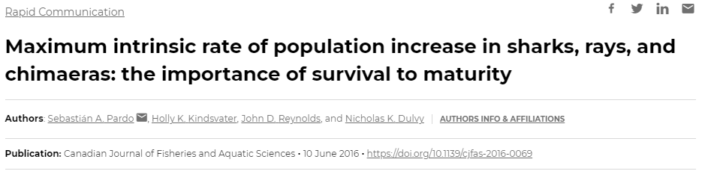
Bayesian State-Space Surplus Production Model (BSPM)
BSPMs were developed and implemented using the STAN probabilistic programming language.
Briefly BSPMs are a simplified, age-aggregated representation of population dynamics where the key leading parameters are population carrying capacity (K), initial depletion (x₀), maximum intrinsic rate of increase (R_{Max}), and shape of the production function (n).
Additional variance parameters related to process error $σ_{P}$, observation error $σ_{O}$, and fishing mortality variability $σ_{F}$ are also estimated.
Informative priors were developed using numerical prior-pushforward simulations and filtering of simulated population trajectories.
Prior development workflow
Use a stochastic numerical simulation based on NPO SMA biology to develop a prior for the intrinsic rate of increase R_{Max} (Pardo et al. 2016, 2018).

Slide 24
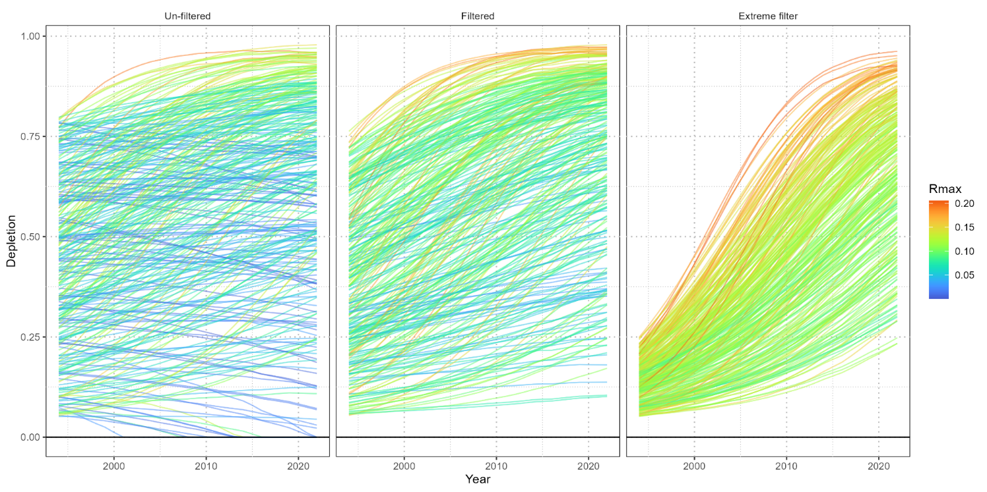
Bayesian State-Space Surplus Production Model (BSPM)
BSPMs were developed and implemented using the STAN probabilistic programming language.
Briefly BSPMs are a simplified, age-aggregated representation of population dynamics where the key leading parameters are population carrying capacity (K), initial depletion (x₀), maximum intrinsic rate of increase (R_{Max}), and shape of the production function (n).
Additional variance parameters related to process error $σ_{P}$, observation error $σ_{O}$, and fishing mortality variability $σ_{F}$ are also estimated.
Informative priors were developed using numerical prior-pushforward simulations and filtering of simulated population trajectories.
Prior development workflow
Use a stochastic numerical simulation based on NPO SMA biology to develop a prior for the intrinsic rate of increase R_{Max} (Pardo et al. 2016, 2018).
Use the R_{Max} prior (along with priors for carrying capacity K and initial depletion x₀) to simulate population trajectories conditioned on observed catch.

Slide 25
Bayesian State-Space Surplus Production Model (BSPM)
BSPMs were developed and implemented using the STAN probabilistic programming language.
Briefly BSPMs are a simplified, age-aggregated representation of population dynamics where the key leading parameters are population carrying capacity (K), initial depletion (x₀), maximum intrinsic rate of increase (R_{Max}), and shape of the production function (n).
Additional variance parameters related to process error $σ_{P}$, observation error $σ_{O}$, and fishing mortality variability $σ_{F}$ are also estimated.
Informative priors were developed using numerical prior-pushforward simulations and filtering of simulated population trajectories.
Prior development workflow
Use a stochastic numerical simulation based on NPO SMA biology to develop a prior for the intrinsic rate of increase R_{Max} (Pardo et al. 2016, 2018).
Use the R_{Max} prior (along with priors for carrying capacity K and initial depletion x₀) to simulate population trajectories conditioned on observed catch.
Filter simulated population trajectories based on baseline (at least ~20% increase in population) and extreme (at least ~200% increase in population) levels.
Baseline
Extreme

Slide 26
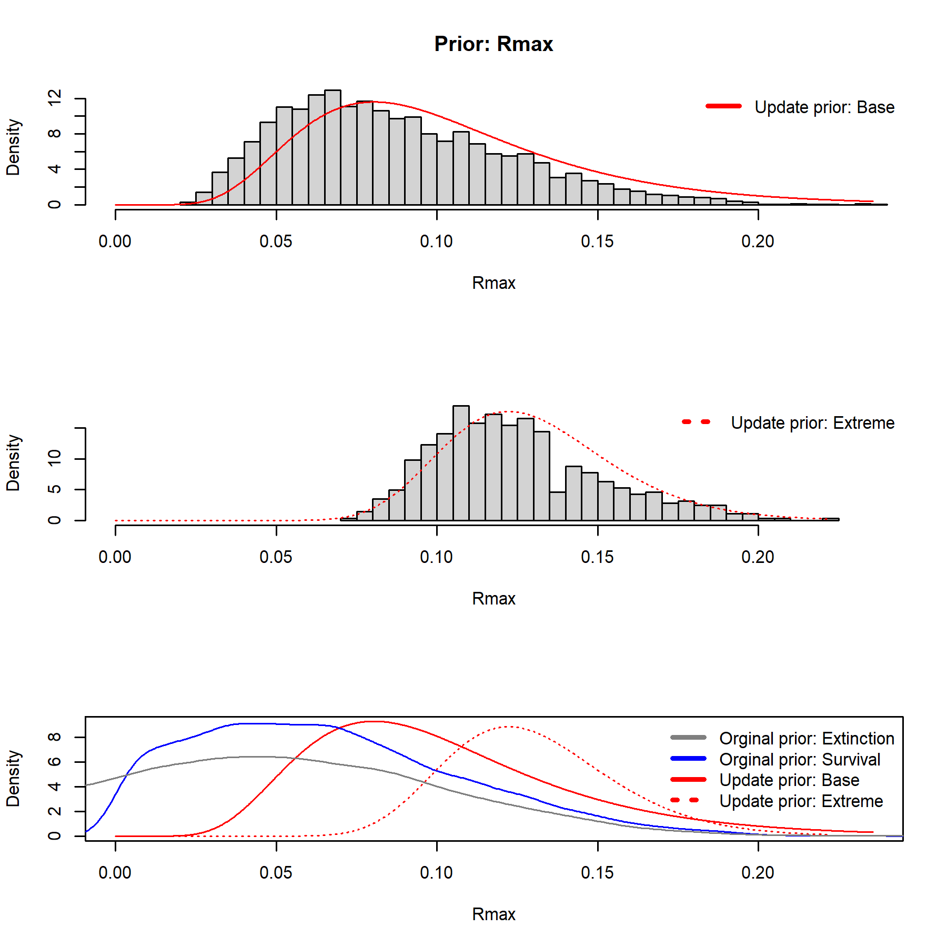

Bayesian State-Space Surplus Production Model (BSPM)
BSPMs were developed and implemented using the STAN probabilistic programming language.
Briefly BSPMs are a simplified, age-aggregated representation of population dynamics where the key leading parameters are population carrying capacity (K), initial depletion (x₀), maximum intrinsic rate of increase (R_{Max}), and shape of the production function (n).
Additional variance parameters related to process error $σ_{P}$, observation error $σ_{O}$, and fishing mortality variability $σ_{F}$ are also estimated.
Informative priors were developed using numerical prior-pushforward simulations and filtering of simulated population trajectories.
Prior development workflow
Use a stochastic numerical simulation based on NPO SMA biology to develop a prior for the intrinsic rate of increase R_{Max} (Pardo et al. 2016, 2018).
Use the R_{Max} prior (along with priors for carrying capacity K and initial depletion x₀) to simulate population trajectories conditioned on observed catch.
Filter simulated population trajectories based on baseline (at least ~20% increase in population) and extreme (at least ~200% increase in population) levels.
Develop parametrized prior distributions based on parameter distributions corresponding to filtered, simulated population trajectories (e.g., $R_{Max}\sim \text{Lognormal}(−2.52, 0.41)$).

Slide 27
Bayesian State-Space Surplus Production Model (BSPM)
A single index was fit (Lognormal likelihood) within each BSPM and model results were sensitive to the choice of index, treatment of the catch, and level of filtering used to define informative priors.
CPUE
US HI all
US HI core
TW
JP

Slide 28
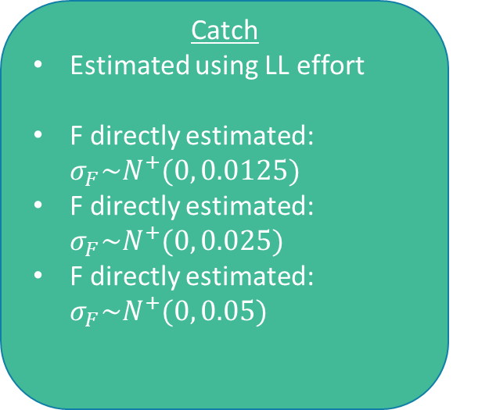
Bayesian State-Space Surplus Production Model (BSPM)
A single index was fit (Lognormal likelihood) within each BSPM and model results were sensitive to the choice of index, treatment of the catch, and level of filtering used to define informative priors.
CPUE
US HI all
US HI core
TW
JP
Catch
Estimated using LL effort
F directly estimated: $σ_{F}\sim N^{+}(0, 0.0125)$
F directly estimated: $σ_{F}\sim N^{+}(0, 0.025)$
F directly estimated: $σ_{F}\sim N^{+}(0, 0.05)$

Slide 29

Bayesian State-Space Surplus Production Model (BSPM)
A single index was fit (Lognormal likelihood) within each BSPM and model results were sensitive to the choice of index, treatment of the catch, and level of filtering used to define informative priors.
CPUE
US HI all
US HI core
TW
JP
Catch
Estimated using LL effort
F directly estimated: $σ_{F}\sim N^{+}(0, 0.0125)$
F directly estimated: $σ_{F}\sim N^{+}(0, 0.025)$
F directly estimated: $σ_{F}\sim N^{+}(0, 0.05)$
Prior filtering
Baseline: 20% increase in simulated populations
Extreme: 200% increase in simulated populations

Slide 30

Bayesian State-Space Surplus Production Model (BSPM)
A single index was fit (Lognormal likelihood) within each BSPM and model results were sensitive to the choice of index, treatment of the catch, and level of filtering used to define informative priors.
Key uncertainties were dealt with using a 32 model, full-factorial ensemble with unequal weighting (relative weight):
  US indices were down-weighted to not over-represent this data source
  Estimated catch using longline (LL) effort down-weighted given that this represented an outlier scenario in terms of catch magnitude.
CPUE
US HI all (~16.6%)
US HI core (~16.6%)
TW (33%)
JP (33%)
Catch
Estimated using LL effort (5%)
F directly estimated: $σ_{F}\sim N^{+}(0, 0.0125)$ (~31.6%)
F directly estimated: $σ_{F}\sim N^{+}(0, 0.025)$ (~31.6%)
F directly estimated: $σ_{F}\sim N^{+}(0, 0.05)$ (~31.6%)
Prior filtering
Baseline: 20% increase in simulated populations (50%)
Extreme: 200% increase in simulated populations (50%)

Slide 31
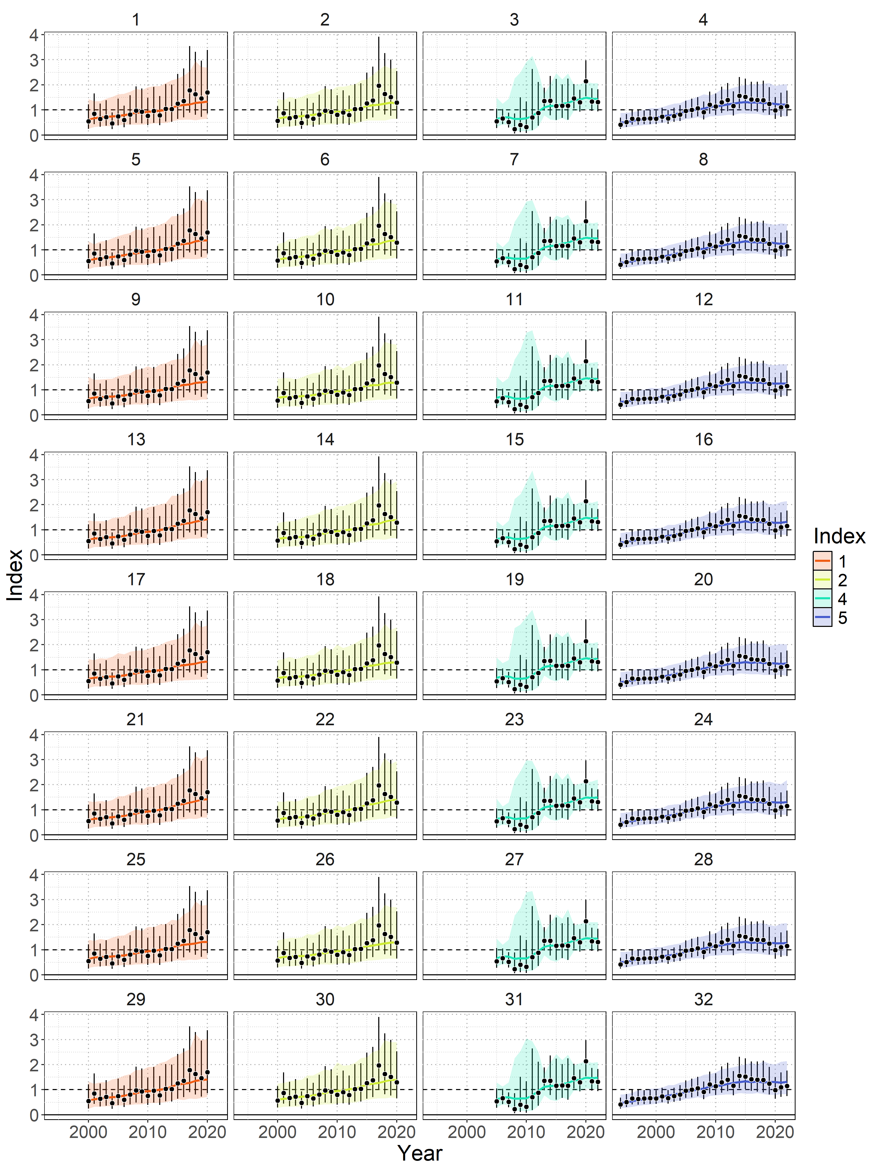

BSPM diagnostics
Diagnostics across the ensemble were good with only 4 of 32 models failing convergence criteria (0 divergent transitions, ESS > 500 and $\hat{R}$<1.01).
Model fits to indices were good (relative to estimated observation error), and posterior predictive checks indicated that the BSPMs were able to replicate the observed indices.
US HI all
US HI core
TW
JP

Slide 32
BSPM diagnostics
Diagnostics across the ensemble were good with only 4 of 32 models failing convergence criteria (0 divergent transitions, ESS > 500 and $\hat{R}$<1.01).
Model fits to indices were good (relative to estimated observation error), and posterior predictive checks indicated that the BSPMs were able to replicate the observed indices.
US HI all
US HI core
TW
JP

Slide 33
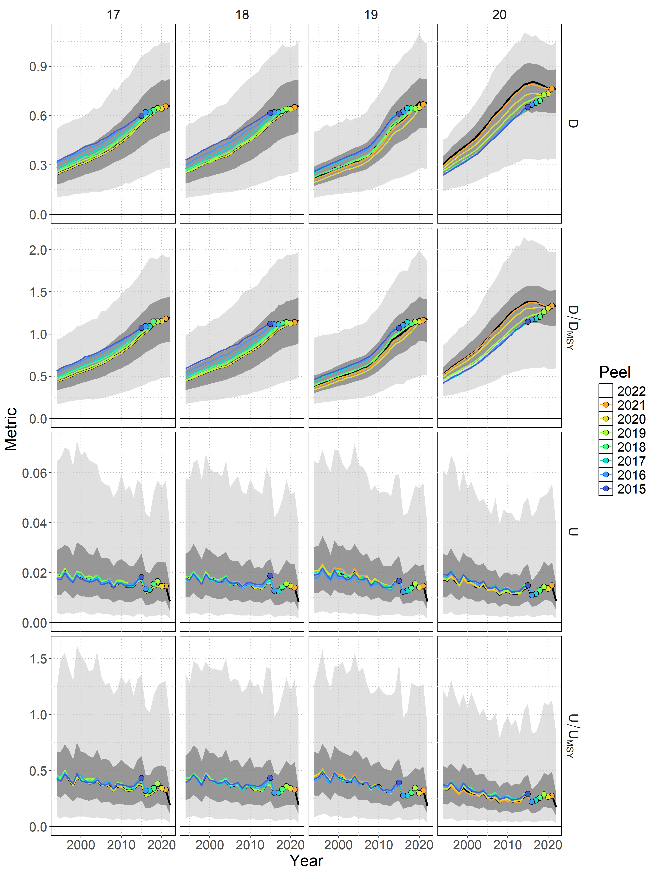

BSPM diagnostics
US all
US core
TW
JP
Diagnostics across the ensemble were good with only 4 of 32 models failing convergence criteria (0 divergent transitions, ESS > 500 and $\hat{R}$<1.01).
Model fits to indices were good (relative to estimated observation error), and posterior predictive checks indicated that the BSPMs were able to replicate the observed indices.
Overall retrospective bias was low and estimates of management quantities relative to MSY were consistently within the credible intervals of the full model.

Slide 34
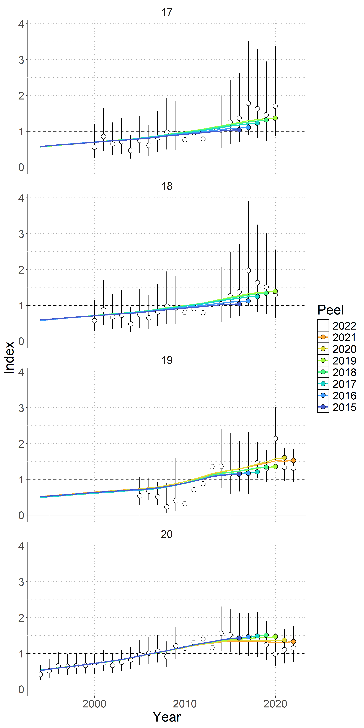

BSPM diagnostics
US all
Diagnostics across the ensemble were good with only 4 of 32 models failing convergence criteria (0 divergent transitions, ESS > 500 and $\hat{R}$<1.01).
Model fits to indices were good (relative to estimated observation error), and posterior predictive checks indicated that the BSPMs were able to replicate the observed indices.
Overall retrospective bias was low and estimates of management quantities relative to MSY were consistently within the credible intervals of the full model.
Hindcast cross-validation was poor.
US core
TW
JP

Slide 35
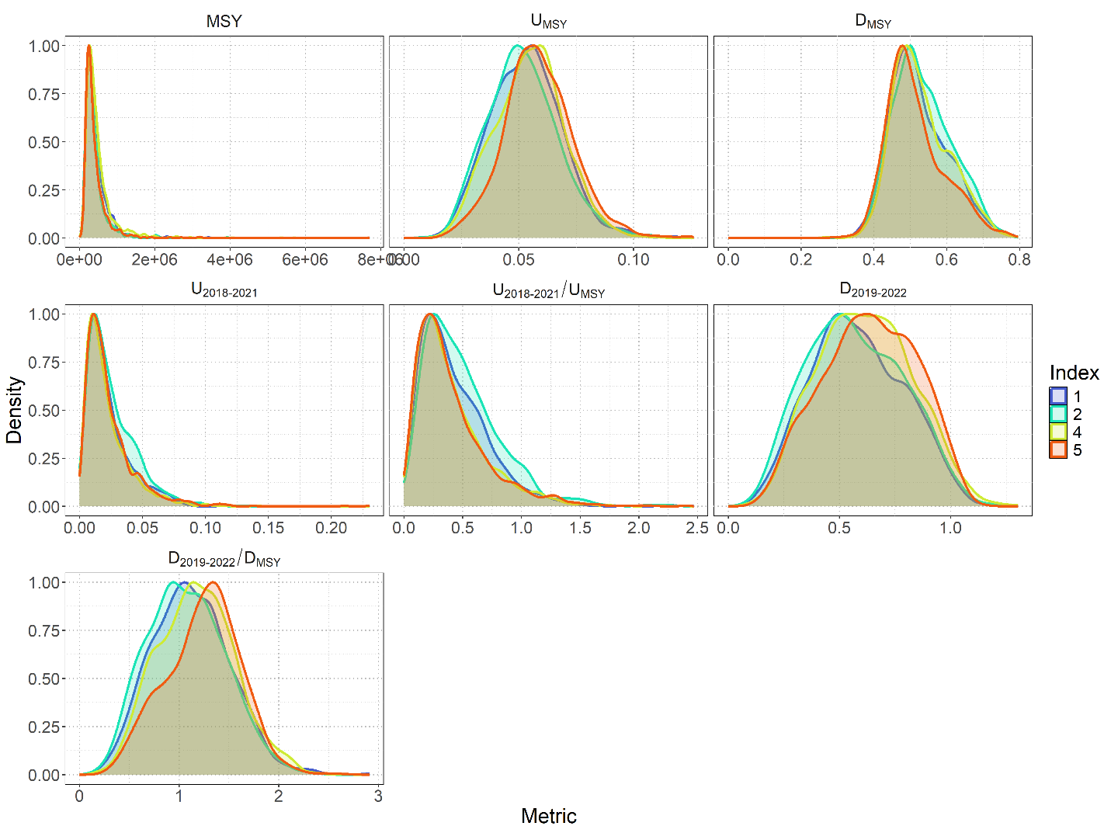
BSPM results
Excluding non-converged models (4 of 32) did not change distributions of management reference points
Models fitting to the Japanese index (5) were most optimistic

Slide 36
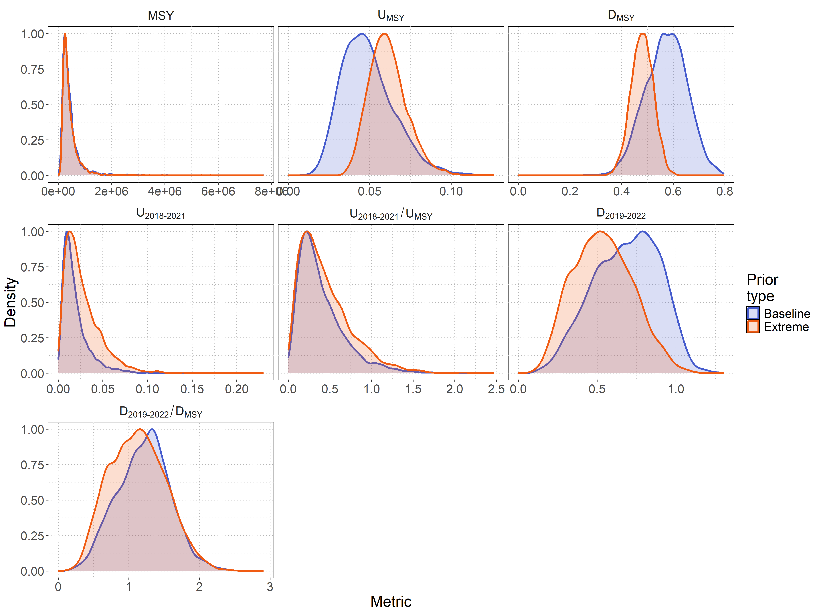
BSPM results
Excluding non-converged models (4 of 32) did not change distributions of management reference points
Models fitting to the Japanese index (5) were most optimistic
Models assuming the “extreme” prior were more pessimistic

Slide 37
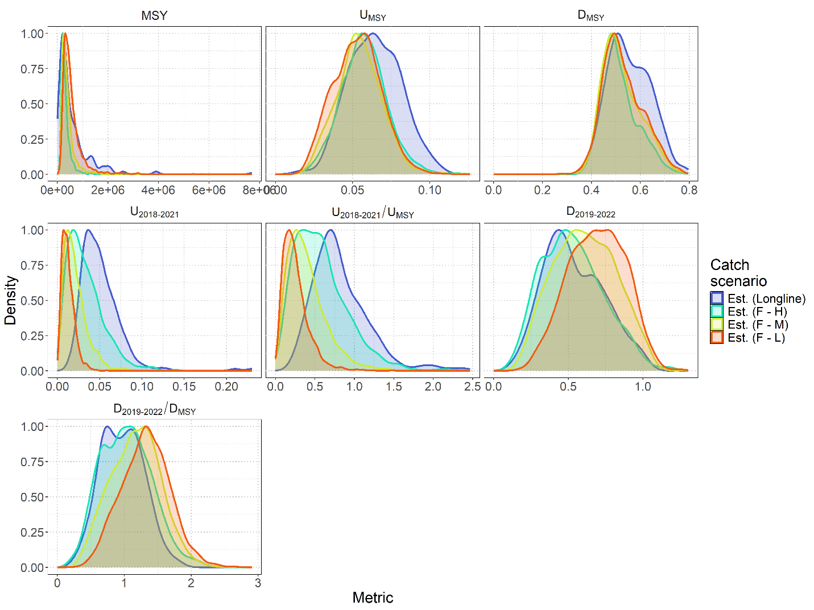

BSPM results
Excluding non-converged models (4 of 32) did not change distributions of management reference points
Models fitting to the Japanese index (5) were most optimistic
Models assuming the “extreme” prior were more pessimistic
Estimating removals using longline effort was more pessimistic, as were models that assumed broader priors for $σ_{F}$

Slide 38
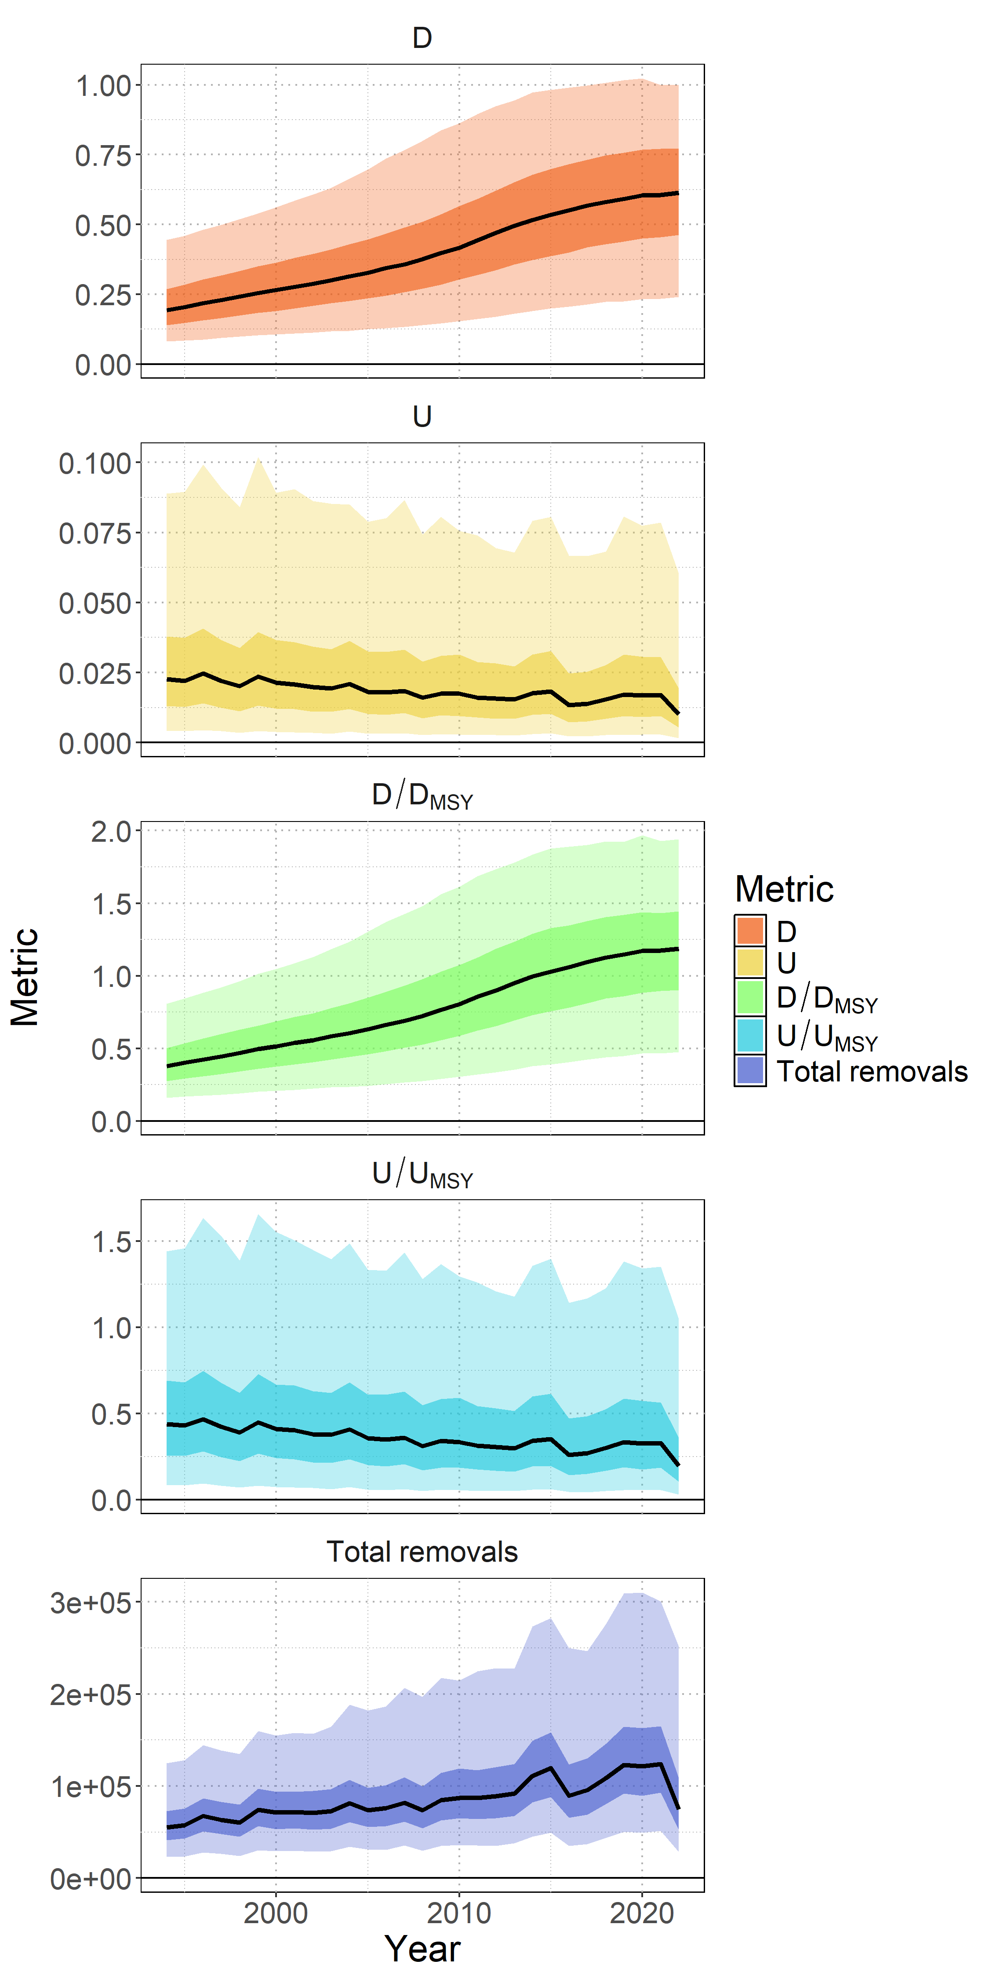

Stock status
No biomass-based or fishing mortality-based limit or target reference points have been established for NPO SMA by the IATTC or WCPFC;
Recent median D ($D_{2019−2022}$) is estimated from the model ensemble to be 0.60 (95% CI = 0.23-1.00). The recent median $D_{2019−2022}$ is 1.17 times $D_{MSY}$ (95% CI = 0.46-1.92) and the stock is likely (66% probability) not in an overfished condition relative to MSY-based reference points.
Recent U ($U_{2018−2021}$) is estimated from the model ensemble to be 0.018 (95% CI = 0.004-0.07). $U_{2018−2021}$is 0.34 times (95% CI = 0.07-1.20) $U_{MSY}$ and overfishing of the stock is likely not occurring (95% probability) relative to MSY-based reference points.

Slide 39
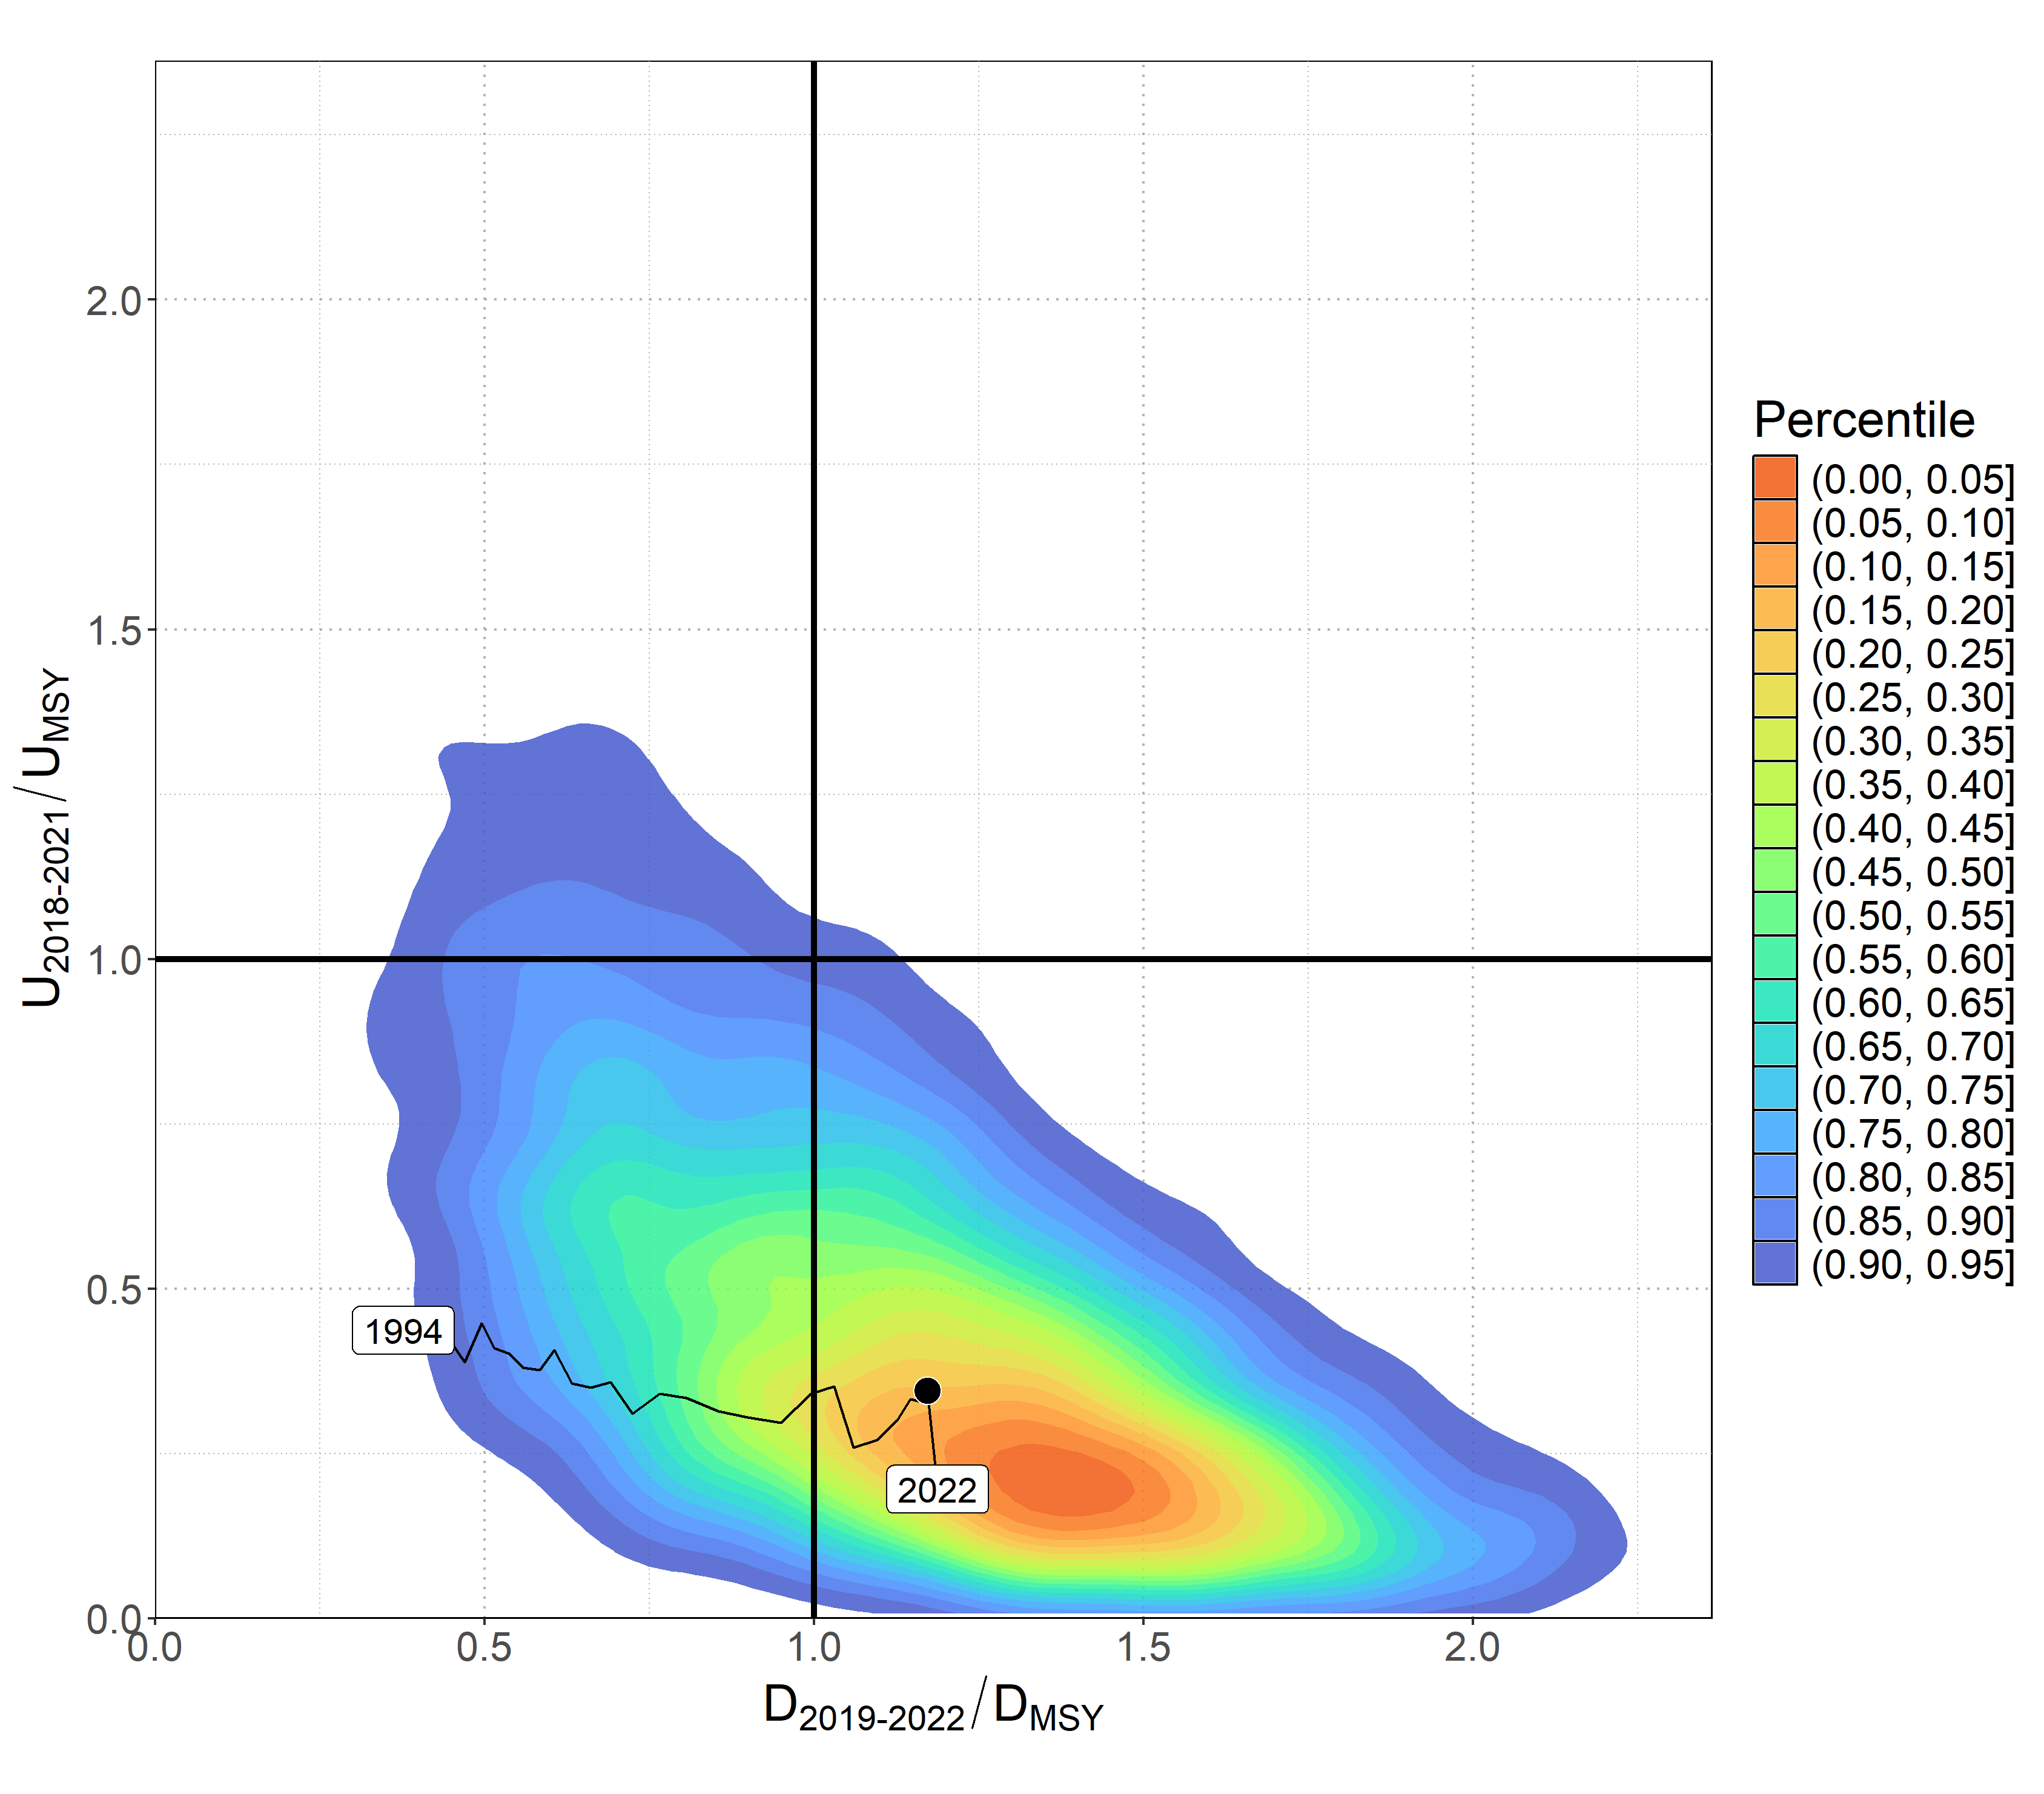
Stock status
The model ensemble results show that there is a 65% joint probability that the North Pacific SMA stock is not in an overfished condition and that overfishing is not occurring relative to MSY based reference points.
Several uncertainties may limit the interpretation of the assessment results including uncertainty in catch (historical and modeled period) and the biology and reproductive dynamics of the stock, and the lack of CPUE indices that fully index the stock.

Slide 40
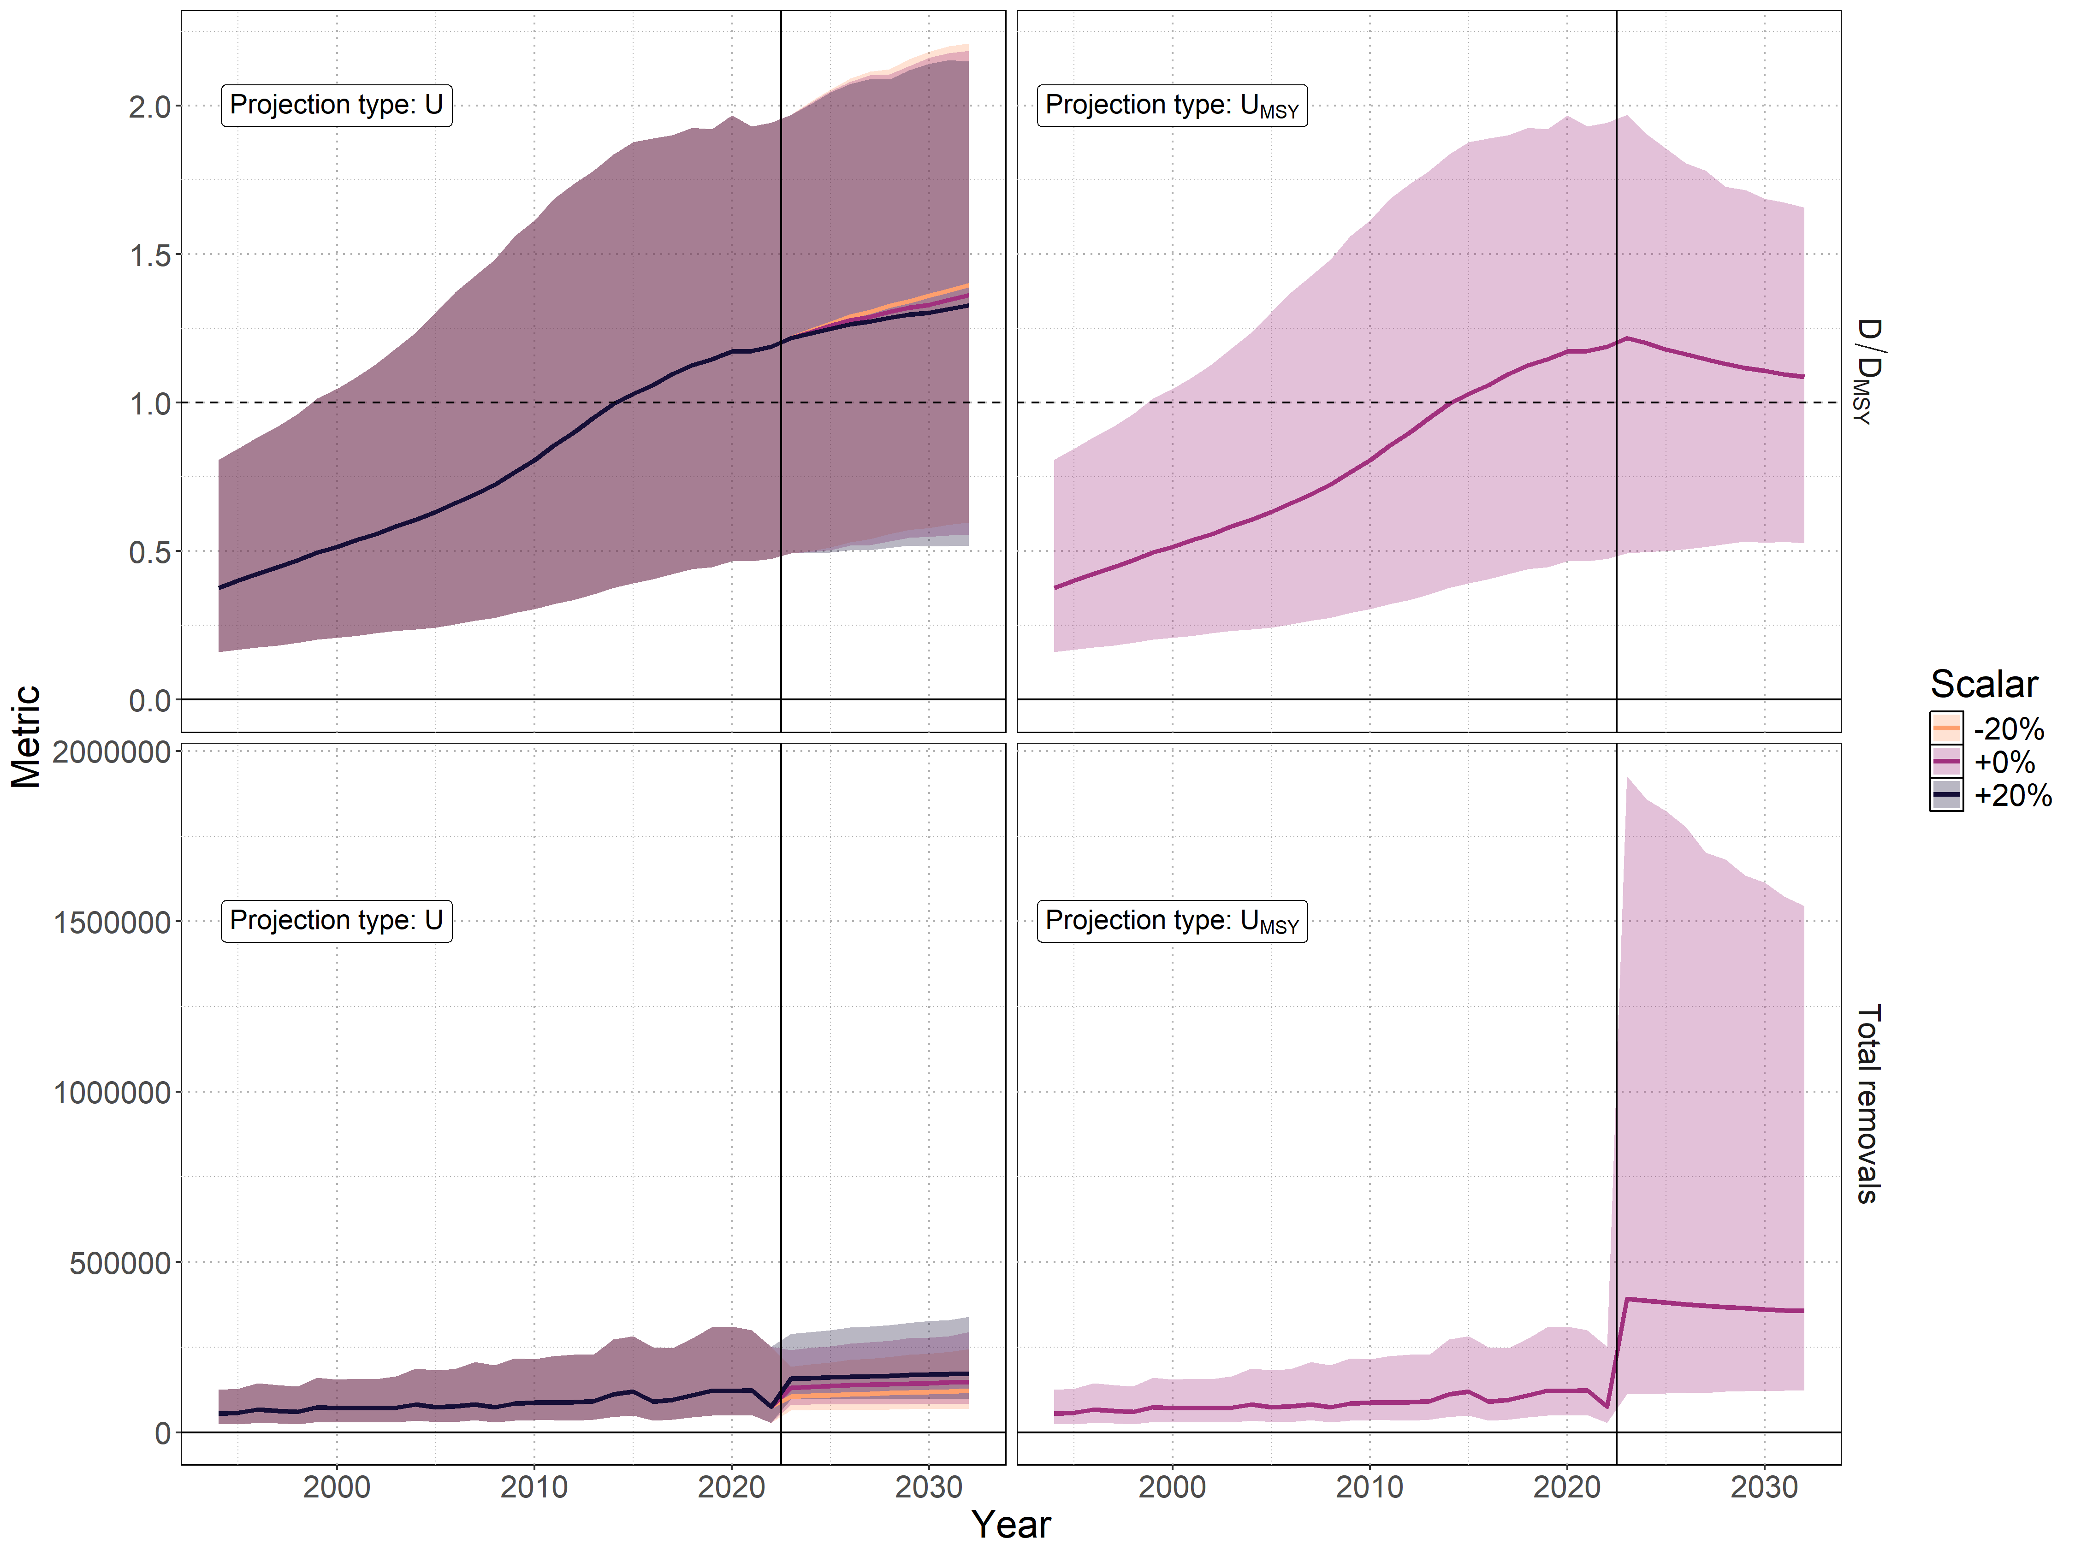
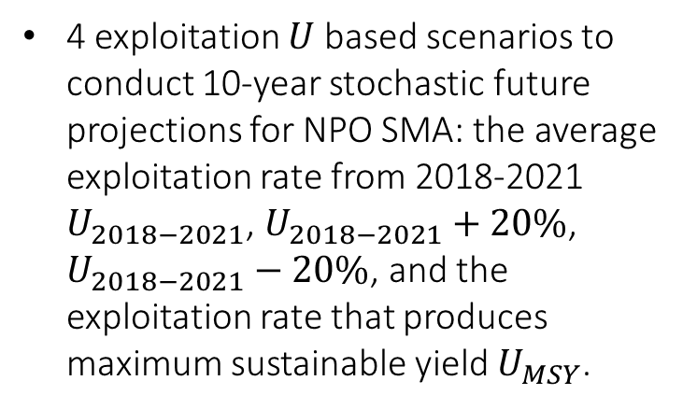
Projections
4 exploitation $U$based scenarios to conduct 10-year stochastic future projections for NPO SMA: the average exploitation rate from 2018-2021 $U_{2018−2021}$, $U_{2018−2021}+20\%$, $U_{2018−2021}−20\%$, and the exploitation rate that produces maximum sustainable yield $U_{MSY}$.

Slide 41
Conservation information
Future projections in three of the four harvest scenarios (U₂₀₁₈₋₂₀₂₁, U₂₀₁₈₋₂₀₂₁+20%, and U₂₀₁₈₋₂₀₂₁-20%) showed that median D in the North Pacific Ocean will likely (>50% probability) increase; only the U_{MSY} harvest scenario led to a decrease in median D.
Median estimated D of SMA in the North Pacific Ocean will likely (>50% probability) remain above D_{MSY} in the next ten years for all scenarios except U_{MSY}; harvesting at U_{MSY} decreases D towards D_{MSY} .
Model projections using a surplus-production model may over simplify the age-structured population dynamics and as a result could be overly optimistic.

Slide 42
Discussion: General remarks
Stock status is trending upwards, however understanding of status relative to MSY is based on aggregated population dynamics. Moving back into an age-structured modeling approach for the next assessment can more appropriately characterize the stock and population dynamics given the important age-structured dynamics observed for NPO SMA.
Data availability for shark assessments is a concern going into the future. Conservation measures and adoption of electronic monitoring may reduce the number of observed interactions and impact the ability to take biological samples. The CITES Appendix II listing also impedes sharing of biological samples between institutes. This all may impact the quality of data going into future assessments, and the ISC SHARKWG should adjust and plan accordingly in order to continue to provide stock status information.

Slide 43
Discussion: Challenges, limitations & uncertainties
As mentioned previously, the lack of age-structure is a limitation to the assessment given the important age-structured dynamics & the length of the model period relative to the population generation time.
There appears to be little information in the available data to estimate total population scale. Incorporating size composition information (in an integrated age-structured model) may not necessarily improve this given the strong likelihood of dome-shaped selectivity.
Catch is highly uncertain both historically (lack of species-specific data for sharks) and in the recent period (uncertainty in level of reporting of discards & associated mortality). Additionally, the Mexican artisanal catches make up an important component of recent catches and this is a challenging fishery to collect data from.

Slide 44
Discussion: Challenges, limitations & uncertainties
Model results are conditioned on the assumption that the indices are representative of the stock dynamics. However, there are reasons (lack of complete spatial coverage & lack of samples for the reproductive component of the population; likely due to dome-shaped selectivity) why that assumption may be violated.
Stock structure is uncertain in the NPO (is it a single well-mixed stock or do the distinct parturition sites engender more complex regional dynamics?) as is understanding of basic biological functions (age, growth and reproduction). Failing to properly account for uncertainty in these components could bias assessment outcomes and limit our understanding of the stocks productivity.

Slide 45
Discussion: Research recommendations
Future research is needed to resolve many of the highlighted uncertainties with the model and the input data. Research priorities include:
Scoping study to develop and evaluate a genetic sampling plan for close-kin mark-recapture (CKMR). CKMR could help resolve many issues related to population scale, information about the reproductive component of the population and stock structure.
Improving aging estimates and methods used for determining age
Improving catch estimates
Improve the spatial representativeness of the index (a joint spatiotemporal analysis of operational longline data)
Building on the BSPM and age-structured simulation by developing a Bayesian age-structured estimation model.
  If using an age-structured approach, standardize size composition data

Slide 46
Acknowledgements
Thank you to members of the of the SHARKWG for the collaboration that made this stock assessment possible.
Thank you also to non-working group members including Davies, N., Kim, K., Neubauer, P., and Soto, E.A for their valuable insights and contributions to discussions.
Thank you to the fisheries agencies and observers of ISC and non-ISC member countries for collecting and providing the data used in the current stock assessment.
Research to develop the age-structured simulation model, and estimation of bias correction was greatly facilitated using services provided by the OSG Consortium, which is supported by the National Science Foundation awards #2030508 and #1836650.

Slide 47
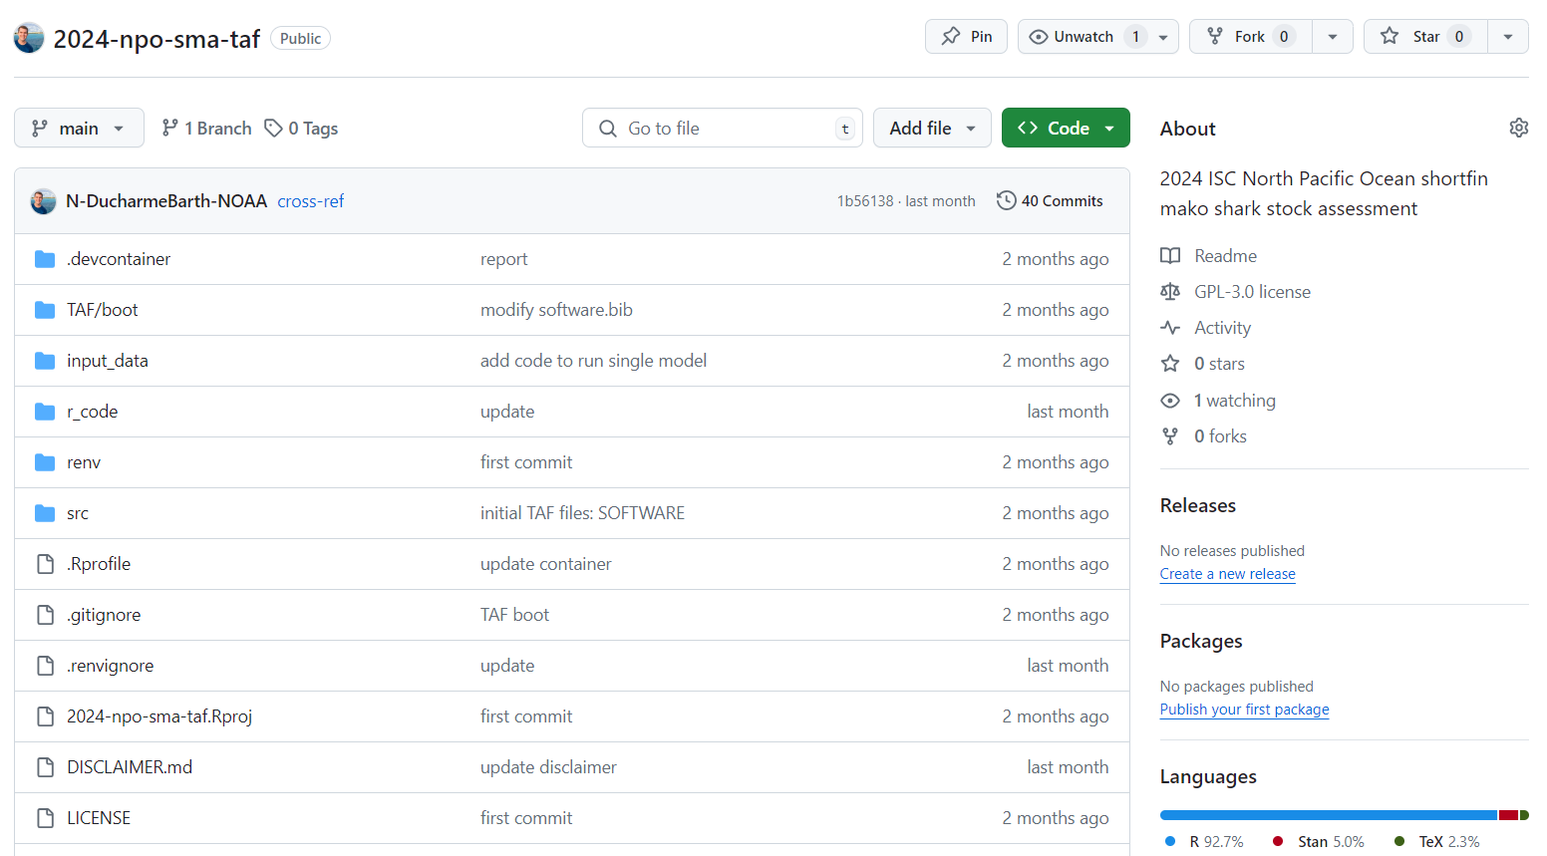
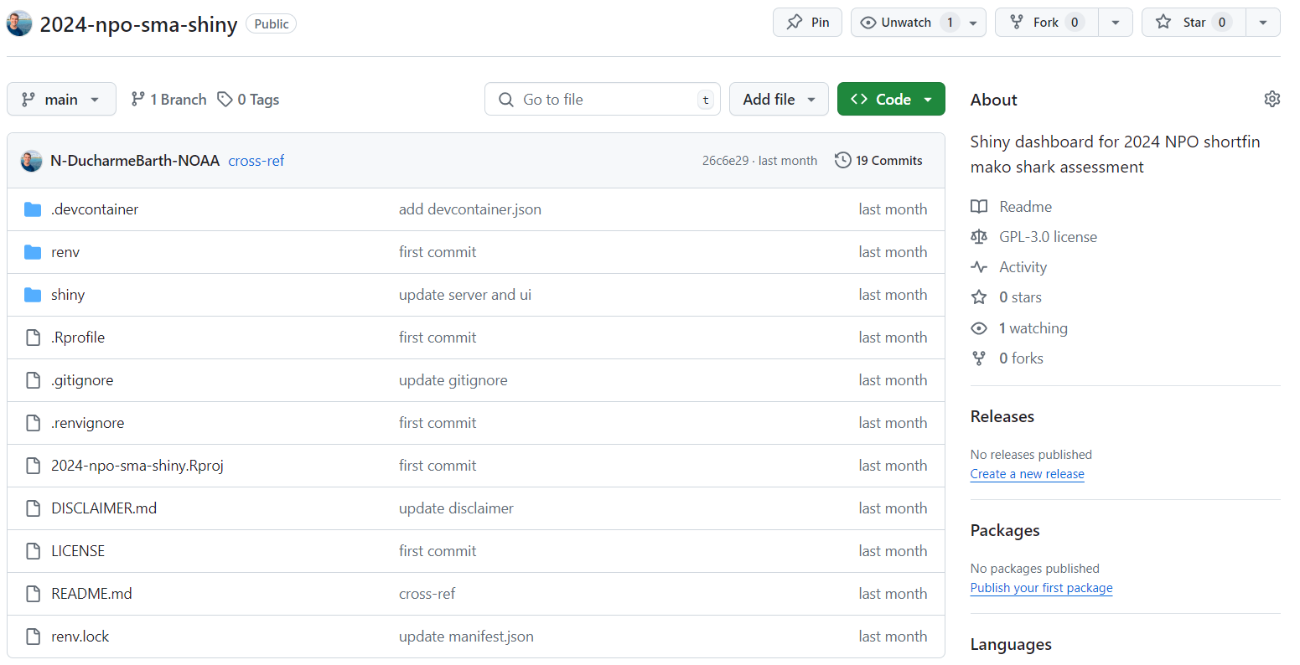
GitHub repositories
Model code and input data for replicating the model ensemble can be found at the 2024-npo-sma-taf GitHub repository: https://github.com/N-DucharmeBarth-NOAA/2024-npo-sma-taf
A Shiny dashboard displaying full diagnostics and estimated quantities for final models can be found at the 2024-npo-sma-shiny GitHub repository: https://github.com/N-DucharmeBarth-NOAA/2024-npo-sma-shiny

Slide 48
Extra slides

Slide 49
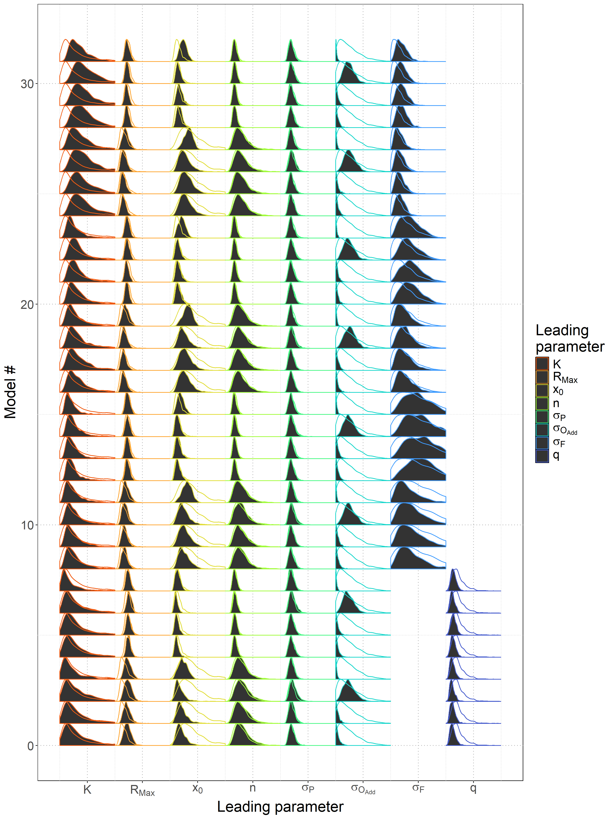
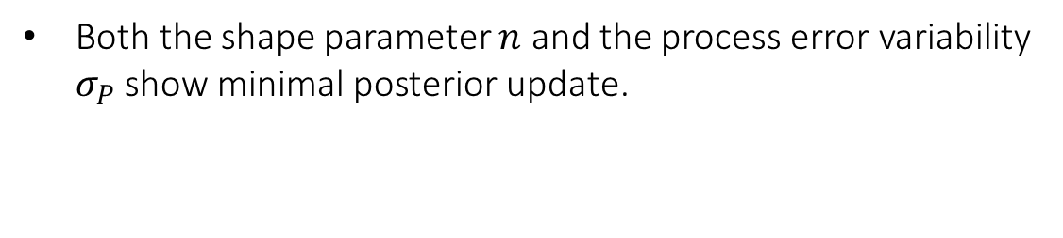
BSPM posterior updates
Both the shape parameter $n$ and the process error variability $σ_{P}$ show minimal posterior update.

Slide 50
BSPM posterior updates
Both the shape parameter $n$ and the process error variability $σ_{P}$ show minimal posterior update.

Slide 51
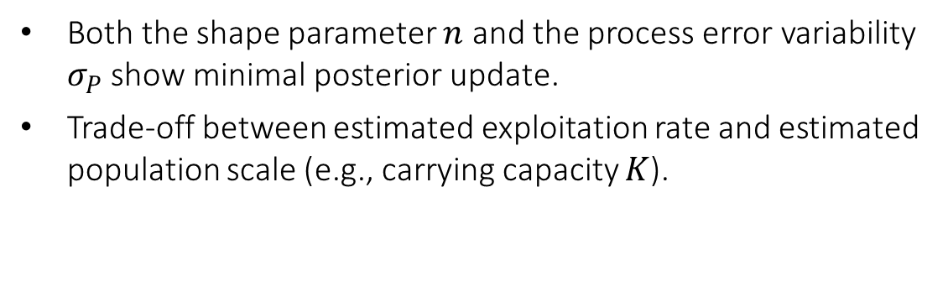
BSPM posterior updates
Larger scale; smaller exploitation rate
Both the shape parameter $n$ and the process error variability $σ_{P}$ show minimal posterior update.
Trade-off between estimated exploitation rate and estimated population scale (e.g., carrying capacity $K$).
Smaller scale; larger exploitation rate

Slide 52

BSPM posterior updates
Both the shape parameter $n$ and the process error variability $σ_{P}$ show minimal posterior update.
Trade-off between estimated exploitation rate and estimated population scale (e.g., carrying capacity $K$).
$R_{Max}$ estimated consistently with prior except for models with removals driven by longline effort and assuming the baseline level of prior filtering.

Slide 53

BSPM posterior updates
Both the shape parameter $n$ and the process error variability $σ_{P}$ show minimal posterior update.
Trade-off between estimated exploitation rate and estimated population scale (e.g., carrying capacity $K$).
$R_{Max}$ estimated consistently with prior except for models with removals driven by longline effort and assuming the baseline level of prior filtering.
Data supports a more depleted initial condition $x_{0}$relative to baseline prior.

Slide 54

BSPM posterior updates
Both the shape parameter $n$ and the process error variability $σ_{P}$ show minimal posterior update.
Trade-off between estimated exploitation rate and estimated population scale (e.g., carrying capacity $K$).
$R_{Max}$ estimated consistently with prior except for models with removals driven by longline effort and assuming the baseline level of prior filtering.
Data supports a more depleted initial condition $x_{0}$relative to baseline prior.
Substantial extra observation error $σ_{O_{Add}}$ is estimated in order to fit the Chinese Taipei index.

Slide 55
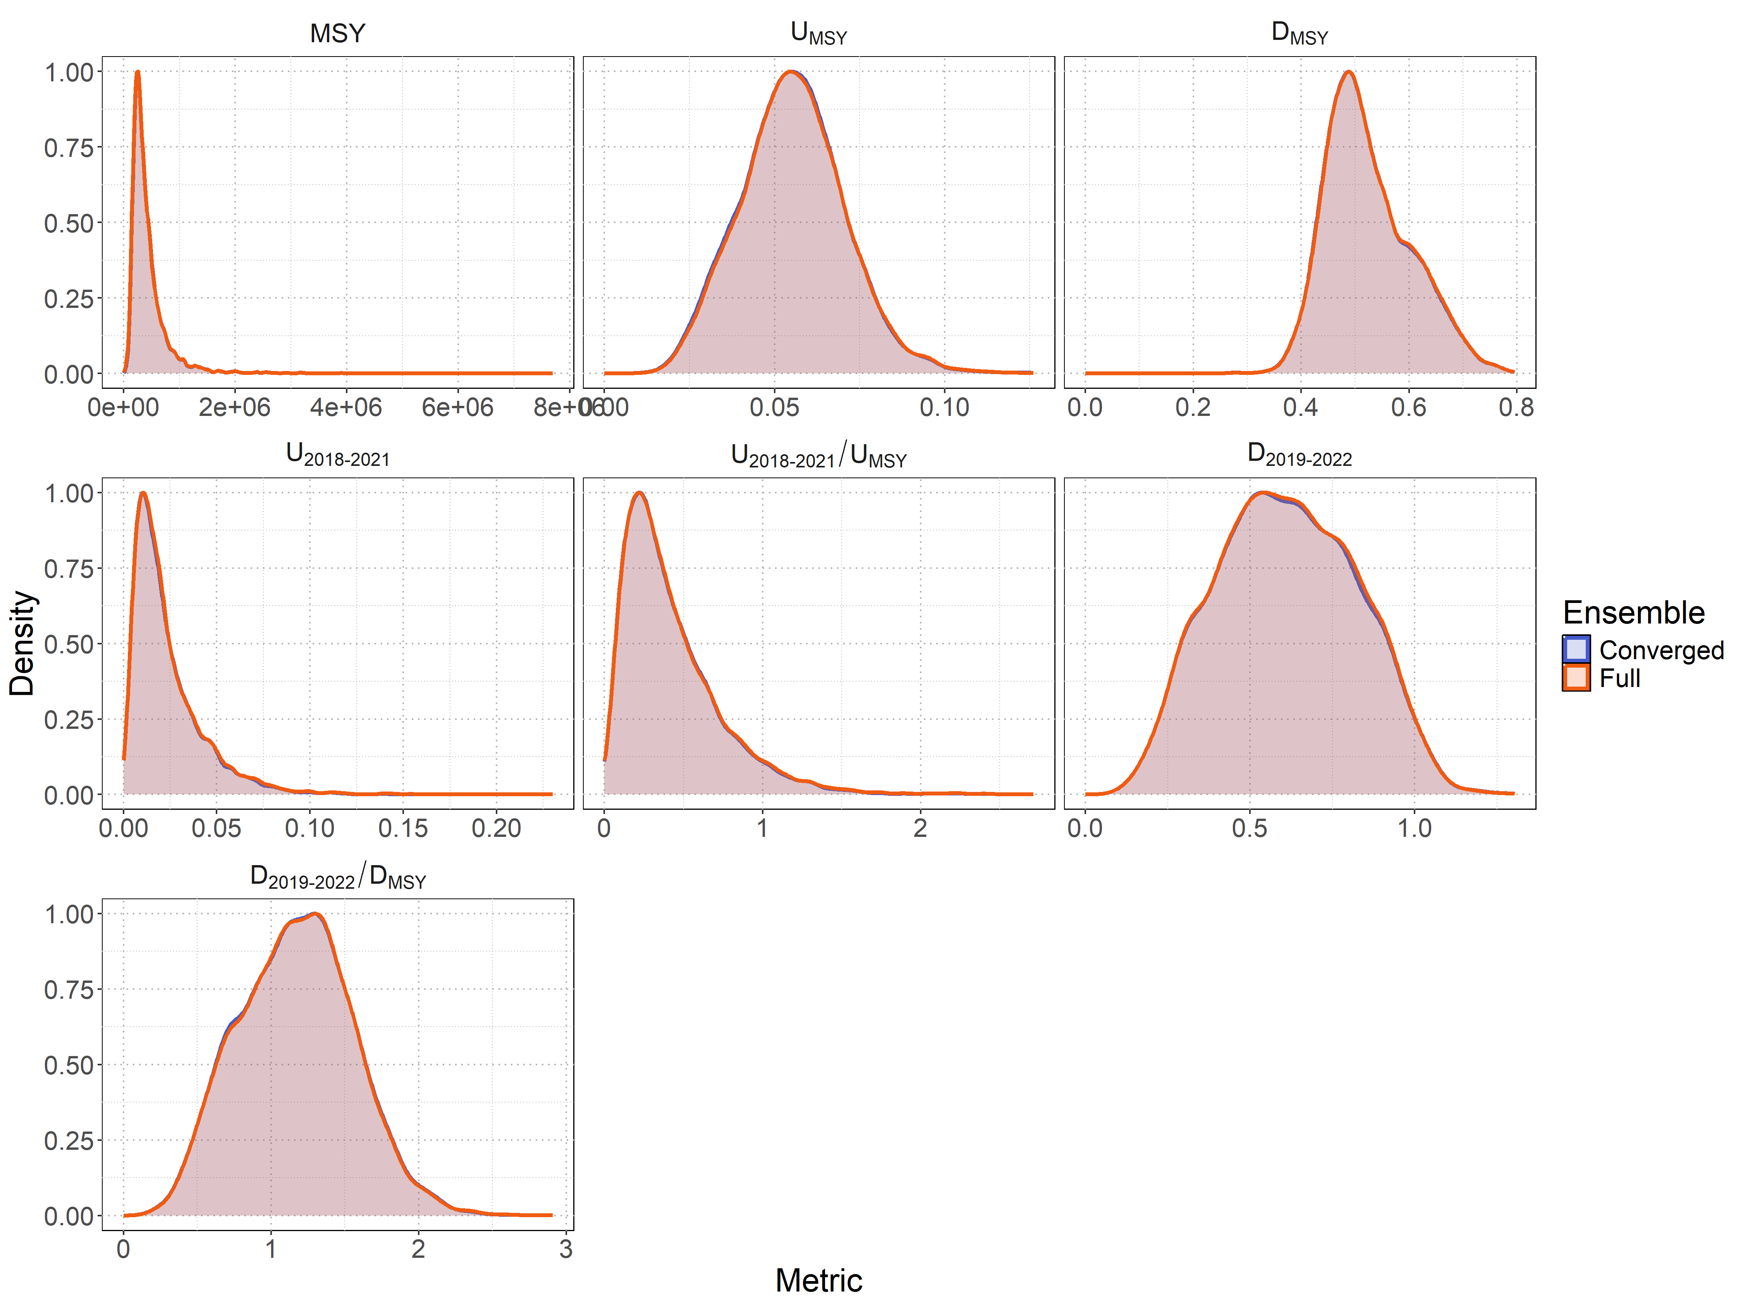
BSPM results
Excluding non-converged models (4 of 32) did not change distributions of management reference points

Slide 56
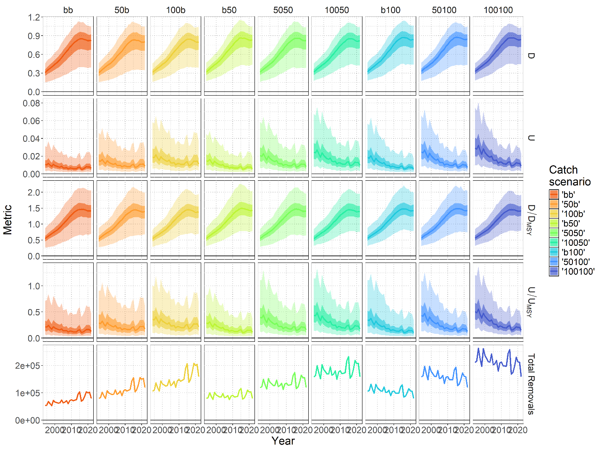
BSPM sensitivities
Additional sensitivities were investigated to look at the effect of:
  Treating catch as fixed
Estimates are stable across alternative fixed catch scenarios

Slide 57
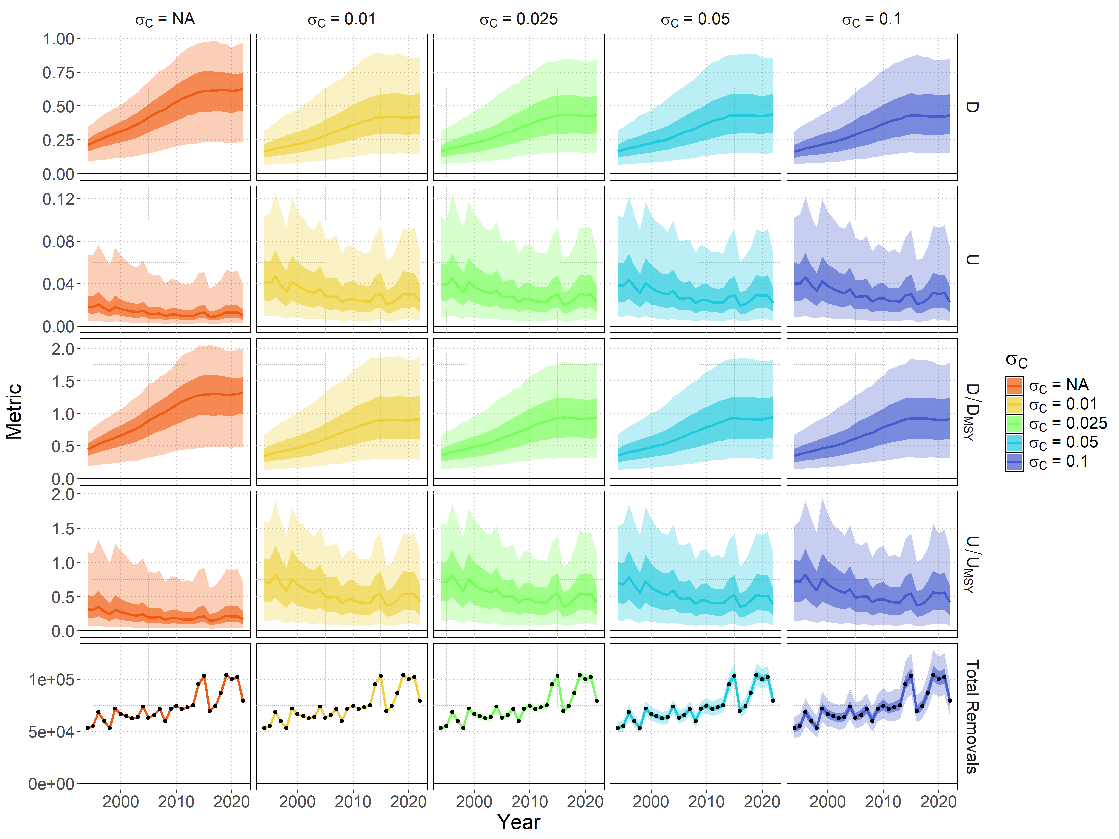
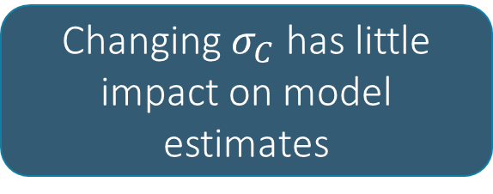
BSPM sensitivities
Additional sensitivities were investigated to look at the effect of:
  Treating catch as fixed
  Varying the level of error in the catch likelihood
Changing $σ_{C}$ has little impact on model estimates

Slide 58
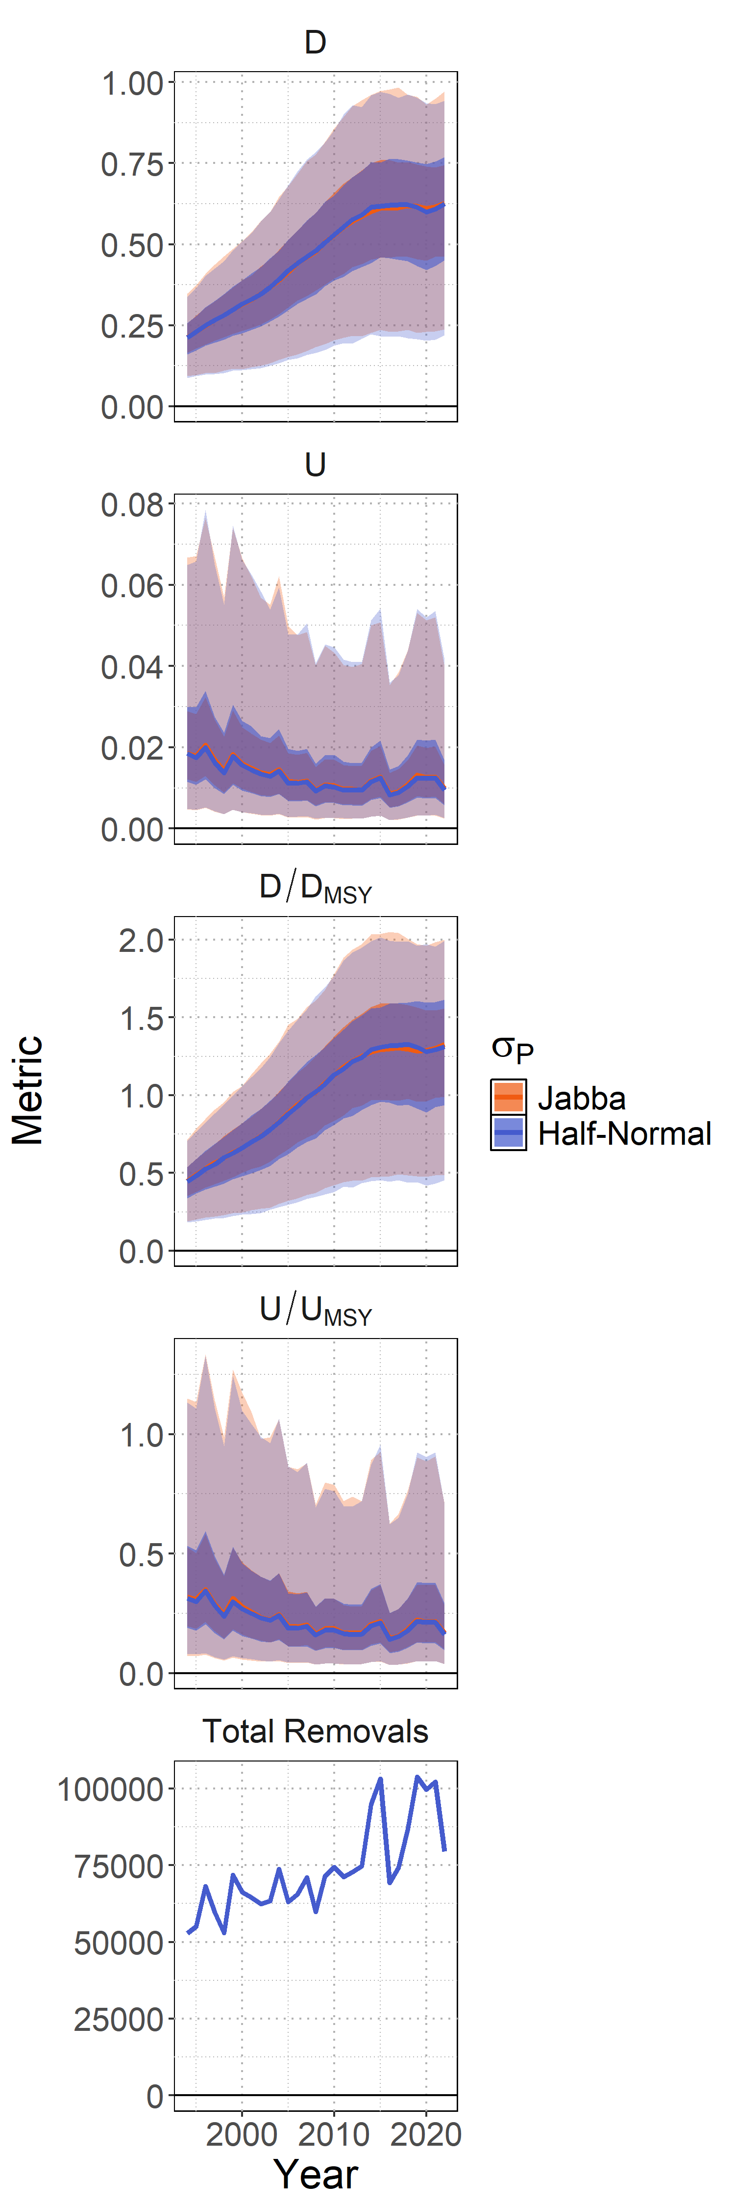
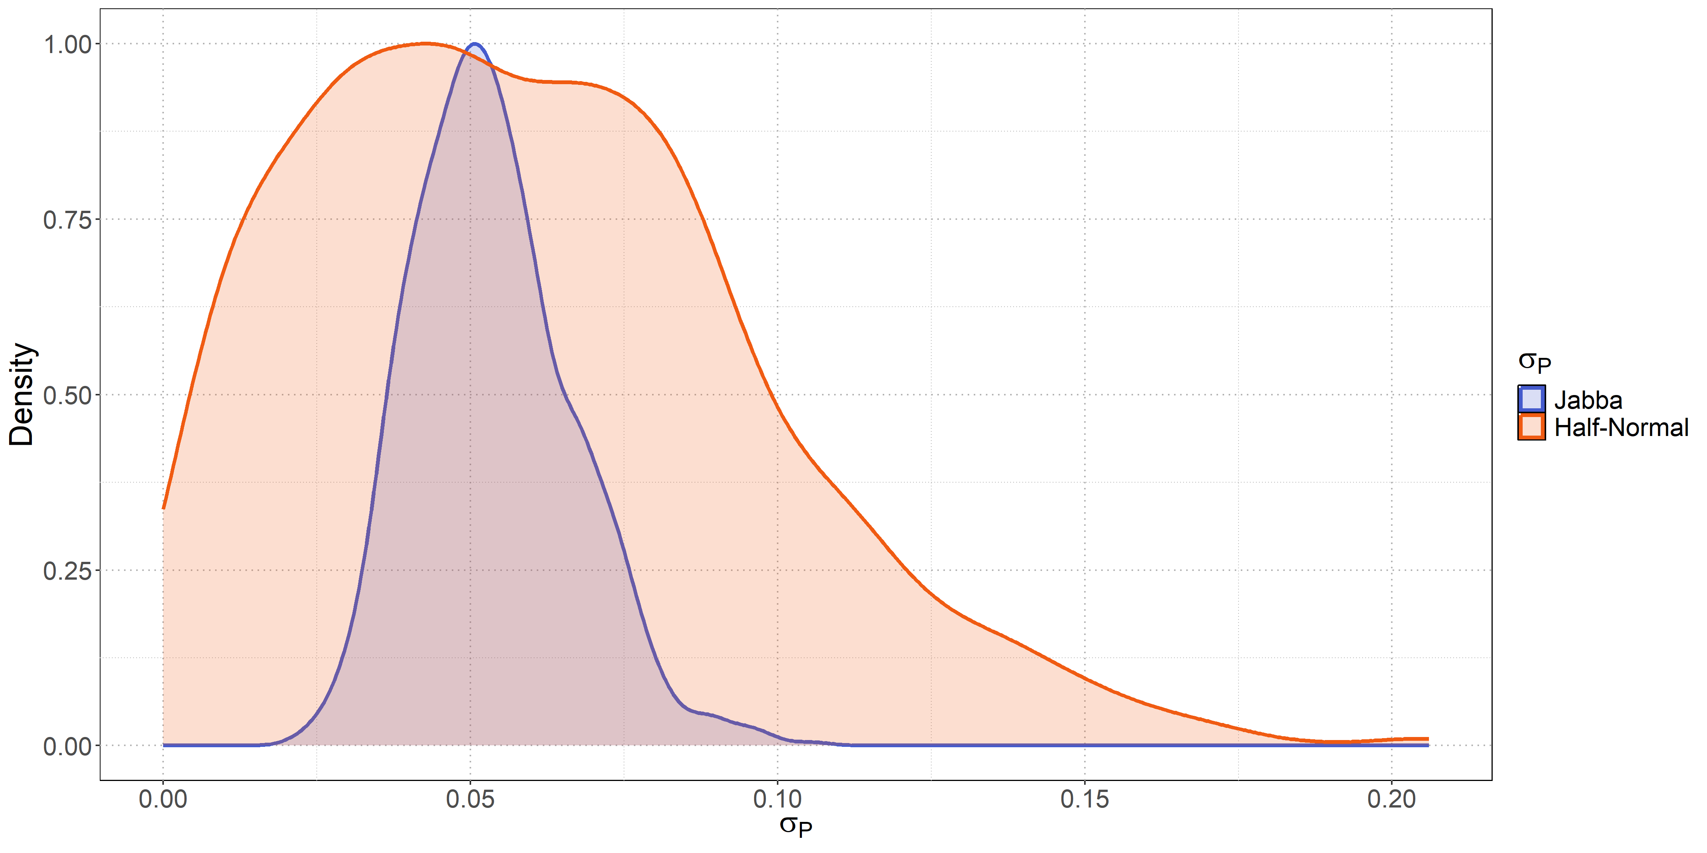

BSPM sensitivities
Additional sensitivities were investigated to look at the effect of:
  Treating catch as fixed
  Varying the level of error in the catch likelihood
  An alternative prior for $σ_{P}$
Posterior estimates with broader prior results in similar medians
Greater variability in the prior/posterior does not translate to greater variability in management quantities

Slide 59


BSPM sensitivities
Used in the ensemble
Additional sensitivities were investigated to look at the effect of:
  Treating catch as fixed
  Varying the level of error in the catch likelihood
  An alternative prior for $σ_{P}$
  Alternative CPUE indices

Slide 60

BSPM sensitivities
Used in the ensemble
Additional sensitivities were investigated to look at the effect of:
  Treating catch as fixed
  Varying the level of error in the catch likelihood
  An alternative prior for $σ_{P}$
  Alternative CPUE indices
    The SHARKWG did not consider indices 3, 7, 8, 9 and 10 to be representative or appropriate for the BSPM

Slide 61

BSPM sensitivities
Additional sensitivities were investigated to look at the effect of:
  Treating catch as fixed
  Varying the level of error in the catch likelihood
  An alternative prior for $σ_{P}$
  Alternative CPUE indices
    The SHARKWG did not consider indices 3, 7, 8, 9 and 10 to be representative or appropriate for the BSPM
Used in the ensemble

Slide 62

BSPM diagnostics
Estimates of leading parameters reasonably stable across retrospectives.

Slide 63

Projections
Retrospective projections were conducted, based on historical levels of longline fishing effort and high seas driftnet effort, to investigate likely historical trajectories of removals given estimated initial conditions in 1994.
Substantial levels of removals in the 1980s, most likely associated with the high-seas driftnet, were required in order to match the rebuilding trends implied by the 1994-2022 indices.

Slide 64

BSPM bias calculation
Concerns exist that the BSPM may over simplify stock dynamics given the long lag to maturity for mako shark (age at 50% maturity is 10+ years).
1000 representative simulations were conducted using a fully age-structured model, and 18 BSPM estimation models were fit to the simulated fisheries data from each population.
140 simulations were retained as they simulated indices that increased by at least 50%.
935 of the 2520 estimation models fit to the 140 simulated populations converged.
These models indicated that the ‘true’ simulated level of depletion, in terms of spawning output, was contained in the estimation model credible interval 97.2% of the time, and that on average the BSPM over-estimated depletion by 7.3%.

