Slide 1
Developing an estimation method for South Pacific albacore MI-WP-05 Scientific Committee Meeting Manila, Philippines 14-21 August 2024
SPC/OFP

Slide 2
Introduction
SC19 – presented results from testing estimation method for SPA (MI-IP-02)
Age-structured production model, implemented using Multifan-CL, (ASPM) performed better than other models
SC19 ASPM based on 2021 stock assessment for SPA
Concerns with the 2021 assessment
Updated for SC20 following 2024 stock assessment
Move to a catch-conditioned approach
Tested against a wide range of simulated data to evaluate performance

Slide 3
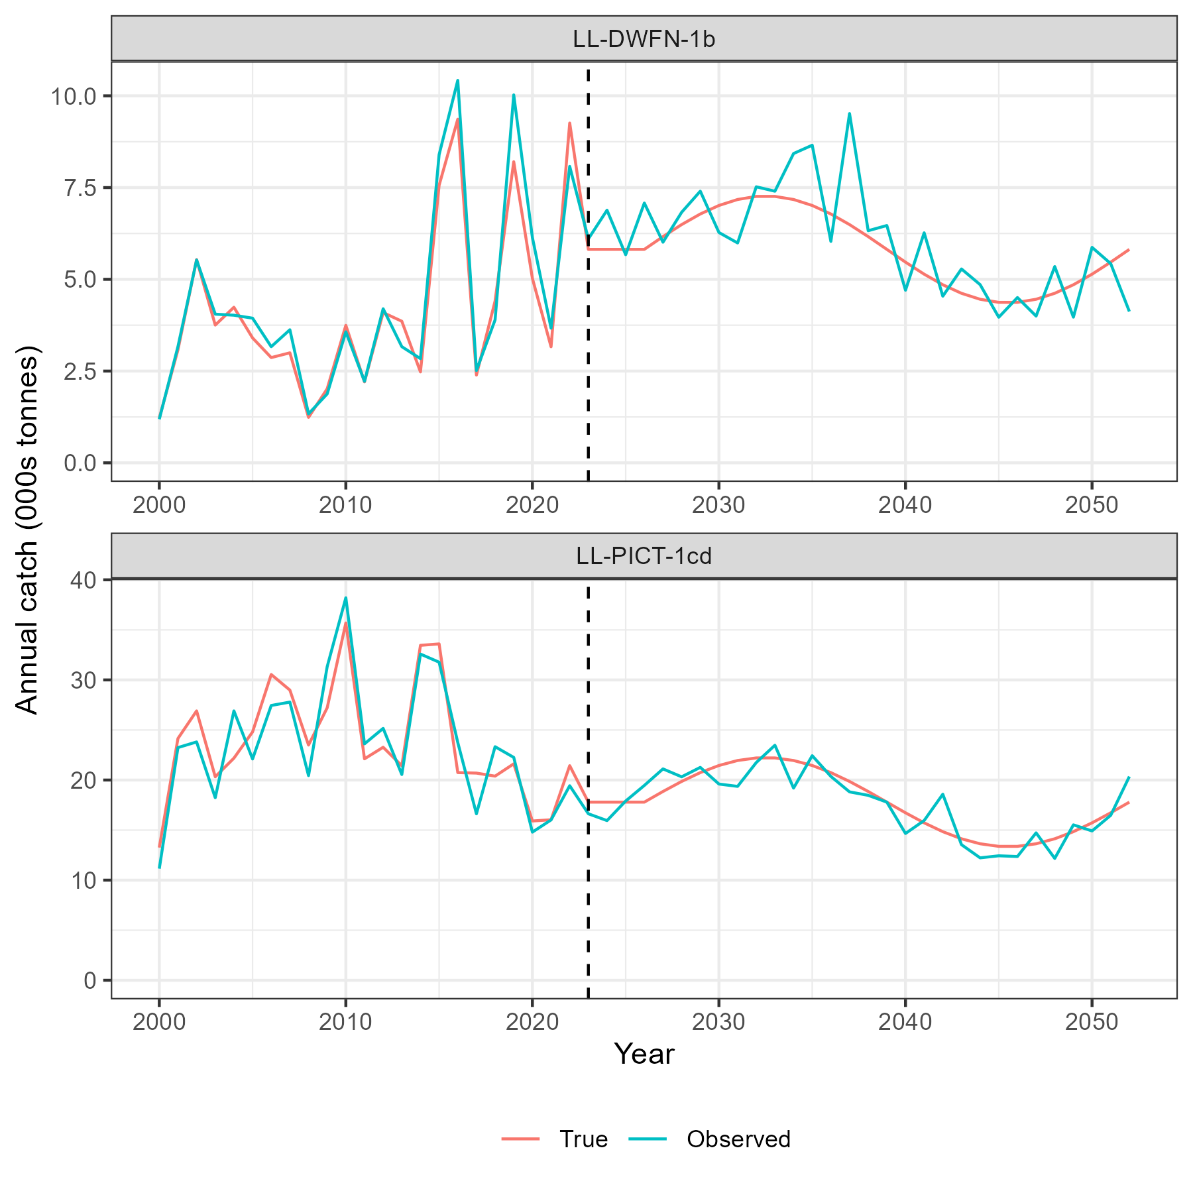
Generation of test data
30 year stochastic projections based on proposed OM grid (MI-WP-04).
Future catches set as sine wave (mean 2020-2020 catches +- 25%)
Include observation error on catch (extraction fisheries) and CPUE (index fisheries)
800 projections across the grid (60 failed due to overfishing)
Truncated time series to different final years in five year periods (up to 2007, 2012, 2017 … 2052)
Gave 7400 data sets on which to fit the ASPM

Slide 4
ASPM
Same model structure as 2024 stock assessment
Two model regions
17 extraction fisheries
3 index fisheries
No size data
Fix parameters to the ‘diagnostic’ case: selectivity, stock-recruitment relationship, movement, natural mortality, growth
Out of the 7400 ASPM fits, 480 models failed (failure rate of 6%).
Unstable population structure
Those that did fit converged well (max. grad. < 1e7)

Slide 5
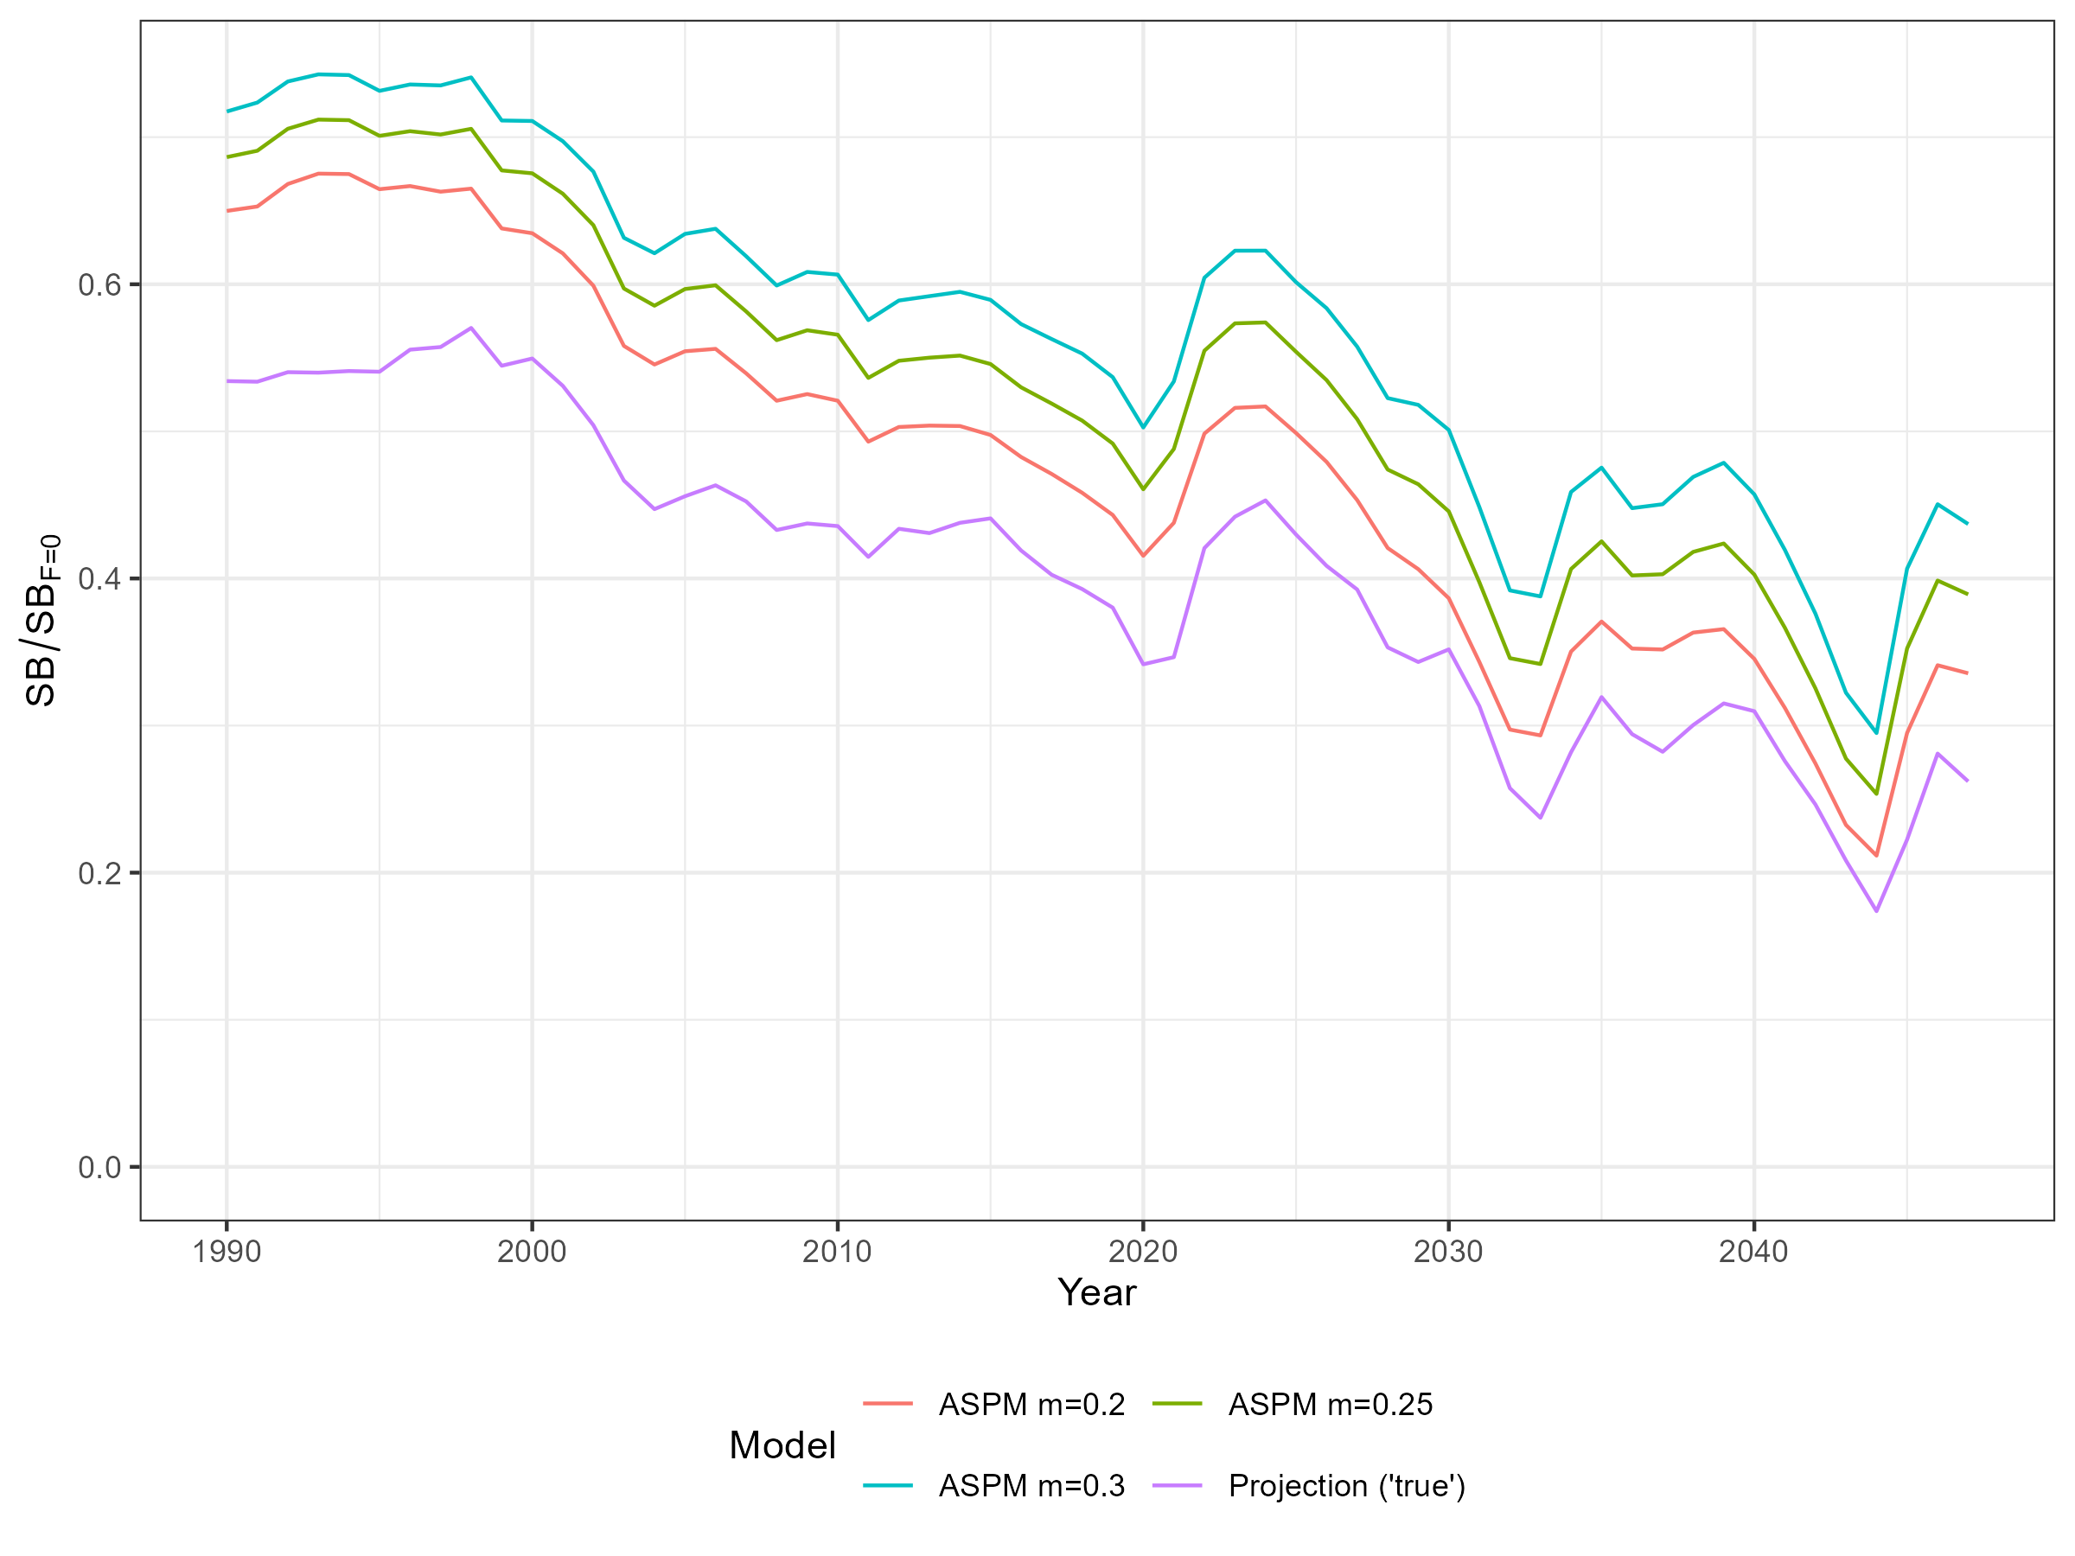
Impact of natural mortality
Natural mortality assumptions influence population scaling
ASPM – single model, single value of M
Expressing estimated stock status as relative to 2017-2019 reduces impact of choice of M in ASPM

Slide 6
ASPM performance
Compare ‘true’ value of stock status from projection to ASPM estimated value
Only interested in generating an input to the HCR, not on how well the whole time series is estimated
Different metrics calculated:
Terminal year SB/SB_{F=0}
Mean SB/SB_{F=0} of last three years
Mean SB/SB_{F=0} of last three years relative to 2000-2002
Mean SB/SB_{F=0} of last three years relative to 2017-2019
For two calculation of SB/SB_{F=0}
Instantaneous (SB_{y}/SB_{F=0,y})
Latest (SB_{latest} / SB_{F=0})
Relative metrics designed to overcome impact of uncertainty in natural mortality

Slide 7
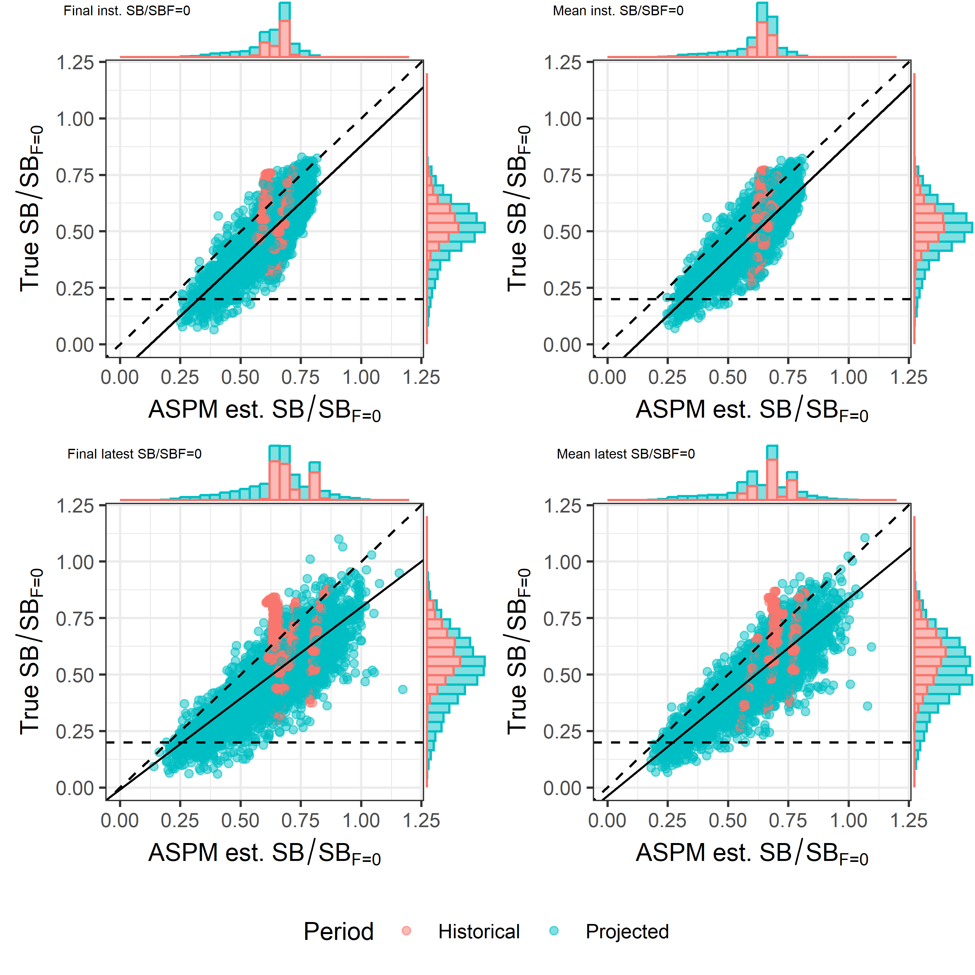
Absolute results
Comparing ‘true’ terminal SB/SB_{F=0} (from projections) to ASPM estimated terminal SB/SB_{F=0}
Solid line is from linear regression, dashed line is 1-1
Fairly noisy and tendency to overestimate stock status
Possible to correct for known bias through HCR
Metric | R-squared | Intercept | Slope
Final inst. SB/SB_{F=0} | 0.59 | -0.13 | 1.01
Mean inst. SB/SB_{F=0} | 0.63 | -0.13 | 1.02
Final latest SB/SB_{F=0} | 0.55 | -0.01 | 0.81
Mean latest SB/SB_{F=0} | 0.67 | -0.04 | 0.87

Slide 8
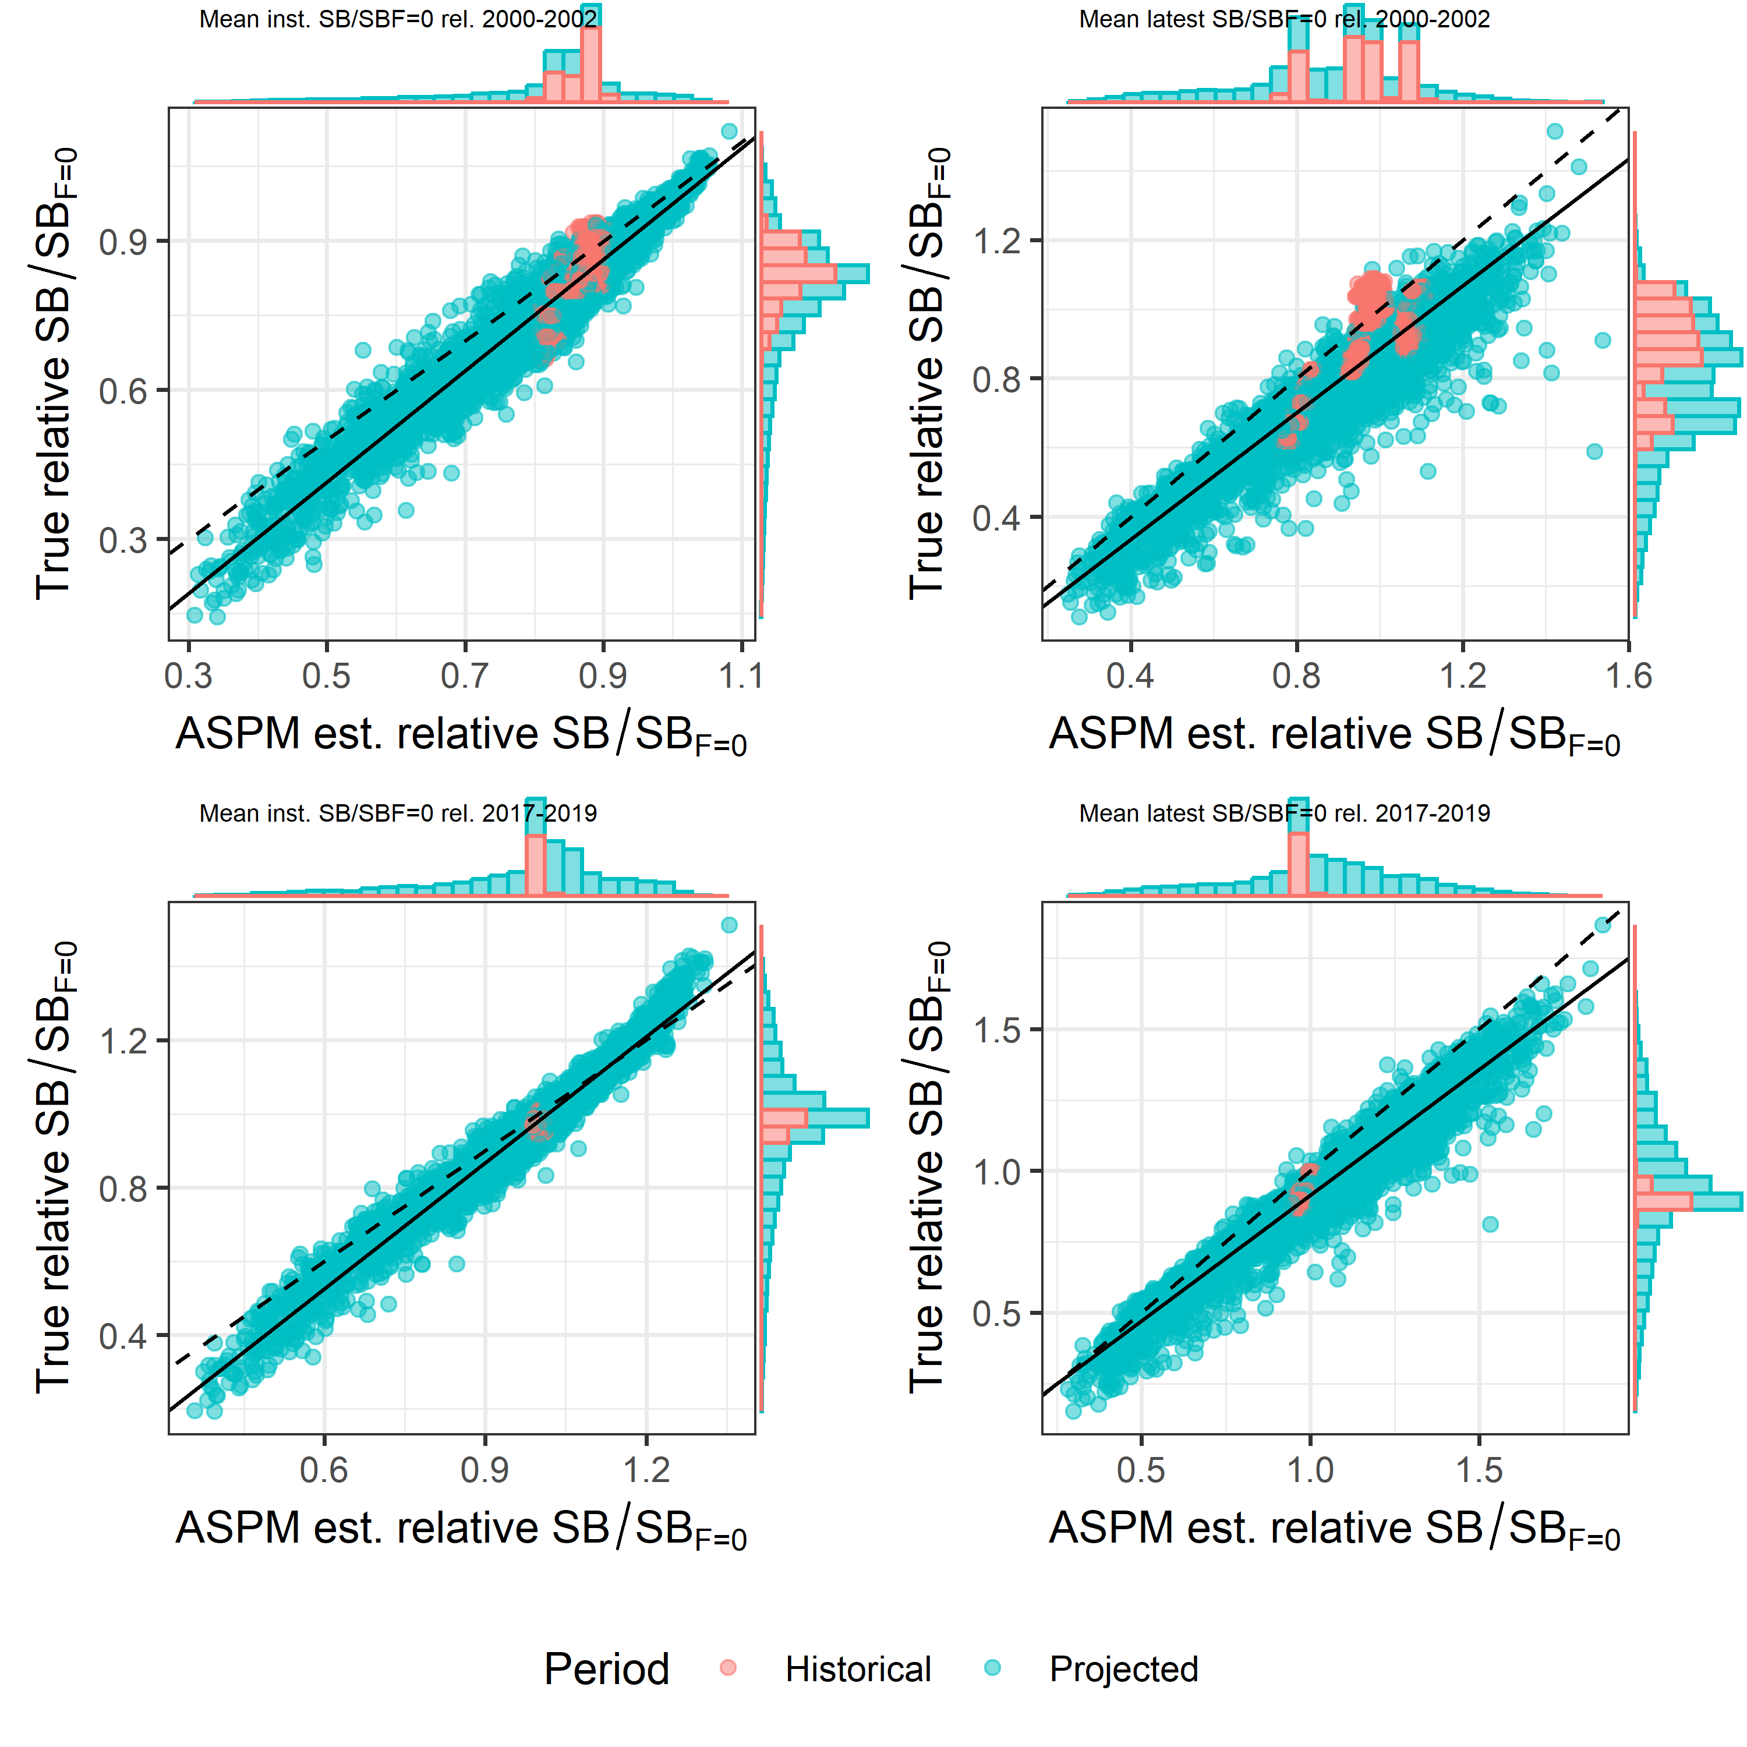
Relative results
True and ASPM estimated SB/SB_{F=0} relative to 2000-2002 or 2017-2019
2017-2019 has less historical data
Solid line is from linear regression, dashed line is 1-1
Reduced scatter and better agreement.
Metric | R-squared | Intercept | Slope
Mean inst. SB/SB_{F=0} relative to 2000-2002 | 0.92 | -0.15 | 1.12
Mean inst. SB/SB_{F=0} relative to 2017-2019 | 0.97 | -0.16 | 1.14
Latest inst. SB/SB_{F=0} relative to 2000-2002 | 0.83 | -0.03 | 0.92
Latest inst. SB/SB_{F=0} relative to 2017-2019 | 0.93 | 0.03 | 0.89

Slide 9
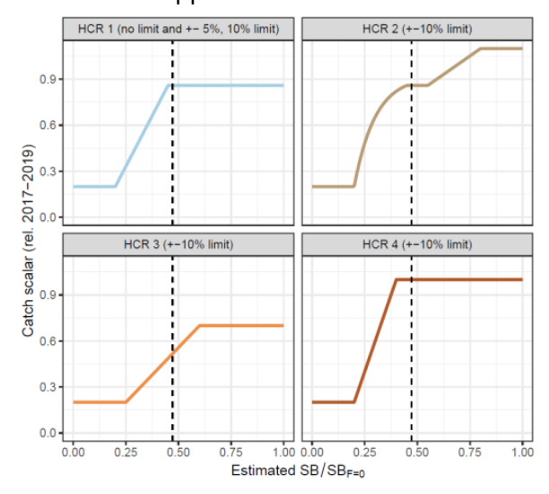
Next steps
Develop candidate MPs using estimation methods based on both absolute and relative measures of stock status.
The shapes of the harvest control rules in the candidate MPs can be adapted from those considered at WCPFC20.
Test the candidate MPs using an updated MSE framework, using the updated operating model grid.
Calculate and present performance indicators so that members may evaluate the relative performance of the candidate MPs and provide feedback.

Slide 10
Recommendations
Consider the results of the estimation method trials for the South Pacific albacore management procedure.
Endorse the use of the proposed ASPM as the estimation method for candidate management procedures.
Endorse the use of relative and absolute depletion metrics for input into candidate South Pacific albacore harvest control rules.

Slide 12
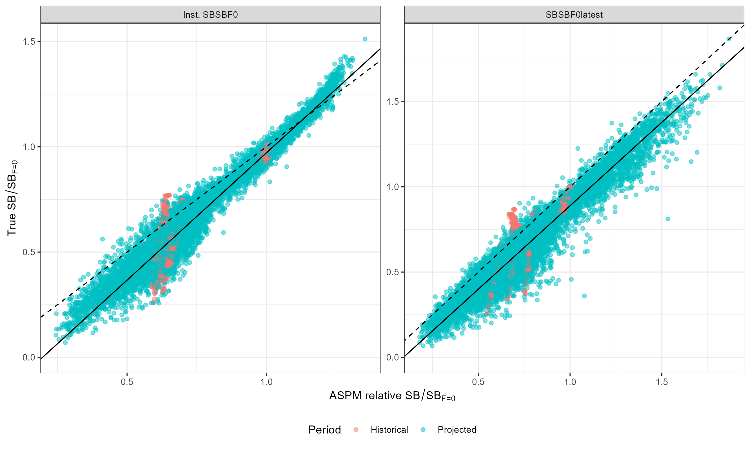
Bonus
Absolute true SB/SB_{F=0} against ASPM estimated relative SB/SB_{F=0} (2017-2019)

Slide 13
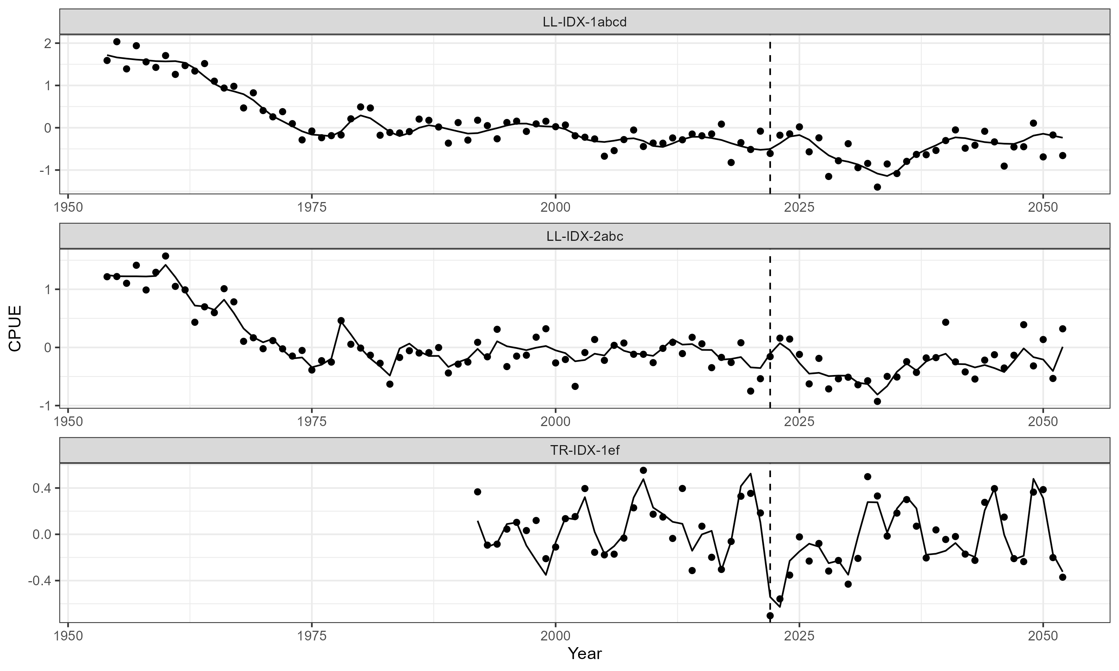
Bonus
Observed and predicted CPUE for the three index fisheries in the ASPM

