Slide 1
South Pacific albacore Operating Models MI-WP-04 Scientific Committee Meeting Manila, Philippines 14-21 August 2024
SPC-OFP

Slide 2
Testing management procedures
Under the harvest strategy approach, management action is determined by an agreed Management Procedure.
Need to test MPs beforehand to ensure they are likely to achieve objectives.
Operating Models – uncertainties against which management procedures tested

Slide 3
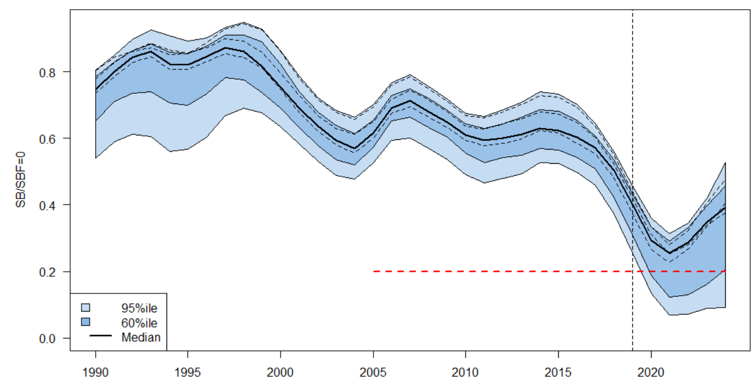
South Pacific albacore – Operating Models
Re-developing OMs based on 2024 assessment
given discomfort with the original 2021 OMs and the ‘big dipper’
2024 assessment
Catch conditioned model
2 regions – fisheries as areas
Similar fishery definitions
Revised CPUE indices
Updated biological assumptions

Slide 4
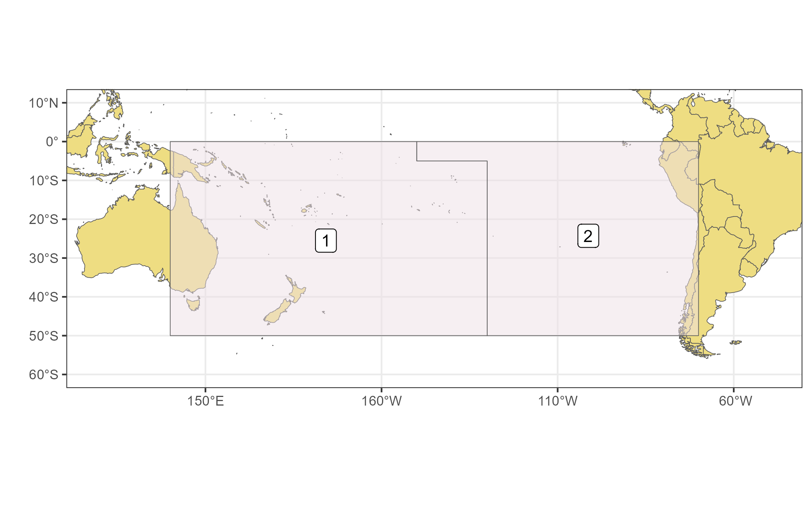
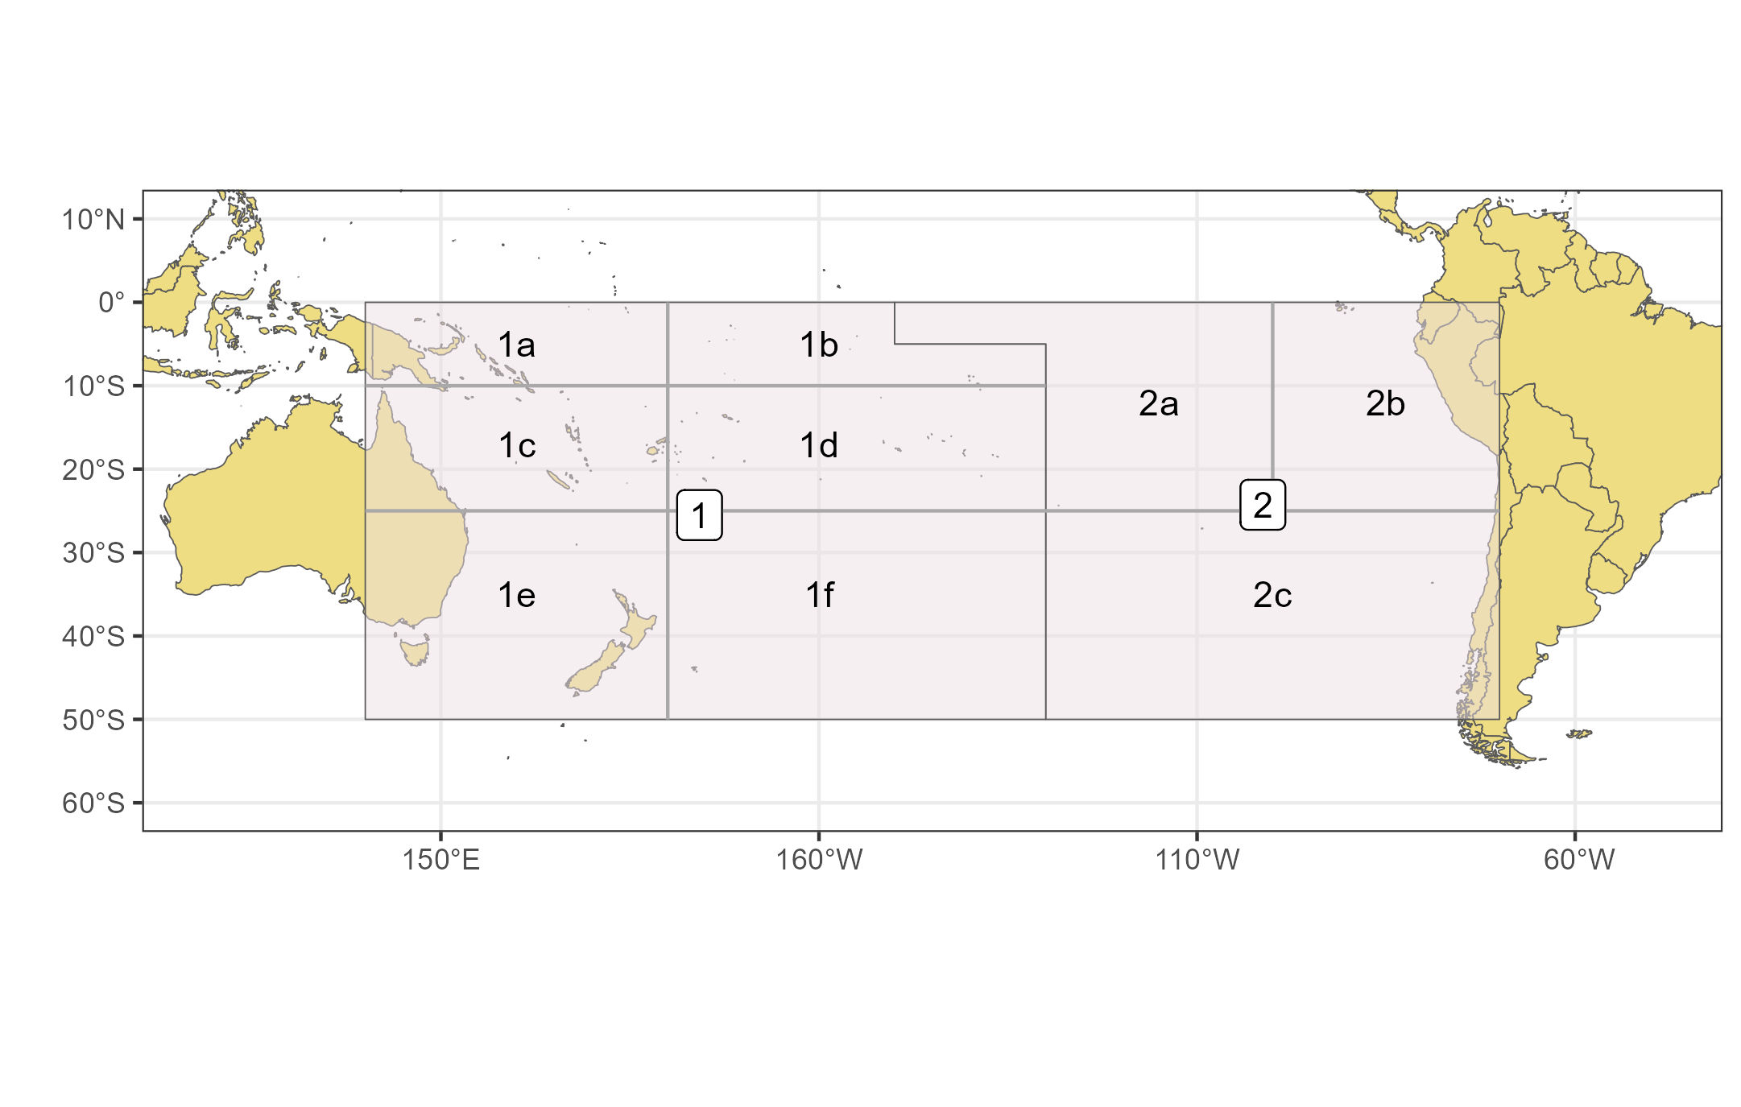
2024 SPA stock assessment
2 region model
17 extraction fisheries – fleets as areas
3 index fisheries
Movement rates determined from SEAPODYM
Recruitment distribution from SEAPODYM
Estimated growth model
Fixed maturity at length (mat at age varies with growth model)
Sampled natural mortality
Sampled steepness

Slide 5
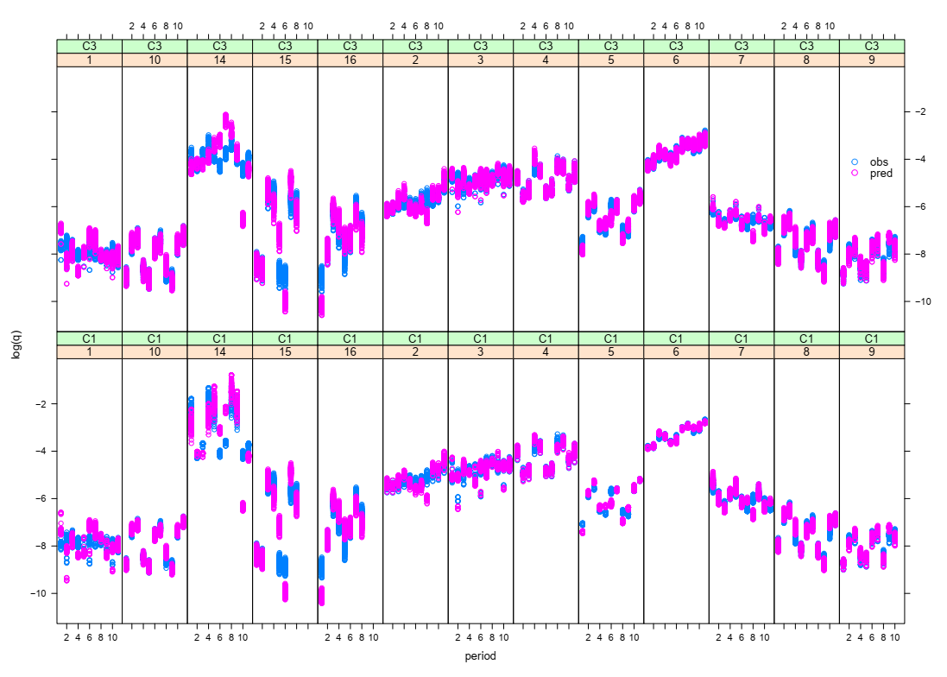
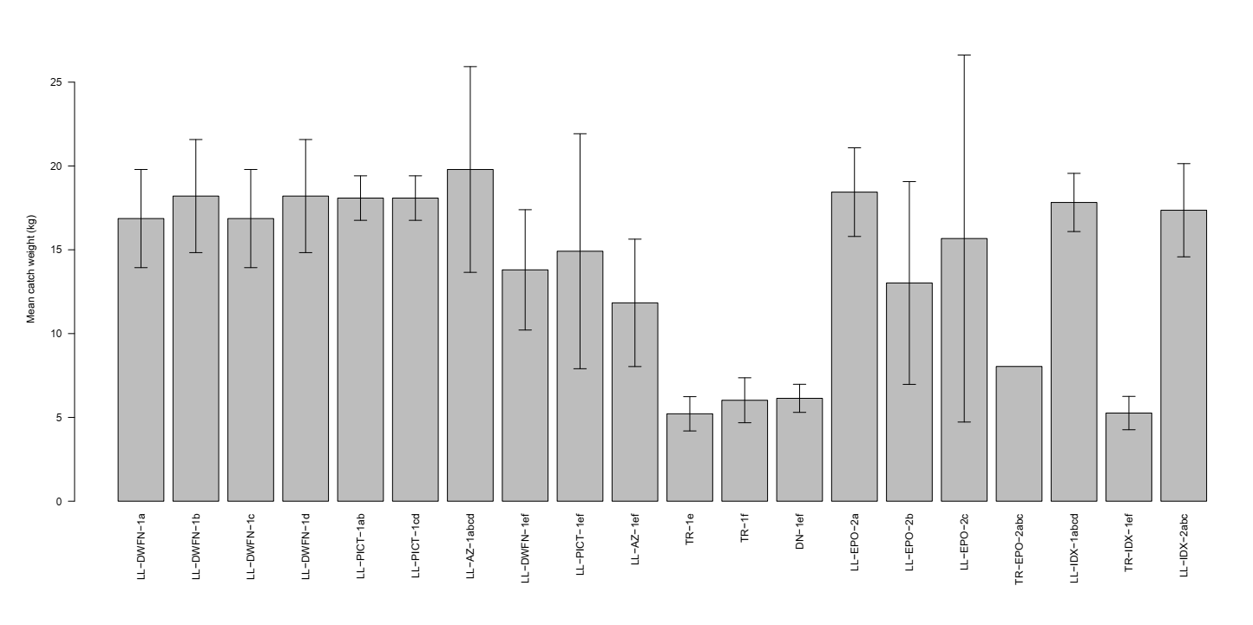
OM conversion
Catch in weight instead of catch in numbers
Quarterly time step assumed for all fisheries
Estimation of terminal catchability

Slide 6
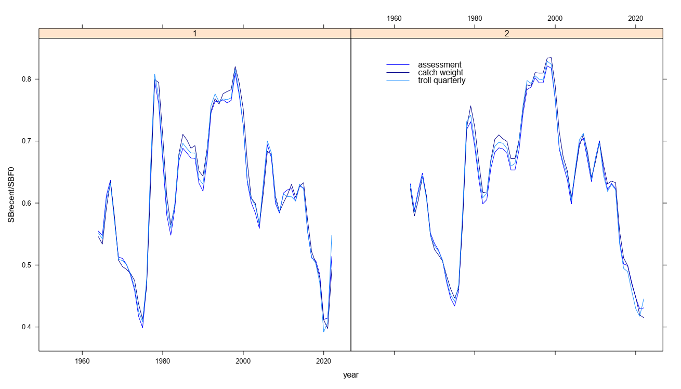
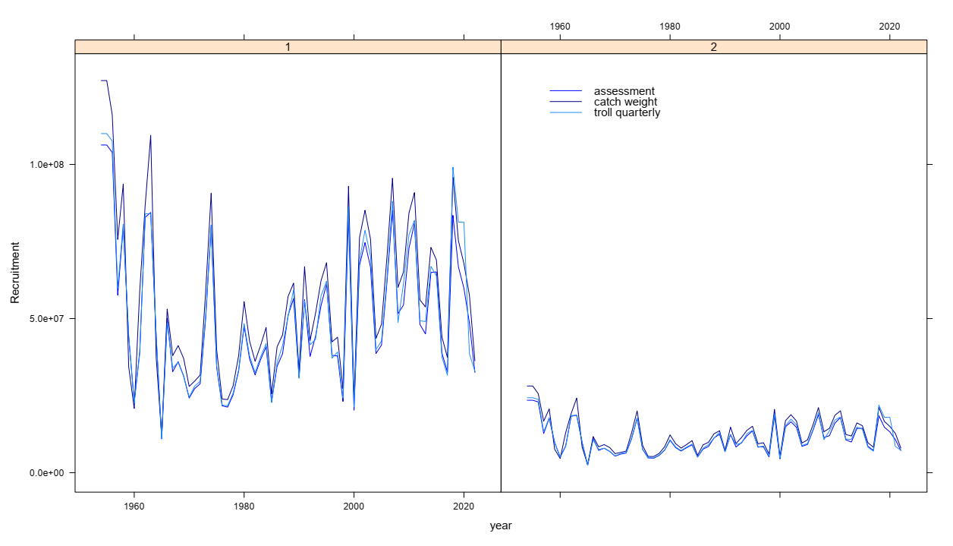
OM conversion
Catch in weight instead of catch in numbers
Quarterly time step assumed for all fisheries
fm regression pars estimated – terminal catchability
Stepwise approach – small changes in model outputs
WCPFC-CA
EPO
WCPFC-CA
EPO
Depletion
Recruitment

Slide 7
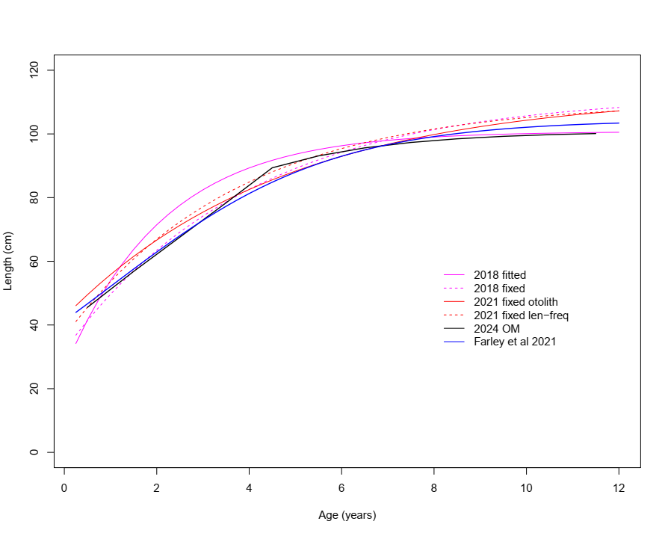
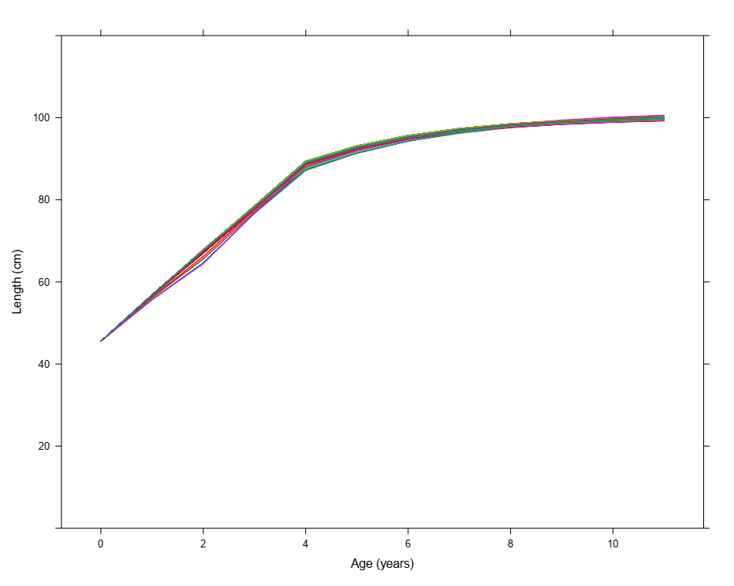
Growth – length at age
Fitted growth models for 2024 and previous assessments
Fitted growth – OM grid

Slide 8
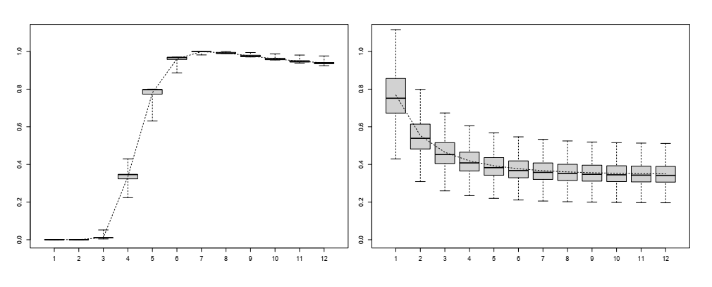
Maturity and natural mortality at age
Reproductive potential
Maturity at length fixed
Dynamically converted maturity at age
Natural mortality
Lorenzen (ages 4-12)

Slide 9
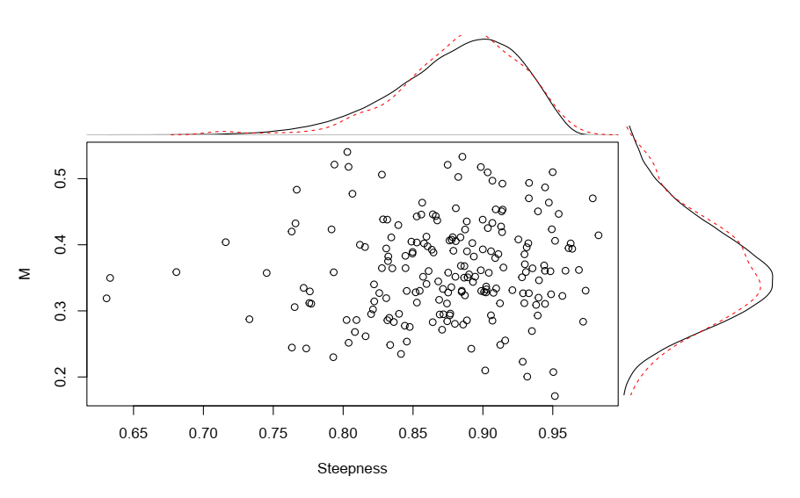
Natural mortality and steepness
200 samples of natural mortality and steepness (pairs) drawn from assumed distributions.

Slide 10
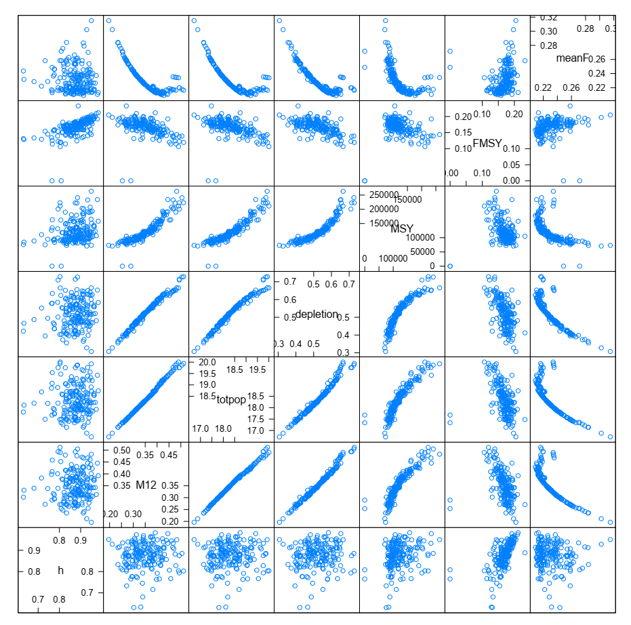
SPLOM
Scatter plot matrix of steepness (h) and natural mortality (M12) inputs and corresponding model estimates of :
Total population scaling parameter
Terminal depletion (SB/SBF=0)
MSY
F/FMSY
Terminal depletion highly correlated with assumed value of natural mortality.

Slide 11
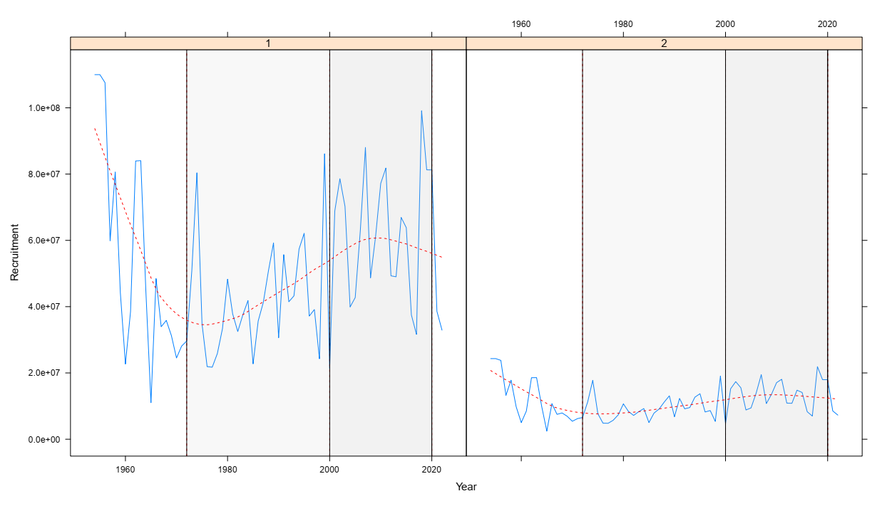
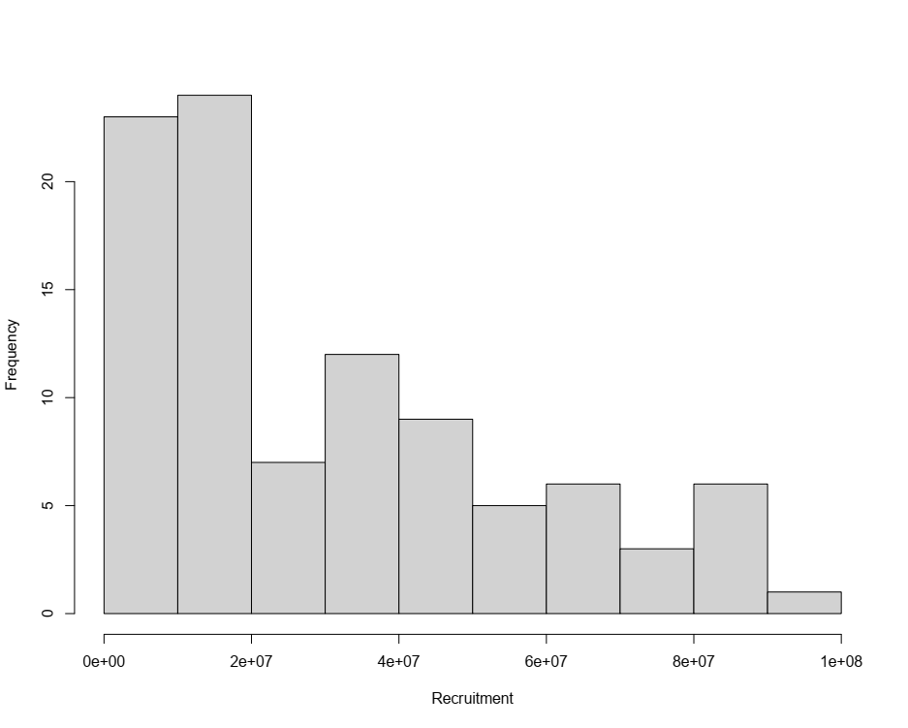
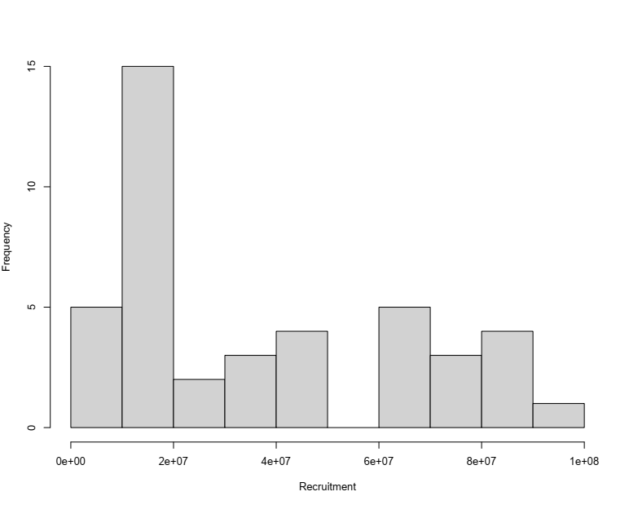
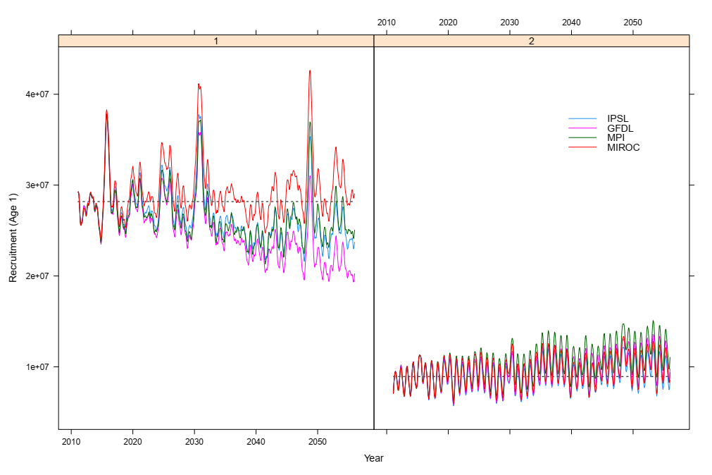
Future Recruitment
1973-2020
2000-2020
Recent recruitment above average
Unclear whether high recruitment will continue
Two recruitment scenarios included
1973-2020
2000-2020

Slide 12
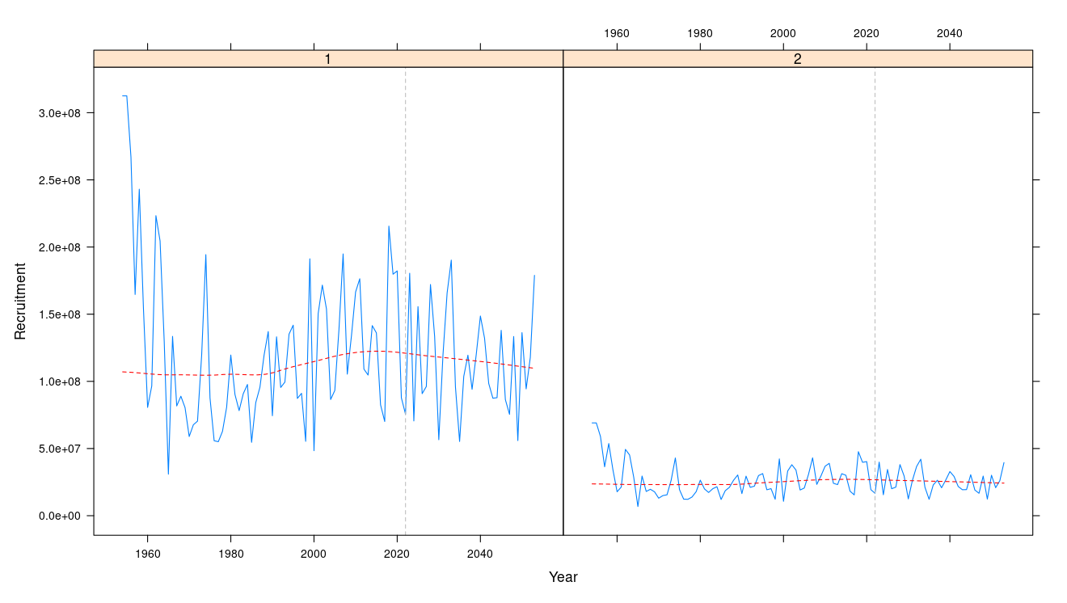
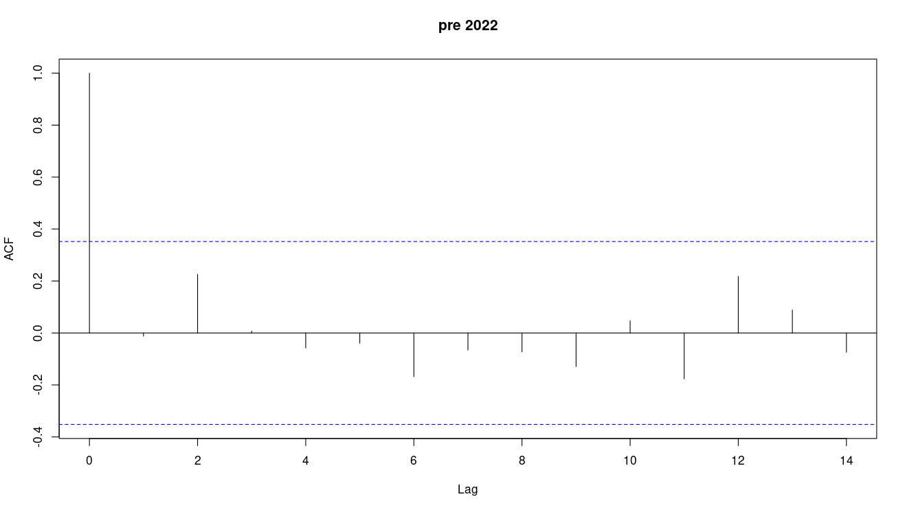
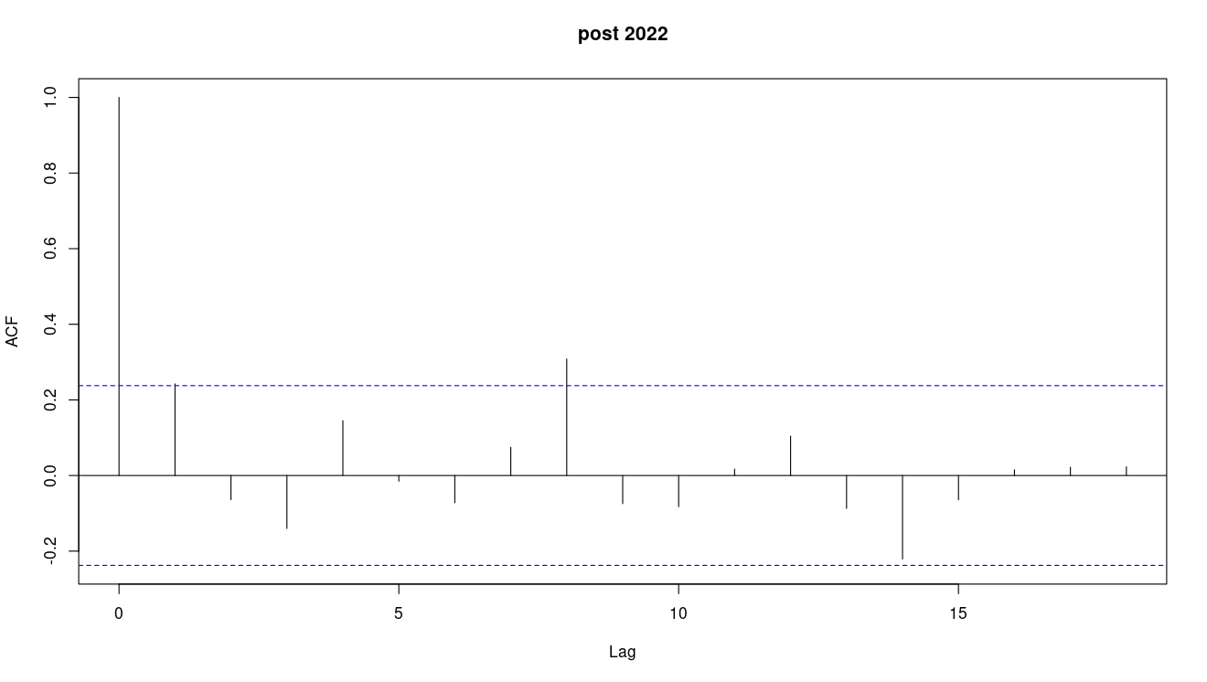
Future Recruitment - autocorrelation
Pre 2022
Post 2022
No indication of significant autocorrelation in the residuals of the de-trended recruitment time series for the WCPO

Slide 13
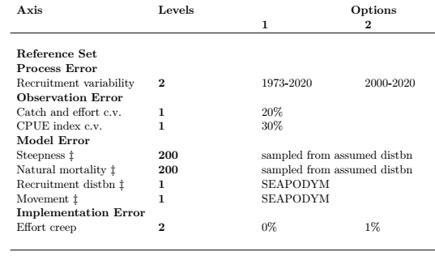
SPA OM Grid

Slide 14
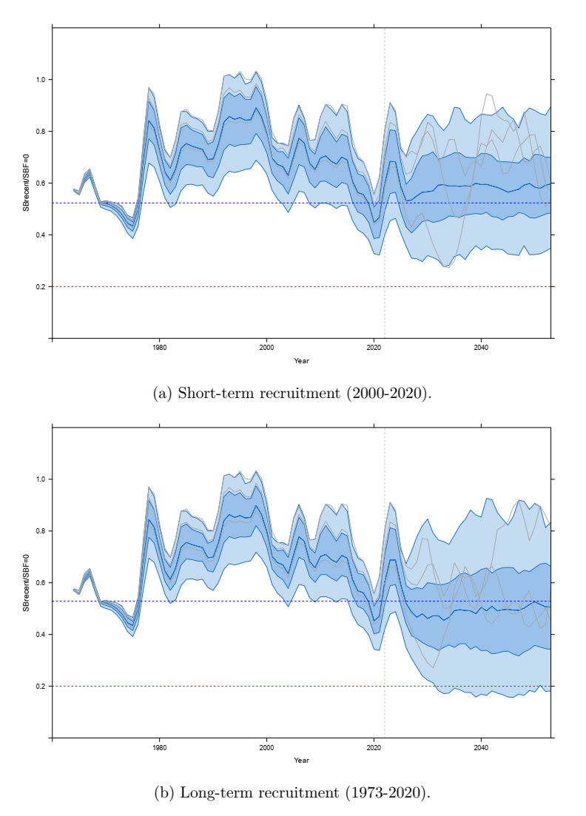
SPA management procedure – OMs
Recruitment assumptions most influential
Impact of catch in weight conversion
small change to average terminal depletion
increased risk of falling below LRP.
Revised OMs more consistent with the stock assessment.
Updated projections show similar results to TRP analyses.
Slightly higher risk of falling below LRP

Slide 15
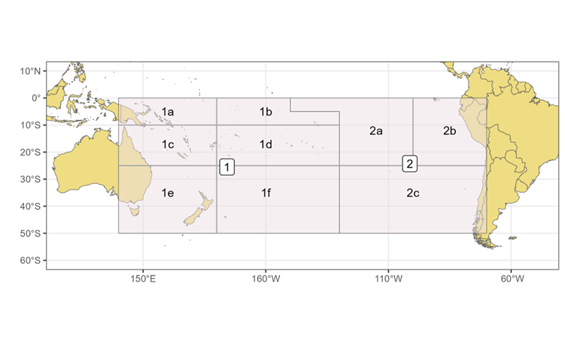
SPA management procedure - OMs
Robustness set
‘Low recruitment’ scenario
Higher level of effort creep
Alternative EPO catch level assumptions
Ongoing investigations
CPUE and hyperstability
Climate change scenarios

Slide 16
Recommendations
advise whether the sources of uncertainty included in the OM grid are sufficient and if any further scenarios should be considered
advise whether the ranges of parameter values adequately reflect our uncertainty in stock dynamics.
and to note:
OM grid represents range of plausible scenarios against which candidate MPs can be tested.
It should not always be necessary to update the suite of operating models each time a new assessment is conducted. Any changes to the OM grid should be considered as part of an agreed monitoring strategy.
The grid of models outlined in this report form the basis of the evaluations of candidate MPs for south Pacific albacore detailed in WCPFC-SC20/MI-WP-06

