Slide 1
WCPO skipjack MP estimation method: planned approach
MI-WP-02
Scientific Committee Meeting
Manila, Philippines
14-21 August 2024
SPC-OFP
August 2024

Slide 2
Reminder – estimation method
Key part of the Management Procedure
  Data collection
  estimation method
  HCR
Provides a ‘fixed’ approach to estimating stock status to feed into the HCR
WCPO skipjack EM:
  fixed implementation of MULTIFAN-CL (~2019 diagnostic case model)
2023 Monitoring strategy report flagged an issue
  Reduced pole and line effort in tropical regions

Slide 3
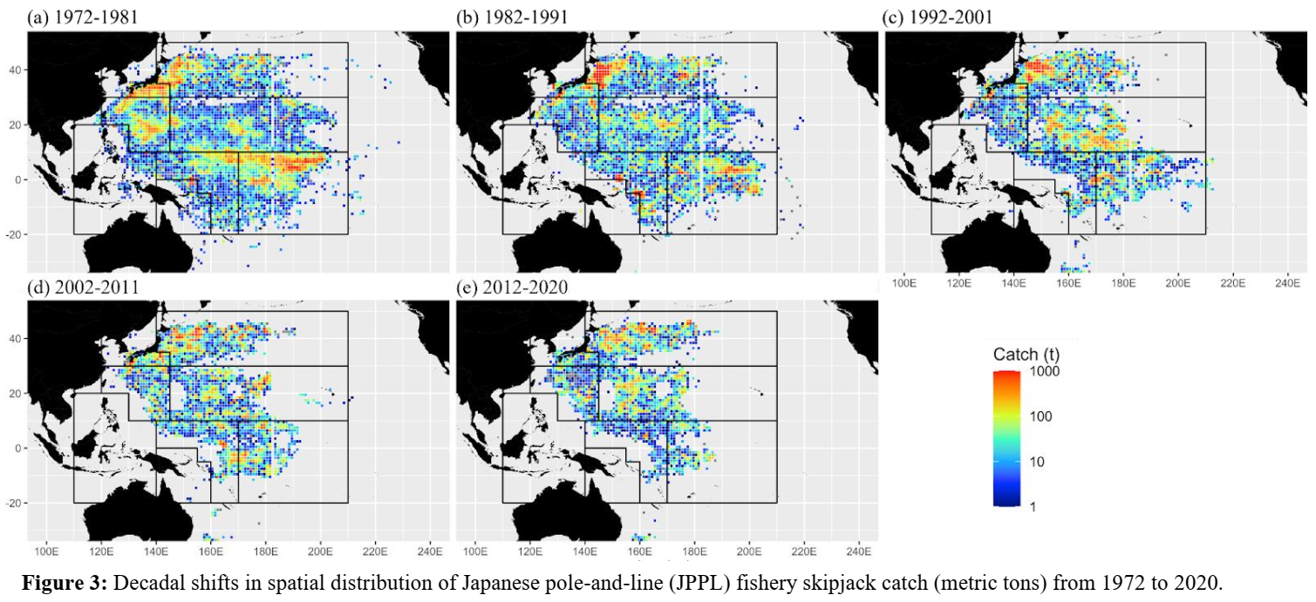
Issue – tropical P&L input data

Slide 4
Solutions
2022 assessment shifted to PS-based tropical index
  Unassociated set data only
In conjunction: catch-conditioned model
  Much faster
Examine alternative platforms
  In past have struggled due to tagging data
  Updates may have improved performance
Evaluate tag-based models
  Key data for SKJ
  Note recent experience that multiple data sources may be better

Slide 5
General notes
Better to ensure OMs and EM are ‘different’
  Avoids overly positive performance
Updates to historical data
  Routine updates of data and re-estimation of time series in CPUE series
  Not as tested in the MSE
  Need to detail differences more clearly, and investigate for potential exceptional circumstances

Slide 6
Work plan
Investigation of alternative modelling approaches
  Focussed specifically on the estimation method
Re-test management procedure
  Data collection, estimation method, HCR – MP package
  Ideally no change to HCR
  Data inputs to the estimation method may change depending on adopted approach.
No change to Operating Models
  OM grid remains as currently specified.
No change to Management Objectives

Slide 7
Timeline
Year | Meeting | Proposed input | Notes
2024 | SMD2 | Discussion of relevant SC20 outcomes
2025 | SC21 | Performance of alternative EMs presented to SC and advice provided | New SKJ assessment is scheduled for this meeting
 | WCPFC22 | Commission agreement of updated MP and update of CMM 2022-01 Annex 2.
2026 | SC22 | Implementation of 2nd running of the MP and provision of advice.
 | WCPFC23 | Actions as per para 8 of CMM 2022-01

Slide 8
Recommendations
Consider and provide advice on the options provided for re-examining the WCPO skipjack MP estimation method; and
Consider the proposed timeline for that re-examination.

