Slide 1
ISC24 Activities Since SC19
John Holmes and Robert Ahrens
ISC Chair and Vice-Chair
https://isc.ac.affrc.go.jp
SC20
August 14-21, 2024
Manila, Philippines

Slide 2
Outline
Stock status & conservation information
  New assessments:
    Pacific Bluefin Tuna – SC20 Agenda #4.3.1
    Shortfin Mako Shark – SC20 Agenda #4.5.3
  Existing information:
    NPO ALB, WCNPO MLS, NPO SWO, BUM, NPO BSH
Responses to requests for scientific information
  Includes projections to support WCNPO MLS rebuilding plan – SC20 Agenda #4.4.2.2
WCNPO MLS external peer review process – SC20 Agenda #4.4.2.1
Incorporating Climate Change Information into Stock Assessment Information and Advice
ISC Chair and Vice-Chair Election Results

Slide 3
Other Species – Forwarding ISC23 Information
Stock | Last Assessment | Reference Points | Stock Status
NPO ALB | 2023 | Yes | Not overfished, not experiencing overfishing relative to dynamic SSB₀ reference points
BSH | 2022 | No | Not overfished, not experiencing overfishing relative to MSY-based reference points
NPO SWO | 2023 | Yes | Not overfished, not experiencing overfishing relative to MSY-based reference points
NPO BUM | 2021 | No | Not overfished, not experiencing overfishing relative to MSY-based reference points
WCNPO MLS | 2023 | Yes | Overfished and experiencing overfishing relative to dynamic SSB₀ reference points
These stocks were not assessed in 2023-24. No new information is available. Stock status and conservation information is from their last assessments is forwarded by the ISC24 Plenary

Slide 4
Requests for Science Information
North Pacific Albacore
  Define exceptional circumstances leading to the suspension or modification of the adopted harvest strategy - Preliminary results in 2023, completed in 2024 (see ISC24/ANNEX/08/Attachment 5). Three elements:
    Stock and/or fleet dynamics beyond previously observed ranges,
    Data needed for assessment no longer collected or not appropriate,
    Implementation differs from prescribed by HCR.
  Advice on how fishing intensity should be translated to management controls (catch or effort) under the adopted harvest strategy - Changes in fishing intensity can be translated to catch for all fleet groups; changes in fishing intensity can be translated to effort for surface fleets only (see ISC24/ANNEX/08/Attachment 6).
Pacific Bluefin Tuna – NC20 Agenda #2.1
  6 additional harvest scenarios requested by JWG included as appendix in stock assessment (ISC/24/ANNEX/13, 13A) to assist JWG discussions
WCNPO Striped Marlin – SC20 Agenda #4.4.2.2
  10 projection scenarios (6 catch, 4 fishing mortality) to support rebuilding plans for the WCNPO MLS stock based on 2023 assessment (see ISC/24/ANNEX/09 for projection results)
  8/10 scenarios can meet the rebuilding target (rebuild to 20%SSB_{F=0} by 2034 with a 60% probability) with small decreases in catch relative to recent average levels;
  F_{MSY} and F₂₀₁₈₋₂₀₂₀ failed to meet the rebuilding target
  New projection scenarios do not change existing stock status and conservation information provided in 2023.

Slide 5
WCNPO MLS external peer review process
2023 WCNPO MLS benchmark stock assessment reviewed by Drs. Hiromu Fukuda, Simon Hoyle, and Ian Stewart (IPHC) supported by the review chair Dr. Robert Ahrens (ISC/24/ANNEX/11).
Goal was to improve the stock assessment and the presentation of the stock assessment results. Guided by comprehensive Terms of Reference focusing on technical aspects of the model, inputs, outputs, research needs and communication of the package through the assessment report.
In-person review meeting took place April 15-19, 2024, at the Institute of Oceanography, National Taiwan University (IONTU), Chinese Taipei.
The BILLWG has compiled responses to reviewer recommendations and was tasked by ISC24 Plenary to present their responses and action plan to the ISC25 Plenary.
ISC24 Plenary discussed institutionalization of this external process and noted the close coordination with the WCPFC Secretariat as a potential model. The current ad hoc approach to funding requires a more permanent approach.
Next peer review to focus on PBF; sometime between completion of the MSE in 2025 and the start of the next benchmark stock assessment currently scheduled for 2027. This scheduling imposes a heavy workload on members of the PBF WG.

Slide 6
Climate Change
All ISC Member Countries engaged in climate change research & adaptation; some countries more advanced than others
WG efforts to incorporate climate change related information into their work.
  Differences in effects related to differing life histories were recognized.
  Lack of data is a major concern and may become more acute as fishery-dependent data becomes more limited for a variety of reasons.
  Need for greater collaboration in data gathering to bridge these gaps.
ISC Working Groups tasked by ISC24 Plenary with compiling information on:
  the ways in which they have begun to incorporate climate considerations into ISC stock assessments; and
  the data they believe would be required in order to do so in the future.
Information will support framework development at ISC25.

Slide 7
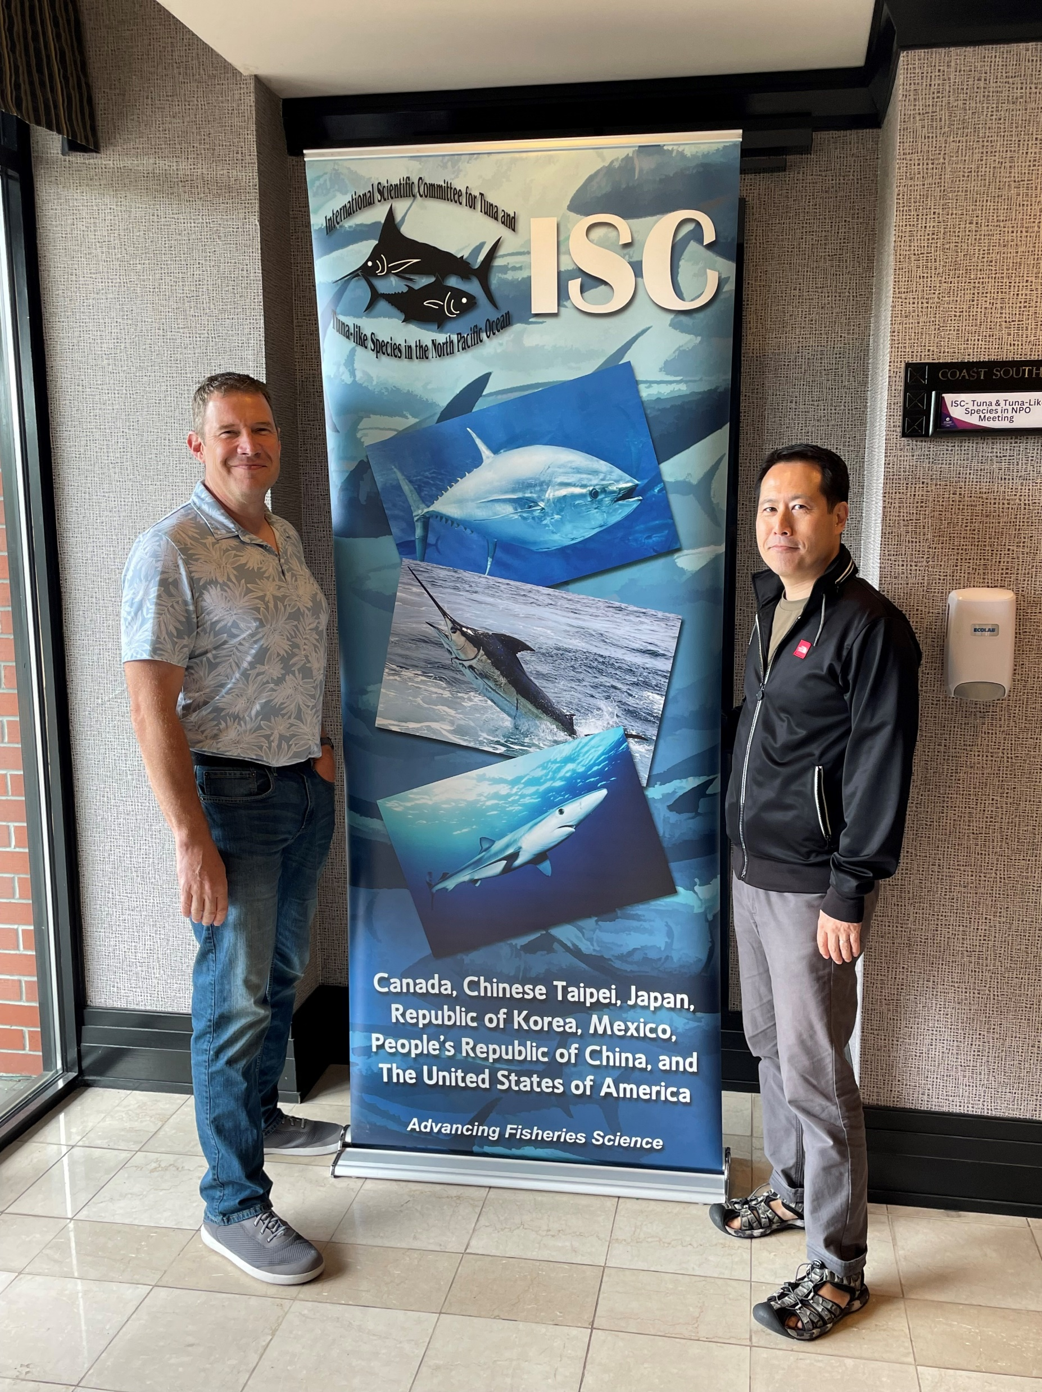
ISC Chair and Vice-Chair Elections
Incoming Chair: Robert Ahrens (USA – NOAA/PIFSC)
Incoming Vice-Chair: Shuya Nakatsuka, (JPN – JFR&EA/FRI)

Slide 8
ISC Workplans, 2024-25
BSH indicator analysis conducted and results reported to ISC25
First iteration of MSE for Pacific Bluefin Tuna to be conducted and results reported to ISC25 and the Joint WG
Exploring and formalizing the use of ‘Open Science’ tools and approaches in conducting stock assessment and other activities
Continuing to work on incorporating climate change considerations into stock status and conservation information
All Working Groups exploring improvements to stock assessment modeling and process
ISC25: June 17-20, 2025; Republic of Korea

Slide 9
QUESTIONS?

