Slide 1

SC20-SA-WP-02 South Pacific albacore stock assessment
SPC-OFP
August 2024

Slide 2
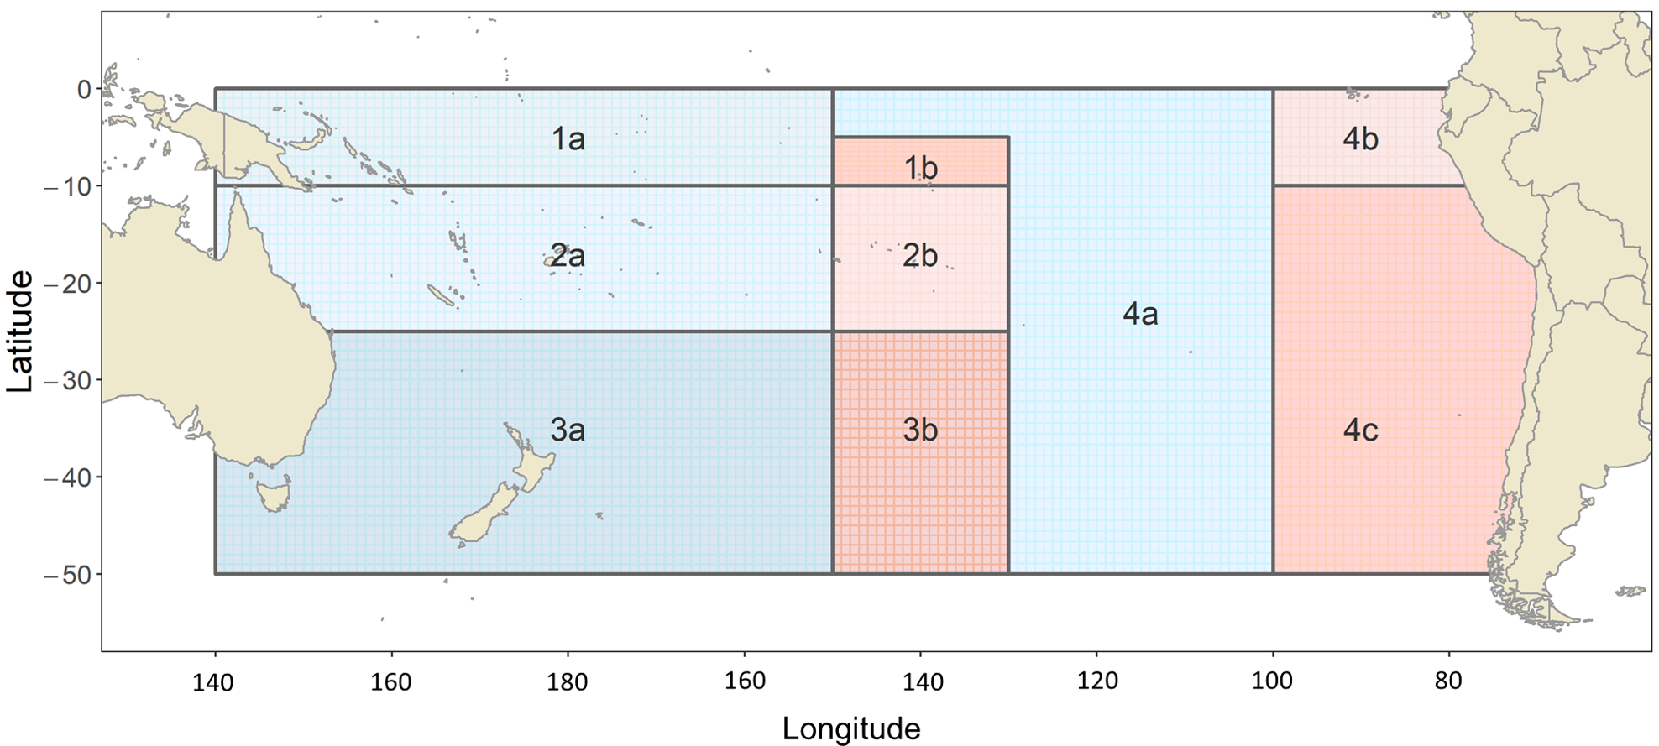
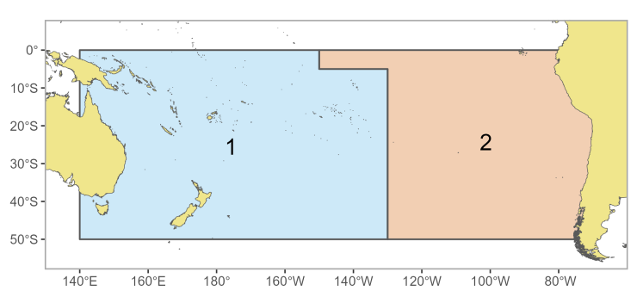
Model regions
2021
Guidance from:
  Previous SAs
  YFT peer-review (2022)
  CAPAM ‘Tuna Stock Assessment Good Practices Workshop’ (2023)
  PAW (2024)
3 more years of data
Simplify the spatial structure to 2 regions
2024

Slide 3
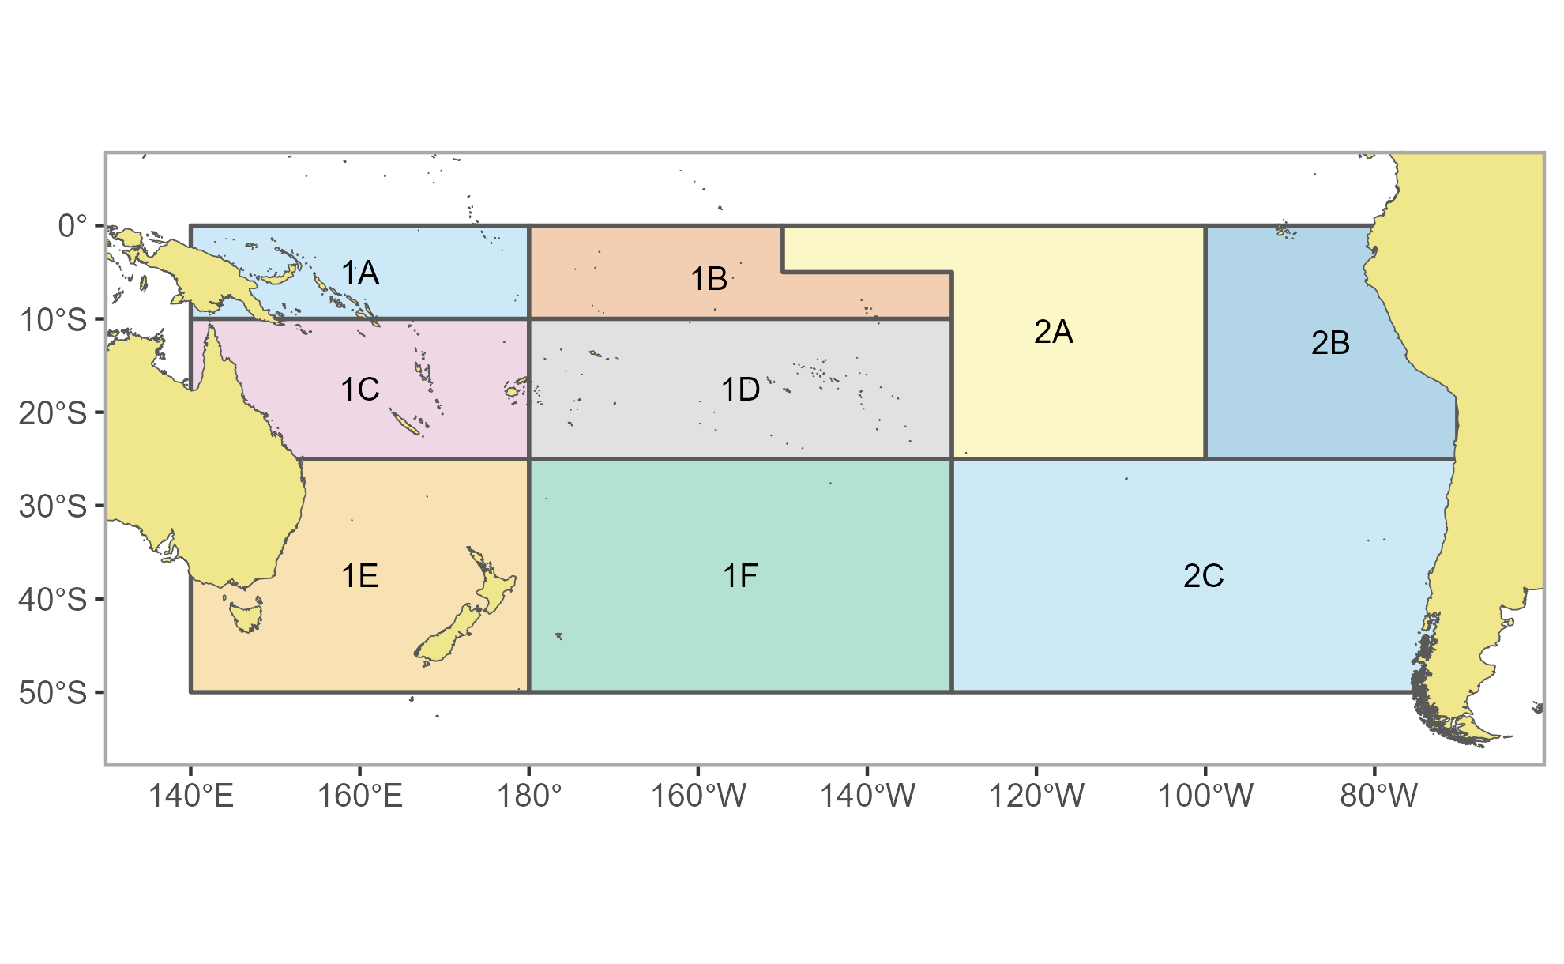
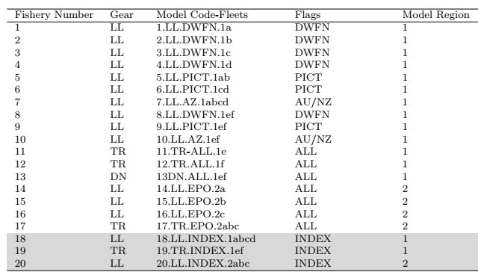
Areas-as-fleets
Informed by regression tree analysis using longline length data
Annual index of abundance from LL (WCPFC-CA (north 25S) and rest of EPO)
Juvenile index from WCPFC-CA troll
Troll data important to ‘control’ recruitment estimates

Slide 4
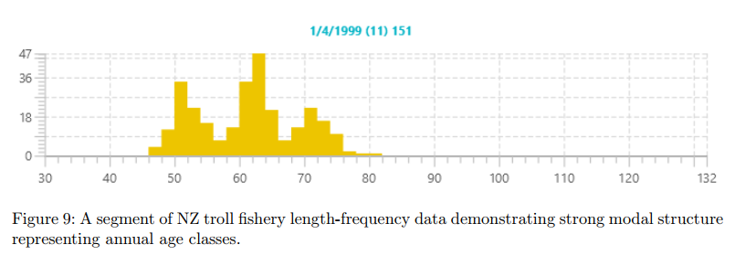
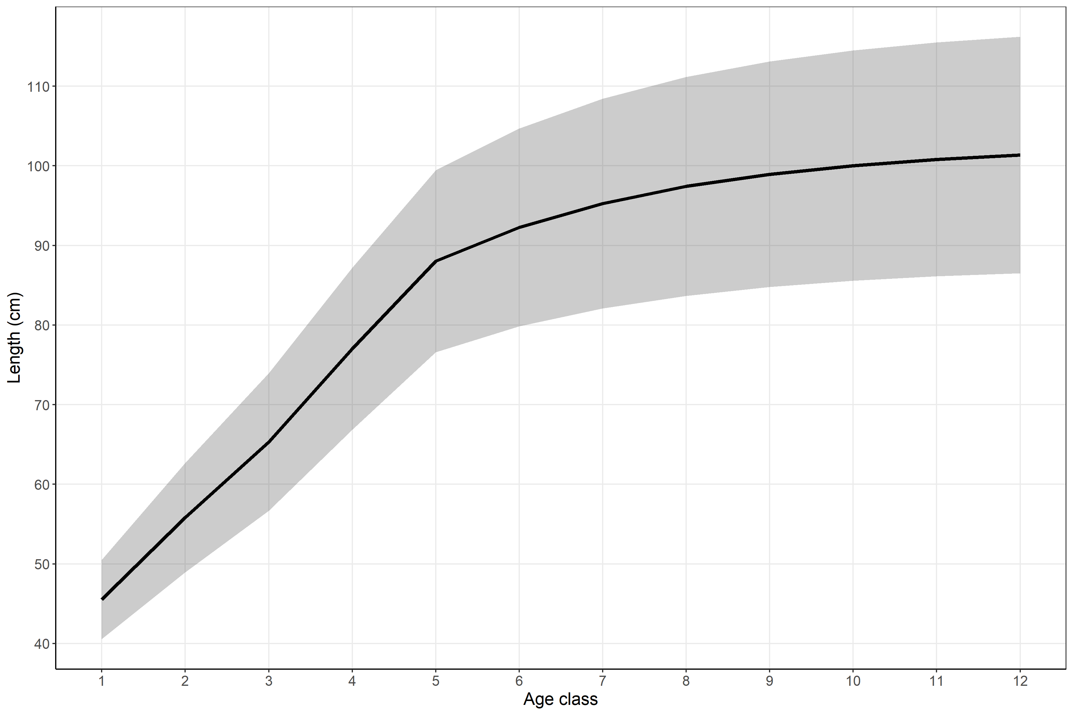
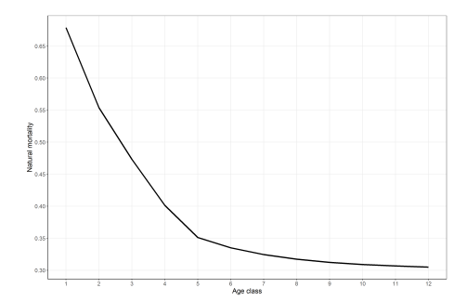
Biology
Growth – informed by conditional age-at-length (otoliths) & size data
  Know there is growth differences W/E
  Effort to fit modes in the troll size data
  VB with ‘offsets’ to fit ages 2-4 yrs
M – Based on Lorenzen formulation
  Avg adult M ~ 0.36 (max-age based; Hamel and Cope 2022)
L-W relationship updated

Slide 5
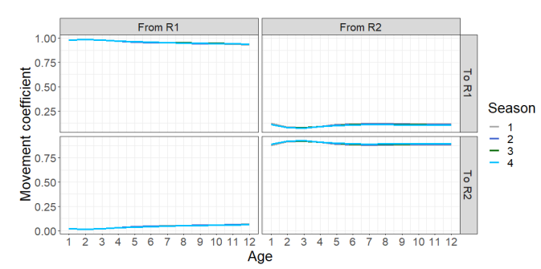
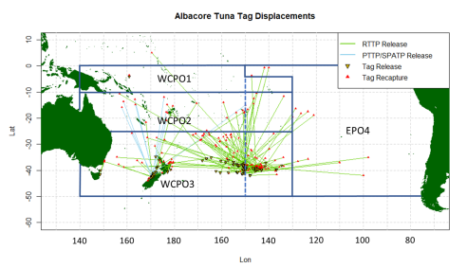
Movement/recruitment
Not really much information from tags (although long times at liberty)
  Movement generally north/south
Use SEAPODYM estimated movement between regions
  Pretty low movement E/W
SEAPODYM also used to fix recruitment distribution (~0.82/0.18)
Recruitment changed from quarterly to annual (occurring in October)

Slide 6
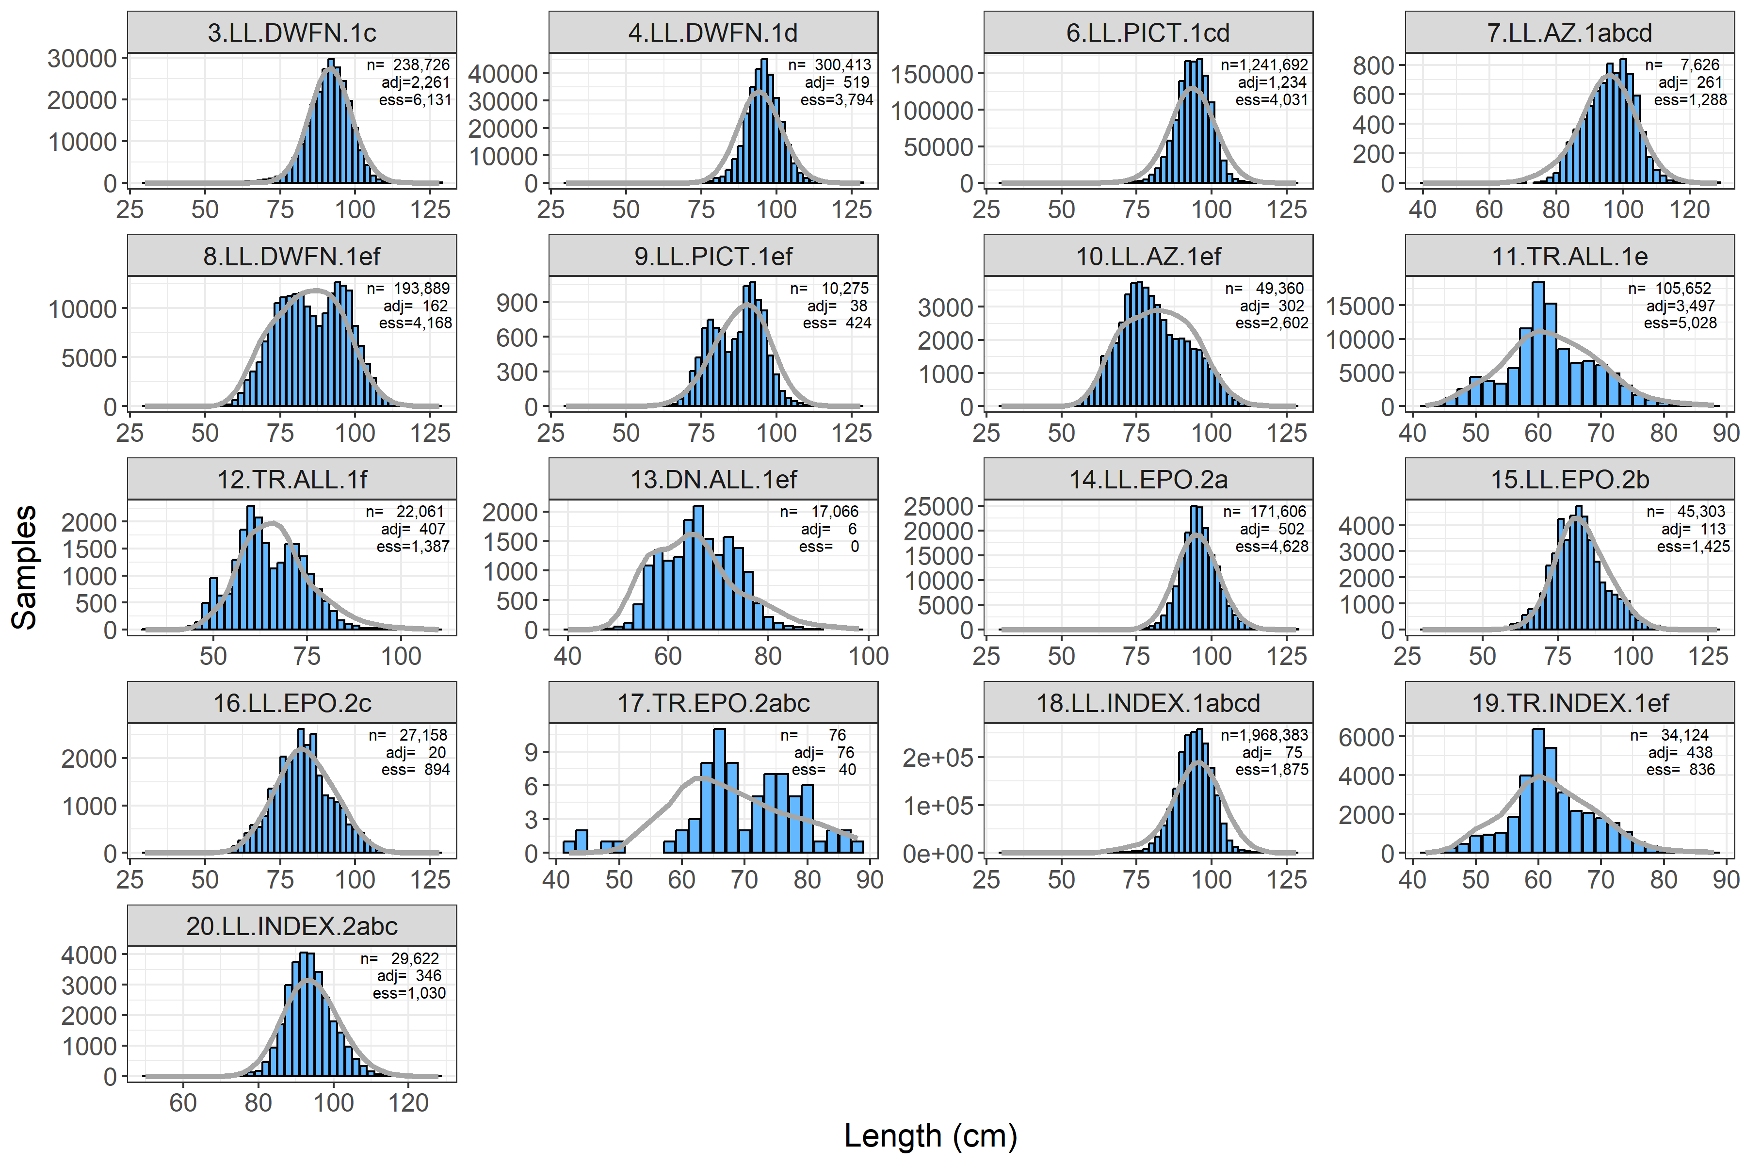
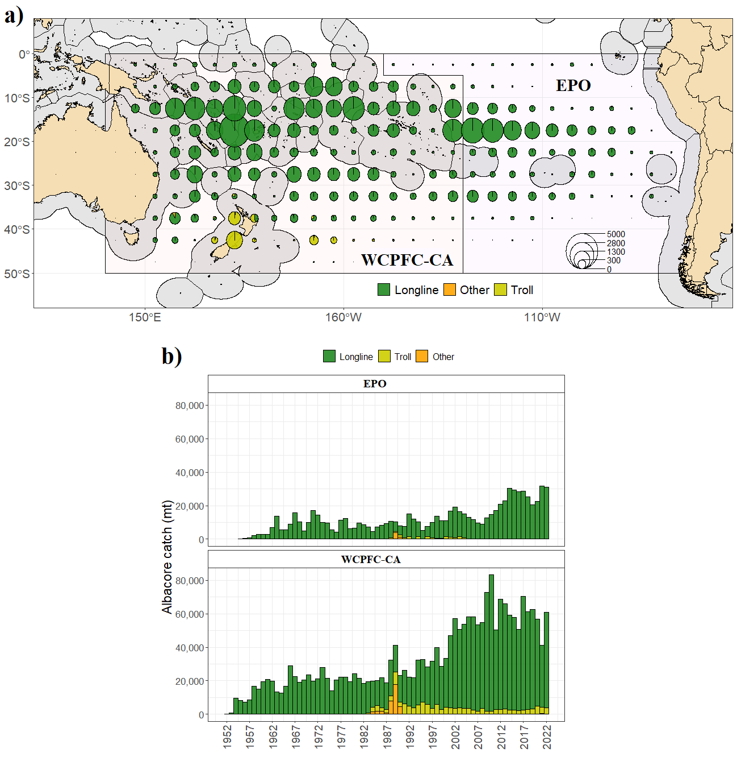
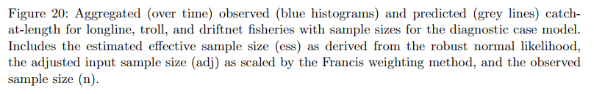
Fishery data – length data
Weighted through Francis weighting approach

Slide 7
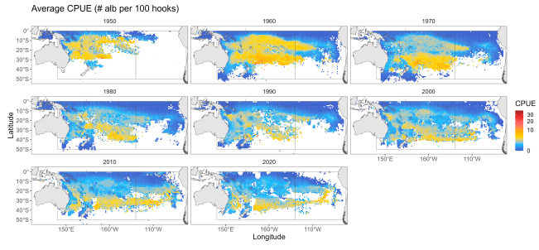
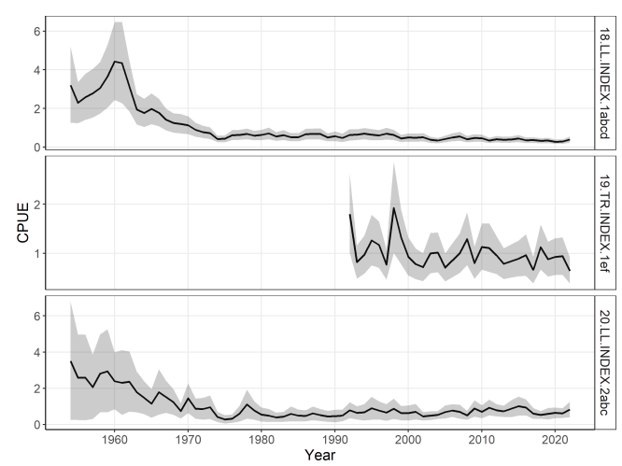
Fishery data – CPUE trends
Time-varying CVs in MFCL
Model period Q1 1954 to Q3 2022
CPUE follows an annual time step

Slide 8
The model
Direction for simpler assessments - simplified region structure, annual model
‘Catch-conditioned’ – exact solution of catch equation for fishing mortality – no estimation of effort deviations and catchability
  Large parameter reductions, aids with positive-definite hessians, and greatly reduce model run times
Size data – 50 x 2cm size classes
  Needed considerable work on the data – provision at different size bins
Initial population (1954) – unexploited
Stepwise approach to development from previous model
  Note big step from ‘complex’ to ‘simple’ in early step – not the standard stepwise

Slide 9
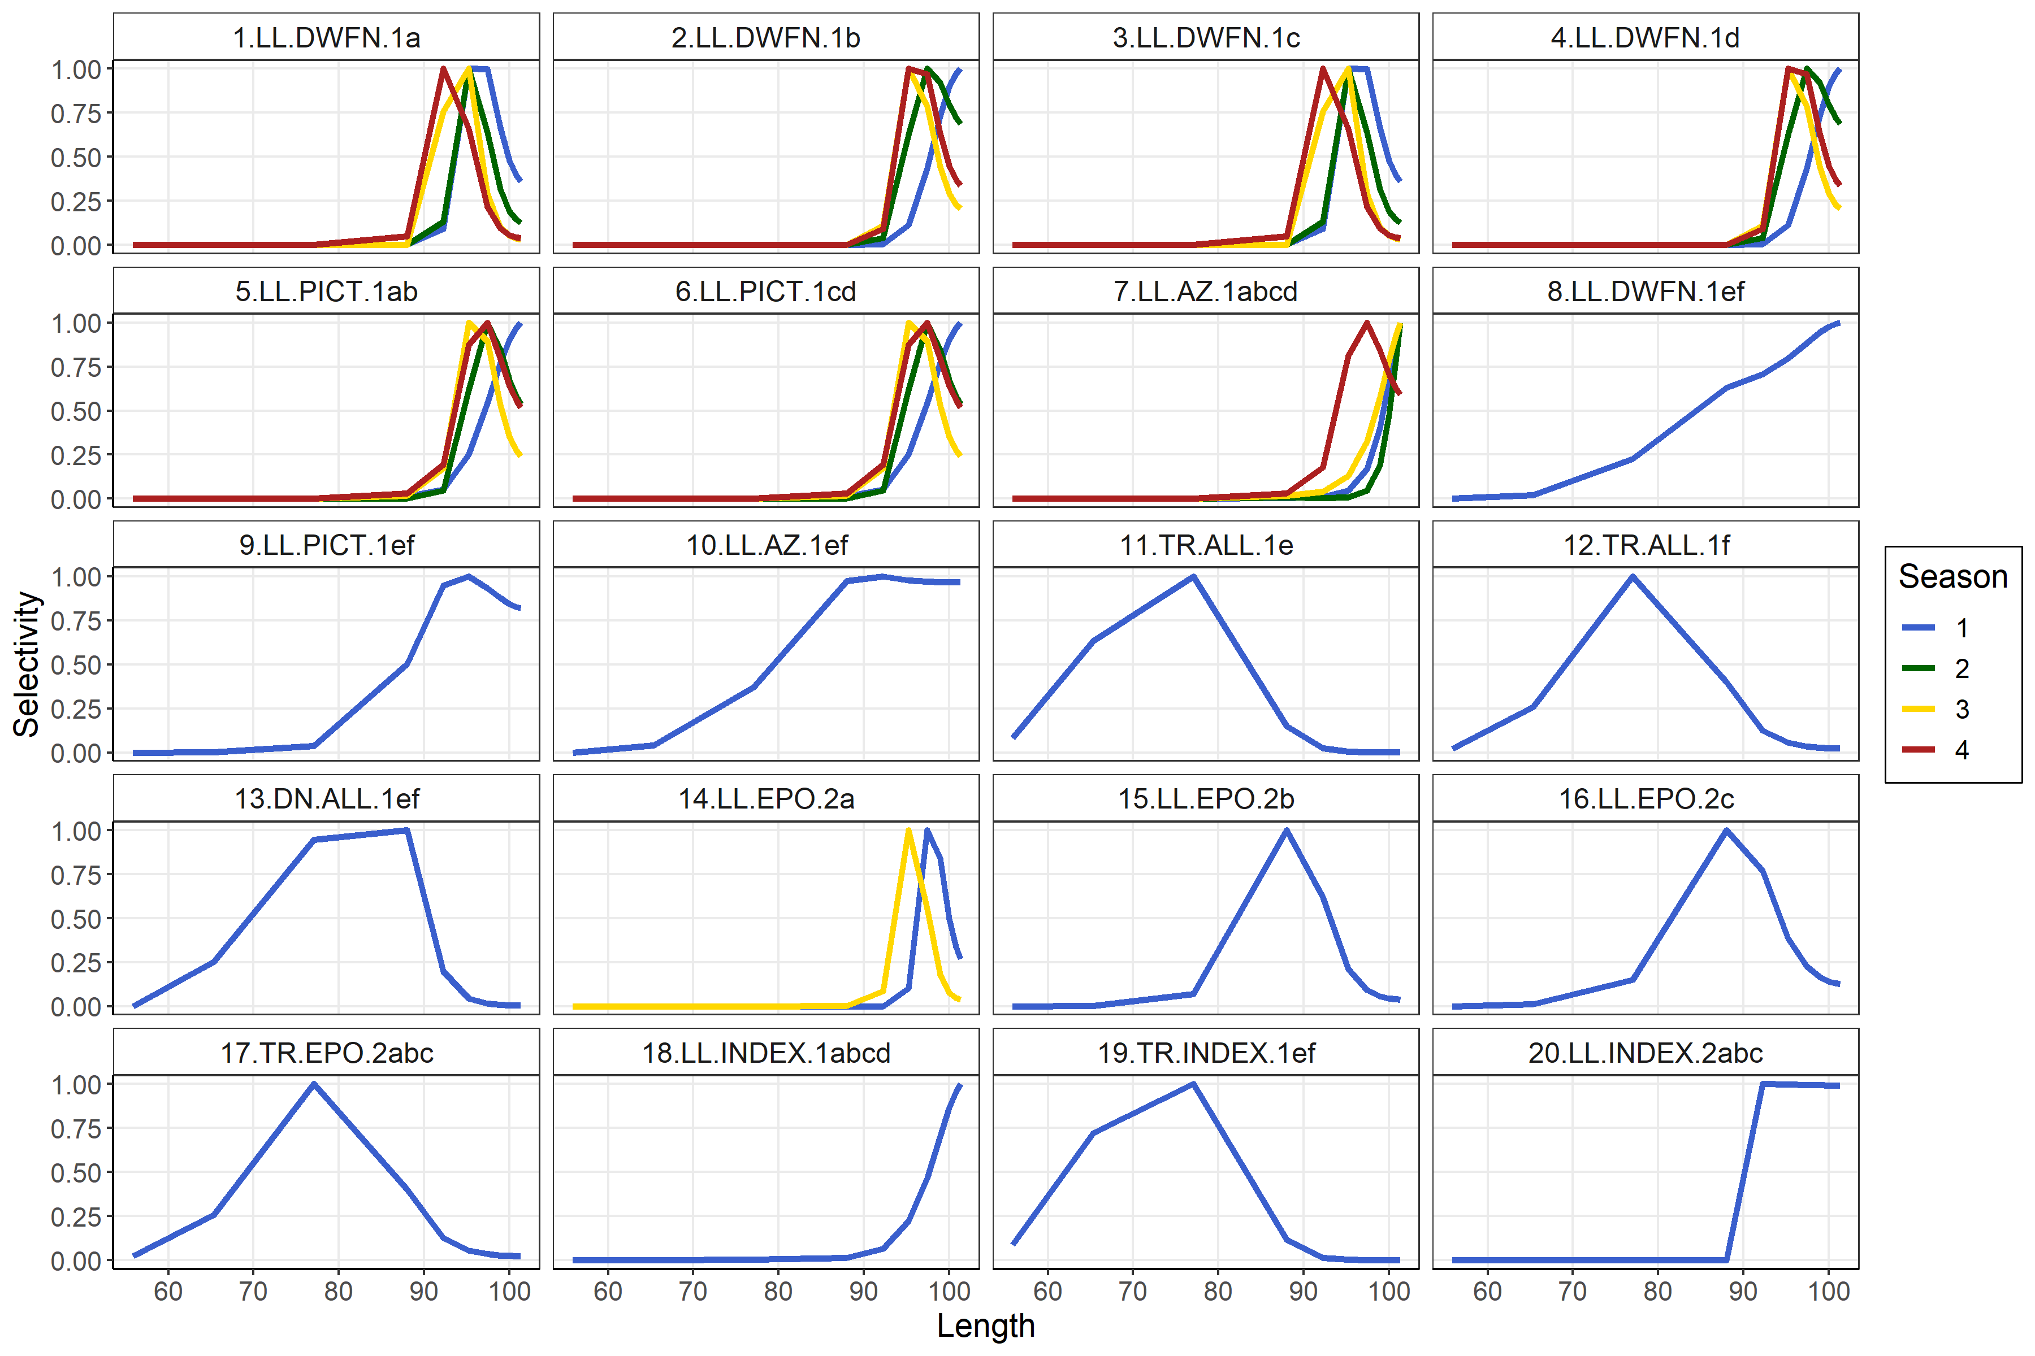
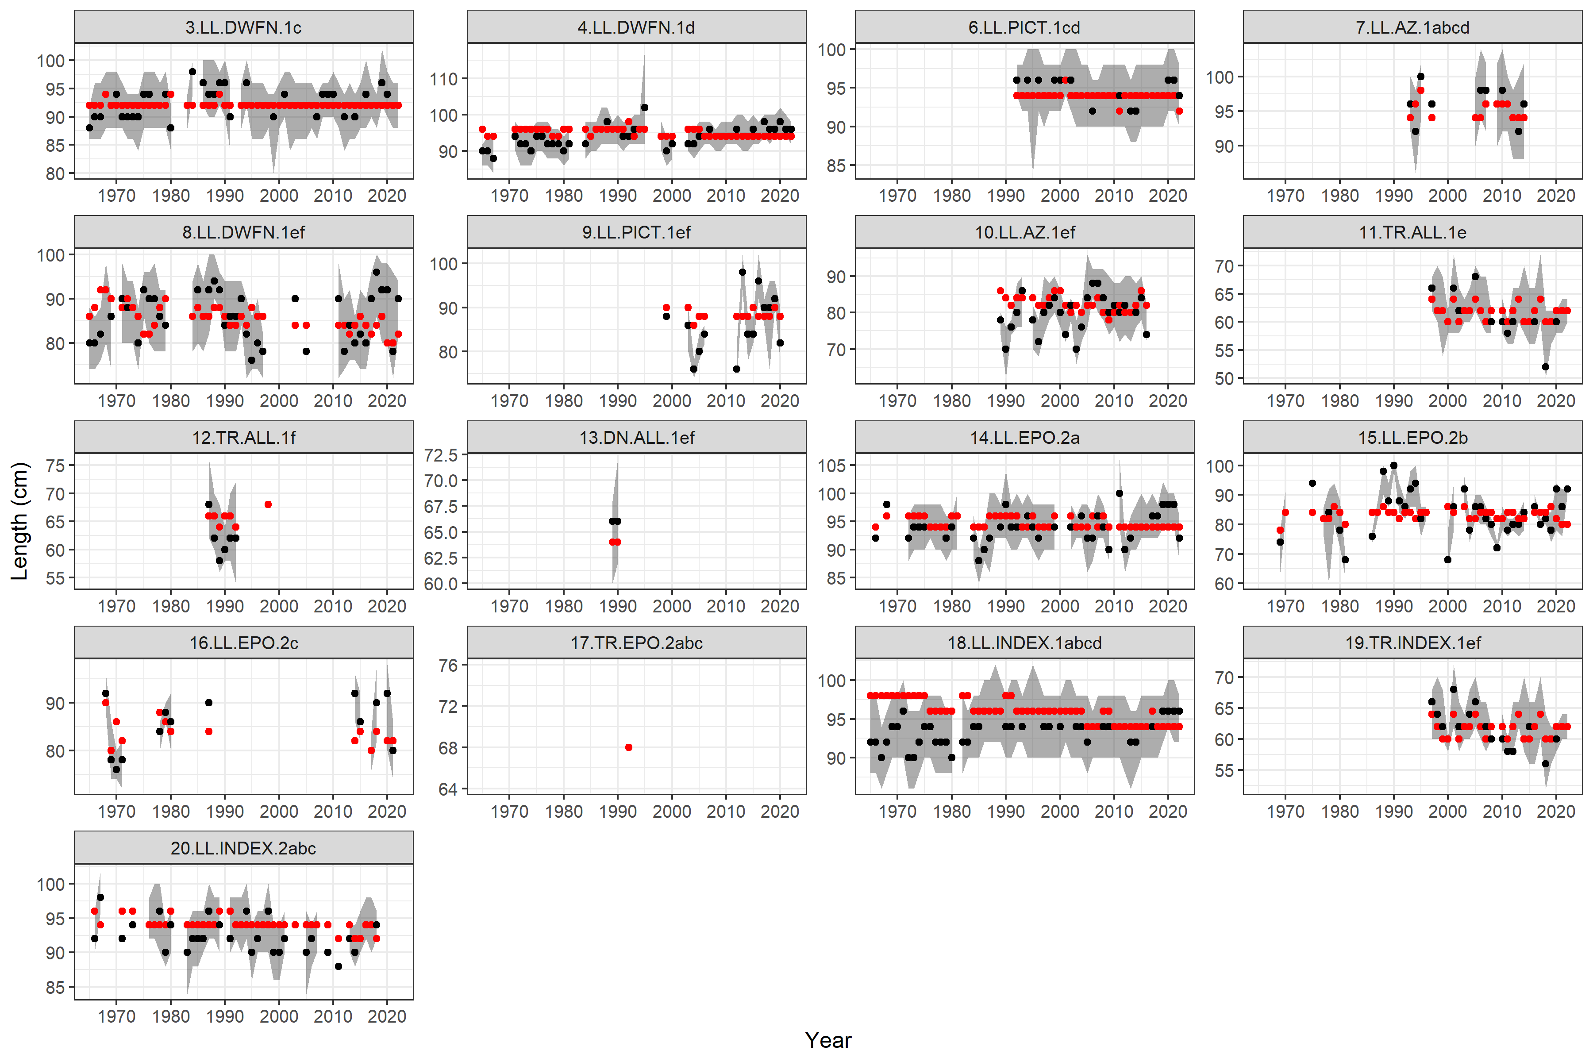
Quick diagnostics

Slide 10
Quick diagnostics

Slide 11
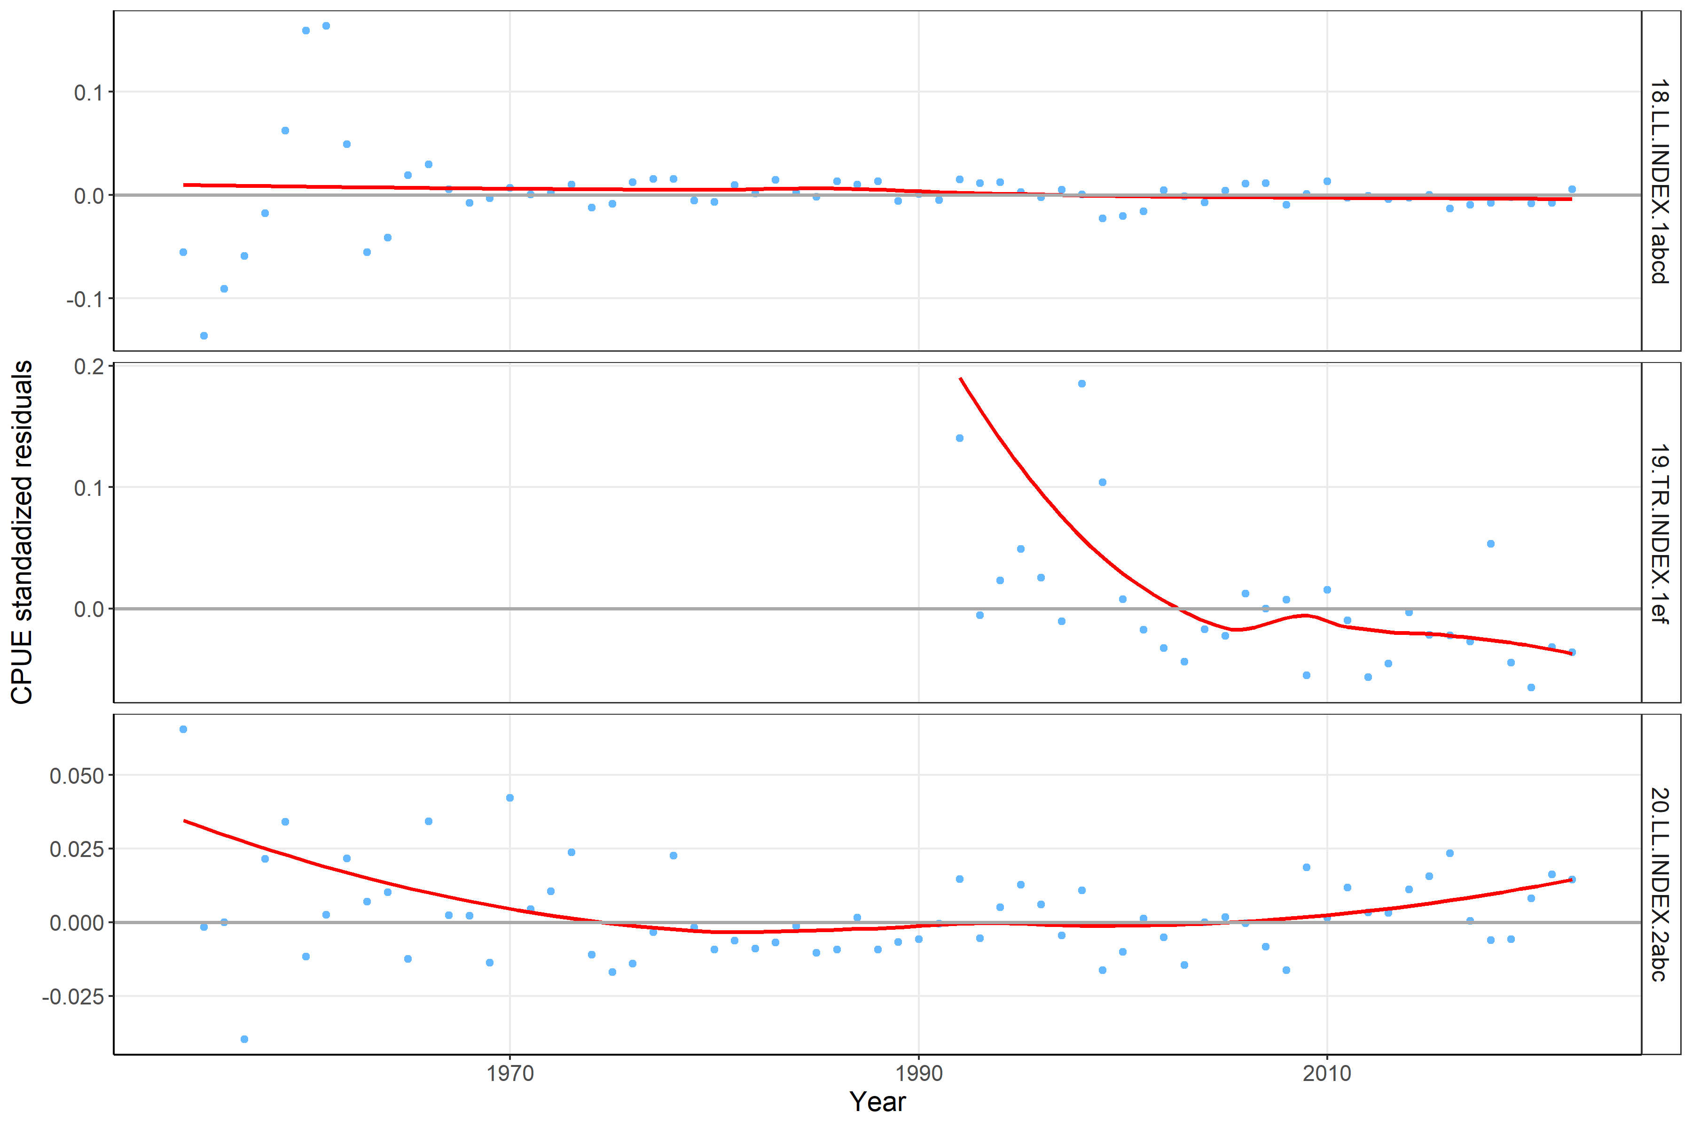
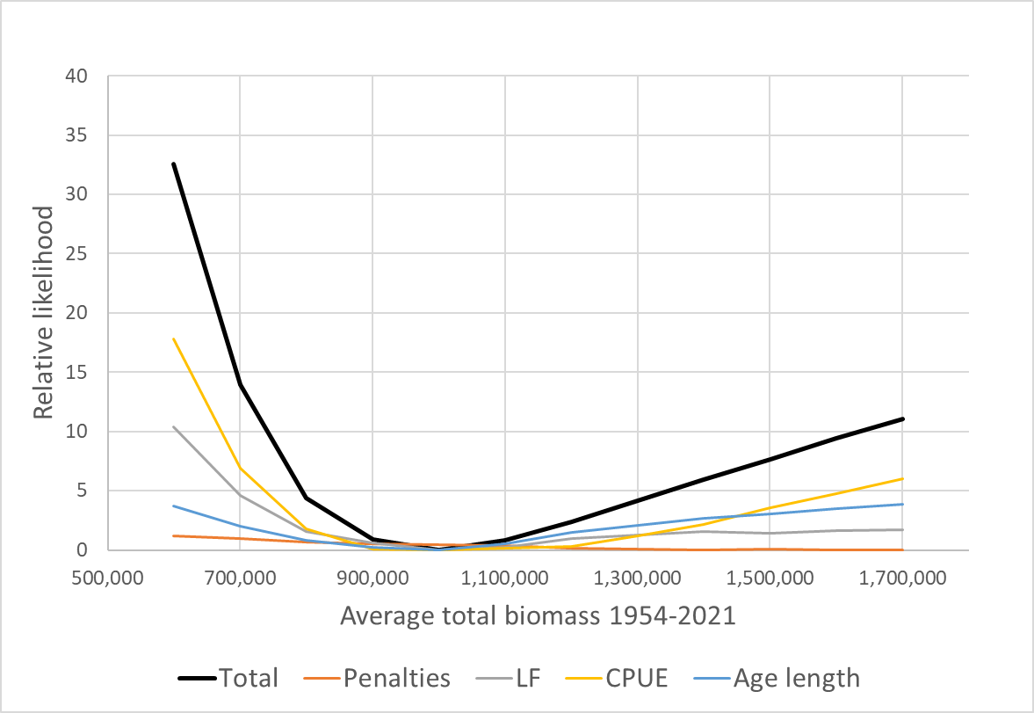
Quick diagnostics
Retrospectives pretty good too
Stable to Jittering

Slide 12
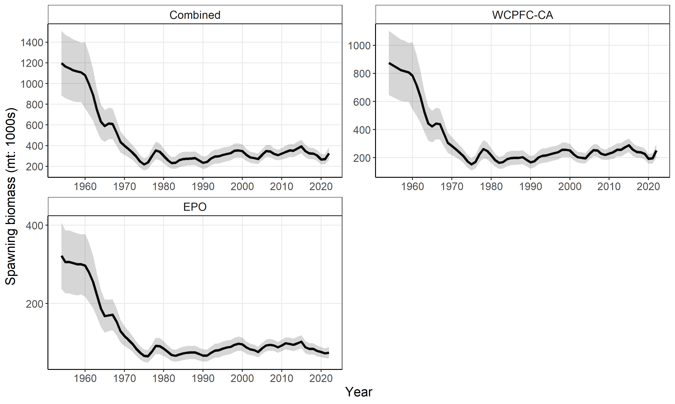
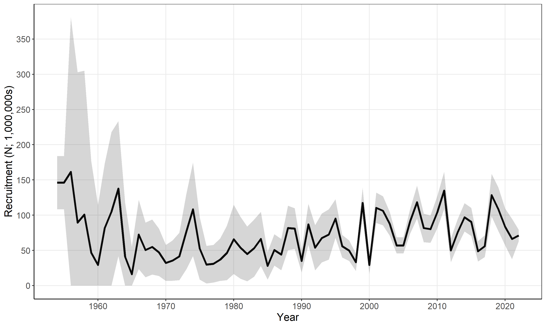
Diagnostic model outcomes

Slide 13
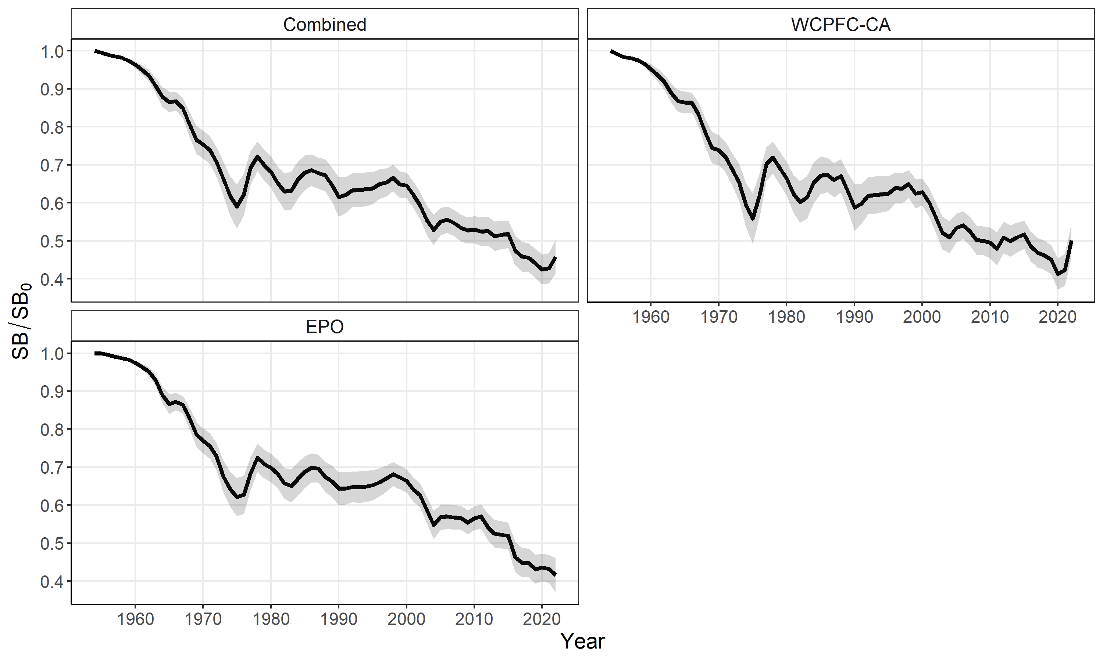
Diagnostic model outcomes
Also looked at alternative assessment approaches as diagnostics - see what is having an impact on the estimation of population scale and trends.

Slide 14
One-off sensitivities
CPUE series
  2 x LL, incl/excl TR
NZ troll LF data exclusion
Conditional L@Age data weighting
Movement
Effort creep
Recruitment distribution assumption
Number age classes
Selectivity/catchability time blocks - no benefit
Growth – no benefit
M – notable impact on results
Steepness – notable impact on MSY-related results

Slide 15
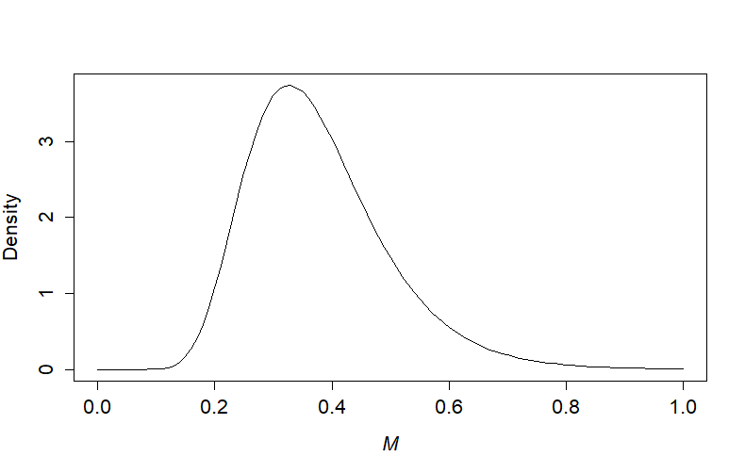
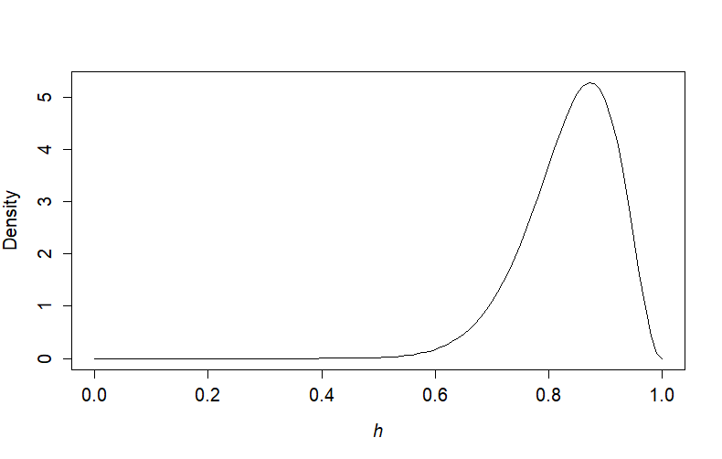
Uncertainty grid – model ensemble
Figure 12: Assumed ‘prior’ distributions of average M (left) and steepness rates (right) considered in the model ensemble uncertainty characterization
Grid of 100 model runs in ‘uncertainty grid’
Reviewed PDH/fit to data to ensure convergence was OK and model behaviour OK

Slide 16
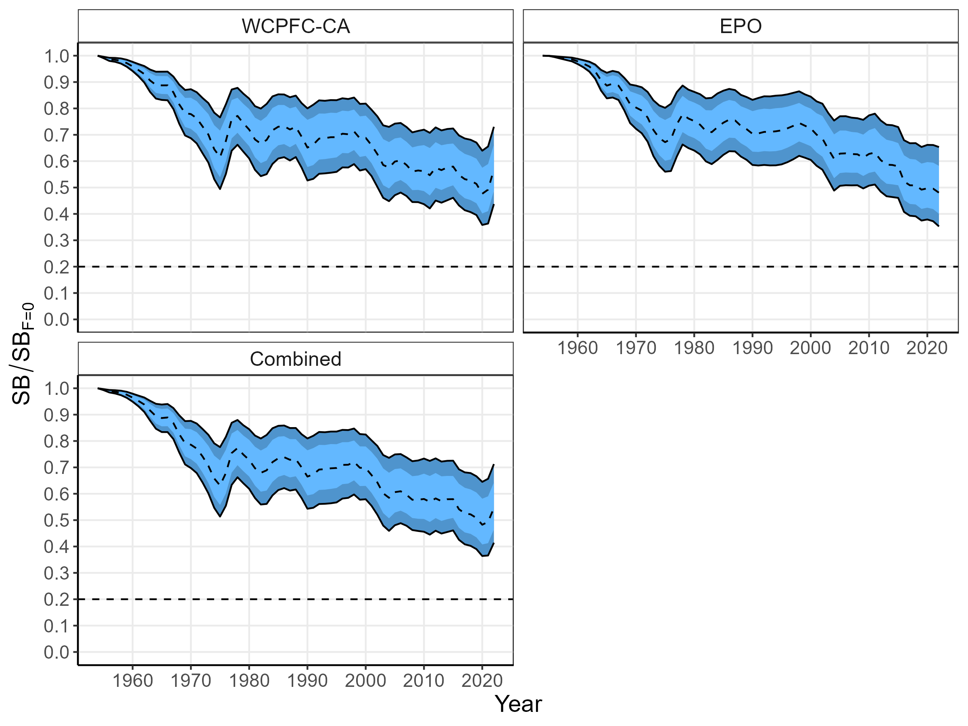
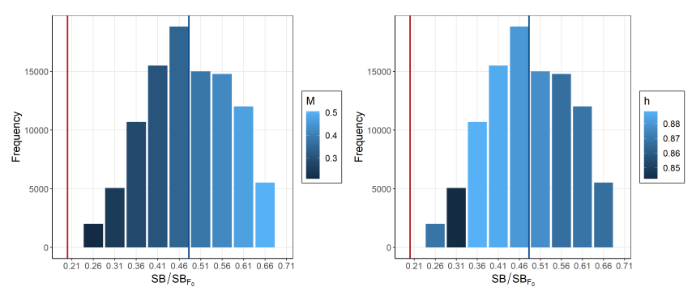
Outcomes - depletion
M
Steepness
Figure 58: Annual estimated 90% (dark blue) and 75% (light blue) quantiles of SBt/SBF =0(t) by region from the model ensemble. The dashed line within the interval indicates the median.

Slide 17
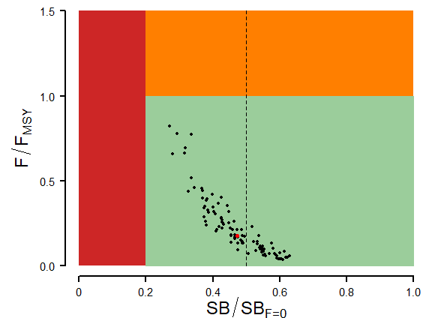
SPA stock assessment

Slide 18
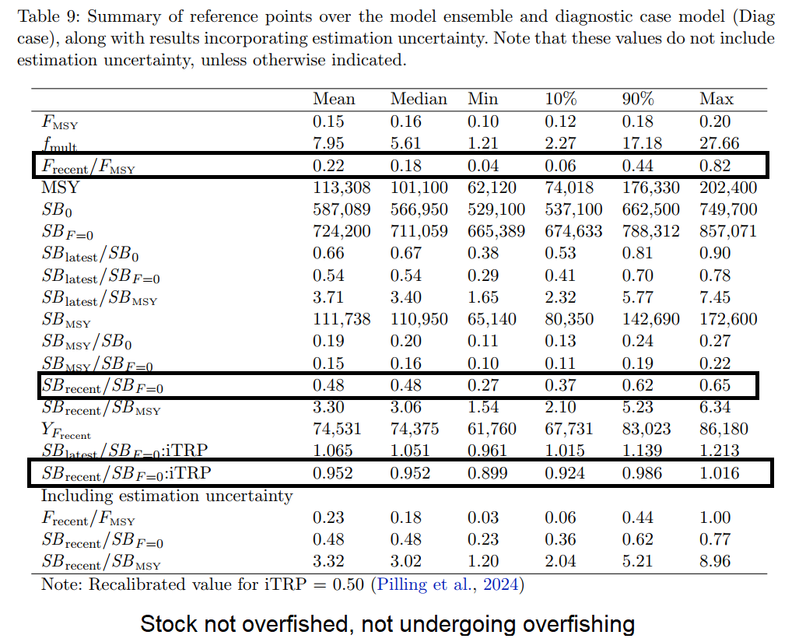
SPA stock assessment
Median – 18% F_{MSY}
(18% with estimation uncertainty)
Zero risk > F_{MSY}
Median – 48% SB_{F=0}
(48% with estimation uncertainty)
Zero risk < LRP
Median – 95% of TRP

Slide 19
Questions

Slide 20
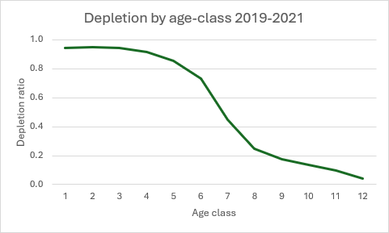
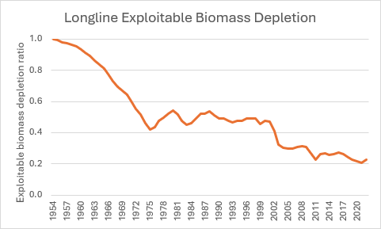
SPA stock assessment
Notes:
F/Fmsy is so low because the yield curve is pretty flat. MSY is only achieved at around 3x recent F levels, but the increase in yield from recent levels is only about 10%.
The depletion plots help explain that even though impact on SB is at moderate levels, impact on the older part of the stock exploited by longline is much greater. The depletion by age class can be looked at in relation to LL selectivity by age, with significant exploitation starting around age 7.
LL exploitable biomass depletion is developed from fishery 18. It is much more depleted than the overall depletion.

Slide 21
Log likelihood comparisons

Slide 22
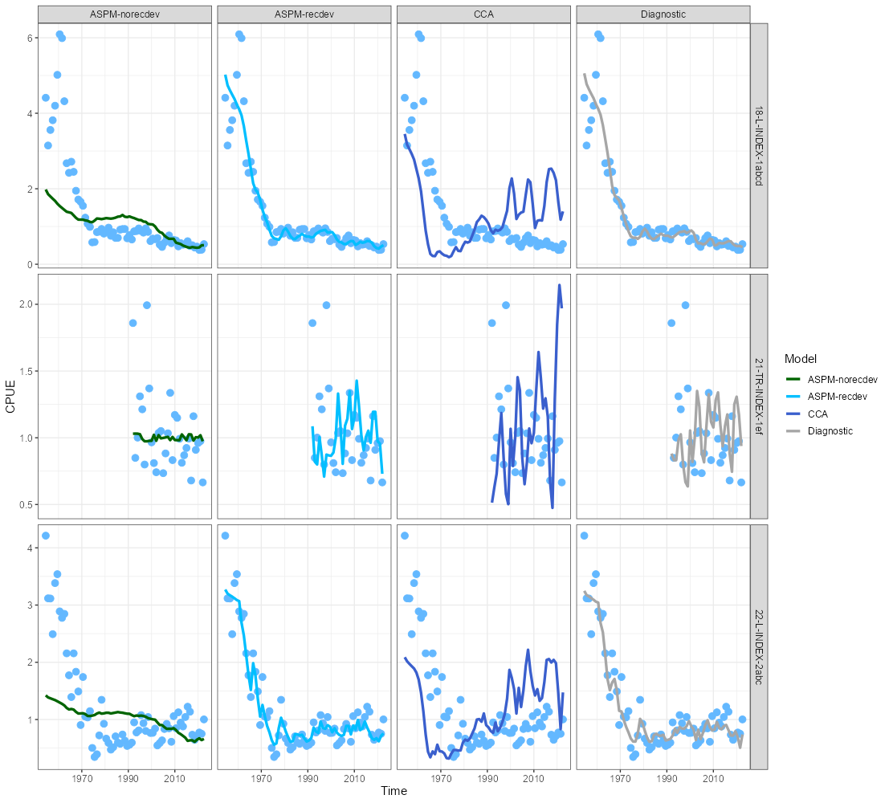
CPUE fits to ASPM & CCA

Slide 23
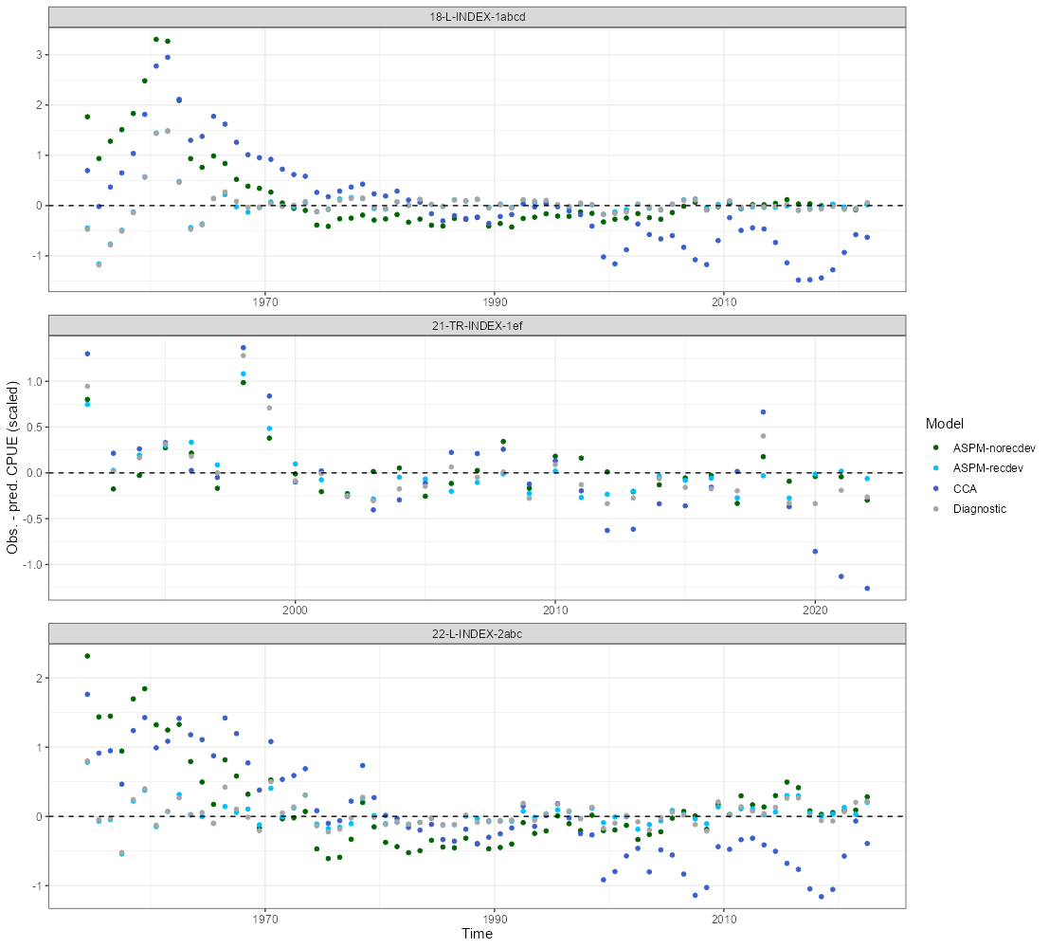
CPUE residuals to ASPM & CCA

