Slide 1
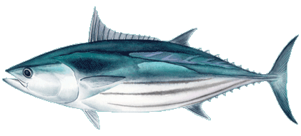
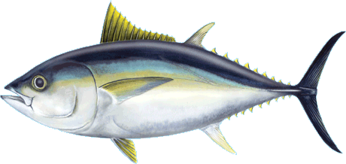
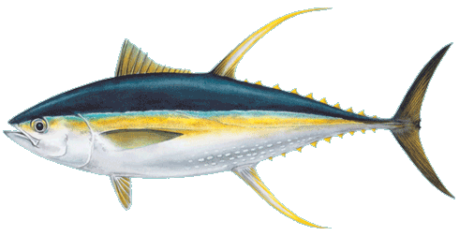
Potential interactions between deep-sea mining and tuna fisheries
Jesse van der Grient
DJ Amon, B-J Dobush, JC Drazen, D McCauley, N Nathan
20th Regular Session of the WCPFC Scientific Committee
grientj@hawaii.edu

Slide 2
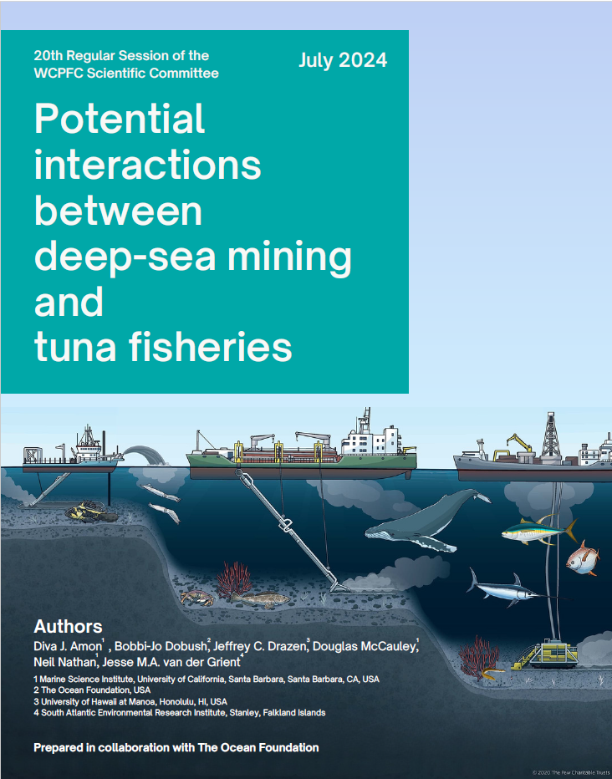
Deep-sea mining should be considered
What is deep-sea mining?
How might deep-sea mining impact tuna fisheries?
What is the potential overlap between deep-sea mining areas and the WCPFC Convention Area?
What is the state of deep-sea mining regulation?

Slide 3
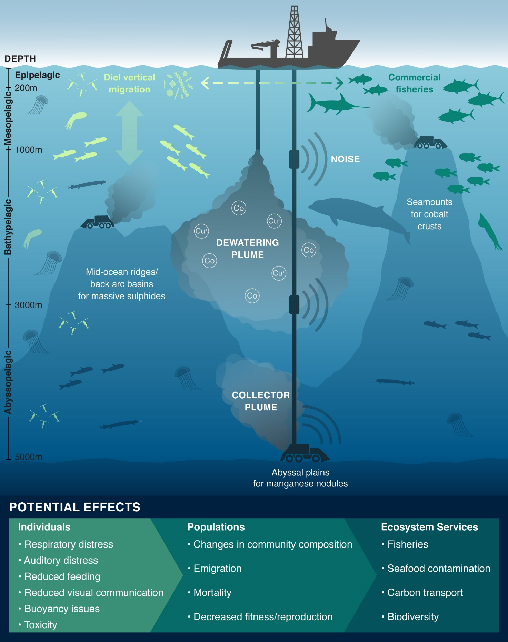
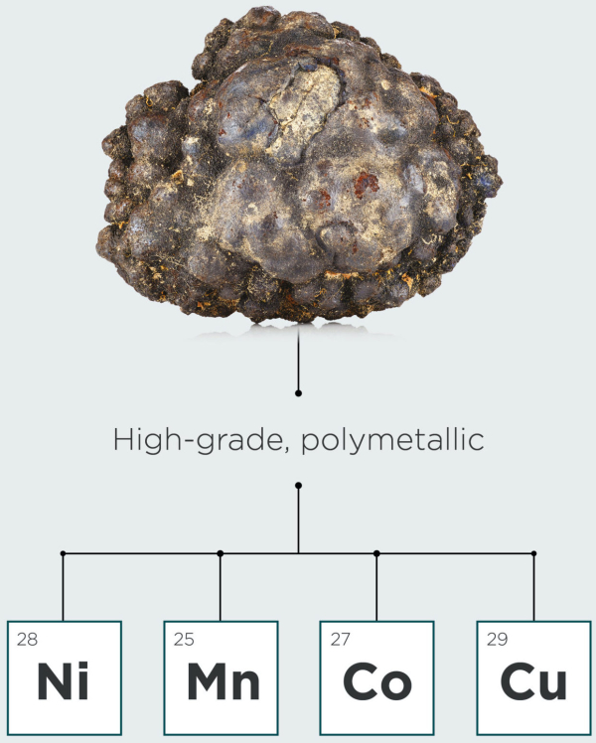
Deep-sea mining
Deep-sea mineral deposits (>200 m depth)
Polymetallic nodules
Cobalt-rich crusts
Seafloor massive sulfides
Occur in WCPFC Convention Area
Drazen et al 2020

Slide 4
Deep-sea mining will have benthic and pelagic impacts
Benthic impacts can extend into the water column
  Especially at seamounts
Pelagic impacts less understood
  Very little or no data
Drazen et al 2020

Slide 5
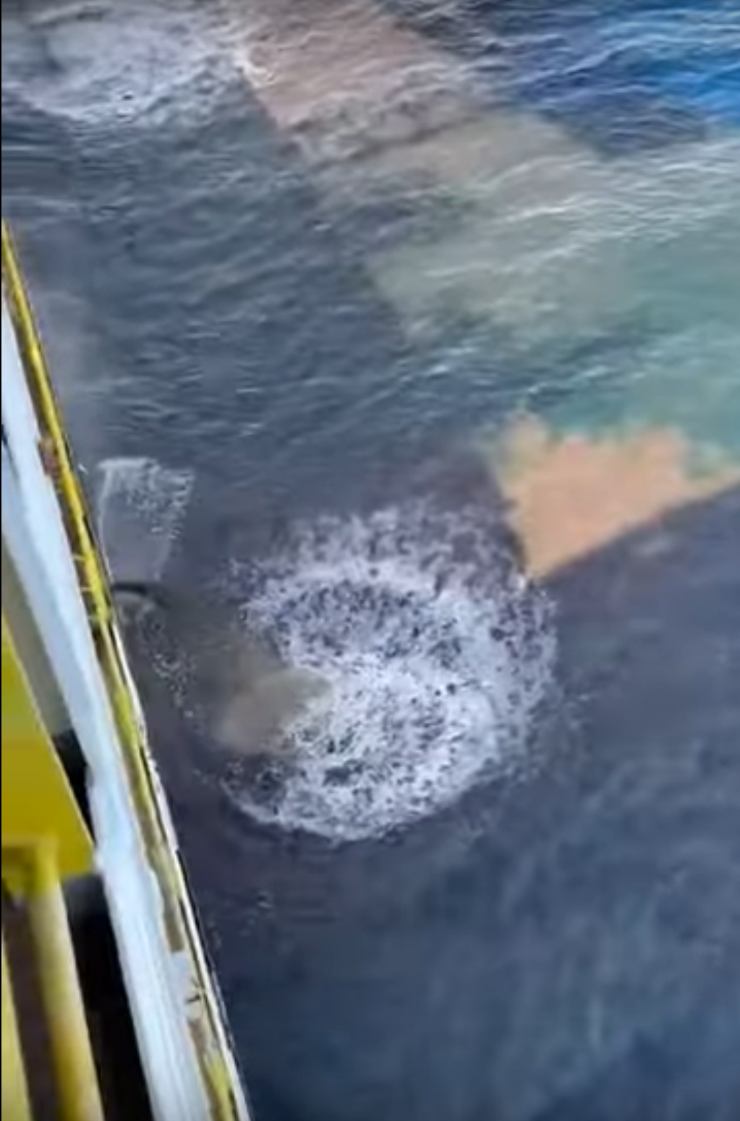
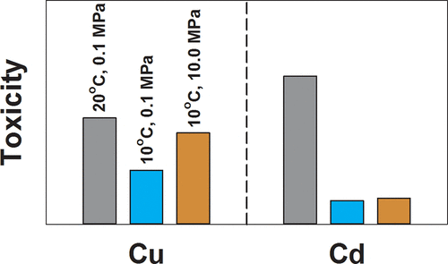
Deep-sea mining has benthic and pelagic impacts
Expected pelagic impacts include:
  Elevated sediment concentrations
  Dissolved metals in plumes
  Noise pollution
  Increased boat traffic
Expected effects include:
  Respiratory distress
  Auditory distress
  Reduced feeding
  Reduced visual communication
  Buoyancy issues
  Metal toxicity
Brown et al. 2017

Slide 6
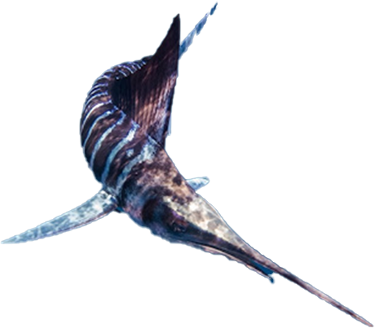
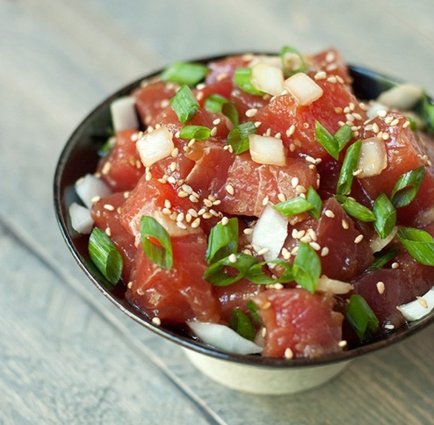
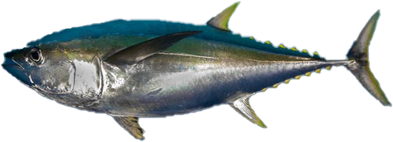

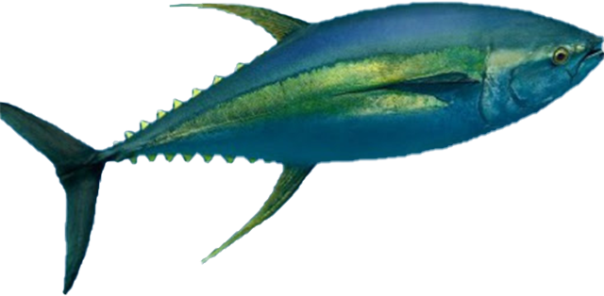
The deep sea has links to our dinner plates
Expected effects on fisheries include:
  Avoidance of area
  Reduced foraging
  Seafood contamination via prey
    Can potentially lead to overreaction in consumer behaviour

Slide 7
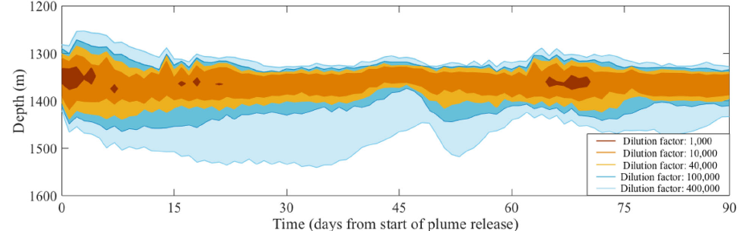
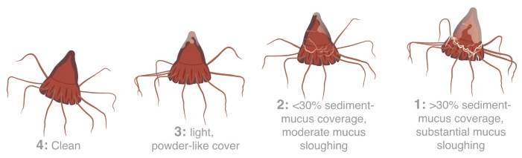

Scale of pelagic impacts could be extensive
Plumes may:
  Extend $≥$10-50 km from release (Muñoz-Royo et al. 2021)
  Cover a large volume
    50,000 m³ per day or one freight train (Oebius et al. 2001)
    1500 – 3000 km³ per year (Quillon et al. 2022)
Noise may:
  Exceed 120 dB re 1 μPa in 4-6-km radius (Williams et al. 2022)
Scale:
  1 polymetallic nodule contract area = 75,000 km²
  1 cobalt-rich crust contract area = 3000 km²
?
Healthy Unhealthy
Stenvers et al. 2023

Slide 8
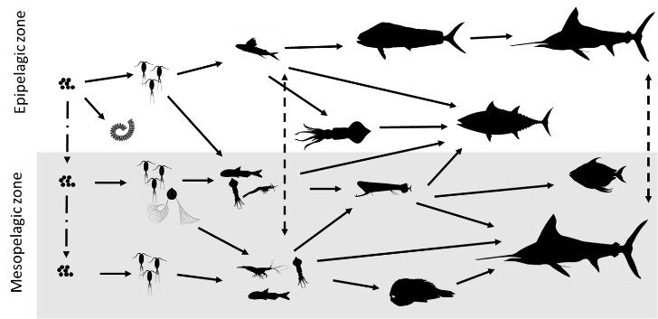
Overlap between high-seas fisheries and mining areas will depend on metric used
Direct impact from infrastructure
Potential clash between gear
  Number of boats and associated gear
  Hours of operation in area
  Requires consideration of all fishing operations in an area
Could be avoided by sharing location
  Note that fishing vessels may need flexibility as fishes move depending on the environment
Does not incorporate mining-related impacts
  Mining plumes
  Noise
  Trophic cascades

Slide 9

Overlap between high-seas fisheries and mining areas will depend on metric used
Spatial overlap in terms of catches
Where are catches obtained?
  Are fisheries operating in mining areas?
  How does this relate to the wider area?
More consideration of spatial spread of mining-related impacts
  Spread of impacts is poorly understood
  Does not consider type of impact
Focused on tunas as these species make up most of catches in high-seas areas overlapping with mining areas
$$Overlap (\%) = \frac{Catch in PCZ}{Catch in RFMO}×100$$
Catch = average annual RFMO-reported catch (2005-2015)

Slide 10
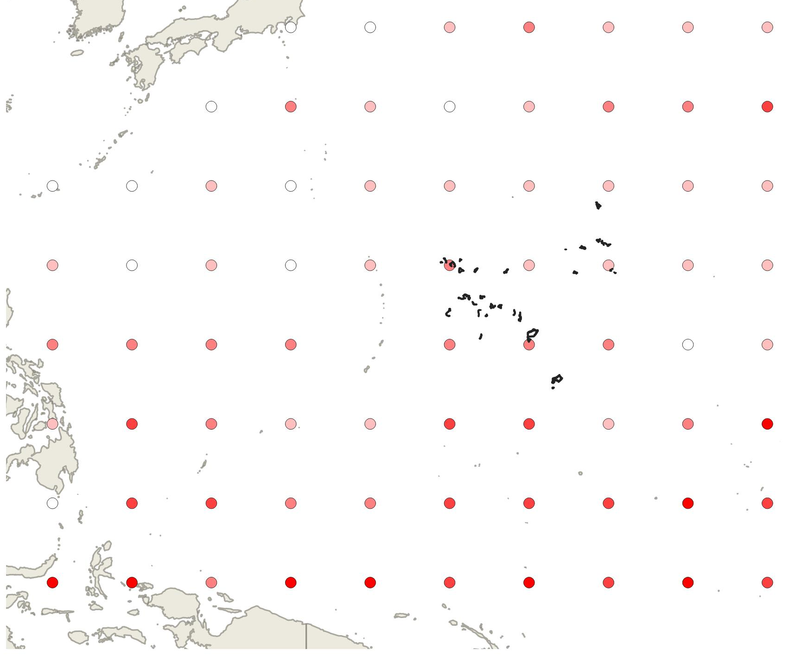
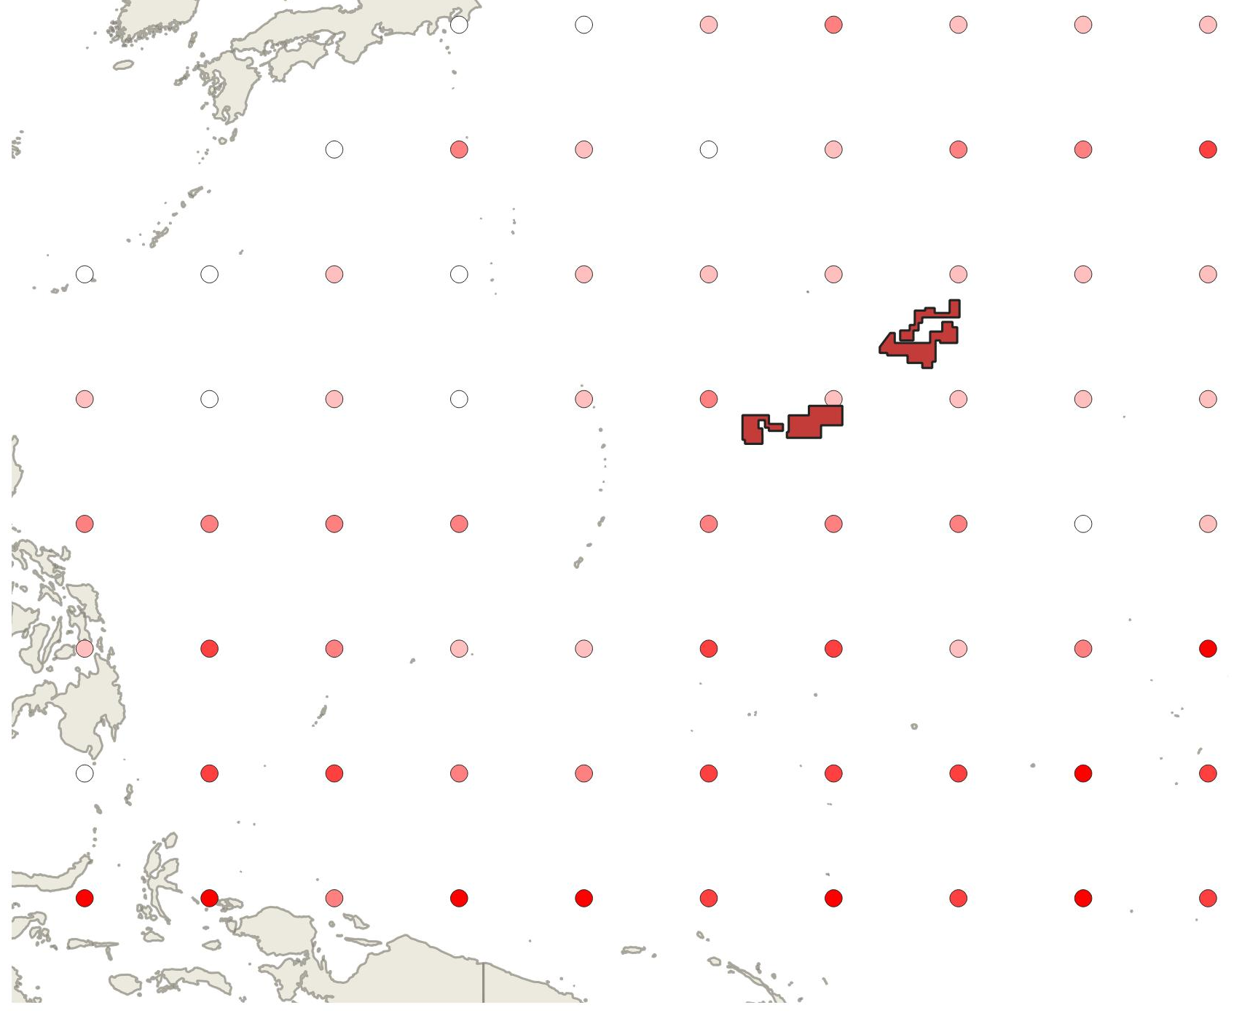
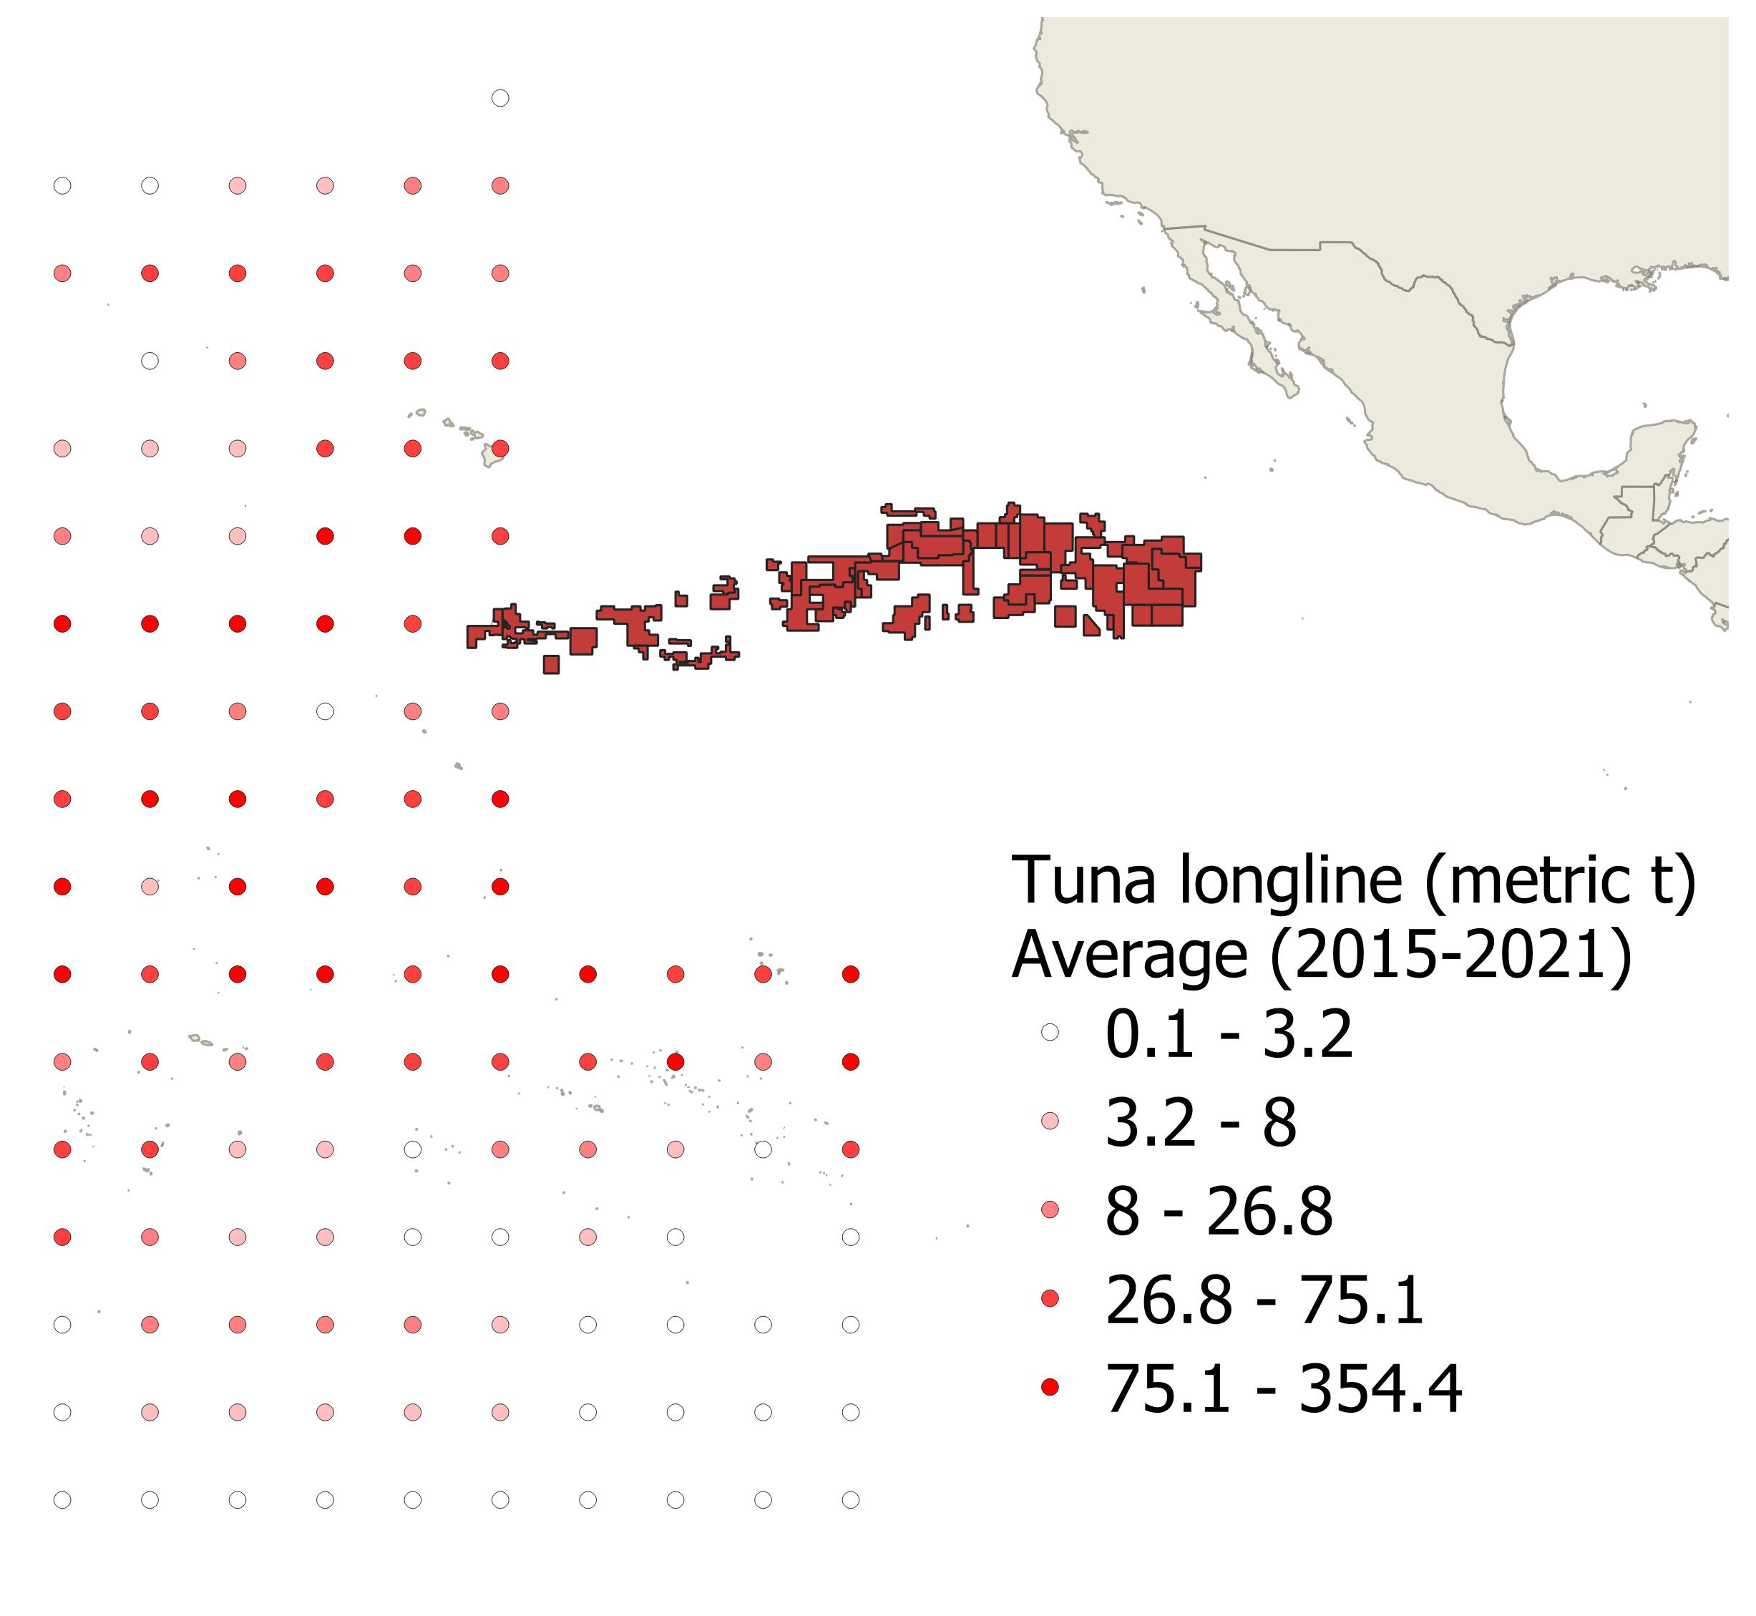
There is spatial overlap between deep-sea mining areas and tuna fisheries
PCZ - Cobalt-rich crusts
PCZ - Polymetallic nodules
CCZ – Polymetallic nodules

Slide 11
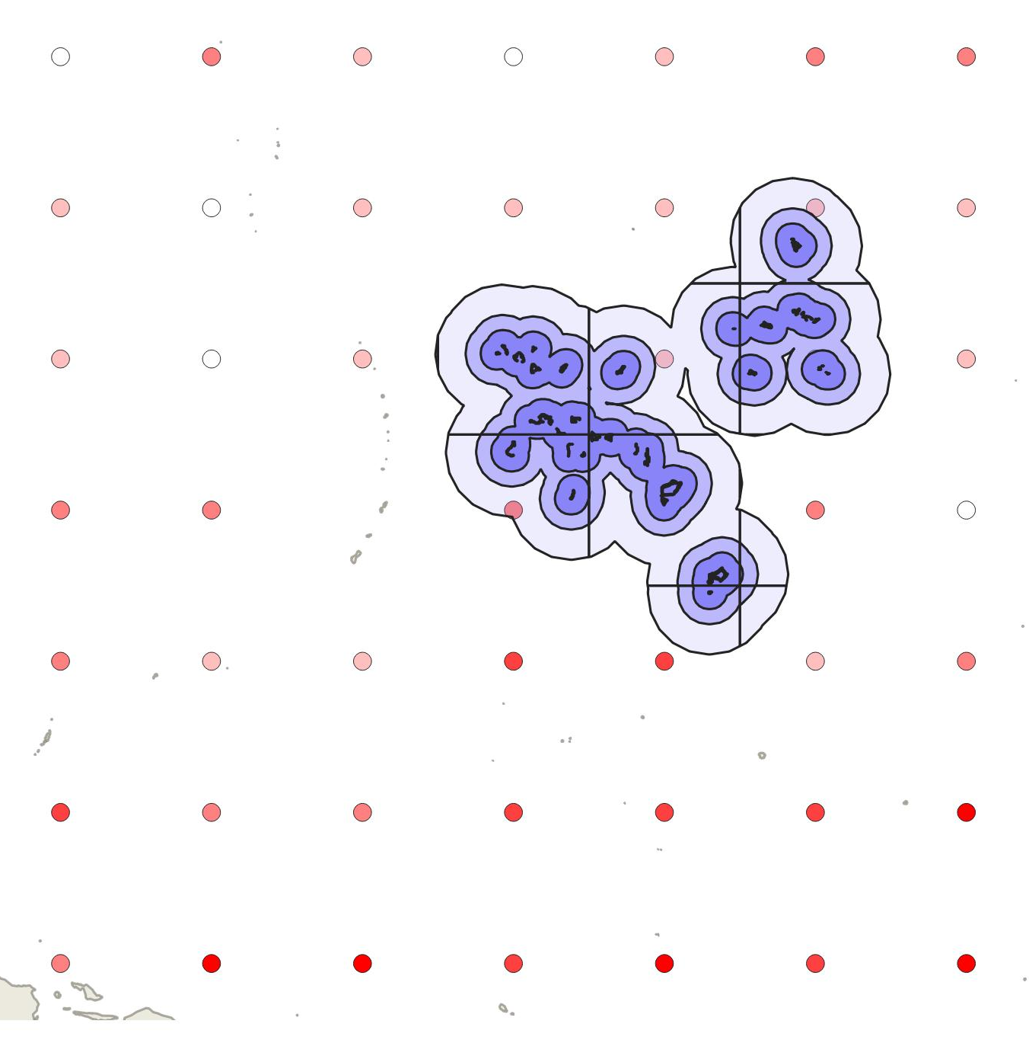
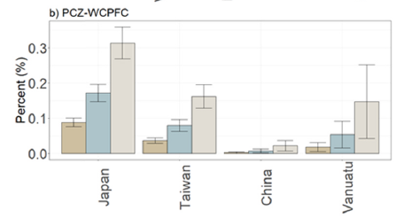

Overlap will depend on spread of impacts, but it is not equal between fishing Nations
$$Overlap (\%) = \frac{Catch in PCZ}{Catch in RFMO}×100$$
Catch = average annual RFMO-reported catch (2005-2015)
Zone of influence | Total (%) | Bigeye tuna (%) | Yellowfin tuna (%)
50 km | 0.06 | 0.14 | 0.18
100 km | 0.12 | 0.29 | 0.37
200 km | 0.22 | 0.55 | 0.70
Note: nodule areas not calculated!
van der Grient & Drazen 2021

Slide 12
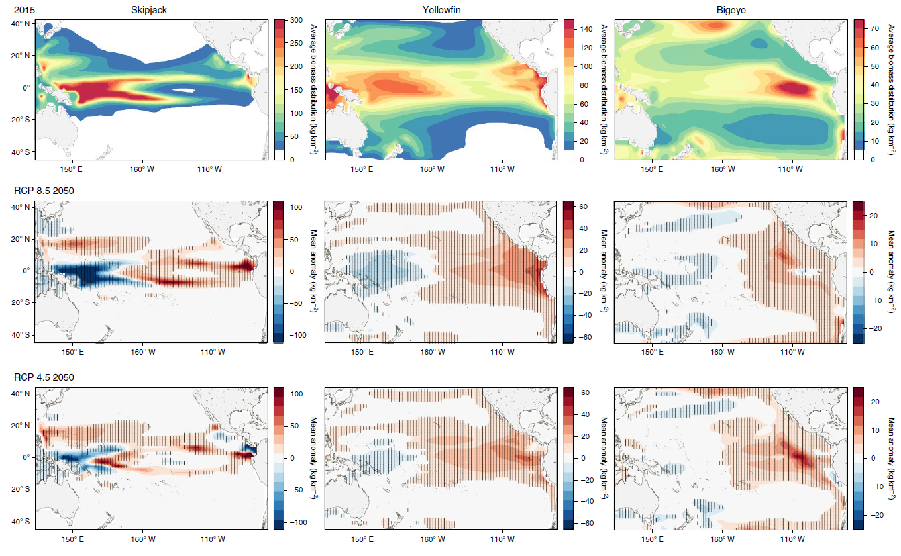
Will climate change change overlap ?
Migration effect?
Mining national waters?
Bell et al., 2021

Slide 13

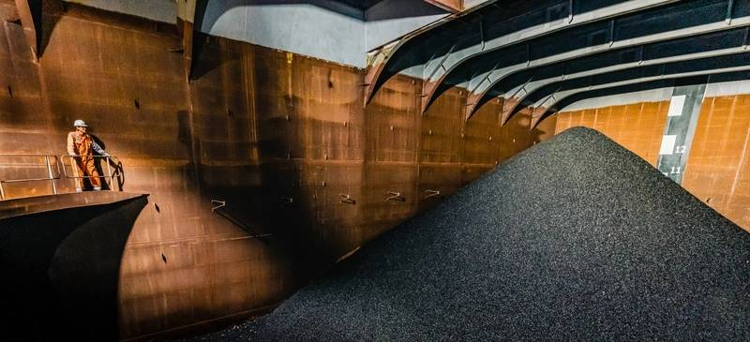
Mining code is currently being developed at the ISA
International Seabed Authority:
  No commercial mining yet
    Mining tests have been conducted
Now is the time to engage
  Discussions on regulations has accelerated
  Regulations not finished
  Regulations discuss ‘other ocean users’
    E.g., sea cables (International Cable Protection Committee is an observer)
    Fisheries are not well represented
  First commercial license application in 2024?
©TMC

Slide 14
Options moving forward
High-seas fisheries and the Blue Economy
  Interest of stakeholder should be considered
WCPFC could request Observer status
Develop mechanisms for information exchange
  Ensure resources and time for WCPFC staff to engage on deep-sea mining and fisheries interactions
  Engage with WCPFC Member States on deep-sea mining and fisheries interactions
    Especially ISA delegates
Encourage ISA to consider ecosystem-based management
  Consider other ocean users in Mining Code and Regional Environmental Management Plan (REMP)

Slide 15




Acknowledgements
grientj@hawaii.edu

