Slide 1
MI-WP-03 REV1 South Pacific albacore iTRP WCPFC SC20 Manila, Philippines
SPC-OFP 14-21 August 2024

Slide 2
SPA iTRP
Recalibrate the iTRP based upon the new assessment
Evaluate the implications of the range of depletion levels requested by WCPFC20 (0.42 – 0.56 SB_{F=0})
Recalibration – used the requested approach of WCPFC20
0.96 x median of
mean(SB₂₀₁₇/SB_{F=0,2007-2016}, SB₂₀₁₈/SB_{F=0,2008-2017}, SB₂₀₁₉/SB_{F=0,2009-2018}) from each assessment run
result: 50% SB_{F=0}

Slide 3
SPA iTRP – alternative depletions
Used stochastic projections and look at long term implications
Catch based projections – based on numbers of fish
Adjust future catch to achieve depletions in the long term
Baseline 2020-2022 catch levels in the WCPFC-CA. Remainder of EPO ‘set’ at 22,500 mt
Two scenarios
Adjust WCPFC-CA LL and TR fisheries up and down, constant catch in remainder EPO
Adjust across the whole of the South Pacific (where EPO adjusted from 22.5k)
50 projections for 40 yrs across the 100 assessment models
Future recruitment ~ 1973 - 2020

Slide 4
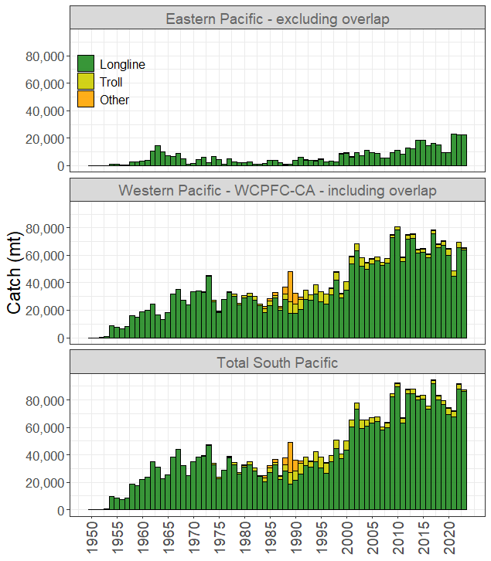
SPA iTRP – catch assumptions
Set 22,500 mt
~60,700 mt (LL + TR)

Slide 5
SPA iTRP ‘fishery control’ – WCPFC-CA

Slide 6
SPA iTRP preliminary results

Slide 7
SPA iTRP
WCPFC-CA only adjustment to catch (numbers)
Catch scalar (cf 2020-2022 avg) | Approx catch (LL+TR, mt) |  | Depletion |  |  |  | Vulnerable biomass |  | F/F_{MSY}
 | WCPFC-CA | Remainder EPO | Long term avg SB/SB_{F=0} (WCPFC-CA) | % 2017-2019 SB_{F=0} | Depletion relative to iTRP | Risk < LRP | VB/VB₂₀₁₇₋₂₀₁₉ | VB/VB₂₀₁₃ | F/F_{MSY} | Risk F>F_{MSY}
0.875 | 53,100 | 22,500 | 0.56 | 1.07 | 1.11 | 3% | 0.82 | 0.74 | 0.18 | 5%
0.935 | 56,750 | 22,500 | 0.53 | 1.01 | 1.05 | 5% | 0.79 | 0.70 | 0.19 | 7%
1 | 60,700 | 22,500 | 0.50 | 0.96 | 1.00 | 8% | 0.74 | 0.67 | 0.20 | 9%
1.180 | 71,300 | 22,500 | 0.46 | 0.88 | 0.92 | 16% | 0.64 | 0.57 | 0.24 | 14%
1.250 | 75,900 | 22,500 | 0.42 | 0.80 | 0.84 | 19% | 0.59 | 0.53 | 0.25 | 18%

Slide 8
SPA iTRP – caveats
Note when considering higher future catches, some projections ‘failed’ (insufficient fish to allow the projected catch to be taken)
These runs set to zero for the estimation of depletion and risk
SPA OMs convert catch in numbers to catch in weight.
Outcomes appear more pessimistic
SC20 will need to think about what approach is better

Slide 9
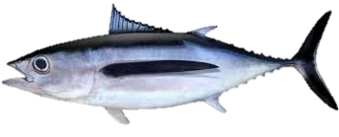
SPA iTRP – caveats
Projected catch
Numbers = 10 fish
Weight = 350kg
Weight = 400kg

Slide 10
SPA iTRP – caveats
Projected catch
Numbers = 10 fish
Weight = 350kg
Weight = 300kg?

Slide 11
SPA iTRP – catch v weight (see Appendix)
WCPFC-CA only adjustment to catch (numbers/weight) (EPO fixed)
Catch scalar (cf 2020-2022 avg) | Approx catch (LL+TR, mt) | Depletion |  | Vulnerable biomass
 | WCPFC-CA | Long term avg SB/SB_{F=0} (WCPFC-CA) | Risk < LRP | VB/VB₂₀₁₇₋₂₀₁₉ | VB/VB₂₀₁₃
0.875/0.85 | 53,100/51,600 | 0.56 | 3%/6% | 0.82/0.83 | 0.74/0.74
0.935/0.925 | 56,750/56,150 | 0.53 | 5%/10% | 0.79/0.78 | 0.70/0.70
1 / 1 | 60,700 | 0.50 | 8% / 14% | 0.74/0.73 | 0.67/0.68
1.18/1.075 | 71,300/65,250 | 0.46 | 16%/20% | 0.64/0.68 | 0.57/0.61
1.25 / 1.15 | 75,900/69,800 | 0.42 | 19%/26% | 0.59/0.64 | 0.53/0.57

Slide 12
Recommendations
Note the recalibrated iTRP depletion value based on the submitted 2024 stock assessment grid, for use in provision of stock status advice relative to this level.
Consider the levels of fishing necessary to achieve the recalibrated iTRP and alternative depletion levels, and corresponding catch, catch rate and risk outcomes.
Consider whether alternative depletion levels should be evaluated.
Consider the implications of management action within the WCPFC Convention Area only, and those where action is taken across the South Pacific.
Provide advice on the methodology for longline catch-based projections in terms of use of catch in numbers of fish or catch weight as their basis.

Slide 14
SP-wide catch (numbers)
Catch scalar (cf 2020-2022 avg) | Approx catch (mt) |  | Depletion |  |  |  | Vulnerable biomass |  | F/F_{MSY}
 | WCPFC-CA | Remainder EPO | Long term avg SB/SB_{F=0} (WCPFC-CA) | % 2017-2019 SB_{F=0} | Depletion relative to iTRP | Risk < LRP | VB/VB₂₀₁₇₋₂₀₁₉ | VB/VB₂₀₁₃ | F/F_{MSY} | Risk F>F_{MSY}
0.880 | 53,400 | 19,800 | 0.56 | 1.07 | 1.11 | 3% | 0.84 | 0.75 | 0.17 | 4%
0.940 | 57,050 | 21,150 | 0.53 | 1.01 | 1.05 | 5% | 0.79 | 0.71 | 0.19 | 6%
1 | 60,700 | 22,500 | 0.50 | 0.96 | 1.00 | 8% | 0.74 | 0.67 | 0.20 | 9%
1.100 | 66,800 | 24,750 | 0.46 | 0.88 | 0.92 | 13% | 0.67 | 0.60 | 0.23 | 13%
1.180 | 71,600 | 26,550 | 0.42 | 0.80 | 0.84 | 17% | 0.62 | 0.56 | 0.24 | 17%

