Slide 1
WCPO skipjack MP monitoring strategy MI-WP-02 Scientific Committee Meeting Manila, Philippines 14-21 August 2024
SPC-OFP August 2024

Slide 2
Monitoring Strategy
Routinely checks management procedure performing as expected
Considers:
procedures for evaluating and testing MPs;
identification of scenarios to be added to the OM grid;
preparation and application of the EM
performance of the MP as a whole.
May identify changes in the dynamics of the fishery resulting from environmental, economic or social factors that may require a reconsideration for the management objectives and the testing of alternative MPs

Slide 3
Where are we?
Elements and outline in CMM 2022-01
Monitoring strategy framework presented to SC19 and WCPFC20
SC19 supported the proposed monitoring strategy (scheduled for adoption at WCPFC20)
WCPFC20 noted a need for intersessional work to develop it further for WCPFC21
Issues arising:
Monitoring catch and effort levels specified under the MP
Practical issues when running the MP
Implementation of catch and effort limits arising from MP

Slide 4
Monitoring catch and effort
Compliance with MP outputs
TCC tasking to review catch and effort in relation to catch and effort limits specified by the MP
For fisheries subject to the MP (CMM 2022-01)
When data become available

Slide 5
Updating estimation method
Issue of reduced pole and line fishing in tropical region
CPUE time series input into estimation method
Covered in SC20-MI-WP-01

Slide 6
Alignment with CMM 2023-01
Implementation of WCPO skipjack MP through TT-CMM (CMM 2023-01)
Disconnect between MP settings and effort levels detailed in Tables 1 and 2
Revise MP to align with CMM 2023-01
Revise CMM 2023-01 to align with MP
Consider the new FAD closure period within CMM 2023-01
May require additional MP testing

Slide 7
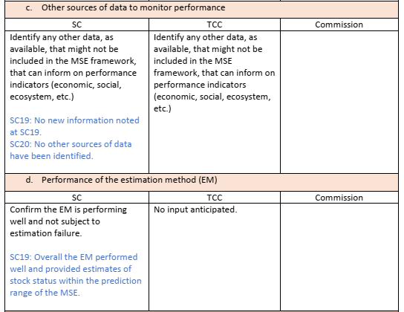
Monitoring strategy table
SC19/WCPFC20 table updated with details above

Slide 8
Recommendations
Review the information provided in the skipjack MP monitoring strategy (Table 1)
Add any additional issues and commentary to Table 1 column 1 (SC) for consideration by TCC20 and WCPFC21.

