Slide 1
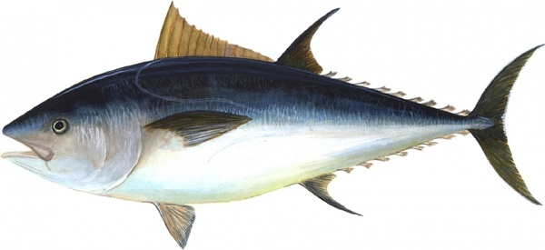
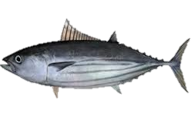
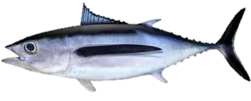
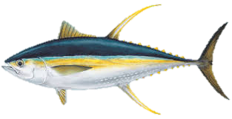
A compendium of indicators for target tuna stocks Steven Hare, Graham Pilling, Robert Scott, Tiffany Vidal, and Peter Williams WCPFC/SC20-2024/SA-WP-07
20th Scientific Committee
14-22 August 2024
Manila, Philippines

Slide 2
Introduction
The “Indicators” paper is an annual SC report tracking a set of indices for the four target tuna stocks (since SC9)
Includes short-term (3 year) projections under status quo (2023) catch/effort levels
An additional report on South Pacific albacore (SA-IP-07) is also produced annually, but results not presented here
Will present indicators for the three tuna stocks other than South Pacific as there is a new assessment (not reported in this paper)
There is overlap with GEN-1, possible time savings to combine; alternatively open to suggestions for enhancements to this paper

Slide 3
Indicators
Catch by gear
CPUE indices by gear
Spatial maps of catch, effort and CPUE
Catch at length/weight by gear type
Mean weight by gear type
Stochastic stock projections

Slide 4
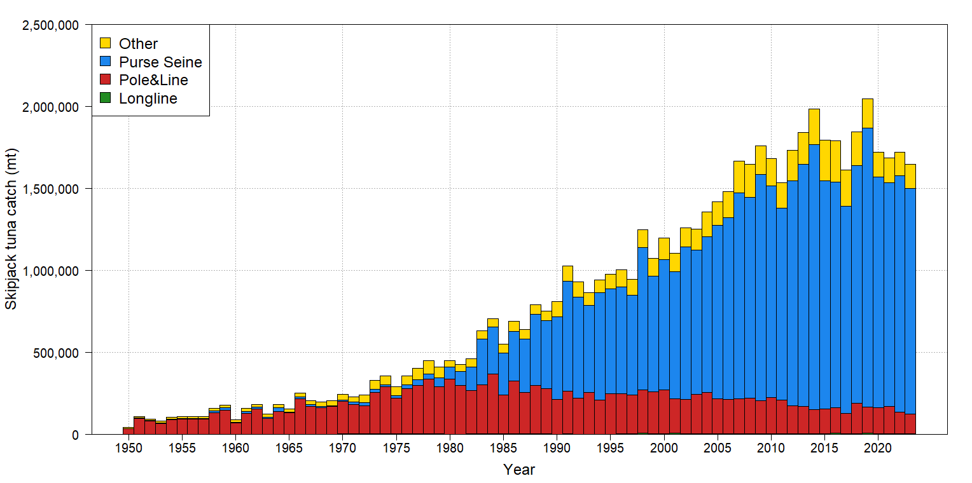
Skipjack – Total catch by gear
Gear | Prop. | Change from 2022 2018-22 | Change from 2017-2021 avg
PS | 84% | - 4% | -7%
PL | 8% | - 8% | - 25%
Other | 8% | + 3% | + 11%
All | 100% | - 4% | - 9%
2023 catch – 1,647,702t. (15th highest)
Info of note:
A relatively stable fishery for 15 years
2023 PS catch was highest proportion on record (same as 2022)
2023 PL catch was lowest in 50 years

Slide 5
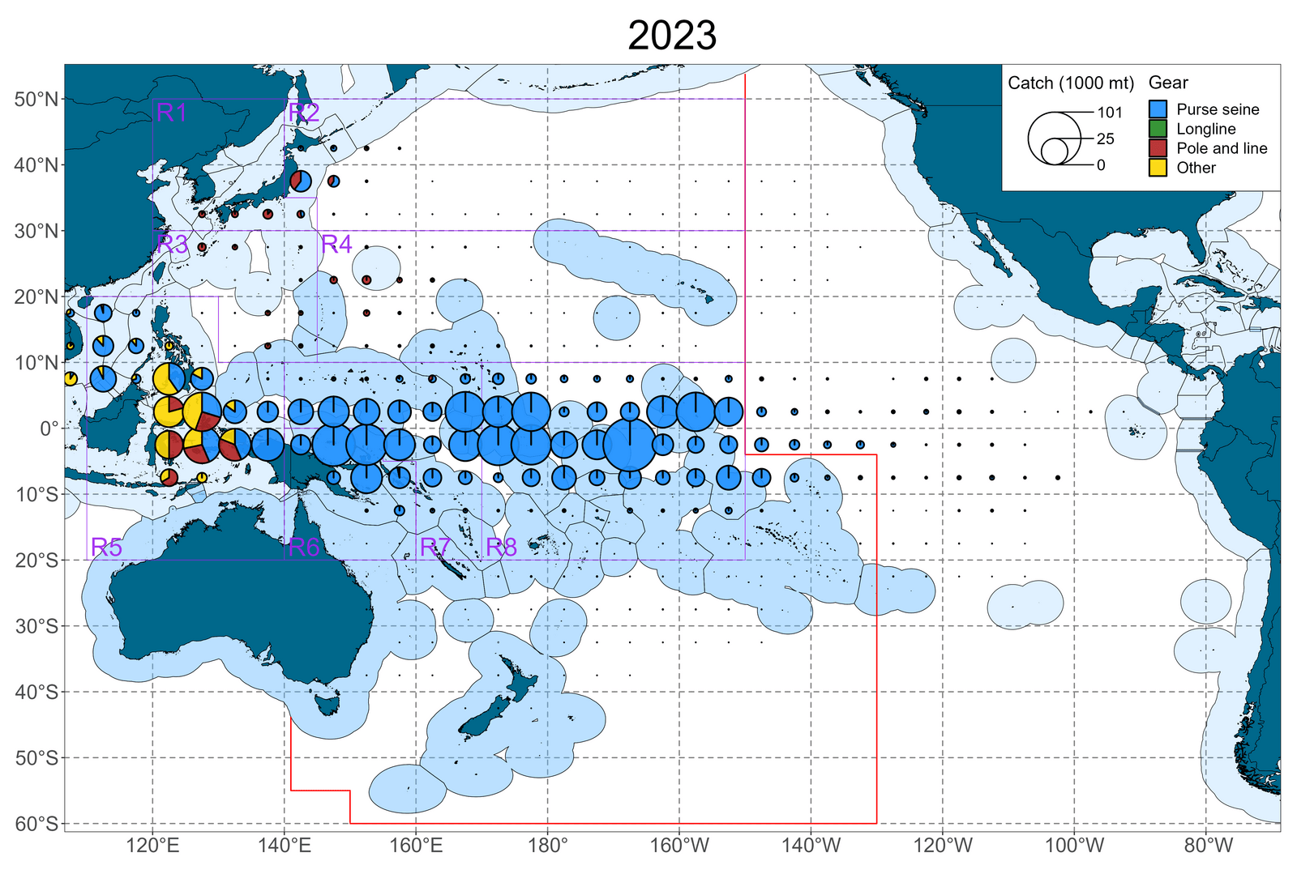
Skipjack – distribution of catch
Catch map details:
2023 Eq. Pacific catches shifted back east relative to recent years (likely due to El Niño conditions)
Pole and line proportion continues decline
2023 EPO catches incomplete

Slide 6
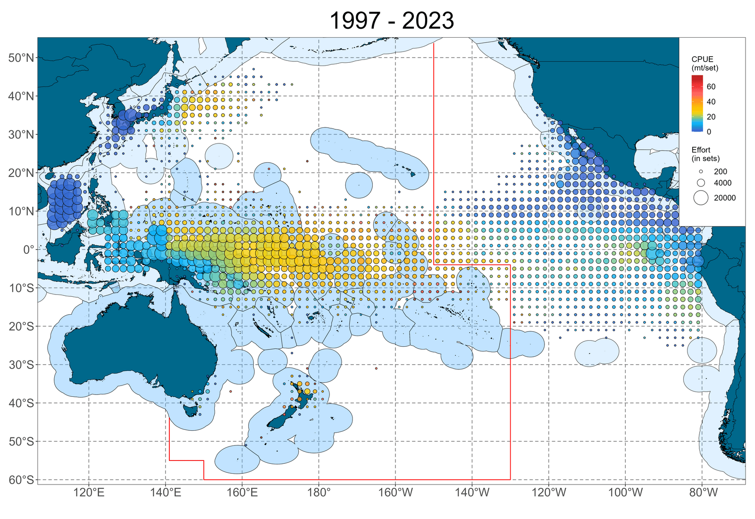
Skipjack – distribution of PS CPUE
CPUE map details:
2023 saw very high CPUE just east of Phoenix islands
El Niño effect most likley

Slide 7
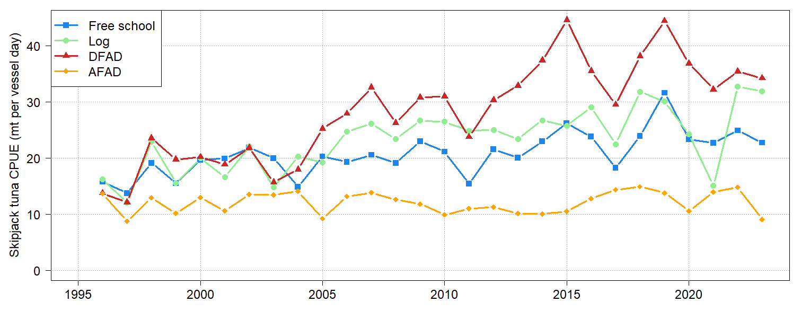
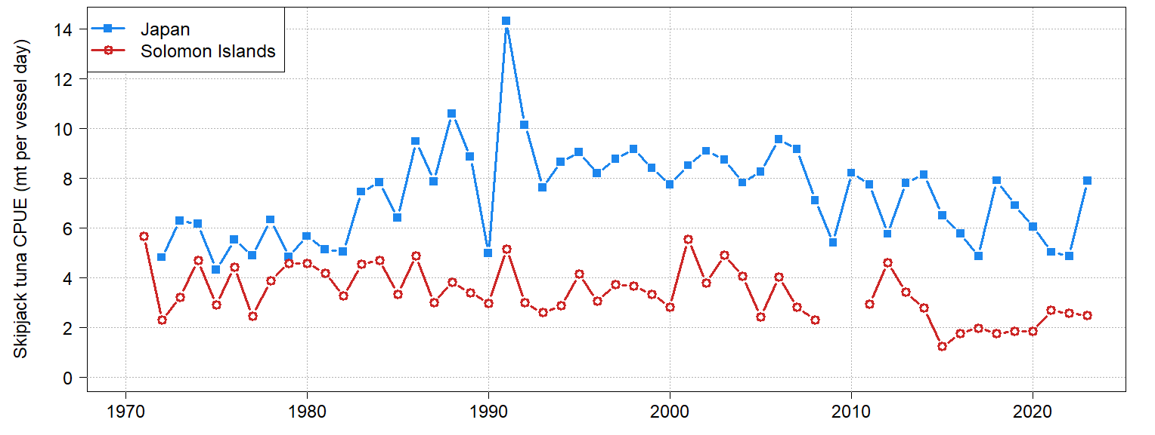
Skipjack – CPUE indices (nominal)
Purse seine
All four PS indices decreased from 2022; anchored FAD by 39%
Pole and line
Japan PL recovered to CPUE seen between 2010-2018; Solomons remains low

Slide 8
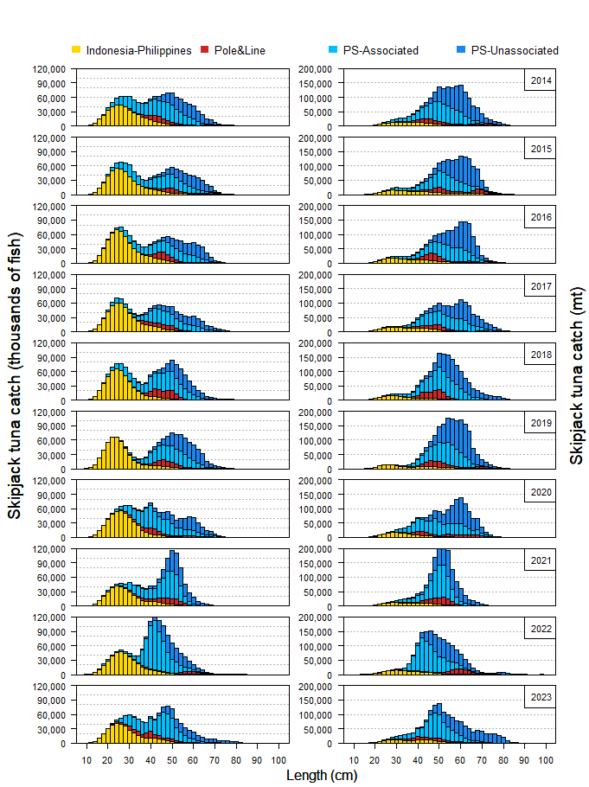
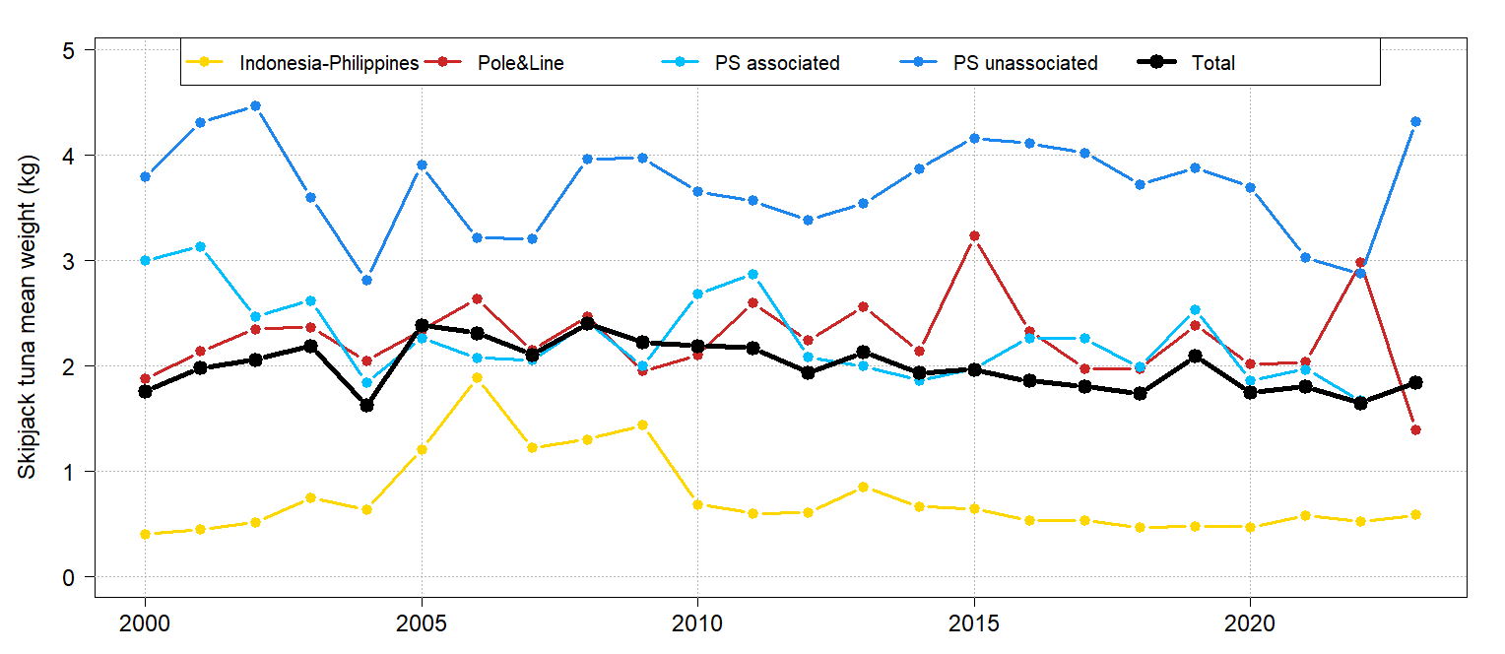
Skipjack – size distribution in catches
Decrease in mean size in 2021-22 may be biased observer sampling as most samples come from PNG, Solomon Islands AW and HSP 1. Big jump in PS Unassociated mean weight
Info of note:
Usually bimodal distribution of catch by length, with equal numbers of 20-40 cm and 45-70 cm

Slide 9
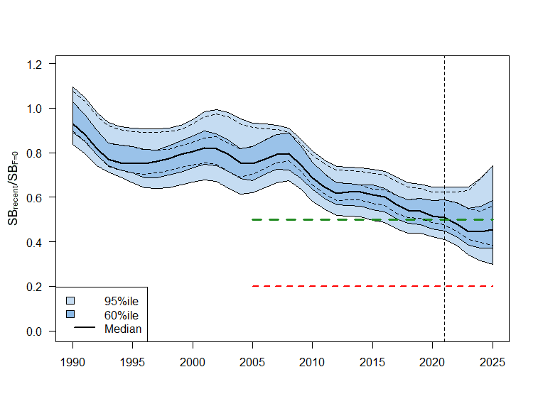
Skipjack – short term projections
Projection details:
Vertical line is last year of assessment
Actual catch/effort through 2023, then 2023 levels used through 2025
Future recruitment taken from 1982-2021 distribution
Projections are 100 simulations from 18 grid models; three example trajectories shown
Risk that recent (2022-2025) depletion
(SB₂₀₂₂₋₂₀₂₅/SB_{F=0}) < LRP = 0%
Notes:
Green line is agreed TRP (CMM 2022-01), which is Depletion of 0.5

Slide 10
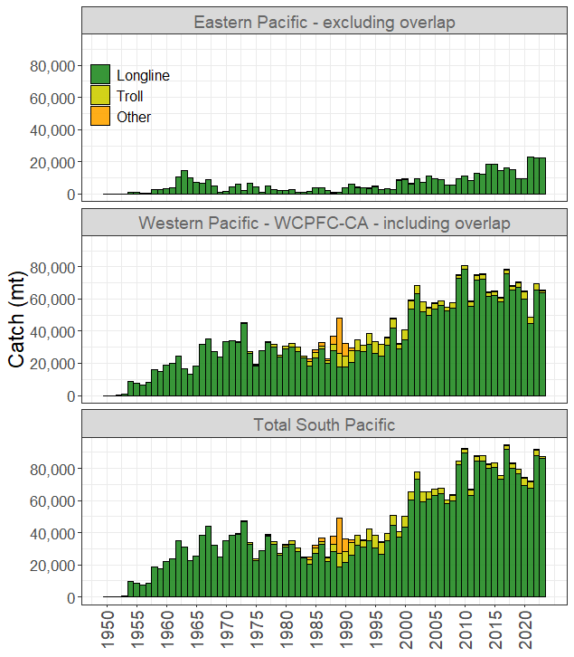
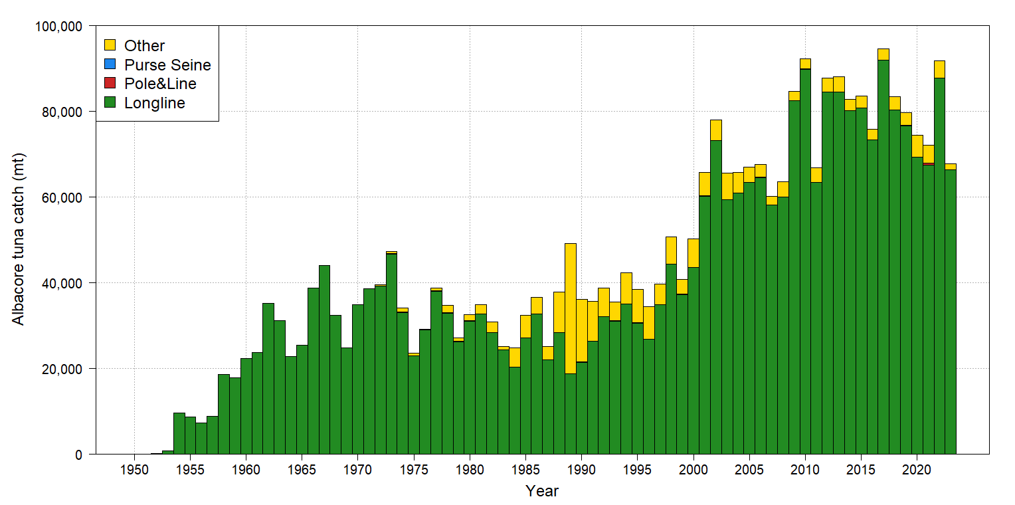
South Pacific albacore – Total catch by gear
Gear | Prop. | Change from 2022 2018-22 | Change from 2017-2021 avg
LL | 98% | - 2% | + 6%
Other | 2% | - 66% | - 63%
All | 100% | + -6% | + 2%
2023 catch – 65,510t (15th highest)
Info of note:
These data are WCPFC only
Highly variable over past 15 years
2022 low catch due in part to increased EPO catch
Troll catch 2020-22 highest since early 2000s, but dropped off again in 2023

Slide 11
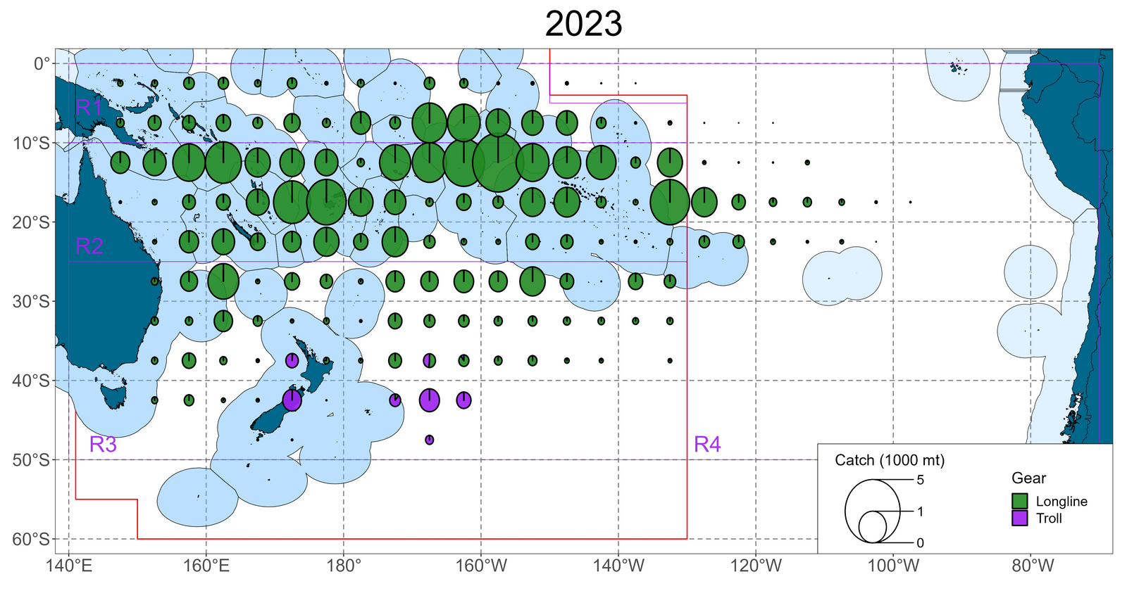
S.Pac. albacore – distribution of catch
Catch map details:
- Exceptional 2023 SPA catches between 5°S and 10°S centered around 160°W between Cook Islands and French Polynesia)

Slide 12
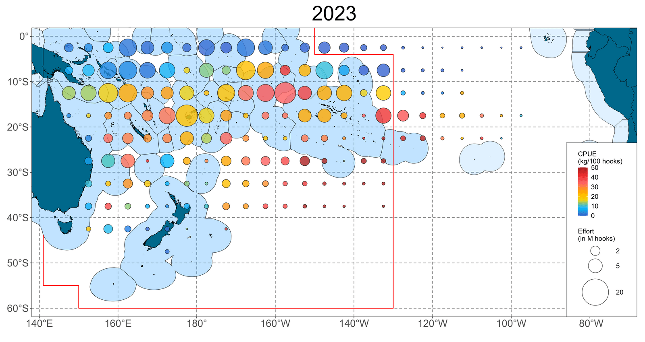
S. Pac. albacore – distribution of LL CPUE
CPUE map details:
Highest SPA LL CPUE in 2023 was same as high effort area

Slide 13
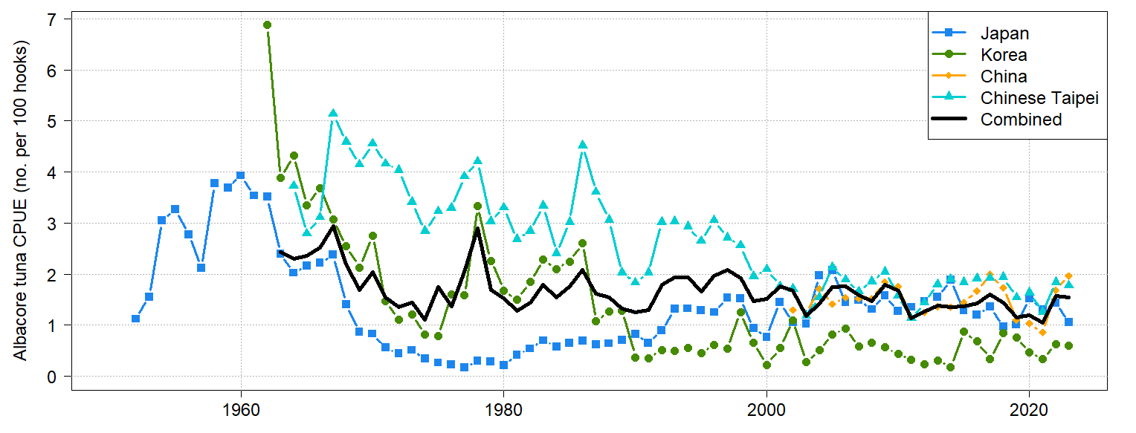
S. Pac. albacore – LL CPUE indices (nominal)
Combined (weighted) index decreased 2% from 2022 to 2023 but was still 20% higher than 2018-2022 average

Slide 14
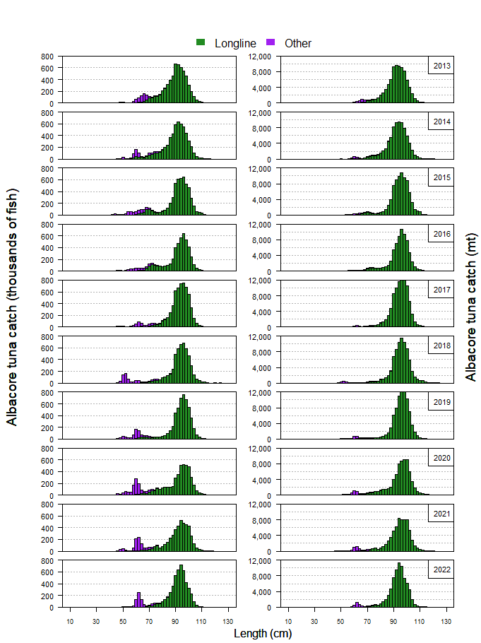
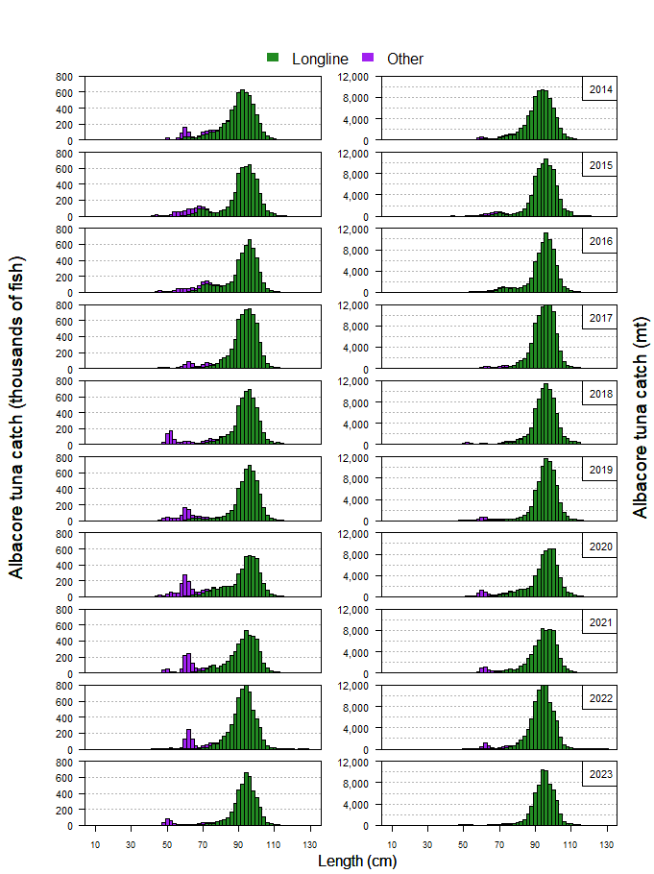
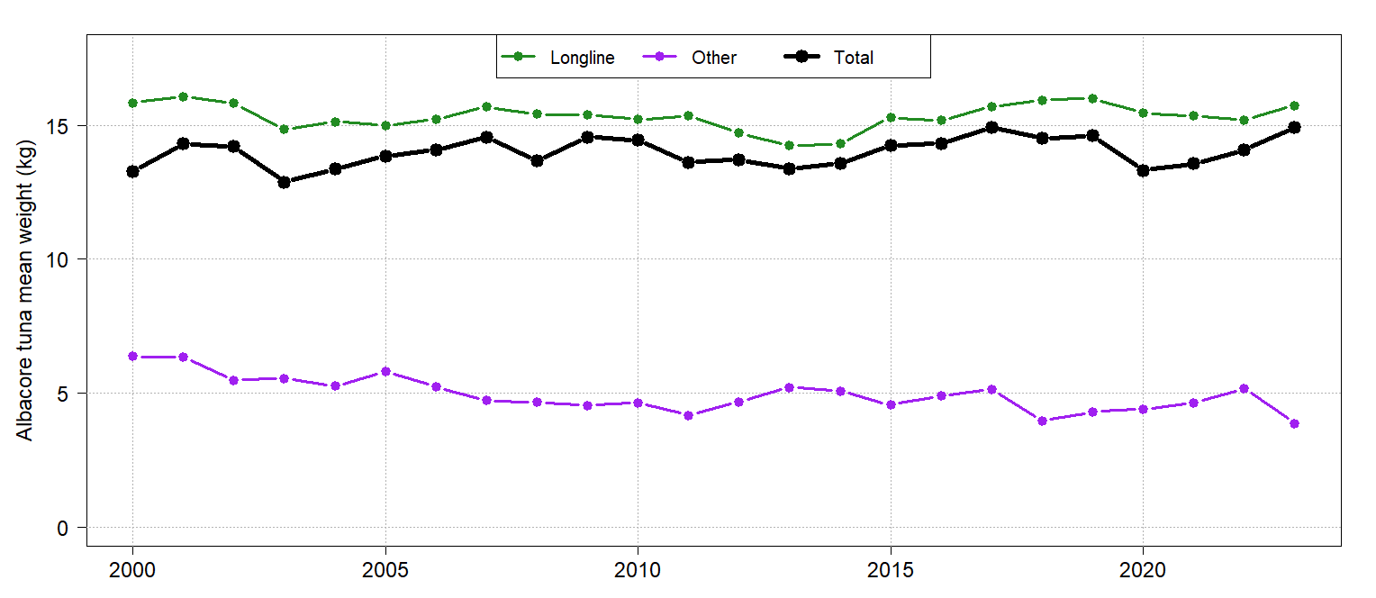
S.Pac. albacore – size distribution in catches
Distribution and mean size of SPA is quite stable over time. Some increase in catch of small (50-70cm) SPA the past 5 years
Info of note:
Troll caught albacore much smaller in size

Slide 15
S.Pac. Albacore – short term projections
See assessment or other Management Issues papers

Slide 16
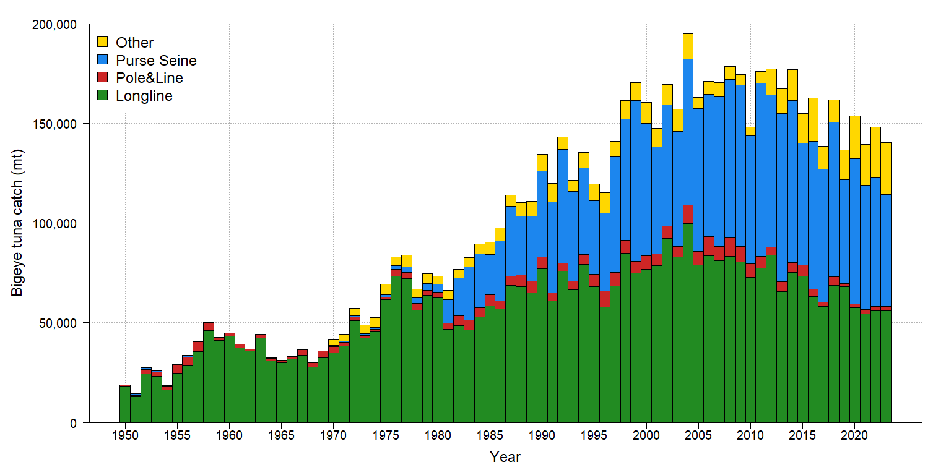
Bigeye – Total catch by gear
Gear | Prop. | Change from 2022 2018-22 | Change from 2017-2021 avg
PS | 40% | - 13% | - 15%
LL | 40% | 0% | - 8%
PL | 1% | - 1% | - 13%
Other | 19% | + 2% | + 39%
All | 100% | - 5% | - 5%
2023 catch – 140,309t (25th highest)
Info of note:
Bigeye catches have declined steadily for a decade, down > 25% since early 2000s
Other catch proportion highest on record

Slide 17
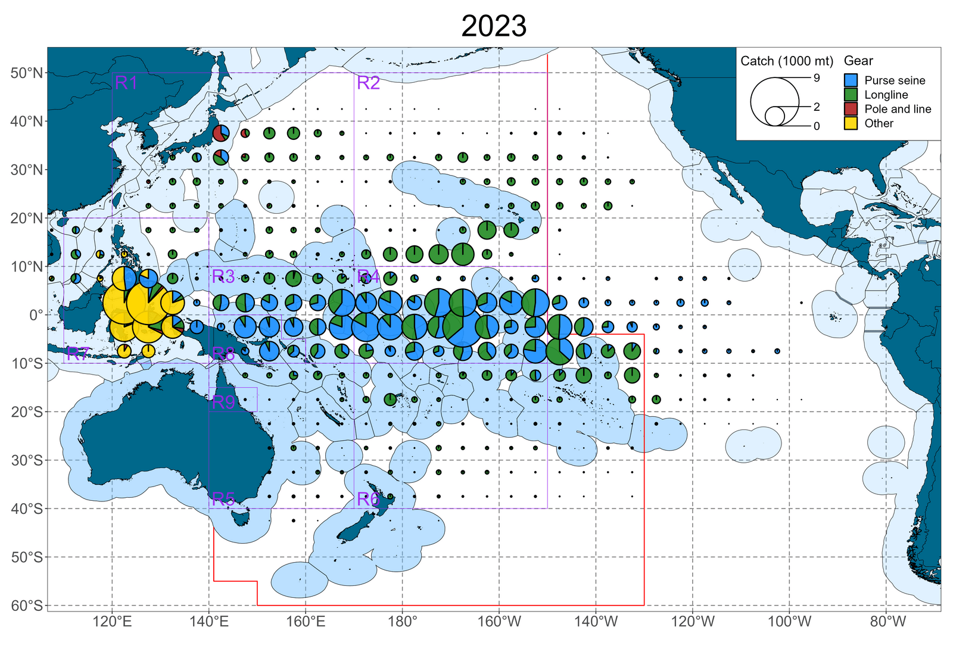
Bigeye – distribution of catch
Catch map details:
Increasing amount of catch in Other fisheries (ID/VN/PH)
Pole and line proportion continues decline
2023 EPO catches incomplete

Slide 18
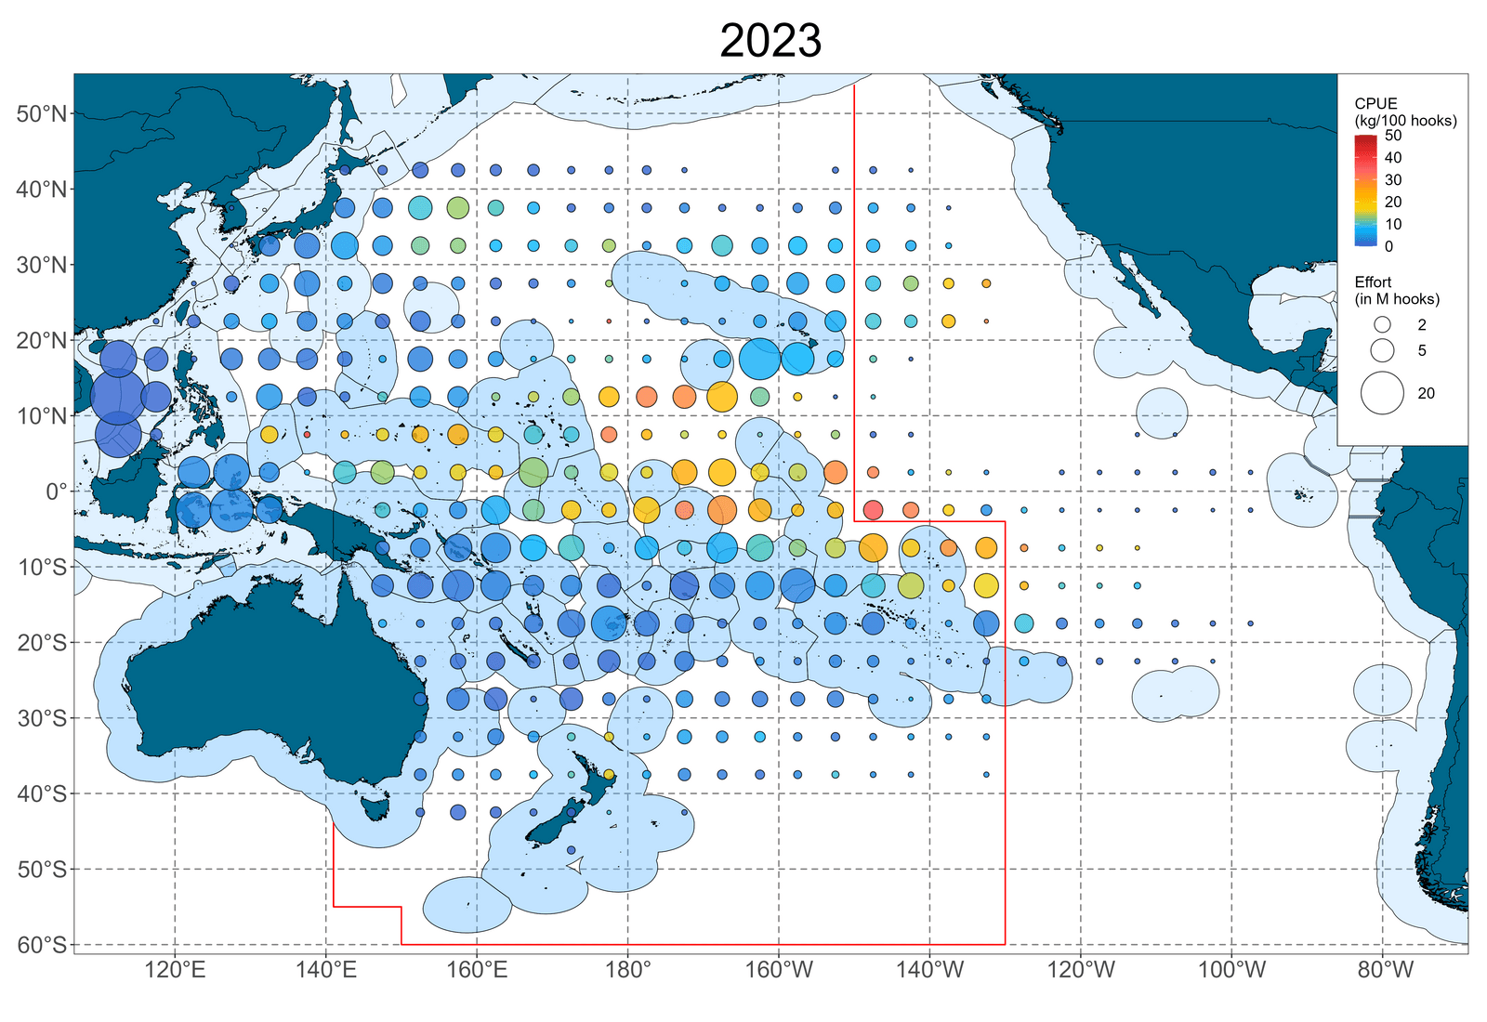
Bigeye – distribution of LL CPUE
CPUE map details:
High catch rates now restricted to equatorial eastern region and mostly east of 170°W
2023 EPO data incomplete

Slide 19
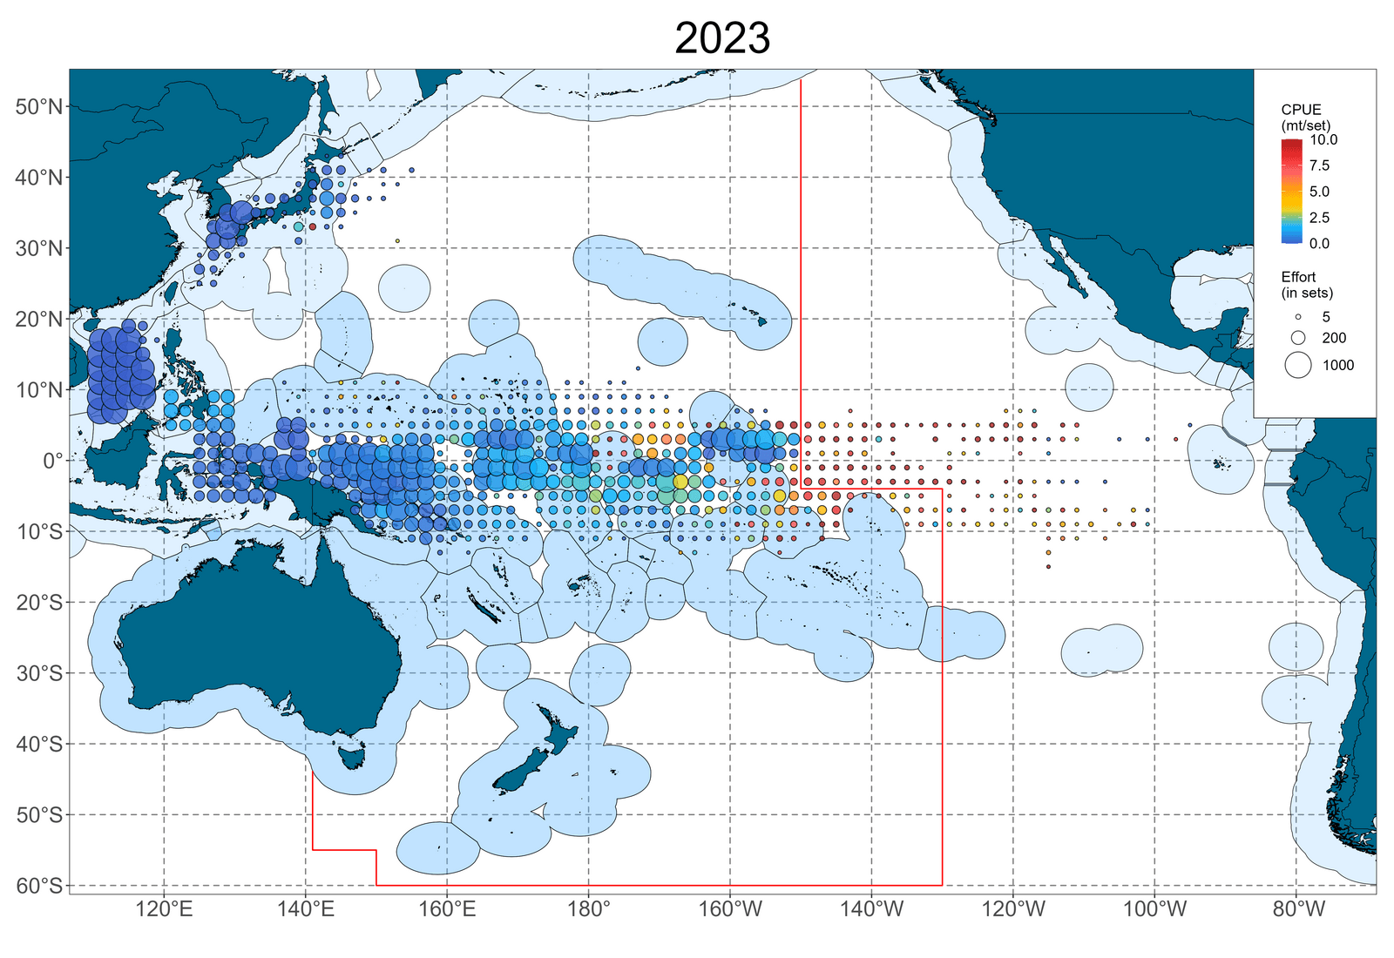
Bigeye – distribution of PS CPUE
CPUE map details:
Region between 155°W and 180° have been a bigeye “hotspot” last few years (HS area between KI-PX and KI-LI)
2023 EPO data incomplete

Slide 20
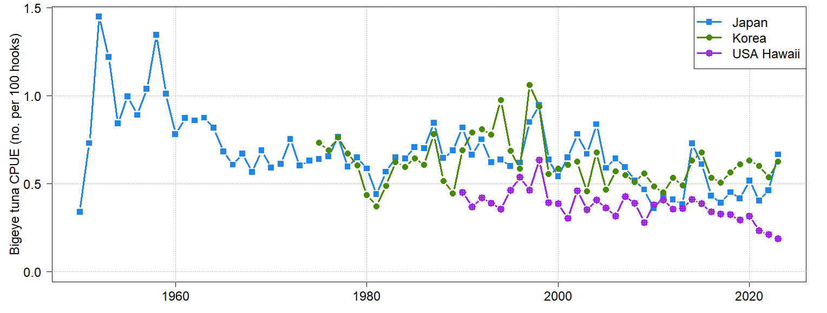
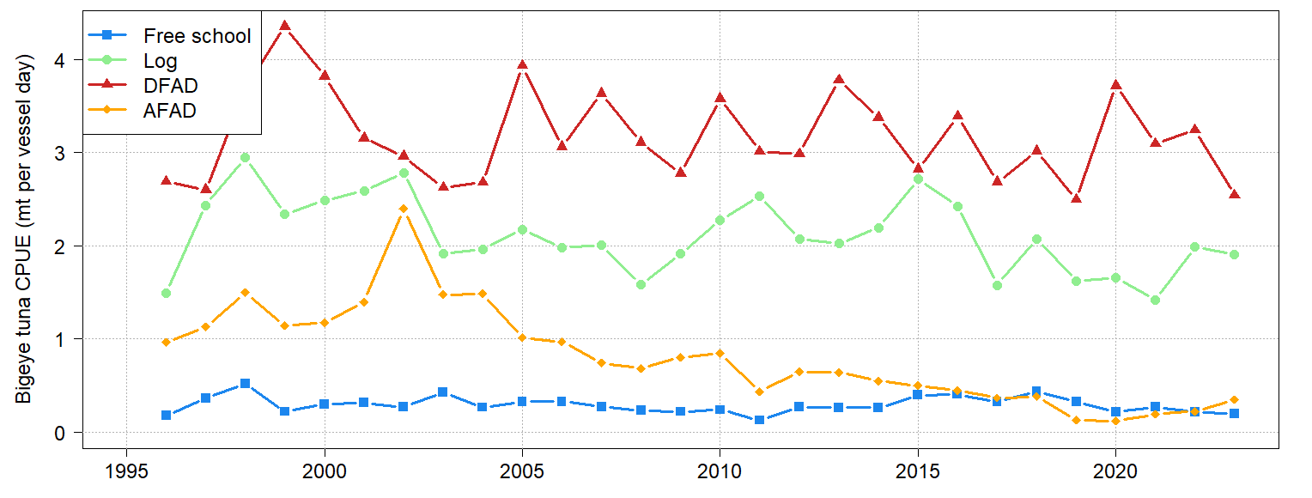
Bigeye – CPUE indices (nominal)
Longline
Japan (+44%) and Korea (+16%) both increased; US index continues decline, 2023 is lowest on record
Purse seine
dFAD index dropped 22%, others stable.

Slide 21
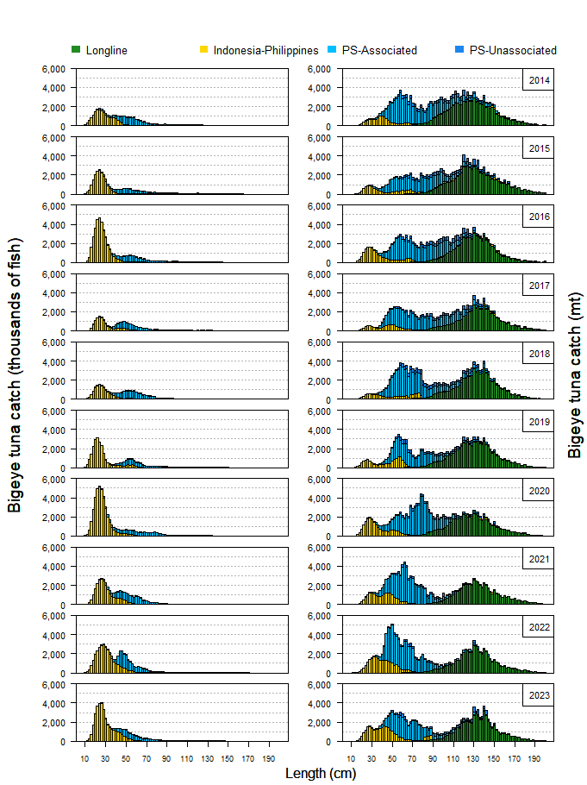
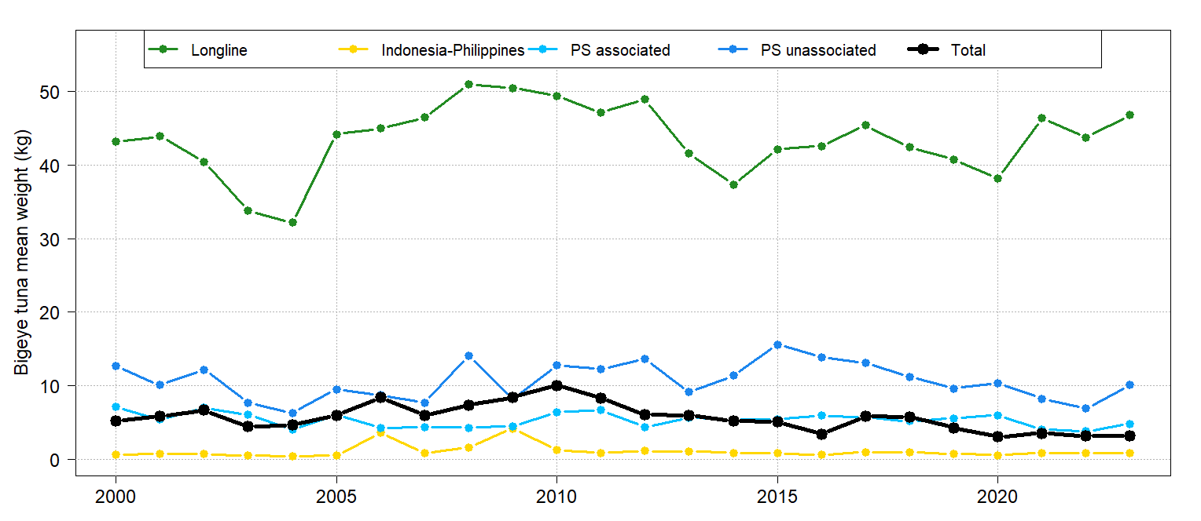
Bigeye – size distribution in catches
Decrease in mean size of PS fish in 2021-22 may be biased observer sampling as most samples come from PNG, Solomon Islands AW and HSP 1.
Info of note:
Overwhelming numbers of small fish taken in IN/PH and FAD PS sets
By weight, relatively similar amounts of small/large fish comprise catch

Slide 22
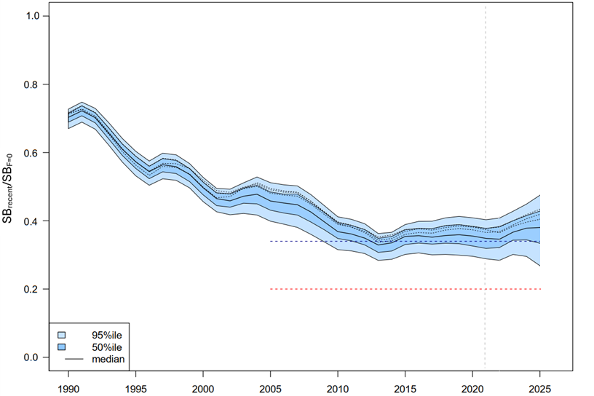
Bigeye – short term projections
Projection details:
Vertical line is last year of data used in assessment
Actual catch/effort through 2023, then 2023 levels used through 2025
Future recruitment taken from 1982-2021 distribution
Projections are 100 simulations from 54 grid models; three example trajectories shown
Risk that recent (2022-2025 depletion
(SB₂₀₂₂₋₂₀₂₅/SB_{F=0}) < LRP = 0%
Notes:
Blue horizontal line is mean 2012-2105 depletion

Slide 23
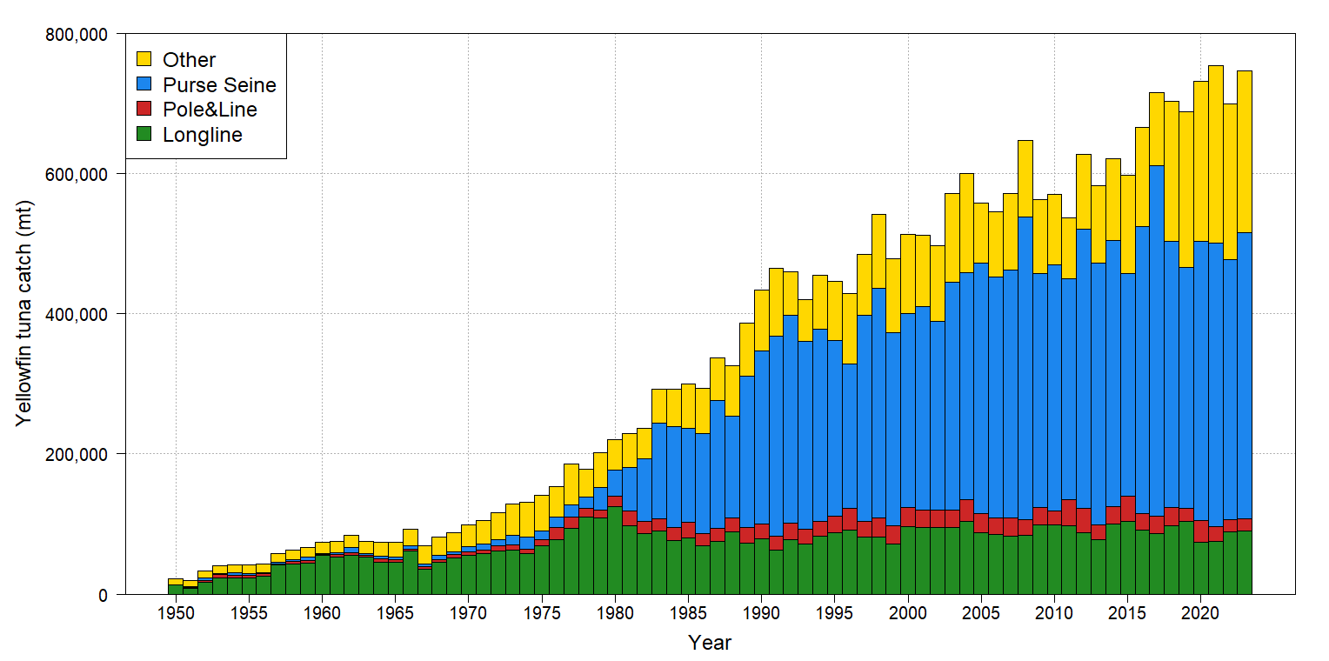
Yellowfin – Total catch by gear
Gear | Prop. | Change from 2022 2018-22 | Change from 2017-2021 avg
PS | 55% | + 10% | + 8%
LL | 12% | + 1% | + 2%
PL | 2% | 0% | - 22%
Other | 31% | + 4% | + 3%
All | 100% | + 7% | + 4%
2023 catch – 746,913t (2nd highest)
Info of note:
After decades of increase, recent stability in catches
Proportion taken in Other fisheries has declined from the recent high of 35%

Slide 24
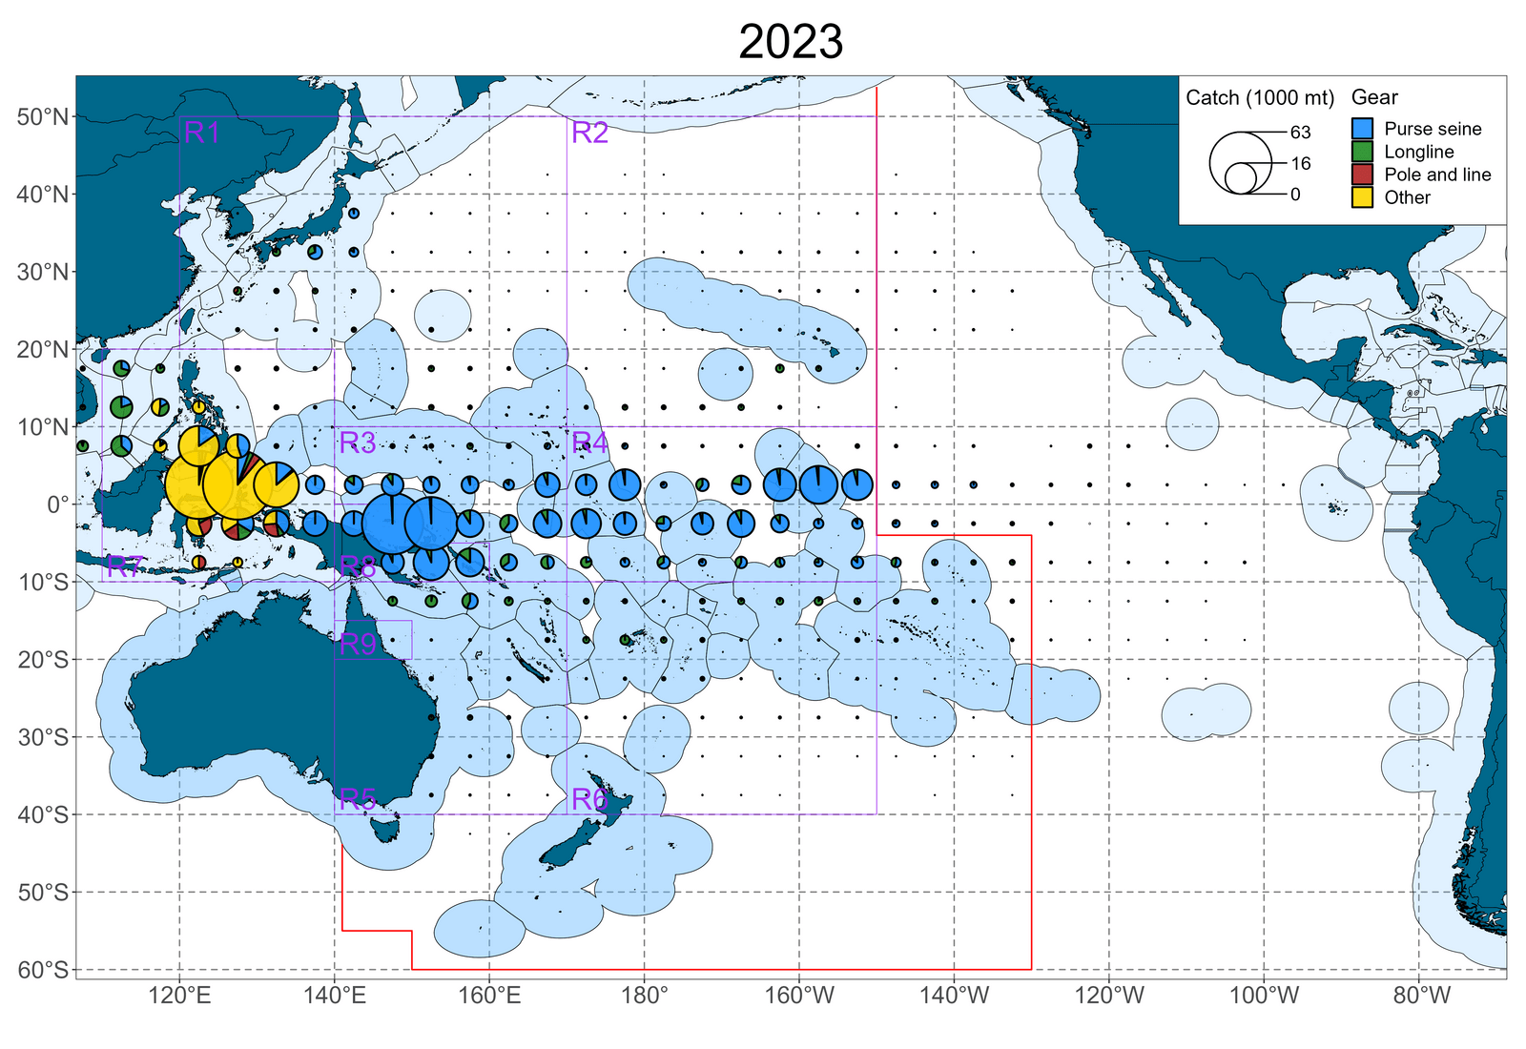
Yellowfin – distribution of catch
Catch map details:
Note westward distribution of catches relative to bigeye
2023 EPO catches incomplete

Slide 25
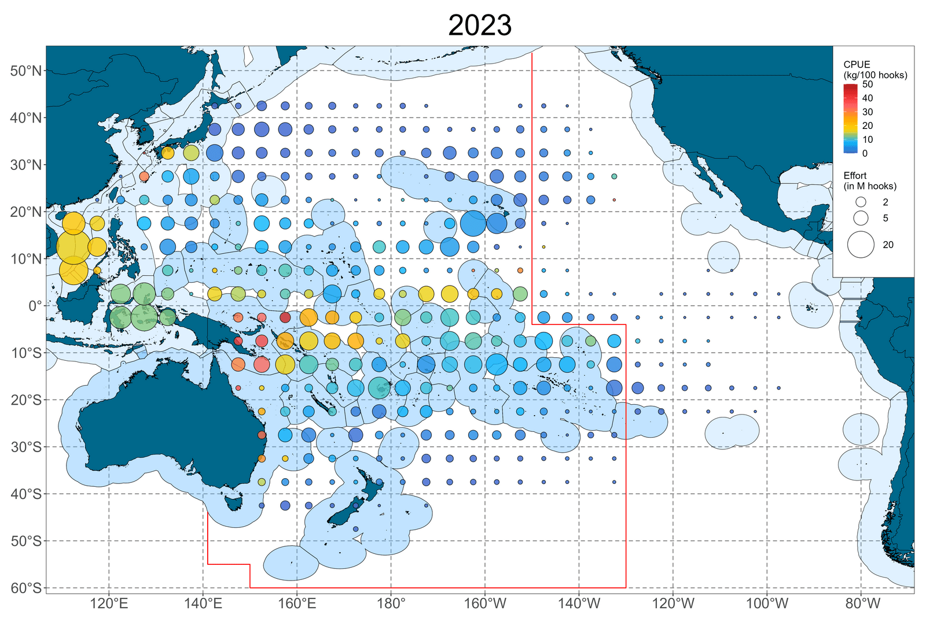
Yellowfin – distribution of LL CPUE
CPUE map details:
High CPUE region mostly just off PNG and Solomons
2023 EPO data incomplete

Slide 26
Yellowfin – distribution of PS CPUE
CPUE map details:
Fragmented locations of high CPUE, mostly now concentrated to west and in HS pocket between TV and KI
2022 EPO data incomplete

Slide 27
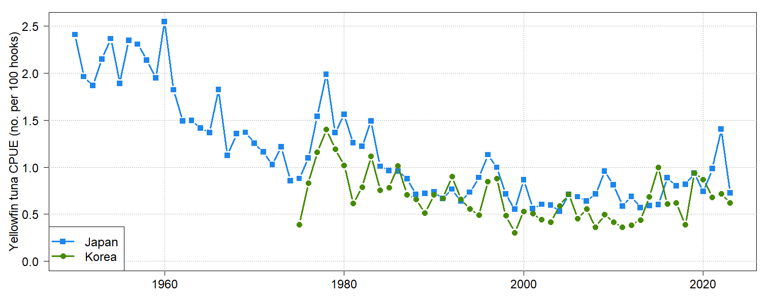
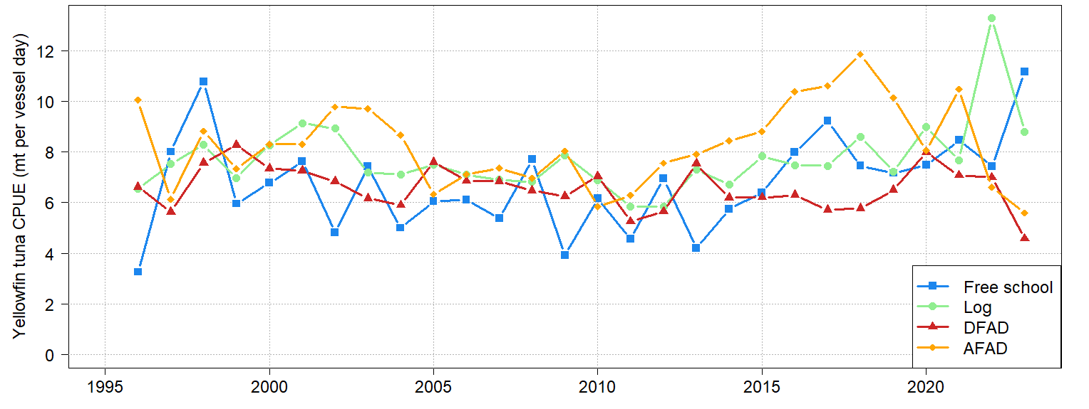
Yellowfin – CPUE indices (nominal)
Longline
Large 2023 decrease in Japan CPUE (-48%) after large 2022 increase
Purse seine
Some large changes in 2023: free school +50%, dFAD -35%

Slide 28
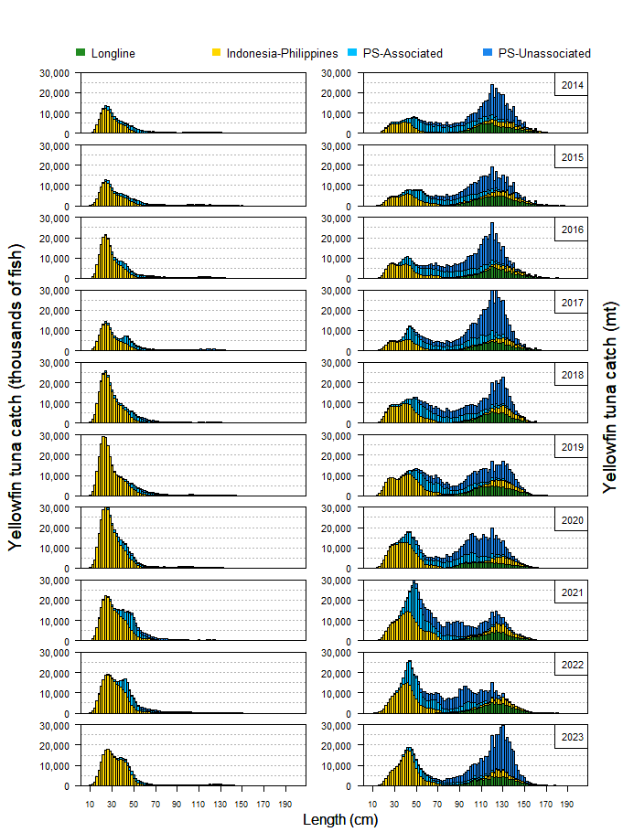
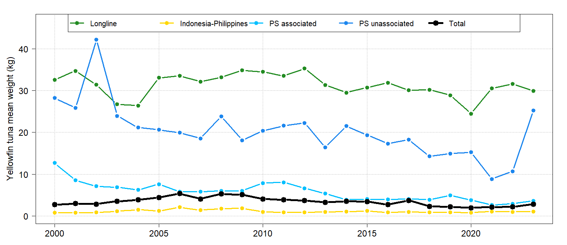
Yellowfin – size distribution in catches
Info of note:
Overwhelming numbers of small fish taken in IN/PH and FAD PS sets
By weight, relatively similar amounts of small/large fish comprise catch
Decrease in mean size of PS fish in 2021-22 may be biased observer sampling as most samples come from PNG, Solomon Islands AW and HSP 1.
Long term decline in mean weight of free school yellowfin.

Slide 29
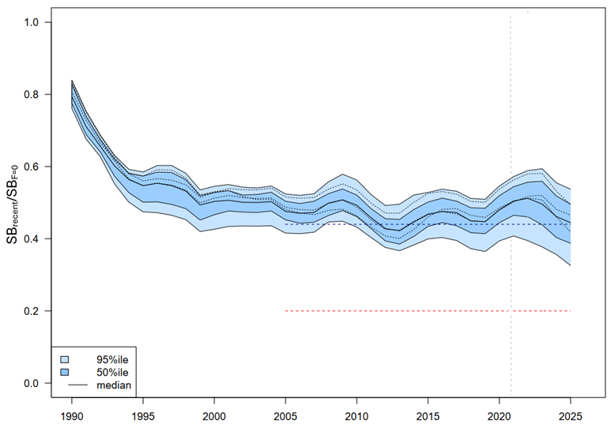
Yellowfin – short term projections
Projection details:
Vertical line is last year of data used in assessment Actual catch/effort through 2023, then 2023 levels used through 2025
Future recruitment taken from 1982-2021 distribution
Projections are 100 simulations from 54 grid models; three example trajectories shown
Risk that recent (2022-2025 depletion
(SB₂₀₂₂₋₂₀₂₅/SB_{F=0}) < LRP = 0%

