Slide 1
PROJ 113b
Development of a stock status and management advice
template for consistent reporting of stock assessment outcomes, uncertainties and risk
SA-WP-10
Philipp Neubauer
Date: August 2024

Slide 2
Survey results
Stock Assessment of WCPO silky shark

Slide 3
Survey
Current reporting
Current reporting of stock status and management advice is sufficiently detailed and clear
Mixed response with regards to reporting of uncertainty being sufficient
(≈2/3) of respondents considered current reporting of uncertainties sufficient for understanding risk
A majority of respondents thought that the current reporting is not sufficient or consistent across stocks.

Slide 4
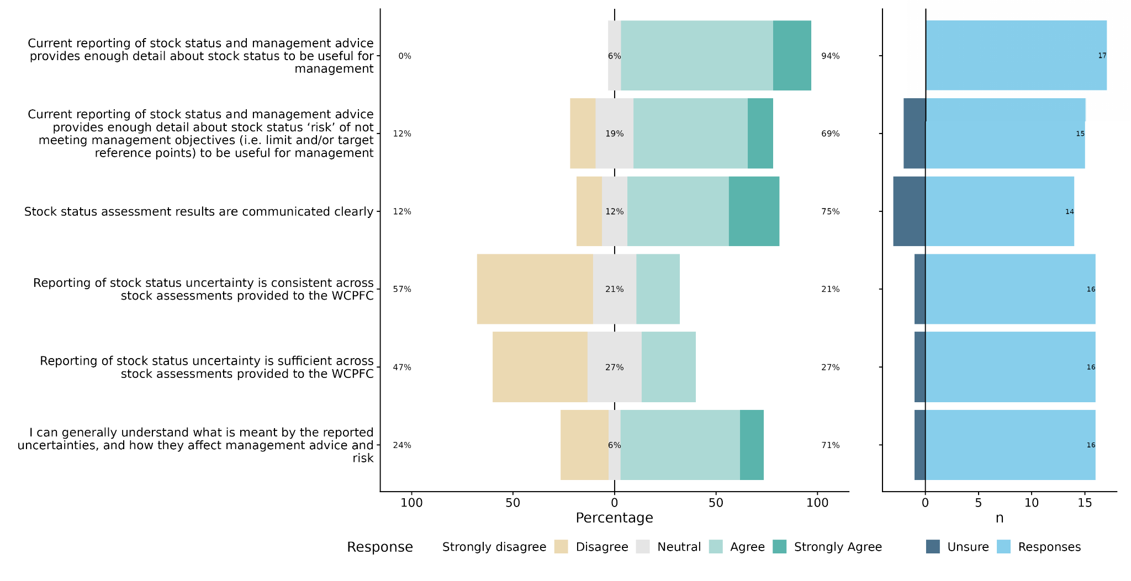
Survey

Slide 5
Survey
The role of uncertainty, and translating uncertainty into management advice and
decisions:
Generally agreement that uncertainty is an important aspect of reporting stock Assessments
Less agreement on whether uncertainty is sufficiently communicated to enable the application of the precautionary principle under the convention text:
only 29% of respondents considered that stock assessment advice is sufficiently informative for this purpose.
53% of respondents considered that that the role of uncertainty in stock assessments is sufficiently considered by the WCPFC SC when formulating management advice
Only 44% considered that uncertainty is sufficiently considered in management decisions.
Nevertheless, 62% of respondents considered that uncertainty influences management decisions at the WCPFC.

Slide 6
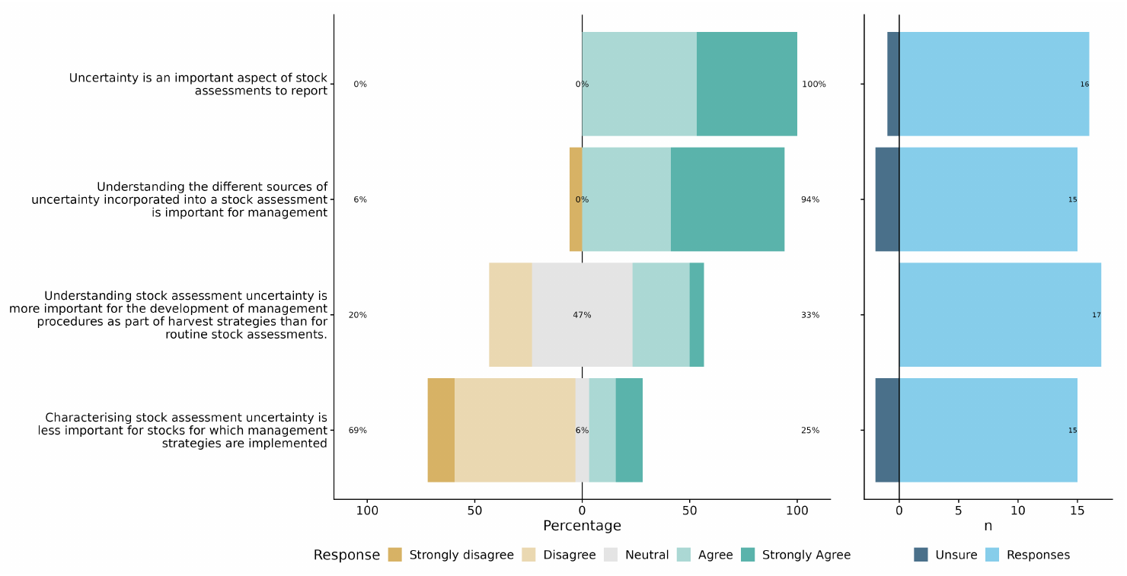
Survey

Slide 7
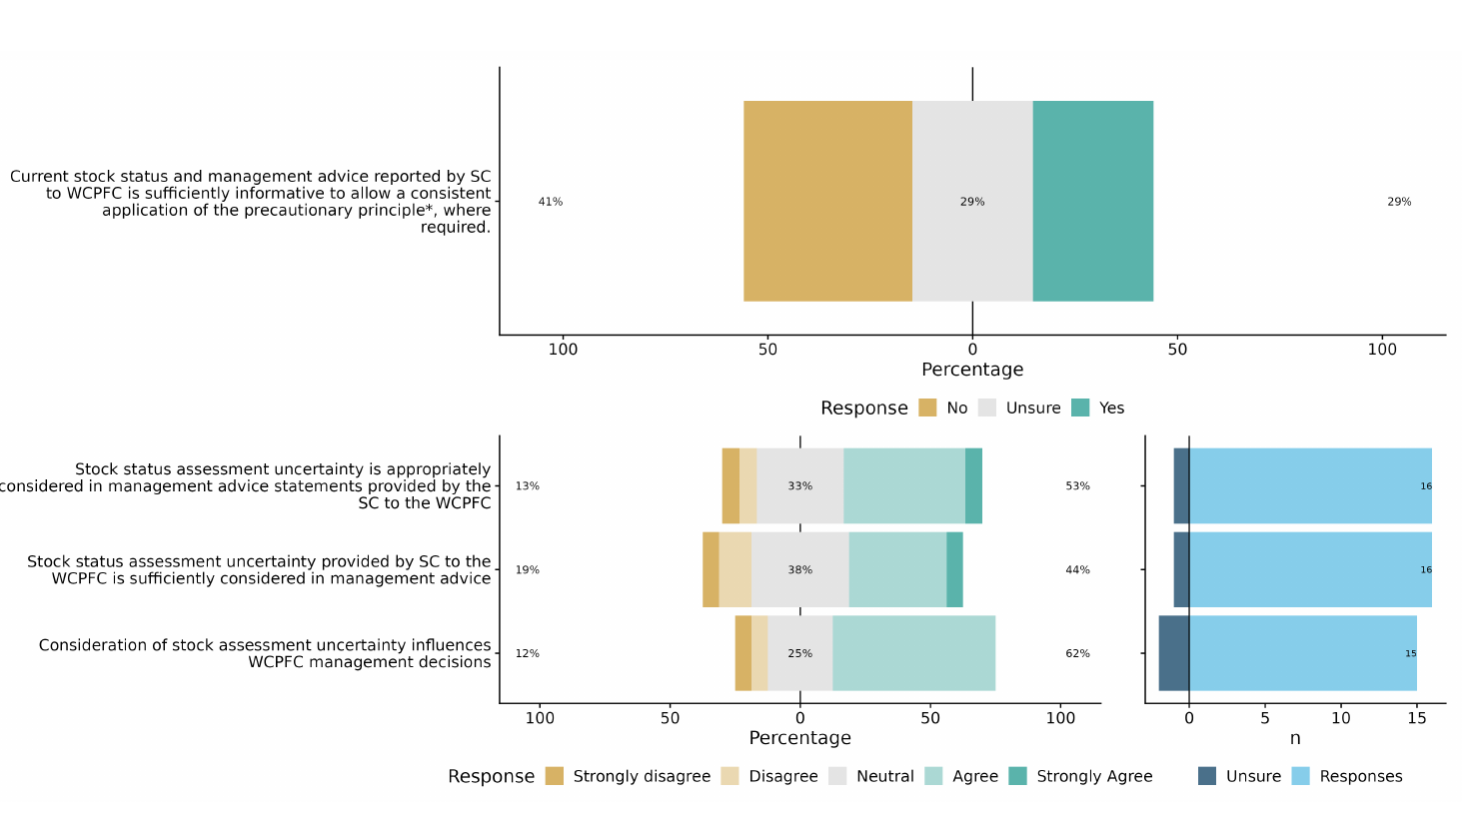
Survey

Slide 8
Survey
Developing a template to report stock status and management advice:
Respondents were asked to consider a template for reporting stock status and management advice, and to provide feedback on the elements of the template.
The template elements were based on aspects of the WCPFC SC’s stock assessment advice, international practice and resulting recommendations from Project 113.
All aspects suggested were found to be important (Useful or Must-have).
We considered that support for the proposed elements was sufficient to consider these in reporting stock status and management advice, and that a sufficiently clear structure should make it make it easier for managers to find the information they consider most useful in a consistent manner.

Slide 9
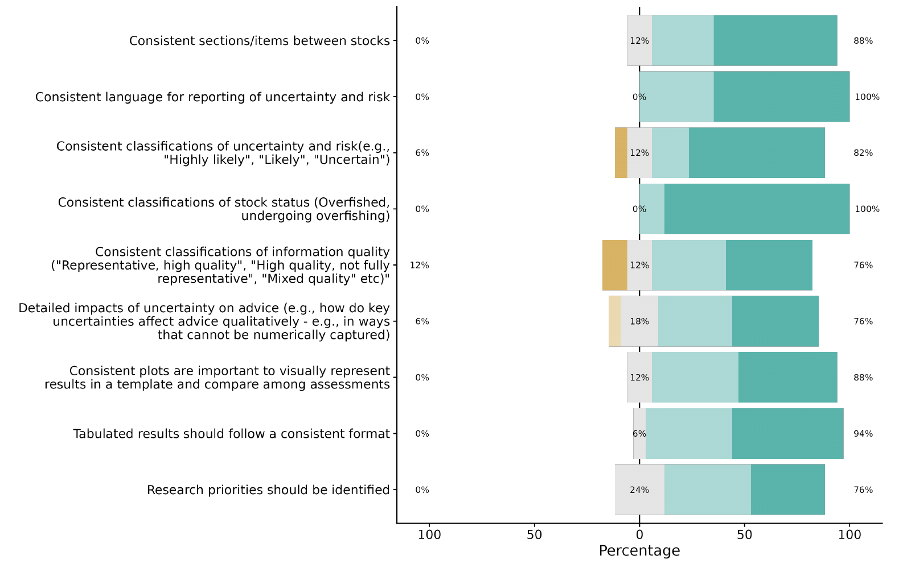
Survey

Slide 10
Recommendations
Stock Assessment of WCPO silky shark

Slide 11
Recommendations
Based on IPCC guidelines: Support transparency, consistency, and comparability, and are designed to support the use of scientific information in decision-making.
“…communicate the degree of certainty in key findings:
Confidence in the validity of a finding, based on the type, amount, quality, and consistency of evidence (e.g., mechanistic understanding, theory, data, models, expert judgment) and the degree of agreement. Confidence is expressed qualitatively.
Quantified measures of uncertainty in a finding expressed probabilistically (based on statistical analysis of observations or model results, or expert judgment).” (Mastrandrea et al. 2010)
The first point expresses the confidence in data, models and other aspects (or assessment) that lead to the findings, while the second point expresses the uncertainty in the findings (or stock status) themselves. This is a useful distinction, as it allows for a clear separation of the confidence in the underlying evidence from the uncertainty in the findings.

Slide 12
Recommendations
1. Rename sections of the Stock Status and Management Advice report to better reflect the content:
Currently, reports are split into ”Stock Status and trends” and ”Management Advice” sections. However, the content of each is not always consistent with the title, and the two sections are not always clearly distinguished.
The Stock Status section should be renamed to ”Stock Assessment and Trends”:
Outlines the evidence and modelling results used to assess the stock.
The Management Advice section should be renamed to ”Stock Status and Management Advice”.
Measures the performance of the stock against management objectives (i.e., stock status; expressed as biomass relative to target and limit reference points)
Resulting advice provided to managers based on status and trends.

Slide 13
Recommendations
2. Consistent section content: Stock Assessment and Trends
(a) Describe assessment structure and rationale (Figure 1, Table 1)
(b) Describe main uncertainties considered (Table 2)
(c) Describe annual catch estimates and trends (Figure 2)
(d) Describe CPUE trends and other indicators of biomass trends (Figure 3)
(e) Describe trends in diagnostic model, including recruitment, spawning potential and fishing mortality (Figure 4-6)
(f) Describe the depletion of spawning stock biomass and associated uncertainty (Figure 7)
• Table 1. Assessment structure, including key fisheries and catch proportions. No defined format to accommodate alternative assessment methods.
• Table 2. Summary of main sources of uncertainty in the assessment, with a degree of confidence assigned to each aspect of the assessment and potential source of uncertainty.
• Figure 1. Spatial structure used in the 20XX stock assessment model.
• Figure 2. Time series of total annual catch (1000’s mt) by fishing gear over the full assessment period.
• Figure 3. Time series of CPUE and/or other main abundance indices.
• Figure 4. Estimated annual average recruitment (by model region, if spatial) for the diagnostic case model, including estimation uncertainty.
• Figure 5. Estimated annual average spawning potential by model region for diagnostic case model,including estimation uncertainty.
• Figure 6. Estimated annual average juvenile and adult fishing mortality for the diagnostic case model, including estimation uncertainty.
• Figure 7. Plot showing the trajectories of spawning biomass and spawning biomass depletion (of spawning potential) by region including uncertainty arising from estimation, structural and intrinsic uncertainties (variability and process error).

Slide 14
Recommendations
2. Consistent section content: Stock Status and Management Advice
(a) Describe stock assessment results compared to the previous assessment
(b) Describe management quantities for recent years related to LRP, TRP, and/or other agreed objectives with CMMs (Table 3, Figures 7 and 8)
(c) Describe projections (where relevant; Figure 9)
(d) Describe agreed recommendations based on the results of the stock assessment (possibly more than 1 paragraph; include in Table 3 summary)
• Figure 7. Majuro plot summarising the results for each of the models including uncertainty arising from estimation, structural and intrinsic uncertainties (variability and process error).
• Figure 8. Kobe plot summarising the results for each of the models including uncertainty arising from estimation, structural and intrinsic uncertainties (variability and process error).
• Figure 9. Plot showing projected stock status under recent fishing levels, including uncertainty arising from estimation, structural and intrinsic uncertainties (variability and process error).

Slide 15
Recommendations
3. Consistent language: Stock assessment and trends
Should include a summary of the main sources of uncertainty in the assessment with a degree of confidence assigned to each aspect of the assessment and potential source of uncertainty, consistent with the IPCC guidelines for statements about evidence.
A simple 3-level scale may be sufficient to achieve this - high, medium, and low confidence. While these are not explicit probabilistic statements, they provide a useful indication of the level of confidence that the assessment team has in each aspect of an assessment.
We note that the confidence level is not a representation of the degree of uncertainty itself (i.e., whether the uncertainty is substantial or minor), but whether the assessment outcomes adequately address the uncertainties.

Slide 16
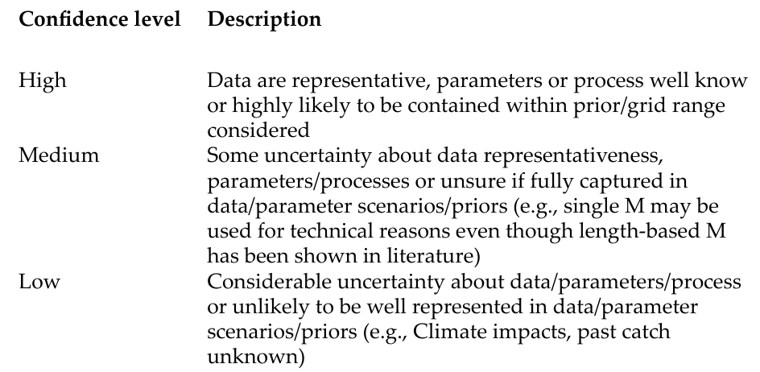
Recommendations
3. Consistent language: Stock assessment and trends

Slide 17
Recommendations
3. Consistent language: Stock Status and Management Advice
IPCC likelihood categories should be applied together with corresponding probability statements to facilitate cross-cultural and contextual understanding.
Assigned probability statements are a direct reflection of the degree of a posteriori uncertainty (i.e., the total uncertainty) resulting from the assessment process.
If the model is thought to adequately represent all major uncertainties (e.g., by integrating over key uncertainties in a Bayesian model or a weighted model ensemble), then the probabilities and associated IPCC likelihood categories can be directly applied to model outcomes (e.g., to the model grid).
If substantial uncertainties (i.e., those likely to give a substantially wider uncertainty or different outcome) are unresolved, then probability statements should be moderated to account for unresolved uncertainties.

Slide 18
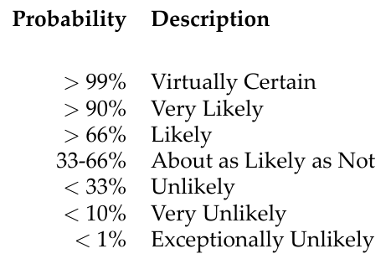
Recommendations
3. Consistent language: Stock Status and Management Advice

Slide 19
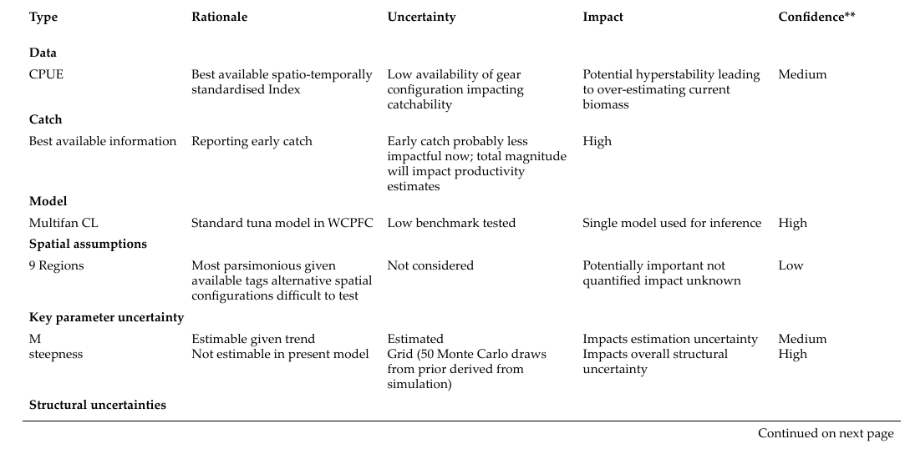
Recommendations
4. Tabulate uncertainties

Slide 20
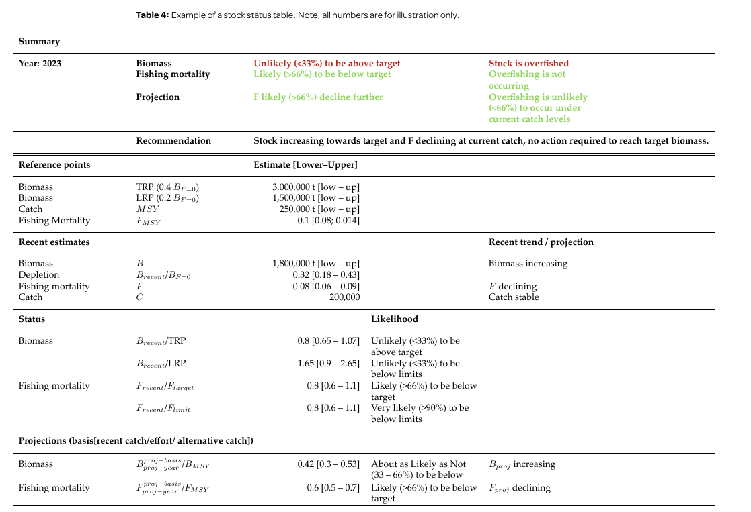
Recommendations
5. Tabulate stock status:

Slide 21
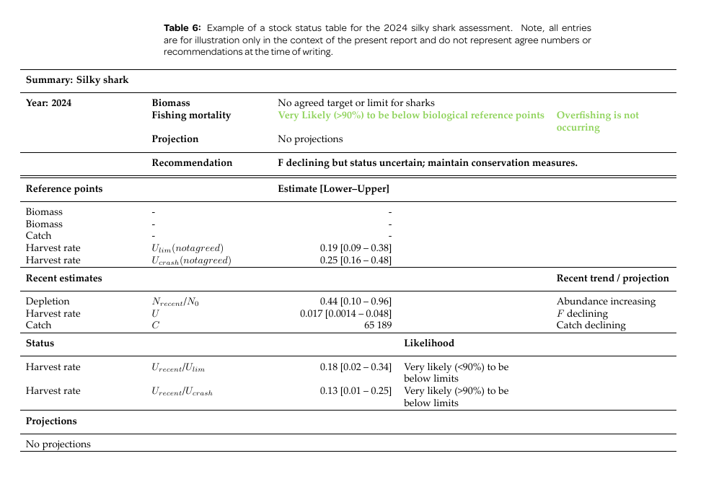
Recommendations
5. Tabulate stock status:

Slide 22
Recommendations
6. Web-based reporting tool
A web-based reporting app, such as the tool used to provide access to reporting by CCAMLAR, could be developed to provide a consistent and user-friendly interface for accessing stock assessment reports.
This tool could allow users to easily navigate between summaries and more detailed reports, view the main results of the assessments, and access the full report in PDF format. Could also provide links to the main figures and tables in the report, as well as any supplementary material that may be available.
This will help to make the reports more accessible to a wider audience, and improve the transparency and consistency of the advice provided.

Slide 23
Thank you for your input!

Slide 24
TOR
Proj 113b
OBJECTIVE
Develop in consultation with assessment working groups and fisheries managers, a reporting
template for stock status and management advice that will assist in making stock assessments
reported to the WCPFC accountable to a consistent reporting framework.

Slide 25
TOR
SCOPE OF WORK
Develop, in consultation with assessment team, the SPC, and fisheries managers, a template for reporting uncertainties alongside stock status and management advice for WCPFC stock assessments. Elements that should be considered as part of this reporting template are:
Consistently applicable terminology around stock status, uncertainty, and management risk for all stock assessments reported to the WCPFC for efficient communication;
Recommended measures/classifications of stock status, uncertainty, and risk to be provided for stock assessments in the WCPFC, including descriptions of the measures so that differences between measures can be understood by managers;
Communication about the quality of information used for determining stock status and management advice,
Qualification and quantification of uncertainties should consider:
Data quality/quantity
Model/population: structural uncertainty, biological information/assumptions
Parameter/estimation uncertainty
Specification of the key uncertainties and potential impacts – qualify the likely impact of key uncertainties for stock status and management advice, and,
Provision of research recommendations to address key uncertainties.
Present a summary report with a proposed reporting template, with alternative options (if necessary), for consideration at SC20.

