Slide 1
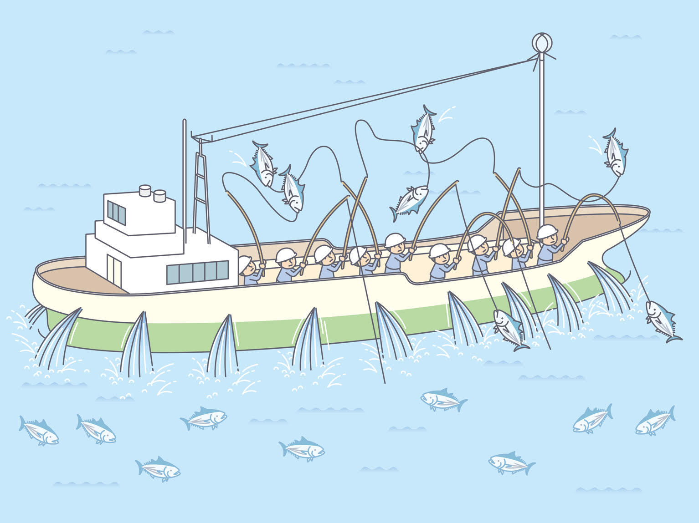
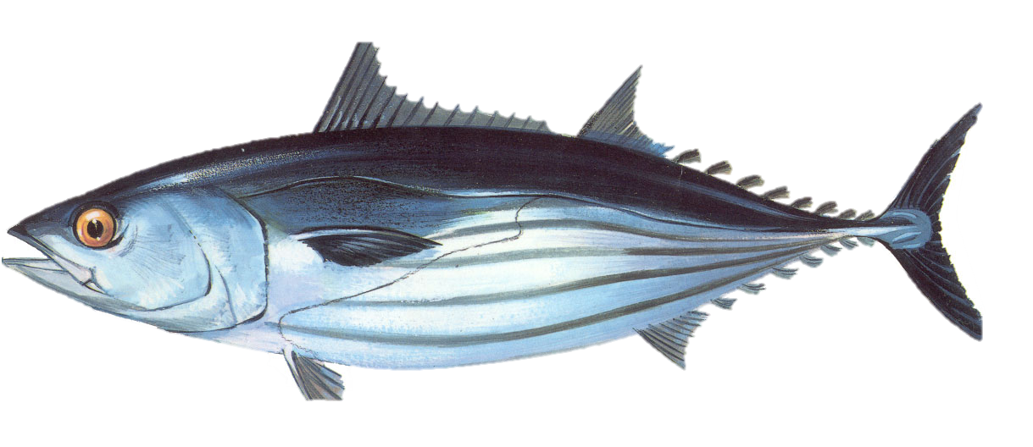
Project 115: Investigating long-term recruitment trend of skipjack tuna in the WCPO and effort creep in the Japanese pole and line skipjack fishery
Paul Hamer, Inna Senina¹, Patrick Lehodey¹, Makoto Nishimoto², Yoshinori Aoki², Naoto Matsubara², Yuichi Tsuda ²
Oceanic Fisheries Programme of the Pacific Community (SPC)
² Japan Fisheries Research and Education Agency (FRA)
WCPFC – SC20 – SA - WP06

Slide 2
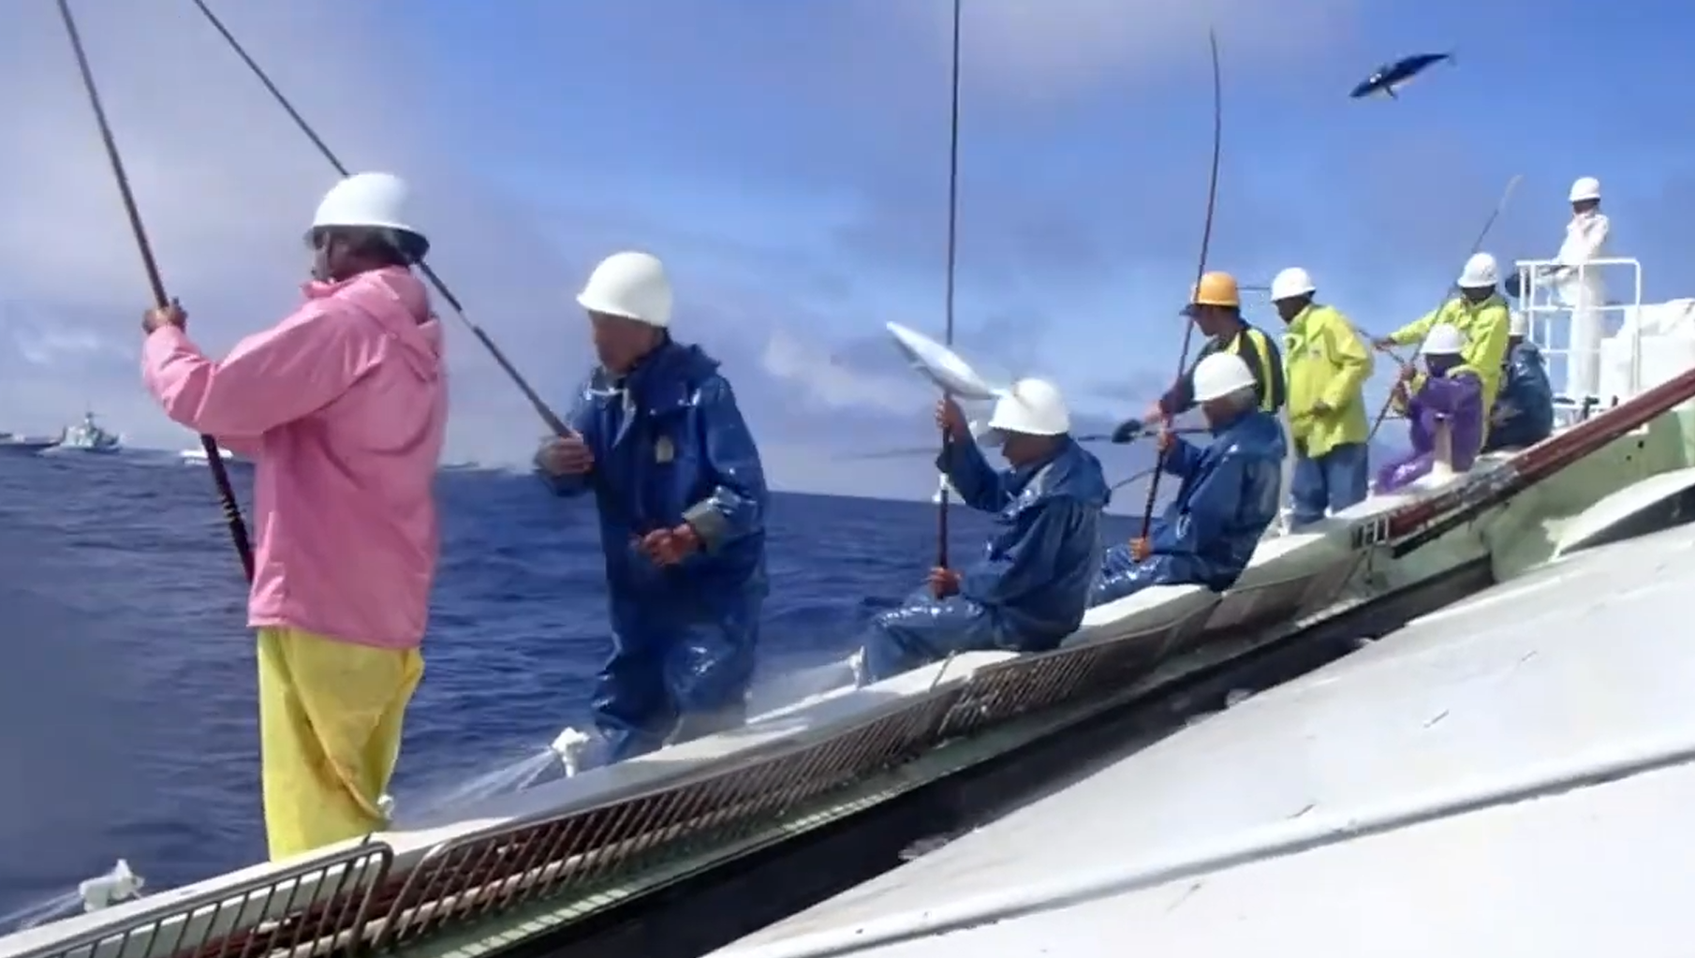
Outline
Part 1 – skipjack recruitment trends - SPC
Part 2 – pole and line effort creep: industry survey and modelling study - Japan Fisheries Research and Education Agency (FRA)

Slide 3
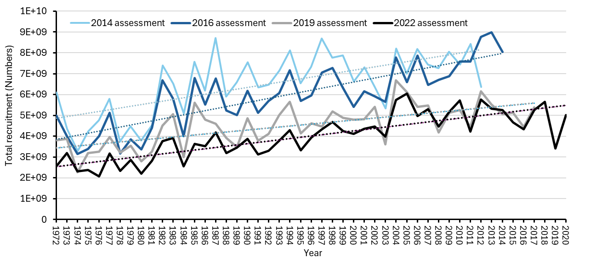
Background – Recruitment trend
Successive WCPO skipjack assessments estimate an increasing trend in recruitment,
moderated somewhat in recent assessments
Hypotheses
1. Trend is real – productivity for skipjack
early life stages has increased over time
2. Trend is not real – but is generated by the assessment model to best fit the data
3. Trend is part real – part modelling artifact

Slide 4
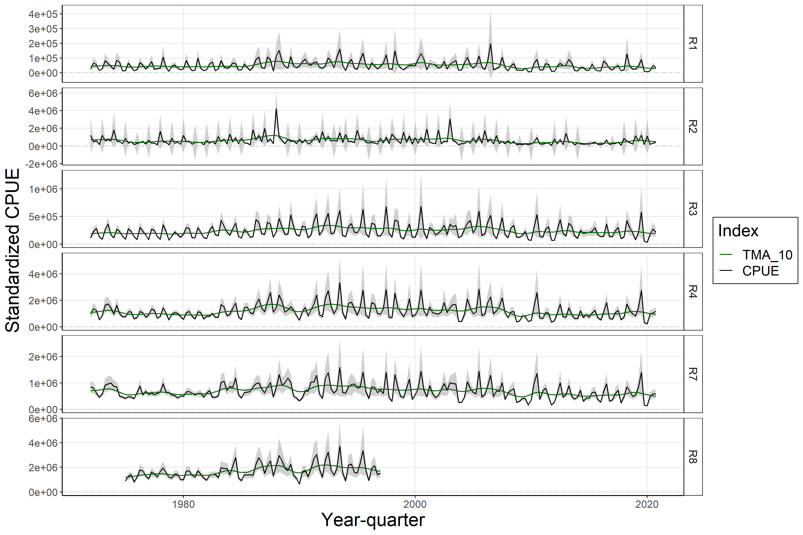
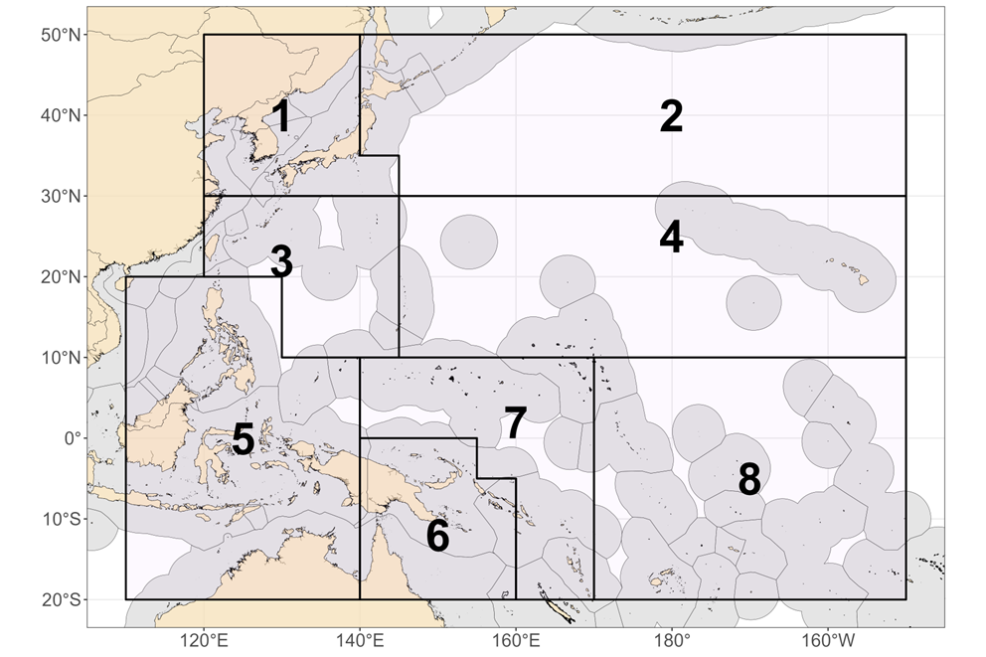
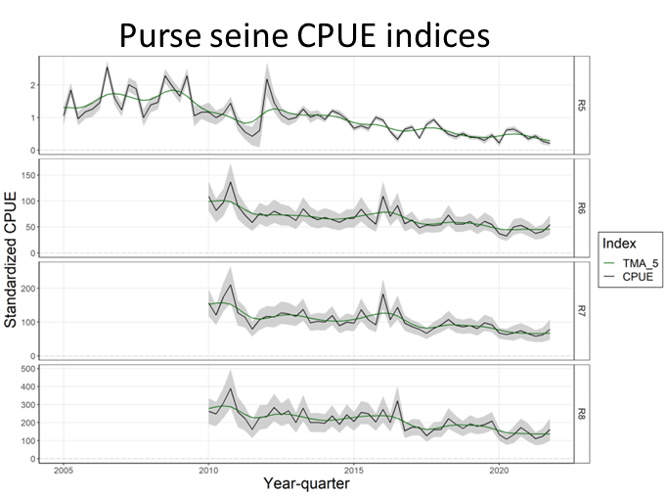
Why is it important?
Pole-and-line CPUE indices
1972
2021
1
2
Implications for how we interpret the stock status from the stock assessment (SB/SB_{F=0}) and potential future resilience of the stock to current fishing levels.
3
Long
term
indices
4
7
8
2005
2021
5
2010
6
Recent
indices
7
8

Slide 5
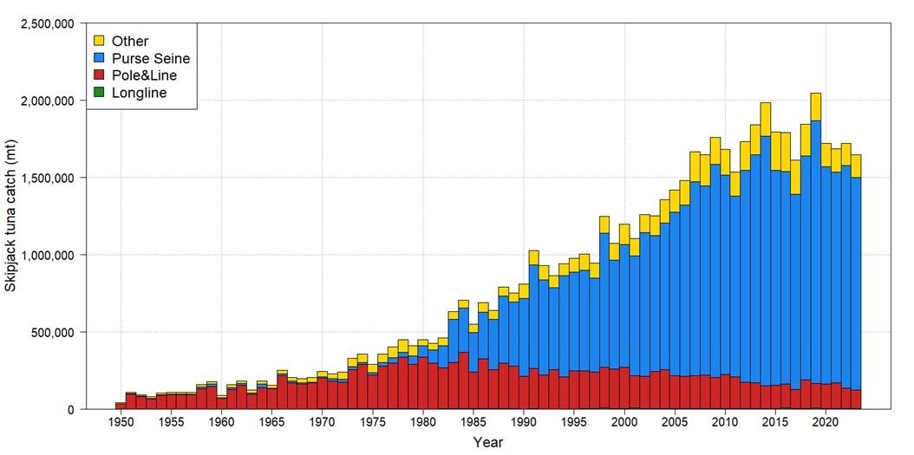
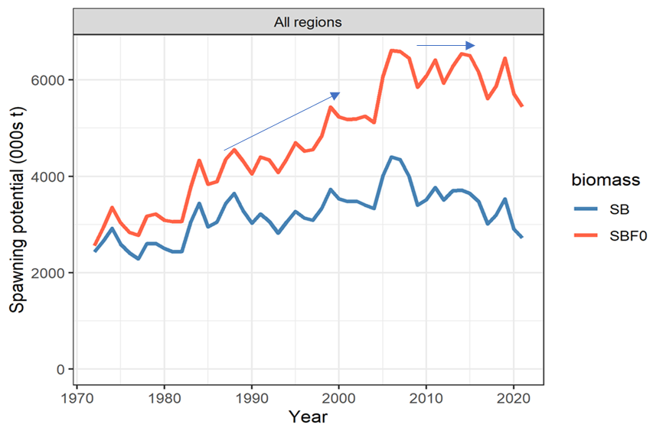
Pole-and-line CPUE indices
?
?
Estimated spawning biomass has not declined, increased recruitment is supporting historical catch increase
Recruitment - MFCL

Slide 6
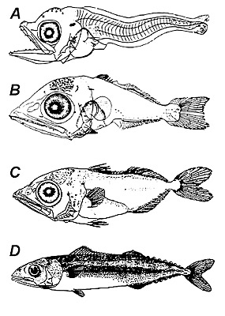
Approach
Understand skipjack early life history and recruitment processes - review
Consider hypotheses of environmental/oceanographic drivers (possible proxy indicators) of recruitment trends and dynamics
Explore the possible environmental/oceanographic drivers
Analyse relationships between environmental/oceanographic drivers and skipjack recruitment estimates from recent skipjack assessment
Consider SEAPODYM estimates of trends
3.7 mm NL
7.1 mm SL
14.5 mm SL
There are no fishery independent data on skipjack recruitment trends/dynamics, not even decadal snapshots, not much to go by
Deplorable lack of field or lab studies of early life history of skipjack in WCPO – the world’s largest tuna fishery!
Upcoming Japan/SPC research voyage in the Warm Pool – very important – focus on larval/juvenile tropical tunas
47.0 mm SL
Matsumoto (1958)

Slide 7
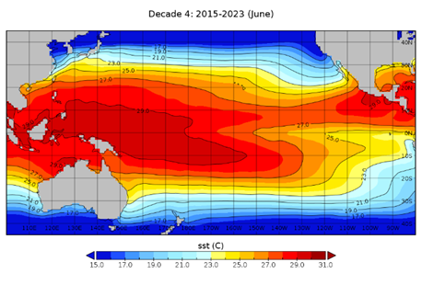
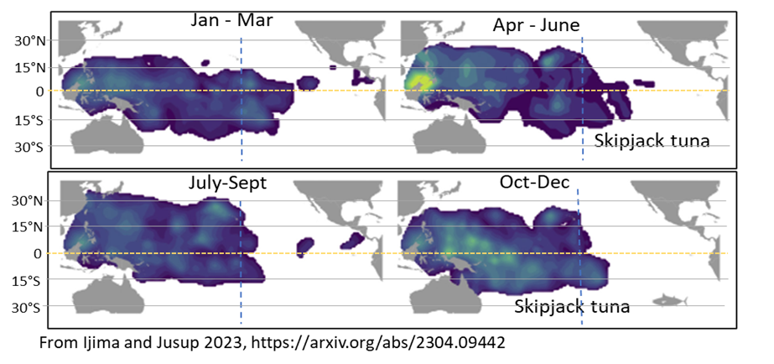
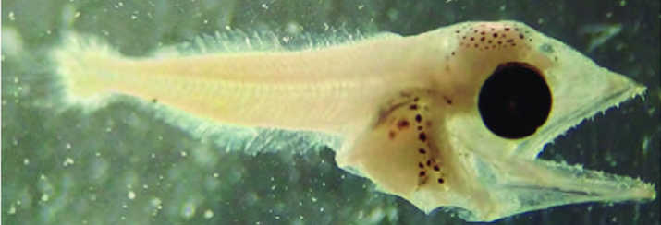
Western Pacific Warm Pool
Western Pacific Warm Pool: core skipjack spawning and larval/juvenile rearing area
To understand skipjack early life history and recruitment – you have to consider the influence of the warm pool trends and dynamics
Skipjack eggs – higher normal hatch rates/faster hatch times 28-31° (Fujioka et al. 2024)
Fast larval growth – high starvation vulnerability – prey abundance is critical in early life
Spawn all year – can take advantage of production pulses
Primary/secondary production as a proxy
Warm Pool
>28-29°C

Slide 8
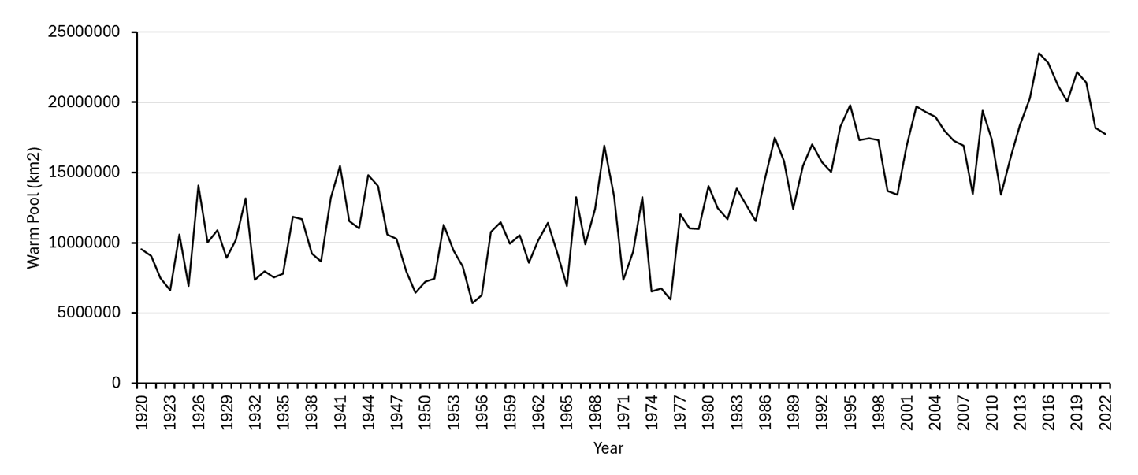
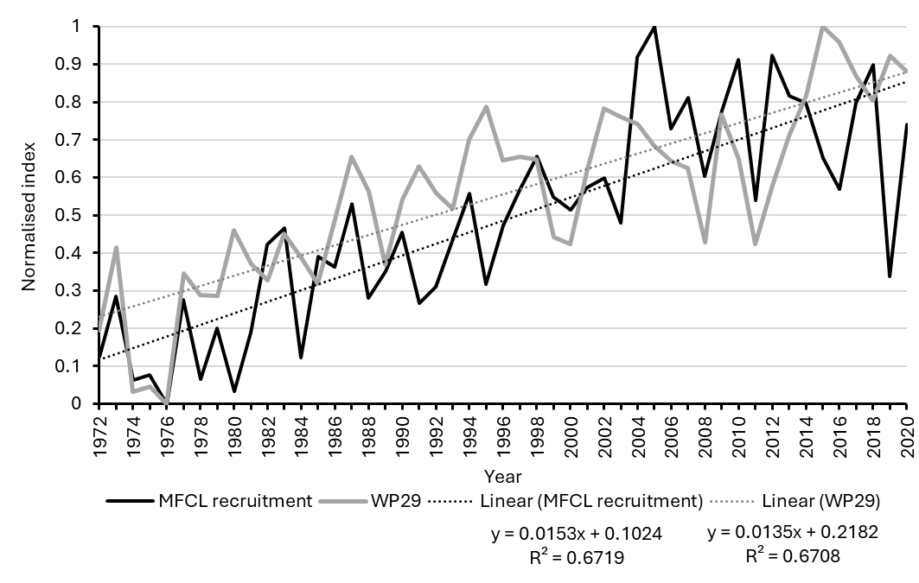
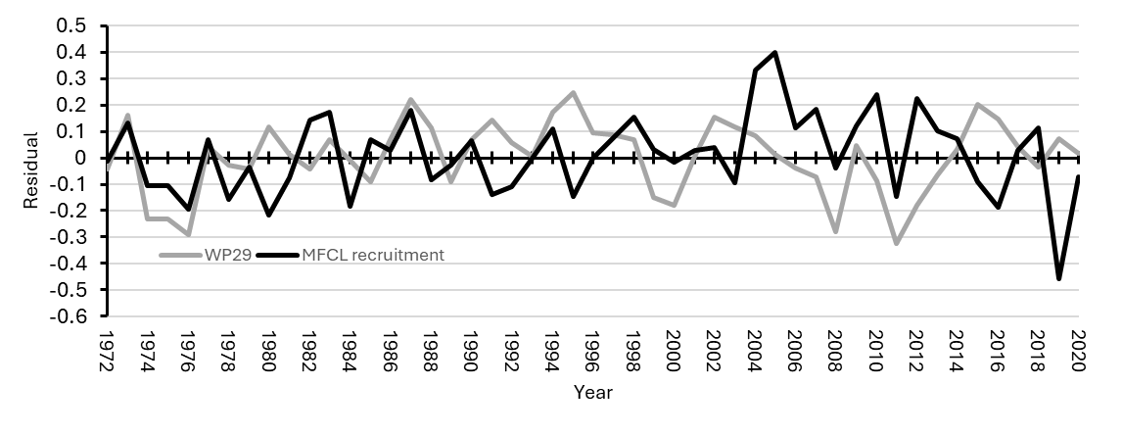
Hypothesis – El Nino = good for recruitment
Warm Pool area
1970
The Hadley Centre sea ice and sea surface temperature (SST)
http://www.metoffice.gov.uk/hadobs/hadisst
R=0.093
Trends
Residuals
(1972-2020: R = 0.049, 1972-2002: R=0.291,)

Slide 9
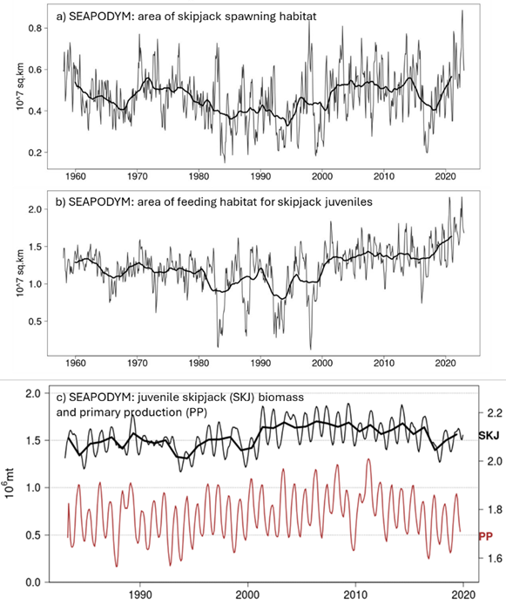
Planktonic production - prey
Lacking in observational data on zooplankton dynamics in the Warm Pool - rely on models to provide time series of primary and secondary production
Temp, PP, epipelagic predators
SEAPODYM (preliminary skipjack update)
SEAPODYM’s estimates of abundances of different life stages in space and time are strongly influenced by the dynamics of environmental forcing variables and their empirical relationships with skipjack biology and physiology.
SEAPODYM can estimate a persistent recruitment trend due to environment, only if there is such a signal in the model forcing information.
Temp, DO, epipelagic micronekton (prey)
Juv. skipjack
Primary production
coupled NEMO-PISCES model with atmospheric forcing JRA55

Slide 10
Summary and recommendations
Recruitment trend is consistent with Warm Pool expansion, but not related to interannual dynamics, or ENSO (ONI)
SEAPODYM skipjack model – predicts recent increased juvenile abundance, no long-term recruitment trend
Lack of relationships between stock assessment recruitment estimates and the environmental data does not mean the environmental variables are not influencing recruitment
recruitment may just be poorly estimated by the assessment,
environmental-recruitment signals are not strong in the fishery dependent data - they are possibly swamped by fishery dependent sampling influences and observation errors.
Based on the information available there is a lack of irrefutable evidence for or against an increasing recruitment trend at some level, the trend should be considered as an uncertainty in the stock assessment.
The most tractable way to develop models that moderate the recruitment trend is through adjustments to CPUE to force declining trends.
Declining trends in CPUE may be underestimated if effort creep is occurring but not appropriately accounted for in CPUE standardisation.

Slide 11
Effort creep
What is effort creep?
Catch (C) = catchability (q) x effort (E) x abundance (B)
Effort creep is increases in catchability (for whatever reason – but typically related to better fishing practices etc.)
C/E*q = B
No effort creep
CPUE
Effort creep
Time
If q is increasing over time CPUE indices need to account for this by increasing the ‘Effort’ component in CPUE
Sometime changes in q can be accounted for in CPUE standardisation – but often it is unlikely that all is accounted
Fishing improvement is driven by many interacting and compounded things that are difficult to measure, or lack data
We need to learn more from industry – develop plausible scenarios, accept there will be uncertainty in q overtime

Slide 12
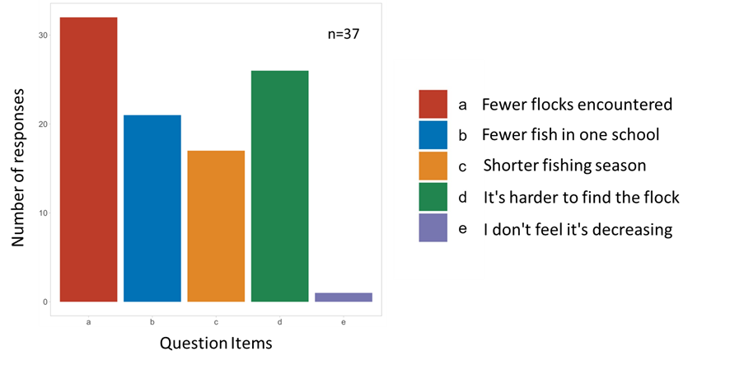
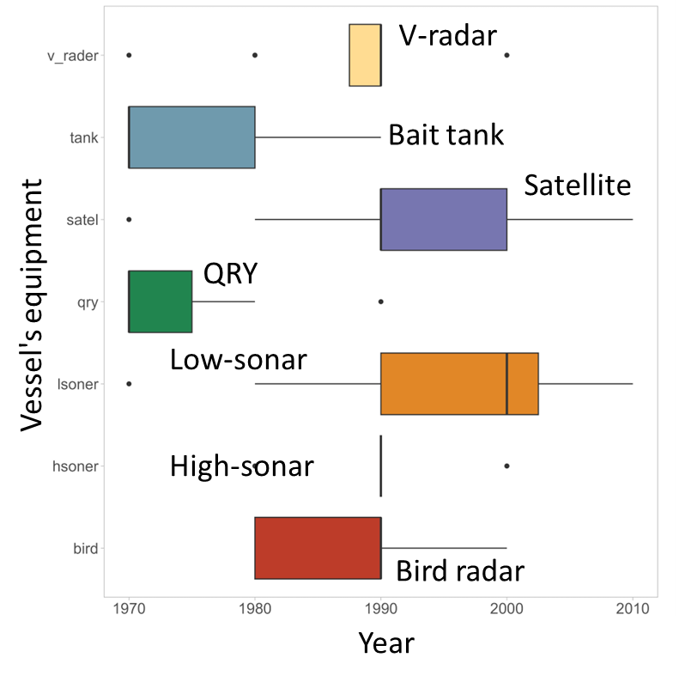
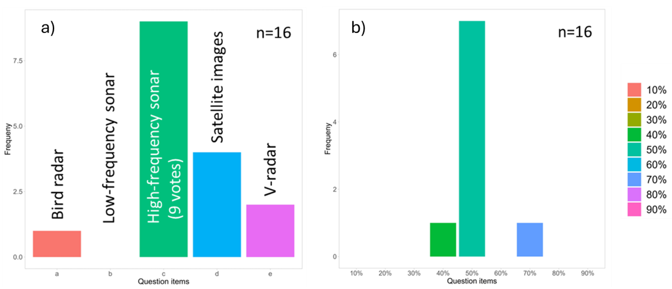
Part 2) Effort creep in the Japanese pole and line fishery
We conducted questionary survey for effort creep problem
to collect data on fishermen's perceptions on the skipjack resource off Japan
to identify the period when the technological innovation occurred
to assess fishermen’s perception of the importance of new technology for catching skipjack (effort creep)
Results (n=37, JPPL fisherman)
Almost all respondents felt that skipjack are decreasing!
Fishermen's perceptions
Introduction timing
1990s
Most important gear for fisherman
High frequency sonar

Slide 13
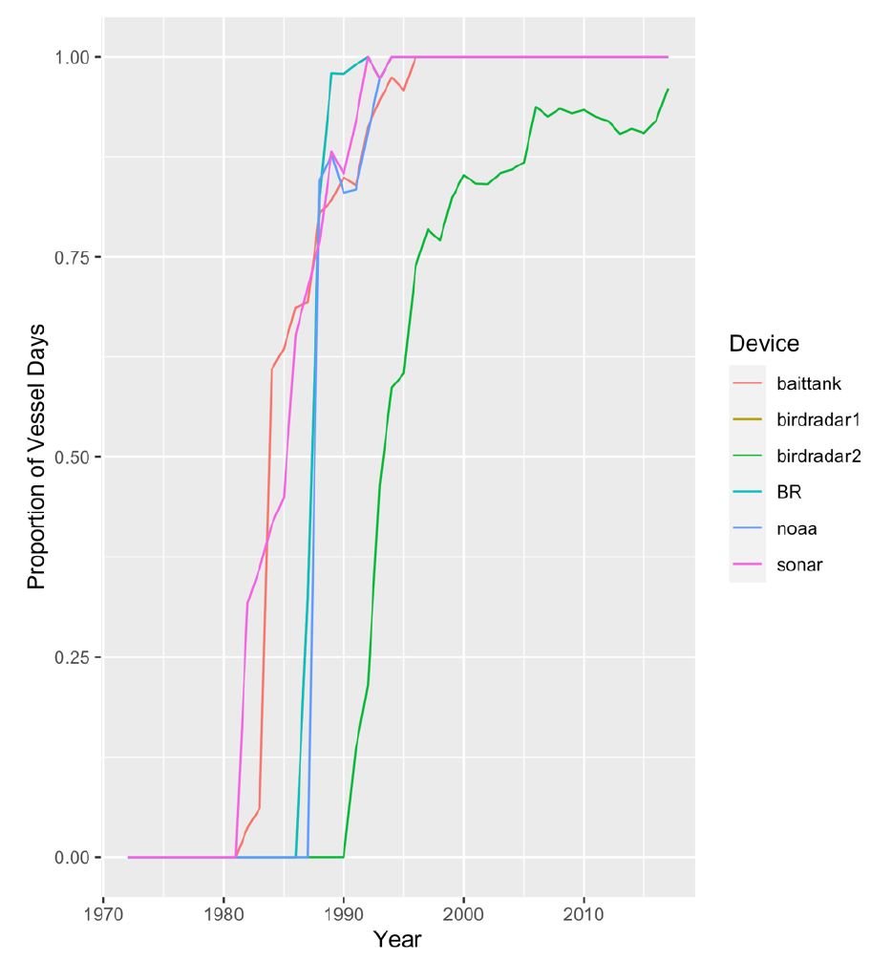
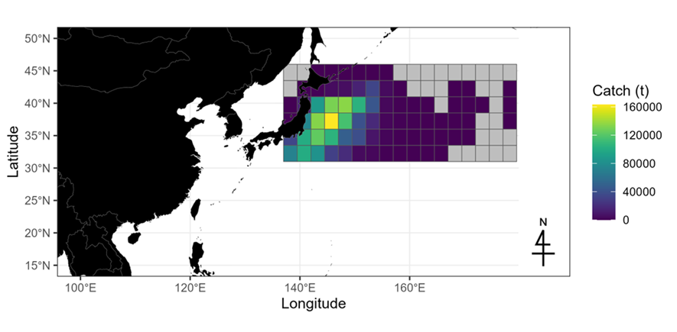
Statistical framework for effort creep
S-shape
catchability?
Technological innovations in large vessels (Matsubara et al. 2022)
Introduction timing
Catchability scenario;
①Constant scenario $q=w$
②S-shape scenario
the questionnaire survey results ⇒ the prior distribution as
t’: 1990±5 years (t’ ~ normal(1990, 2.5)).
$$q\left[t\right]=a+\frac{b}{1+e^{−X\left[t−t′\right]} }$$
(w, a, b are parameters)
JPPL data from 1972 to 2019

Slide 14
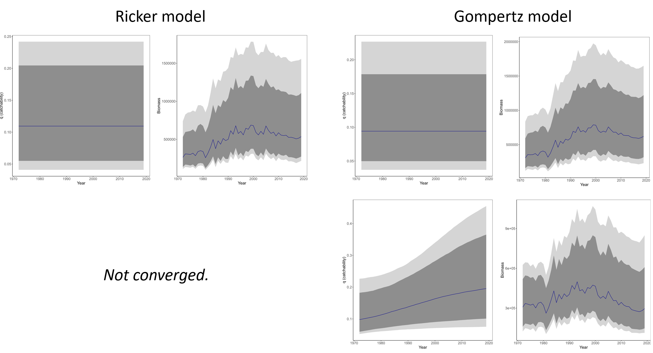
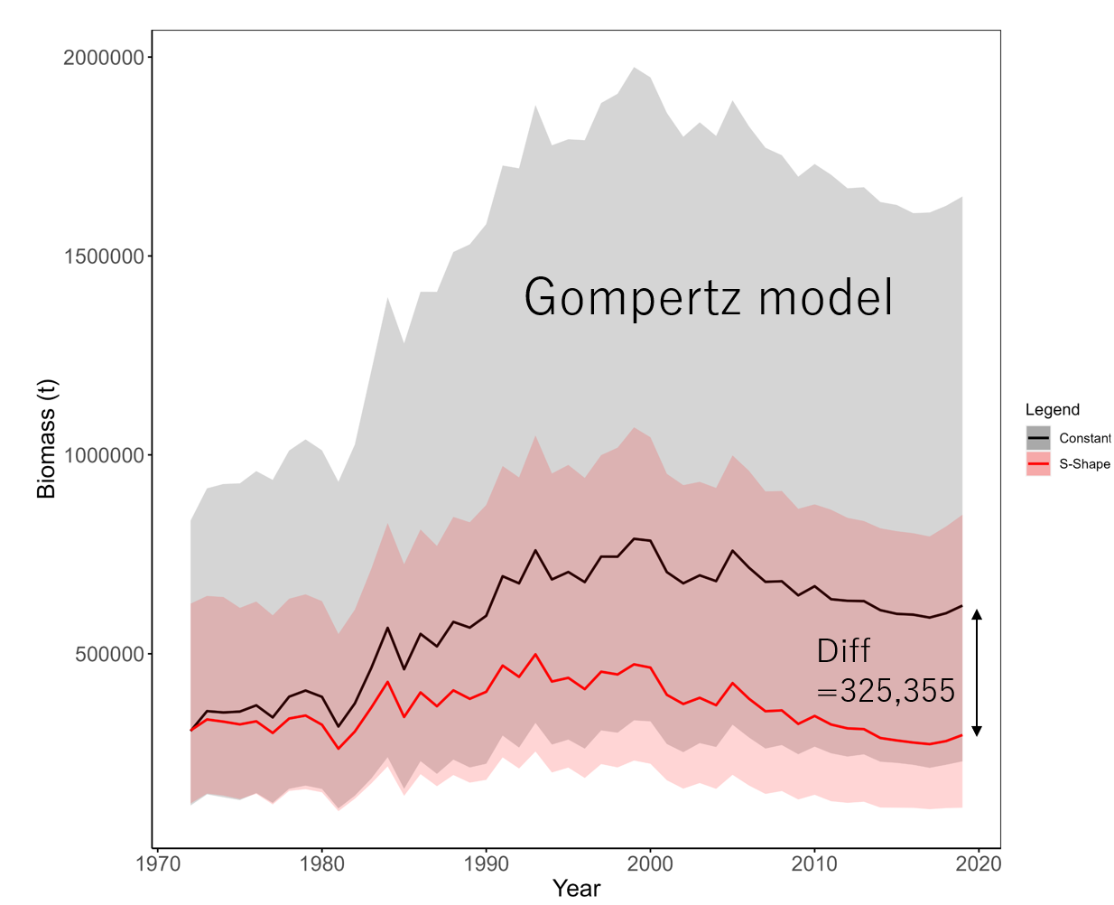
Results of application to JPPL data
Bayesian estimation using MCMC language stan in Ricker and Gompertz models
Under the S-shaped scenario, median catchability increased by 1.99 from 1972 to 2019.
Ignoring the increase in catchability due to effort creep revealed that an overestimation of nearly twice the stock biomass can occur.

Slide 15
Part 2) Effort creep in the Japanese pole and line (JPPL) fishery
Summary
Survey results indicate that JPPL and fishers sense that skipjack stocks are declining in their fishing region of Japan.
Significant technology/equipment advances have occurred - the timing of equipment installation in the JPPL was concentrated in the 1990s.
Both fisher perceptions and modelling suggest catchability for the JPPL increased by a factor of 1.99 from the 1970s to the present.
The main reason for this increase is thought to be the introduction of high-frequency sonar, based on the results of the questionnaire survey, but other advancements have also been important.
Recommendation
Effort creep should be considered in stock assessments using JPPL data for skipjack to prevent overestimation.
Industry surveys are useful both for determining the functional form of catchability and for interpreting the results of statistical analyses.

Slide 16
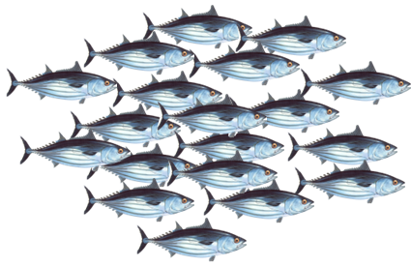
Ongoing work leading to 2025 assessment
Run alternative models that employ a broad range of effort creep scenarios (with some implausible levels) on the JPPL CPUE which will provide alternative recruitment trends.
Present results of the alternative models to the Pre-assessment workshop for review.
Based on project 115 and the model explorations choose plausible JPPL scenario(s) to include in the 2025 assessment uncertainty characterisation.

Slide 18
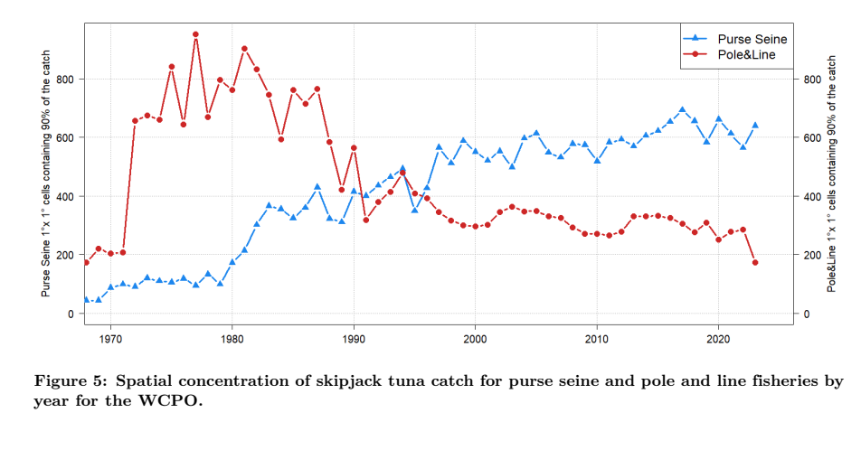
If increasing recruitment is not real – what might support the catch increases and continued
high fishery production over a decade of more
Another interesting observation
To be continued……

