Slide 1
Earth Island International Marine Mammal Project (Dolphin Safe)
Proposal for undertaking research analyses to inform discussions of mitigating impacts on cetaceans in the WCPFC purse seine tuna fishery
SC20-EB-WP-13, D. Phillips & S. Elzea (Earth Island Institute International Marine Mammal Project)

Slide 2
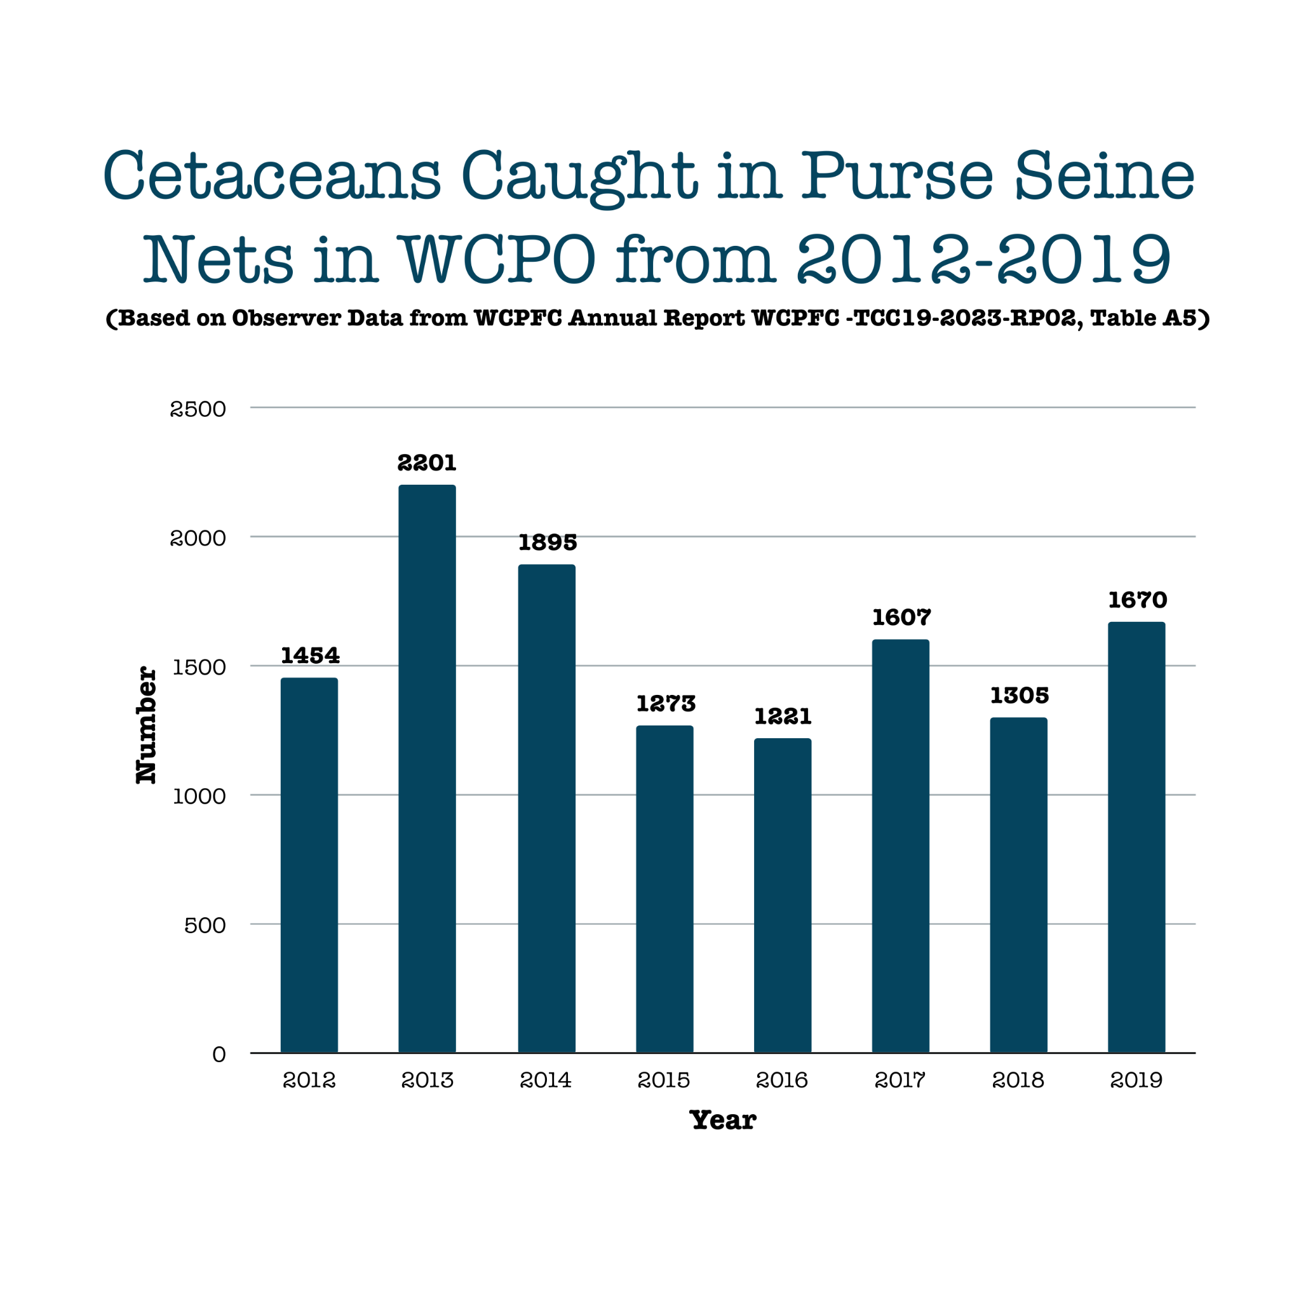
Figure 1 shows a range from 1221 – 2201, with an average of 1578 cetaceans caught. Years 2020-2022 have been excluded as COVID-19 caused reduction of observers preventing accurate yearly data.

Slide 3
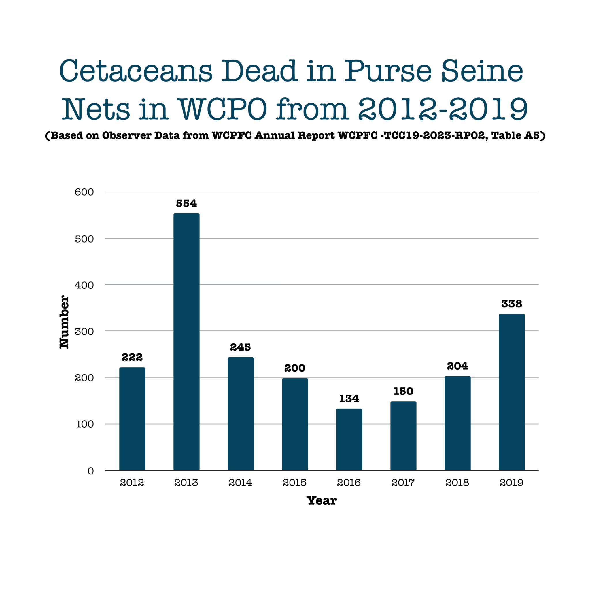
Figure 2 shows a range from 134 – 554, with an average of 256 cetacean mortalities. Years 2020-2022
have been excluded as COVID-19 caused reduction of observers preventing accurate yearly data.

Slide 4
