Slide 1
Progress Report of Project 110: Non-entangling and Biodegradable FAD Trial in the Western and Central Pacific Ocean
WCPFC-SC20-EB-WP-03
Lauriane Escalle,
Gala Moreno , Iker Zudaire , Jon Uranga, Donald David, and Paul Hamer

Slide 2
Introduction
WCPFC project 110: Non-entangling and biodegradable FAD trial
in the WCPO
NOAA BREP project: Towards the Use of Biodegradable FADs
in the Pacific Ocean
Objectives:
1. Explore design and cost-feasibility of non-entangling and bio-FADs.
2. Train dFAD manufacturers on the construction of bio-FADs.
3. Undertake at-sea experiments to compare the performance/functionality of non-entangling and biodegradable dFADs to conventional dFADs. Deploying them together in pairs.
4. Provide robust scientific advice to industry and national fisheries managers on the performance of non-entangling and biodegradable dFAD designs.
5. Dissemination of the bio-FADs, construction and use through workshops with fishers

Slide 3
Method
The Jelly-FAD
Neutral buoyancy: after 20-25 days, it drift neutrally in the water column just like a jelly-fish.
Reduces structural stress: reduced component at the surface, helping increasing lifetime of biodegradable materials
Reduces the size of dFADs: 3-D shape of the drogue ensures slow drift
Materials
- Bamboos - Cotton canvas - Cotton ropes - Sand or clay
Non-biodegradable:
- Purse seine corks
- Satlink buoy
34m
65m
Notes:
Principle (developed with physical oceanographers)
The weight (sand or clay in the bottom bamboos of the cube) slowly dissolves in seawater, bamboos and cotton get saturated in seawater after 20-25 days. The density then becomes similar to seawater, making the structure drift neutrally in the water column just like a jelly-fish.
Minimizing the emerged component of dFAD structures at the surface helps to increase its lifetime through reduced structural stress (from wind, waves, and differing surface vs deeper currents)

Slide 4
Method
430 jelly-FADs to be tested
Partners | Vessels | Flag | Construction | No. of BioFADs
 |  |  |  | WCPFC 110 | BREP
Caroline Fisheries Corporation | 6 | FSM | Pohnpei | 50
FCF Co. ltd | 8 | Taiwan | Pohnpei | 50
American Tunaboat Association Cape Fisheries Others | 6 10 | US | Manta Manta and Pago Pago | 30 50 | 108 108
Silla | 2 | Korea | Pohnpei | 34
TOTAL | 32 |  |  | 214 | 216
Notes:
Several training workshops for skippers, crew, fisheries managers and representatives, and companies in port have been conducted. These workshops aimed at presenting the project, its objectives and the jelly-FAD design. A practical part of the workshop involved training in how to build the jelly-FADs step by step.
Even if we plan to deploy 400 jelly FADs. From previous trial experience an duse of FAD in WCPO, we might expect to get visit and data from 10- 20% (just my guess). So additional funds to add more would be needed to get robust results

Slide 5
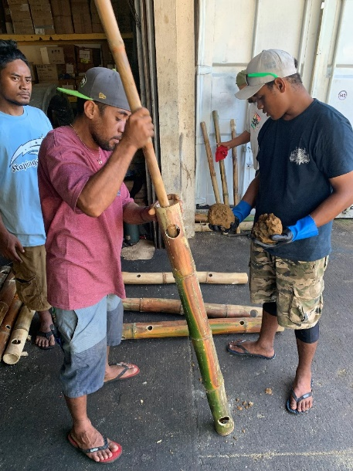
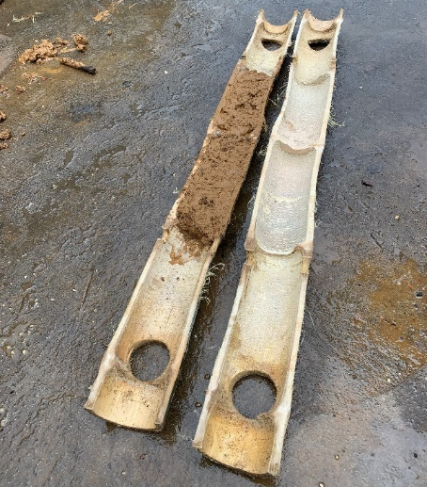
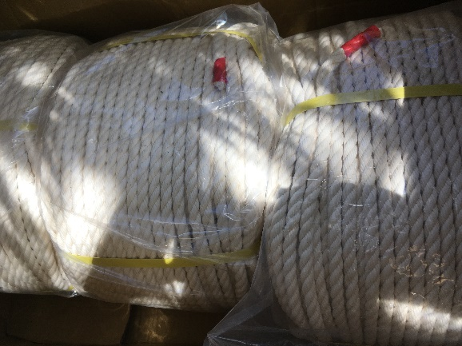
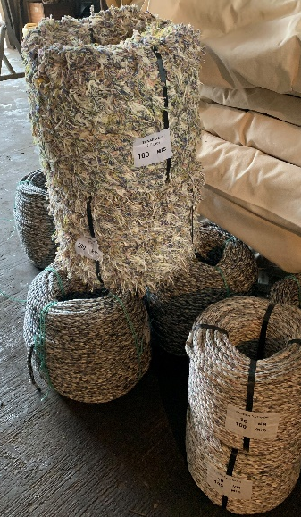
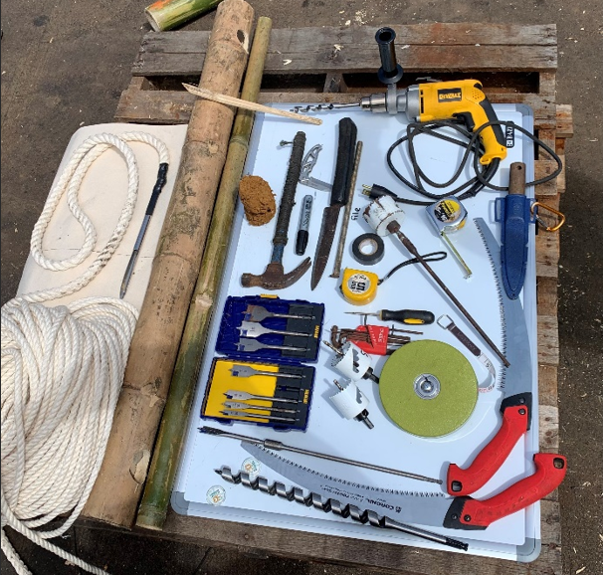
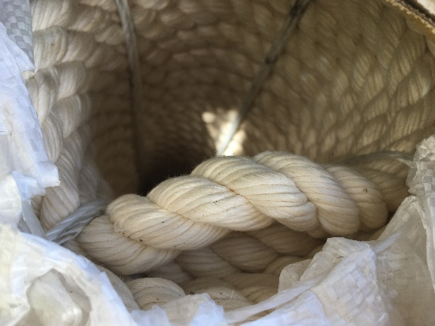
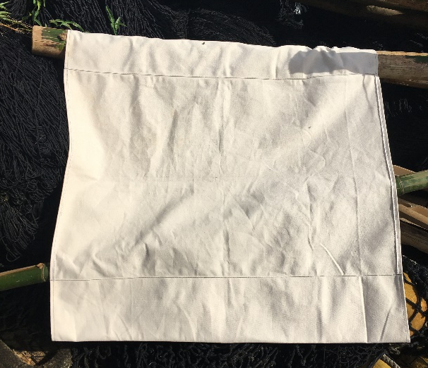
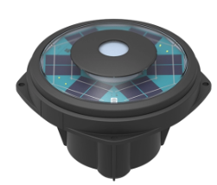
Method
Clay
Local : buoys, bamboos and clay
Local
Materials & tools
Bamboos
Local
Cotton ropes
Itsaskorda (Spain)
Sea Master (Chinese Taipei)
Purse seine corks
Local
Tools
Satellite echosounder
buoy
Cotton canvas
Soluciones Anmarsaq (Ecuador)
Sea Master (Chinese Taipei)
Satlink SLX+ (Spain)

Slide 6
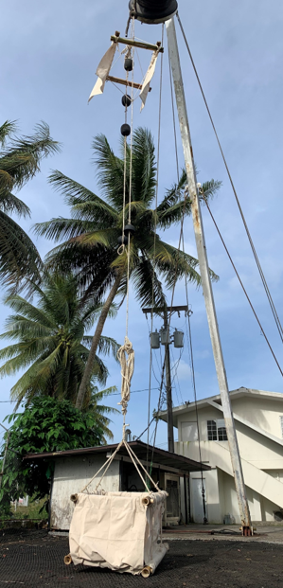
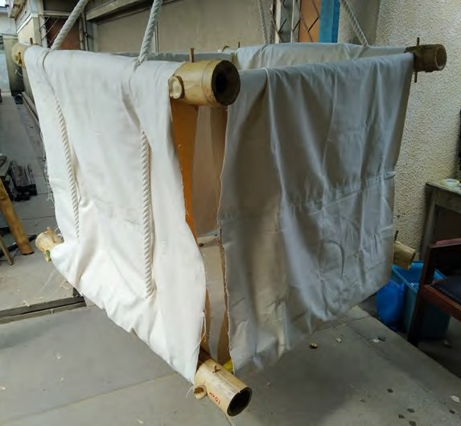
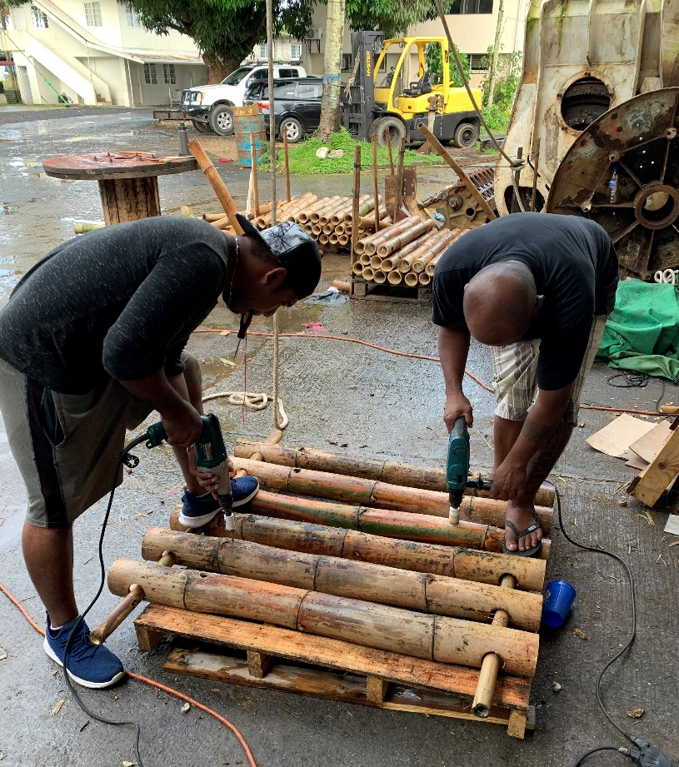
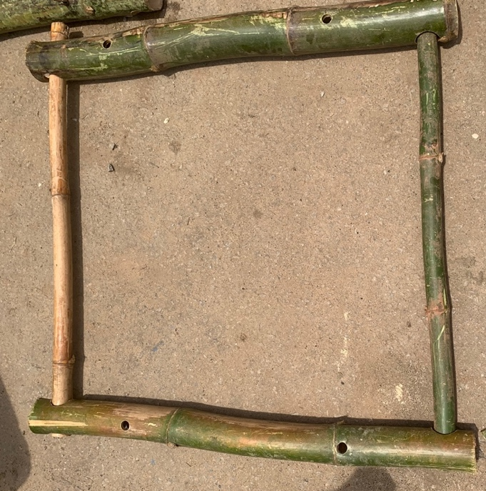
Method
Construction
Notes:
Some challenges and lessons learned in construction and storage of jelly-FADs

Slide 7
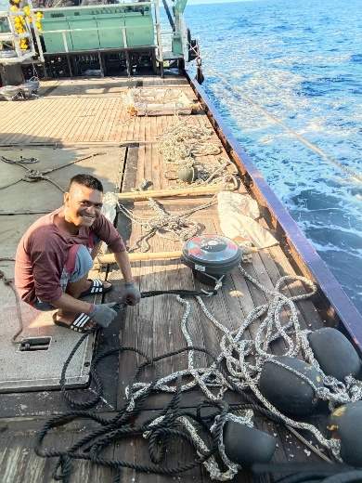
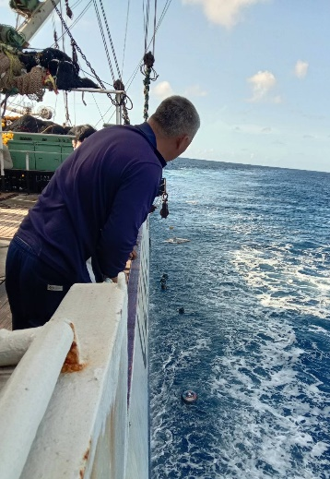
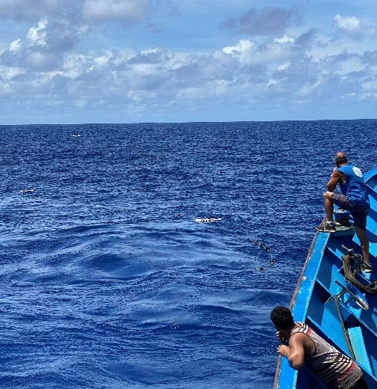
Results
At-sea trials – preliminary results
 | FM |  | KR |  | TW |  | US fleet
 | Jelly | Conv. | Jelly | Conv. | Jelly | Conv. | Jelly | Conv.
Convention Area | WCPFC |  | WCPFC |  | WCPFC |  | WCPFC & IATTC
Nb FADs planned | 50 | 50 | 34 | 34 | 50 | 50 | 296 | 296
Deployments | 50 | 27 | 3 | 3 | 42 | 26 | 191 | 167
Deployment period | 03/04/23 – 12/04/24 |  | 12/04/24 |  | 02/03/23 – 11/07/23 |  | 04/09/22 – 04/05/24
Sets | 1 | 0 | 0 | 0 | 4 | 0 | 15 | 50
Visit (without set) | 3 | 0 | 0 | 0 | 0 | 0 | 1 | 0
Buoy deactivation | 0 | 0 | 1 | 0 | 10 | 4 | 26 | 24
Stranding events | 0 | 0 | 0 | 0 | 3 | 0 | 0 | 0

Slide 8
Results
At-sea trials – preliminary results

Slide 9
Results
At-sea trials – preliminary results: duration at-sea
 | Other fleets |  | US fleet
 | Jelly-FADs | Conventional | Jelly-FADs | Conventional
Deployments | 83 | 44 | 132 | 114
Data available | 74 | 42 | 129 | 112
Duration (days)
Min | 0 | 1 | 1 | 12
Mean | 123 | 82 | 160 | 163
Max | 284 | 248 | 457 | 321

Slide 10
Results
At-sea trials – preliminary results: speed
SPEED | Other fleets |  | US fleet
 | Jelly-FADs | Conventional | Jelly-FADs | Conventional
Min | 0.0 | 0.0 | 0.0 | 0.0
Mean | 0.9 | 0.9 | 1.1 | 1.2
Max | 4.9 | 4.9 | 4.9 | 4.9

Slide 11
Results
At-sea trials – preliminary results: catch
FAD type | Number of sets | Total tuna catches (mt)
 |  | Min | Mean | Median | Max
Jelly-FAD | 20 | 0 | 53.6 | 35.0 | 185
Conventional | 50 | 5 | 71.3 | 52.5 | 260
2023 WCPO FADs | 11,005 | 0 | 46.3 | 30.0 | 481

Slide 12
Results
At-sea trials – preliminary results: catch on same pairs
Jelly-FADs Conventional FADs
Pair | Deployment | Bio | Total catch (t) | Months after deployment | Conv | Total catch (t) | Months after deployment
Pair 1 | 12/02/2023 | Set 1 | 35 | 1 | Set 1 | 155 | 6
 | 12/02/2023 | Set 2 | 35 | 2 | Set 2 | 95 | 6
 | 12/02/2023 | Set 3 | 55 | 2
 | 12/02/2023 | Set 4 | 43 | 2
Pair 2 | 04/05/2024 | Set 1 | 26 | 2 | Set 1 | 55 | 2
Pair 3 | 04/05/2024 | Set 1 | 161 | 2 | Set 1 | 25 | 2
Pair 4 | 04/05/2024 | Set 1 | 134 | 1 | Set 1 | 35 | 2

Slide 13
Results
At-sea trials – preliminary results: Aggregation patterns from echosounders
Notes:
Same aggregation patterns – max biomass at 2 months then decrease for both

Slide 14
Results
At-sea trials – preliminary results: condition

Slide 15
Follow-up project – WCPFC 110a
Additional work on trialing and supporting development of non-entangling and biodegradable FADs in the WCPO
To enhance WCPFC project 110 with the deployment of additional non-entangling and biodegradable FADs to increase the robustness of the results and related management and industry advice.
Additional 150 jelly-FADs
To increase the regional capacity to support industry uptake and use of non-entangling and biodegradable FADs in the WCPO.
Training workshops
Additional base ports
Exploring options for regional materials supply
Notes:
Overall I would also emphasis that project really services the need for resources to continue and build on this work to support a platform for industry adoption

Slide 16
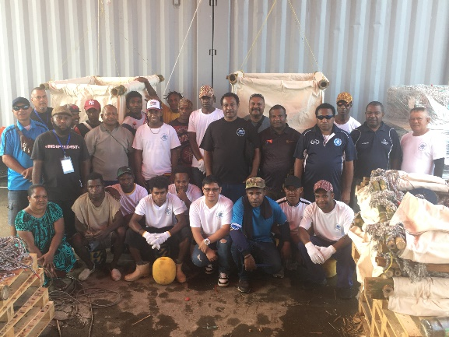
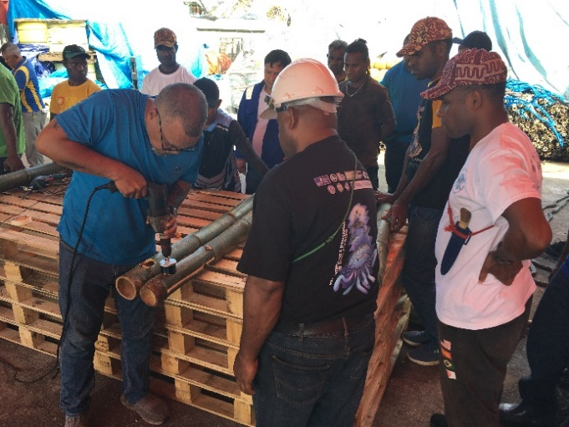
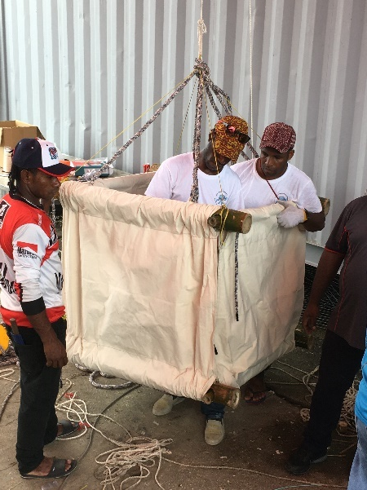
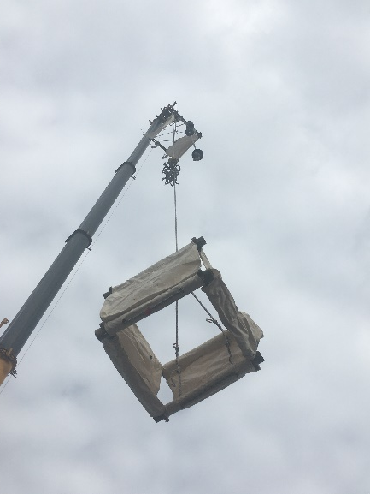
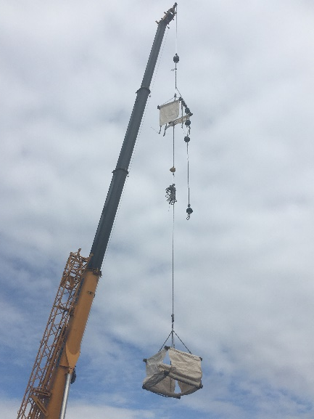
Follow-up project – WCPFC 110a
Partners | Vessels | Flag | Construction | No. of BioFADs | No. Constructed
Fishing Industry Association PNG | 12 | PG | Lae (PNG) | 60 | 35
Koo’s | 2 | MH | Majuro | 10 | 0
??? |  |  |  | 80
TOTAL |  |  |  | 150 | 35
Notes:
Overall I would also emphasis that project really services the need for resources to continue and build on this work to support a platform for industry adoption

Slide 17
Recommendations
Note that 430 jelly-FADs have been constructed, including 216 as part of WCPFC Project 110, and that 286 jelly-FADs have been deployed (67%) under the WCPFC and BREP project collaboration.
Note that the drift speed of conventional and jelly-FADs is similar and
that jelly-FADs were monitored longer than the conventional dFADs, indicating that based on buoy data, they have comparable at sea durability to traditional dFADs. However more visits are needed after 6 months to validate this result.
Note that aggregation patterns measured using biomass data from echosounder buoys attached to dFADs, were similar between the conventional and jelly-FADs, with a peak 2 months after deployment.
Note that 20 fishing sets have been performed on jelly-FADs in this trial so far, representing 7% of the jelly-FADs deployed, with an average tuna catch of 53.6 t per set.
Conventional dFADs showed a higher average catch per set (71.3 t)
The median catch per set on the jelly-FADs for this trial were higher to that of the whole fleet in 2023 (i.e., 53.6 vs 30 t per set for jelly-FADs of the trials and conventional dFADs of the whole fleet, respectively).
17

Slide 18
Recommendations
Note that this work is ongoing and complete results from the trial and analyses of all non-entangling and biodegradable dFADs from Project 110 and the follow-up project P19X4 are expected to be available by SC 22.
Encourage fishing fleets to join these trials, to both increase the sample size and their involvement in the development of non-entangling and biodegradable dFADs.
Note that industry involvement requires a commitment to deploy a certain number of non-entangling and biodegradable dFADs systematically along with conventional dFADs. Reports from any independent trials of non-entangling and biodegradable dFADs should be made available to the SC.
Note that these trials and the associated industry engagement and training are essential to support transition to the use of more ecologically friendly dFADs in the Western and Central Pacific Ocean.
18

Slide 19
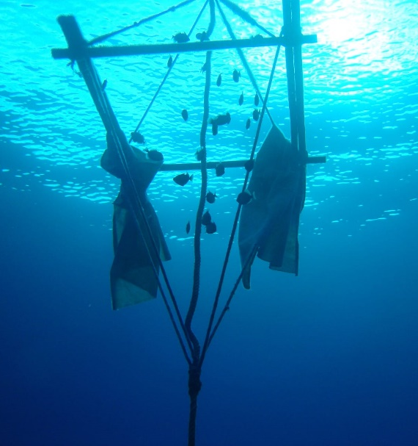
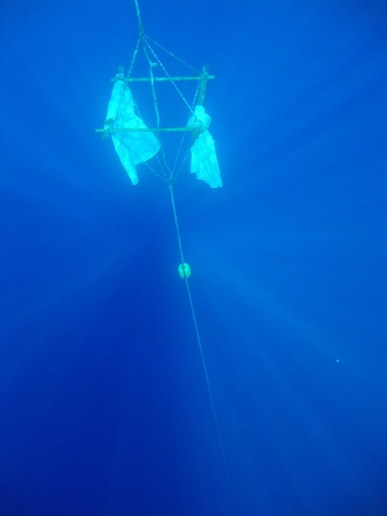
© ISSF
© ISSF
© ISSF
For additional information, contact
laurianee@spc.int or gmoreno@iss-foundation.org
Acknowledgments

Slide 20
Other trials : EPO SC20-EB-IP-14
SC20-EB-IP-15
2,000 non-entangling and biodegradable FADs (Jelly-FADs) by UGAVI fleet
Red: Jelly-FAD_Hybrid
Blue: Jelly-FAD organic
Yellow: Conventional FAD
20

Slide 21
Other trials : EPO SC20-EB-IP-14
SC20-EB-IP-15
2,000 non-entangling and biodegradable FADs (Jelly-FADs) by UGAVI fleet
Canvas in cube
Cube structure
Main rope cotton
Main rope plastic
Raft canvas
Raft structure
2
6
12
2
6
12
21

Slide 22
Other trials : EPO SC20-EB-IP-14
SC20-EB-IP-15
2,000 non-entangling and biodegradable FADs
Jelly-FADs by UGAVI fleet
JellyFADs aggregate tuna as conventional FADs do or even more.
70 fishing sets: similar average tuna catch: 39.4 t on jelly-FADs ; 35.9 t on conventional FADs
JellyFADs drift as slow as conventional FADs but with less weight and volume
Lifespan: sets were made after 11 months at sea, and many occurred after 5 months with the FAD being in perfect condition and re-deployed at sea. This meets fishers´ needs for dFADs lifespan.
The success relies on the number of Jelly-FADs deployed which should be systematically tested supported by the shipowner and with the feedback from fishers at sea.
22

Slide 23
SC20-EB-IP-15
SC20-EB-IP-15
23

Slide 24
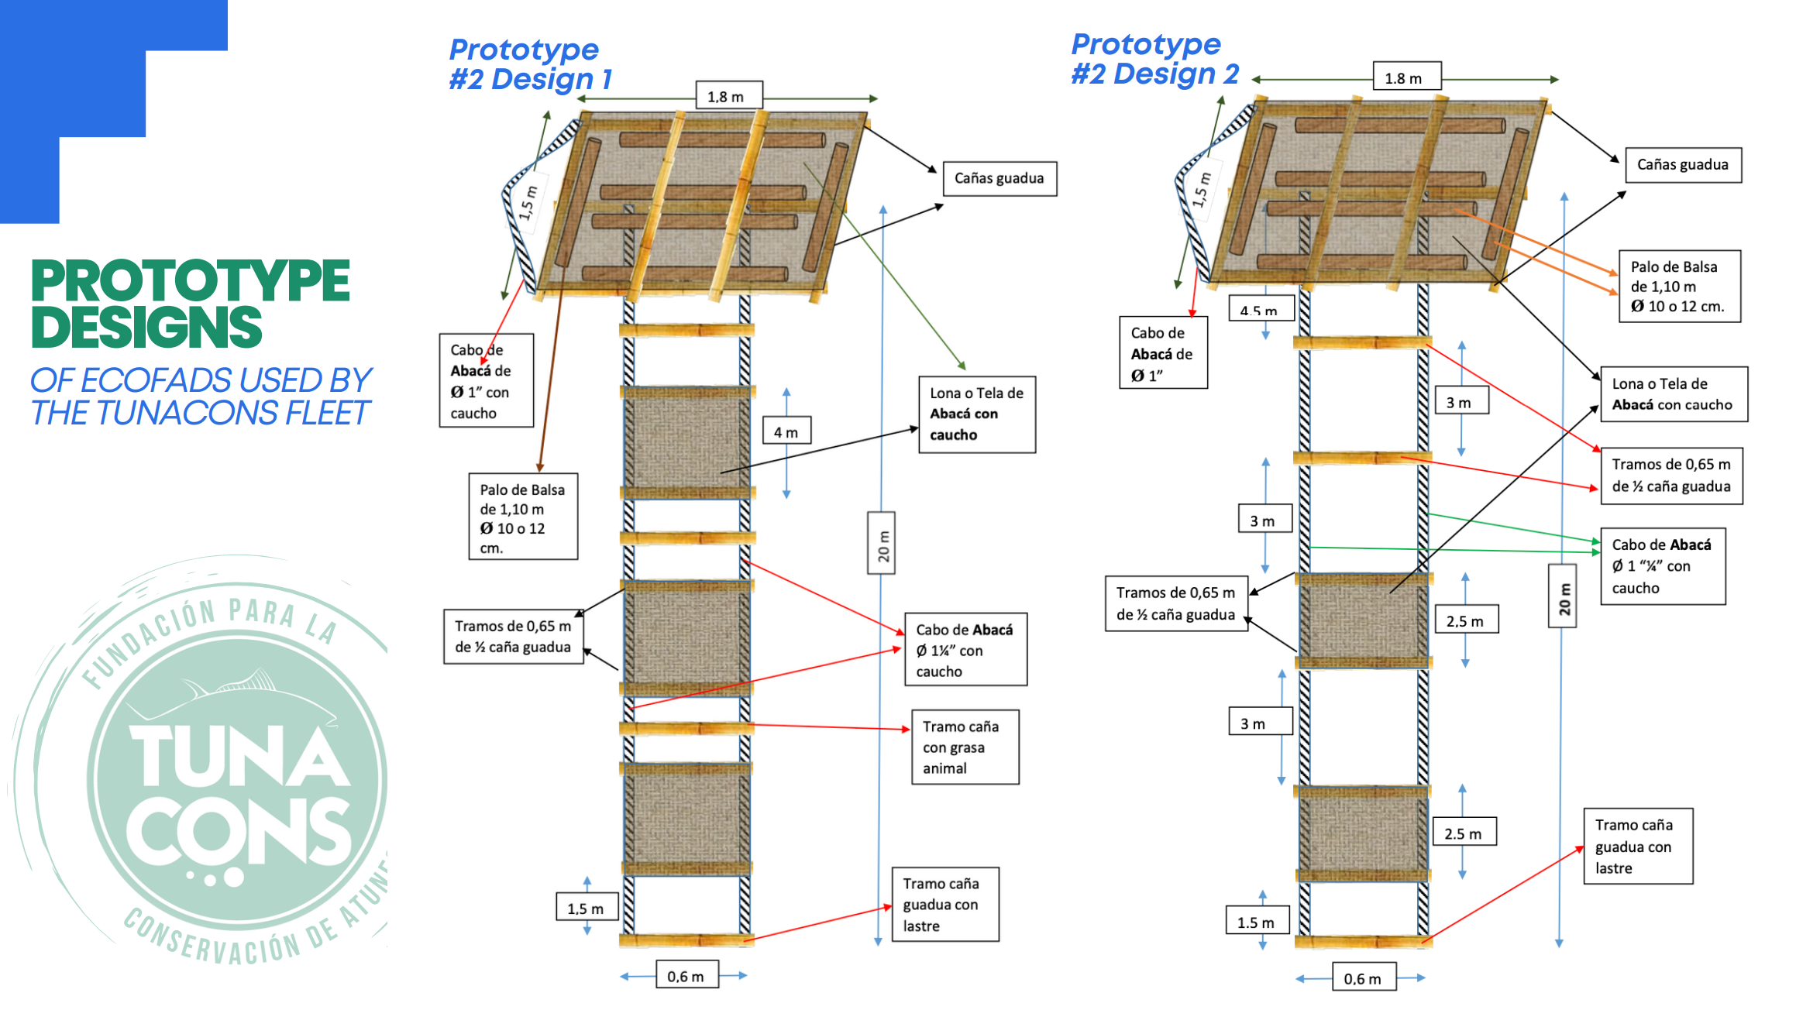
SC20-EB-IP-15
24
Notes:
5,000 non-entangling and biodegradable FADs deployed by TUNACONS fleet in 2021-2023

Slide 25
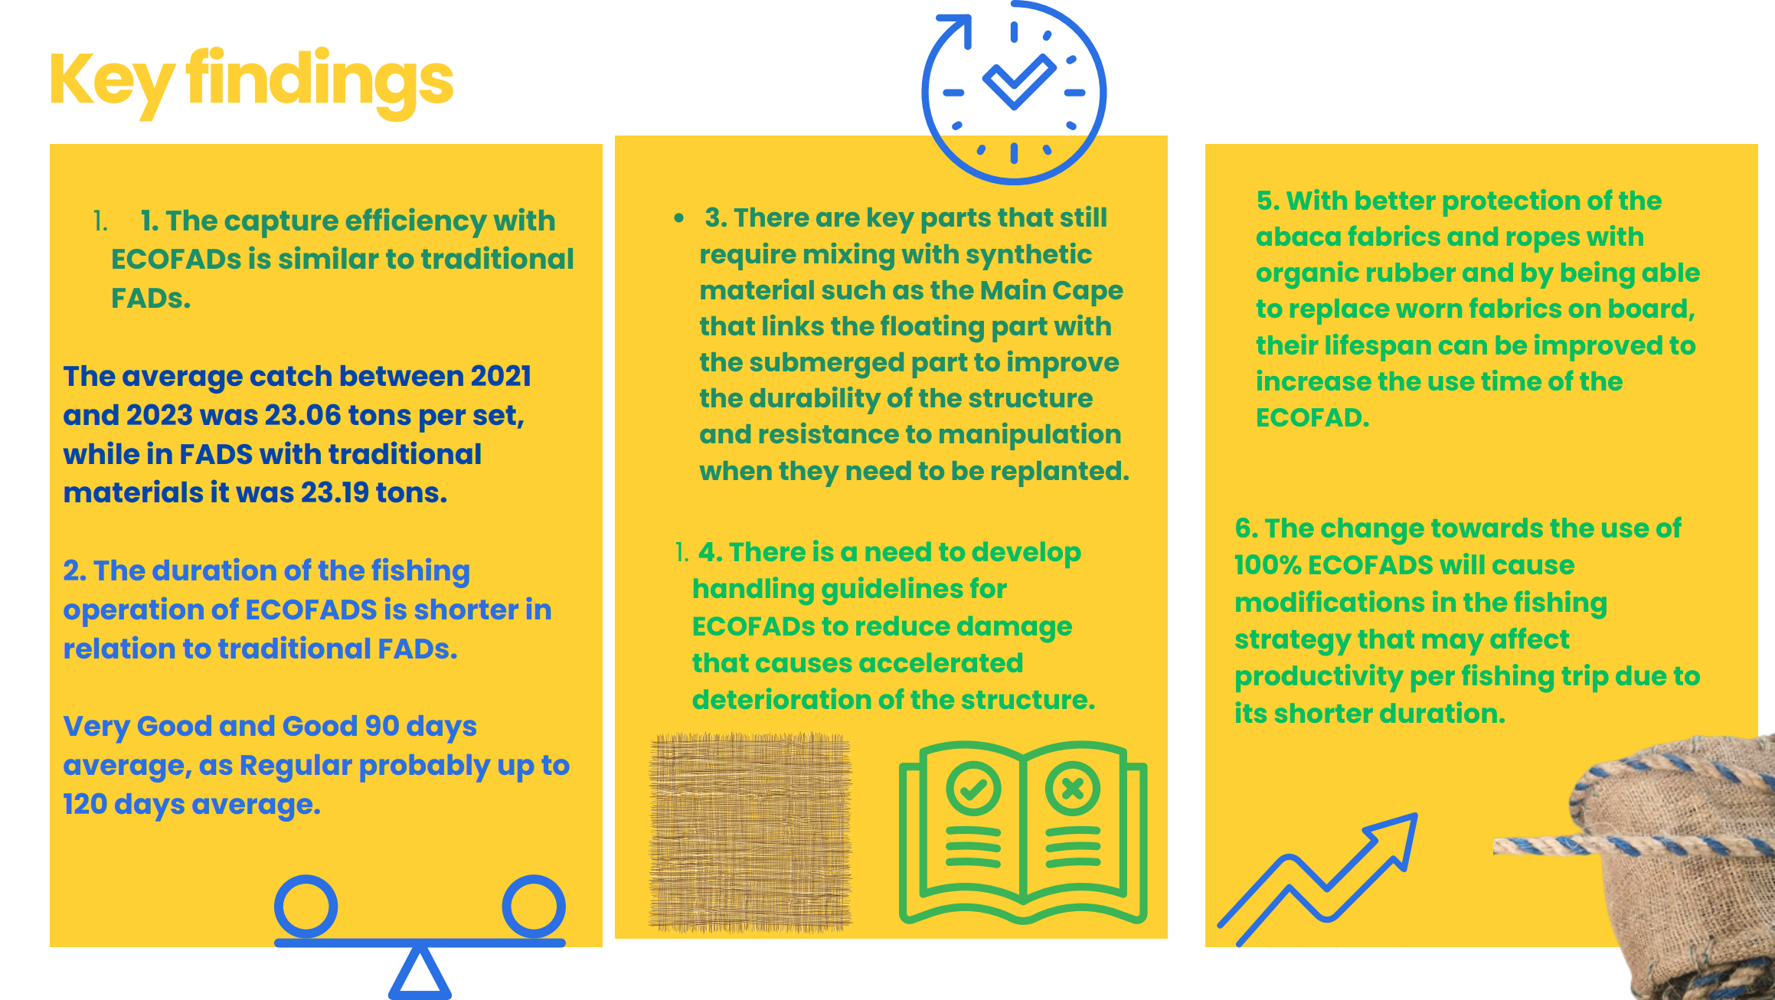
SC20-EB-IP-15
25

Slide 26
SC20-EB-IP-15
26

Slide 27
SC20-EB-IP-15
27

