Slide 1
Scientific Data Available to the Western and Central Pacific Fisheries Commission (Data Gaps) SC20-2024 ST-WP-01
Tiffany Vidal and Peter Williams
SPC-OFP
20th Regular Session of the Scientific Committee (SC 20)
Manila, Philippines

Slide 2
Overview
Summary of data reporting to the WCPFC, noting any issues or gaps in data submissions
Review 2023 provisions of Sci Data to the WCPFC
Review SC19 Recommendations
Highlight any other data gap matters
Brief takeaways:
Data gaps have continued to decline
A list of outstanding data gaps remains [refer to paper]
Standardized ACE template proving effective
Opportunities to expand data collection and increase efficiencies

Slide 3
Relevant SC20 Papers
Notes:
ROP- Standing paper
Will chat bilaterally with countries identified in the cannery paper, in the margins of this meeting.

Slide 4
2023 Sci Data Submissions
Annual Catch
Aggregate Catch and Effort
Operational Catch and Effort
Two CCMs have low coverage, noting challenges associated with small-scale vessels
One CCM still missing several required longline fields
Improvements in reporting of shark catches
Size Data – all but one CCM provided size data
32/34 CCMs satisfied 100% of the binding reporting requirements
2 others met at least 75% of the requirements

Slide 5
Data Gaps and Notes

Slide 6
SC19 Recommendations

Slide 7
SC19 Recommendations
SC20 ST-WP-08

Slide 8
SC19 Recommendations
SC20 ST-WP-06
SC20 ST-WP-09

Slide 9
Standardizing data submissions
ACE
ACE Template
Reporting interface ?
Operational/aggregate catch and effort data
TUFMAN 2
E-reporting
JSON standards – API
Templates based on current WCPFC standards
Standard for aggregate data to be proposed
Further standardization possible – would create efficiencies and improved timeliness for data availability each year
Notes:
Possible WCPFC project – proposal presented to SC21? To visit countries, see what might be possible, develop tools, etc.

Slide 10
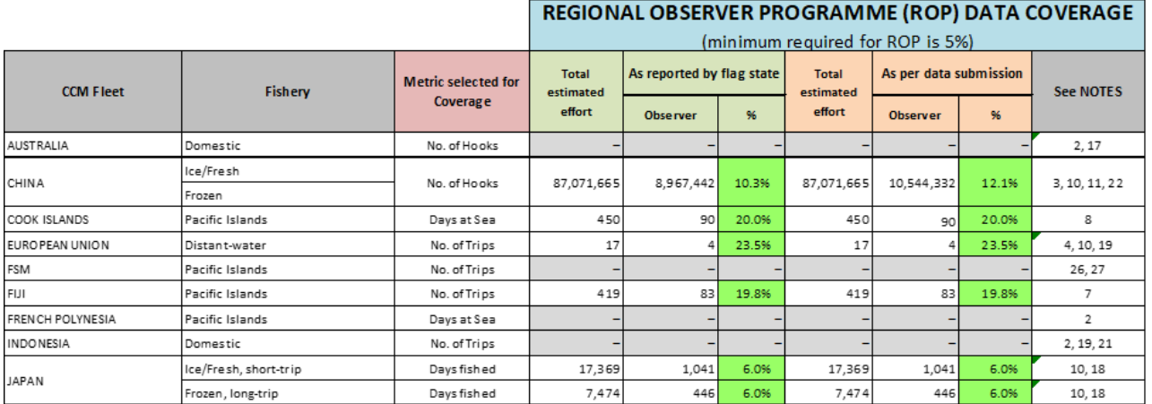
Regional Observer Programme
SC20 ST-IP-03
Purse seine observer data submissions
ROP longline coverage by fleet
Overall longline coverage (5.3% in 2023)
Transhipment observer data submissions
Notes:
Note that there are sometimes delays in the receiving observer data for various reasons, and recently there have been some delays in data entry due to the unrest in Noumea. So, in some cases the actual coverage may be higher than indicated in this paper, and figures for 2023 will be updated in the subsequent paper.

Slide 11
WCPFC Data Products
Notes:
There are a suite of public domain data sets available on the WCPFC website under Scientific Data. These include ACE, aggregate catch and effort, size data, bycatch estimates, and ACE by EEZ (which is a new product available through the website as of this year).

Slide 12
Actions
Please review the status of your scientific submissions and any gaps identified in this and companion papers
Contact SPC if there are updates or corrections required
The SSP is available to assist as necessary to improve gaps or develop efficiencies for data submissions and review
Revision to this, and accompanying papers, will be made following this session
Thank you

