Slide 1
Stock assessment of WCPO silky shark (Carcharhinus falciformis, FAL)
SA-WP-04
Philipp Neubauer
Kyuhan Kim
Kath Large
Stephen Brouwer
Date: August 2024

Slide 2
Summary
Stock assessment of WCPO silky shark
Inputs and assumptions across assessments:
Stock structure
Biology - growth
Data inputs
Alternative models: overview
SS3 model - key outcomes
Dynamic surplus production
Length-based hybrid spatial risk assessment model
Length and age-structured model

Slide 3
2024 Assessment: Inputs
Stock Assessment of WCPO silky shark

Slide 4
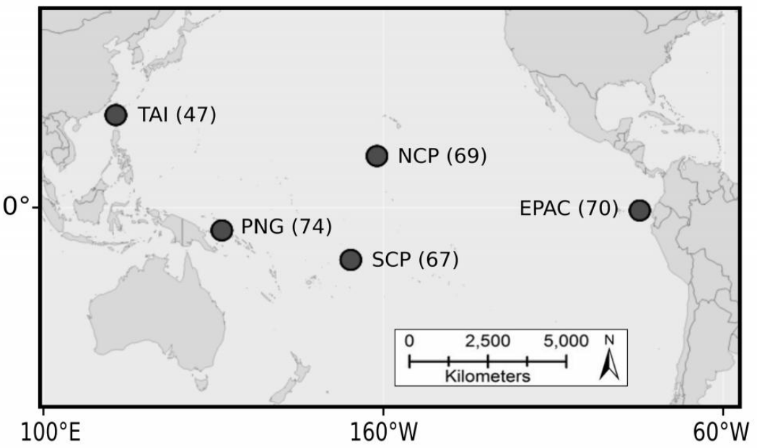
Stock structure
Stock assessment of WCPO silky shark
Open question, conflicting hypotheses
Tagging: Hutchinson et al. (2019),Francis et al. (2023)
Long range movements possible, but also some local movements
Genomics: Kraft et al. (2018, SC14-EB-IP-04)
Nuclear markers yielded significant population structure between five regions

Slide 5
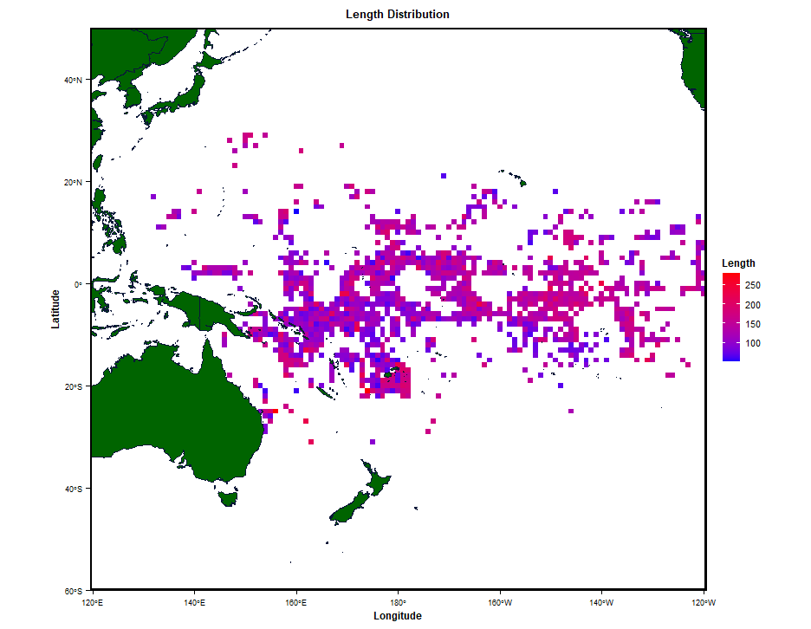
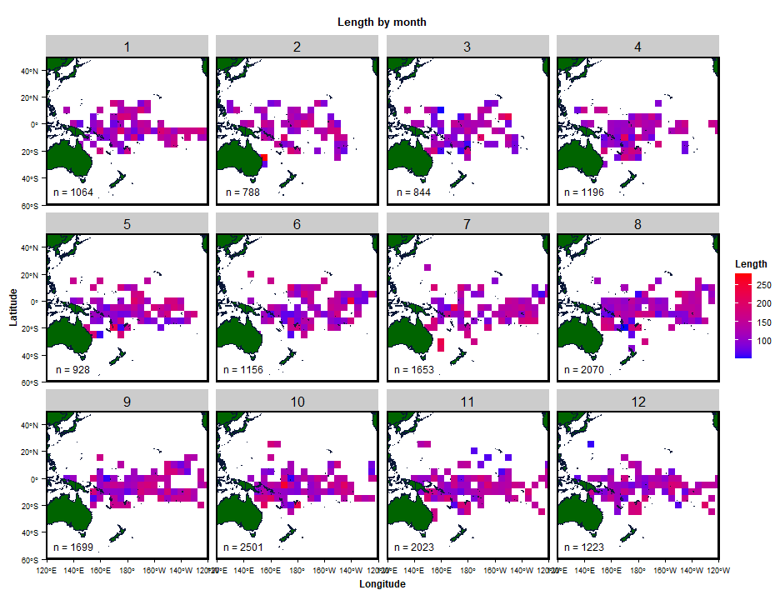
Stock structure
Stock assessment of WCPO silky shark
No indication of strong patterns in mean length in space

Slide 6
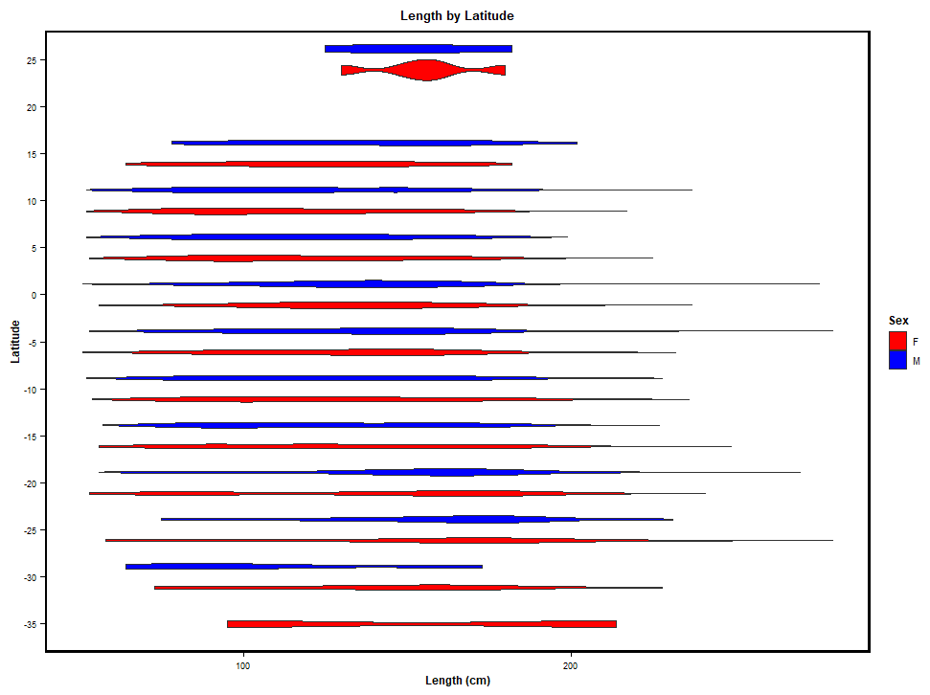
Stock structure
Stock assessment of WCPO silky shark
No indication of strong patterns in mean length in space
No data to inform spatially structured model

Slide 7
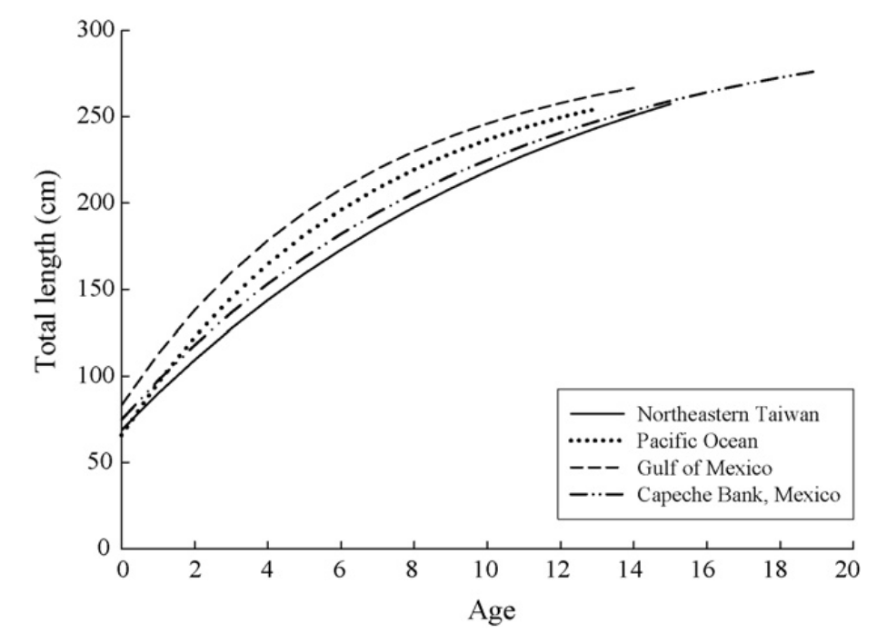
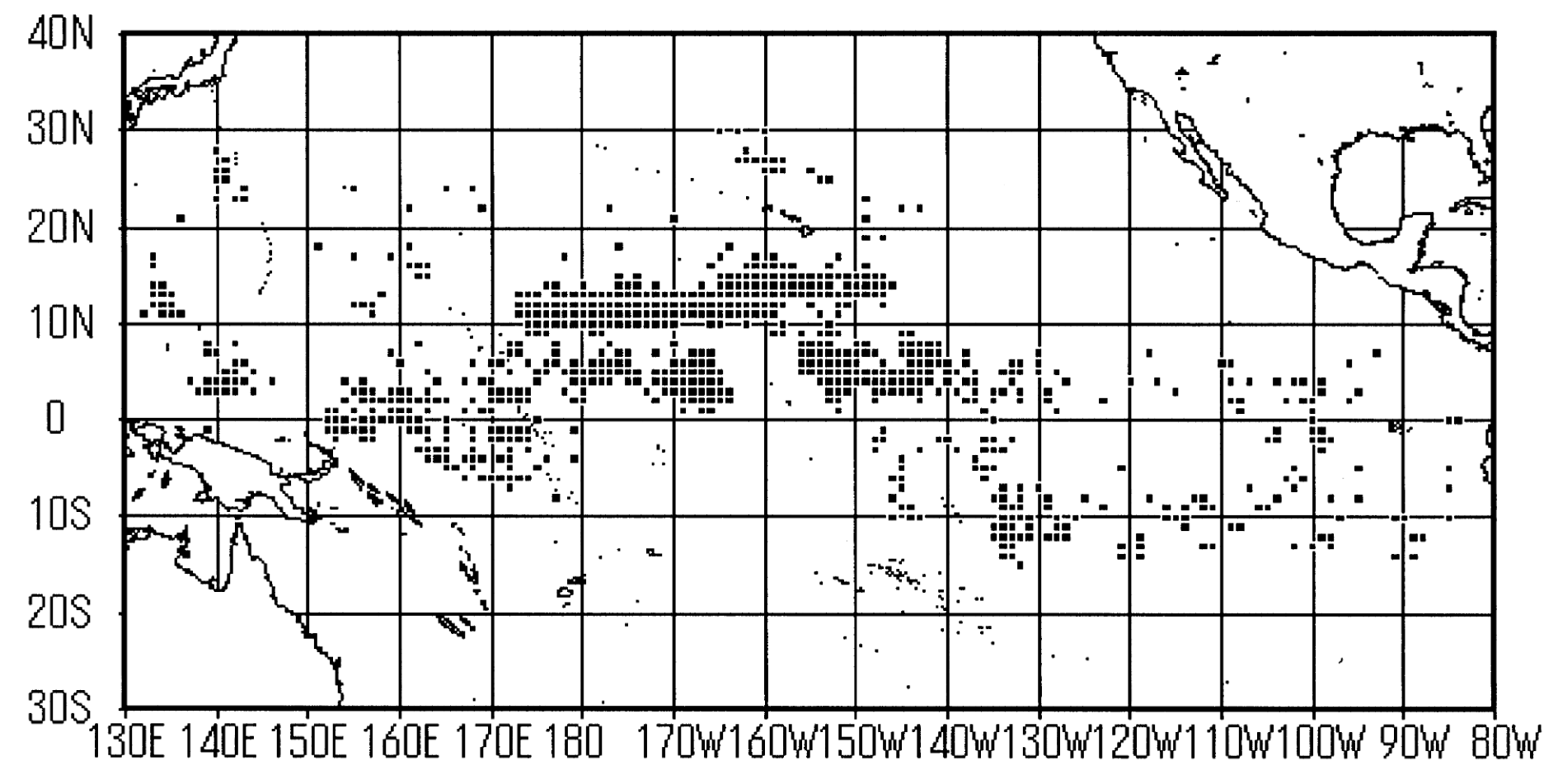
Growth
Stock assessment of WCPO silky shark
Two growth curves available
Oshitani et al. 2003
Joung et al 2008
Oshitani study based on individuals caught in tropical longline fishery, mostly WCPO
Alternative setup
Previous/current base setup

Slide 8
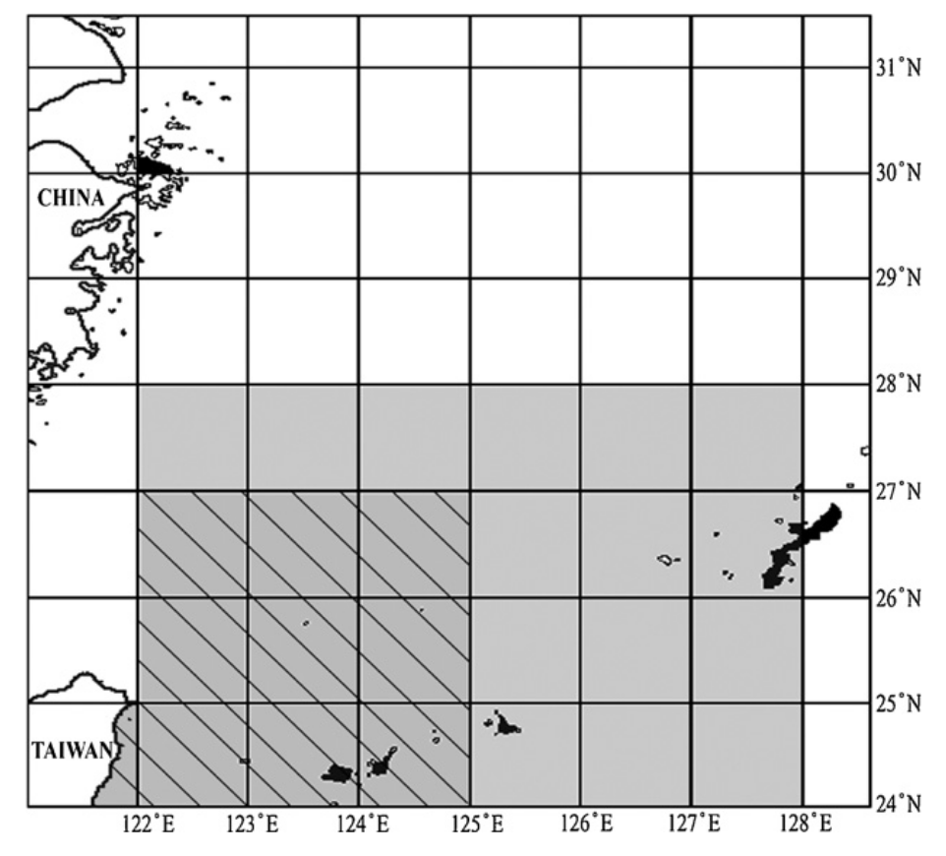
Growth
Stock assessment of WCPO silky shark
Two growth curves available
Oshitani et al. 2003
Joung et al 2008
Oshitani study based on individuals caught in tropical longline fishery, mostly WCPO
Joung et al. growth used in last assessment
Alternative setup
Previous/current base setup

Slide 9
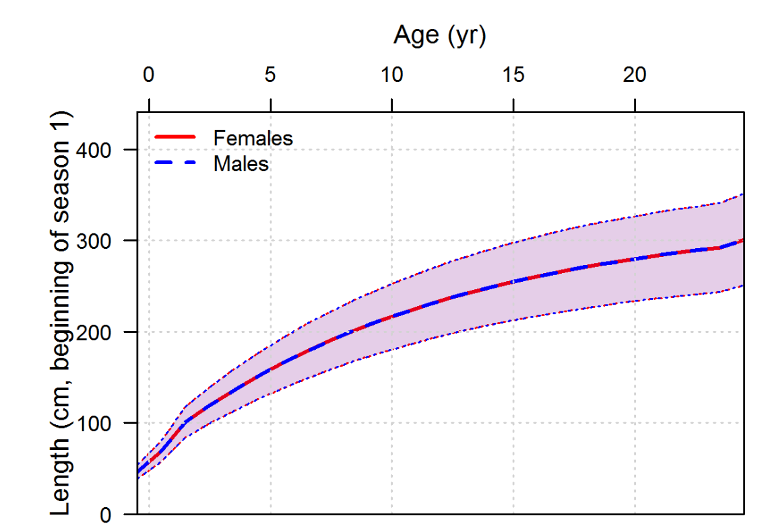
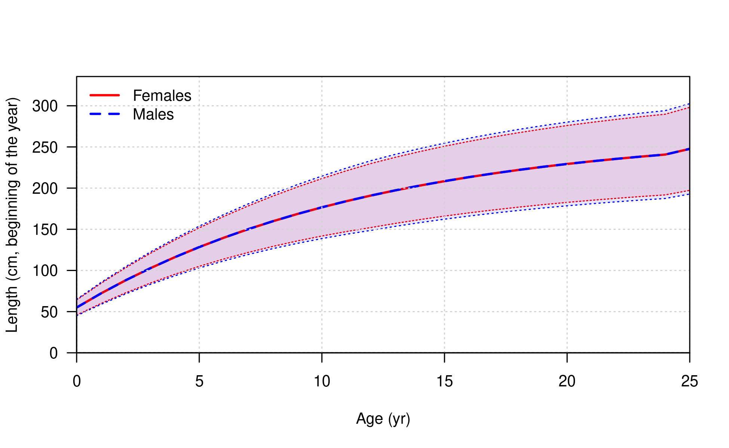
Growth
Stock assessment of WCPO silky shark
Model LFs are in terms of fork length (as mostly recorded by observers).
Previous growth model used TL for parameters;
Conversion leads to different growth assumption.

Slide 10
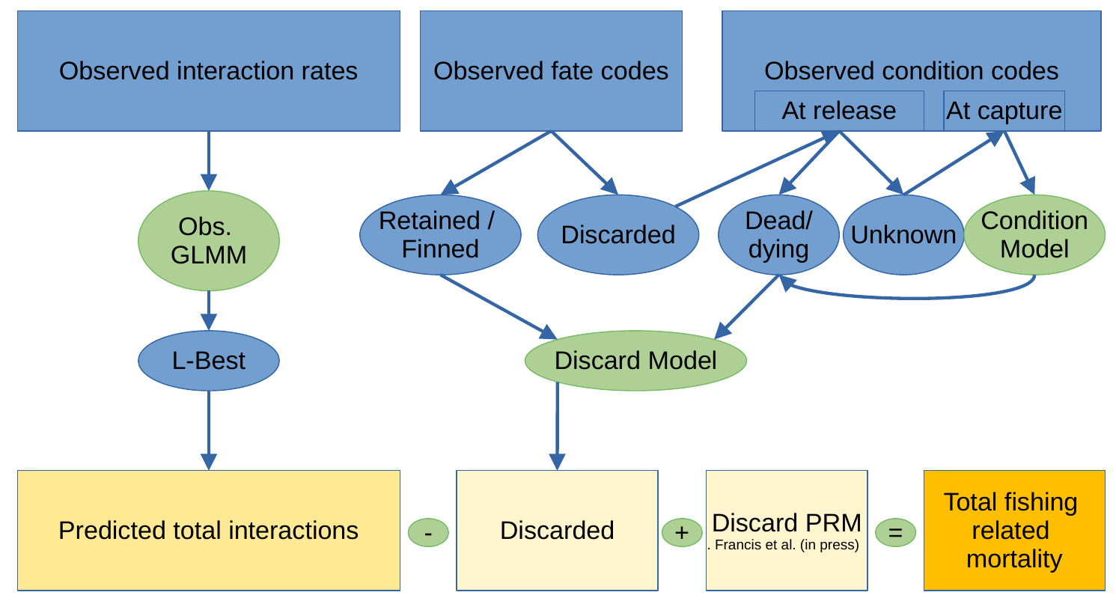
Catch
Stock assessment of WCPO silky shark
Model uses predicted catch from catch reconstruction, not reported catch
Need to account for discarding and survival in recent years
Condition model: estimated condition at release (dead (A3/D) or alive (A1/A2) from condition at capture.
Discard model: attempts to estimated proportion of sharks released alive
PRM (0.15 LL, 0.85 PS) applied to total discarded catch.

Slide 11
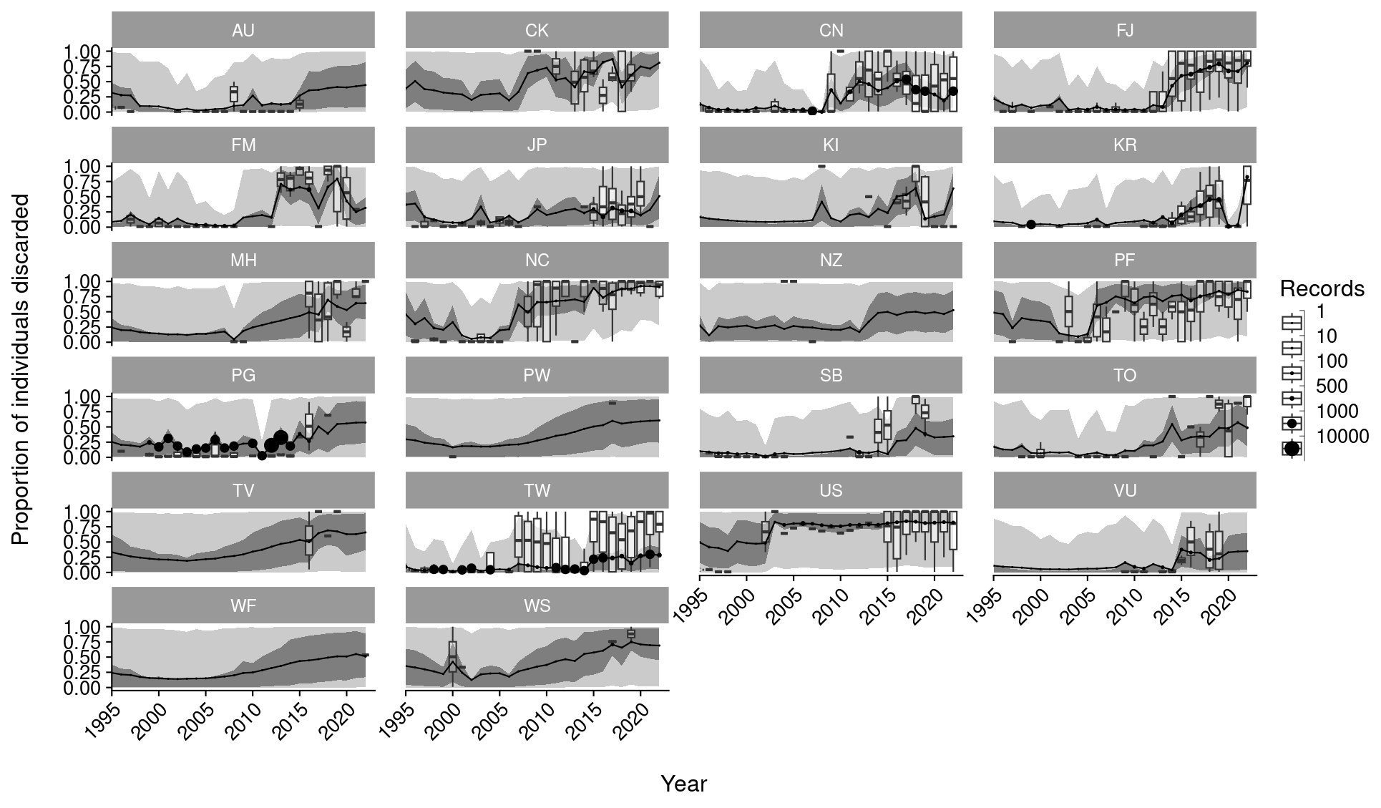
Catch
Stock assessment of WCPO silky shark
Model uses predicted catch from catch reconstruction, not reported catch
Need to account for discarding and survival in recent years
Condition model: estimated condition at release (dead (A3/D) or alive (A1/A2) from condition at capture.
Discard model: attempts to estimated proportion of sharks released alive
PRM (0.15 LL, 0.85 PS) applied to total discarded catch.

Slide 12
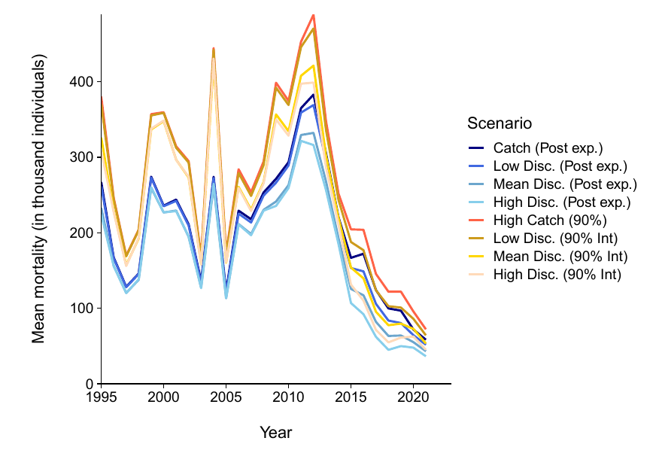
Catch
Stock assessment of WCPO silky shark
Model uses predicted catch from catch reconstruction, not reported catch
Need to account for discarding and survival in recent years
Condition model: estimated condition at release (dead (A3/D) or alive (A1/A2) from condition at capture.
Discard model: attempts to estimated proportion of sharks released alive
PRM (0.15 LL, 0.85 PS) applied to total discarded catch.

Slide 13
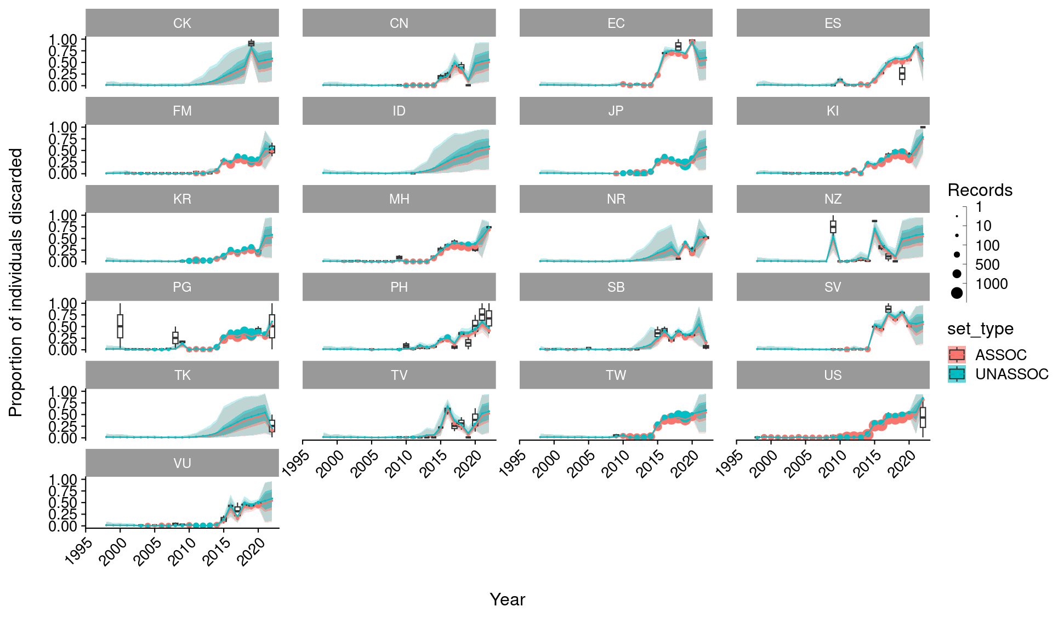
Catch
Stock assessment of WCPO silky shark
Model uses predicted catch from catch reconstruction, not reported catch
Need to account for discarding and survival in recent years
Condition model: estimated condition at release (dead (A3/D) or alive (A1/A2) from condition at capture.
Discard model: attempts to estimated proportion of sharks released alive
PRM (0.15 LL, 0.85 PS) applied to total discarded catch.

Slide 14
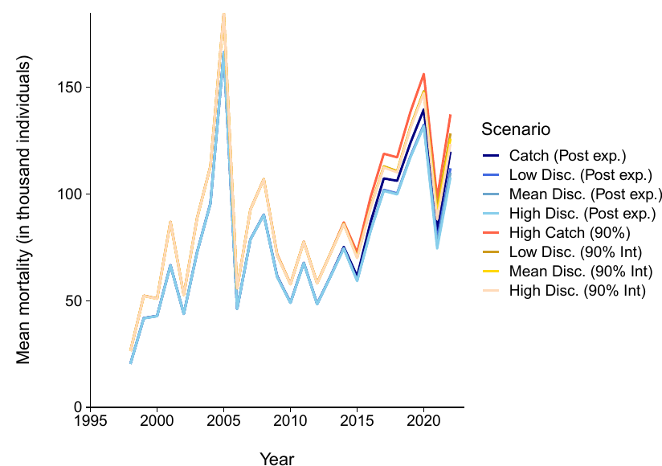
Catch
Stock assessment of WCPO silky shark
Model uses predicted catch from catch reconstruction, not reported catch
Need to account for discarding and survival in recent years
Condition model: estimated condition at release (dead (A3/D) or alive (A1/A2) from condition at capture.
Discard model: attempts to estimated proportion of sharks released alive
PRM (0.15 LL, 0.85 PS) applied to total discarded catch.

Slide 15
CPUE
Stock assessment of WCPO silky shark
Previous models used longline CPUE:
Inconsistent between assessments
Inconsistent between regions, very sensitive to inclusion of particular datasets

Slide 16
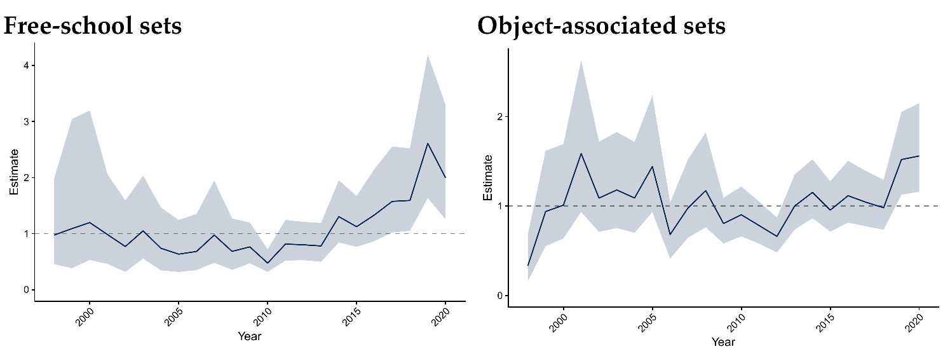
CPUE
Stock assessment of WCPO silky shark
PS CPUE is very consistent, shows recent increase;
High obs coverage means much more representative sample
Standardisation by

Slide 17
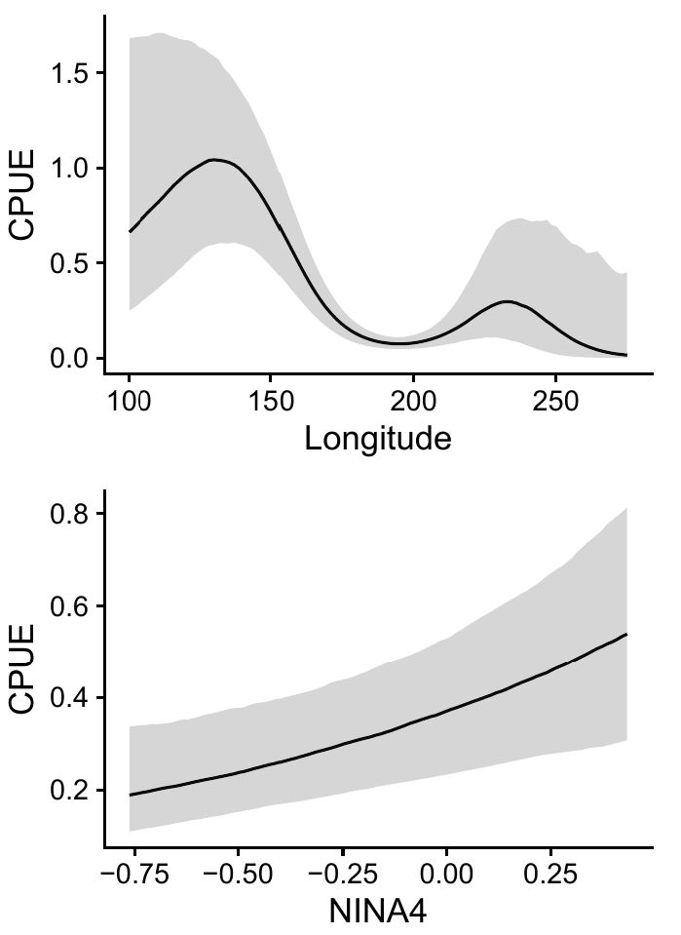
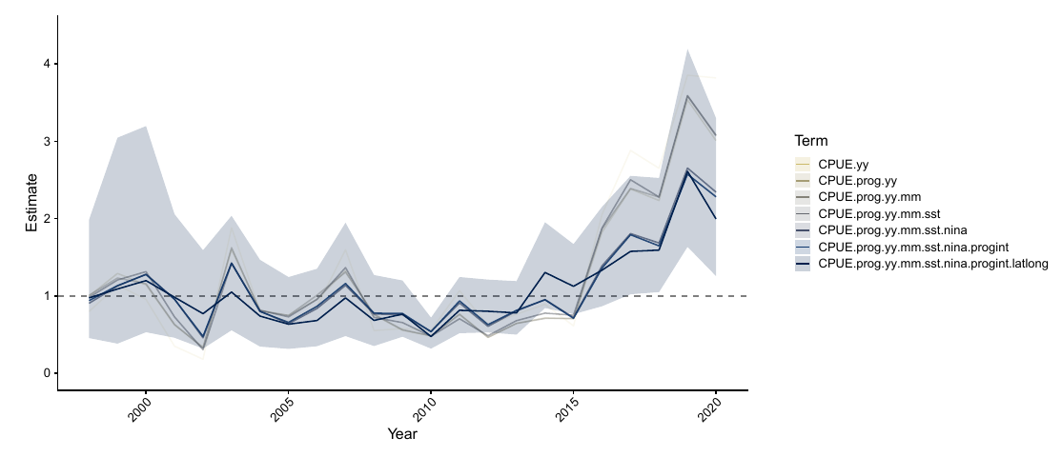
CPUE
Stock assessment of WCPO silky shark
PS CPUE is very consistent, shows recent increase;
High obs coverage means much more representative sample
Standardisation by spatial and ENSO terms

Slide 18
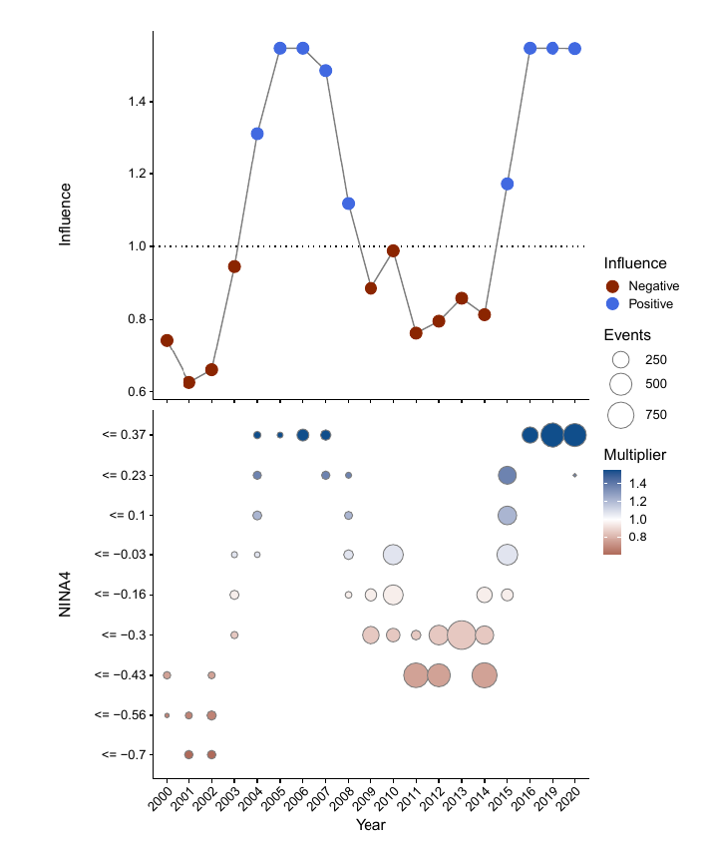
CPUE
Stock assessment of WCPO silky shark
PS CPUE is very consistent, shows recent increase;
High obs coverage means much more representative sample
Standardisation by spatial and ENSO terms

Slide 19
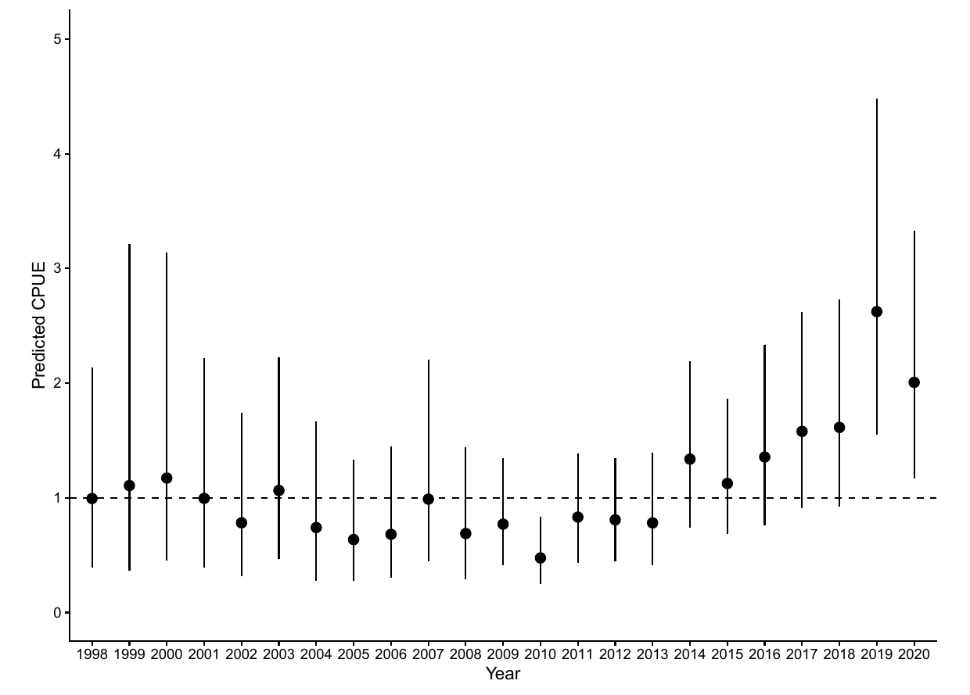
CPUE
Stock assessment of WCPO silky shark
PS CPUE is very consistent, shows recent increase;
High obs coverage means much more representative sample
Standardisation by spatial and ENSO terms
Spatio-temporal model with lat-long-year effect tested to understand if effects due to inconsistent spatial coverage of the fleet
Index produced by predicting lat-lon-year effect over a consistent area
Index near identical to original index

Slide 20
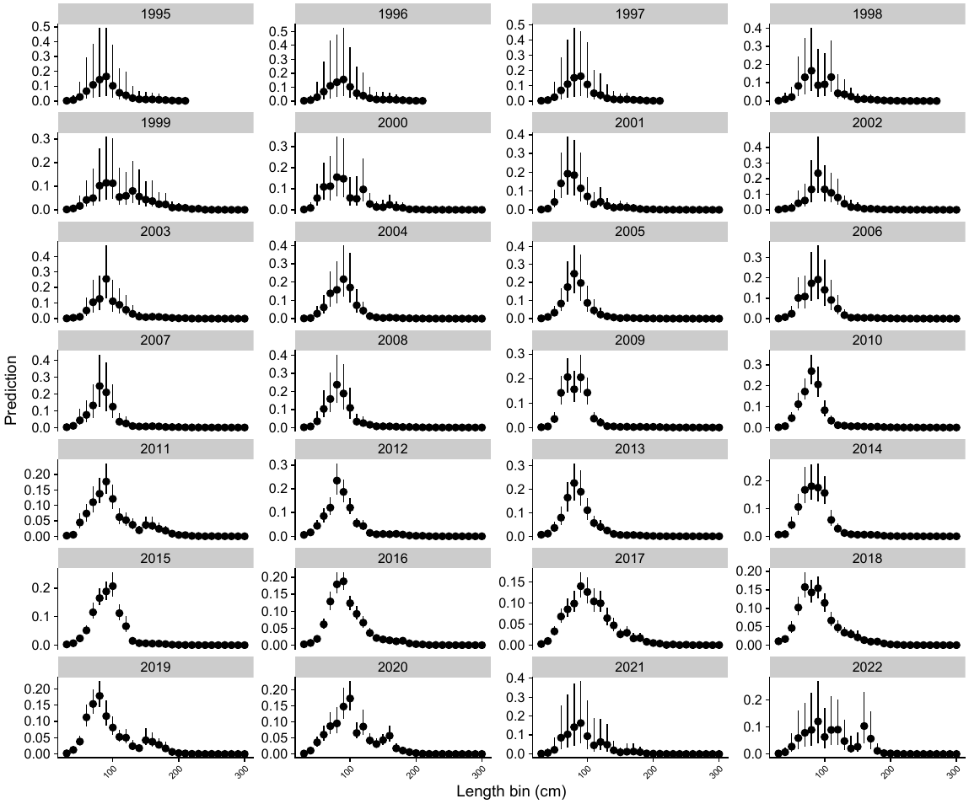
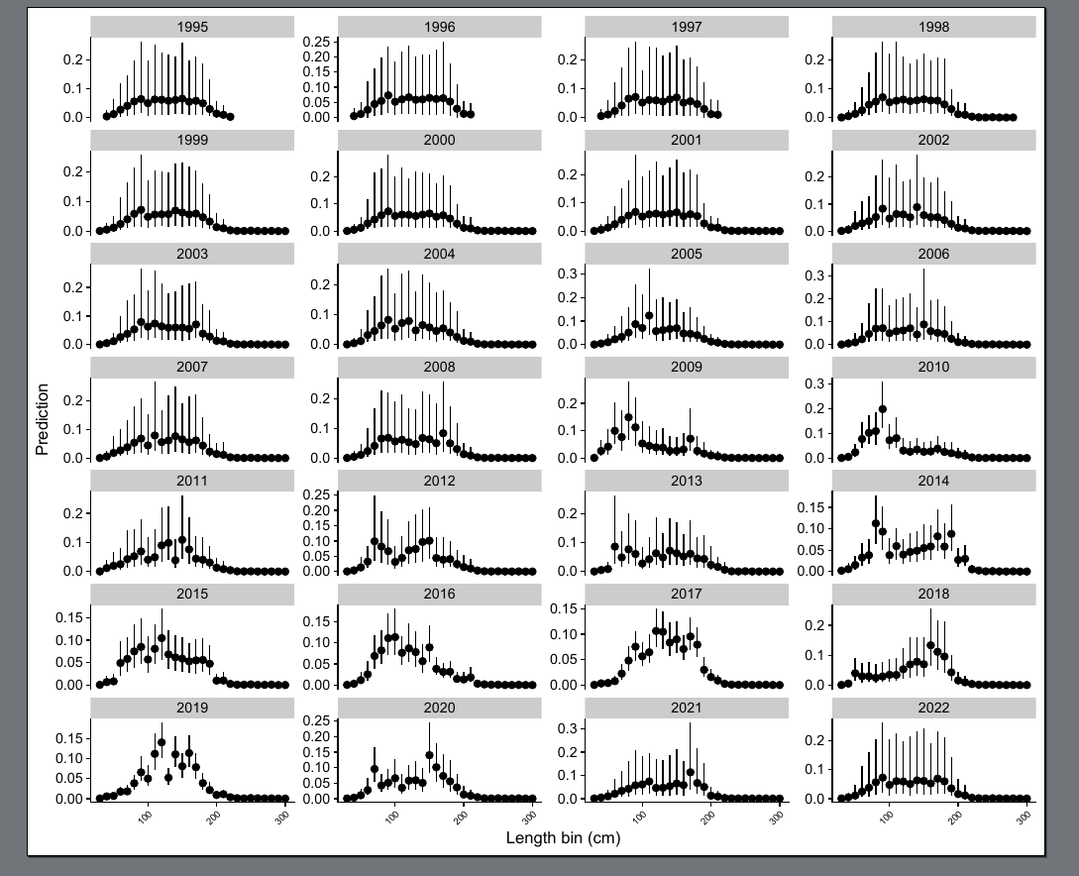
Scaled LFs - catch
Stock assessment of WCPO silky shark
Purse-seine: Object-associated
Purse-seine: Free-school
Notes:
segregated data from vessels operating in PNG and Solomon Islands that declared they targeted sharks (for catch and standardised CPUE)
given high value of fins, abundance in shark fin trade, and low observer coverage, likely that targeting occurred in other areas
expected that factors leading to catching FLA while targeting them would be different than catching FLA as bycatch

Slide 21
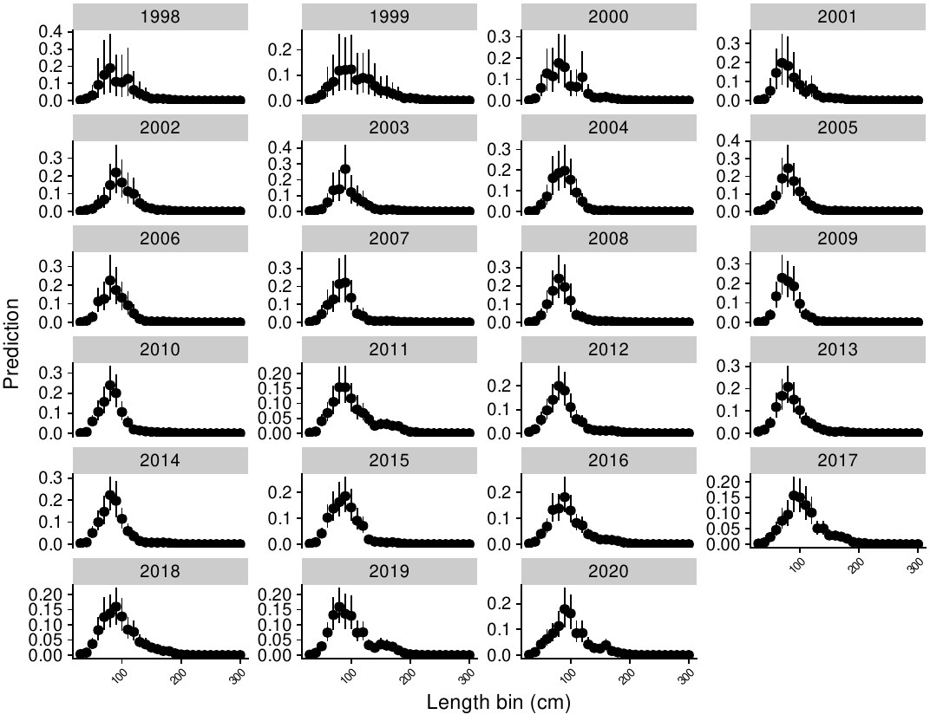
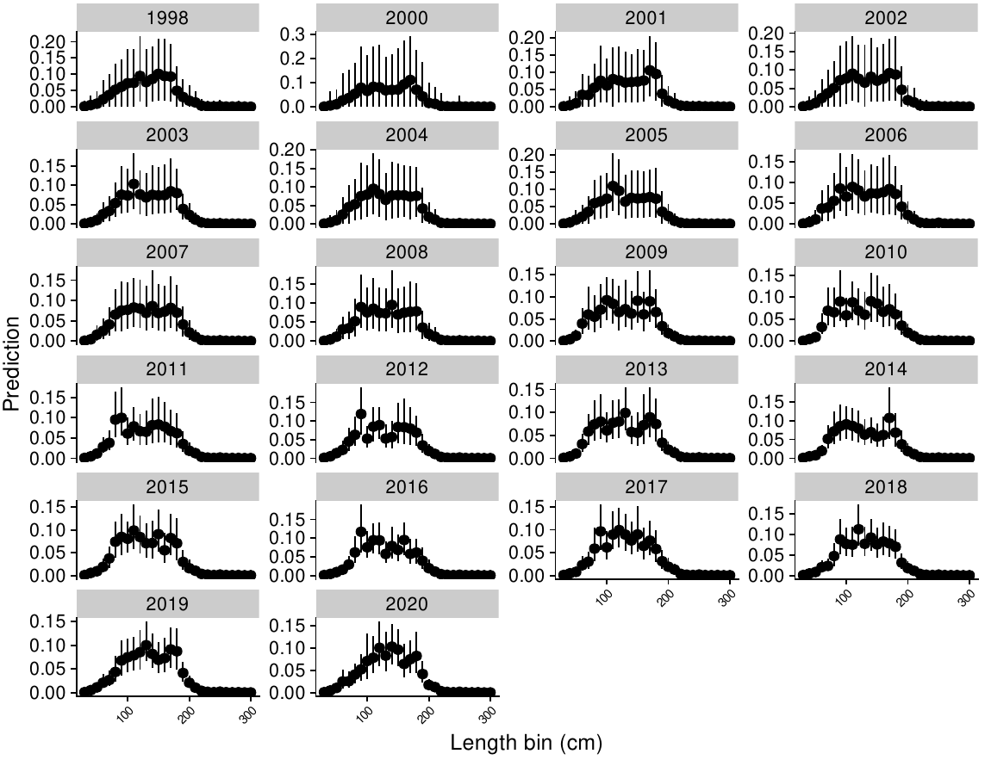
Scaled LFs - CPUE
Stock assessment of WCPO silky shark
Purse-seine: Object-associated
Purse-seine: Free-school
Notes:
segregated data from vessels operating in PNG and Solomon Islands that declared they targeted sharks (for catch and standardised CPUE)
given high value of fins, abundance in shark fin trade, and low observer coverage, likely that targeting occurred in other areas
expected that factors leading to catching FLA while targeting them would be different than catching FLA as bycatch

Slide 22
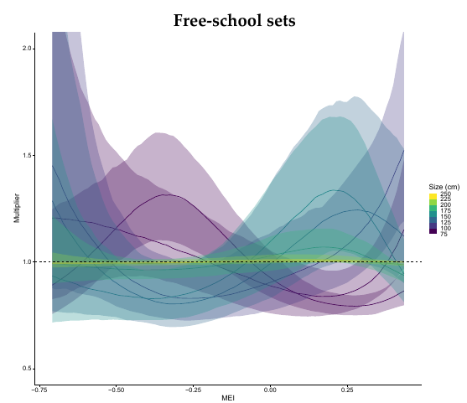
Scaled LFs -
CPUE
Stock assessment of WCPO silky shark
Clear ENSO effect on size compositions
Notes:
segregated data from vessels operating in PNG and Solomon Islands that declared they targeted sharks (for catch and standardised CPUE)
given high value of fins, abundance in shark fin trade, and low observer coverage, likely that targeting occurred in other areas
expected that factors leading to catching FLA while targeting them would be different than catching FLA as bycatch

Slide 23
2024 Assessment: Stock synthesis
Stock Assessment of WCPO silky shark

Slide 24
Model setup
Stock assessment of WCPO silky shark
CPUE:
Free-school purse-seine used to fit model,
Object associated (juvenile fish only) not fitted but compared with model predictions
LFs:
Capture fisheries (Longline, Purse Seine x2)
Index fisheries - free-school and object associated purse-seine
Notes:
segregated data from vessels operating in PNG and Solomon Islands that declared they targeted sharks (for catch and standardised CPUE)
given high value of fins, abundance in shark fin trade, and low observer coverage, likely that targeting occurred in other areas
expected that factors leading to catching FLA while targeting them would be different than catching FLA as bycatch

Slide 25
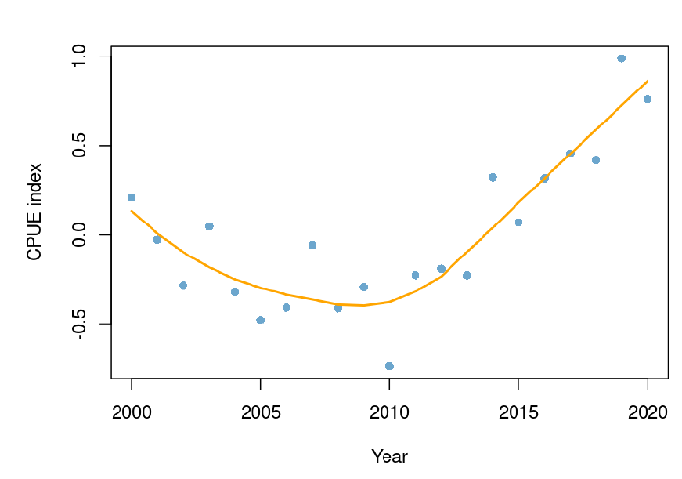
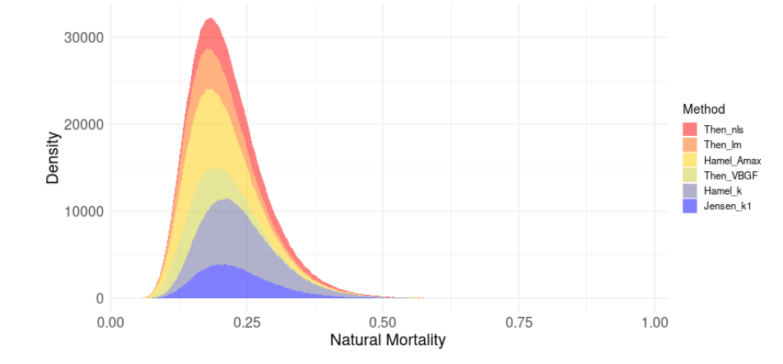
Model setup
Stock assessment of WCPO silky shark
Capture fishery LFs fitting using time-varying selectivities (2DAR)
Index fishery LFs use constant selectivity
CPUE/LF weighted using Francis (2011) method (not converging)
M estimated from informed prior derived from meta-analysis with relatively high SD (0.2)
Stock recruitment used survival-based function with estimated degree of over-compensation (BH did not work)
Notes:
segregated data from vessels operating in PNG and Solomon Islands that declared they targeted sharks (for catch and standardised CPUE)
given high value of fins, abundance in shark fin trade, and low observer coverage, likely that targeting occurred in other areas
expected that factors leading to catching FLA while targeting them would be different than catching FLA as bycatch

Slide 26
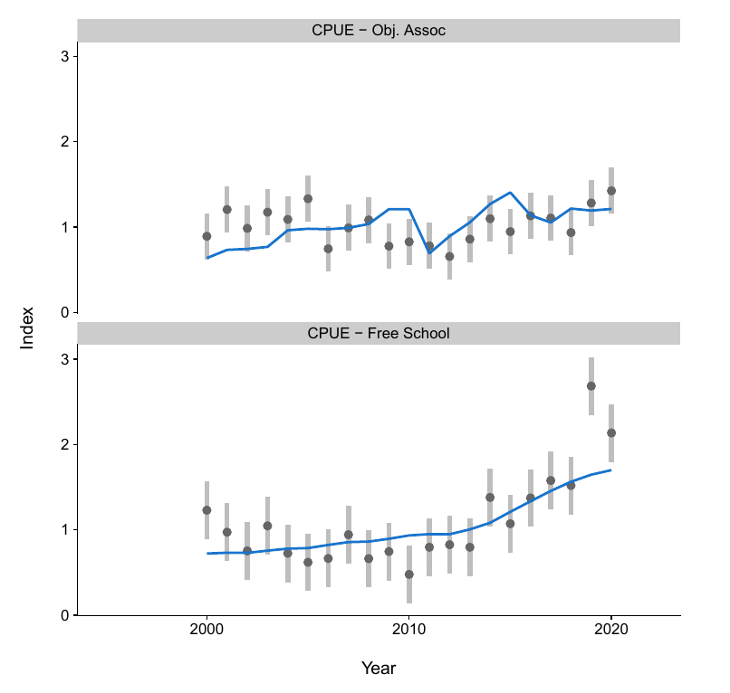
SS model fits
Stock assessment of WCPO silky shark
Model fits to CPUE are not great
Notes:
segregated data from vessels operating in PNG and Solomon Islands that declared they targeted sharks (for catch and standardised CPUE)
given high value of fins, abundance in shark fin trade, and low observer coverage, likely that targeting occurred in other areas
expected that factors leading to catching FLA while targeting them would be different than catching FLA as bycatch

Slide 27
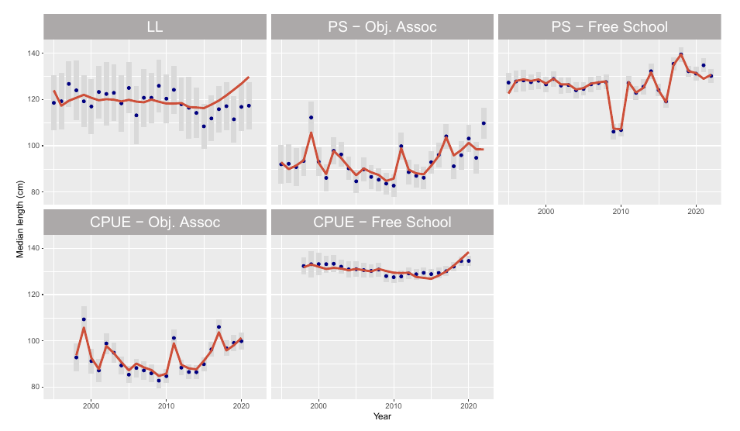
SS model fits
Stock assessment of WCPO silky shark
Model fits to CPUE are not great
Fits to Length Compositions are good except for LL
Notes:
segregated data from vessels operating in PNG and Solomon Islands that declared they targeted sharks (for catch and standardised CPUE)
given high value of fins, abundance in shark fin trade, and low observer coverage, likely that targeting occurred in other areas
expected that factors leading to catching FLA while targeting them would be different than catching FLA as bycatch

Slide 28
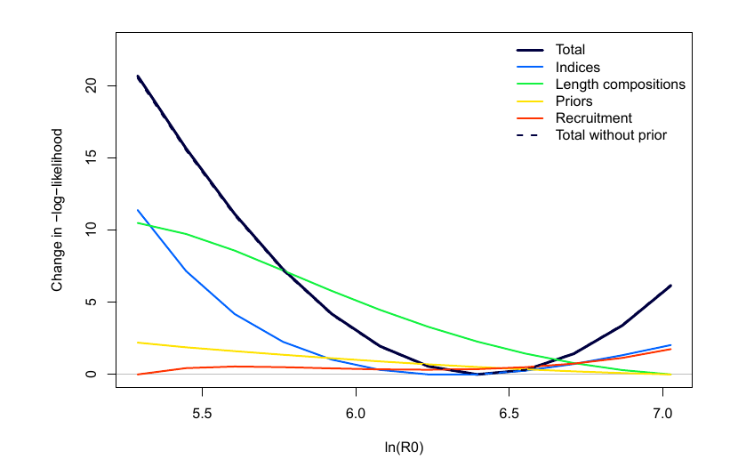
SS model diagnostics
Stock assessment of WCPO silky shark
Model fits to CPUE are not great
Fits to Length Compositions are good except for LL
R0 and M were well-estimated, but conflict between length-comps and index.
Indices suggest smaller R0 and M than LFs
Notes:
segregated data from vessels operating in PNG and Solomon Islands that declared they targeted sharks (for catch and standardised CPUE)
given high value of fins, abundance in shark fin trade, and low observer coverage, likely that targeting occurred in other areas
expected that factors leading to catching FLA while targeting them would be different than catching FLA as bycatch

Slide 29
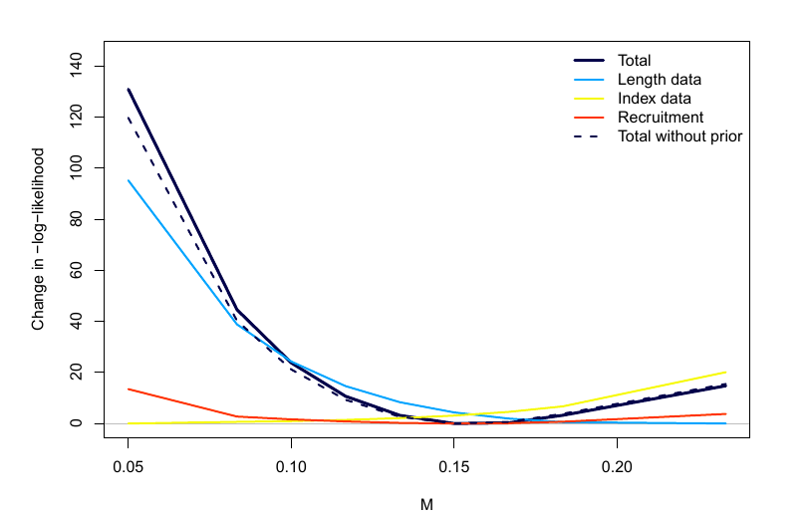
SS model diagnostics
Stock assessment of WCPO silky shark
Model fits to CPUE are not great
Fits to Length Compositions are good except for LL
R0 and M were well-estimated, but conflict between length-comps and index.
Indices suggest smaller R0 and M than LFs
Notes:
segregated data from vessels operating in PNG and Solomon Islands that declared they targeted sharks (for catch and standardised CPUE)
given high value of fins, abundance in shark fin trade, and low observer coverage, likely that targeting occurred in other areas
expected that factors leading to catching FLA while targeting them would be different than catching FLA as bycatch

Slide 30
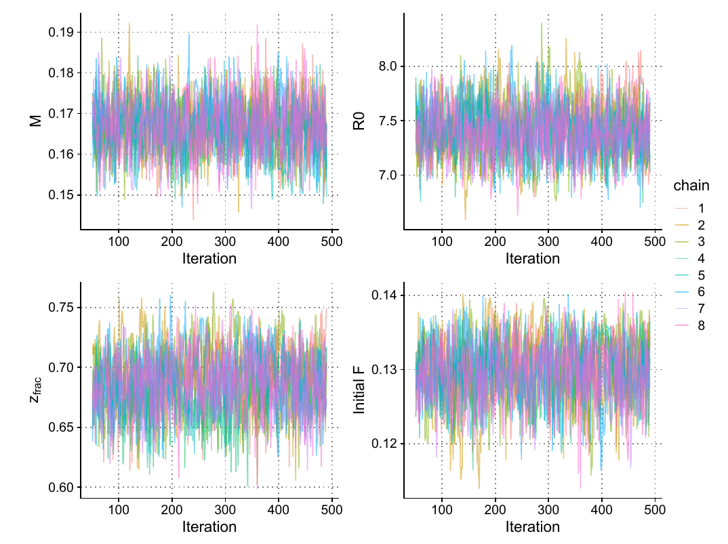
SS model diagnostics
Stock assessment of WCPO silky shark
Model fits to CPUE are not great
Fits to Length Compositions are good except for LL
R0 and M were well-estimated, but conflict between length-comps and index.
Indices suggest smaller R0 and M than LFs
MCMC attempts led to poor MCMC for most models (divergent transitions), few for base model
Divergences linked to time-varying selectivity - model cannot fit LFs without it
Notes:
segregated data from vessels operating in PNG and Solomon Islands that declared they targeted sharks (for catch and standardised CPUE)
given high value of fins, abundance in shark fin trade, and low observer coverage, likely that targeting occurred in other areas
expected that factors leading to catching FLA while targeting them would be different than catching FLA as bycatch

Slide 31
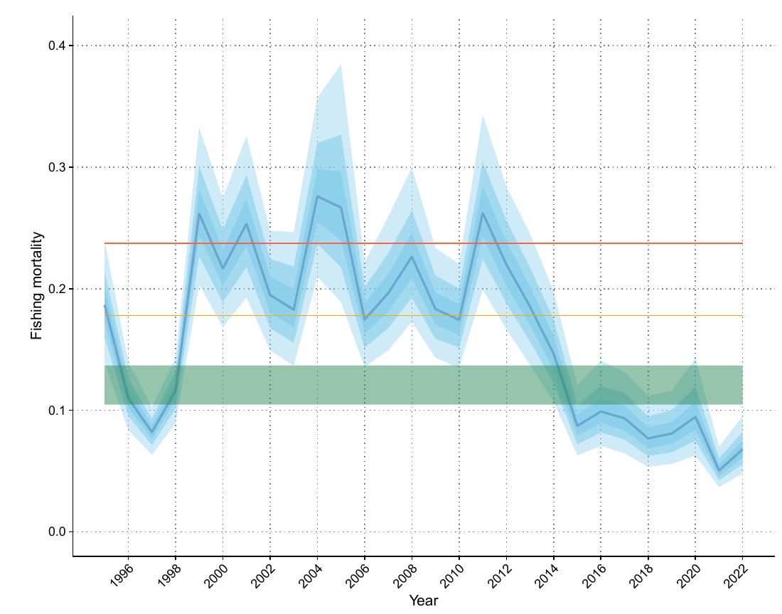
SS model outputs
Stock assessment of WCPO silky shark
Model estimates declining fishing mortality, to below F_{MSY}
Notes:
segregated data from vessels operating in PNG and Solomon Islands that declared they targeted sharks (for catch and standardised CPUE)
given high value of fins, abundance in shark fin trade, and low observer coverage, likely that targeting occurred in other areas
expected that factors leading to catching FLA while targeting them would be different than catching FLA as bycatch

Slide 32
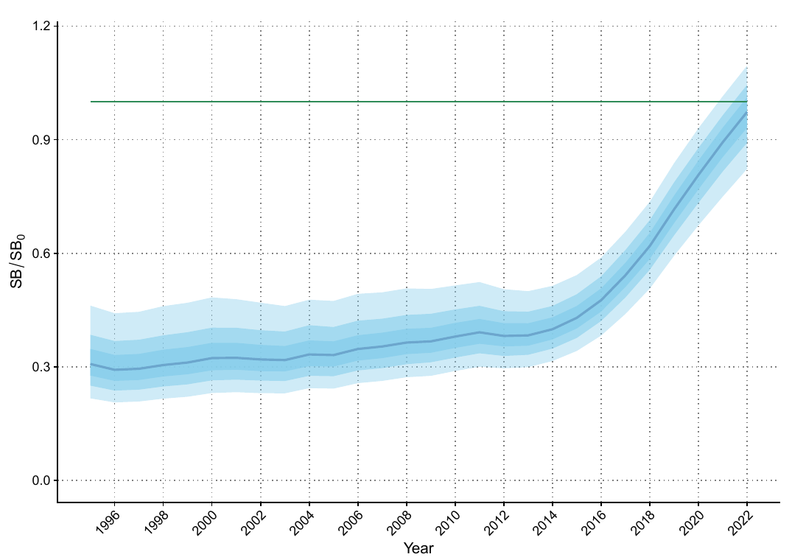
SS model outputs
Stock assessment of WCPO silky shark
Model estimates declining fishing mortality, to below F_{MSY}
Increasing stock status to near B₀ in recent years
Notes:
segregated data from vessels operating in PNG and Solomon Islands that declared they targeted sharks (for catch and standardised CPUE)
given high value of fins, abundance in shark fin trade, and low observer coverage, likely that targeting occurred in other areas
expected that factors leading to catching FLA while targeting them would be different than catching FLA as bycatch

Slide 33
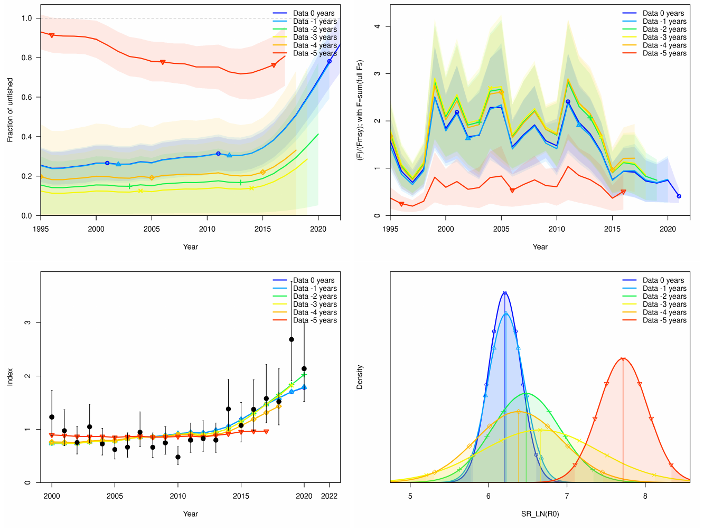
SS model outputs
Stock assessment of WCPO silky shark
Model estimates declining fishing mortality, to below F_{MSY}
Increasing stock status to near B₀ in recent years
Retrospectives show that recent information contributes to status estimates
Notes:
segregated data from vessels operating in PNG and Solomon Islands that declared they targeted sharks (for catch and standardised CPUE)
given high value of fins, abundance in shark fin trade, and low observer coverage, likely that targeting occurred in other areas
expected that factors leading to catching FLA while targeting them would be different than catching FLA as bycatch

Slide 34
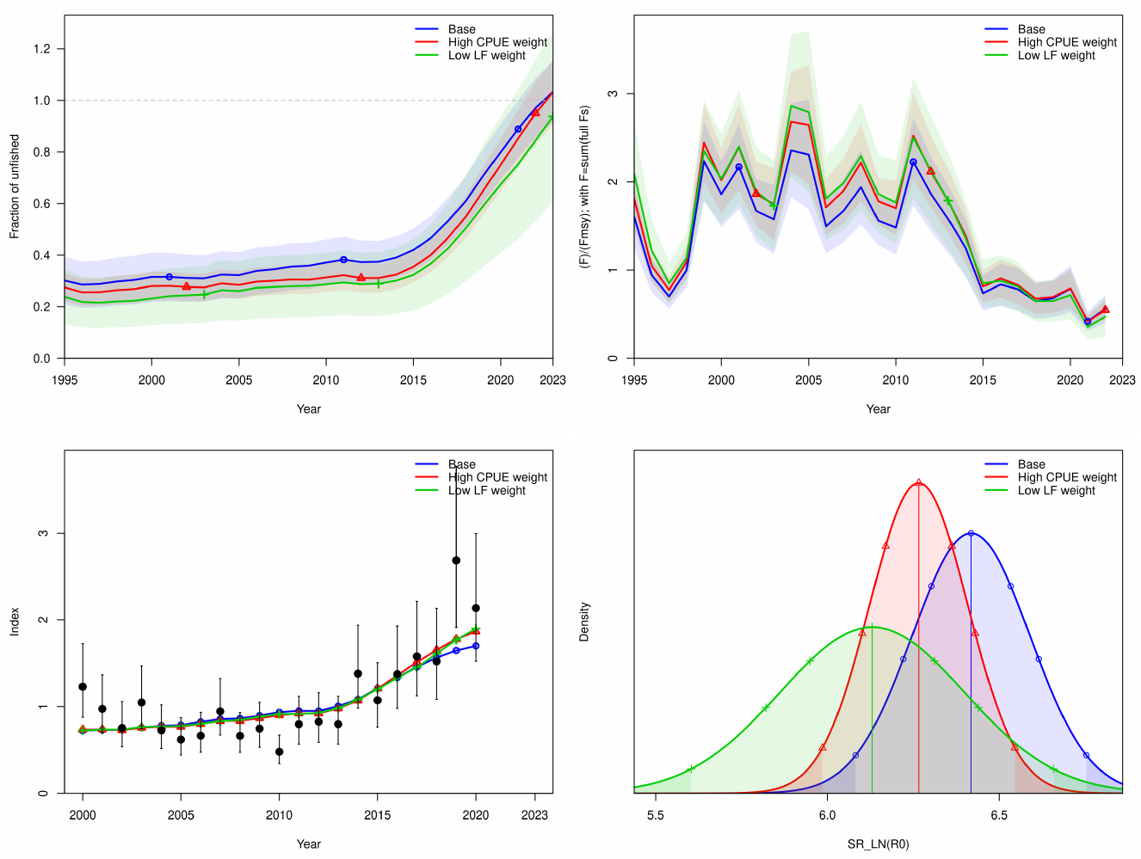
SS model outputs
Stock assessment of WCPO silky shark
Model estimates declining fishing mortality, to below F_{MSY}
Increasing stock status to near B₀ in recent years
Retrospectives show that recent information contributes to status estimates
Data weighting does not change the picture appreciably
Notes:
segregated data from vessels operating in PNG and Solomon Islands that declared they targeted sharks (for catch and standardised CPUE)
given high value of fins, abundance in shark fin trade, and low observer coverage, likely that targeting occurred in other areas
expected that factors leading to catching FLA while targeting them would be different than catching FLA as bycatch

Slide 35
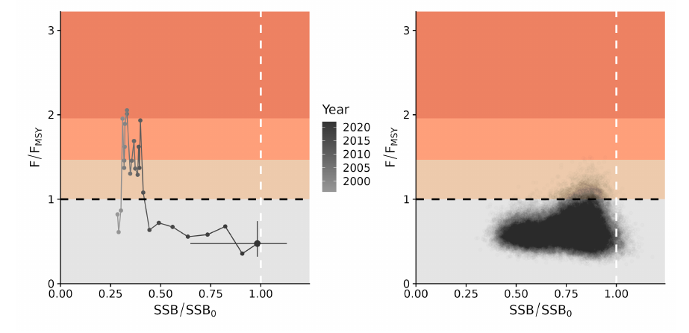
SS model summary
Stock assessment of WCPO silky shark
All models showed recent increase in biomass and reduction in fishing mortality
Data conflict and CPUE fit suggests some work needs to be done to improve the model
Poor MCMC performance and non-convergence of data weighting a concern. May require further investigation of time-varying selectivity in these regards.
Notes:
segregated data from vessels operating in PNG and Solomon Islands that declared they targeted sharks (for catch and standardised CPUE)
given high value of fins, abundance in shark fin trade, and low observer coverage, likely that targeting occurred in other areas
expected that factors leading to catching FLA while targeting them would be different than catching FLA as bycatch

Slide 36
2024 Assessment: Dynamic surplus production model (DSP)
Stock Assessment of WCPO silky shark

Slide 37
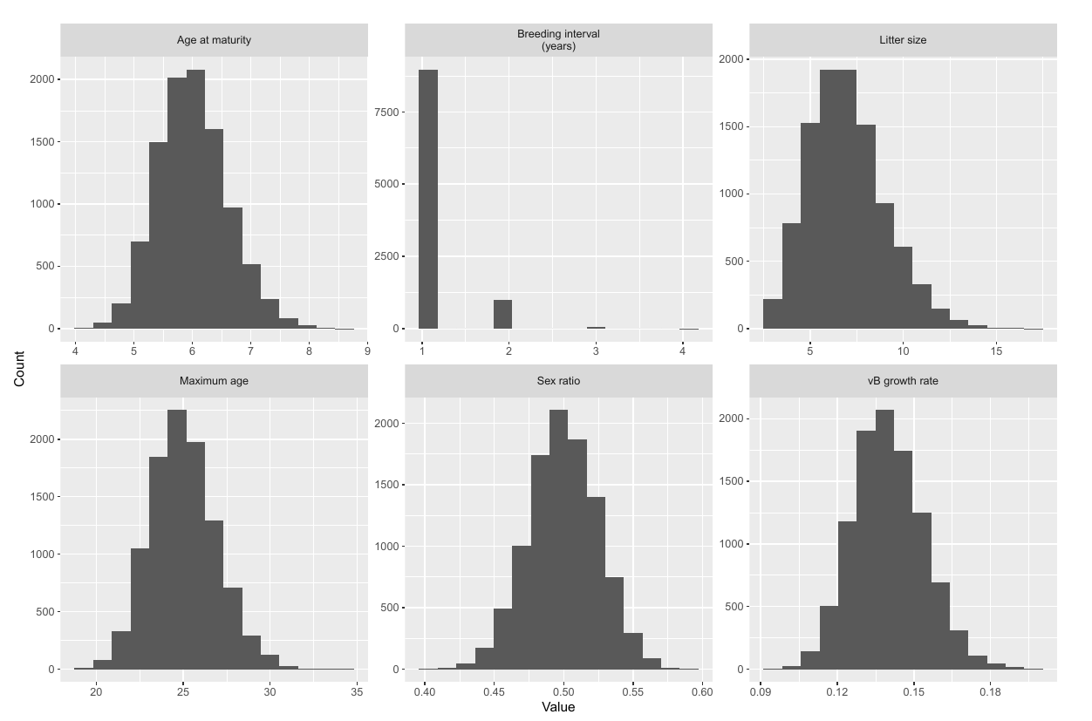
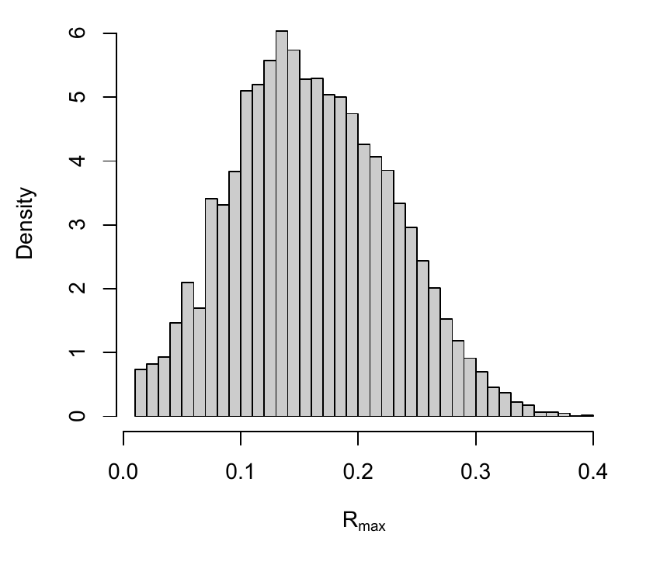
DSP model
Stock assessment of WCPO silky shark
R_{max} prior derived from meta-analysis as done for previous shark assessments
Notes:
segregated data from vessels operating in PNG and Solomon Islands that declared they targeted sharks (for catch and standardised CPUE)
given high value of fins, abundance in shark fin trade, and low observer coverage, likely that targeting occurred in other areas
expected that factors leading to catching FLA while targeting them would be different than catching FLA as bycatch

Slide 38
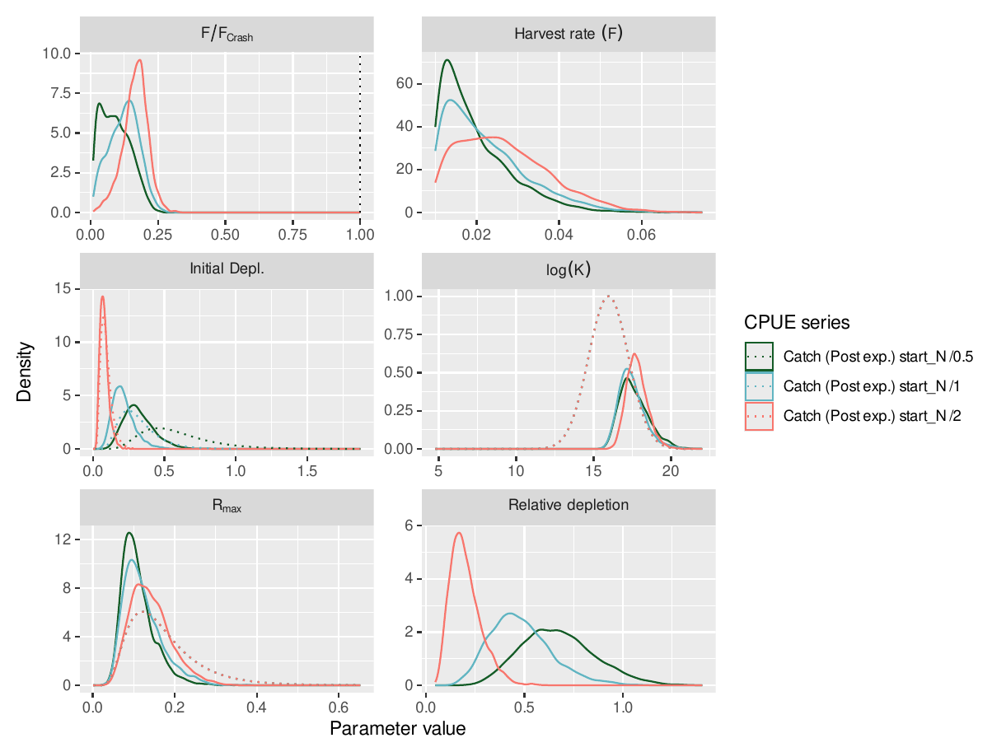
DSP model
Stock assessment of WCPO silky shark
R_{max} prior derived from meta-analysis as done for previous shark assessments.
Model fitted to CPUE index with same observation error as for SS assessment.
Three alternative prior distributions for initial depletion .
Notes:
segregated data from vessels operating in PNG and Solomon Islands that declared they targeted sharks (for catch and standardised CPUE)
given high value of fins, abundance in shark fin trade, and low observer coverage, likely that targeting occurred in other areas
expected that factors leading to catching FLA while targeting them would be different than catching FLA as bycatch

Slide 39
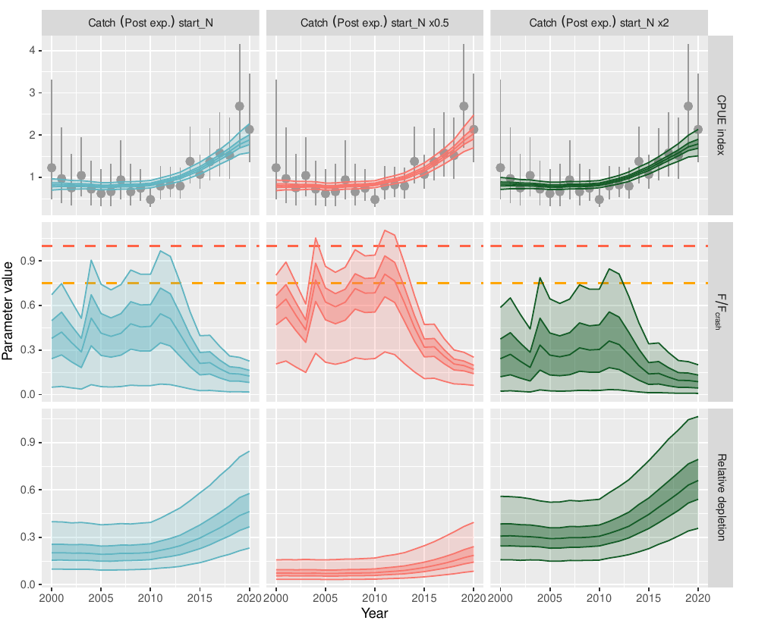
DSP model
Stock assessment of WCPO silky shark
R_{max} prior derived from meta-analysis as done for previous shark assessments
Model fitted to CPUE index with same observation error as for SS assessment.
Three alternative prior distributions for initial depletion
Notes:
segregated data from vessels operating in PNG and Solomon Islands that declared they targeted sharks (for catch and standardised CPUE)
given high value of fins, abundance in shark fin trade, and low observer coverage, likely that targeting occurred in other areas
expected that factors leading to catching FLA while targeting them would be different than catching FLA as bycatch

Slide 40
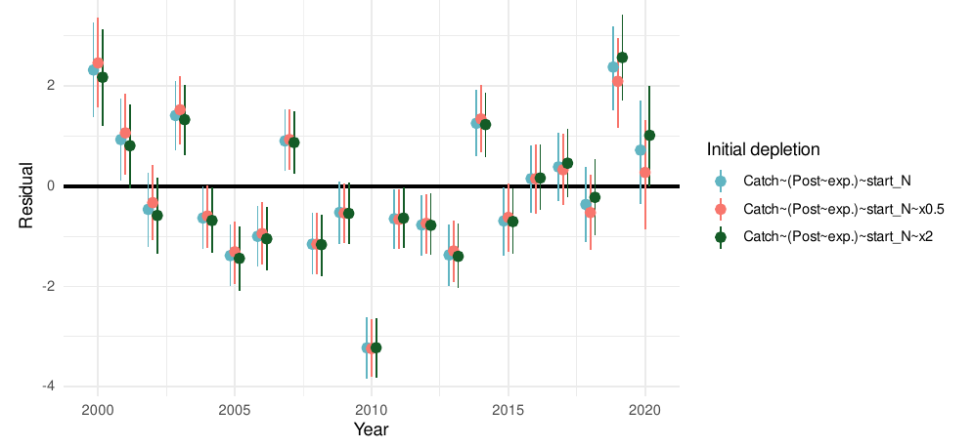
DSP model
Stock assessment of WCPO silky shark
R_{max} prior derived from meta-analysis as done for previous shark assessments
Model fitted to CPUE index with same observation error as for SS assessment.
Three alternative prior distributions for initial depletion
Notes:
segregated data from vessels operating in PNG and Solomon Islands that declared they targeted sharks (for catch and standardised CPUE)
given high value of fins, abundance in shark fin trade, and low observer coverage, likely that targeting occurred in other areas
expected that factors leading to catching FLA while targeting them would be different than catching FLA as bycatch

Slide 41
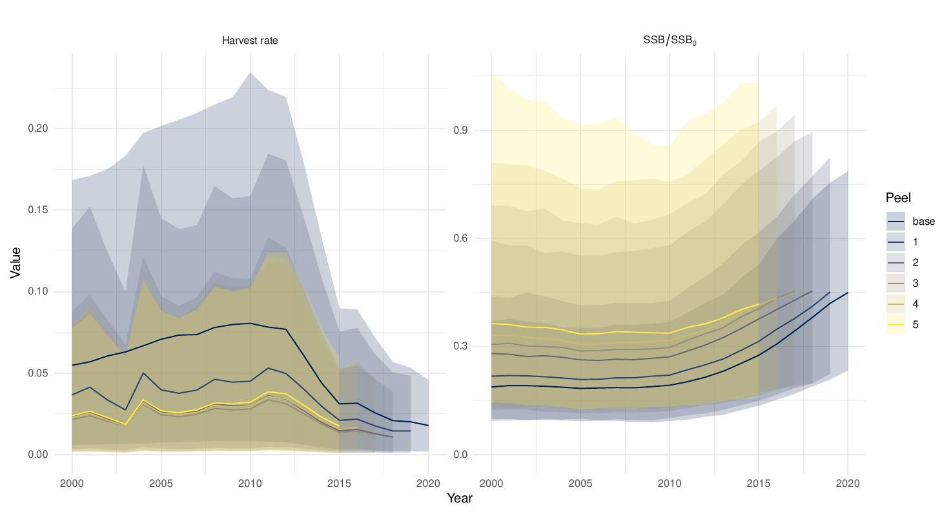
DSP model
Stock assessment of WCPO silky shark
R_{max} prior derived from meta-analysis as done for previous shark assessments
Model fitted to CPUE index with same observation error as for SS assessment.
Three alternative prior distributions for initial depletion
Retrospectives suggests increasing amount of information from recent increase - high uncertainty in past estimates contains more recent estimates
Notes:
segregated data from vessels operating in PNG and Solomon Islands that declared they targeted sharks (for catch and standardised CPUE)
given high value of fins, abundance in shark fin trade, and low observer coverage, likely that targeting occurred in other areas
expected that factors leading to catching FLA while targeting them would be different than catching FLA as bycatch

Slide 42
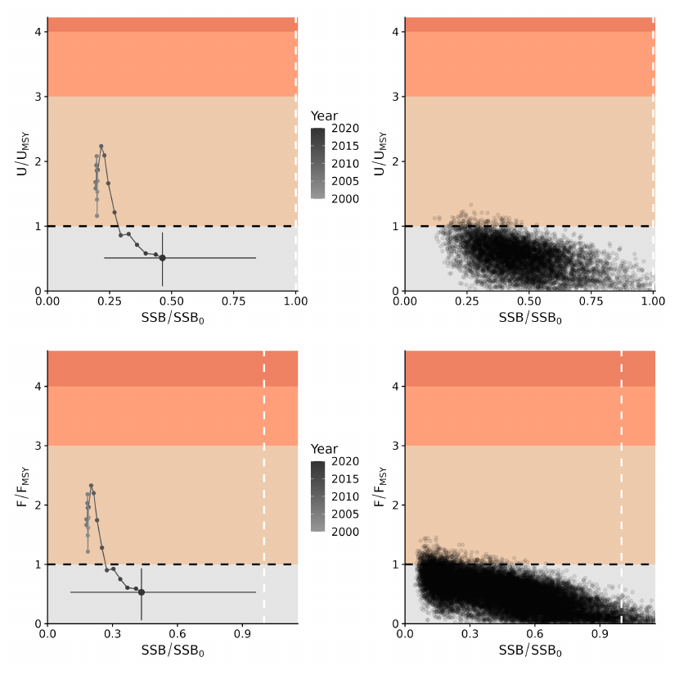
DSP model outcomes
Stock assessment of WCPO silky shark
High uncertainty about recent stock status
Low uncertainty about recent fishing mortality being below U_{MSY} and potential limit reference points
Notes:
segregated data from vessels operating in PNG and Solomon Islands that declared they targeted sharks (for catch and standardised CPUE)
given high value of fins, abundance in shark fin trade, and low observer coverage, likely that targeting occurred in other areas
expected that factors leading to catching FLA while targeting them would be different than catching FLA as bycatch

Slide 43
2024 Assessment: Length and age-structured model (LAM)
Stock Assessment of WCPO silky shark

Slide 44
Rationale for LAM Development
Stock assessment of WCPO silky shark
Conventional length-based age-structured models (e.g., SS3 and MULTIFAN-CL) often assume time-invariant age-specific length distributions:
However, if large individuals are selectively removed by fishing, the surviving populations will become dominated by slower-growing individuals.
Incorporating the cumulative impact of size-selective mortality using age-structured dynamics is challenging without introducing additional parameters (e.g., the platoon approach in SS3).
Cumulative impacts of size-dependent mortality can be substantial, particularly for species with low fecundity and late maturation, such as sharks.
Combining length-based dynamics with age structure can provide a more realistic representation of population dynamics by incorporating the cumulative impacts of length-dependent processes while tracking the age structure.

Slide 45
LAM structure
Stock assessment of WCPO silky shark
Within each age group, LAM follows length-structured dynamics, where growth transitions are age-specific (i.e., G in the equations) due to age-specific growth variability.
Only surviving individuals within each age group, where mortality is length-dependent, can transition to the next time step with increments in both length and age.
The model was developed in Stan:
Other submodel structures follow those in SS3 (e.g., growth, stock-recruitment, etc.)
A catch-conditioned approach, similar to that in MULTIFAN-CL (i.e., no error in catch), was also implemented.
Age-structured model
Length-structured model
Length and age-structured model

Slide 46
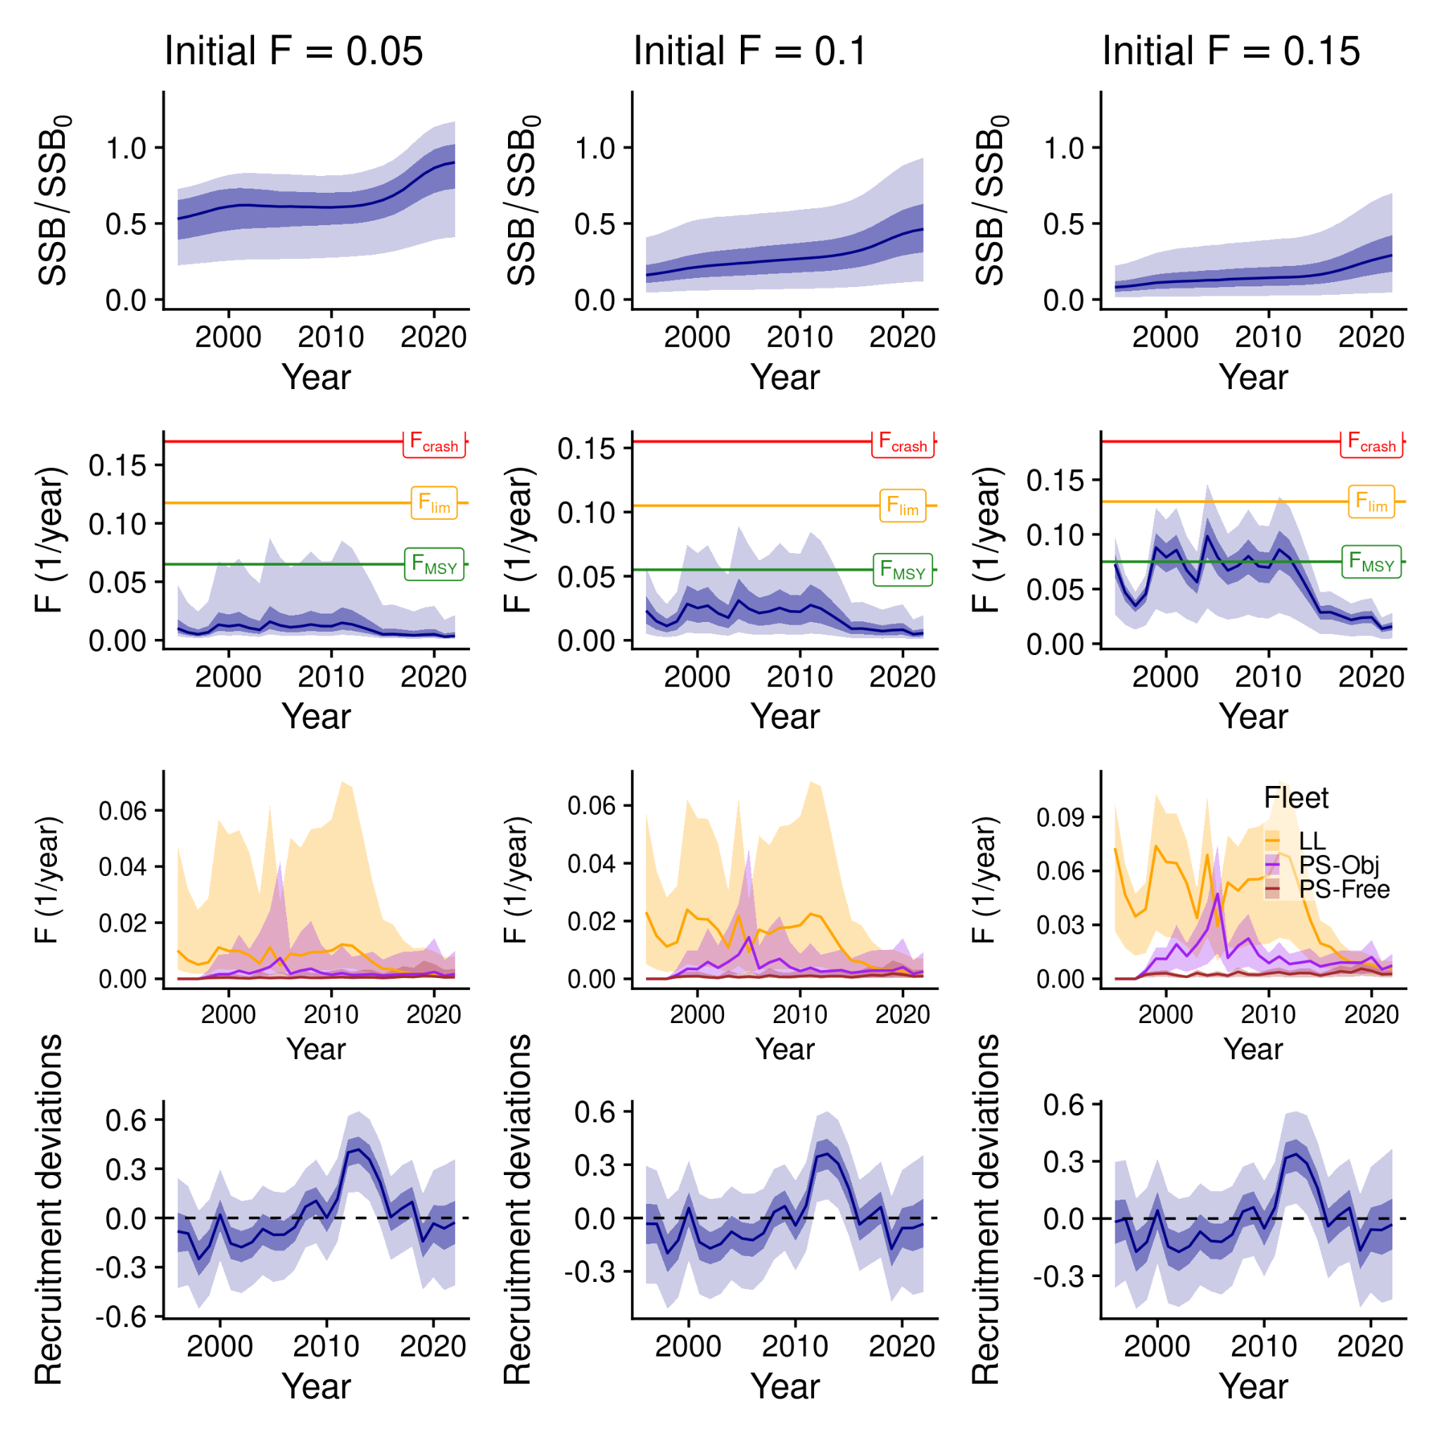
Results
Stock assessment of WCPO silky shark
The models were sensitive to assumptions on initial F values but generally showed increasing trends in stock status and decreasing trends in fishing mortality, similar to those observed in the SS3 and the dynamic surplus production model results.
For all three models, the longline fleet showed the highest fishing mortality rates, followed by purse-seine object-associated sets and purse-seine free-school sets (as shown in the panels in the third row)

Slide 47
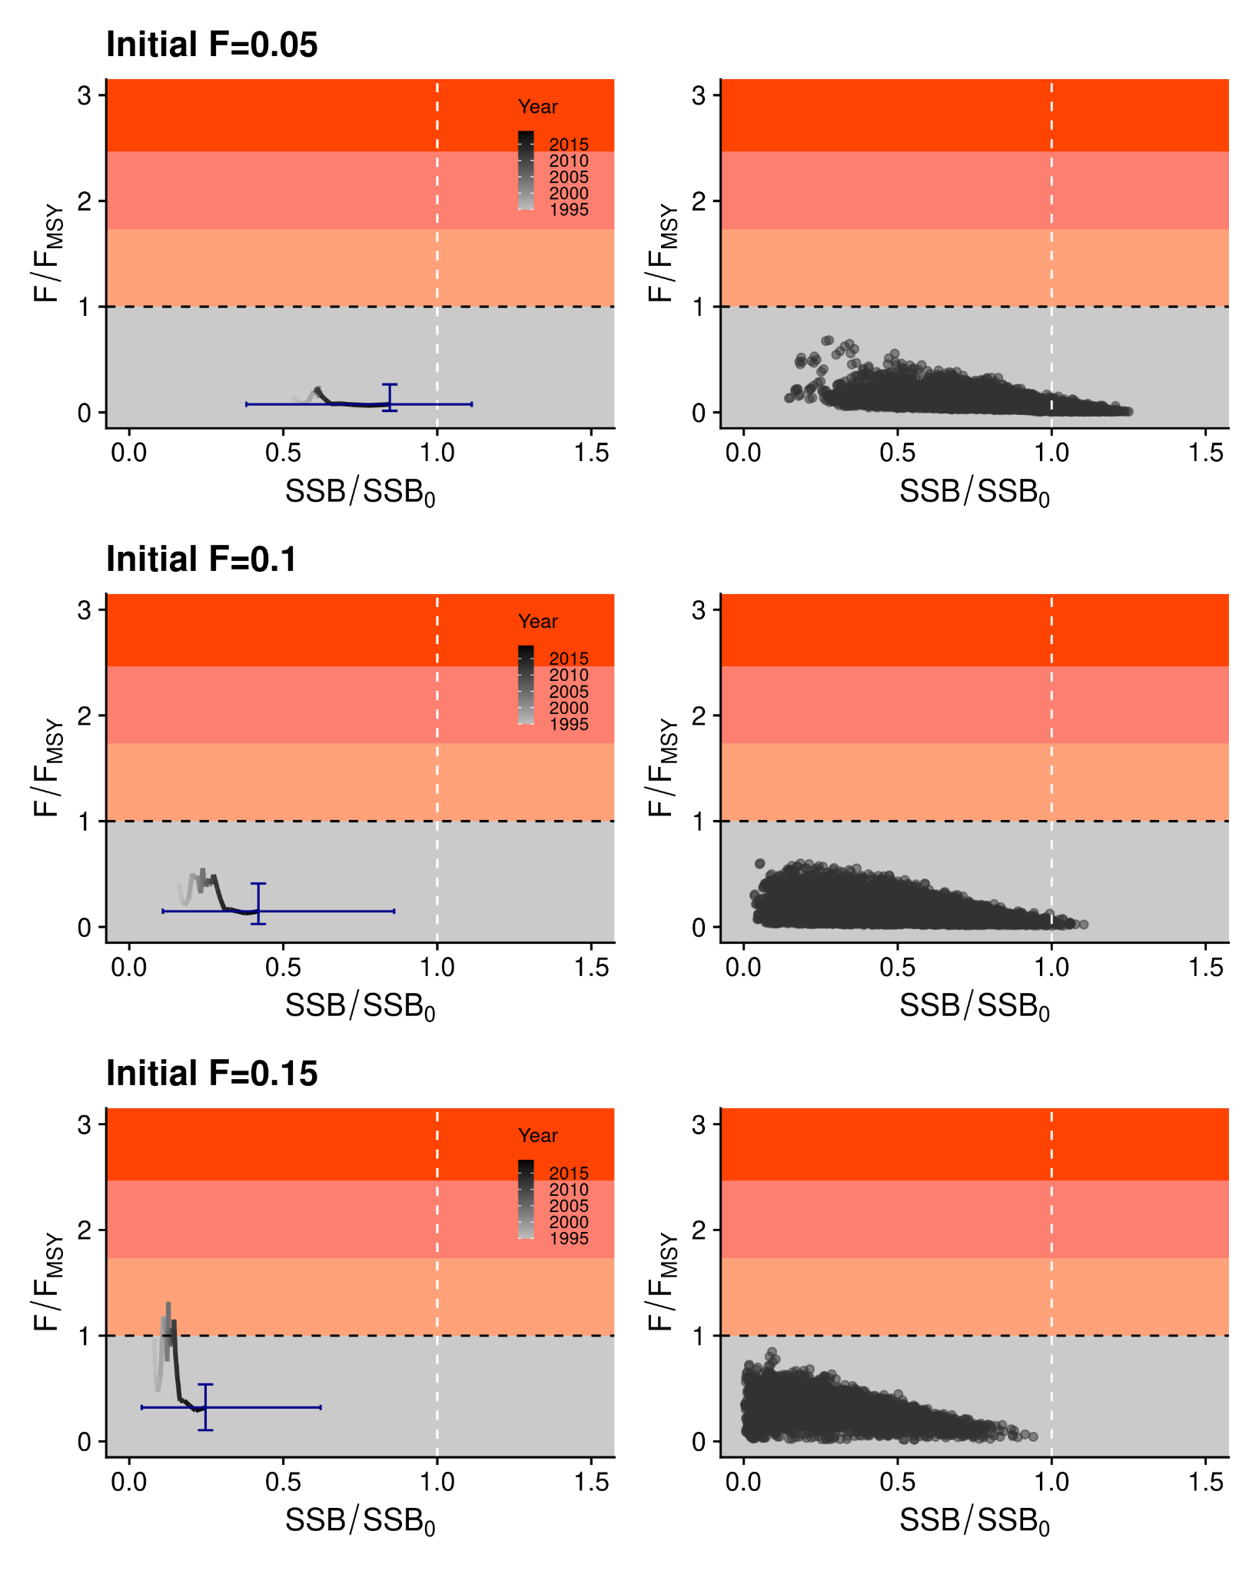
Results
Stock assessment of WCPO silky shark
The stock status in the recent two years (2019–2020) underwent lower fishing mortality rates than the corresponding FMSY across all three models.
The model with the highest initial fishing mortality rate (init F = 0.15) showed the lowest stock status in the recent two years, approximately 25% of its unfished status, whereas the model with the lowest initial fishing mortality rate (init F=0.05) showed the highest stock status, around 90% of its unfished status.

Slide 48
Discussion
Stock assessment of WCPO silky shark
The LAM uses the same number of parameters as the SS3 models, but provides a better representation of population dynamics, naturally incorporating the cumulative impact of fishing pressures on the length distribution of the population.
Although the complexity of the LAMs was not well supported by the current information on LFs and CPUE data, we believe that the model provides a useful avenue of research towards incorporating cumulative impacts of fishing pressure.
A parameter for determining growth variability, which was fixed in the SS3 models, was estimated.
However, LF fits for some years were not satisfactory, indicating that further studies on spatio-temporal growth may be required to apply this type of integrated model.

Slide 49
2024 Assessment: Length-based hybrid spatial risk assessment model
Stock Assessment of WCPO silky shark

Slide 50
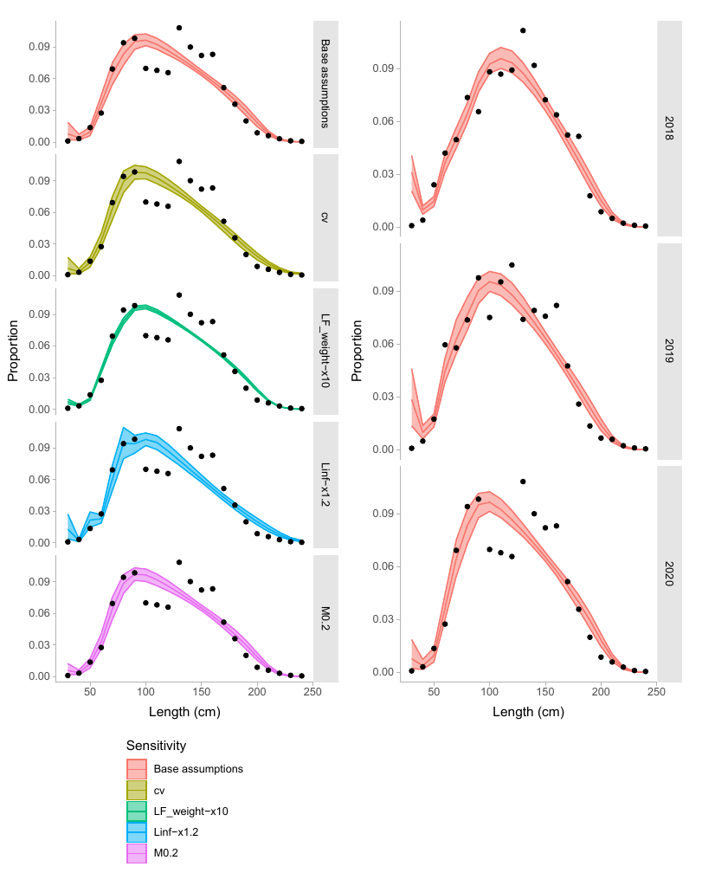
Summary
Stock assessment of WCPO silky shark
Most risk assessment methods are assumption driven based on overlap with fishing effort and species life-history
Statistical risk assessment approaches attempt to fit to data, but require information to scale from observed interaction to total fishing mortality and risk
Discussion at PAW - difficult for many stocks, especially for longline and purse-seine
If no reliable index, LF data can inform of status (assuming equilibrium with F).

Slide 51
Summary
Stock assessment of WCPO silky shark
Hybrid method uses LFs to derive total fishing mortality, then partitions the mortality across fleets or areas.
Requires representative LFs - used standardised LFs from purse-seine
Custom model in Stan based on eSafe model used for OCS, but integrated estimation of F and spatial density of FAL.
Data weight (LFs vs observed captures) largely affects uncertainty, but not location of estimates.

Slide 52
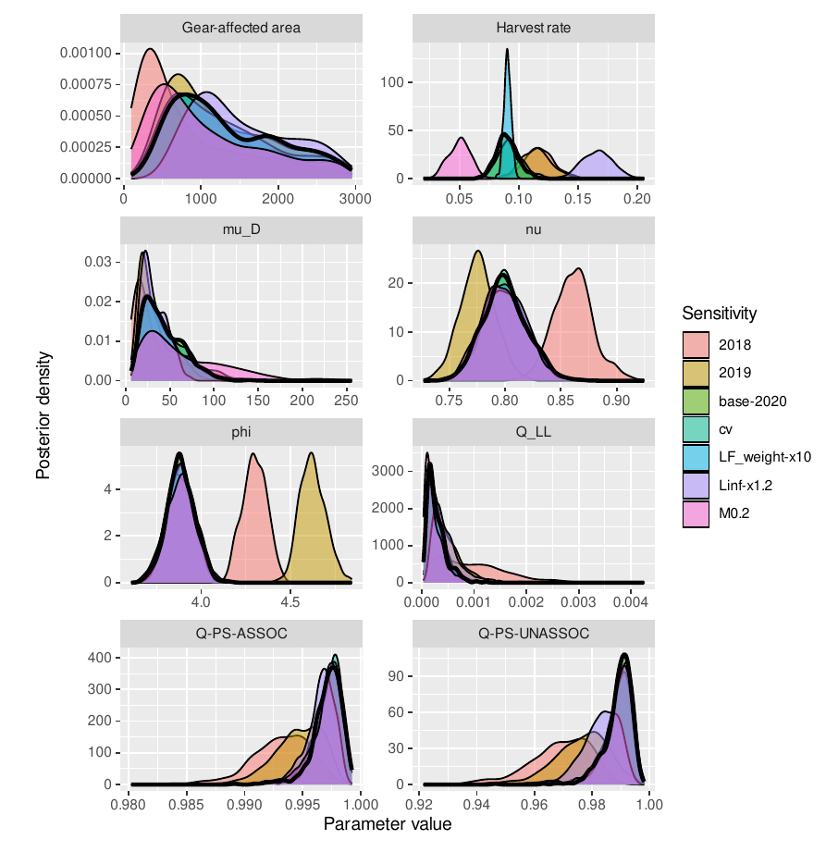
Summary
Stock assessment of WCPO silky shark
Hybrid method uses LFs to derive total fishing mortality, then partitions the mortality across fleets or areas.
Requires representative LFs - used standardised LFs from purse-seine
Custom model in Stan based on eSafe model used for OCS, but integrated estimation of F and spatial density of FAL.
Data weight (LFs vs observed captures) largely affects uncertainty, but not location of estimates.
Sensitive to life-history assumptions

Slide 53
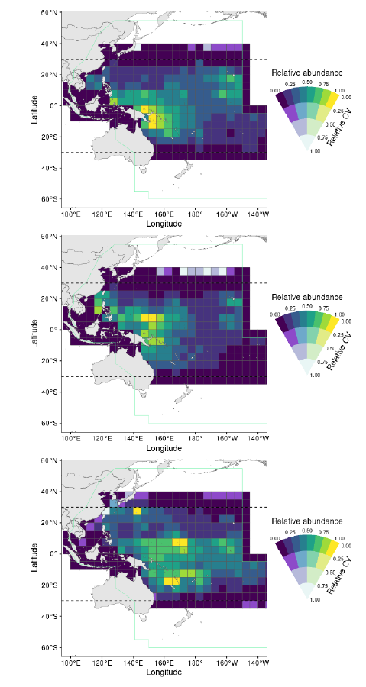
Summary
Stock assessment of WCPO silky shark
Spatial harvest rate and relative density estimates are highly variable between years

Slide 54
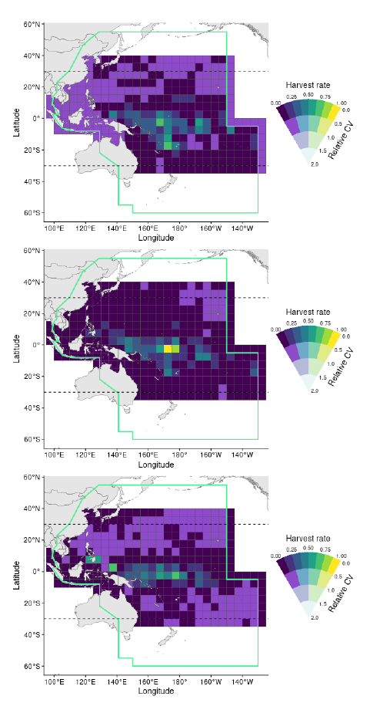
Summary
Stock assessment of WCPO silky shark
Spatial harvest rate and relative density estimates are highly variable between years

Slide 55
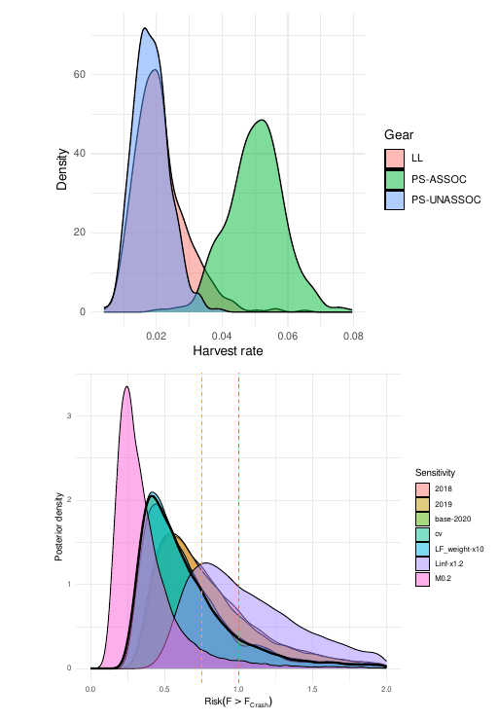
Summary
Stock assessment of WCPO silky shark
Spatial harvest rate and relative density estimates are highly variable between years
Highest harvest rate currently from object-associated PS
High risk only if growth mis-specified (L_{inf} too small), otherwise low risk of F>F_{crash}

Slide 56
2024 Assessment: Summary & Recommendations
Stock Assessment of WCPO silky shark

Slide 57
Summary
Stock assessment of WCPO silky shark
Comparable ranges of estimates for status across assessments
Low probability of F_{recent}>F_{crash}

Slide 58
Conclusions
Stock assessment of WCPO silky shark
The multi-model approach to assessing silky shark resulted in an uncertain stock status, but high confidence that recent fishing mortality is below levels that would preclude stock rebuilding.
We suggest that the dynamic surplus production model be used for providing management advice.
The model ensemble across initial depletion priors may be over-representing uncertainty (especially the prior for low initial depletion), -> suggest output from the intermediate assumption as a candidate model for management advice
The largest fishing mortality was estimated to have come from longline fisheries capturing nearly the full size-range of silky sharks, and reductions in interactions as a result of changes in fishing practices over the last decade may have substantially reduced this source of mortality, allowing the stock to rebuild.
The stock status has been improving since 2010, and the recent fishing mortality rates are below biological reference points for the ensemble (Diagnostic F_{recent} /F_{crash} : 0.13 [0.01–0.25]; P(F_{recent} /F_{crash} >1)=0; P(F_{recent} /F_{lim} >1)=0).

Slide 59
Conclusions
Stock assessment of WCPO silky shark
With respect to other shark stocks with lower levels of information:
Surplus production models should be used when composition data are problematic
Risk assessments should only be used in the context of prioritisation across species.
However, data driven risk assessments could provide an avenue to use a risk assessment approach when time-series are not sufficiently long or reliable to estimate productivity
With non-retention measures leading to sharks and other bycatch species being cut free from longlines, data collection may be problematic. In these cases, the only alternative to provide estimates of risk would be methods such as EASI- fish, which estimate risk from assumptions about fishery overlap with the species distributions and vulnerability to fishing effort.

Slide 60
Recommendations
Stock assessment of WCPO silky shark
Additional tagging should be carried out using satellite tags in a range of locations as well as high seas areas to resolve fundamental questions about the species interactions with local oceanography and the dynamics of ENSO.
Additional growth studies and validation of aging methods from a range of locations could help build a be er understanding of typical growth, as well as regional growth differences. Current growth data are conflicting, with insufficient data to understand the underlying process.
Additional genetic/genomic studies across a broader set of locations could be undertaken to augment the tagging and existing genomics work to help resolve the stock/sub-stock structure patterns.

Slide 61
Thank you for your input!

