Slide 1
20th Regular Session of the Scientific Committee
14-21 August 2024, Manila, Philippines
Summary of bycatch in WCPFC purse seine fisheries at a regional scale, 2003-2022
WCPFC-SC20-2024/ST-WP-07
Tom Peatman¹, Nick Hill², Joanne Potts², Simon Nicol²
¹ Consultant for the Oceanic Fisheries Programme, Pacific Community
² Oceanic Fisheries Programme, Pacific Community

Slide 2
Summary
Focus on improvements to the estimation approach compared with the previous iteration (Peatman & Nicol, 2021)
  Catch rate models
  Estimation groups

Slide 3
Previous catch rate models
Presence/absence models (Generalised Estimating Equations):
  ~ s(year) + s(SST) + quarter + set type
Catch when present estimated by bootstrapping from observations, stratified by set-type
Spatial variation in catch rates was not (explicitly) accounted for in presence/absence models
Inclusion of spatial effects should:
  Mitigate against bias in estimated catch rates pre-2010 (and post COVID)
    Lower observer coverage rates, and less representative (spatially & by fleet)
  Increase utility of catch rate models in monitoring for species requiring more targeted analyses
    Reduce influence of spatial coverage of observer data on year effects
  Allow exploration of spatial variation of catch rates (and catches)
splines
categorical variables

Slide 4
Updated catch rate models
Moved to spatially explicit models, implemented in R package sdmTMB
  Delta-lognormal models for estimation groups with catch rates of tonnes
  Negative binomial or delta-negative binomial models for estimation groups with catch units of individuals
Base catch rate model specification:
  ~ (1 | year) + (1 | flag) + s(month) + s(depth 20°C) + set type + ONI class + ω_{s}
For selected estimation groups, also included additional spatial random fields specific to quarter, ONI class or set-type (separately)
  Prioritised elasmobranchs, sea-turtles and marine mammals, as well as frequently encountered teleosts and billfish
For these estimation groups, used ensemble model predictions
  Model weights maximising log-likelihood across the (4) model specifications
spatial random field
random intercepts
splines
categorical variables
Notes:
ONI – Oceanic Nino Index

Slide 5
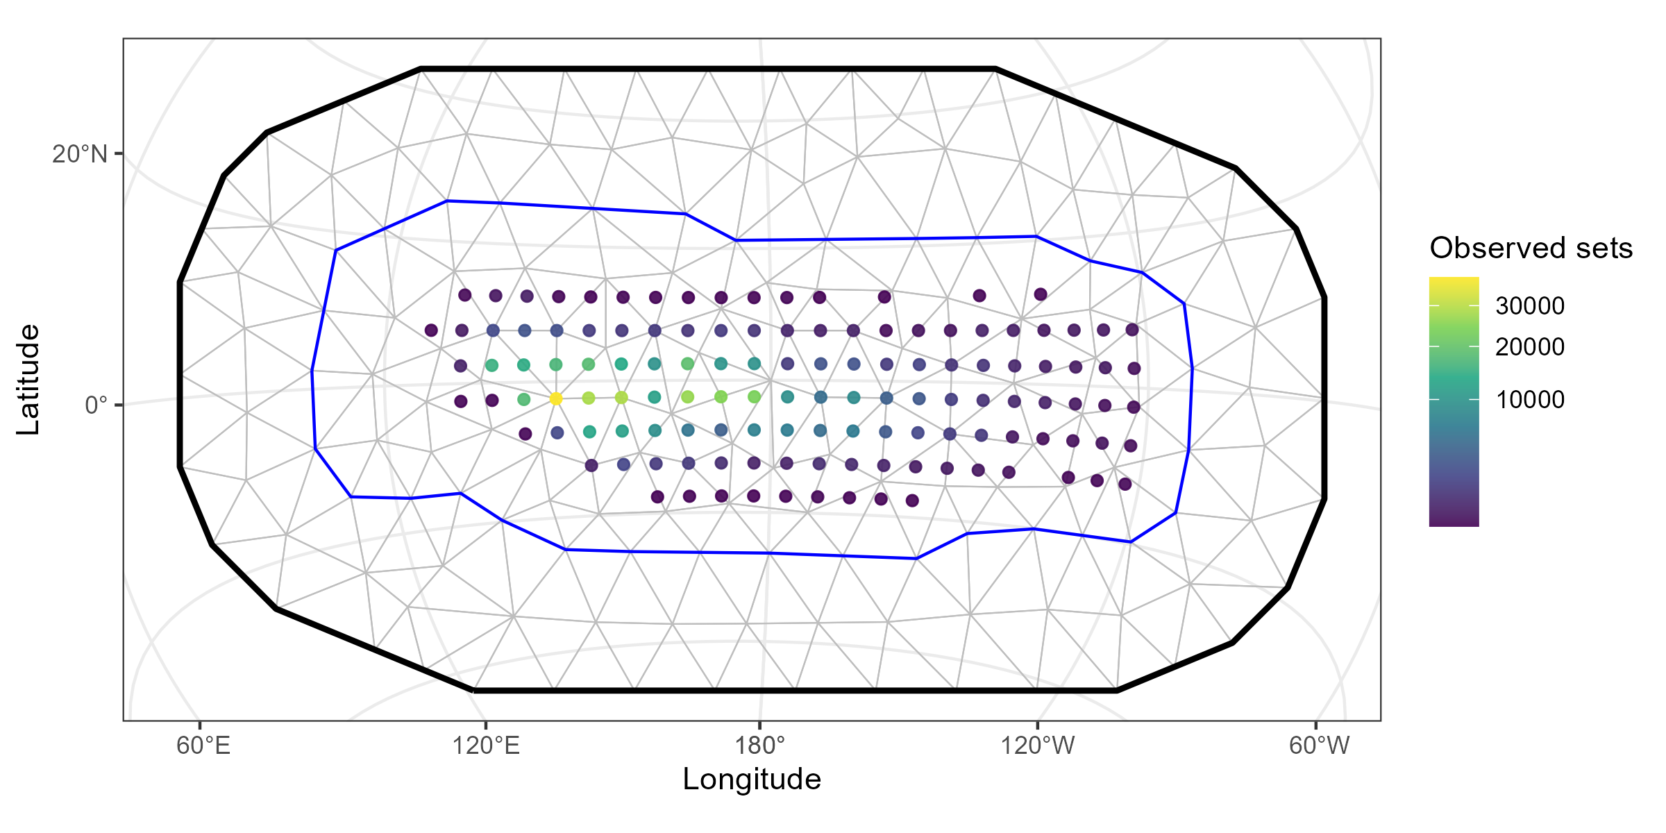
Spatial random fields
Meshes defined using distribution of observed captures for each estimation group
  Same mesh used for spatial random fields and ‘spatiotemporal’ random fields
Example mesh for false killer whale (Pseudorca crassidens):
Notes:
Points give distribution of observed sets
Blue line – non convex hull encompassing reported effort

Slide 6
Estimation groups – marine mammals
Previously a single ‘marine mammals’ estimation group
Increased taxonomic resolution of estimation groups for marine mammals, informed by recommendations by Miller (2023)

Slide 7
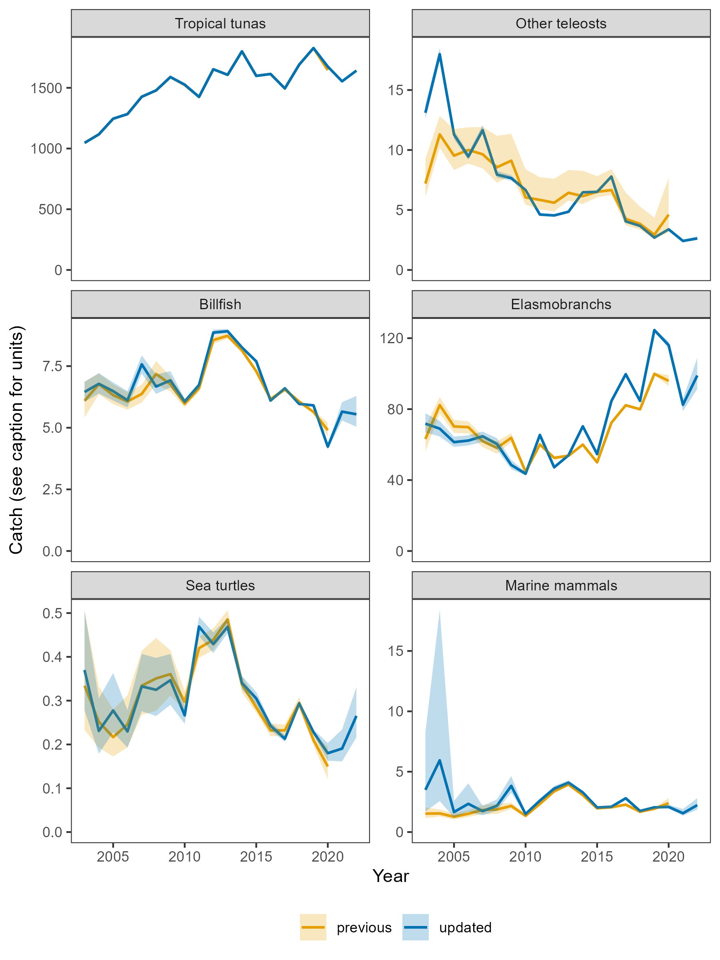
Updated catch estimates
‘000 tonnes
‘000 individuals
‘000 individuals
Notes:
Annual catch estimates were relatively insensitive to the updates
Apart from marine mammal catches pre-2010)
And stronger temporal trends in elasmobranch catches

Slide 8
Recommendations
The SC is invited to:
Note the estimates of bycatch of the large-scale equatorial purse seine fishery in the WCPFC Convention Area.
Note that the bycatch estimates should be interpreted as the bycatch that would have been recorded by observers with 100% coverage of fishing events.
Note that other studies suggest that shark bycatch estimates are likely to be underestimates, due to underestimation of captures by observers.
Note the refinements to the estimation approach, including the implementation of spatially-explicit catch rate models. This should improve the utility of catch rate models for identification of species that may warrant additional targeted analyses.
Note the impacts of recent reductions in observer coverage on the precision of catch rate and catch estimates, and the extent to which they can be used to monitor for temporal trends.
Note the refinements to the taxonomic resolution of catch estimates for marine mammals.

