Slide 1
Additional longline data fields for collection within WCPFC. Proposal to reiterate SC19 recommendations to the Commission
Australia
ST-WP-08
WCPFC SC20, Manila, Philippines August 2024

Slide 2
Background
This paper was presented at SC19 in 2023 from which the Scientific Committee made a series of recommendations.
At WCPFC20 in December 2023 these recommendations were briefly discussed but were not formally adopted by the Commission due to time constraints.
It is proposed that SC20 briefly reconsider this matter with a view to again providing the recommendations to the TCC20 and WCPFC21 for their consideration.

Slide 3
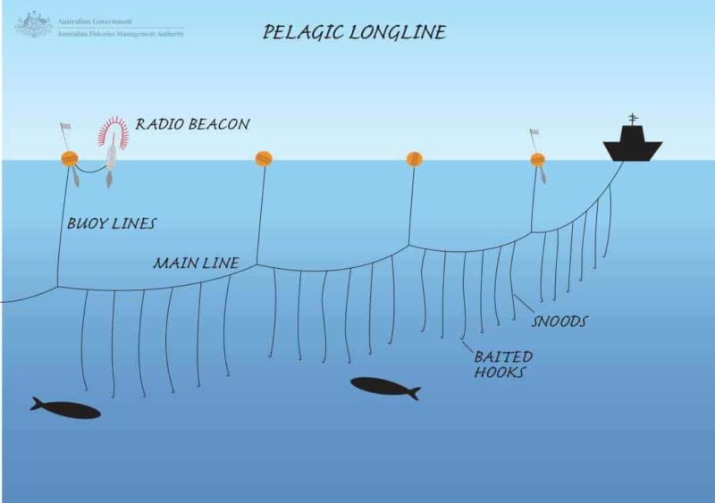
Proposed new operational Longline fields + one additional code
FIELD | Level
1. Target species for the set | SET
2. Number of lightsticks used in set | SET
3. Bait type used in set | SET
4. Mainline length | SET or TRIP
5. Length of branch line | SET or TRIP
6. Length of float line | SET
7. Vessel speed during setting | SET
8. Speed of the line setter | SET
9. New ACTIVITY ‘transhipment’ code | ACTIVITY
1
7
8
6
9
5
4
/BRANCHLINES
2
3

Slide 4
WCPFC Scientific Committee 19 Summary Report, Paragraphs 77-81:
SC19 acknowledged the scientific value of the additional longline operational data fields in Table ST-01 and recommended that these fields be considered for inclusion in the “Scientific Data to be Provided by the Commission (SciData)”.
However, SC19 noted broad implementation concerns of CCMs with respect to the collection of these data, recommended that TCC and the Regular Session of the Commission take account of these concerns, and suggested a possible option would be to include them as voluntary reporting items.
DATA FIELD | Suggested PROTOCOL for data collection
Target species for the set | Record the primary target species, or group of species, for this set.
Number of lightsticks used in set | Record the total number of lightsticks used in the set.
Bait type used in set | Record the FAO code for type of bait used for the set. Example types: Squid (class Cephalopoda) Sardine or Pilchard (family Clupeidae) Mackerel (family Scombridae) Mixed Mackerel and Sardine …
Mainline length | Record the mainline length (in kilometres) used in the trip or set, as appropriate.
Length of branch line | Record the average length in metres of the branch lines in the trip or set. (The total length from the mainline to the hook).
Length of float line | Record the average length in metres of the float lines in the set. (The total length from the float to the mainline).
Vessel speed during setting | Record the average speed in knots of vessel during line setting.
Speed of the line setter | Record the speed in knots of the line setter (i.e., the line shooter speed).

Slide 5
WCPFC Scientific Committee 19 Summary Report, Paragraphs 77-81:
Additional code for the ACTIVITY field
SC19 acknowledged that the proposal for the addition of a new activity code for any day when a "transhipment at sea occurs” would allow the WCPFC’s Scientific Services Provider (SSP) to define ‘trips’ within the operational data submitted to the Commission.
SC19 also noted the explanation from the SSP that aggregating the catch by species in the longline operational data at the trip level (when the trip is terminated by an at-sea transhipment) is fundamental for the validation processes using other independent sources of data (e.g., transhipment observers and carrier declarations) to provide more certainty in the data used in assessments and other work of the Commission.
SC19 recommended that this proposal be considered further by TCC and the Regular Session of the Commission.

