Slide 1


Overview of tuna fisheries in the Western and Central Pacific Ocean, including economic conditions – 2023
SC20-2024 GN-WP-01
Tiffany Vidal, Peter Williams, Thomas Ruaia
20th Regular Session of the Scientific Committee (SC 20)
Manila, Philippines

Slide 2
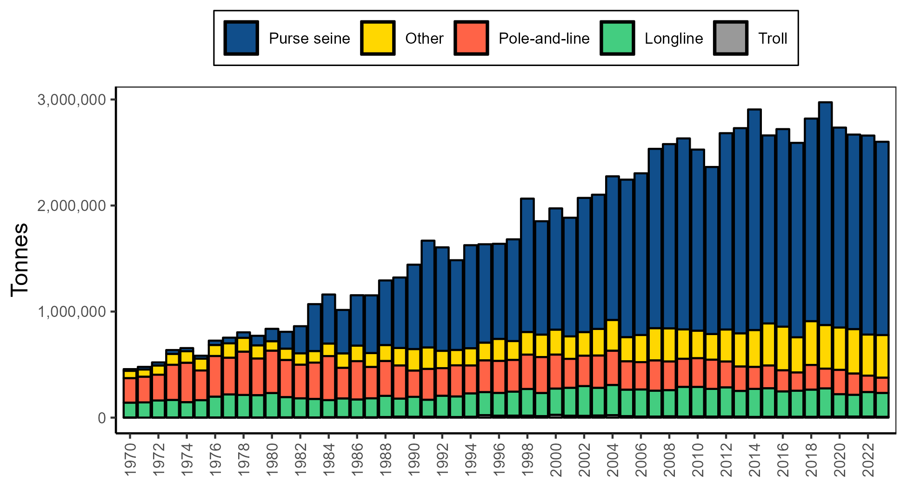
WCPFC Catch by Gear
2023 Provisional Estimates
Total Catch: 2.6 mill mt
Purse seine: 1.8 mill mt (70%)
Longline: 234K mt (9%)
Pole-and-line: 143K mt (5%)
Other: mostly artisanal gears from Indonesia, Vietnam, and Philippines (16%)
~52% of the global tuna catch
~79% of the Pacific Ocean tuna catch
~80% of WCPFC catch comes from coastal state waters
Notes:
Provisional catches from 2023 are slightly lower than for 2022, but overall catches have been fairly stable for the past 4 years
The PS fishery remains the dominant gear, followed by the combined ‘Other’ category which includes the handline fisheries from the VIP countries.
Pole-and-line fishery continues to contract, while longline catches has been fairly stable over the time series.
Longline catches over the past 2 decades have been some of the highest of the time series, but 2023 catches were below the recent 10-year average

Slide 3
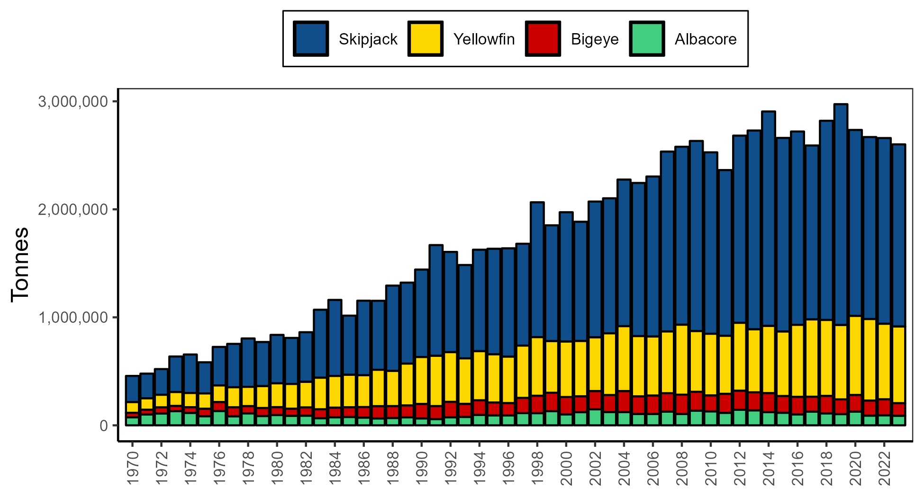
WCPFC Catch by Species
2023 Provisional Estimates
SKJ: 1.65 mill mt (63%)
YFT: 747K mt (28%)
BET: 140K mt (5%)
ALB: 94K mt (4%)
Notes:
Skipjack catch declined a bit from the high in 2019, but has been comparable to catches form recent years.
YFT was the 2nd highest catch on record, second to catches from 2021
BET catches declined to one of the lowest catches in the past 20 years, but similar to catches from the past 2 years.
ALB catches remain relatively low, about 50K mt lower than the record catch in 2002

Slide 4
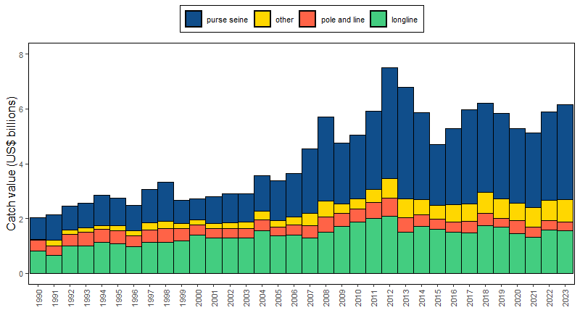
WCPFC Tuna Catch Value by Gear
2023 Estimates (billions)
Total Catch: $6.15 (+4%)
Purse seine: $3.46 (+7%) – 56% value
Longline: $1.55 (-1%) – 25% value
Pole-and-line: $0.31 (-11%) – 5% value
Other: $0.82 (+11%) – 13% value

Slide 5
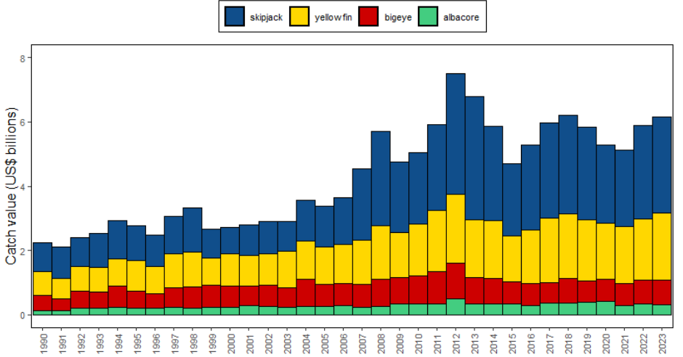
WCPFC Tuna Catch Value by Species
2023 Estimates (billions)
SKJ: $2.98 (+2%) – 49% value
YFT: $2.07 (+10%) – 34% value
BET: $0.78 (+4%) – 13% value
ALB: $0.30 (-9%) – 5% value

Slide 6
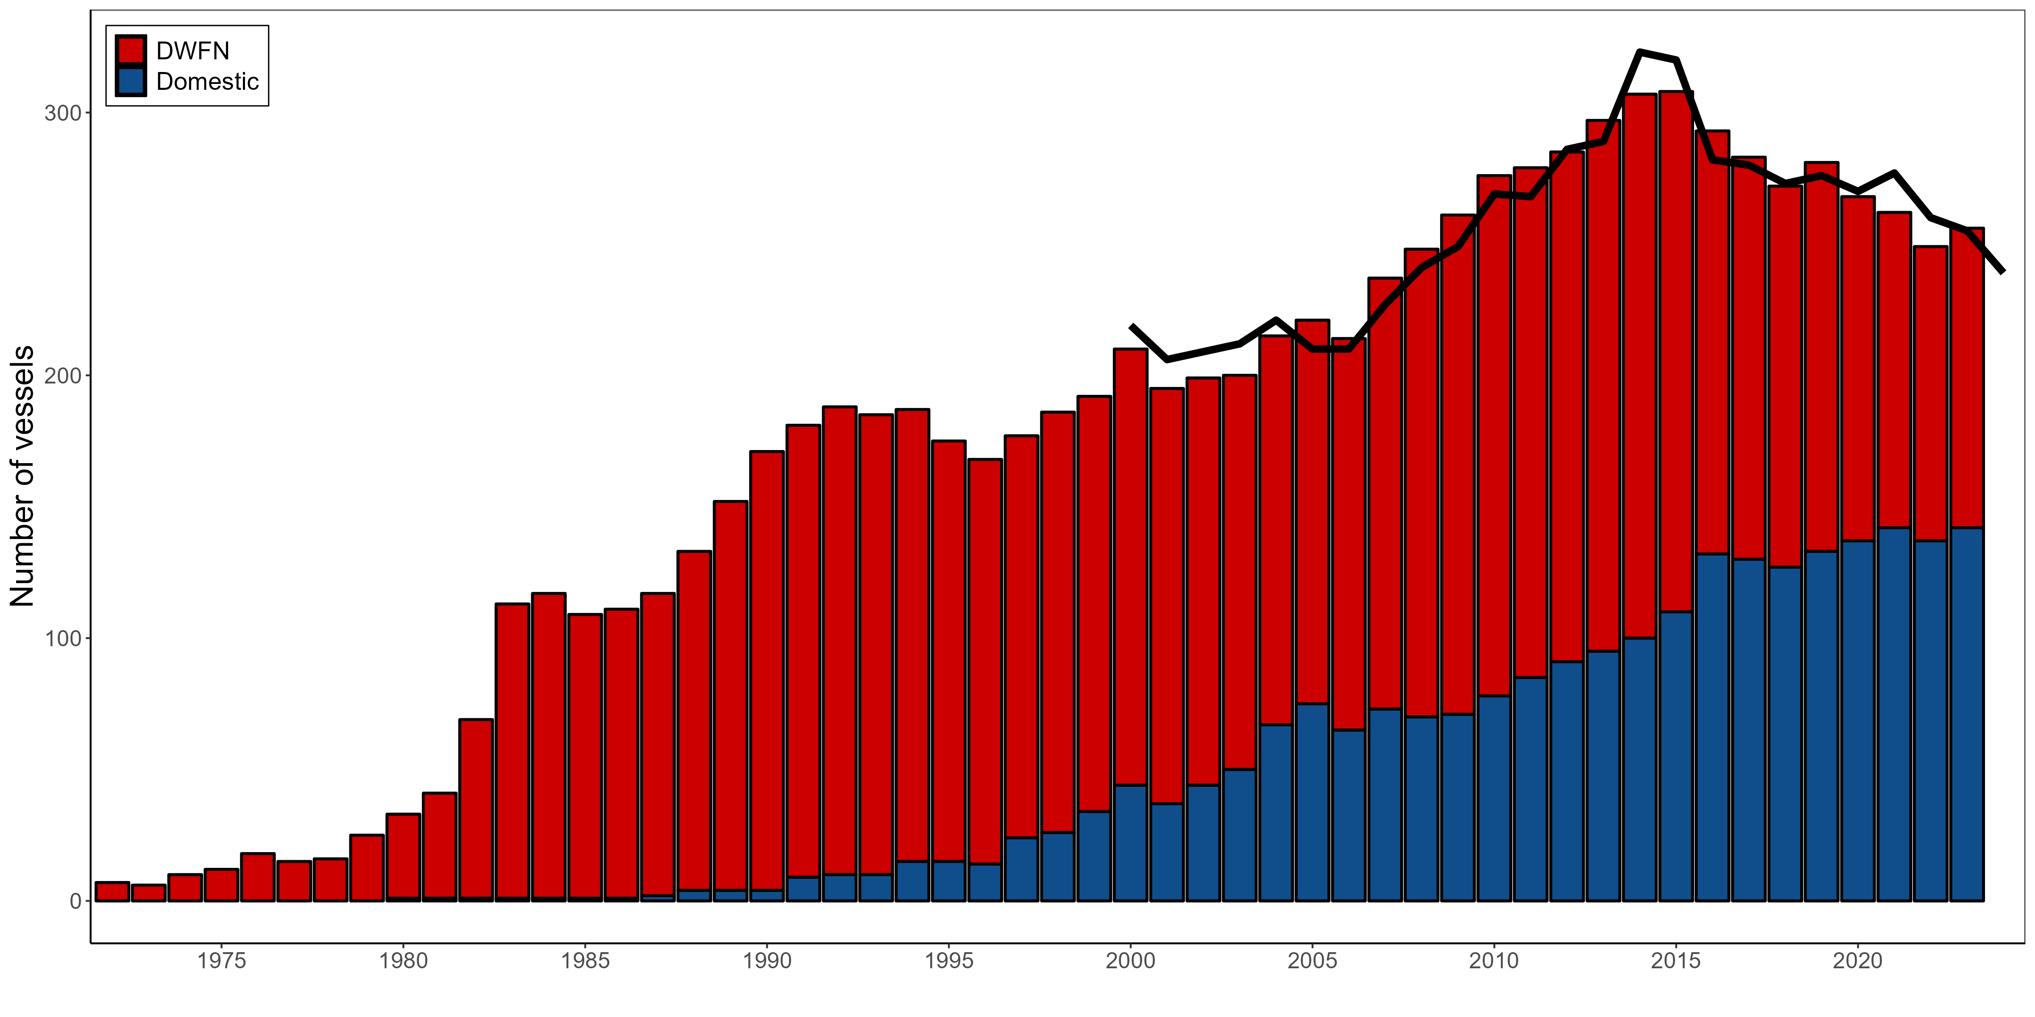
WCPFC Purse Seine Fishery
Notes:
The number of purse seine vessels declined since about 2015, however 2023 the fleet size increased slightly to 239
~60% of the PS fleet were flagged to Pacific Island countries

Slide 7
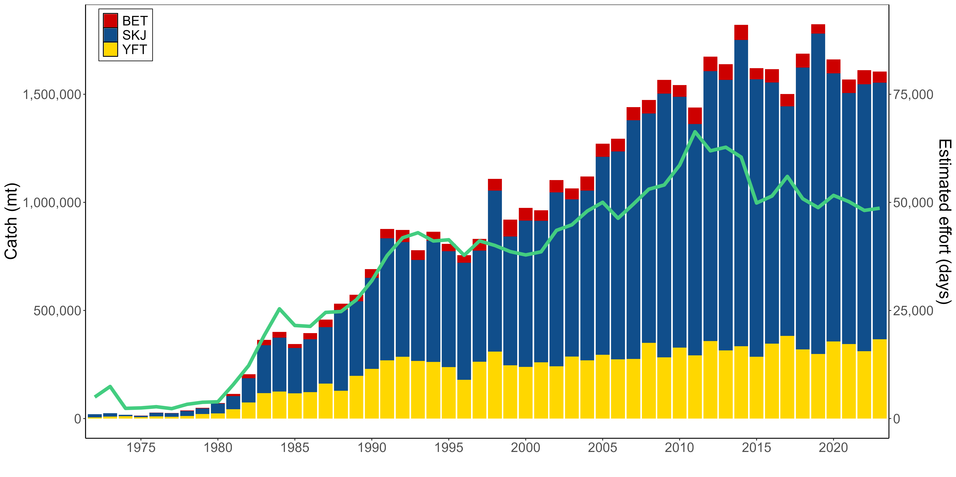
WCPFC Purse Seine Fishery
2023 Provisional Estimates
SKJ: 1.4 mill mt (75%)
YFT: 408K mt (22%)
BET: 56K mt (3%)
Notes:
Purse seine catches have fluctuated since 2010, with the last 3-4 years showing relative stability in catch and effort.
SKJ catches were slightly below the 10-year average
YFT catch was 4th highest on record
The species composition has remained fairly stable as well, noting that the species composition in purse seine catches is adjusted based on observer data, but could potentially be adjusted using cannery data in the future as cannery receipt data increases.

Slide 8
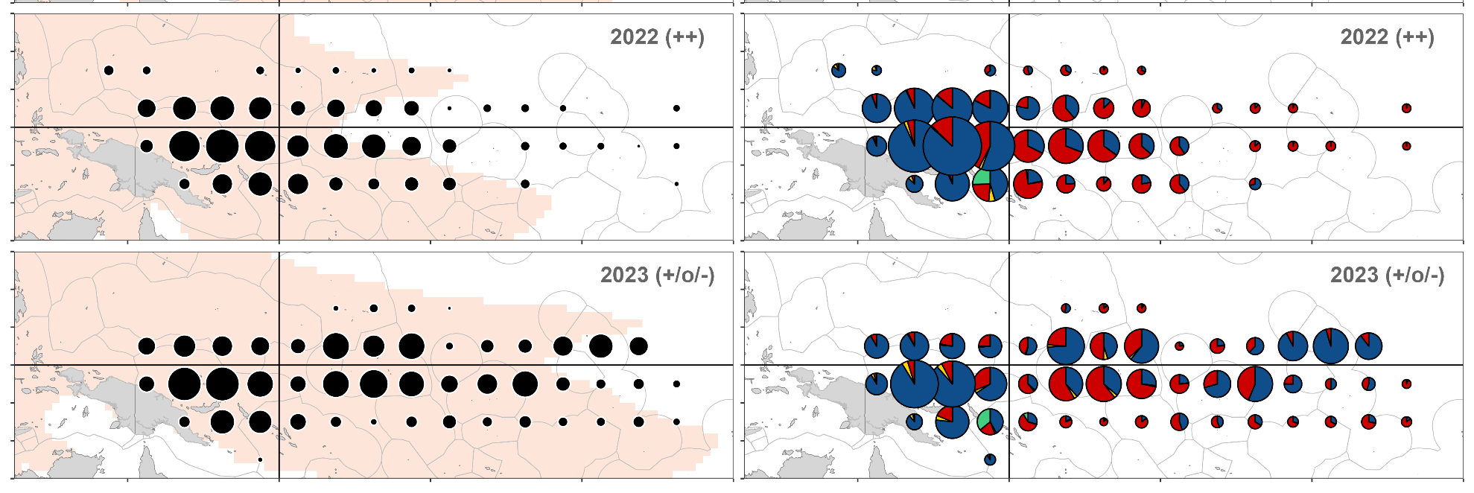
WCPFC Purse Seine Fishery
Days Sets
Notes:
Distribution of purse seine effort (days fishing – left; sets by set type – right), 2022–2023 (blue – unassociated; yellow – log; red – drifting FAD; green – anchored FAD). Pink shading represents the extent of average sea surface temperature > 28.5◦ ENSO trends are denoted by ‘+’: La Ni˜na; ‘-’: El Ni˜no; ‘o’: transitional period

Slide 9
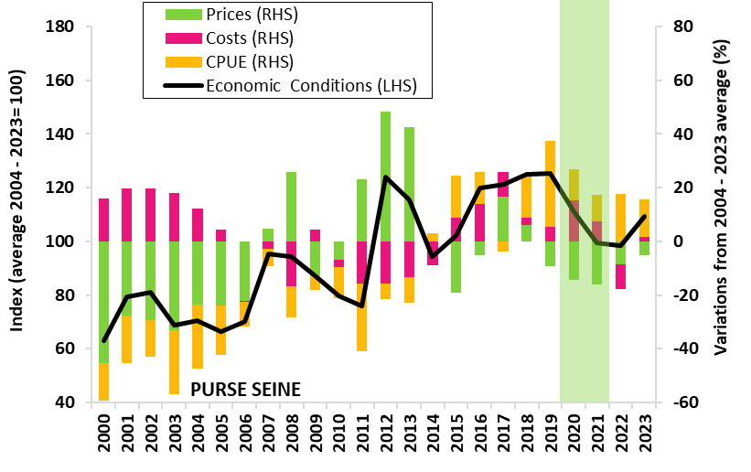
Purse Seine – Economic Conditions
In 2023, economic conditions is above average driven by an increase in fish prices, declining fuel costs and high CPUE.
Recent years
2017, conditions driven by high prices.
2018-2022, conditions driven by high CPUE
PURSE SEINE ECONOMIC CONDITIONS INDEX
Note: Caveat: 2020-21, the impact of COVID-19 pandemic on the cost structure may have been underestimated.

Slide 10
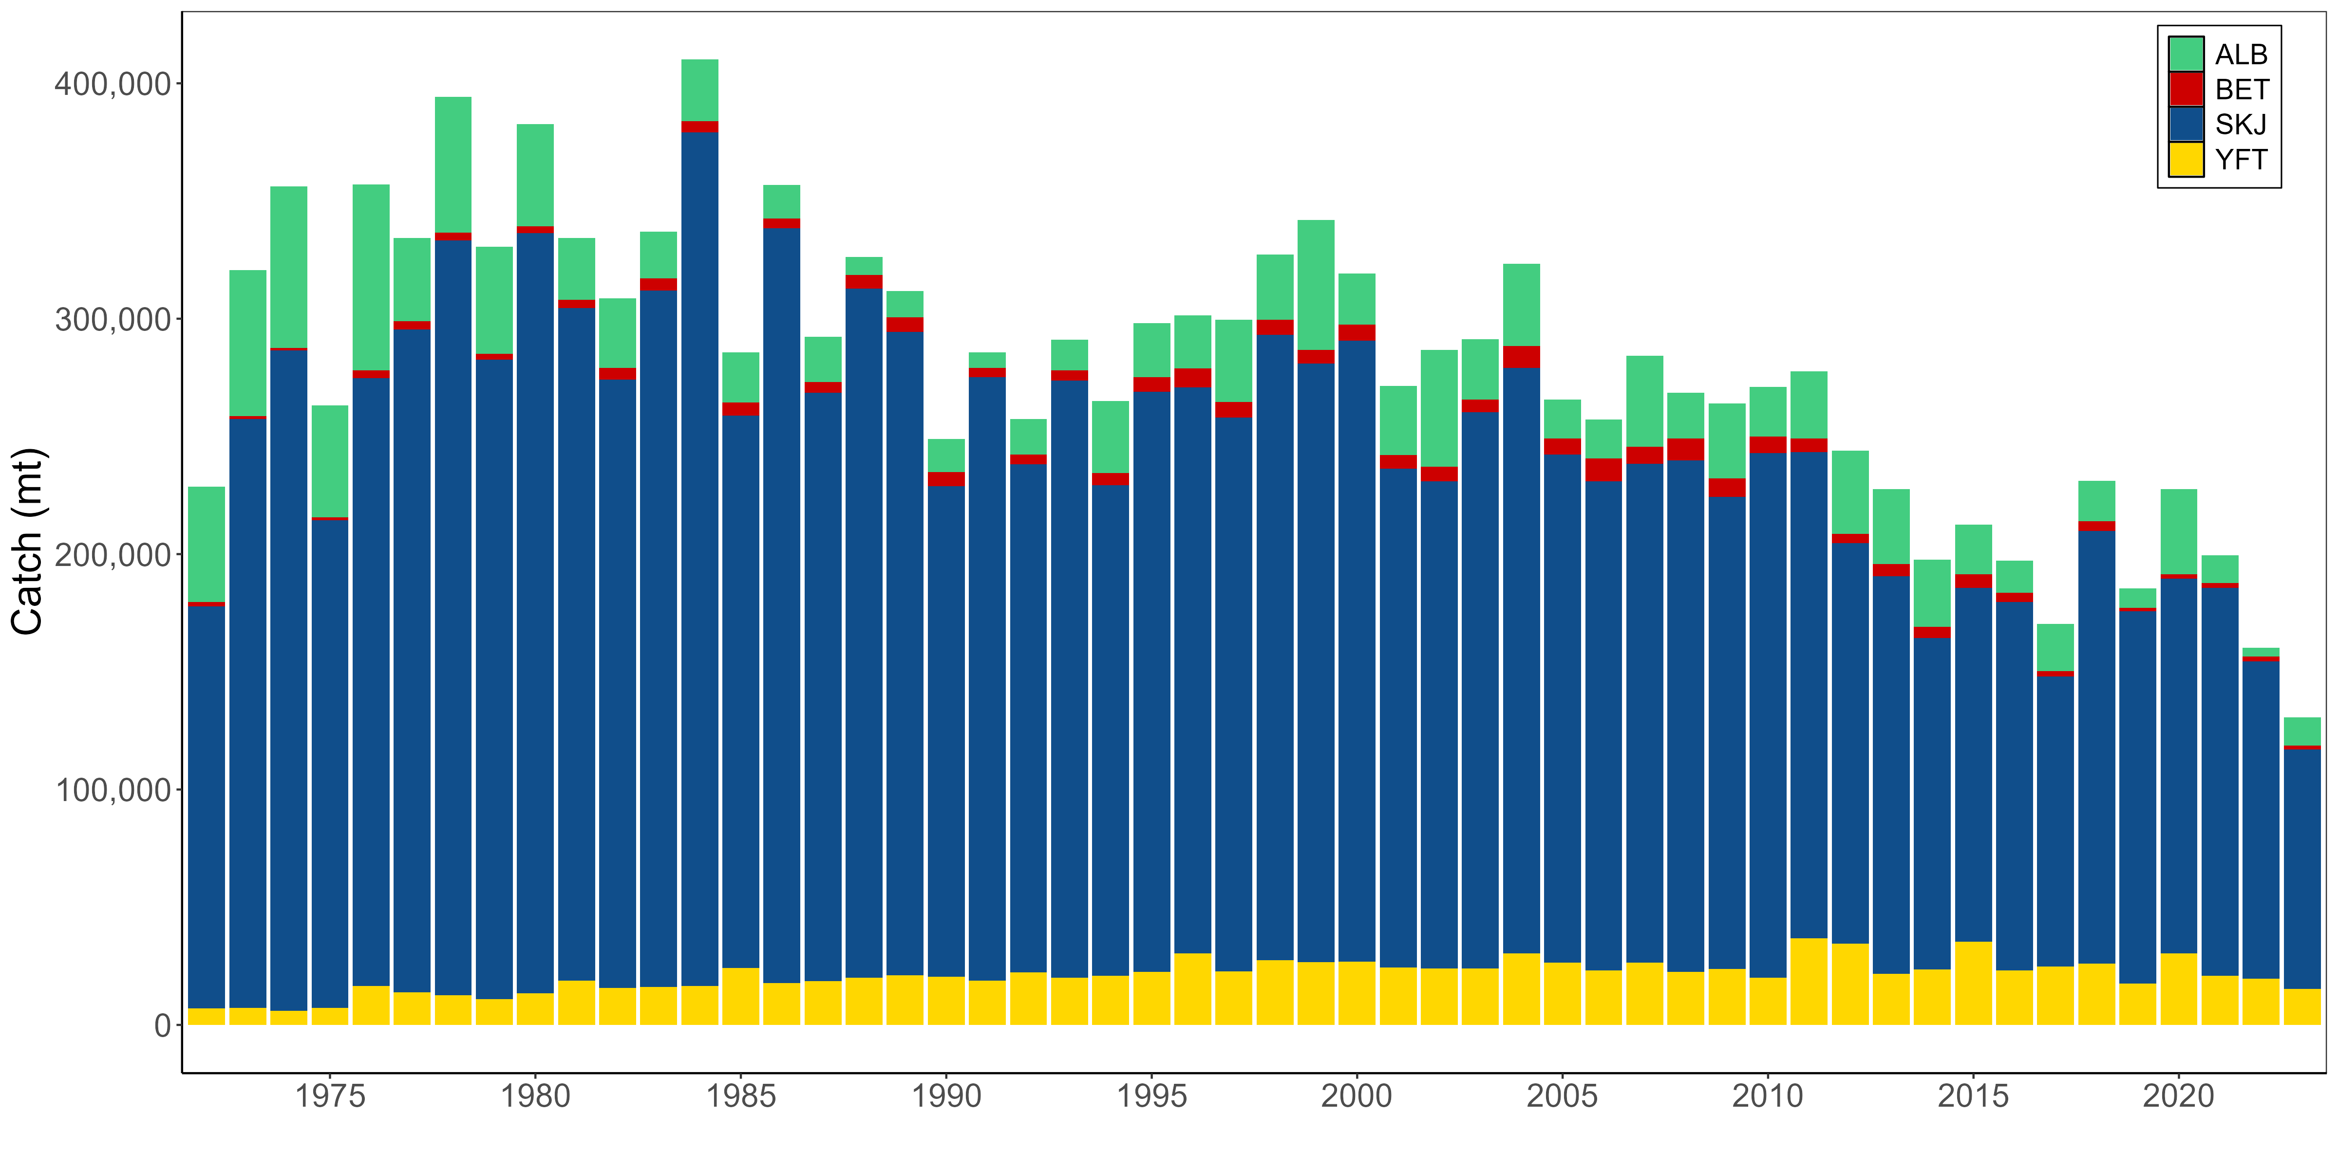
Pole-and-Line Catch
Notes:
PL catch was about 143K mt, the lowest of the time series with evidence of continued fleet contraction
Currently only 4 pole-and-line fleets active in the WCPO: Japan, Indonesia, French Polynesia, and Solomon Islands
Vast majority (~98%) of the catch is landed by the Japan and Indonesia fleets – 58K mt for Japan in 2023 and 85K for Indonesia

Slide 11
Pole-and-Line Catch Value
2023
Total value $312m
down 11% primarily due to a 7% decline in catch and 13% decline in prices
Value of skipjack down 14% ($40 million) to $254 million

Slide 12
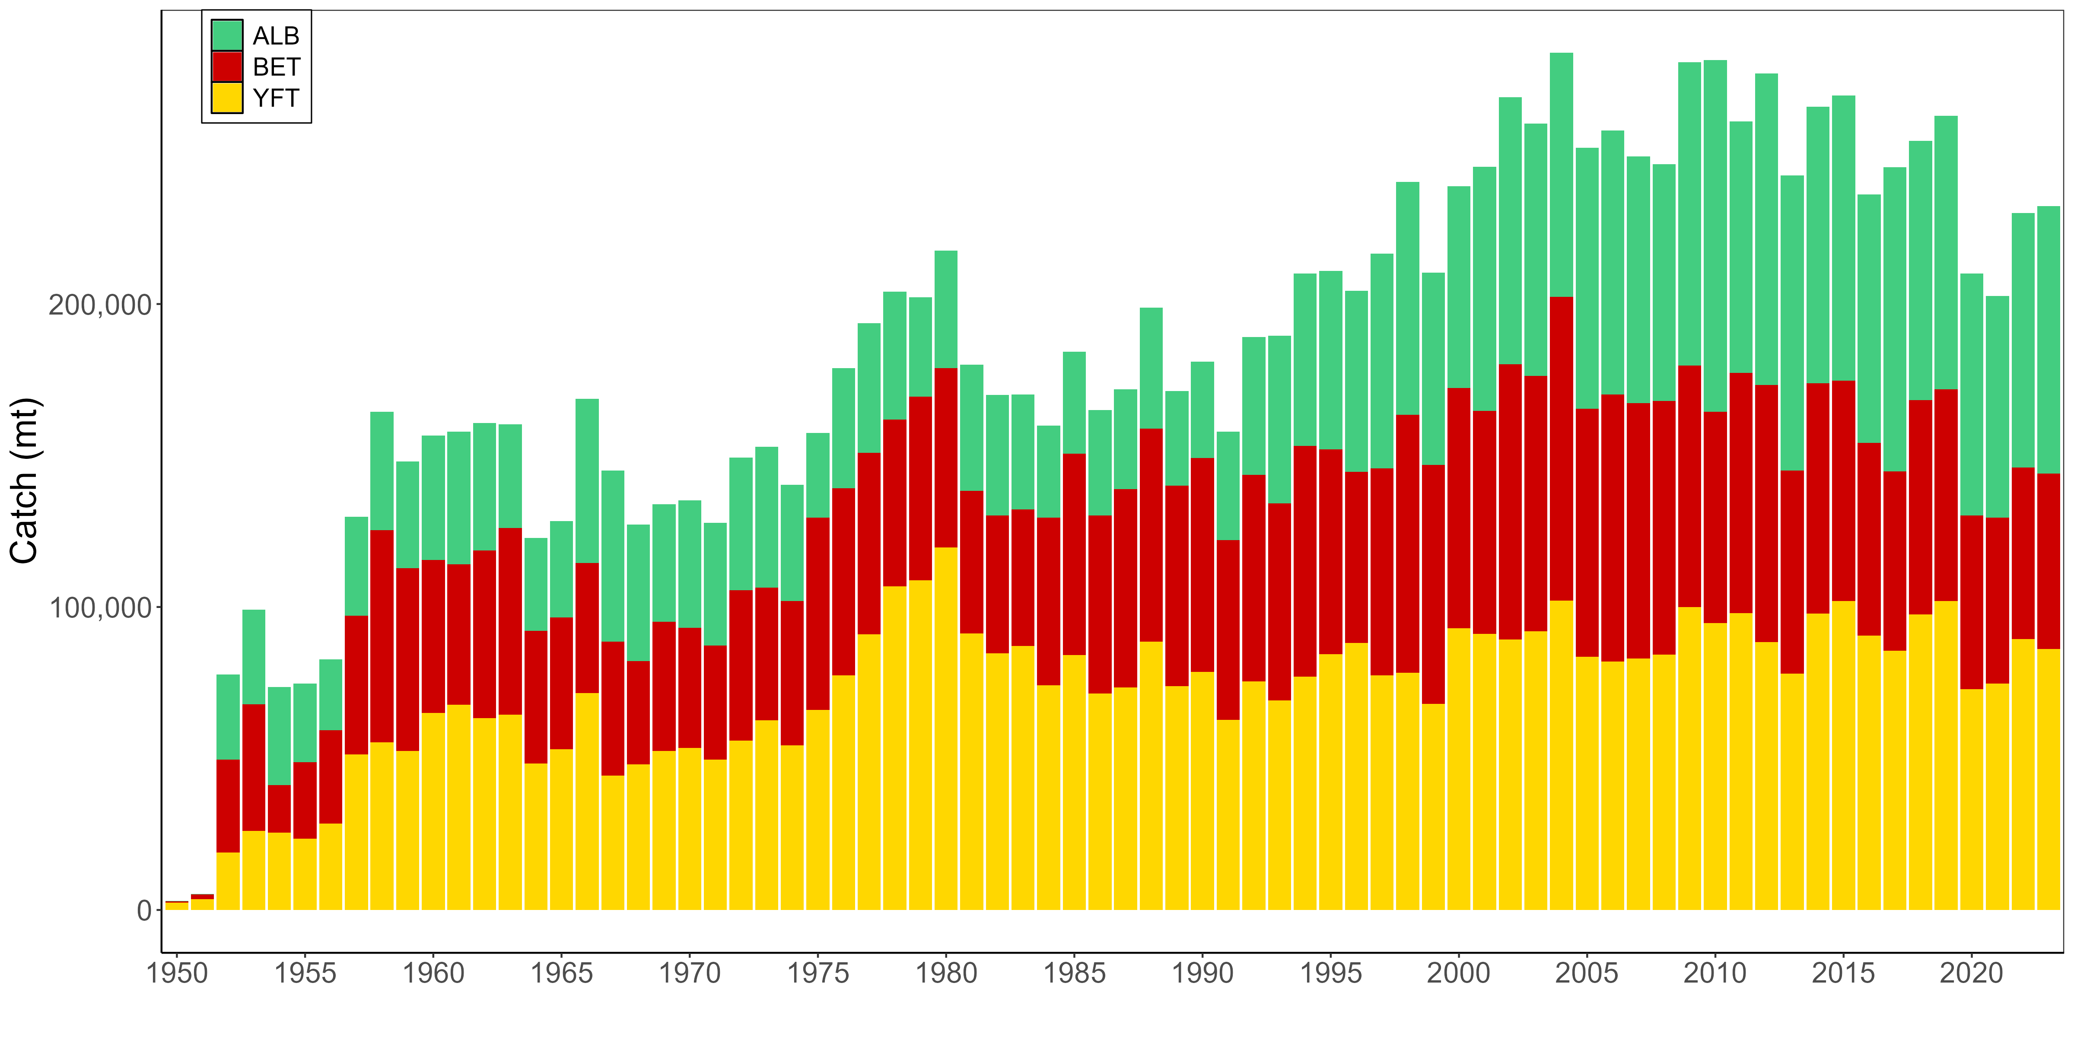
Longline Catch
Notes:
Longline accounts for 8-10% of the landed catch, but rivals the purse seine in terms of catch value.
The number of vessels active in the fishery has been fairly stable over the past 5 years – at 2,355 in 2023
The catch composition has shifted to an increase an ALB and reduction in YFT compared to the early part of the time series, but that may be due in part to the recent prevailing La Nina conditions.
Handline gears are separated form longline where possible. Large-fish Handline fisheries in Indonesia, Philippines and Vietnam, largely targeting YFT harvested approximately 45K mt in 2023.

Slide 13
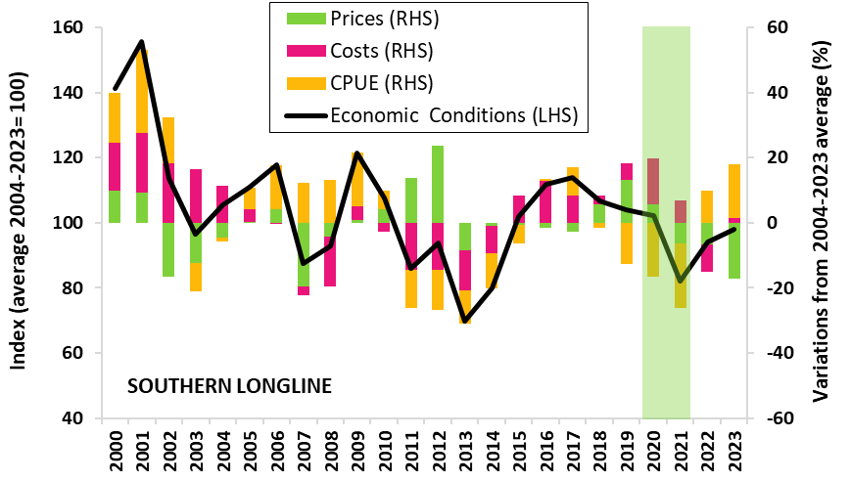
Southern Longline – Economic Conditions
In 2023, economic conditions approaching its 20-year average, primarily due to an increase in catch rates and lower fuel costs
Recent years
2018-2019, conditions driven by high prices
2020-2021 conditions worsened due to low CPUE.
2022, conditions improved due to increase in CPUE.
SOUTHERN LONGLINE ECONOMIC CONDITIONS INDEX
Note: Caveat: 2020-21, the impact of COVID-19 pandemic on the cost structure may have been underestimated.

Slide 14
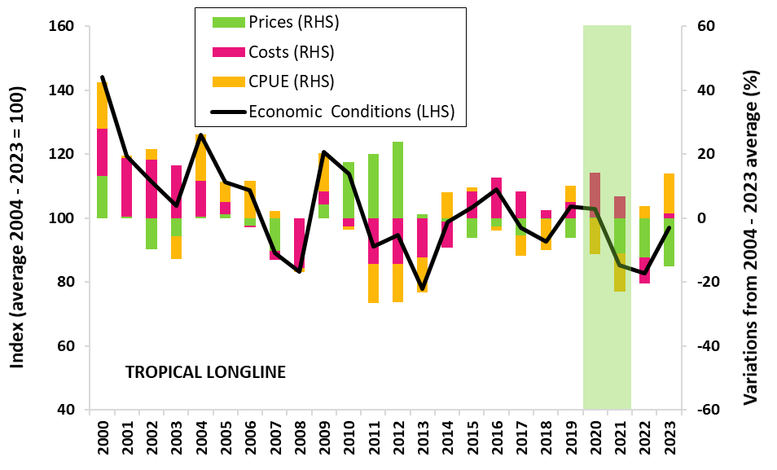
Tropical Longline – Economic Conditions
Economic conditions in 2023 improved approaching the 20 year average due to high CPUE and decrease in fuel prices
Recent years
2019-2020, conditions hovering around 20 year long term average.
2021 conditions worsened due to low CPUE.
2022, condition worsened due to escalating fuel prices from the Russia/Ukraine conflict.
TROPICAL LONGLINE ECONOMIC CONDITIONS INDEX
Note: Caveat: 2020-21, the impact of COVID-19 pandemic on the cost structure may have been underestimated.

Slide 15
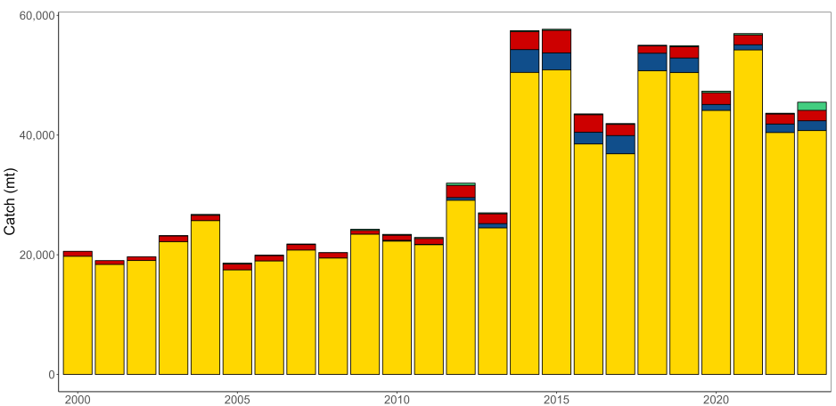
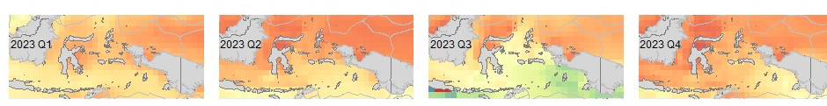
Large-fish Handline Fisheries
Notes:
The provisional large-fish handline catch estimates suggest similar catches to 2022 (~45K mt), but with more albacore.
In the Banda Sea region of ID there can be seasonal cooling of the sea surface temperatures, as shown for Q3 of 2023. During these periods of cooler water and potential upwelling, catches of albacore have increased.

Slide 16
Key highlights from 2023
Catch
Most fisheries have been relatively stable over the past few years
YFT catch was 2nd highest on records, while SKJ dipped below the 10-year average
BET catches stable, largely due to management
Provisional SP ALB catches are down for 2022, but do not yet include EPO catches
Catch values
LONGLINE - US$ 1.6 billion (1% decrease on 2022)
PURSE SEINE - US$ 3.5 billion (7% increase on 2022)
POLE & LINE - US$ 312 million (11% decrease on 2022)
Economics conditions
PURSE SEINE - Index remain above the 20-year average at 109
SOUTHERN LONGLINE - Index approaching the 20-year average at 98
TROPICAL LONGLINE - Index approaching the 20-year average at 97

