Slide 2
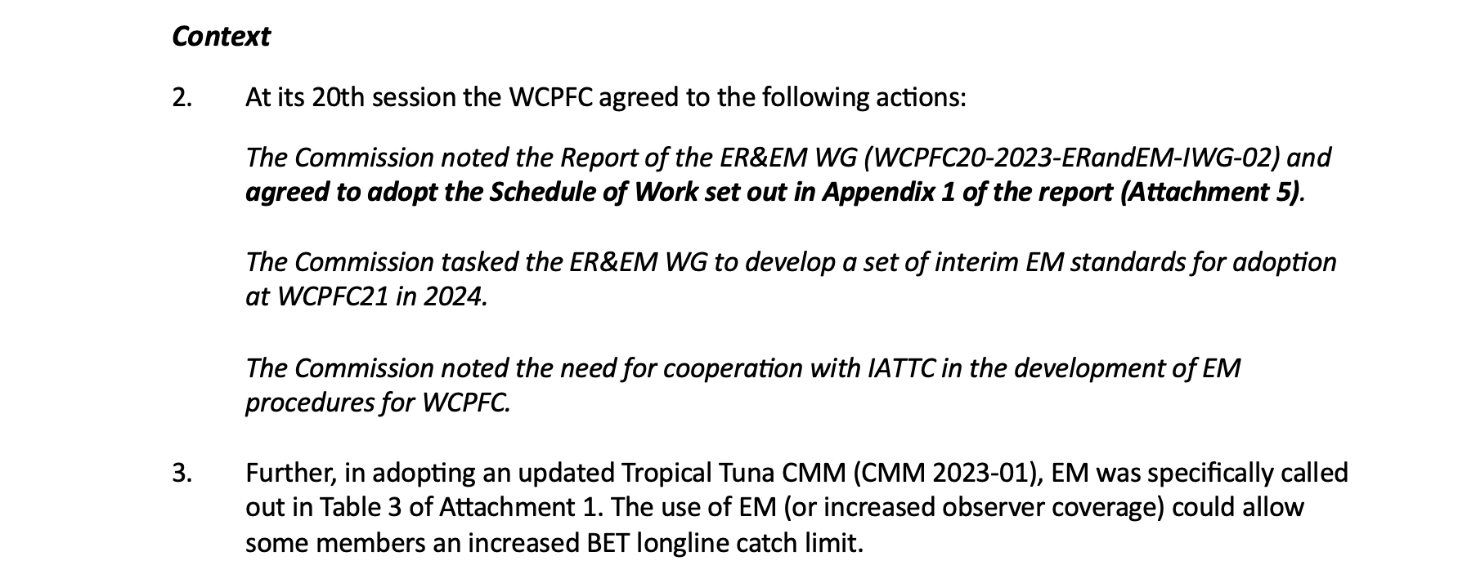

Slide 3
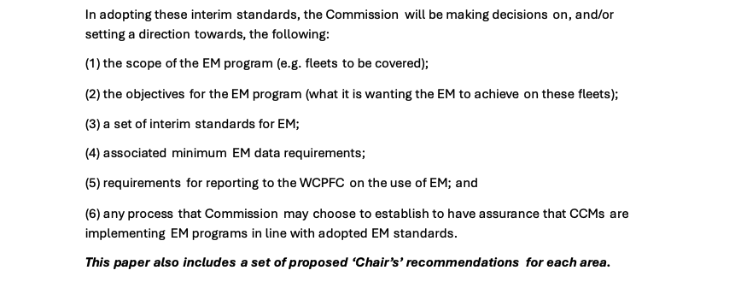

Slide 5
Chair’s
recommendations

Slide 6
Other relevant SC ST papers
Paper | Chair’s thoughts
WP-02 | Automated species and size ‘generation’ is still a while way from being a ‘MUST’ but when proven will be valuable for Purse Seine to address biases in grab sampling
WP-04 | There is a lot of ongoing work required thru this IWG to update the ROP MSDF to reflect information CCMs are required to report on for Non-target and associated and dependent species [NTADs]. We need to exercise care if using the ROP MSDF alone as a base for EM data requirements
WP-09 | This is only relevant to a few CCMs. The development of EM-related audit points essentially mirrors the proposed approach described in Appendix 3 of WP-05. There will likely be a delay between collecting EM records and being able to submit EM data. Addressing this, and the reporting approaches, will add more nuance to Appendix 3 of WP-05. Para 15 of WP-09 provides some more detail on the calculation of coverage rates that could be usefully added to Appendix 3 of WP-05. Para 17 of WP-09 essentially follows Option 2 from WP-05 for EM data, but does give some guidance on ‘MUSTs’ fields and proposes that coverage is something determined from submitted EM data.

