Slide 1
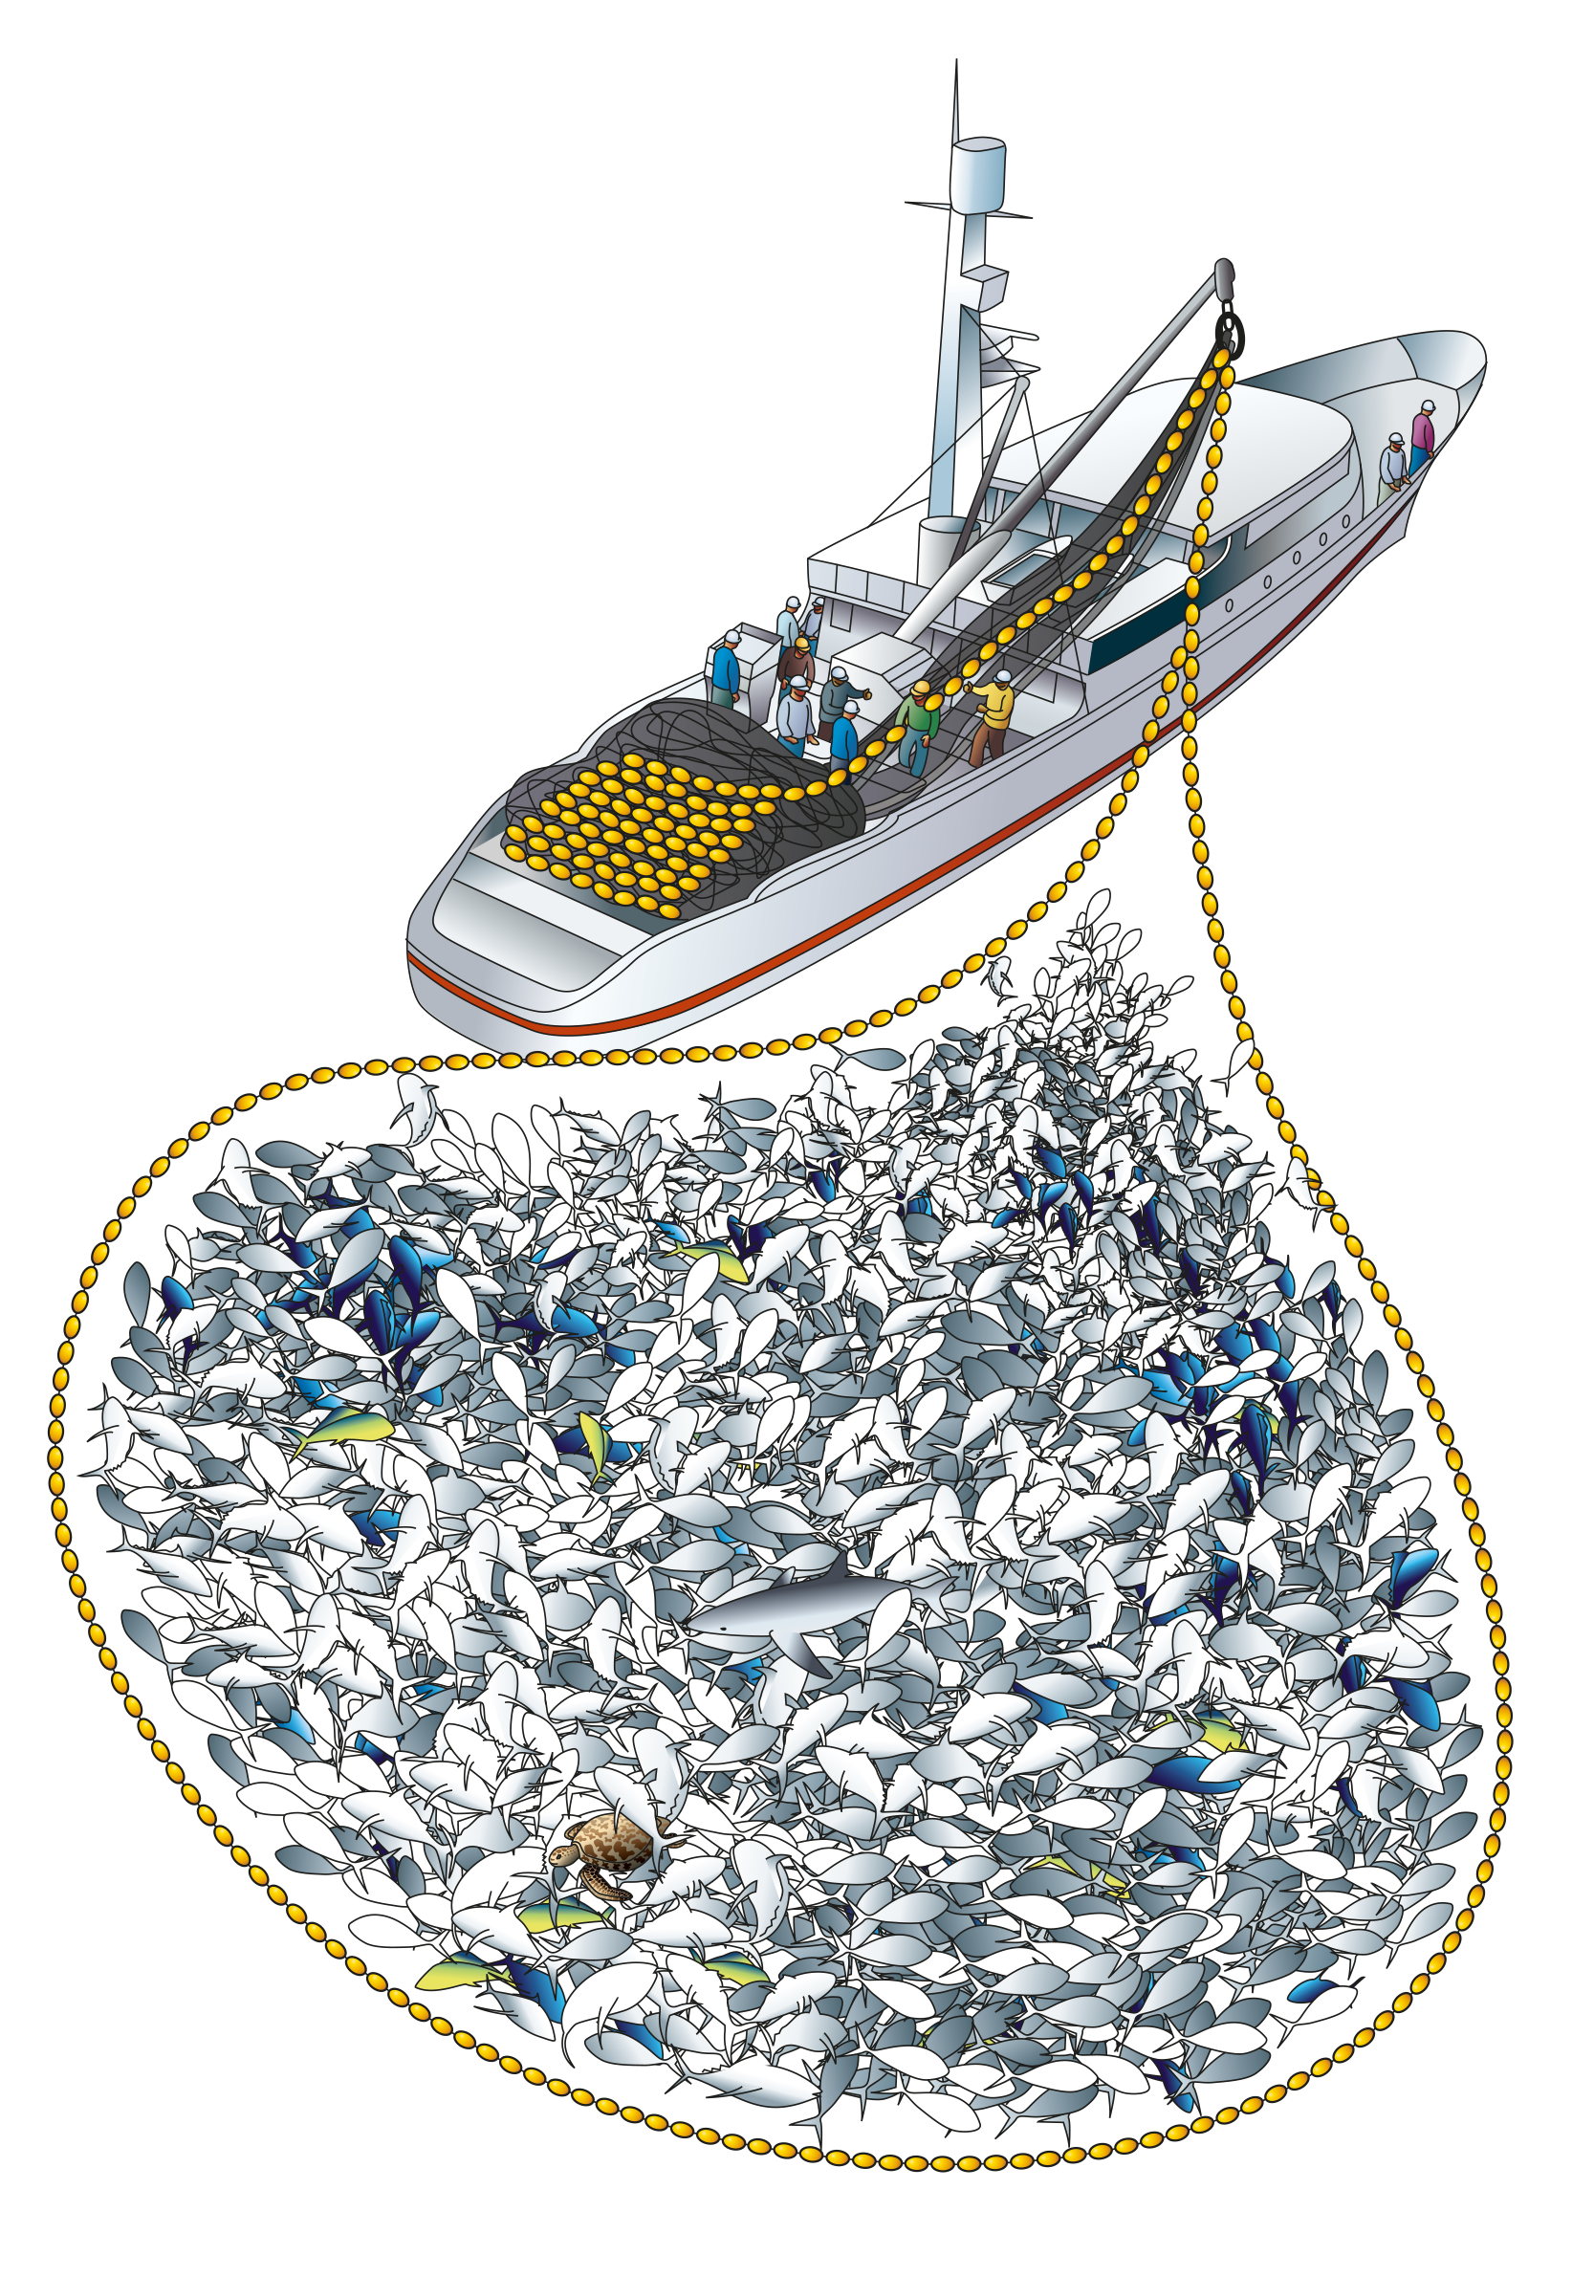
Evaluation of activities within the purse seine fishery through time SC20 ST-WP-03_rev1
Tiffany Vidal, Peter Williams, Paul Hamer and Steven Hare
SPC-OFP
20th Regular Session of the Scientific Committee (SC 20)
Manila, Philippines

Slide 2
Introduction
This paper is an initial investigation into potential changes in reporting behavior by the purse seine fleet
The observed pattern in question is increasing divergence between days at sea and fishing days
Logsheet, observer and VMS data examined to compare fishing vs. non-fishing reporting days
Scenarios developed to reclassify some daily activities reported on logsheets
Reclassification resulted in potential increases of 2-32% in fishing days, on average, in recent years

Slide 3
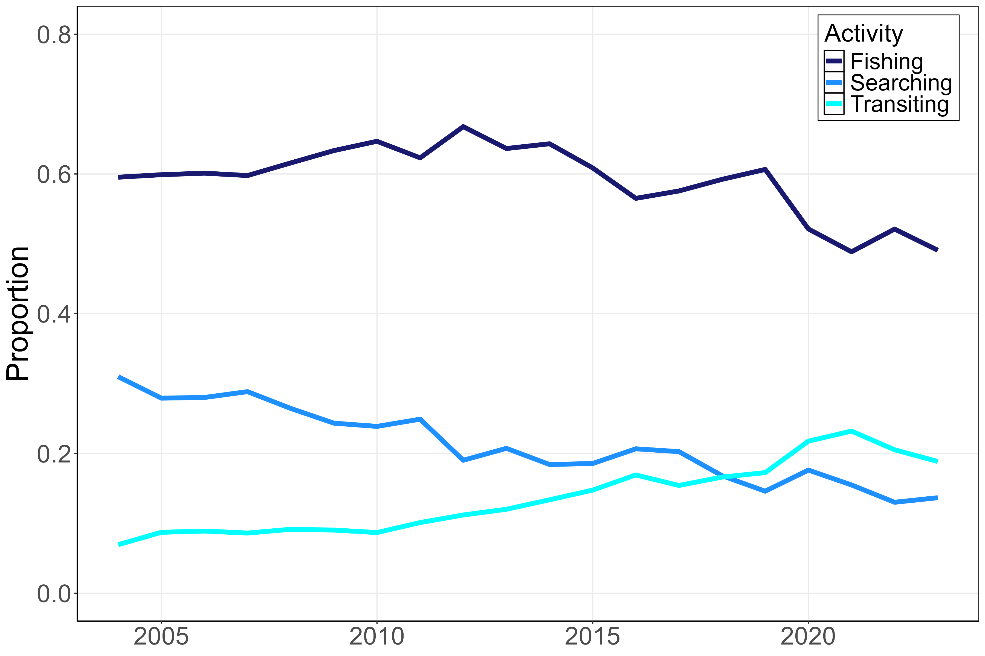
Logsheet activities
Fishing has declined from 65% to 50% of logsheet activities over past decade
Searching has declined from 30% to < 20% while transiting has increased from 10 to 20%
Note these are the three main activities, not all of them so the sum here is not 100%

Slide 4
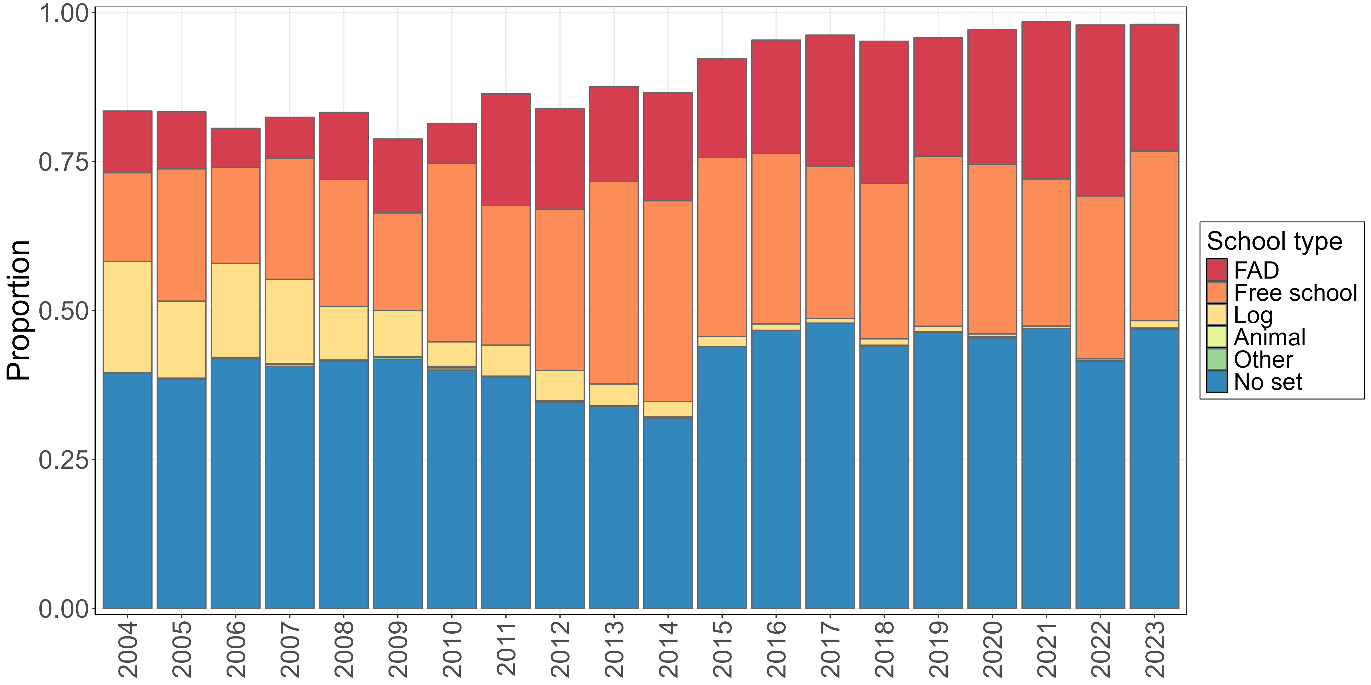
Set types after “Transiting”
Since 2010 FAD sets more often follow transiting (now 20-30%)
Free school (FS) sets about the same
Log sets now rare

Slide 5
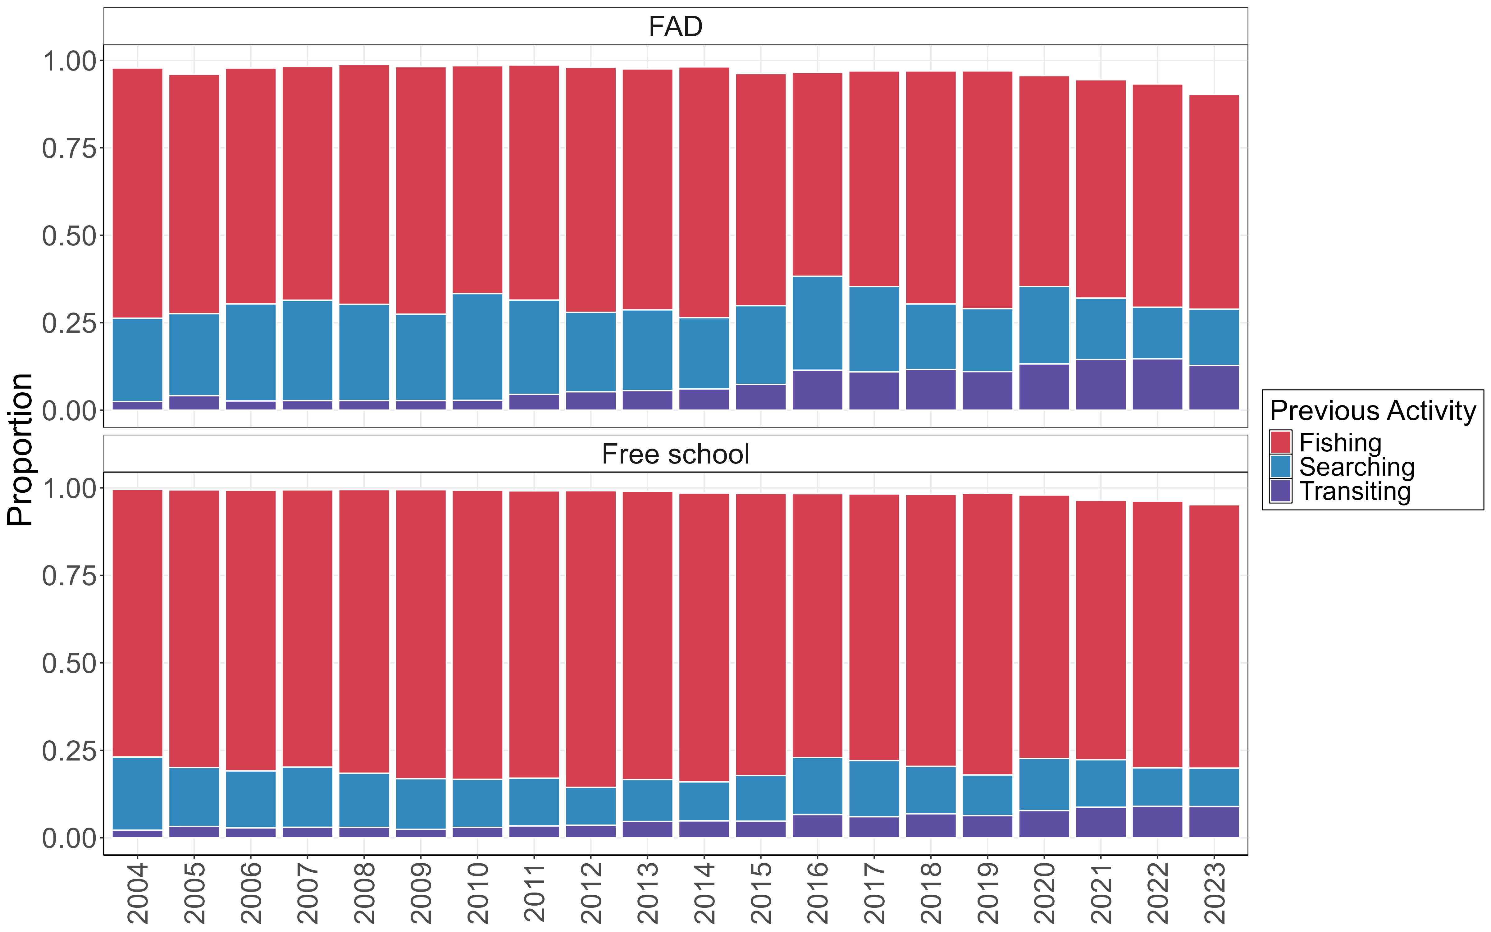
Activities before a set
Since 2010, searching activity prior to a FAD set has decreased by 50% (transiting has doubled)
Search time also decreased prior to FS sets

Slide 6
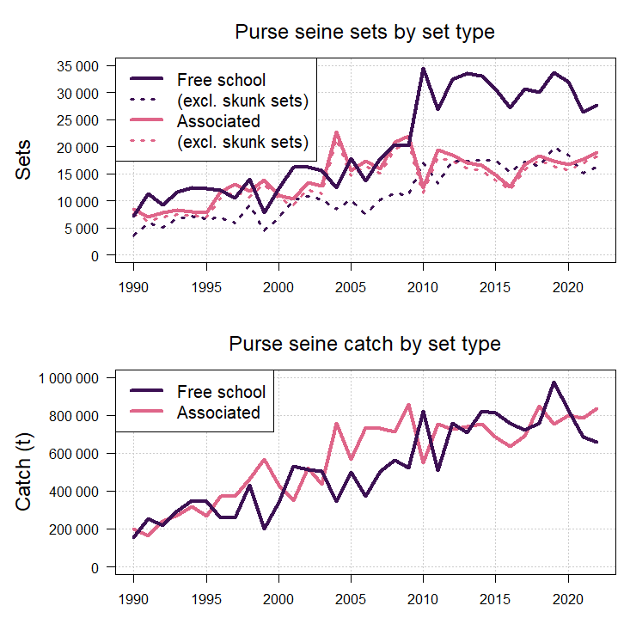
Activities before a set
In 2010, a big jump in FS sets, but level afterwards
Big increase in FS “skunk” sets
Couple of hypotheses for this – shift to FS during FAD-closure and/or opportunistic FS sets

Slide 7
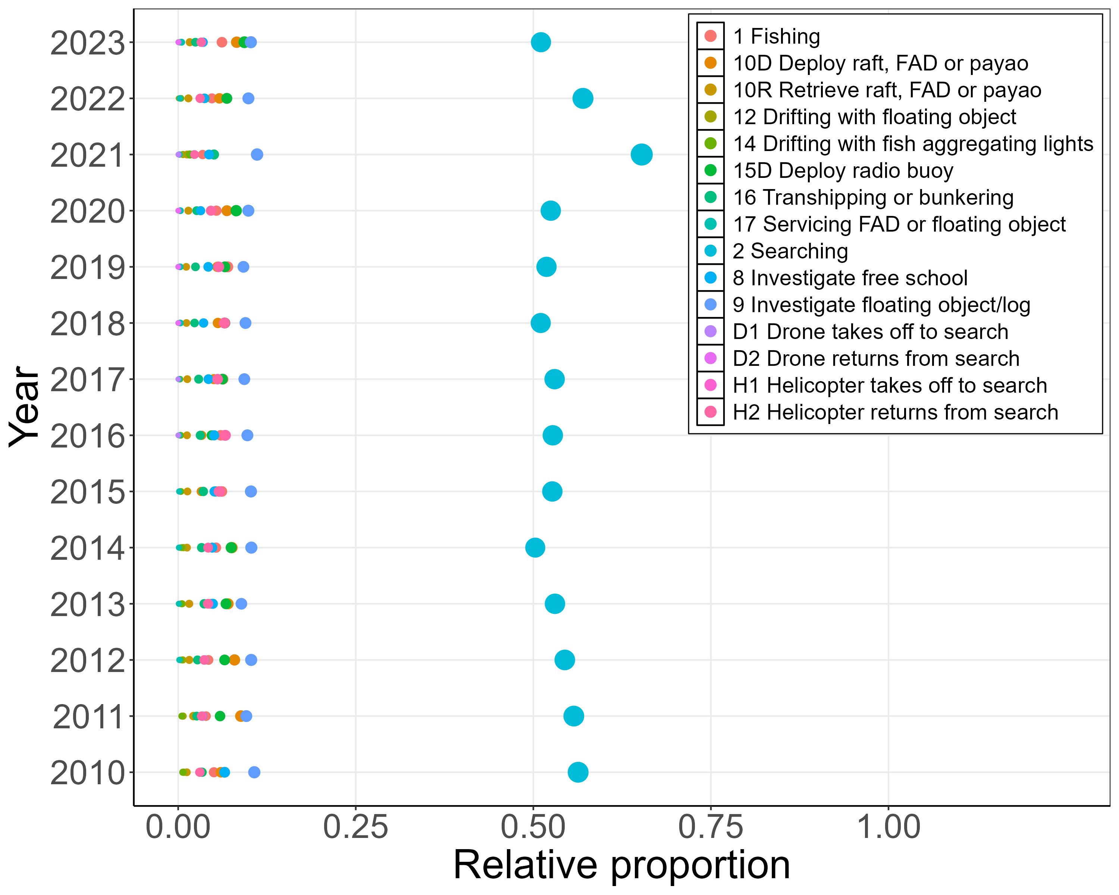
Observer match with logsheet reporting
83-91% of activities matched between logsheets and observers
7-15% of observer fishing days were logsheet non-fishing (see plot at left)

Slide 8
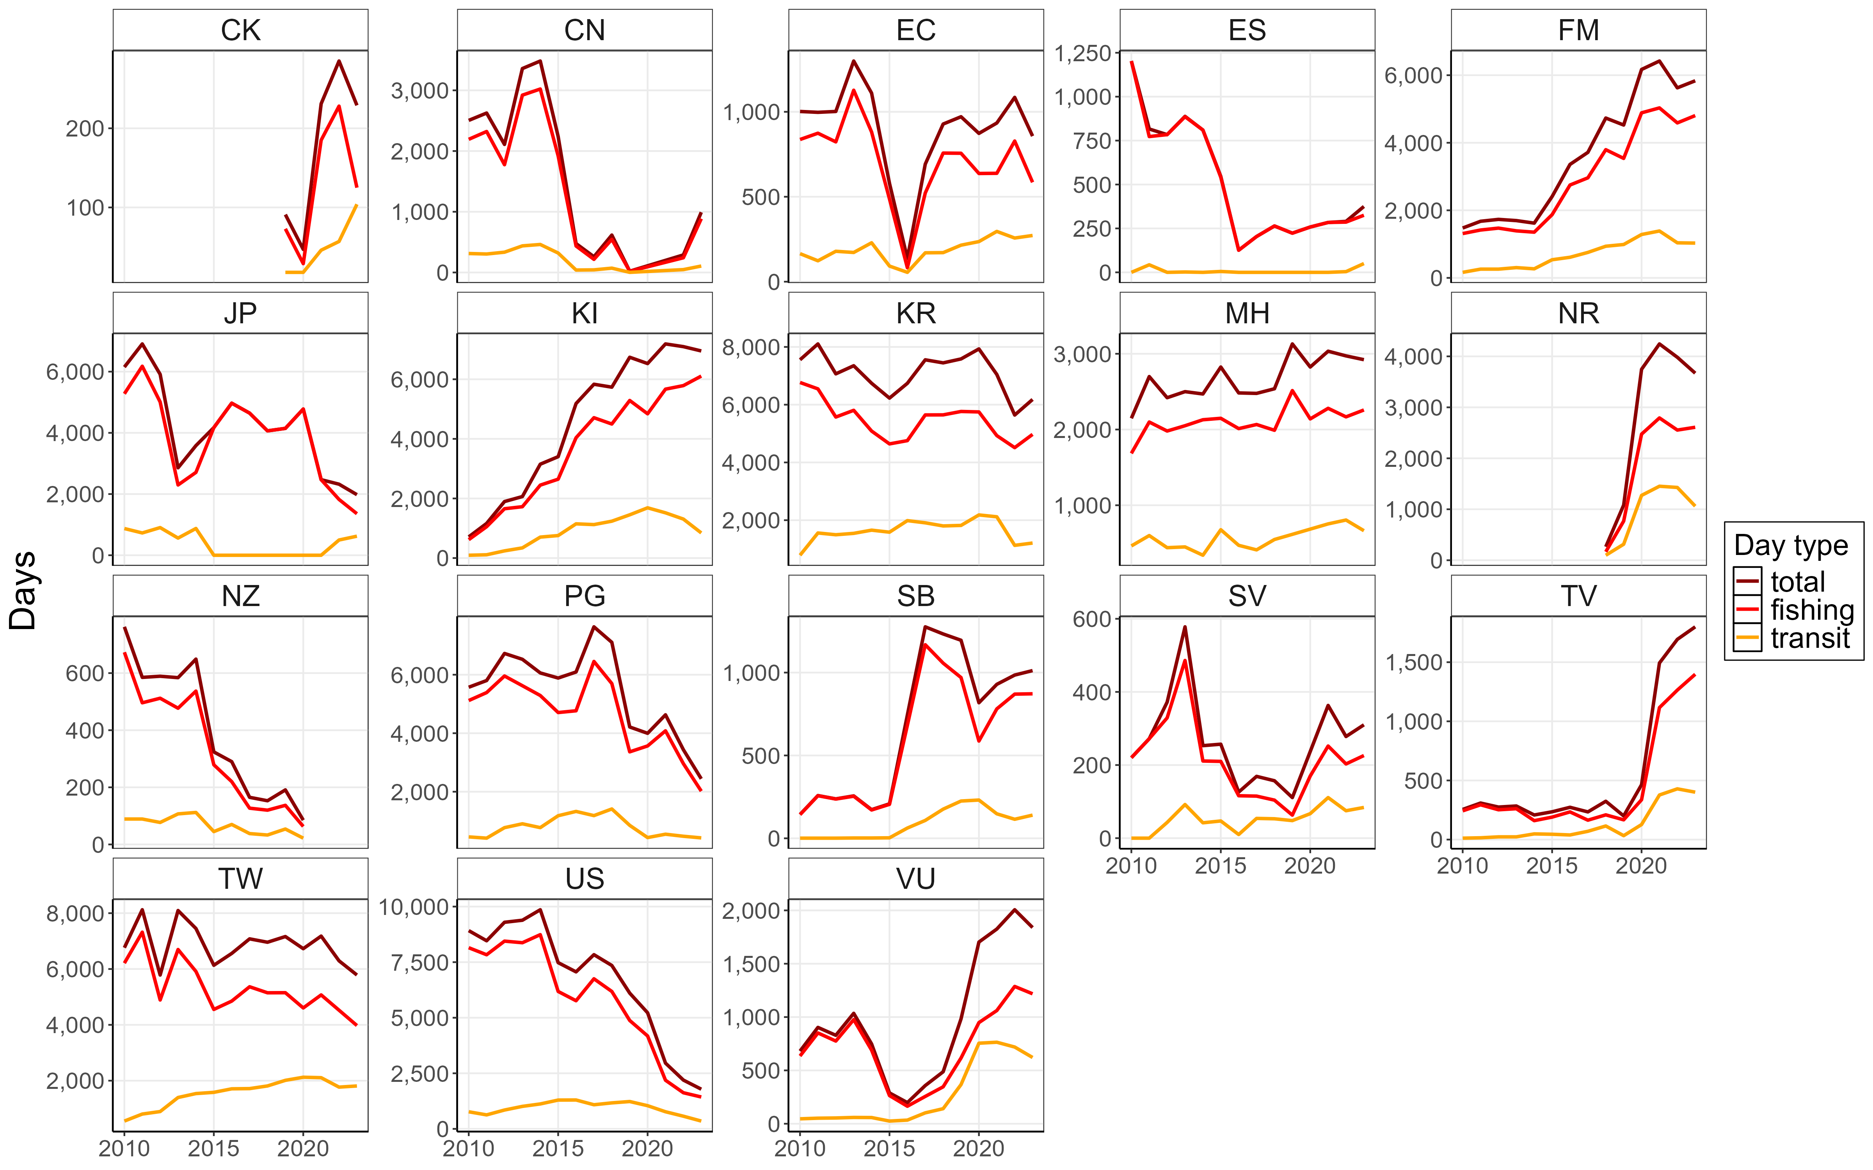
VMS match with logsheet reporting
Days estimated from VMS using the purse seine effort algorithm
Days calculated from purse seine logsheet data based on reported activities

Slide 9
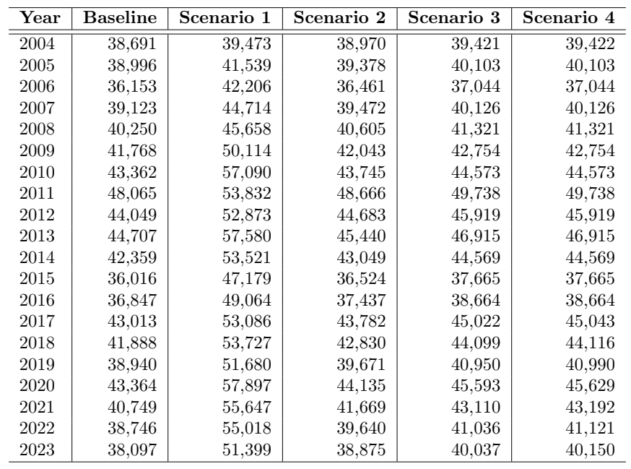
Scenarios investigated for reclassifying
Activity | Explanation | Scenario
Baseline reporting | Sum of effort as reported as a set or searching | 0
All days at sea | Consider all days minus the day of departure and day of return to port, as days fishing, unless the sum of reported fishing days is higher, in which case the higher value is used | 1
Fish - Fish | Assume that if a vessel goes from one fishing set to another with only transiting activity in between, this activity is in fact searching, as it may be unrealistic to make a set without any searching | 2,3,4
Transit - Fish | Similar to the logic for Fish - Fish, the assumption here is that it may be unrealistic to make a set without searching, direct from transiting behaviour | 3,4
Boundary - Fish | For these records, it appears that fishing or searching activity has been declared just prior to or just after crossing a boundary. This may be a case of licensing. For example, if a vessel is not authorised to fish in a given area, they do not search nor fish there as a result. Even so, for this exercise (and in some scenarios), we will assume if a vessel was searching prior to crossing a boundary it is likely searching after crossing the boundary. Similarly, if a fishing set is made after crossing a boundary, the transiting prior to the boundary crossing is assumed ot be searching. | 4
Notes:
4 scenarios evaluated: baseline unraised fishing days reported by logbook data
1 – Days at sea
2 – fishing activity to fishing activity – must have searching
3 – Transit to fish, again assuming searching should precede fishing
4 – if a boundary activity changes the activity from searching to transit or vice versa

Slide 10
Summary
This evaluation was at a relatively coarse level, aggregating across fleets
However, several changes in fishing strategies/reporting behaviours were identified
Understanding effort is key for the scientific work of the Commission, including for CPUE analyses to inform assessments
Potential future work: review logsheet reporting requirements, further develop VMS algorithm, explore FAD closure impact on behaviour/reporting, evaluate HS vs EEZ differences

