Slide 1
A Review of the Scope and Feasibility of an Assessment of WCPFC Conservation and Management Measures (CMMs) Susceptibility to Climate Change Impacts (SC20-EB-WP-07) SPC-OFP and WCPFC Secretariat
20th Regular Session of the Scientific Committee (SC20)
Luxent Hotel, Quezon City, Philippines
14 – 21 August 2024

Slide 2
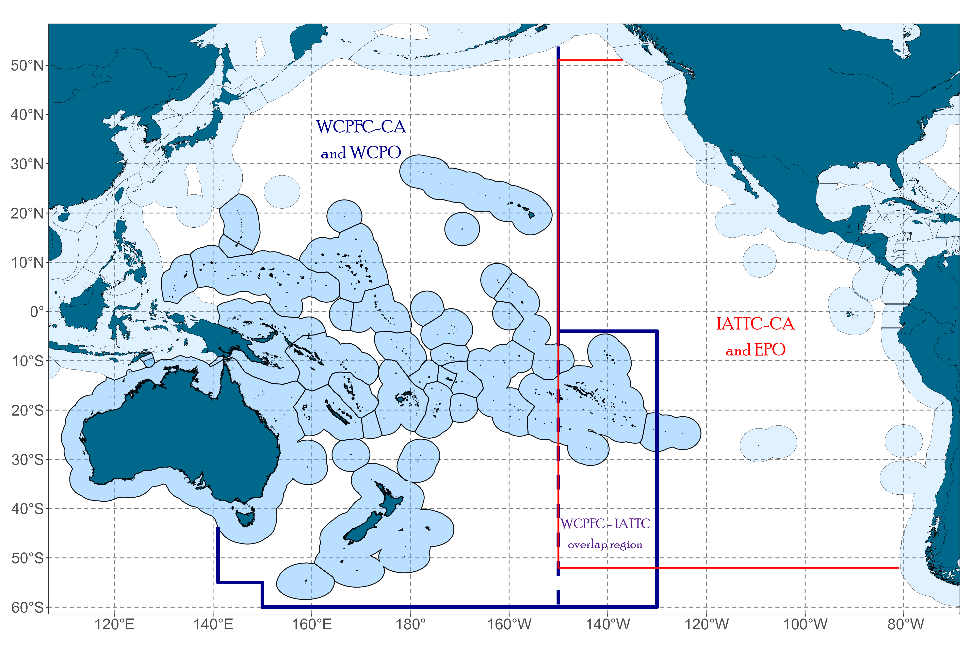
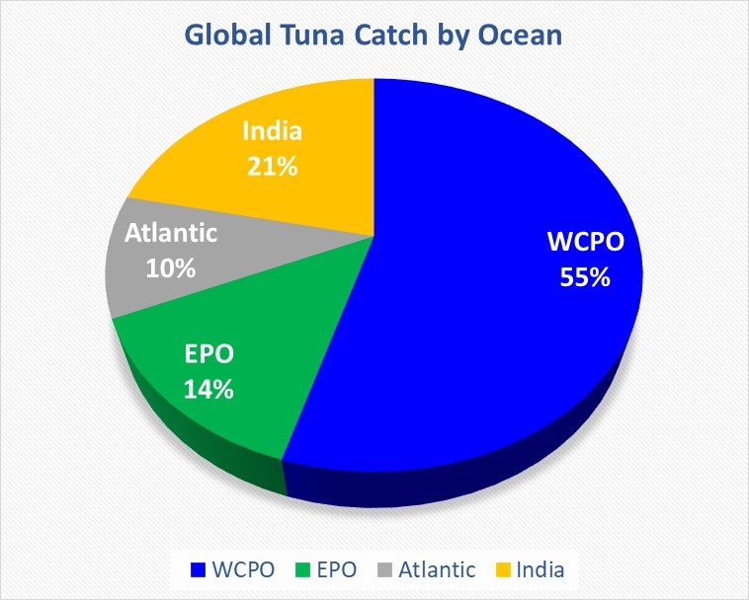
Tuna Fisheries in the WCPO and Climate Change
The WCPO tuna catches is estimated at 2.7 million MT
55% of the total global tuna catch
80% of the total Pacific Ocean catch
over 85% of the WCP–CA tuna catch occurs in the waters of the coastal states
Climate change is causing significant shifts in stock distribution and altering the marine ecosystems globally
rising sea surface temperatures
ocean acidification
changing ocean currents, etc
Source: SC19-GN-WP-01; WCPFC Tuna Fishery Yearbook 2022

Slide 3
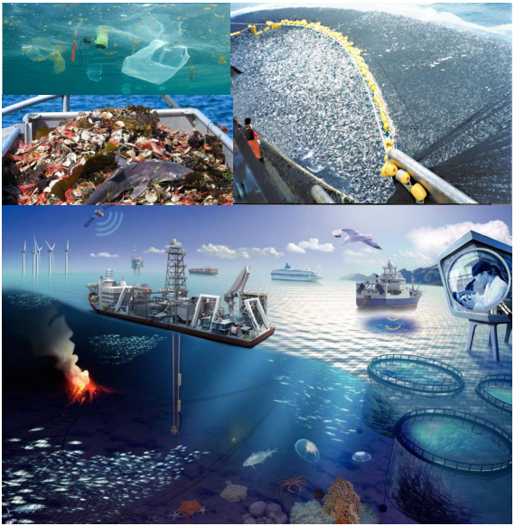
Purpose
Explore the scope and feasibility of assessing active CMMs
to determine specific CMM provisions that may be susceptible to the impacts of climate change
Findings from the CMM assessment can provide additional data and information needed to supplement:
NTADs species CMMs
MCS-related CMMs
incorporation of climate change impacts into the WCPFC harvest strategy framework

Slide 4
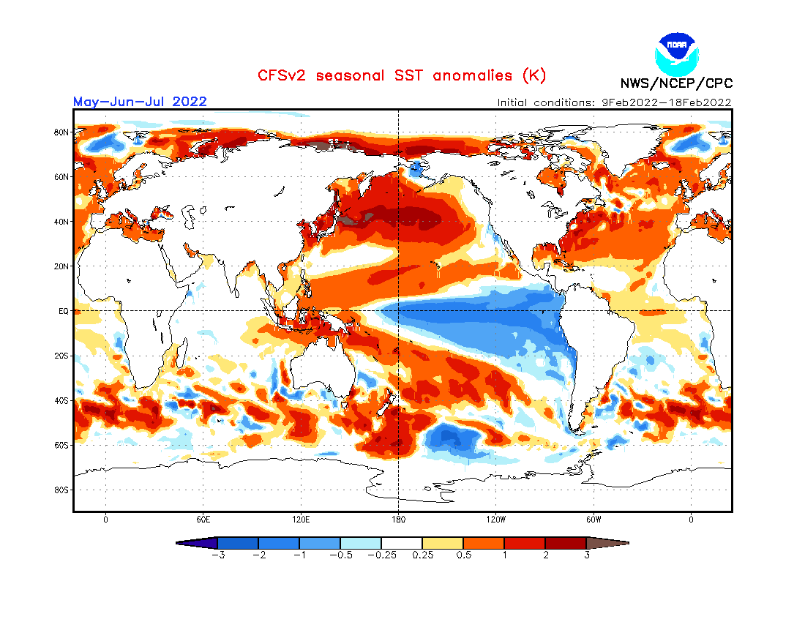
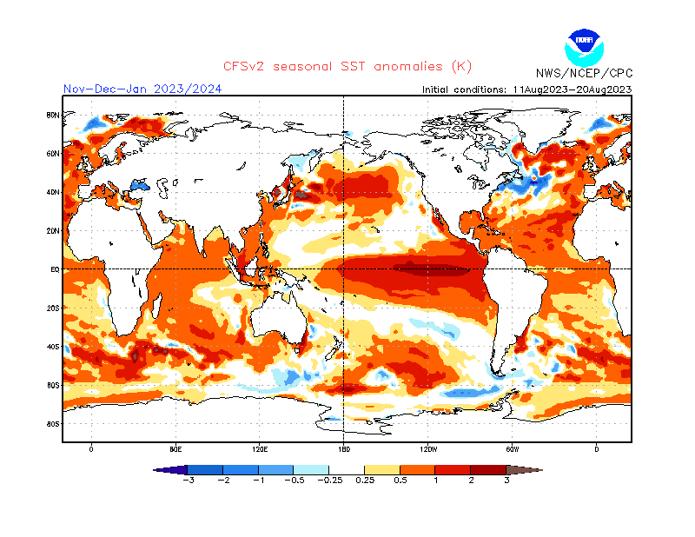
Background
Climate-related discussions in WCPFC
Development of SEAPODYM
Directive from WCPFC20

Slide 5
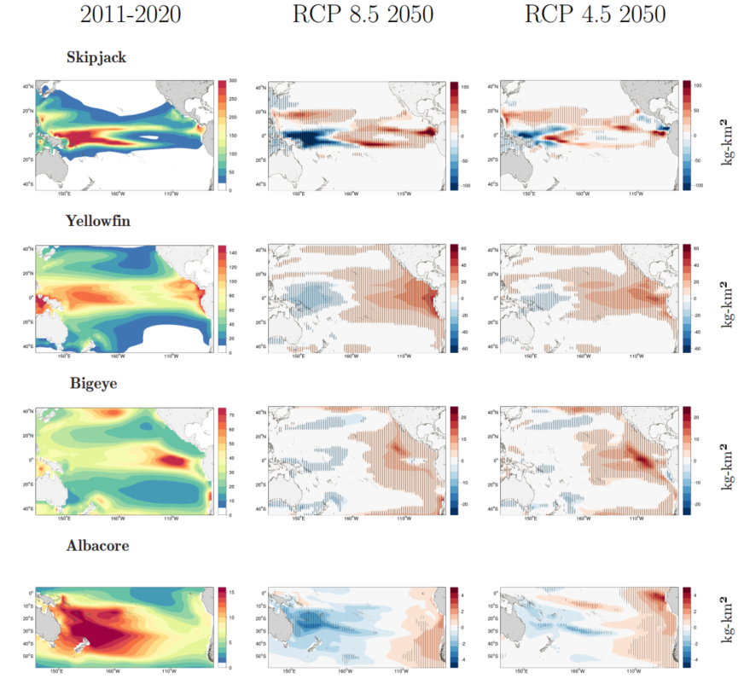
Approach for Assessing CMMs
through a consultancy
approved Terms of Reference (TOR) by WCPFC21
conduct a full assessment
Comprehensive review of CMMs
include possible actions in response to an obligation’s level of vulnerability
inform a subsequent work program of the Commission
multi-year schedule (2-3 years)
review the level of data and information

Slide 6
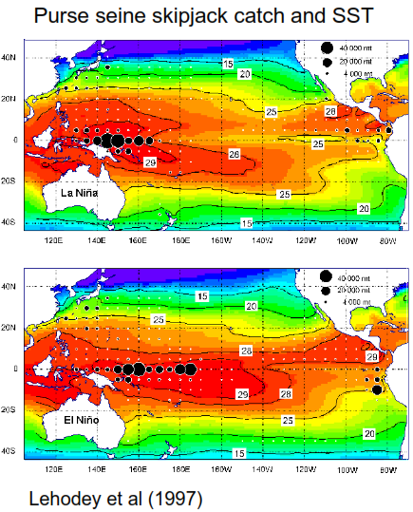
Framework for Assessing CMMs
Consider criteria for the selection of CMMs that are explicitly susceptible to the impacts of climate change
Preliminary Findings
Examples in Attachment 1
CMM 2023-01 (Tropical tunas)
CMM 2018-03 (Seabirds)

Slide 7
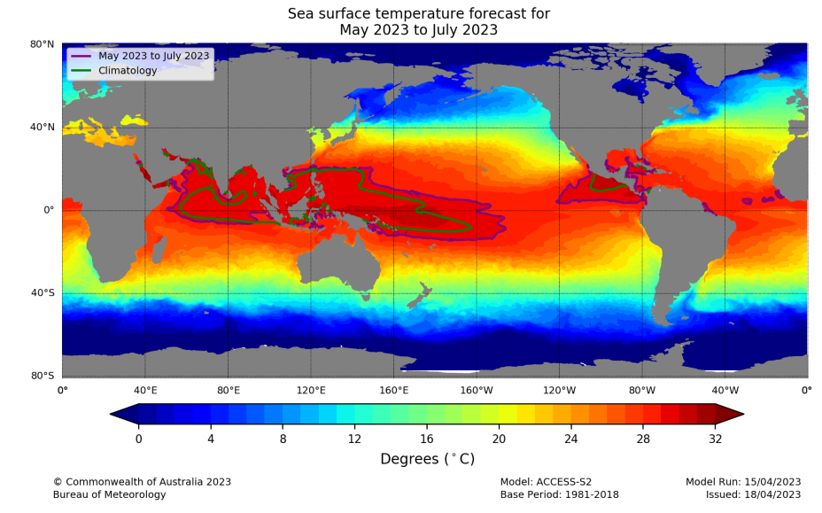
Results and Recommendations from CMM Assessment
Key findings
Provide recommended actions that could help mitigate the potential impacts of climate change
Potential recommendations
amendment to the CMM provisions
modifying the fishing seasons, fishing operations, or catch/effort limits
increase collaboration with scientific bodies to improve understanding of climate impacts
enhanced data collection and monitoring

Slide 8
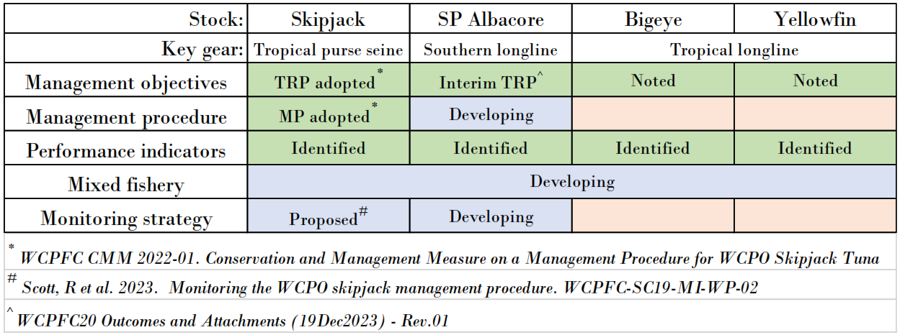
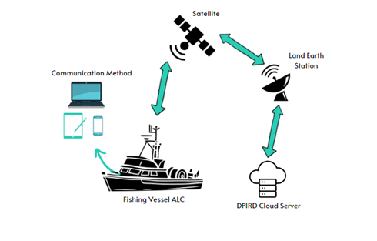
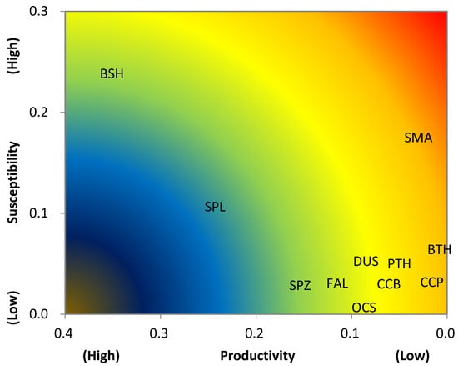
CMM Assessment and Supplementary Initiatives
Harvest Strategy
NTADs
MCS

Slide 9
Recommendations
Note this paper and consider the general approaches to implement the assessment of CMMs susceptible to climate change impacts, including consideration of an appropriate timeframe for completing the assessment and the required resources to support it.
Review the Terms of Reference (TOR) for CMM assessment in Attachment B in SC20-EB-WP-02 and provide advice on refining it.

Slide 10
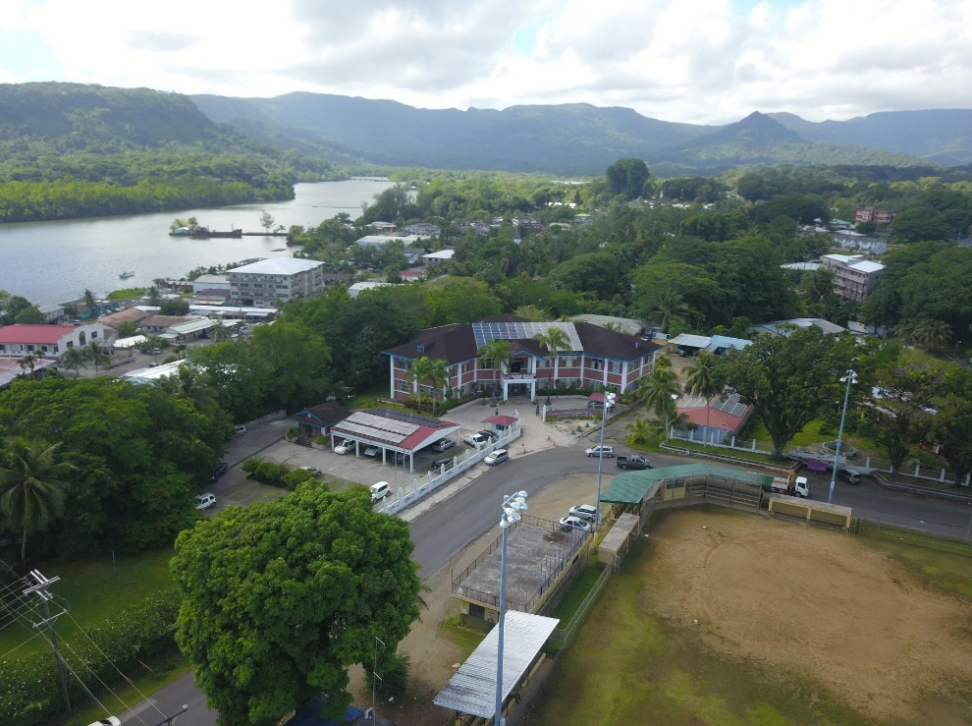
Thank you ☺
WCPFC Headquarters, Pohnpei, Federated States of Micronesia
WCPFC Website: https://www.wcpfc.int/

