Slide 1
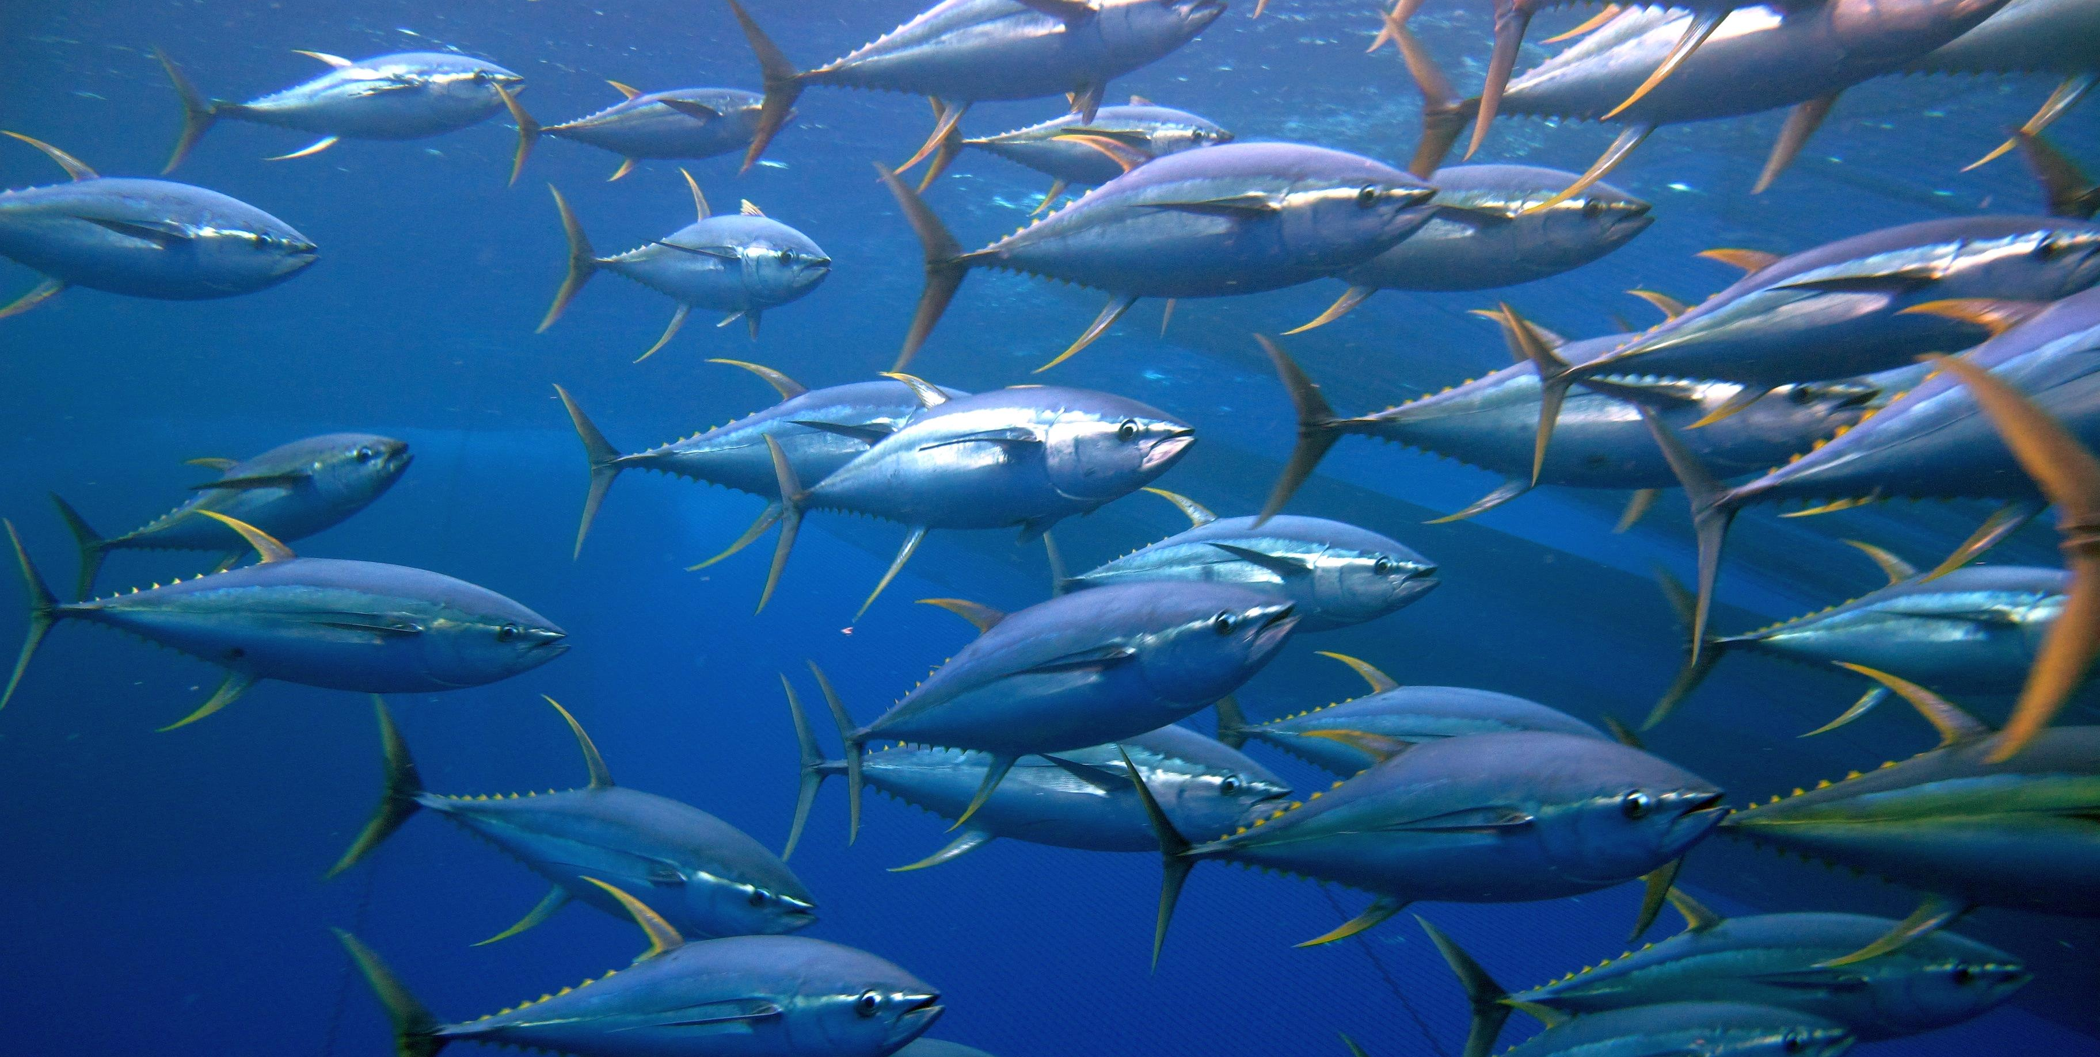
FADMO-IWG 09
Progress Report
SC20-EB-WP-04

Slide 2
BACKGROUND
Following the WCPFC Circular 2024/09 the FADMO-IWG started to discuss its priority tasks for 2024.
The following slides will highlight some key points that the FADMO-IWG discussed for SC to consider.

Slide 3
1. Satellite Buoy Data Transmission Requirements
Consider requirements for the transmission of satellite buoy data from drifting FADs in 2024 to promote effective and sustainable FAD management in the WCPFC (paragraph 56, WCPFC20 Outcomes Document)
Key Point/s:
FAD Buoy Registration
FAD Buoy Communication/Transmission
Timing of Data Submission
Please refer to paragraph 10, SC20-EB-WP-04
Notes:
The FADMO-IWG discussion suggested/proposed some minimum elements to be considered for these items but further consideration is needed. Ranging from having FAD Buoy Register or CCMs nominated/recognized FAD Buoy Register (e.g. PNA FAD Register); to the minimum fields required for each transmission sent; and even the deadline for data submission of historical data.

Slide 4
2. FAD Recovery Programs/Strategies
Consider ways to implement FAD recovery programs/strategies, including economic aspects and standards required for programs to be effective (paragraph 52, WCPFC20 Outcomes Document)
Key Point/s:
FADMO-IWG suggested/shared some best practices/guidelines based on CCM's experience having encountered these challenges and how they were able to address or how they think this could be addressed this issue.
Please refer to paragraph 13, SC20-EB-WP-04
Notes:
Some of these would include:
CCMs should consider having a stranded FAD data reporting and collection system to better quantify FAD stranding events and the impacts of FADs on marine and coastal environments, noting that data on entangling events is very sparse/limited.
CCMs should require the FAD/and or buoy owner to have the capacity to retrieve both the FAD and the buoy.
CCMs should encourage the FAD and/or buoy owner to retrieve both the FAD and the buoy in the open ocean or fishing ground (if possible) before these are abandoned or lost and eventually reach coastal areas or break-up.
Consider banning deactivation of FAD buoys while they are drifting in open water or fishing ground.

Slide 5
3. FAD logbook
Consider relevant information/materials to develop the WCPFC FAD logbook for vessel operators (paragraph 53c, WCPFC20 Outcomes Document)
Key Point/s:
IATTC Resolution C-19-01 on the Collection and Analysis of Data on FADs and Table 1 of SC19-ST-WP-05
SC20-ST-WP-06: FAD Minimum Data Fields to be Recorded by WCPFC Vessel Operators
SC20-ST-IP-09: Modifications to the Scientific Data to be Provided by the Commission to support the submission of FAD Minimum Data Fields to be Recorded by WCPFC Vessel Operators
The FADMO-IWG will be focusing on the FAD data fields considering these documents
Notes:
The FADMO-IWG will be focusing on the FAD data fields considering these documents

Slide 6
4. Biodegradable FADs
Consider ways for the implementation of the stepwise introduction of biodegradable dFADs (paragraph 53a, WCPFC20 Outcomes Document)
Key Point/s:
The FADMO-IWG will periodically review WCPFC Project 110 outcomes (as well as other relevant projects) as the projects’ progress, to have robust information on NEBD FADs discussion concerning the timeline for the stepwise introduction of biodegradable FADs including its design, cost-effectiveness, and performance and any monitoring and reporting requirements.

Slide 7
5. DFAD Deployment
Provide advice to WCPFC23 on the effectiveness of the limit on the number of dFADs deployed as set in paragraph [21] of the CMM 2023-01 (paragraph 53b, WCPFC20 Outcomes Document)
Key Point/s:
The FADMO-IWG has limited discussion/feedback on this topic.

Slide 8
SUMMARY and RECOMMENDATIONS
There was no consensus on the ranking of priority topics for discussion by the FADMO-IWG.
More responses and inputs were received on these topics: satellite buoy data transmission, FAD logbook, FAD recovery programs/strategies, and biodegradable FADs.
It is acknowledged that these topics being discussed by the FADMO-IWG are technical, complex, and interconnected which needs further consideration by the IWG. SC20 is requested to provide suggestions on how the FADMO-IWG could efficiently progress its work on i) Satellite Buoy Data Transmission Requirements; ii) FAD Recovery Programs/Strategies; iii) FAD logbook; iv) Biodegradable FADs; and v) DFAD Deployment.
Noting that the FADMO-IWG work plan for 2024-2026 identified having a physical meeting on September 2024 and/or September 2025 but mindful that there was no funding for this year, it may be worth considering that SC20 supports a physical meeting of the FADMO-IWG in 2025 to be endorsed and funded by the Commission, back-to-back with TCC to reduce meeting cost.

Slide 9
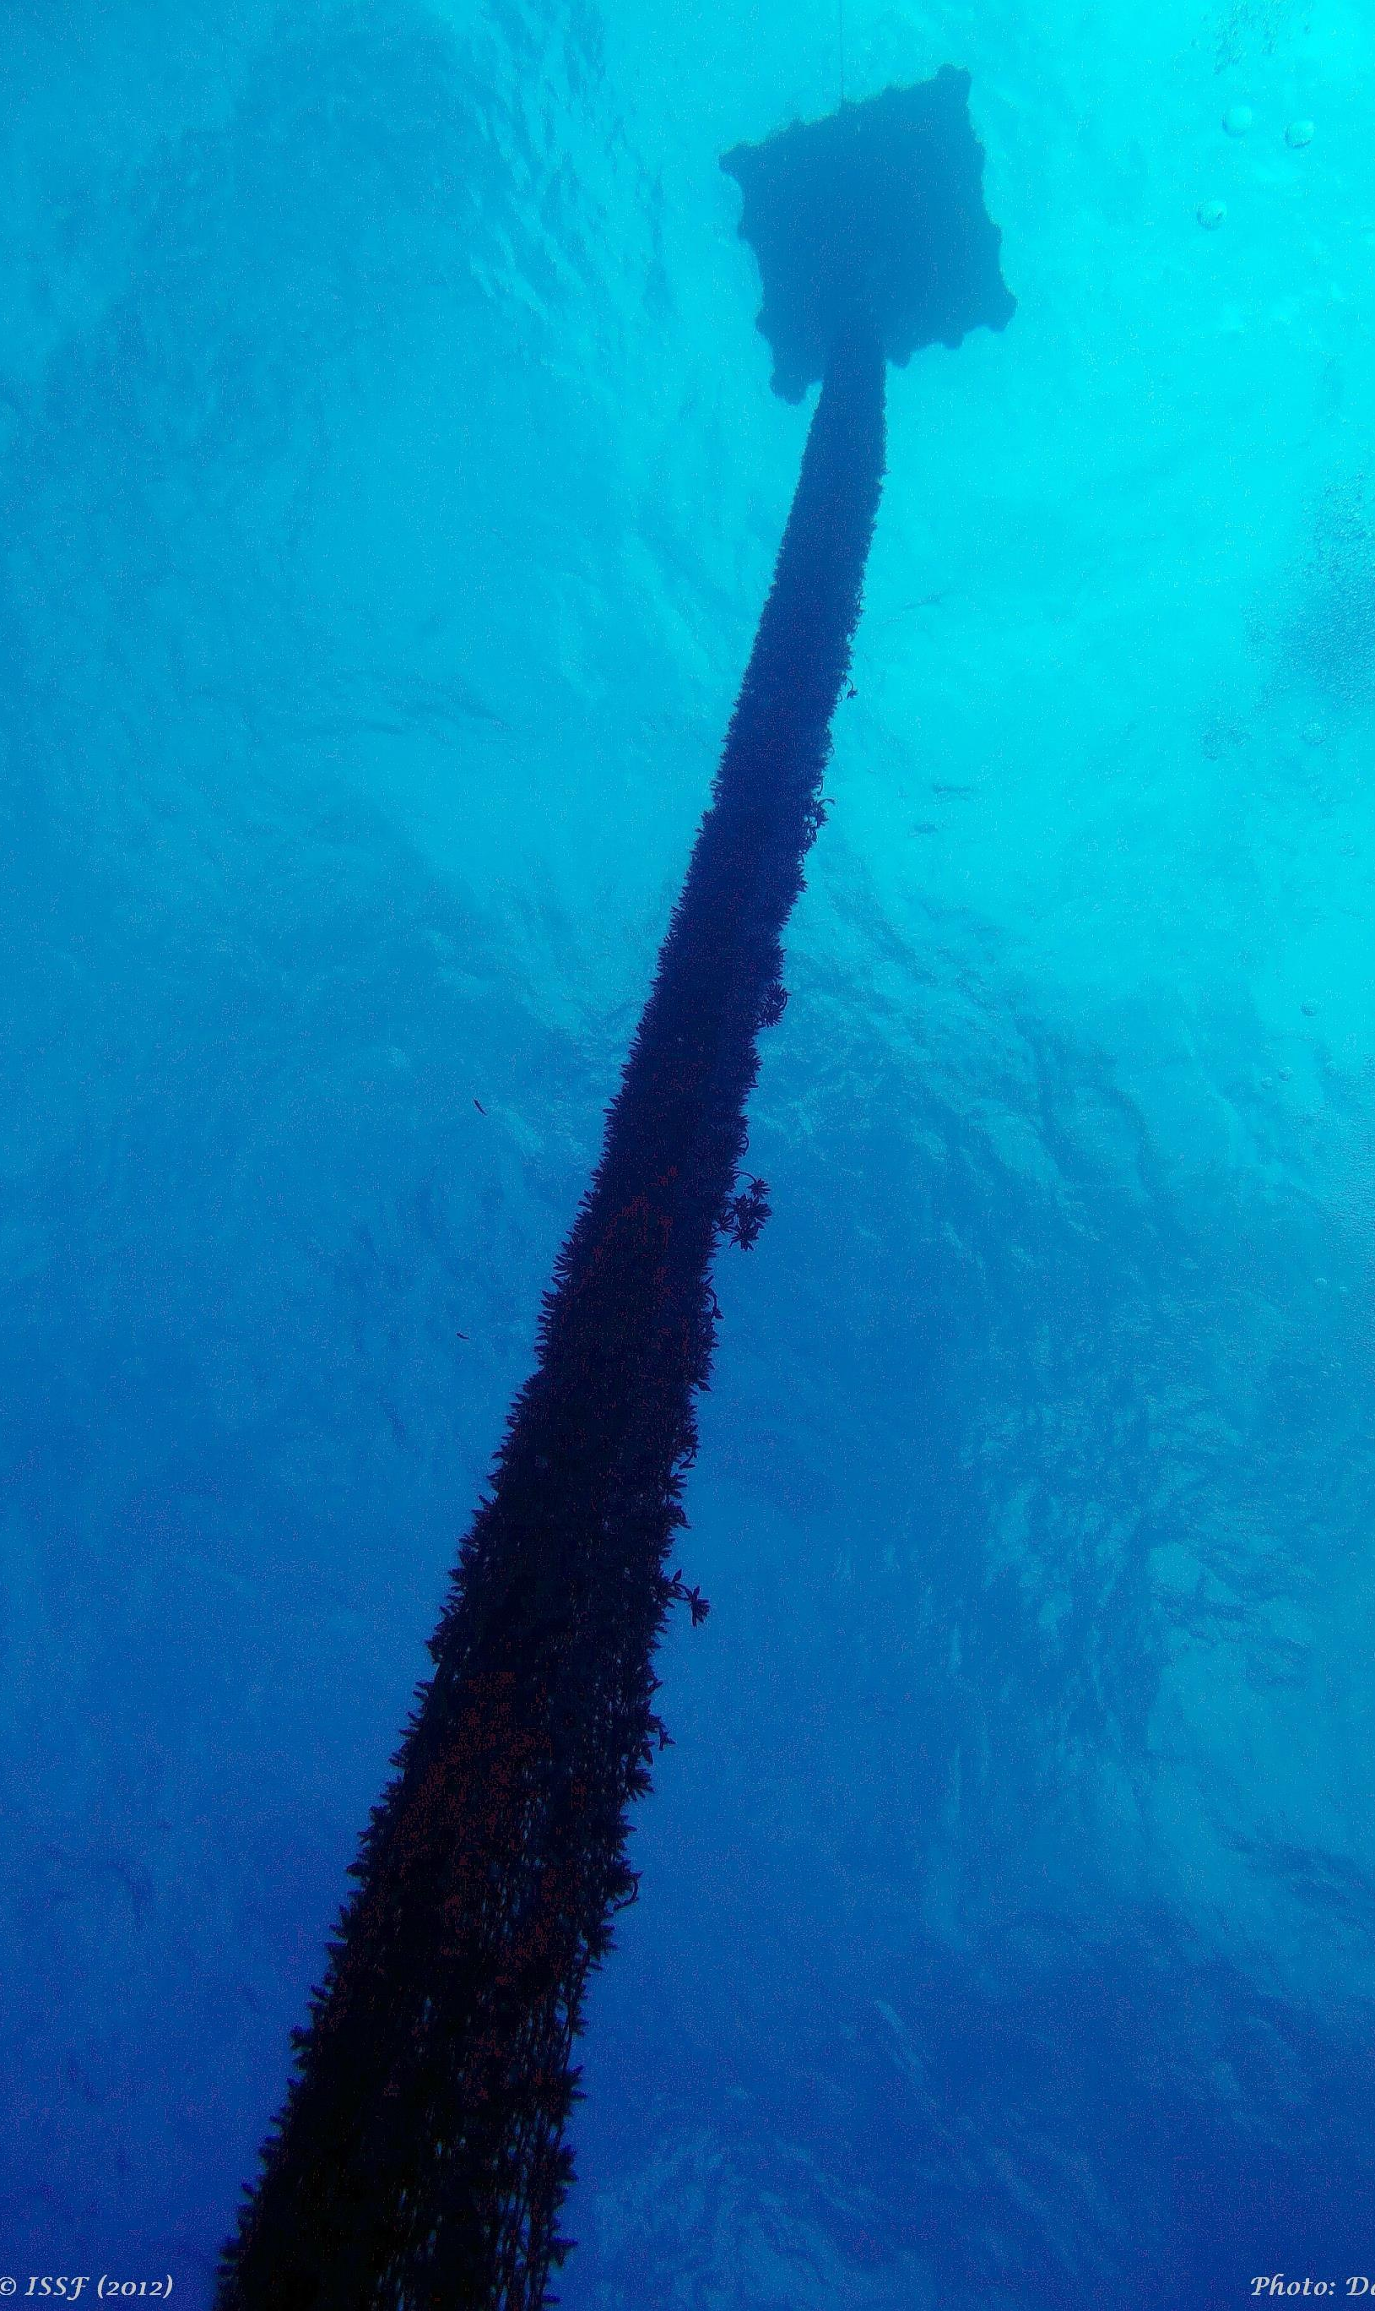
THANK YOU
SC20-EB-WP-04: Progress of the FADMO-IWG Priority Tasks for 2024

