Slide 1
WCNPO MLS Rebuilding Scenarios
Michelle Sculley, ISC BILLWG Chair

Slide 2
WCNPO MLS Rebuilding Scenarios - A history
2018:
NC14 requested the ISC BILLWG to provide rebuilding scenarios, which the WG provided with the 2019 stock assessment.
“NC14 agreed to request ISC to conduct projections examining rebuilding scenarios for North Pacific striped marlin that cover a range of rebuilding targets (20%SSBF=0, FMSY, and 0% to 50% reductions in increments of 10% from current catch limits), timelines (10, 15 and 20 years), and probabilities of each scenario to reach each target within different timelines.
ISC should produce additional scenarios of catch reduction if the probability of reaching the rebuilding target in 10, 15, and 20 years is not at least 60%.”
2019:
“Recognizing the need for additional scientific advice to refine a rebuilding strategy, NC15 requested that the ISC Billfish Working Group provide advice on which future recruitment scenario is the most likely one over the near term.”
WCPFC16 adopted Interim Rebuilding Plan for NP striped marlin
Rebuilding objective: The interim rebuilding target for North Pacific striped marlin is 20%SSBF=0, to be reached by 2034, with at least 60% probability. This rebuilding objective will be subject to further consideration and decision at WCPFC17, taking into account any additional scientific advice
2023:
ISC BILLWG produces a new stock assessment for WCNPO MLS. Due to time constraints, only simple deterministic projections were provided, but the WG agreed to update the requested projection scenarios to meet the adopted rebuilding plan requirements for 2024.
At its annual meeting in 2023, the WCPFC indicated it may consider changes to the CMM 2010-01 for WCNPO MLS.
2024:
ISC BILLWG completes the requested projections that meet the targets of the interim rebuilding plan.
The ISC24 Plenary agreed to provide a brief summary of these results to WCPFC SC as part of MLS discussion. In doing so, it needs to be clarified that ISC conservation information for MLS was maintained, that the additional projections are provided as supplementary information, which are stochastic projection results based on the 2023 stock assessment, and that the next MLS assessment results could change if the WG address the recommendations of the external peer review.

Slide 3
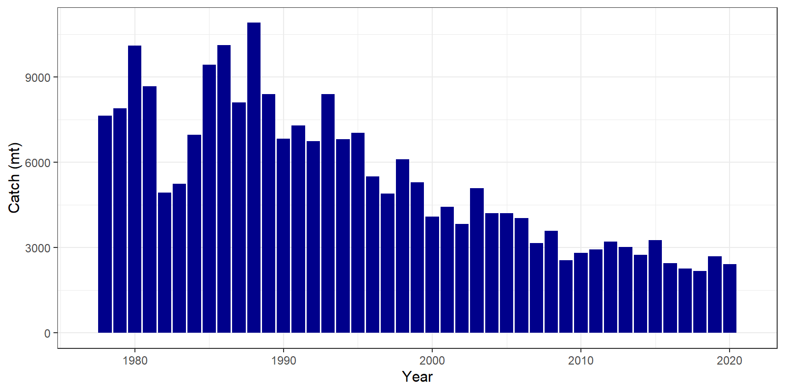
WCNPO MLS Rebuilding Scenarios
The WG used the projection software AGEPRO, an age-structured projection software to produce projections from the 2023 WCNPO MLS assessment for 2021-2034
Note that average catch in 2018-2020 was ~2,400 mt, and catch in general has been declining since the 1990s

Slide 4
WCNPO MLS Rebuilding Scenarios
Four F scenarios and six catch scenarios were run, of these all but two of the F scenarios meeting the rebuilding plan requirements
Scenarios had estimated catch or recent average F for 2021-2024, with management actions occurring beginning in 2025
Management actions could occur all at once or be phased in using either two or three time periods
Time periods coincide with next scheduled WCNPO Stock assessments: 2027 and 2032
Two catch scenarios included a retention limit for small MLS (<120EFL fish were discarded)
Two survivorship rates were considered
High - survivorship probability of 0.4
Low - survivorship probability of 0.2
3 Recruitment scenarios were used with weighting:
Long term (0.04) - based on the Stock Recruitment Curve
Medium term (0.84) - empirical distribution function using the recruitment from 2001-2020
Short term (0.12) - empirical distribution function using the recruitment from 2016-2020
Ran a comparison between SS3 projections and AGEPRO projections without recruitment variability to confirm consistency between the programs

Slide 5
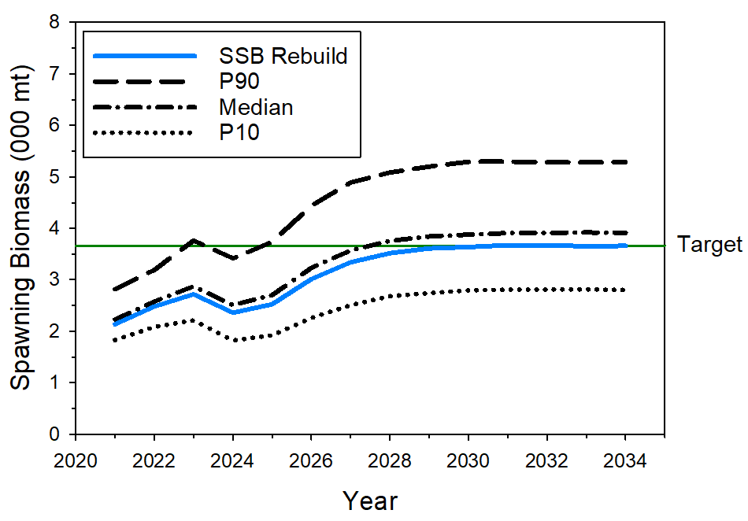
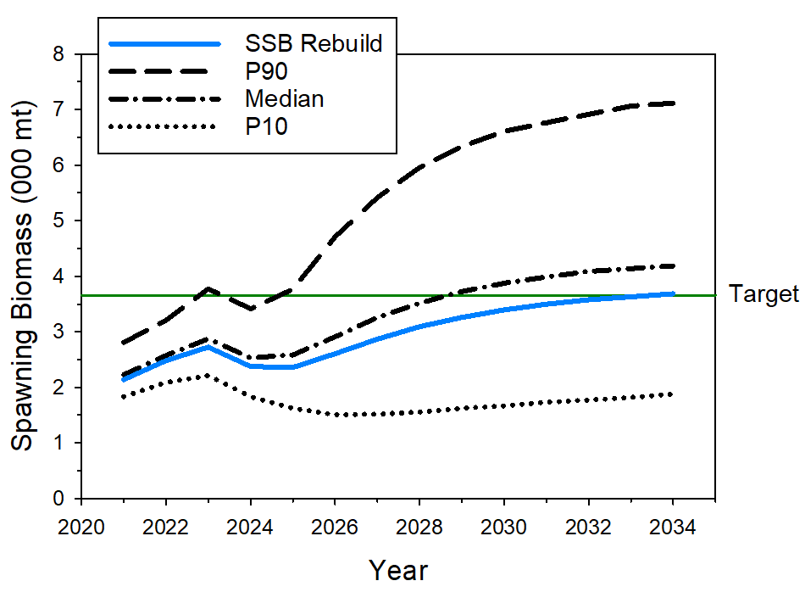
WCNPO MLS Rebuilding Scenarios
Scenario 1: F₂₀₂₅₋₂₀₃₄=0.373
Scenario 2: Catch₂₀₂₅₋₂₀₃₄= 2,175 mt

Slide 6
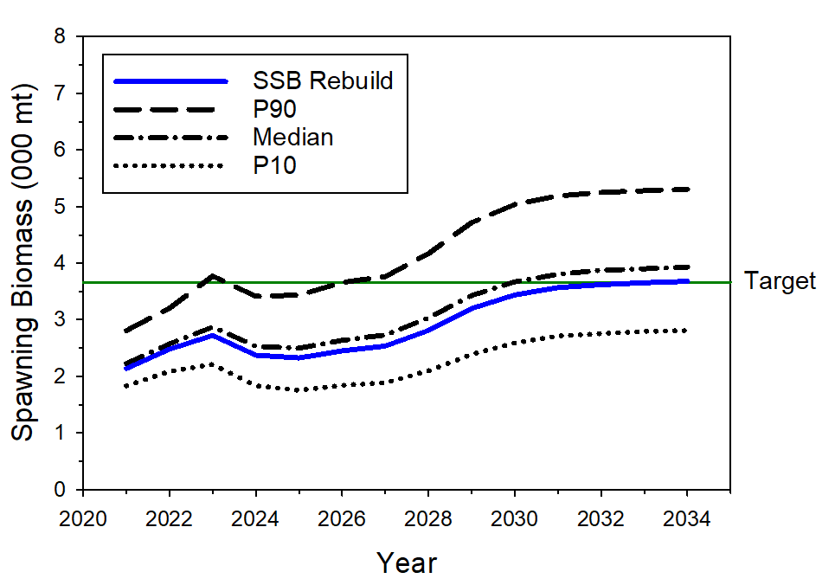
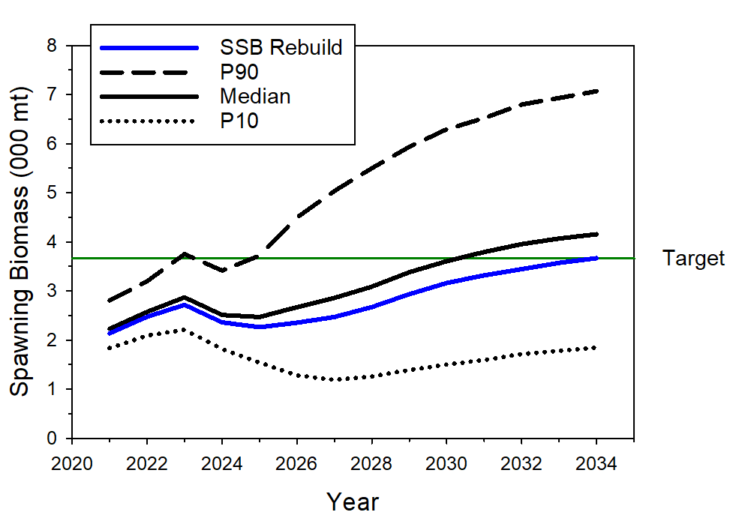
WCNPO MLS Rebuilding Scenarios
Scenario 3: F₂₀₂₅₋₂₀₂₇=0.55
F₂₀₂₈₋₂₀₃₄ = 0.37
Scenario 4: Catch₂₀₂₅₋₂₀₂₇= 2,400 mt
Catch₂₀₂₈₋₂₀₃₄= 2,150 mt

Slide 7
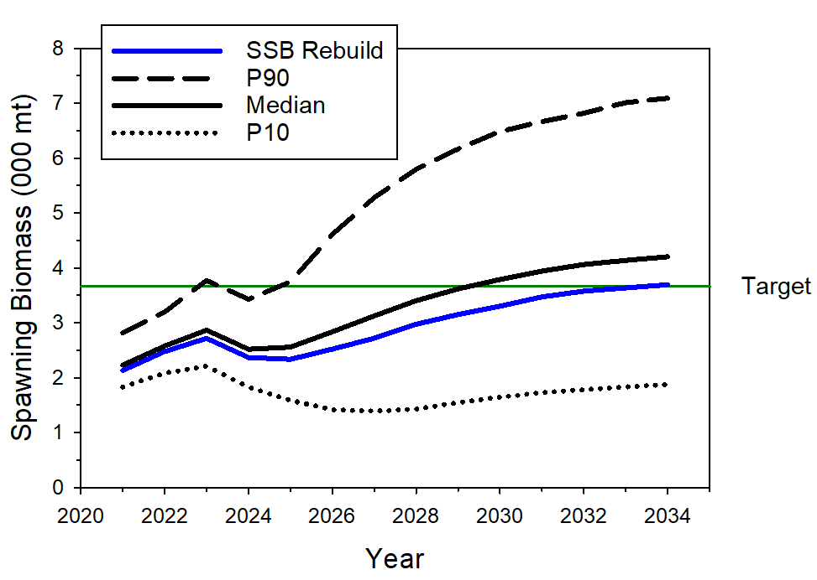
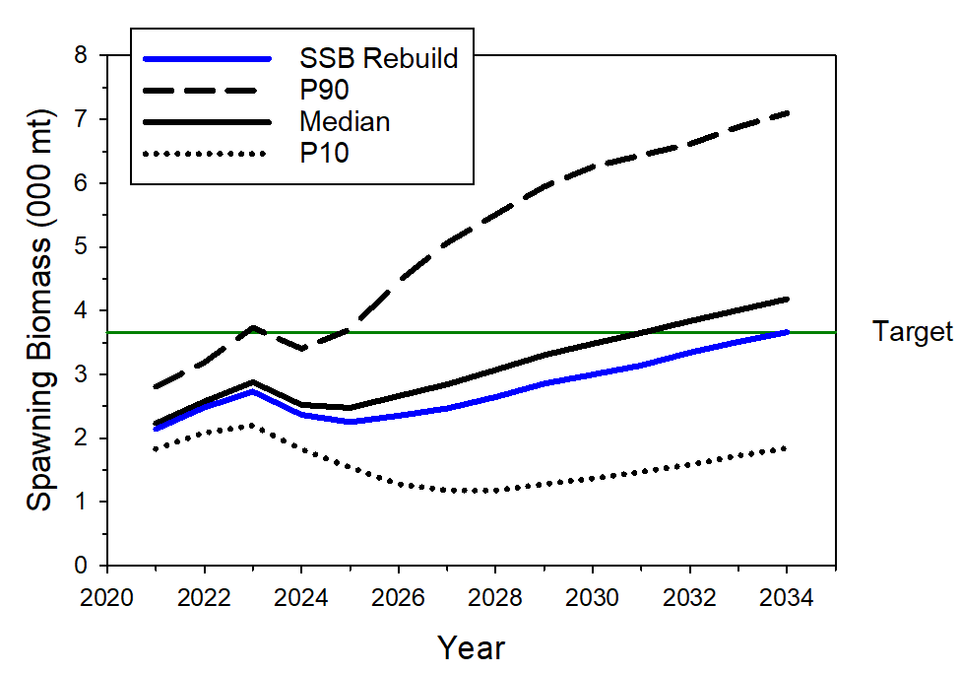
WCNPO MLS Rebuilding Scenarios
Scenario 5: Catch₂₀₂₅₋₂₀₂₇= 2,250 mt
Catch₂₀₂₈₋₂₀₃₄ = 2,175 mt
Scenario 6: Catch₂₀₂₅₋₂₀₂₇= 2,400 mt
Catch₂₀₂₈₋₂₀₃₂= 2,200 mt
Catch₂₀₃₃₋₂₀₃₄ = 2,100 mt

Slide 8
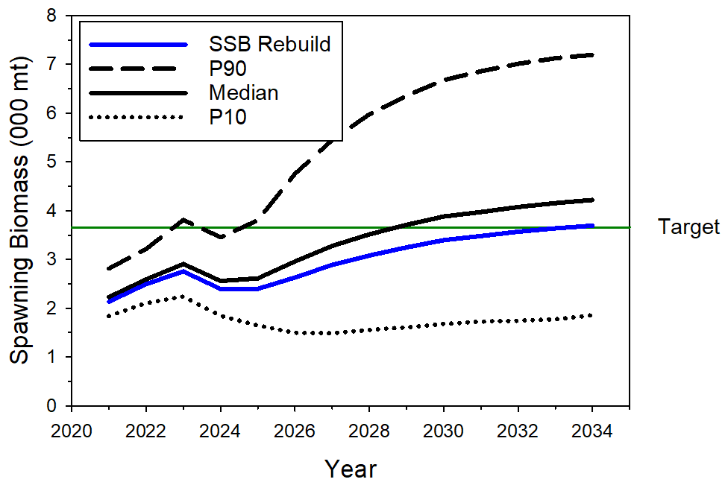
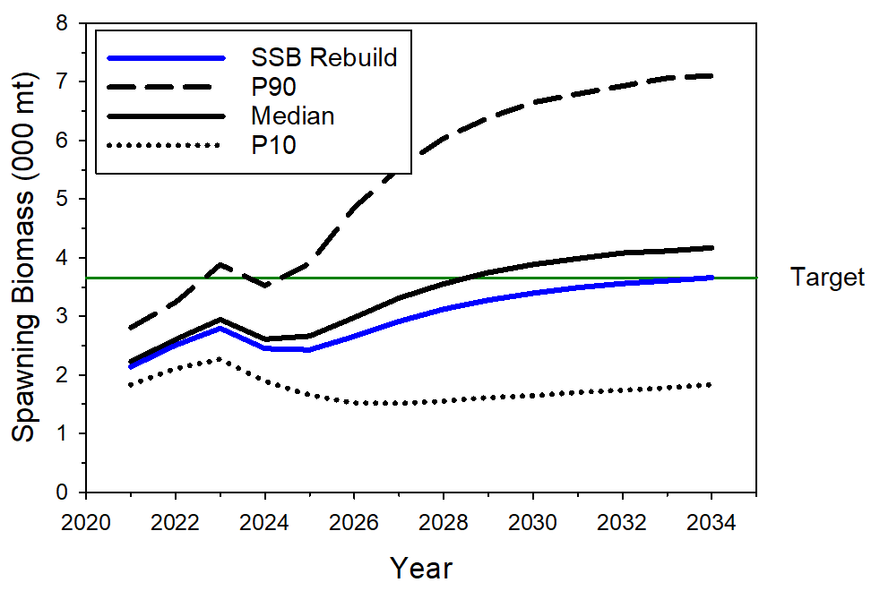
WCNPO MLS Rebuilding Scenarios
Scenario 7: Catch₂₀₂₅₋₂₀₃₄= 2,180 mt
Release fish <120 EFL with 0.2 probability of survival
Scenario 8: Catch₂₀₂₅₋₂₀₃₄= 2,185 mt
Release fish <120 EFL with 0.4 probability of survival

Slide 9
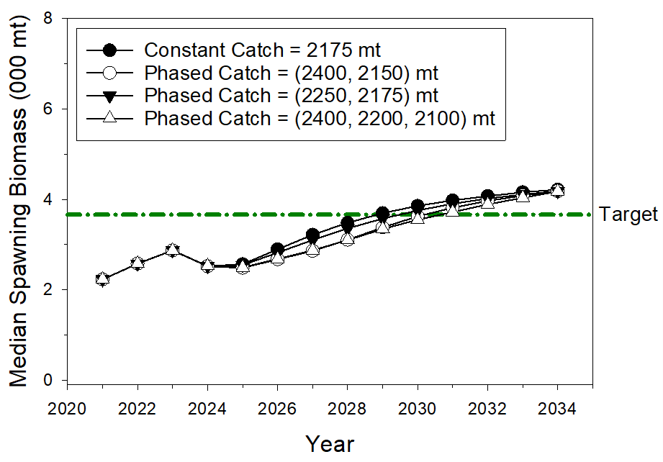
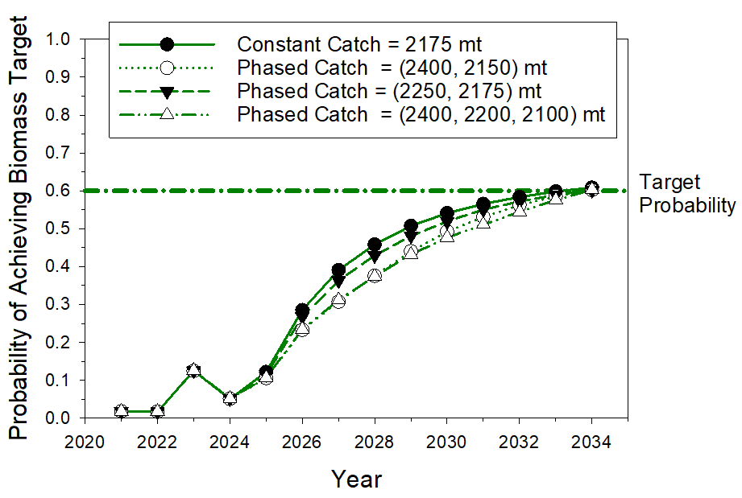
WCNPO MLS Rebuilding Scenarios

Slide 10
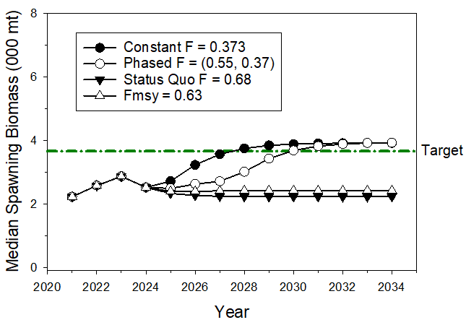
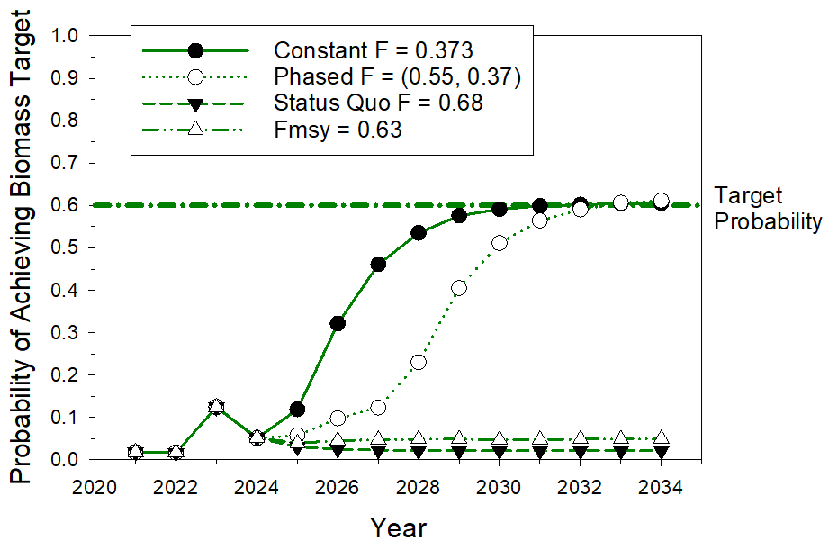
WCNPO MLS Rebuilding Scenarios

Slide 11
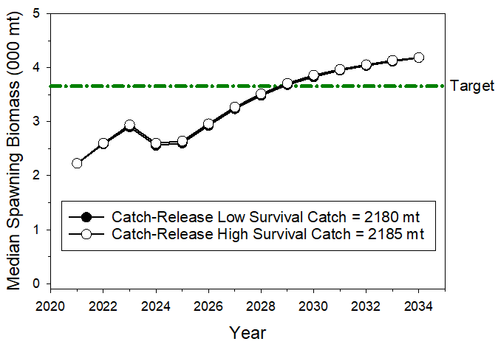
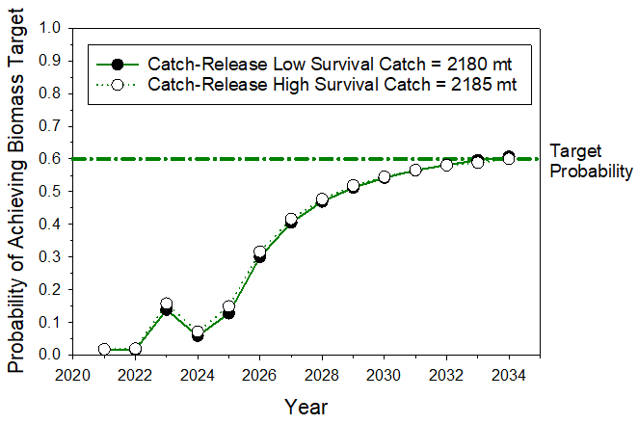
WCNPO MLS Rebuilding Scenarios

Slide 12
WCNPO MLS Rebuilding Scenarios
F_{status quo} (average F 2018-2020) and F_{MSY} runs do not meet the rebuilding plan requirements
More details available in the WG report (ISC/24/Annex/09) and ISC/24/BILLWG-01/03 working paper
Projections for each individual recruitment scenario are also available in the working paper

Slide 13
WCNPO MLS Stock Status and Conservation Information
The following information on the status of the WCNPO MLS stock is provided by the ISC24 Plenary:
1. When the status of WCNPO MLS is evaluated relative to dynamic 20%SSB_{F=0} based reference points, the 2020 spawning stock biomass of 1,696 t is 54% below 20%SSB_{F=0} (3,660 t) and the 2018-2020 fishing mortality is about 28% above F_{20%SSBF=0}; and
2. Therefore, relative to 20%SSB_{F=0} based reference points, the WCNPO MLS stock is very likely to be overfished (>99% probability) and is likely to be subject to overfishing (>66% probability).
The following information on the conservation of the WCNPO MLS stock is provided by the ISC24 Plenary:
1. It is recommended that catch should be kept at or below the recent level (2018-2020 average catch = 2,428 t); and
2. The results of deterministic projection show that when catches are 2,400 t, or less, the stock is expected to recover above SSB_{MSY} and near the 20% SSB_{F=0} reference level by 2040, or sooner at the lower catch levels under a low recruitment regime (3,660 t).

