Slide 1
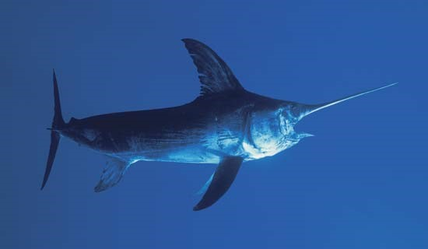
North Pacific Swordfish
2023 Benchmark Stock Assessment
Dr. Michelle Sculley, BILLWG Chair

Slide 2
Overview
  Review of the 2018 Benchmark Stock Assessment
  2023 Assessment Data and Model
    NP Swordfish Life History Information
    Fishery Definitions and Selectivity Modeling
    Catch, Standardized CPUE, and Size Composition Data
    Likelihood Components and Data Weighting
    Model Diagnostics
  2023 Assessment Results
    Stock Status
    Sensitivity Runs
    Stock Projections

Slide 3
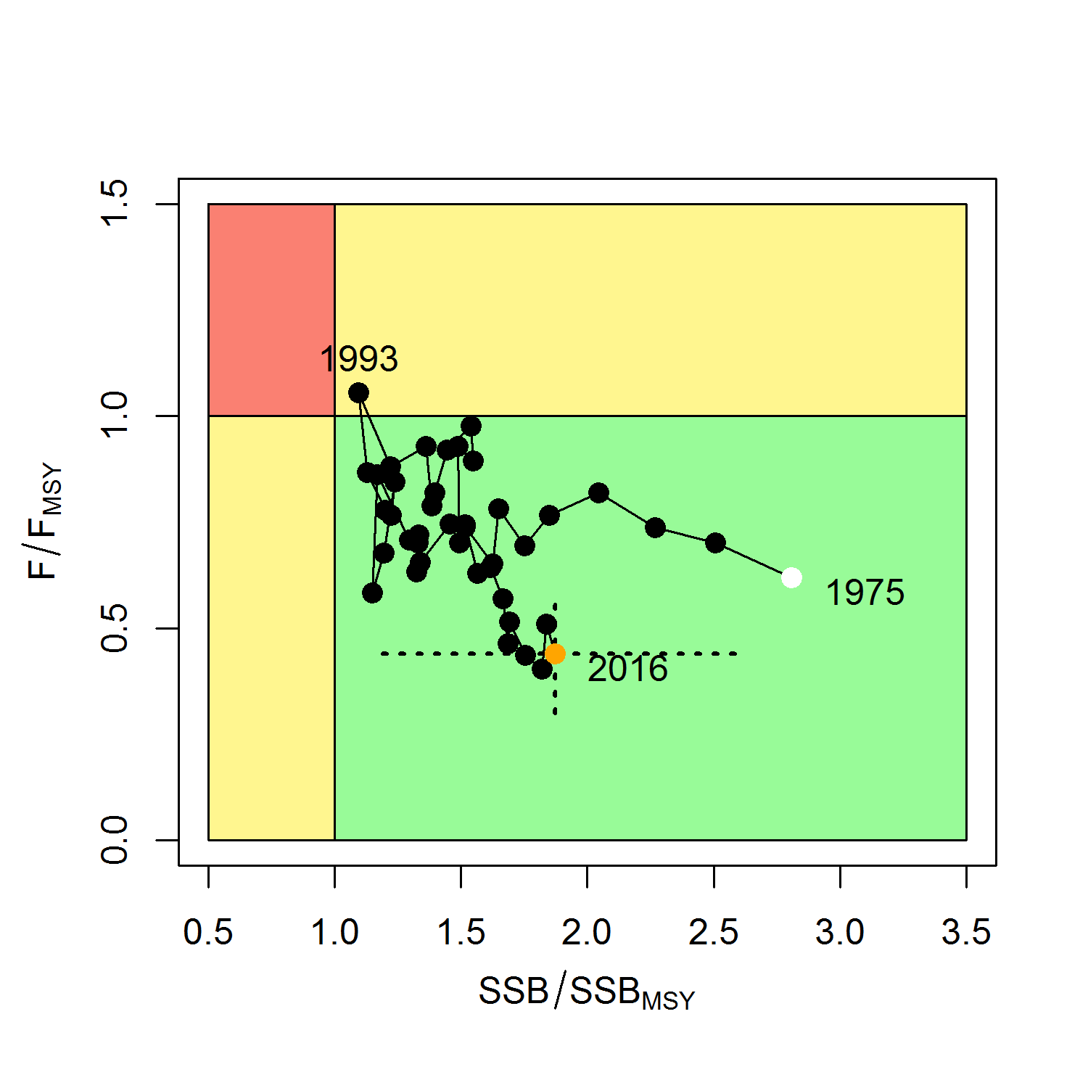
    Overview of the 2018 Stock Assessment
2018 Stock Assessment Summary
  Stock Synthesis 3.30 model (ISC 2018)
  SSB₂₀₁₆ = 29,403 mt (87% above SSB_{MSY})
  F₂₀₁₄₋₂₀₁₆ = 0.08 (47% below F_{MSY})
  NP SWO was not experiencing overfishing and was not overfished relative to MSY-based reference points

Slide 4
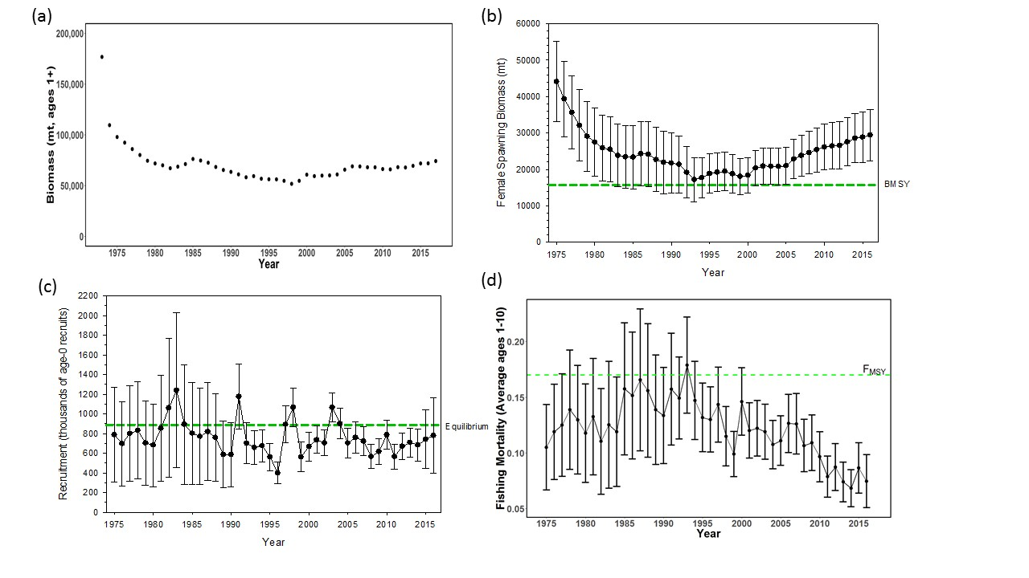
NP Swordfish Stock Status in 2018

Slide 5
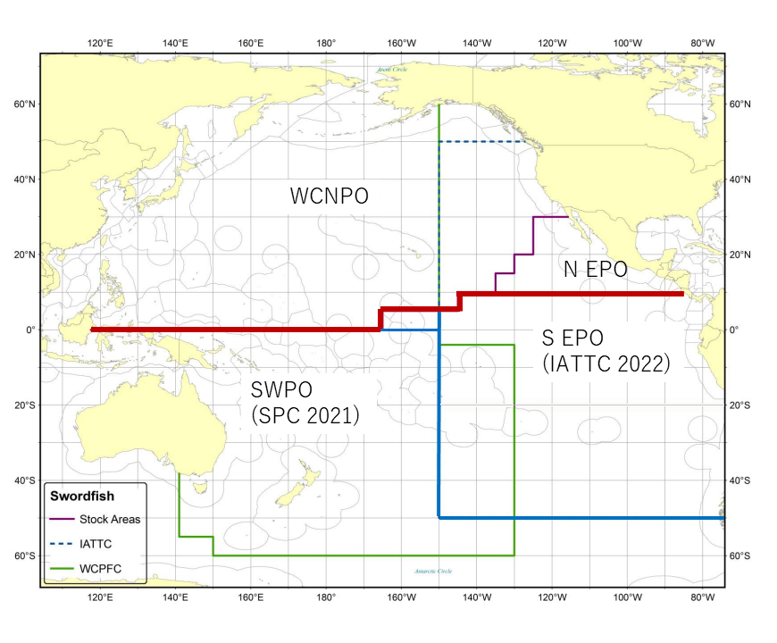
2023 NP SWO Modeling Changes
Stock structure is expanded to include the N EPO “triangle”
  Using fleets-as-areas to account for stock structure
Fleet structure is consistent with 2018 assessment
Biological information is unchanged from 2018
2018 assessment

Slide 6
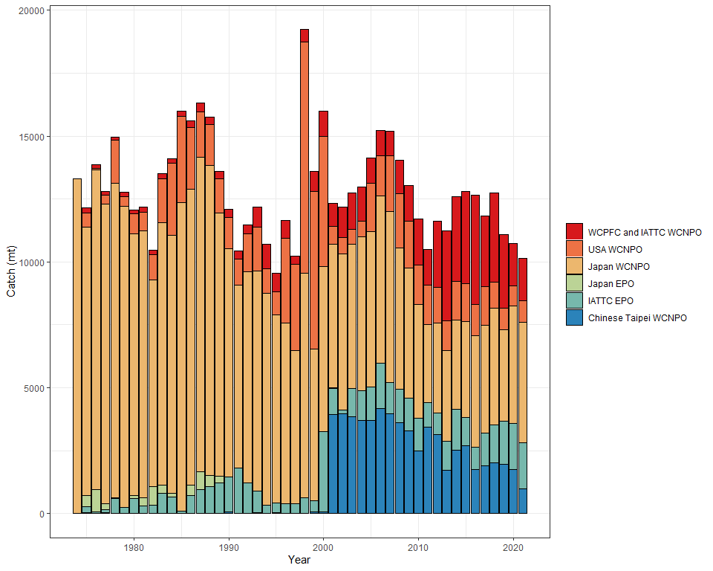
WCNPO Swordfish Catch by ISC Country

Slide 7
Modeling approach
2023 benchmark assessment used the Stock Synthesis 3.30 assessment model in a maximum likelihood estimation framework with some parameter constraints for fishery selectivity parameters
The assessment covers almost the entire North Pacific, using a fleets-as-areas approach to account for the WCNPO and N EPO regions.
The N EPO region only contributed about ~10% of the total catch on average over the last 20 years
Stock projections were conducted for 2022-2031 using the deterministic forecasts through SS with 100 bootstraps for each scenario using the stock-recruitment curve.

Slide 8
NP Swordfish Benchmark Stock Assessment
Stock Status and Conservation Information

Slide 9
NP Swordfish Reference Points
WCPFC16 established a limit reference point for the exploitation rate of North Pacific Swordfish of F_{MSY}
SSB_{F=0} was set to equal the average of the last 5 years dynamic B0 if fishing ceased after that year.
NP swordfish reference points will be provided with reference to MSY and with reference to 20%SSB_{F=0}

Slide 10
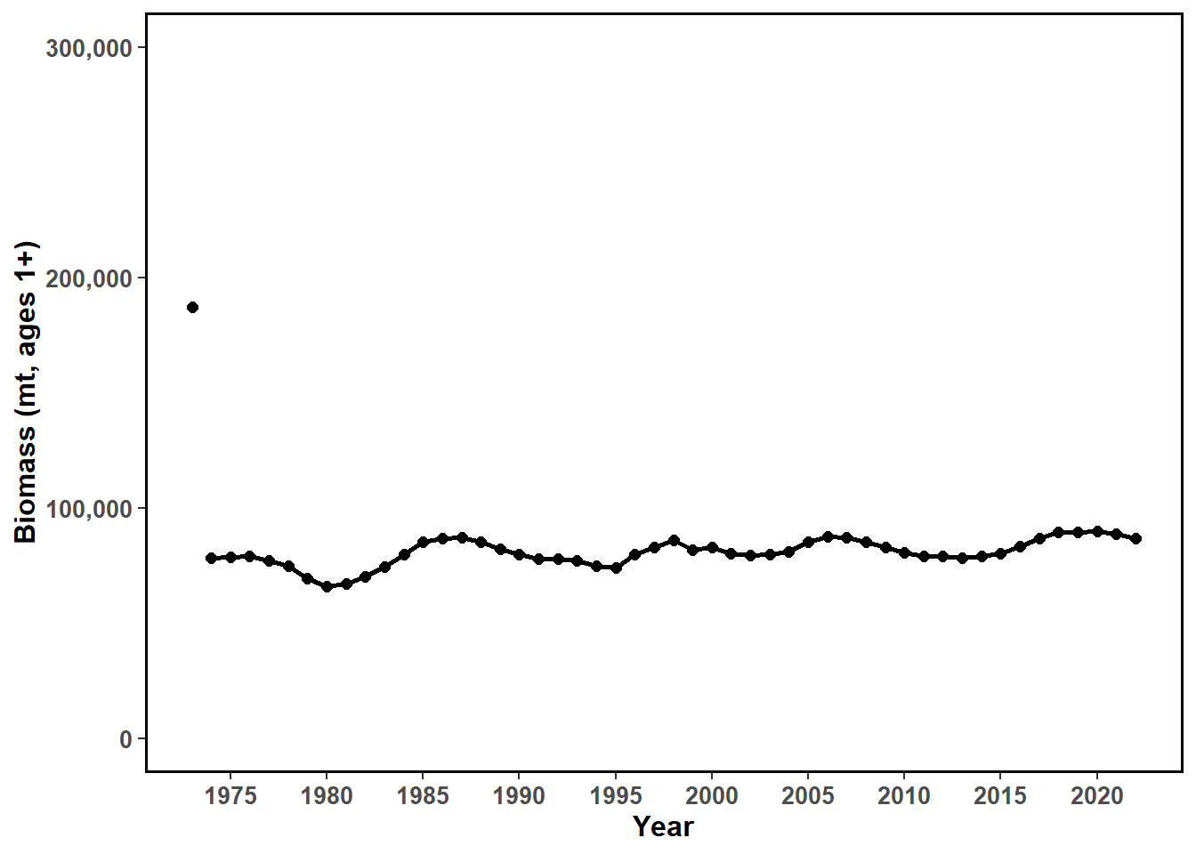
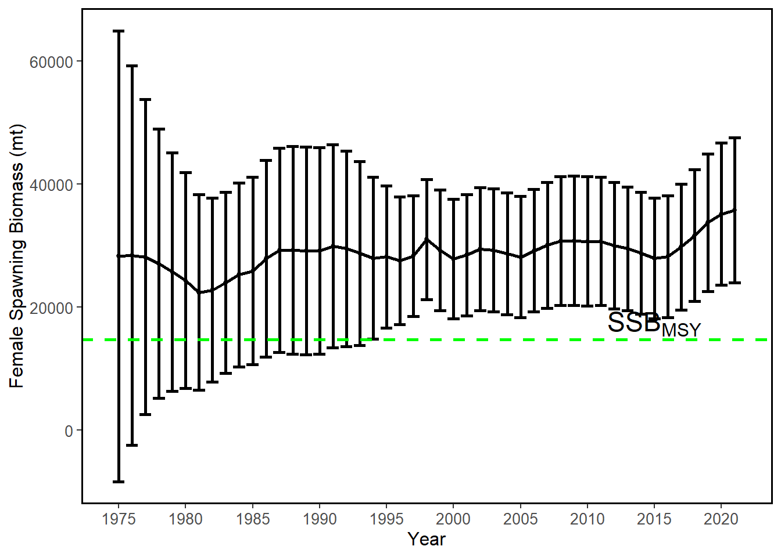
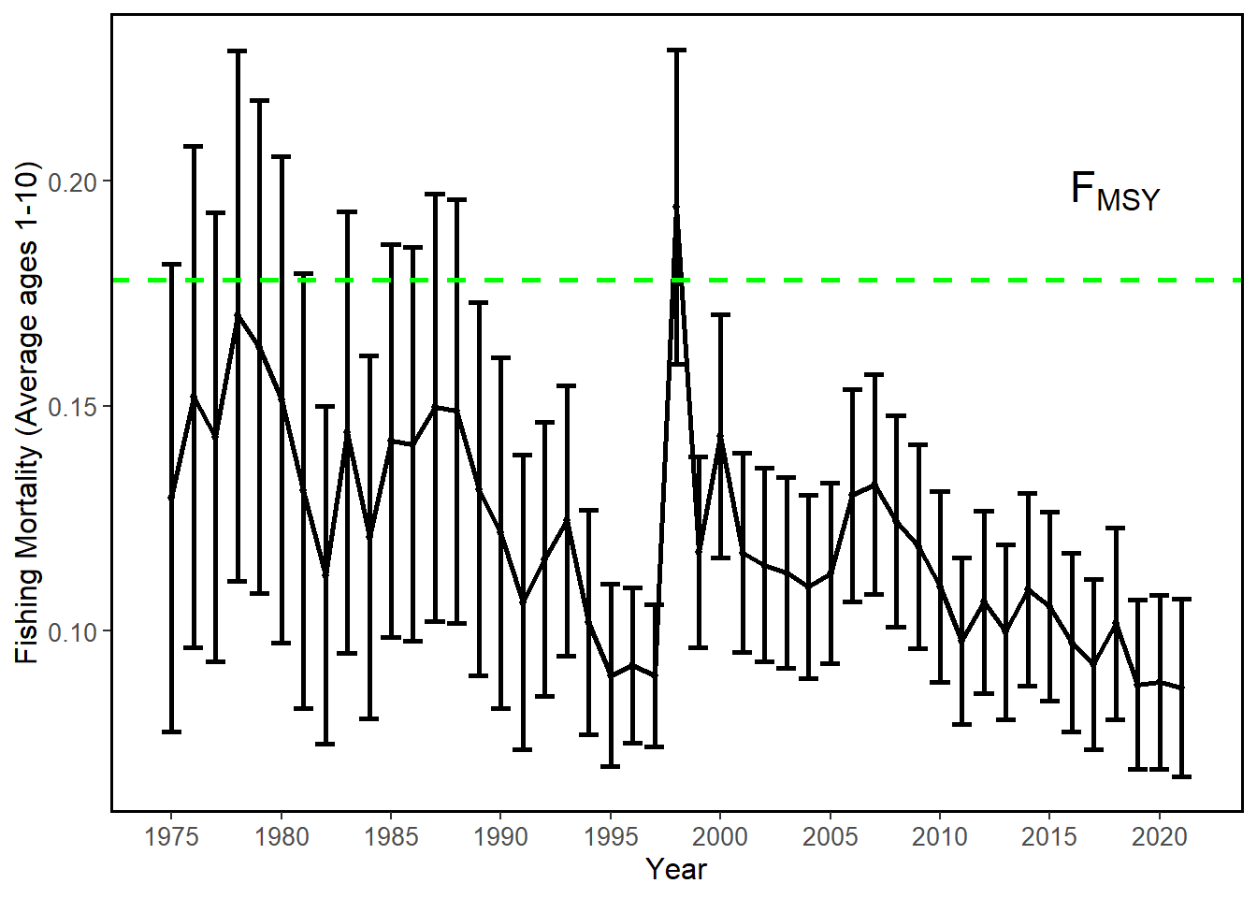
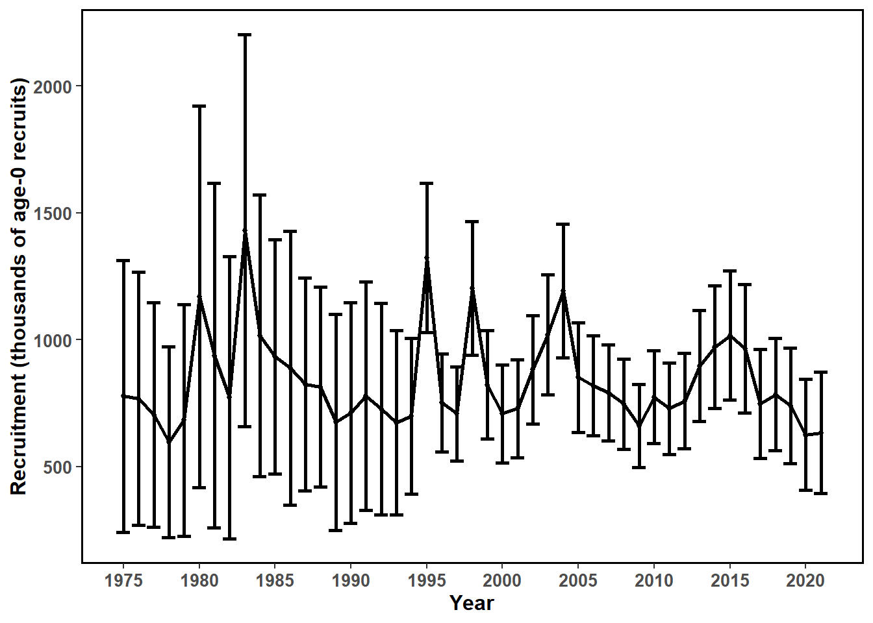

Slide 11
NP Swordfish Spawning Biomass
Estimates of female spawning stock biomass have been flat to increasing since 1975, with a slight increase in the last five years.
Current SSB is above 20%SSB_{F=0}- and MSY-based reference levels

Slide 12
Information on Stock Status
Female spawning stock biomass was estimated to be 35,778 mt in 2021, with a relative SSB/SSB_{MSY} = 2.18.
Estimated F (arithmetic average of F for ages 1 – 10) averaged roughly F=0.09 during 2019-2021, with a relative fishing mortality of F/F_{MSY} = 0.49 in 2021.
Relative to MSY-based reference points, overfishing is very likely not occurring (>99% probability) and the NP SWO stock is very likely not overfished (>99% probability)

Slide 13
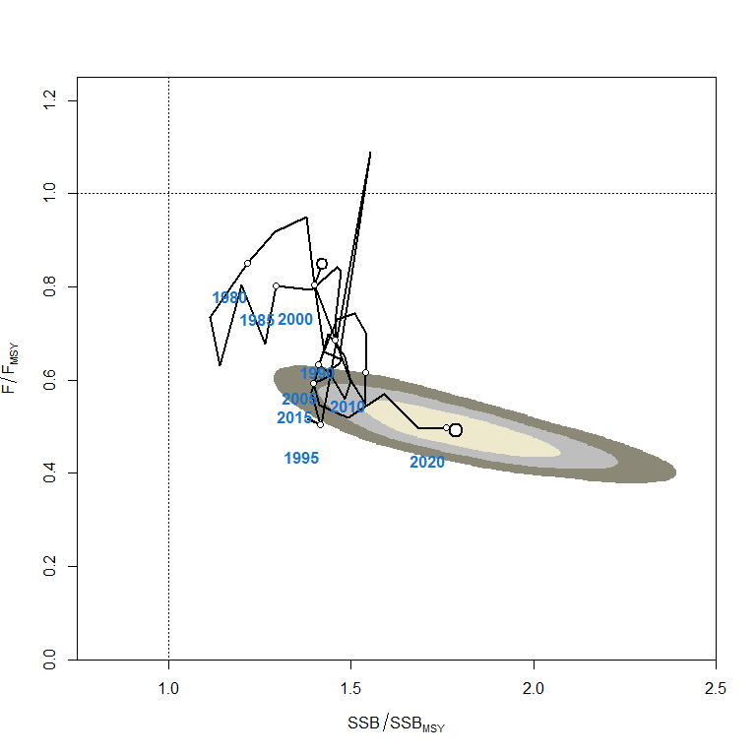
Reference Point | Estimate
F_{20%SSB(F=0)} (age 1-10)* | 0.16
F_{MSY} (age 1-10) | 0.18
F₂₀₂₁ | 0.09
F₂₀₁₉₋₂₀₂₁ | 0.09
SSB_{F=0}* | 95,732 mt
20%SSB_{F=0}* | 19,146 mt
SSB_{MSY} | 16,388 mt
SSB₂₀₂₁ | 35,778 mt
SSB₂₀₁₉₋₂₀₂₁ | 34,899 mt
C_{20%SSB(F=0)}* | 14,815 mt
C_{MSY} | 14,924 mt
C₂₀₁₉₋₂₀₂₁ | 10,653 mt
SPR_{20%SSB(F=0)}* | 22%
SPR_{MSY} | 19%
SPR₂₀₂₁ | 44%
SPR₂₀₁₉₋₂₀₂₁ | 43%
*20%SSB_{(F=0)} values based upon the average of the last 5 years dynamic B₀ (2017-2021)

Slide 14
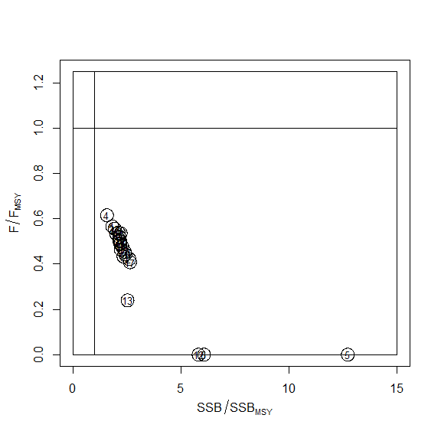
Sensitivity Runs Kobe Plot
Sensitivity runs on:
Natural Mortality
Steepness
Growth
Maturity
Catch
Model configuration
CPUE
Size Data
Notes:
19 Sensitivity runs

Slide 15
NP Swordfish Stock Projections
    Five future harvest scenarios were analyzed:
      F Low Scenario with F = F_{SPR30%}
      F CMM 2022-02 Scenario with F = F₂₀₀₈₋₂₀₁₀
      F Status Quo Scenario with F = F₂₀₁₉₋₂₀₂₁
      F at MSY Scenario with F = F_{MSY}
      F needed to reach 20%SSB_{F=0} with F =F_{20%SSBF=0}
    Recruitment based upon the stock-recruitment curve, based upon 100 bootstrap model runs

Slide 16
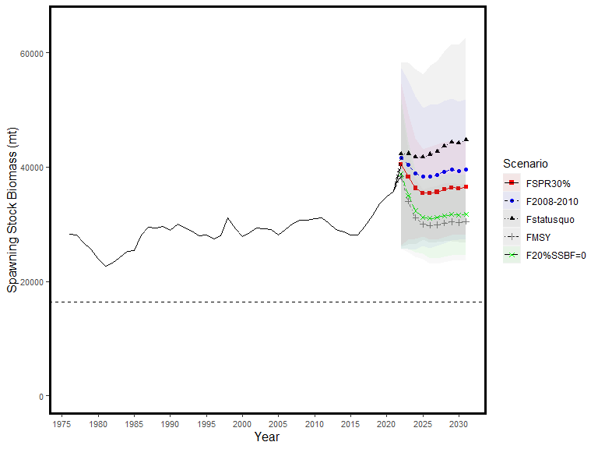
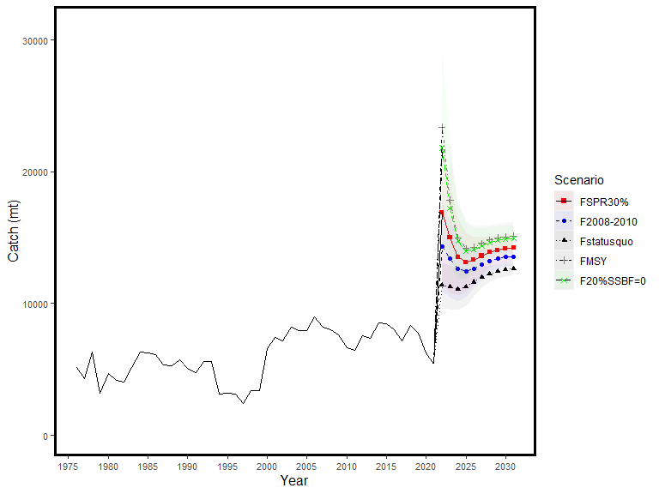
Projections
SSB_{MSY}

Slide 17
Conservation Information
The NP SWO stock has produced annual yields of around 11,500 mt per year since 2016, or about 2/3 of the MSY catch amount.
Swordfish stock status is positive with no evidence of excess F above F_{MSY} or substantial depletion of spawning potential.
It was also noted that retrospective analyses show that the assessment model appears to underestimate spawning potential in recent years.

Slide 18
ISC BILLWG response to NC18
In response to a request from the WCPFC Northern committee, the BILLWG used WCPFC and IATTC public domain data and yearbooks to compile catch and effort north and south of 20°N through 2020.
Much of the swordfish catch is from longlines, and only longline data are available for effort.
A large proportion of the effort south of 20°N includes Vietnam and Indonesia.
  The longline effort for Indonesia and Vietnam has been estimated because the logbook coverage for these fleets is believed to have variable coverage over time.
Recently, catches of longline fishery in the 0°-10°N area of the eastern Pacific have increased.
The gillnet fishing conducted in the waters around Vietnam is also responsible for the increase in catch south of 20°N.

Slide 19
ISC BILLWG response to NC18
catch
Catch and effort from 2021 is not included as it is preliminary

Slide 20


Slide 21
Data Observation Model
Abundance Indices
Lognormal observation errors for abundance indices
log(SE) = sqrt(log(1+CV²)) for the individual CPUE standardizations
Values of log(SE) < 0.20 were rescaled to set log(SE) = 0.20
Size Composition Data
Multinomial observation errors for size composition data
Size compositions with fewer than 15 individuals measured were removed
Effective sample size was number of fish measured/10, with all year/quarters greater than 50 set to 50.

Slide 22
Estimation of Recruitment Deviations
From Stock-Recruitment Curve
Recruitment was estimated during 1977-2020 (with bias adjustment) and used the expected recruitment value from the estimated stock-recruitment curve for 2020
Recruitment variability (σ_{R}, the standard deviation of log-recruitment) was fixed at σ_{R} = 0.6. Rescaling σ_{R} was not suggested by the model outputs.

Slide 23
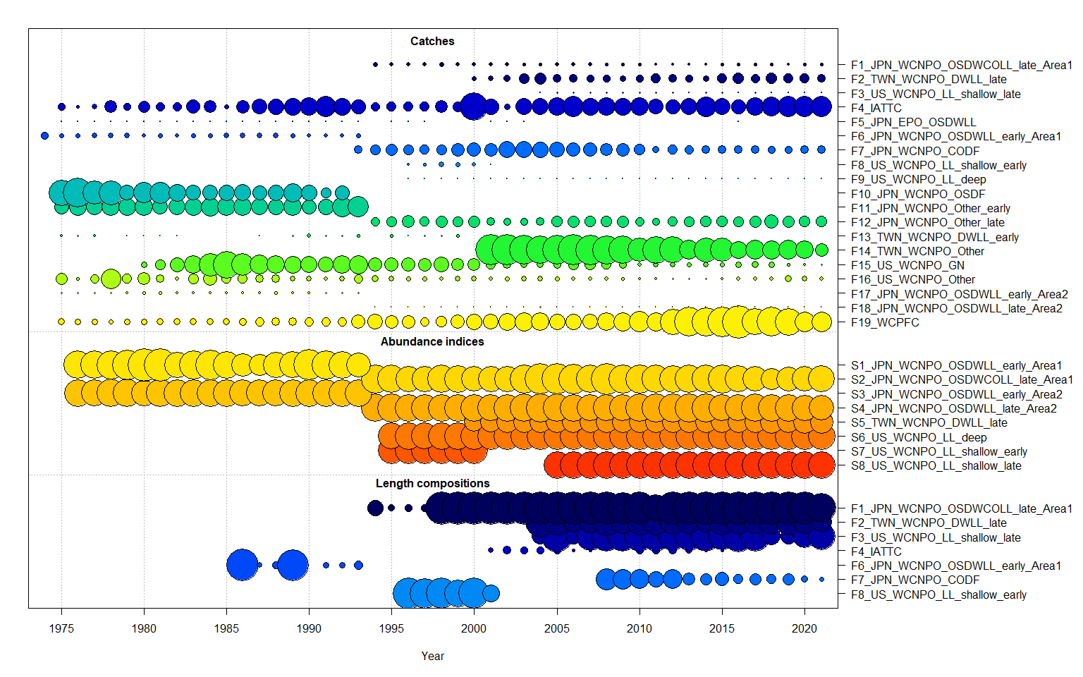
Fleet Structure

Slide 24
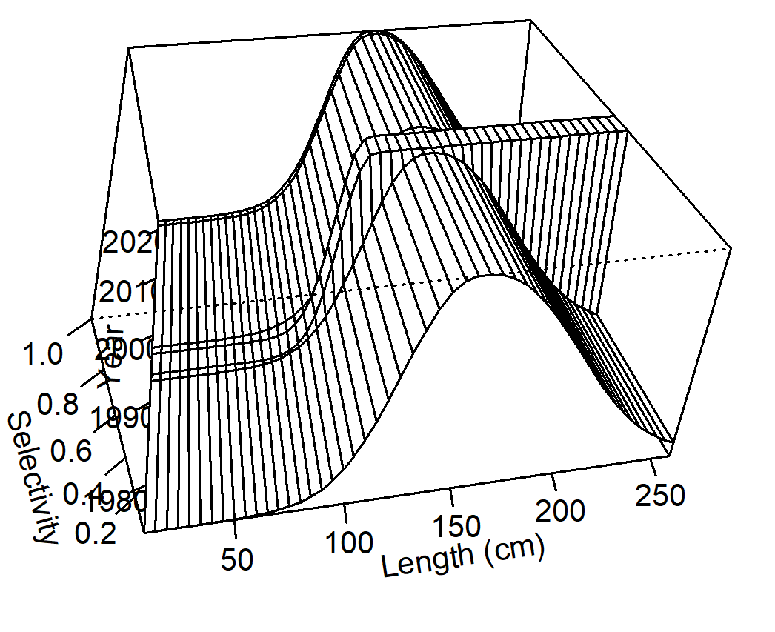
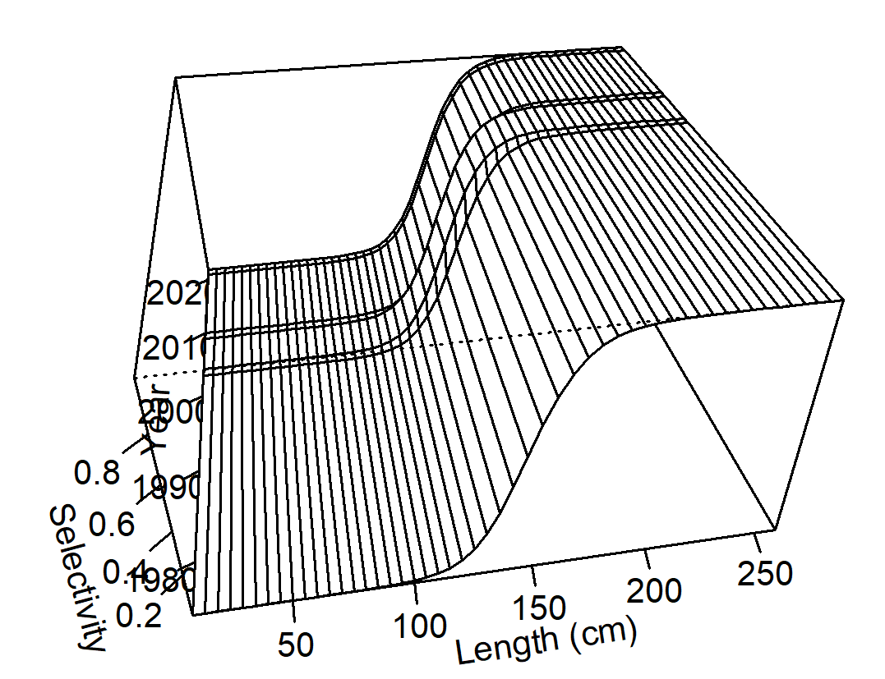
Time-varying Selectivity
F01 Japanese LL Area 1 Late
F02 Chinese Taipei LL late

Slide 25
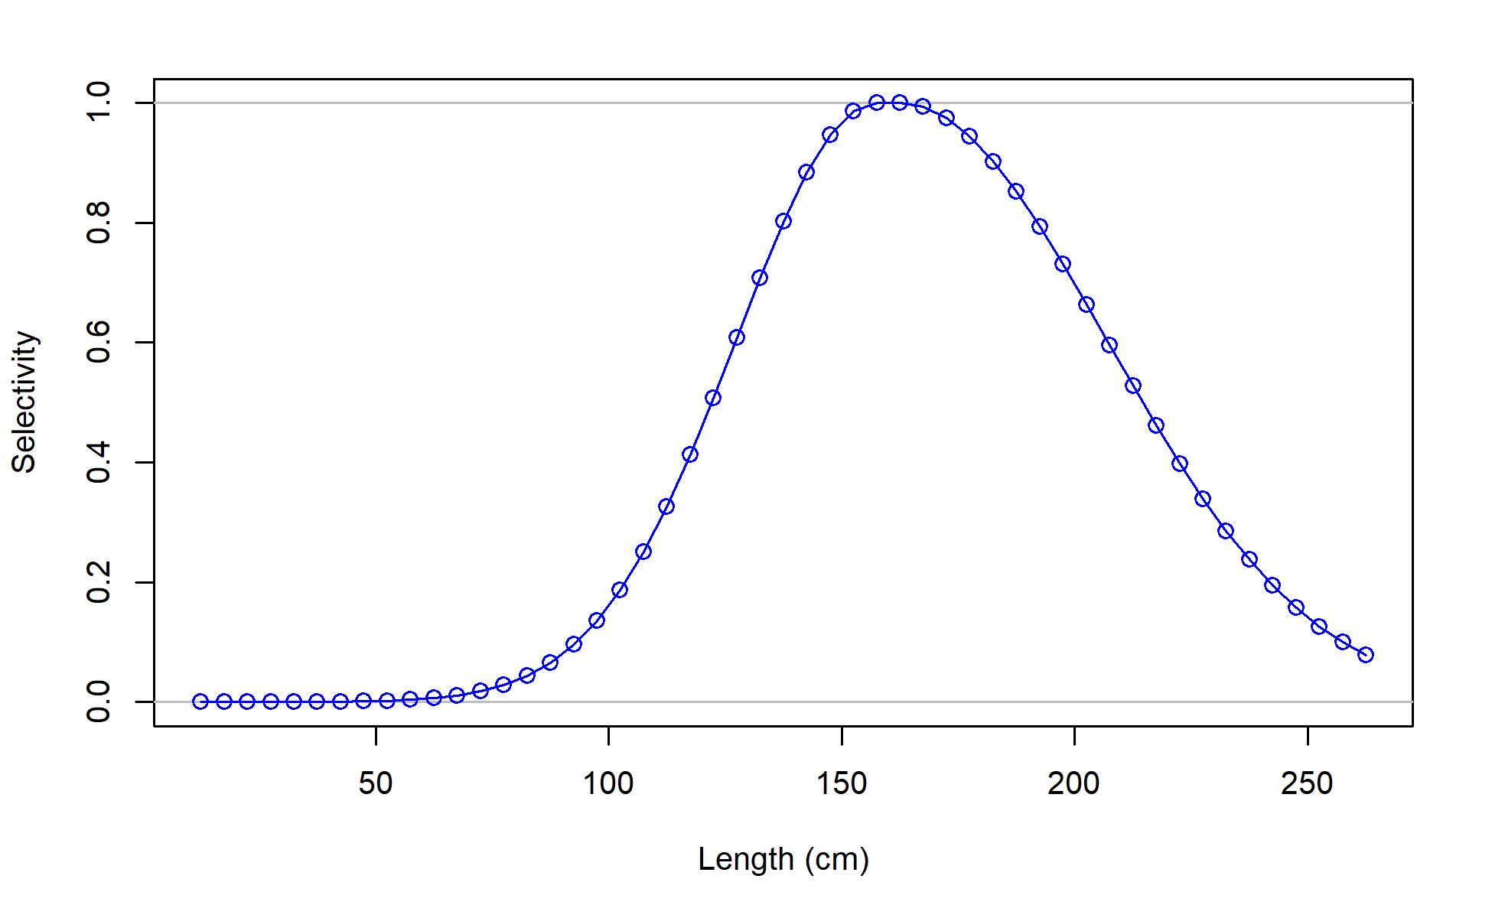
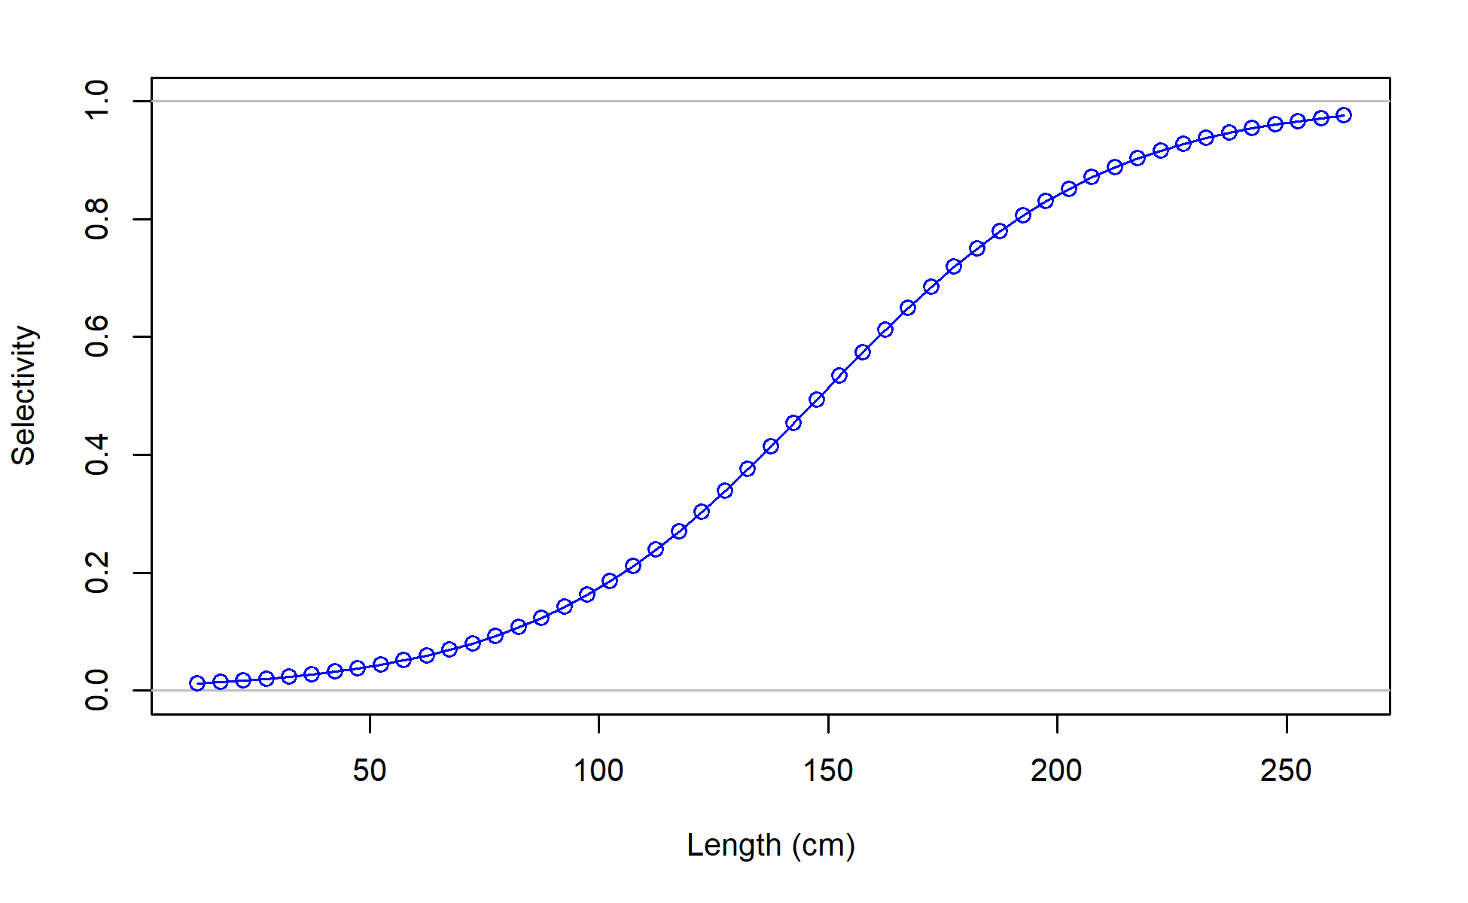
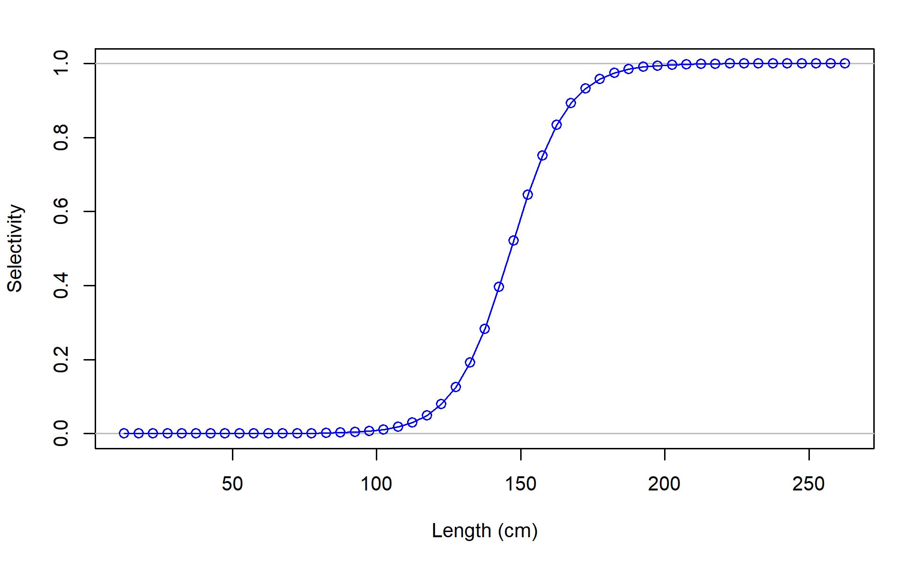
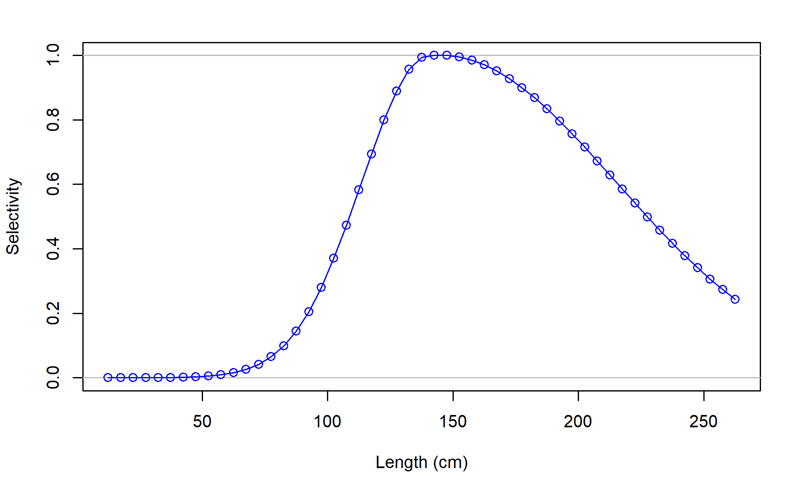
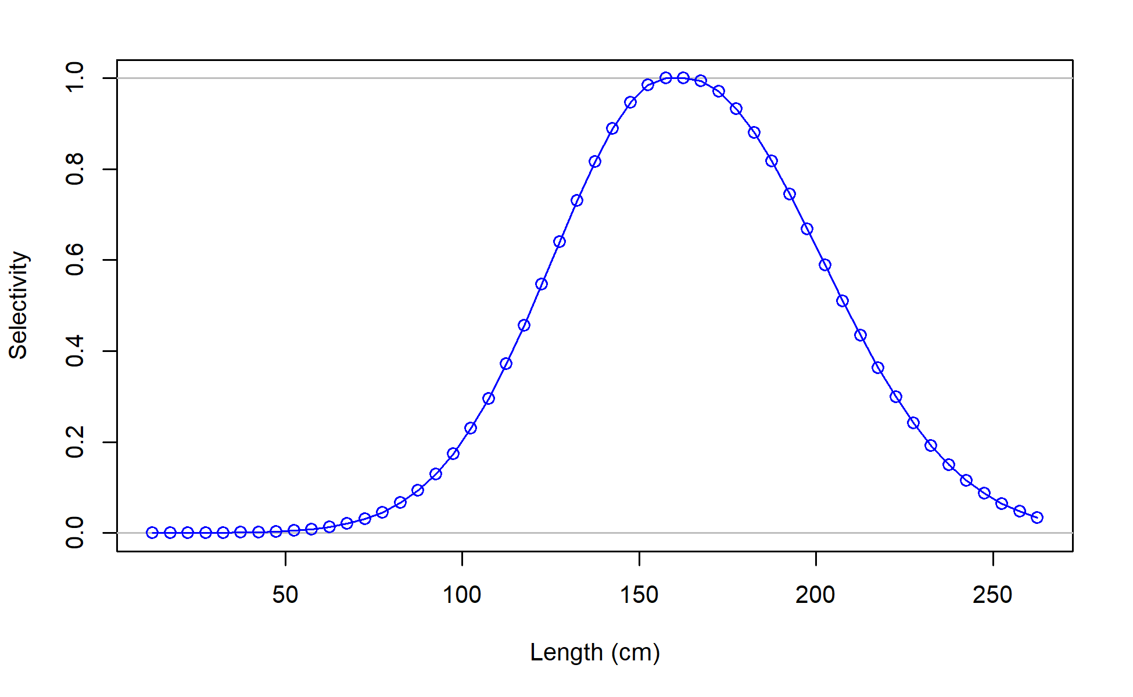
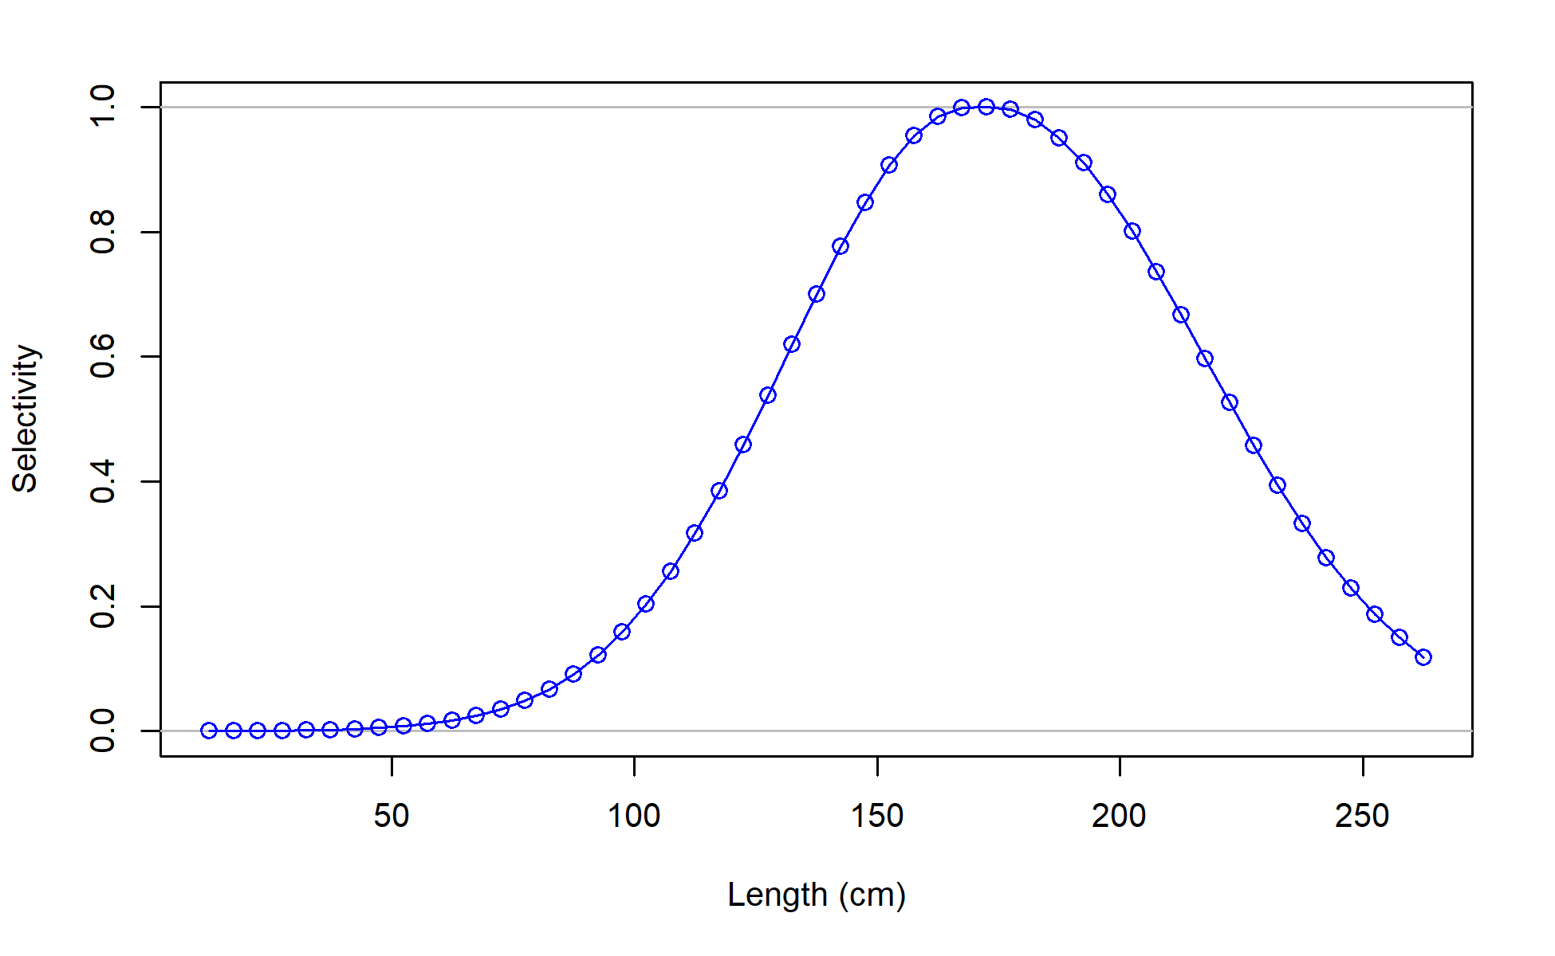
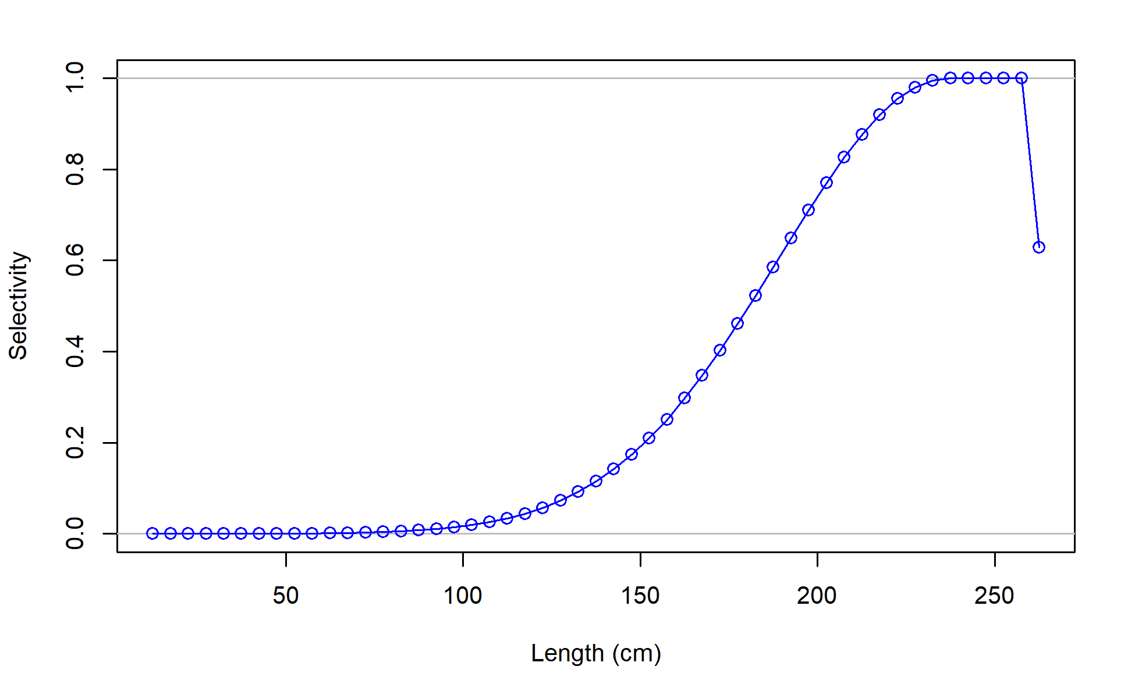
Selectivity
F01_JPN_WCNPO_OSDWLL_late_area1
F04_IATTC
F02_TWN_WCNPO_DWLL_late
F06_JPN_WCNPO_OSDWLL_early_area1
F08_US_WCNPO_LL_shallow_early
F03_US_WCNPO_LL_shallow_late
F07_JPN_WCNPO_CODF

Slide 26
Model Diagnostics
Fits to the data
Runs Test and Residual plots
Hindcast cross-validation prediction ability
Age-Structured Production Model
Likelihood profiles with Piner Plots
Jitter/Gradient

Slide 27
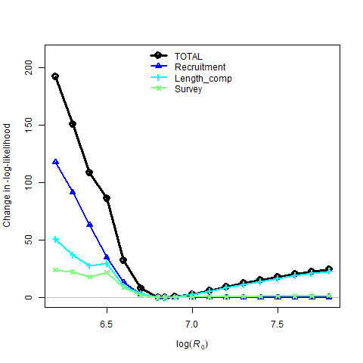
Results of Likelihood Profiles by Data Component for Unfished Recruitment R₀

Slide 28
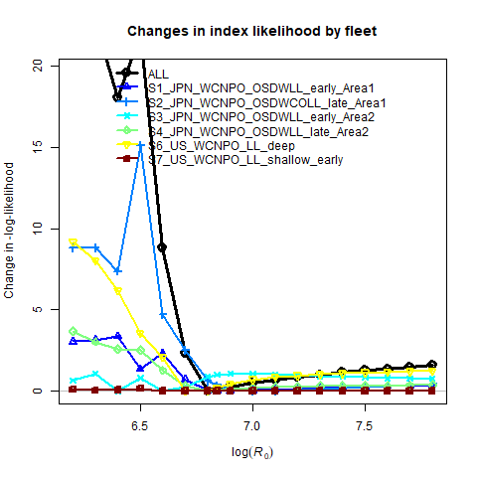
Results of Likelihood Profiles by Data Component for Unfished Recruitment R₀

Slide 29
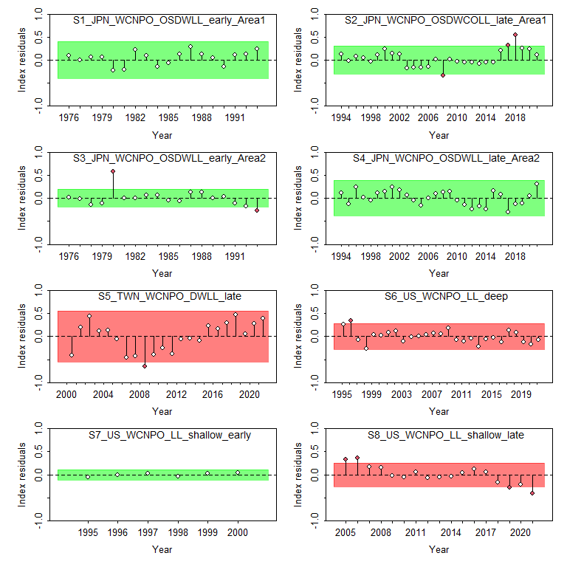
CPUE Runs Test
Index of recruitment

Slide 30
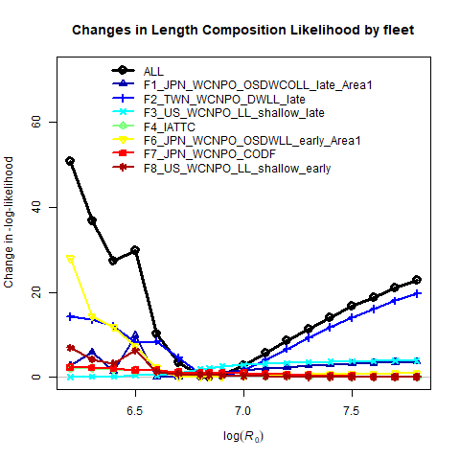
Results of Likelihood Profiles by Data Component for Unfished Recruitment R₀

Slide 31
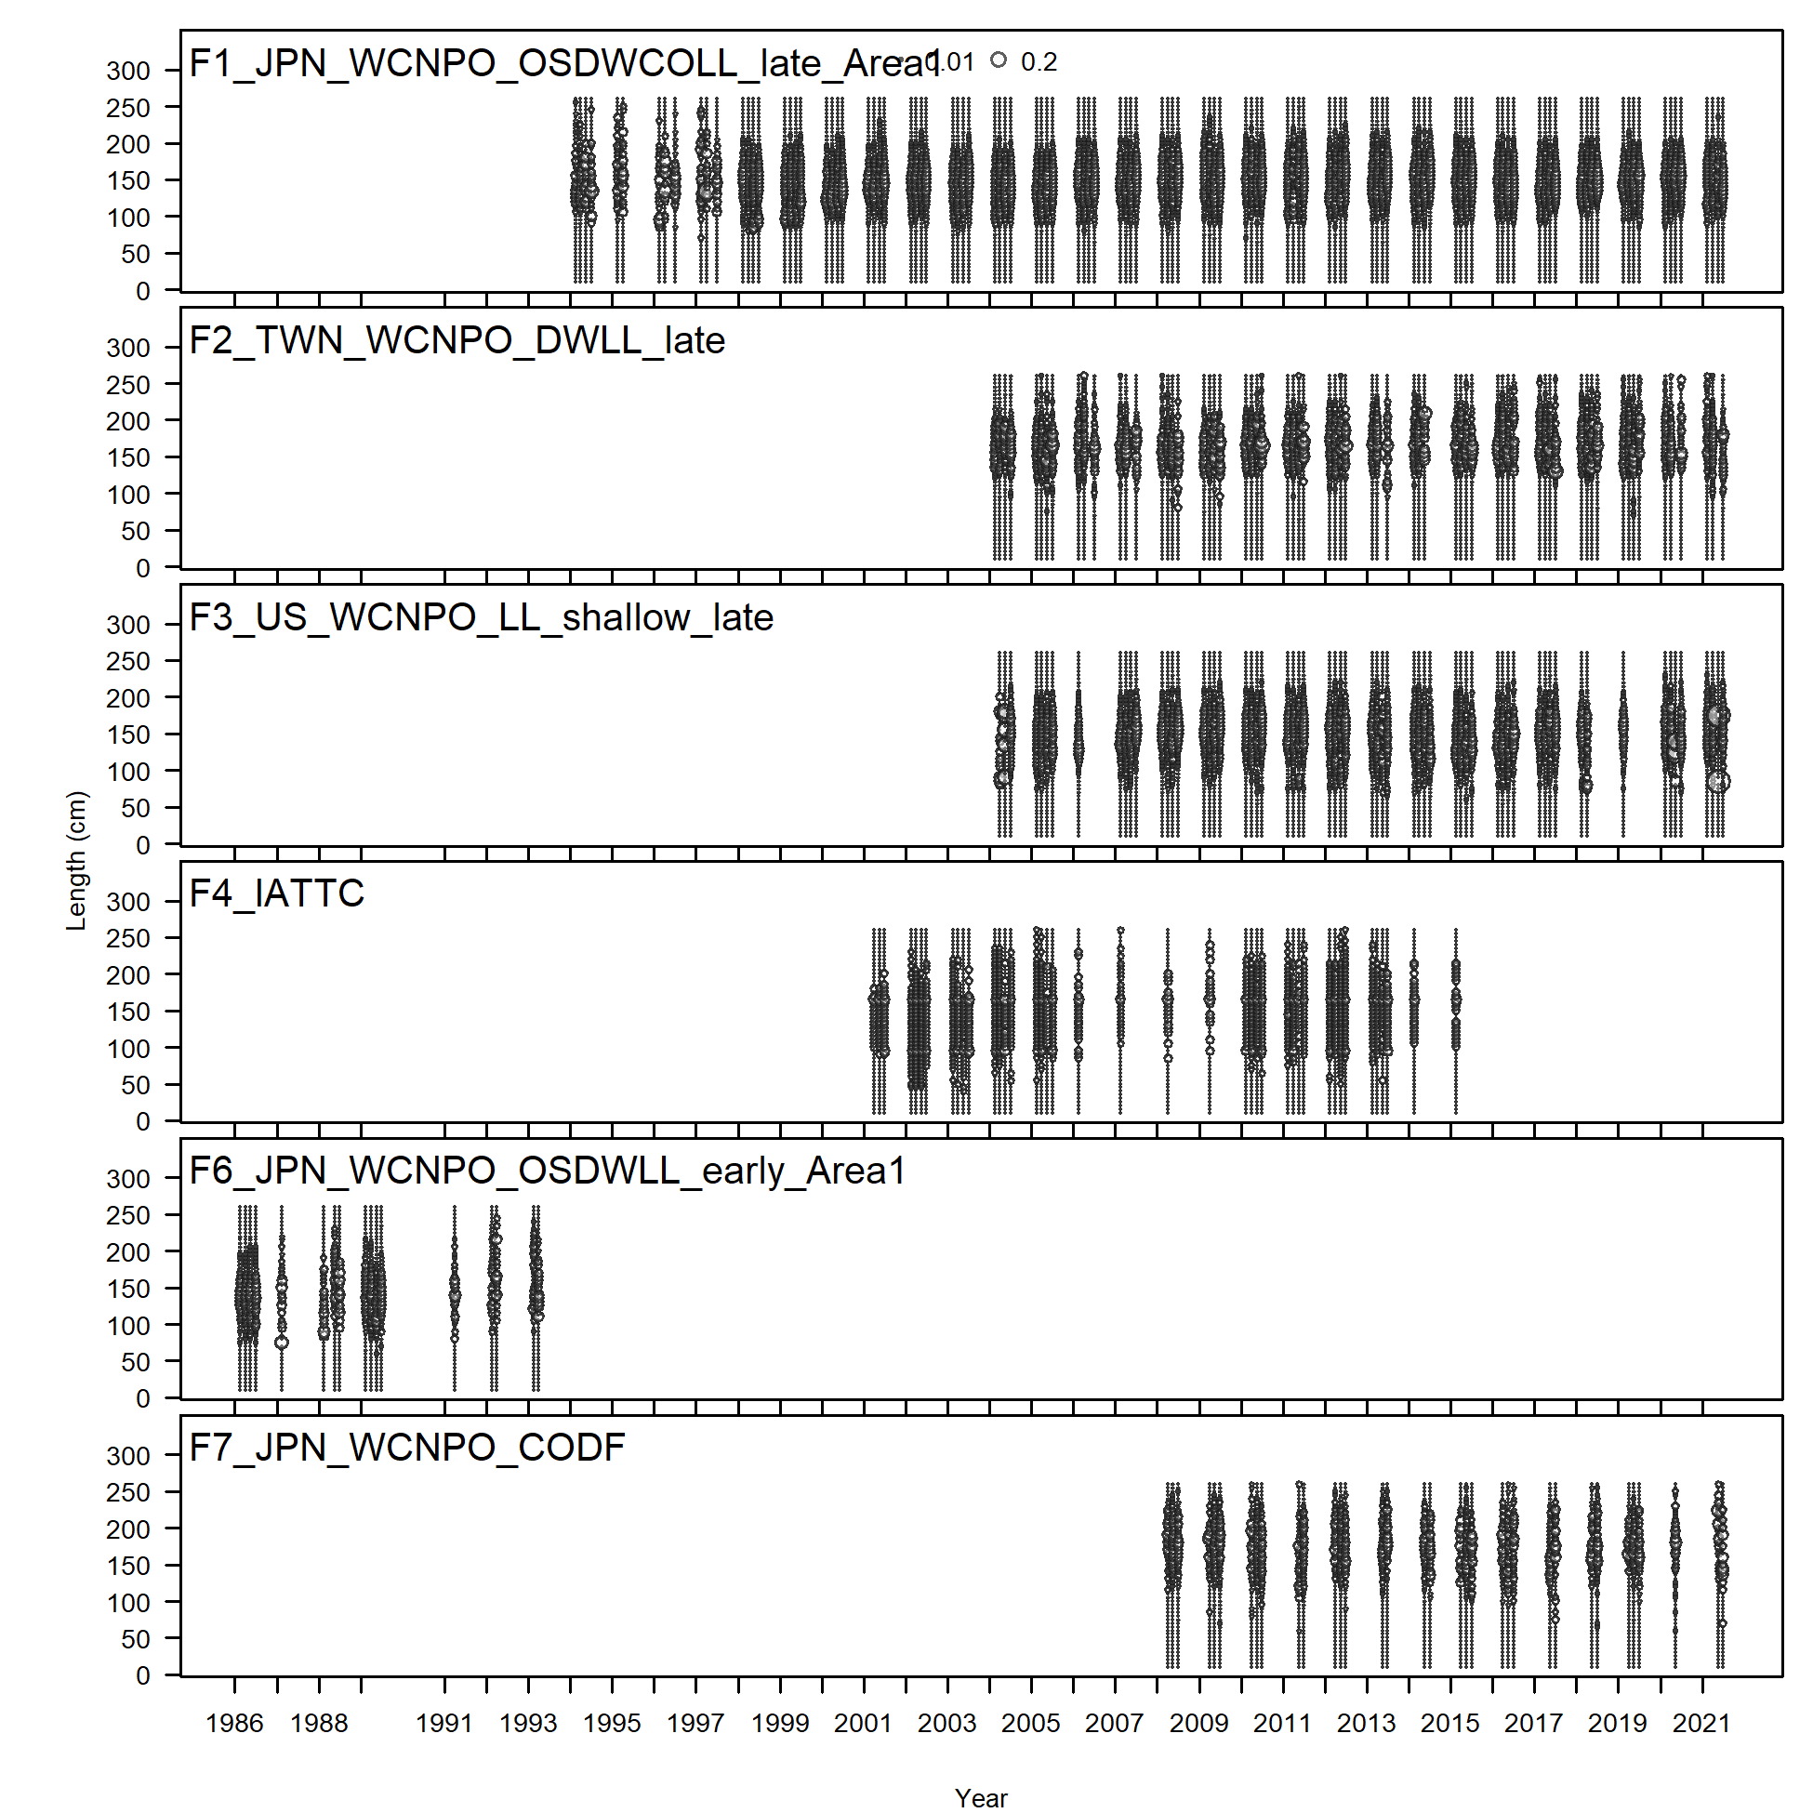
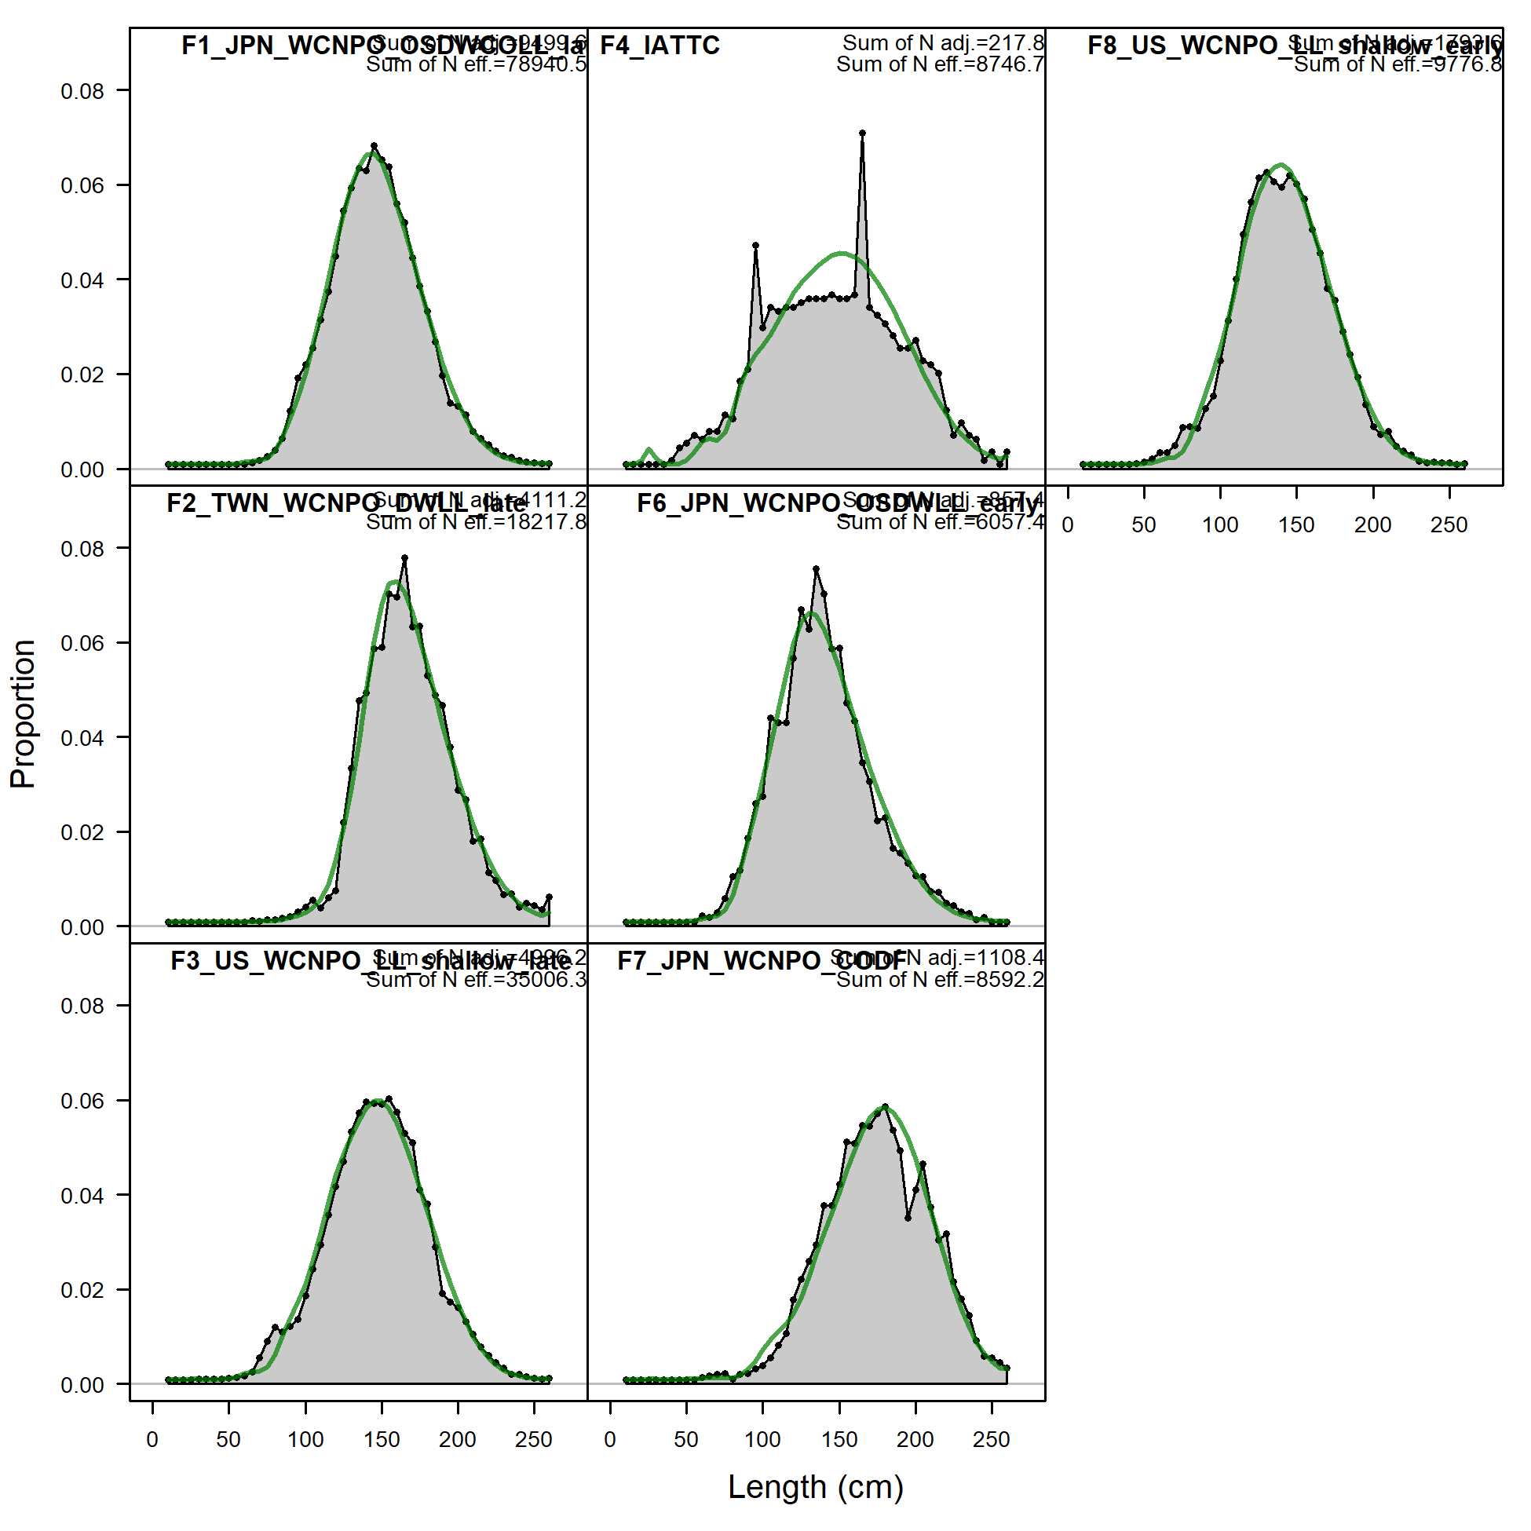
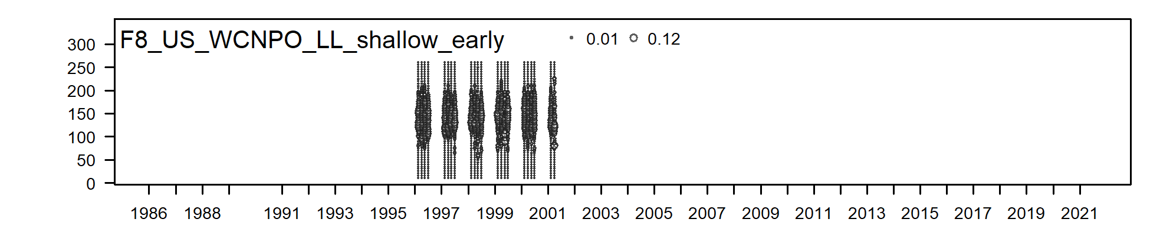
Size Composition Data by Fleet

Slide 32
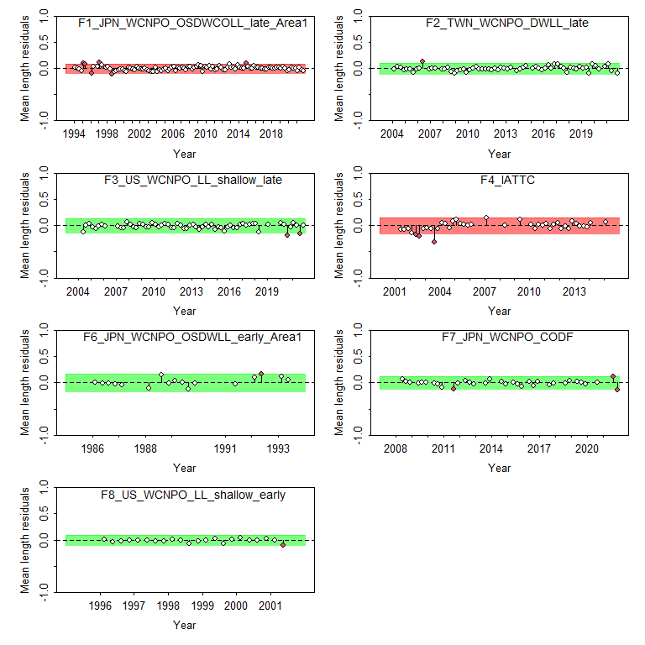
Length Runs Test

Slide 33
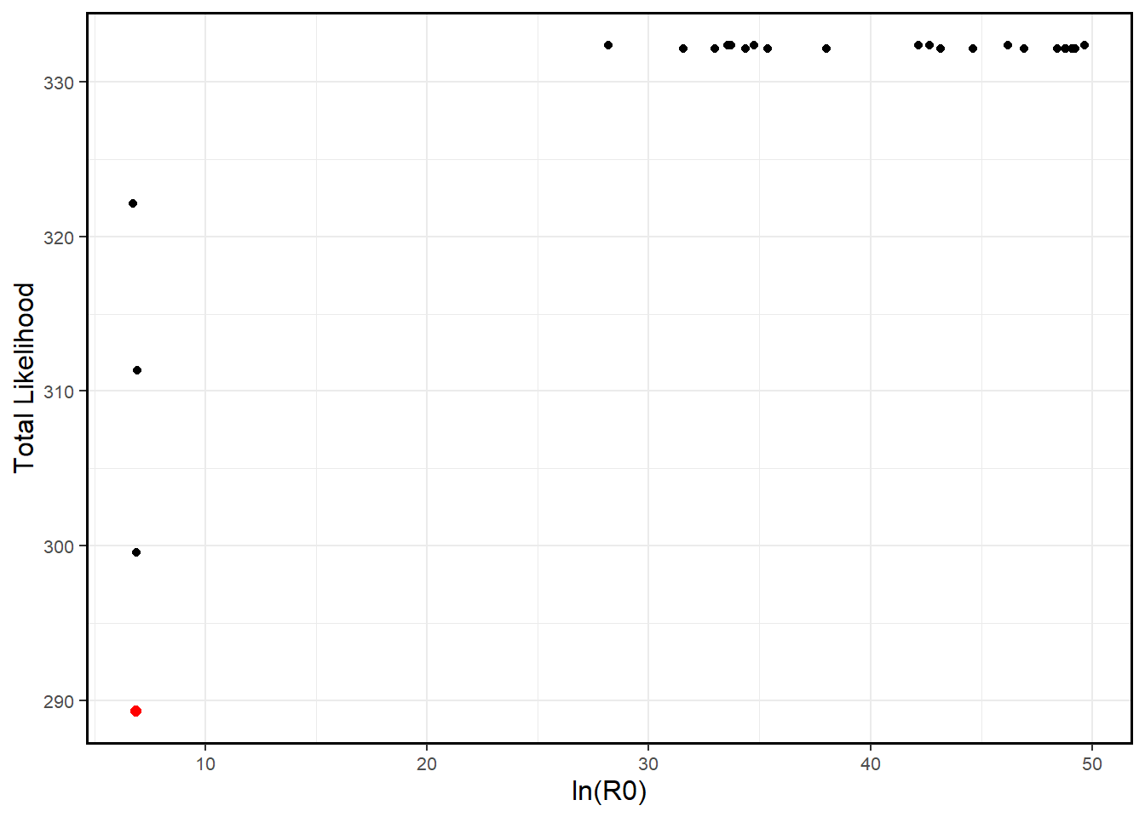
Jitter Plot

Slide 34
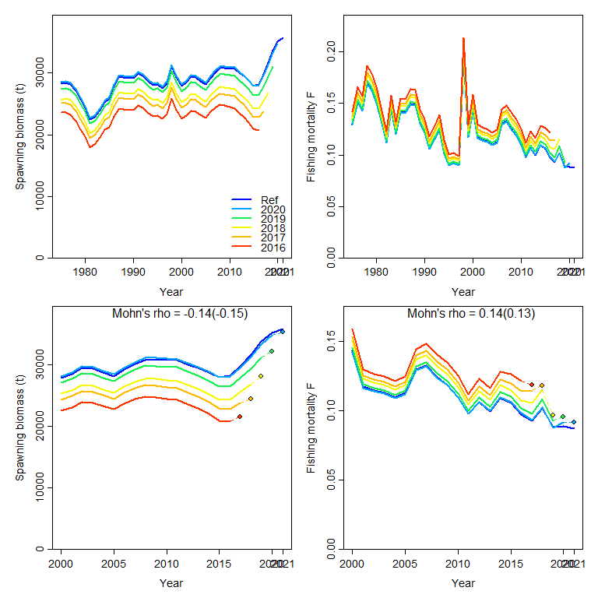
Retrospective Analysis

Slide 35
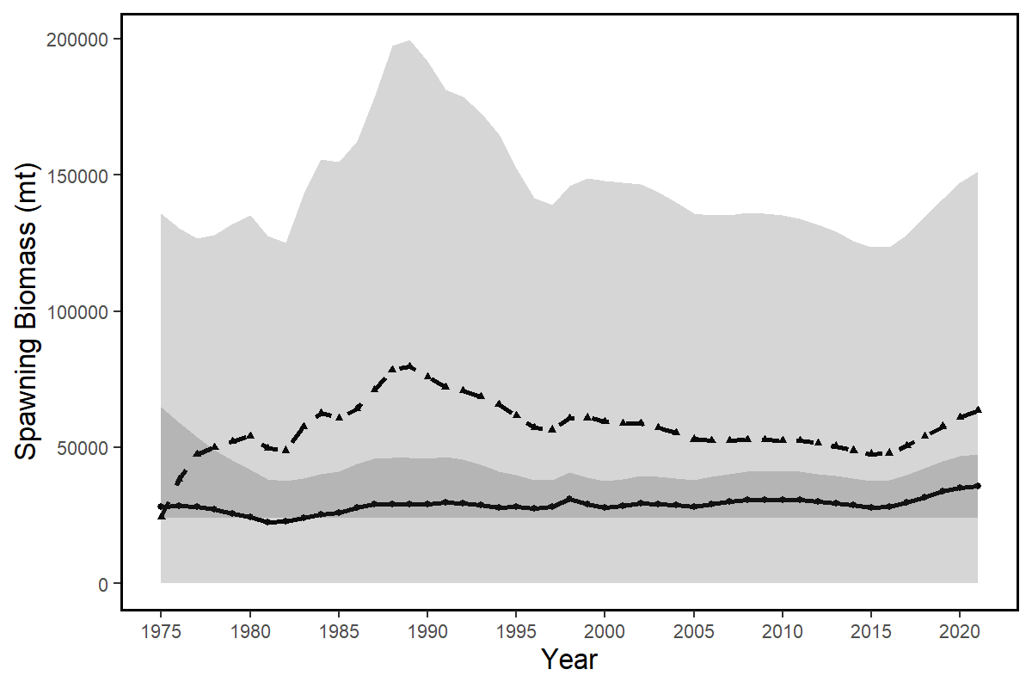
Age Structured Production Model

Slide 36
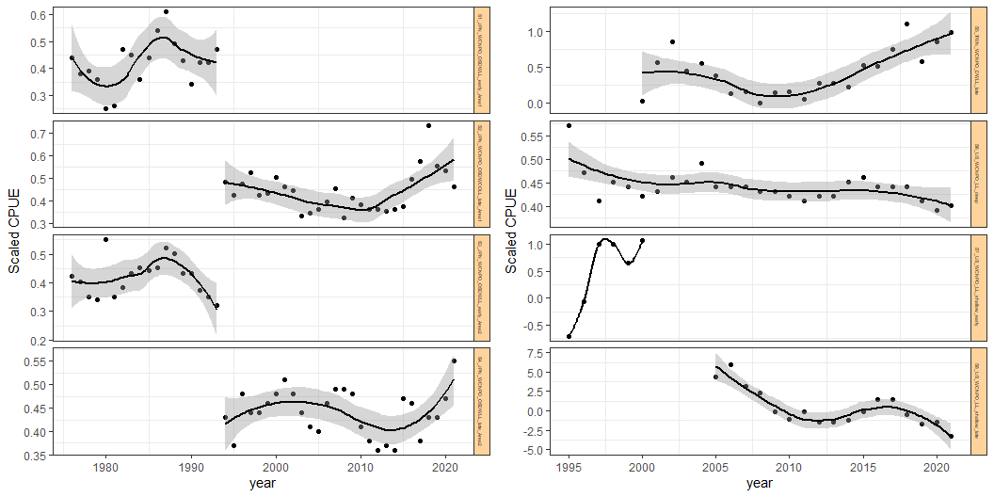
Standardized CPUE by fleet
S1_JPN_WCNPO_OSDWLL_Early_Area1
S5_TWN_WCNPO_DWLL_late
S2_JPN_WCNPO_OSDWLL_Late_Area1
S6_US_WCNPO_LL_Deep
S3_JPN_WCNPO_OSDWLL_Early_Area2
S7_US_WCNPO_LL_shallow_early
S4_JPN_WCNPO_OSDWLL_Late_Area2
S8_US_WCNPO_LL_shallow_late

Slide 37
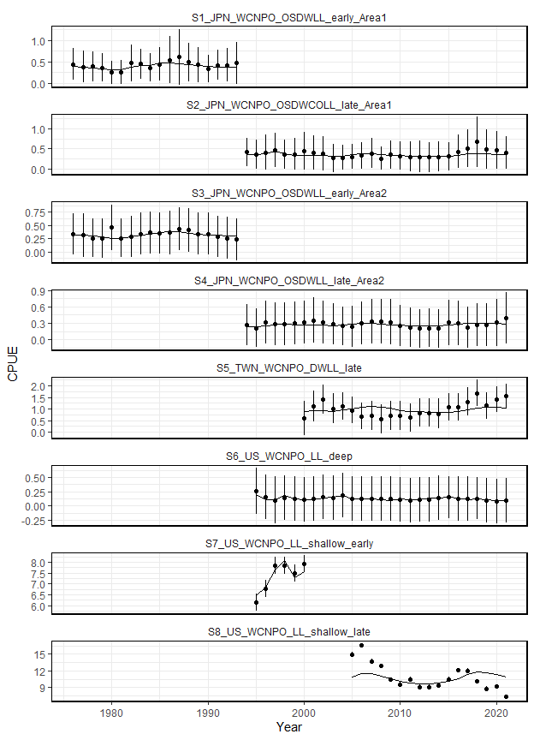
CPUE Diagnostics
S5 and S8 were not fit in the likelihood
S6 is fit as an index of recruitment

Slide 38
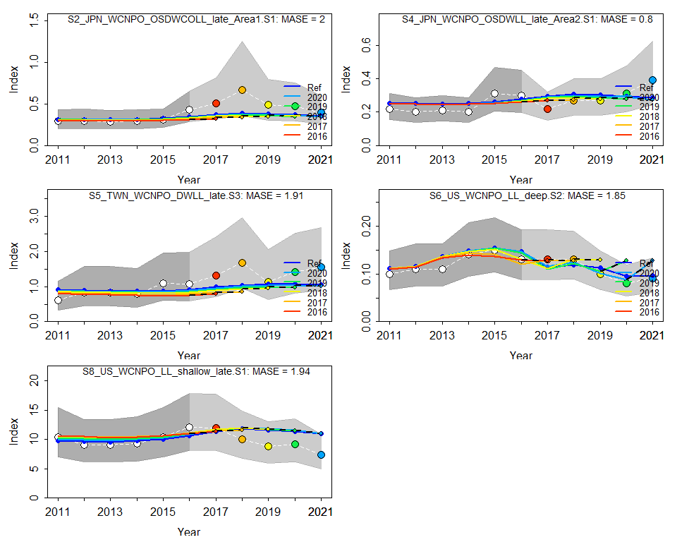
CPUE Hindcast cross-validation

Slide 39
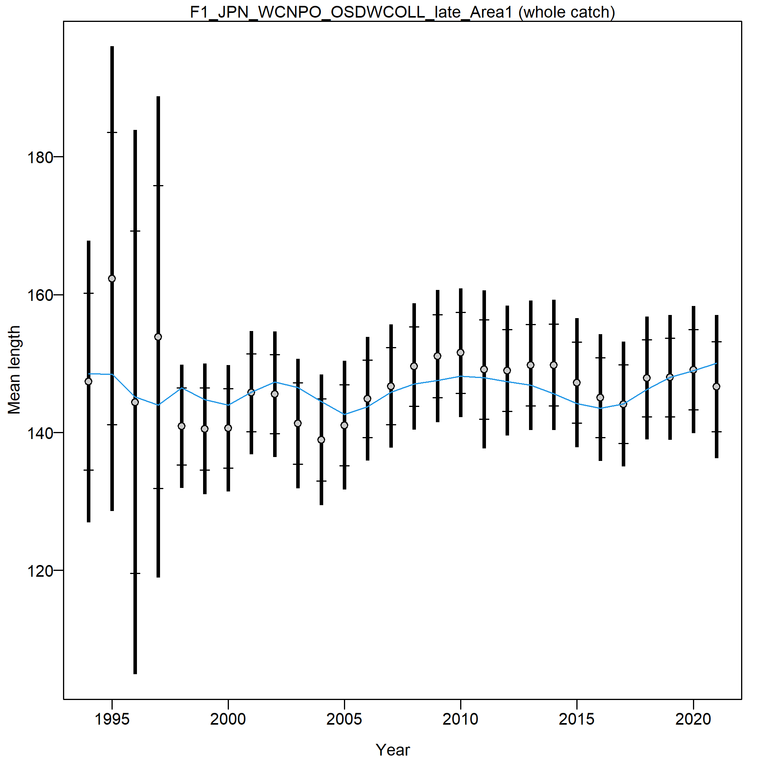
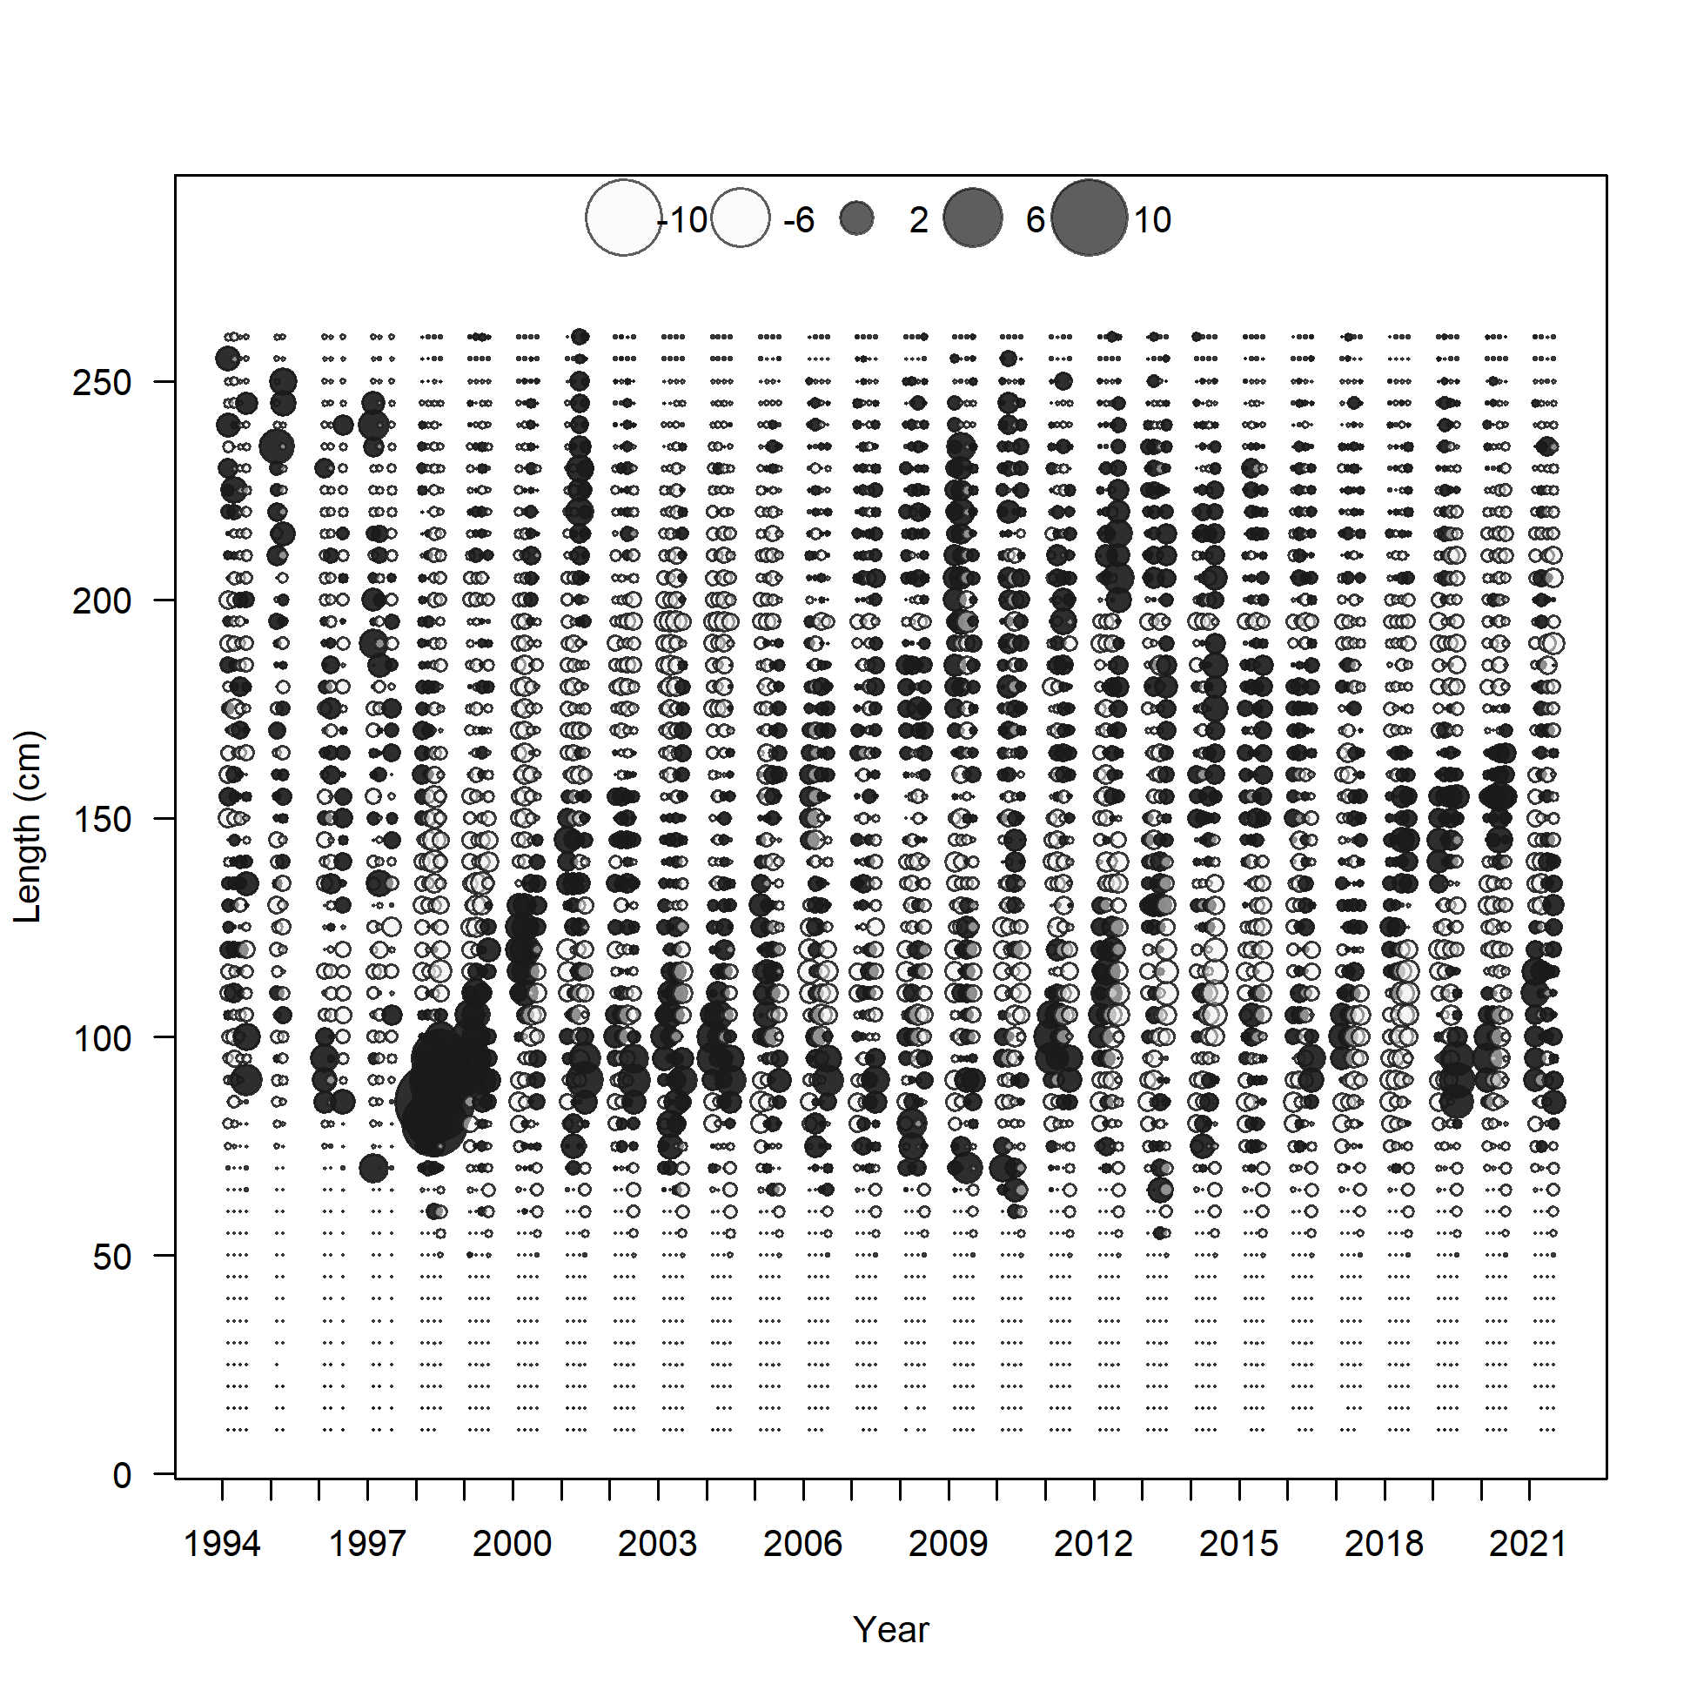
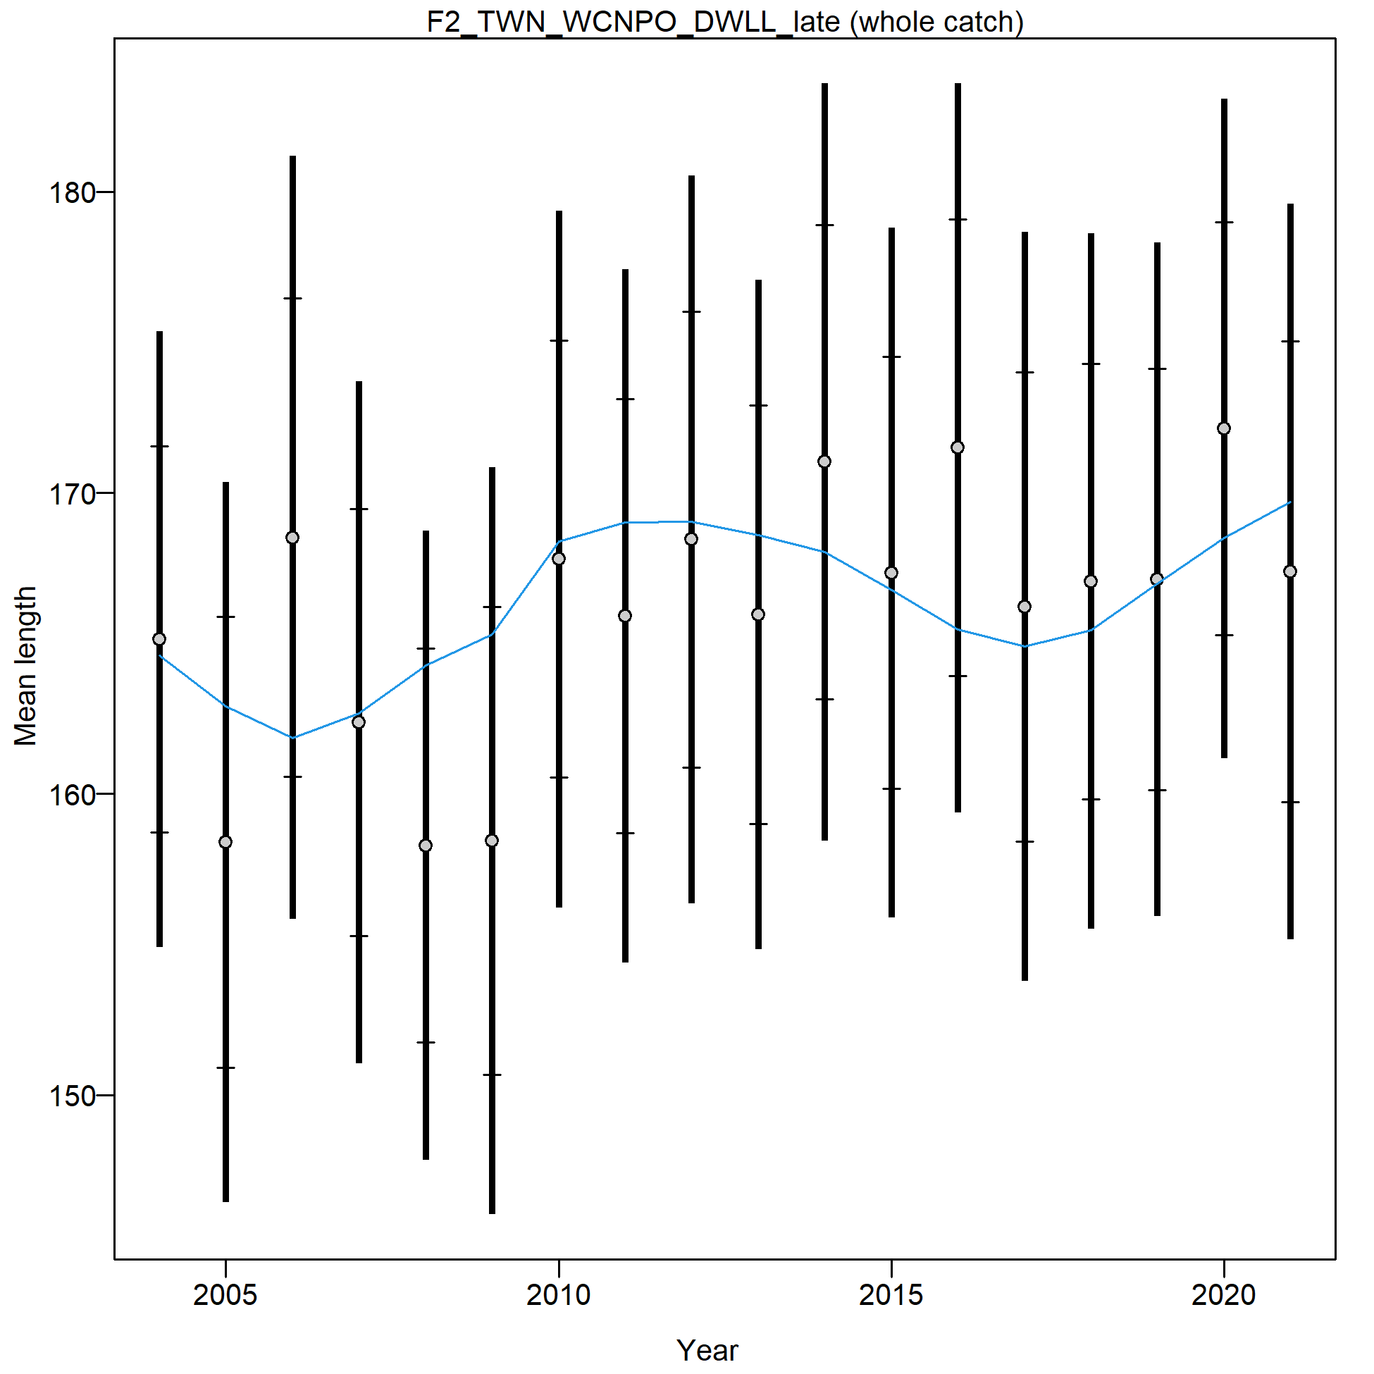
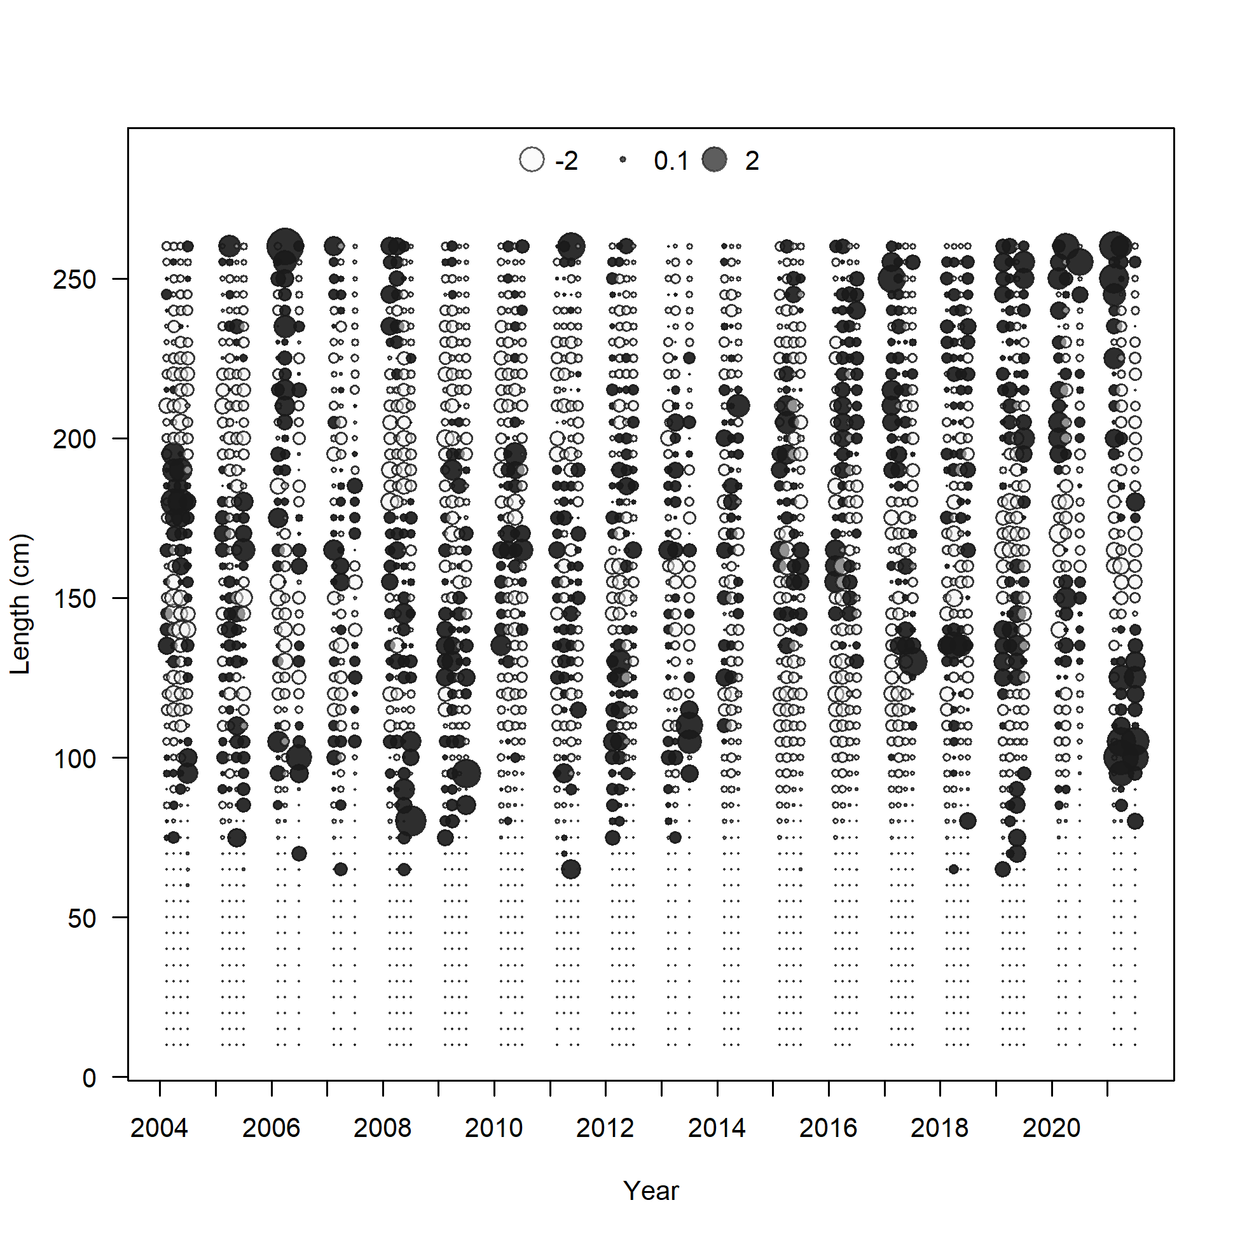
Fit to the Size Composition Data

Slide 40
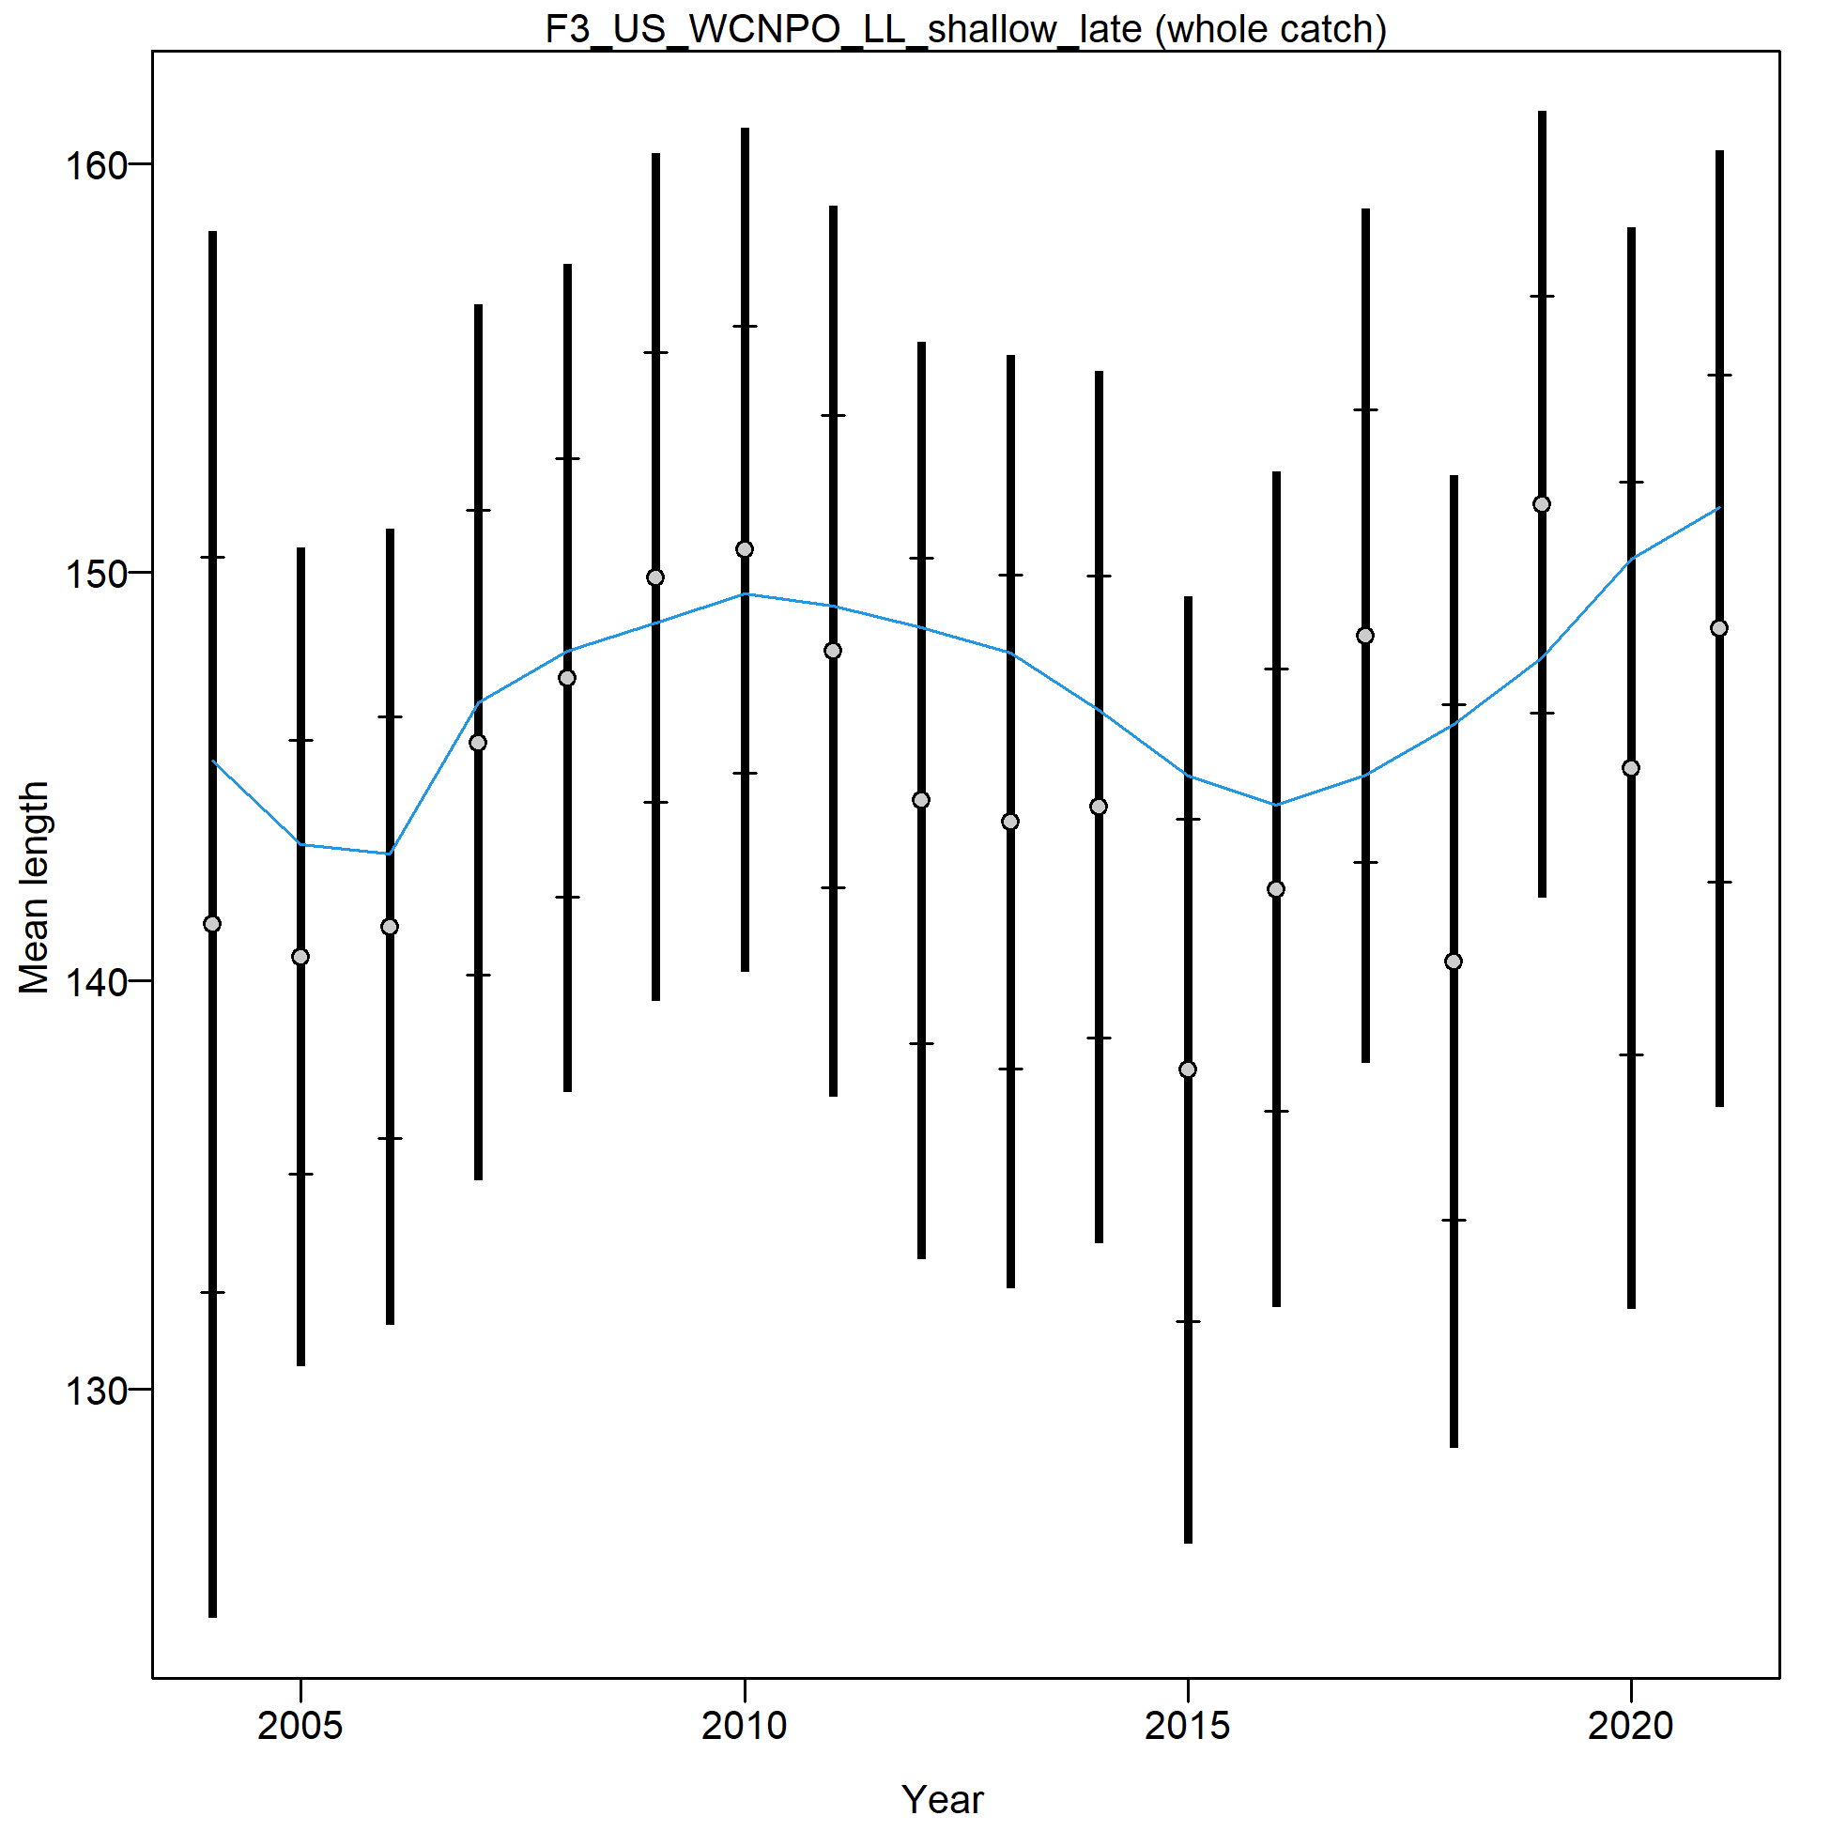
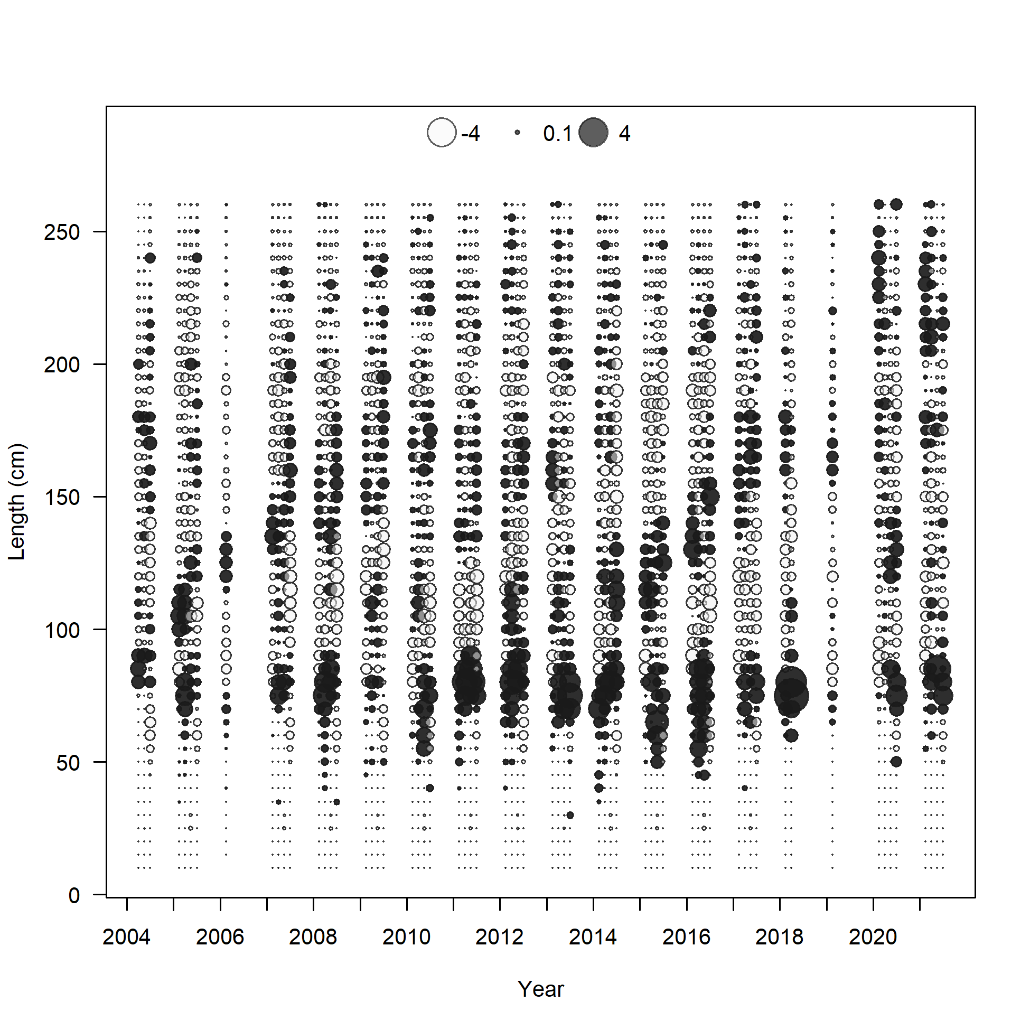
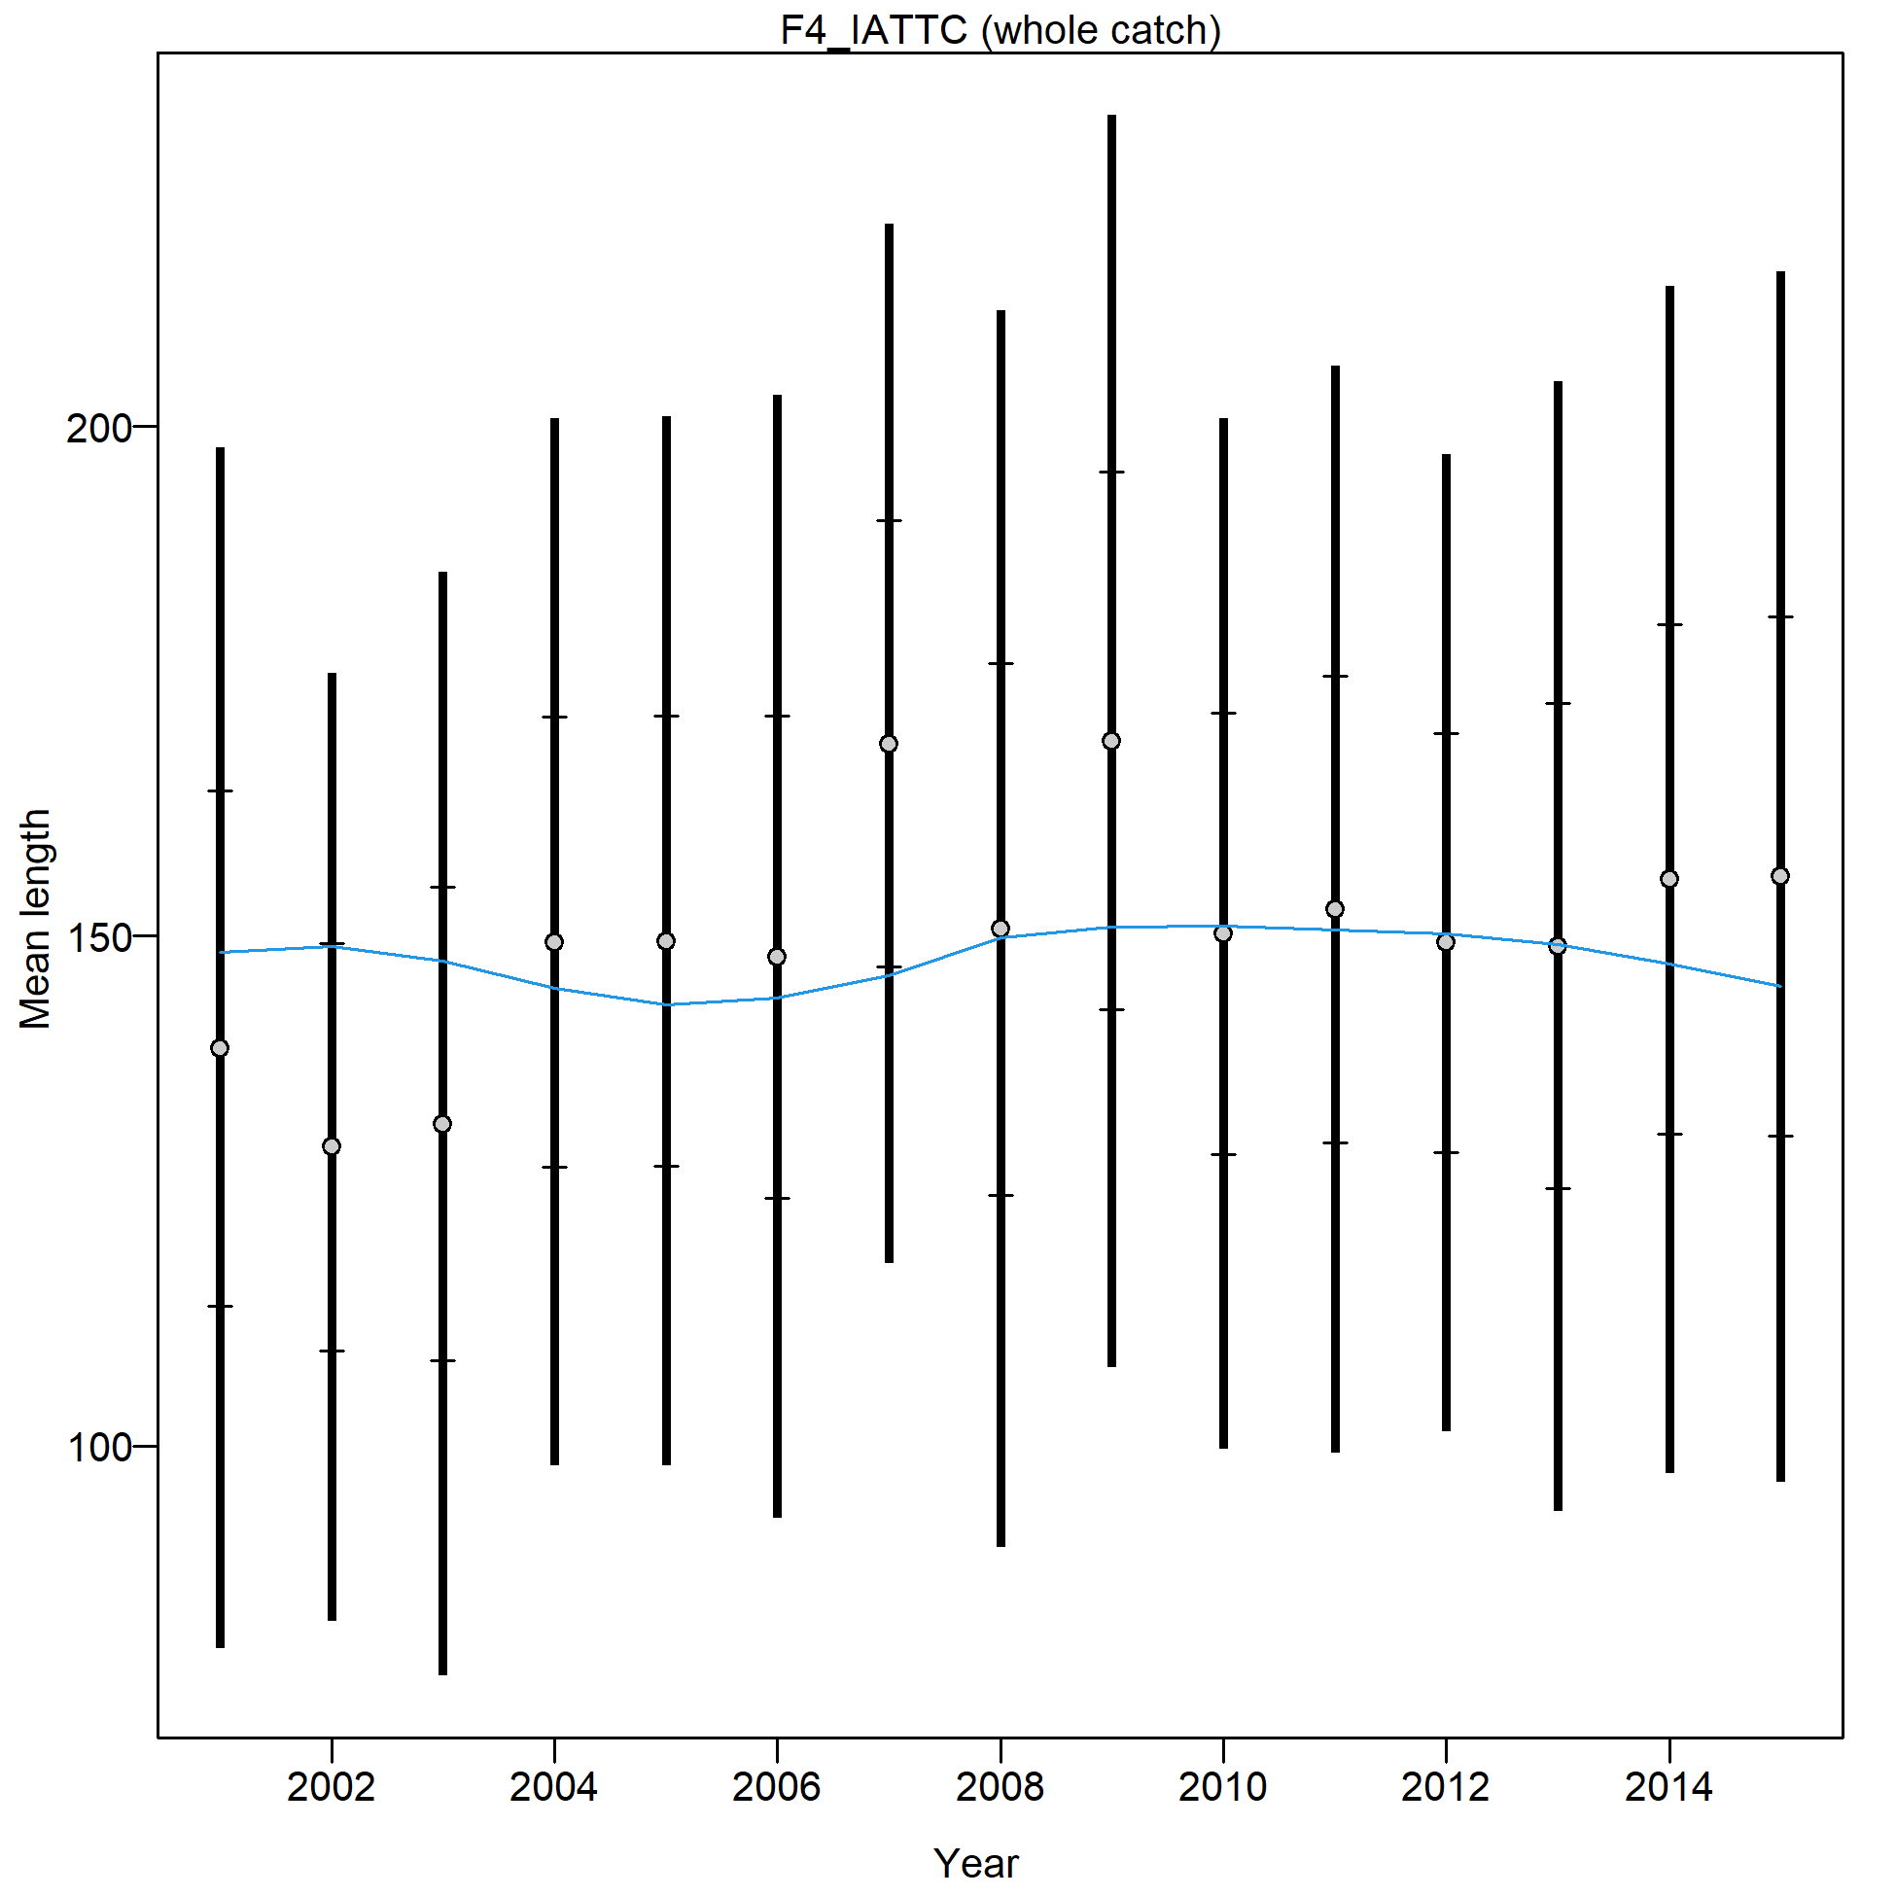
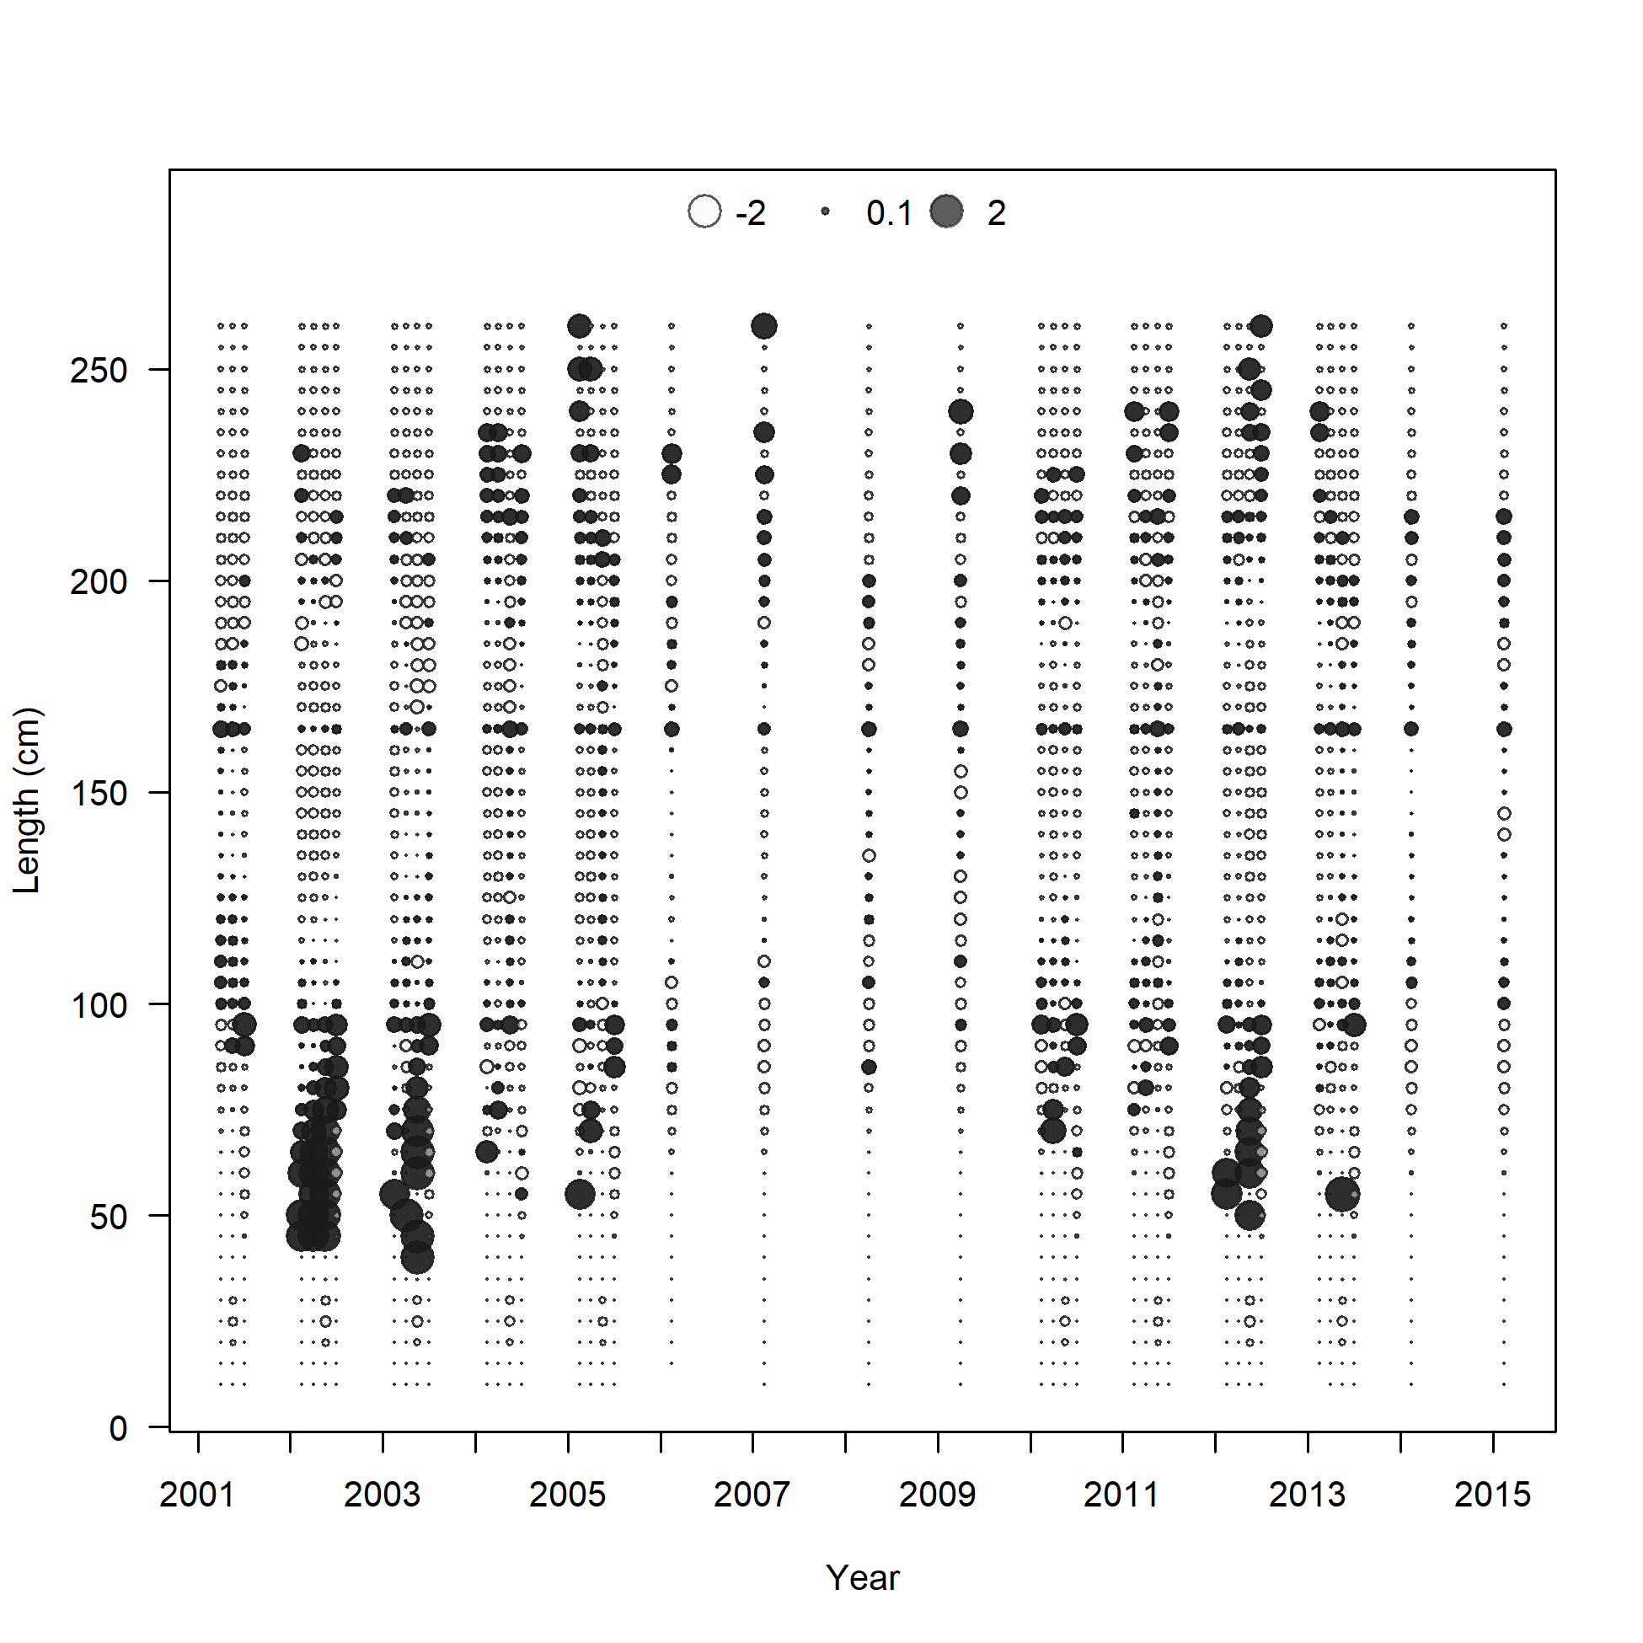
Fit to the Size Composition Data

Slide 41
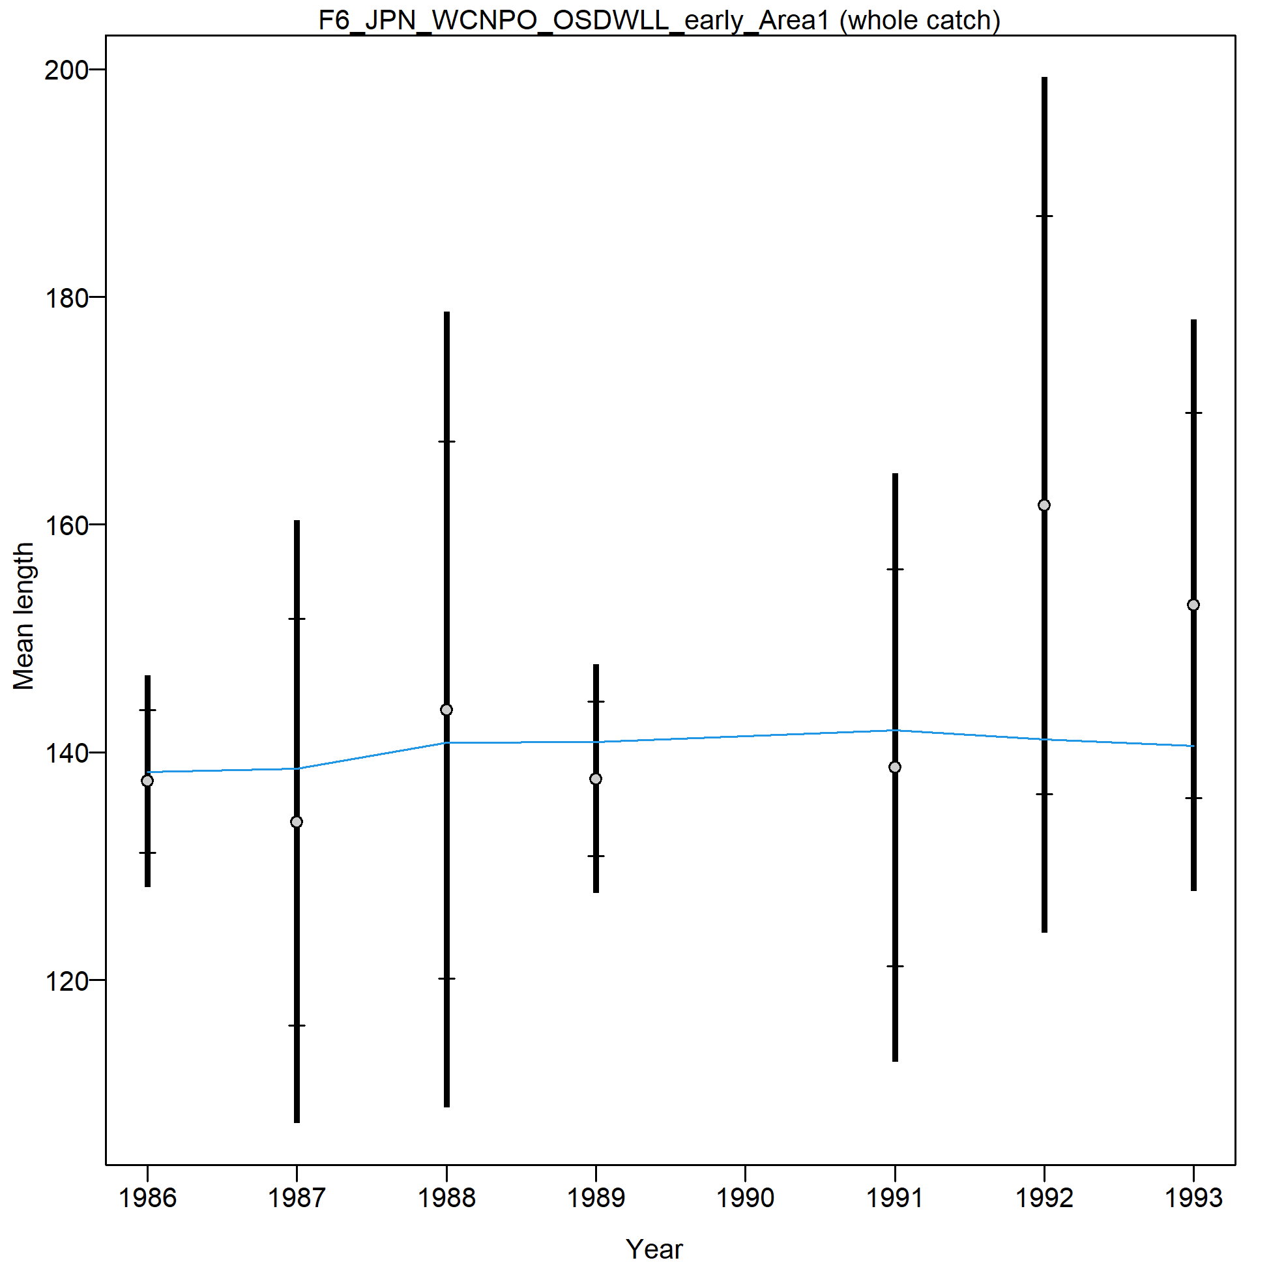
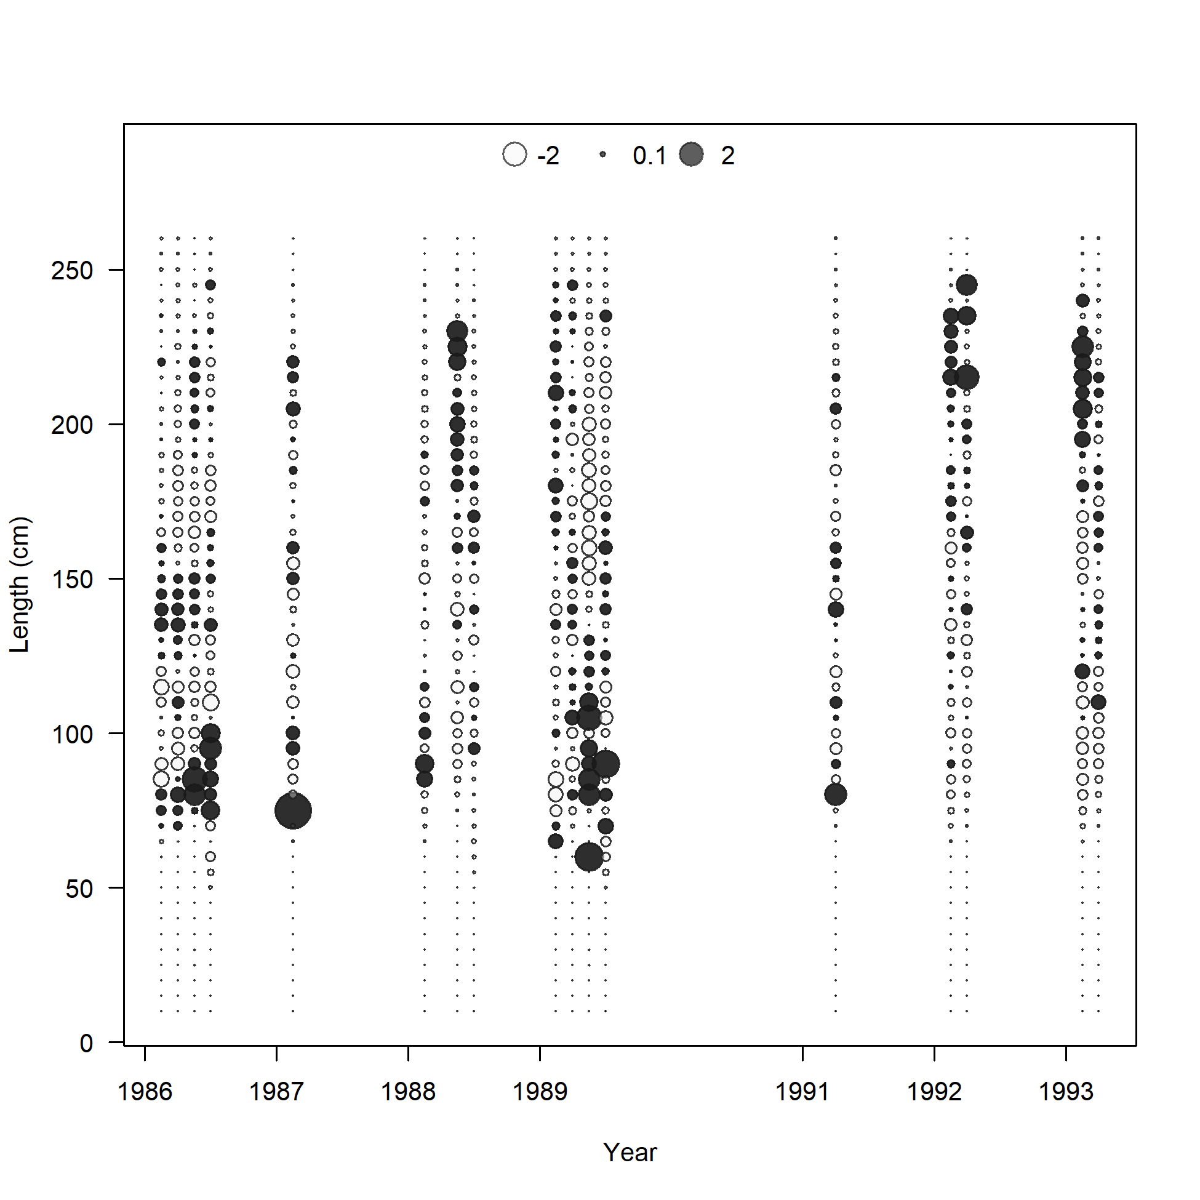
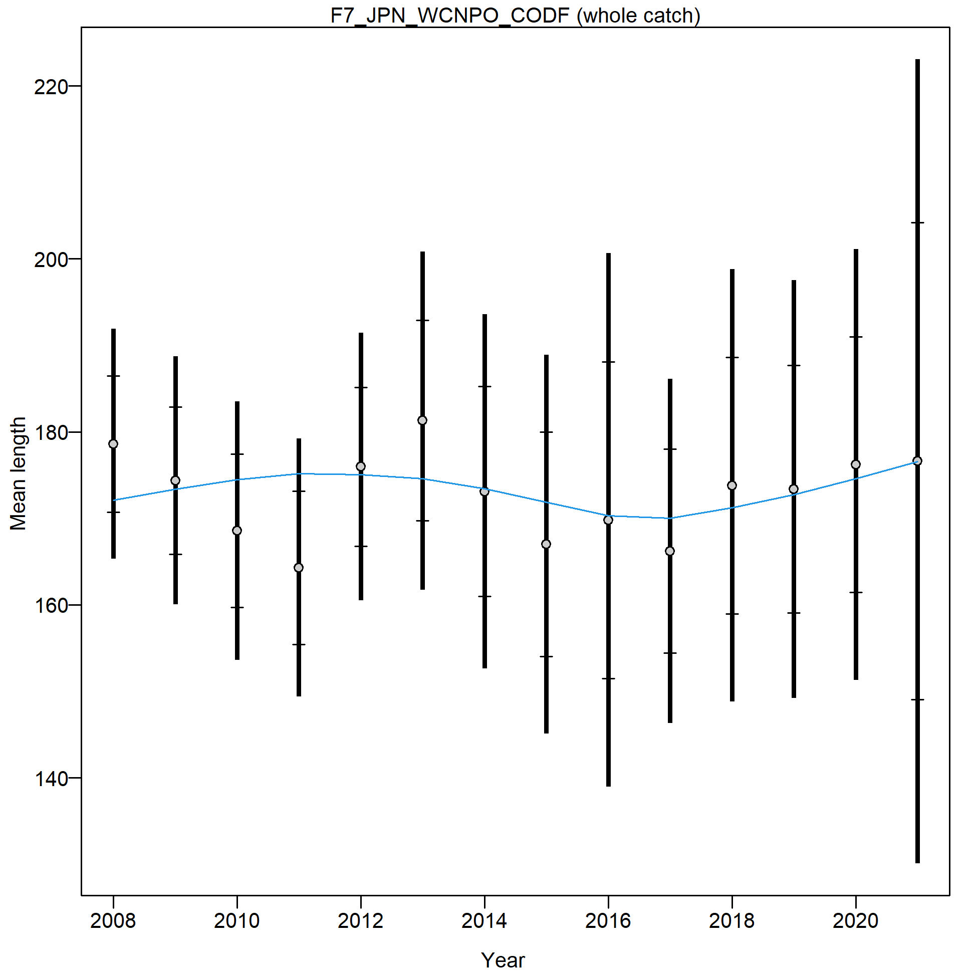
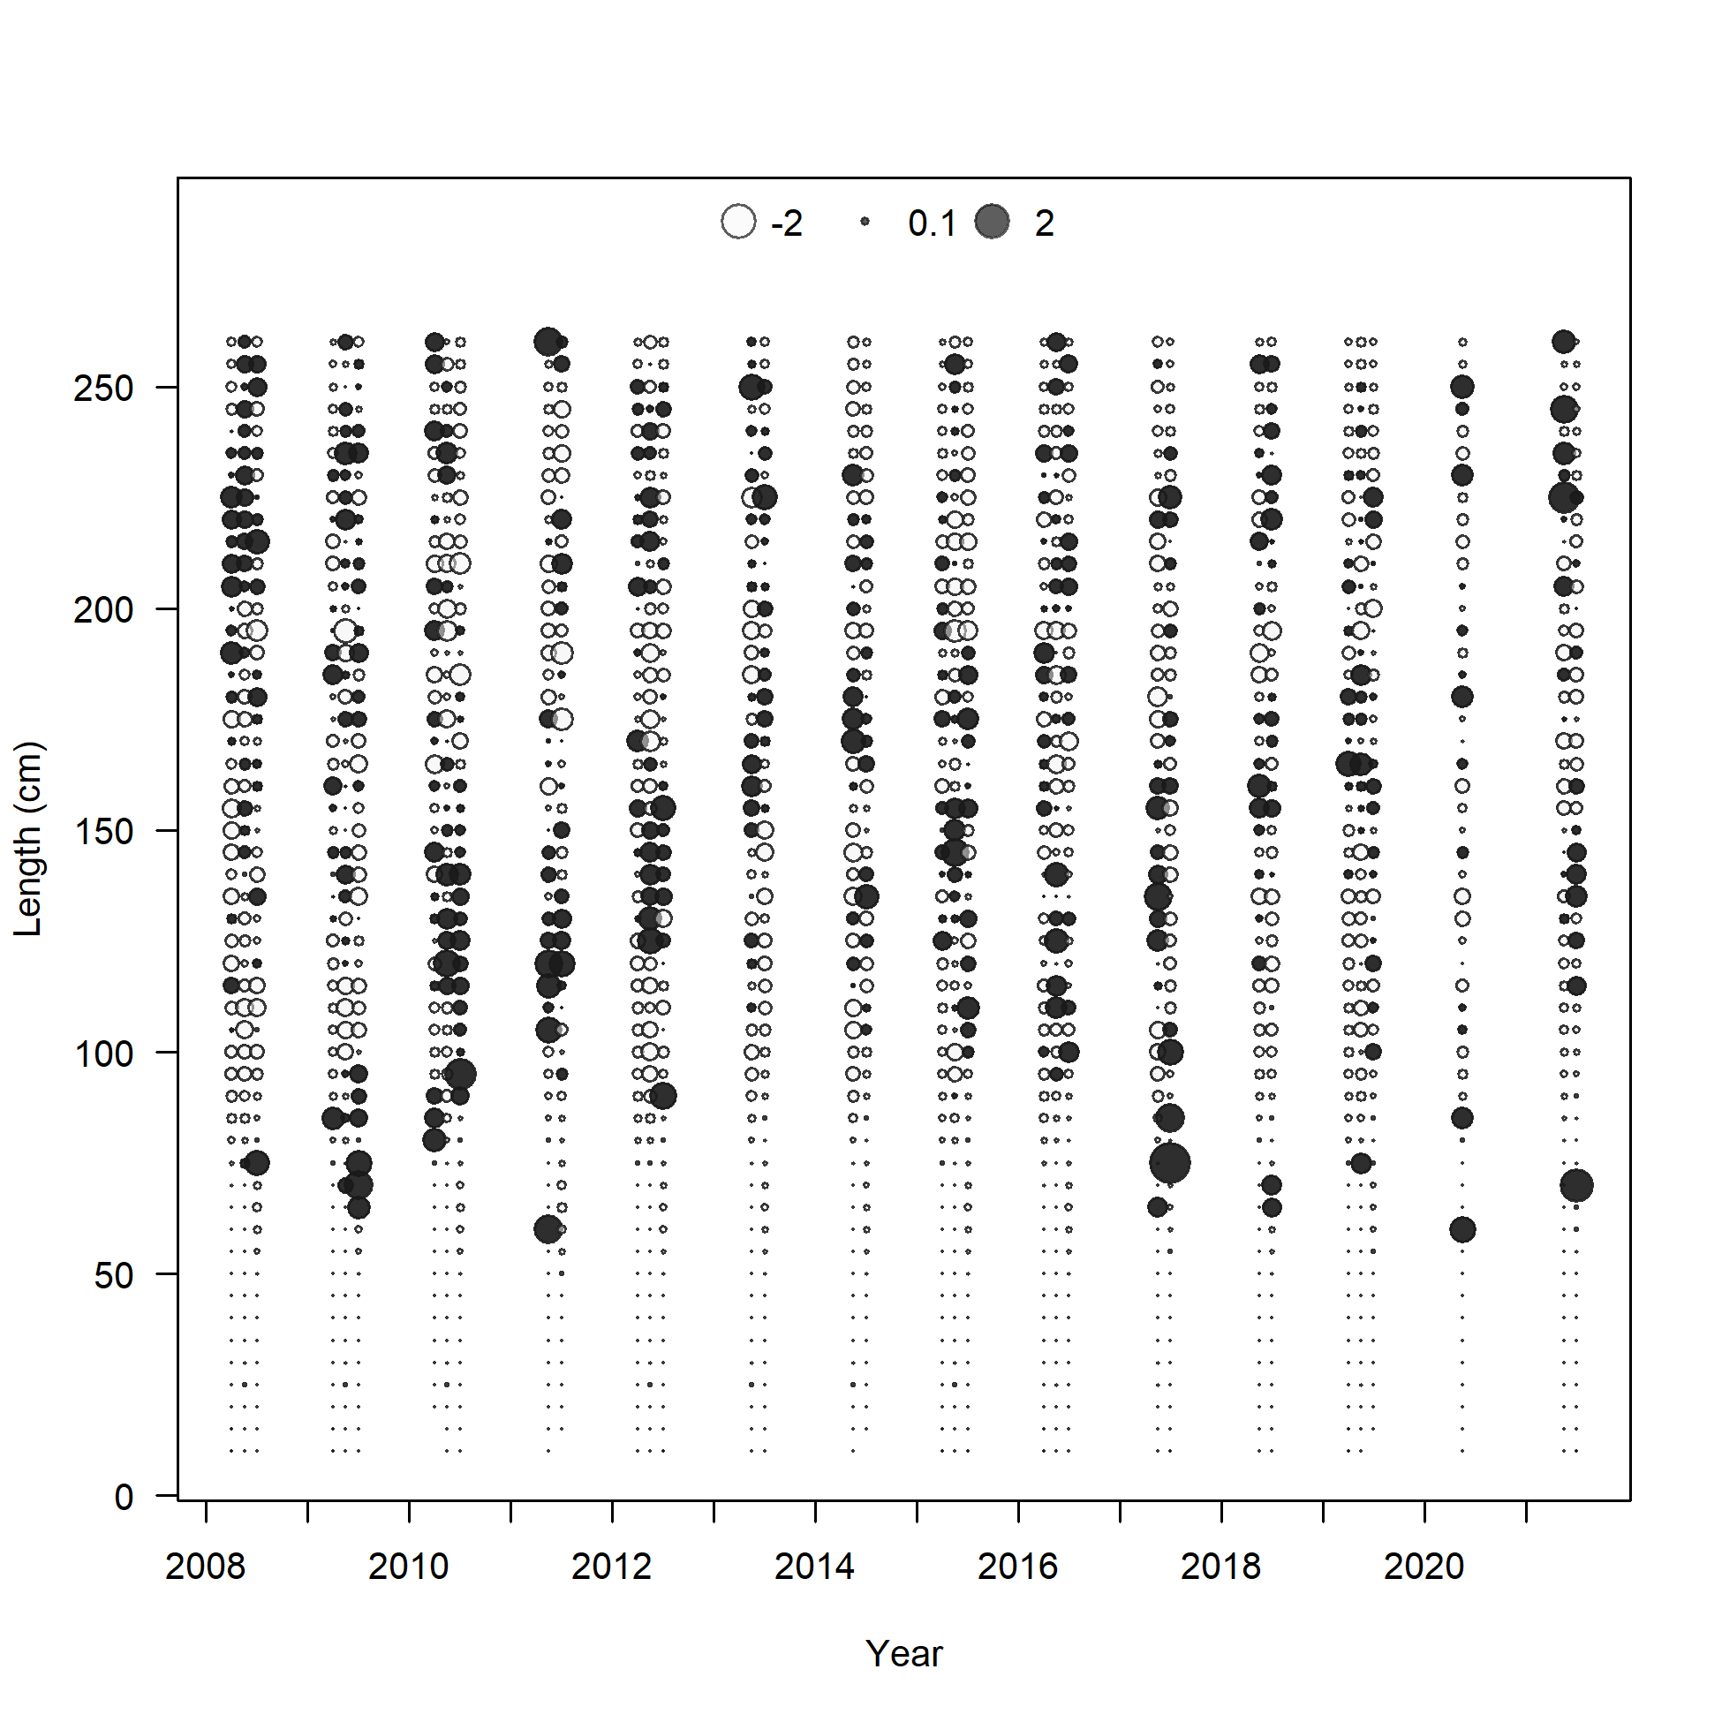
Fit to the Size Composition Data

Slide 42
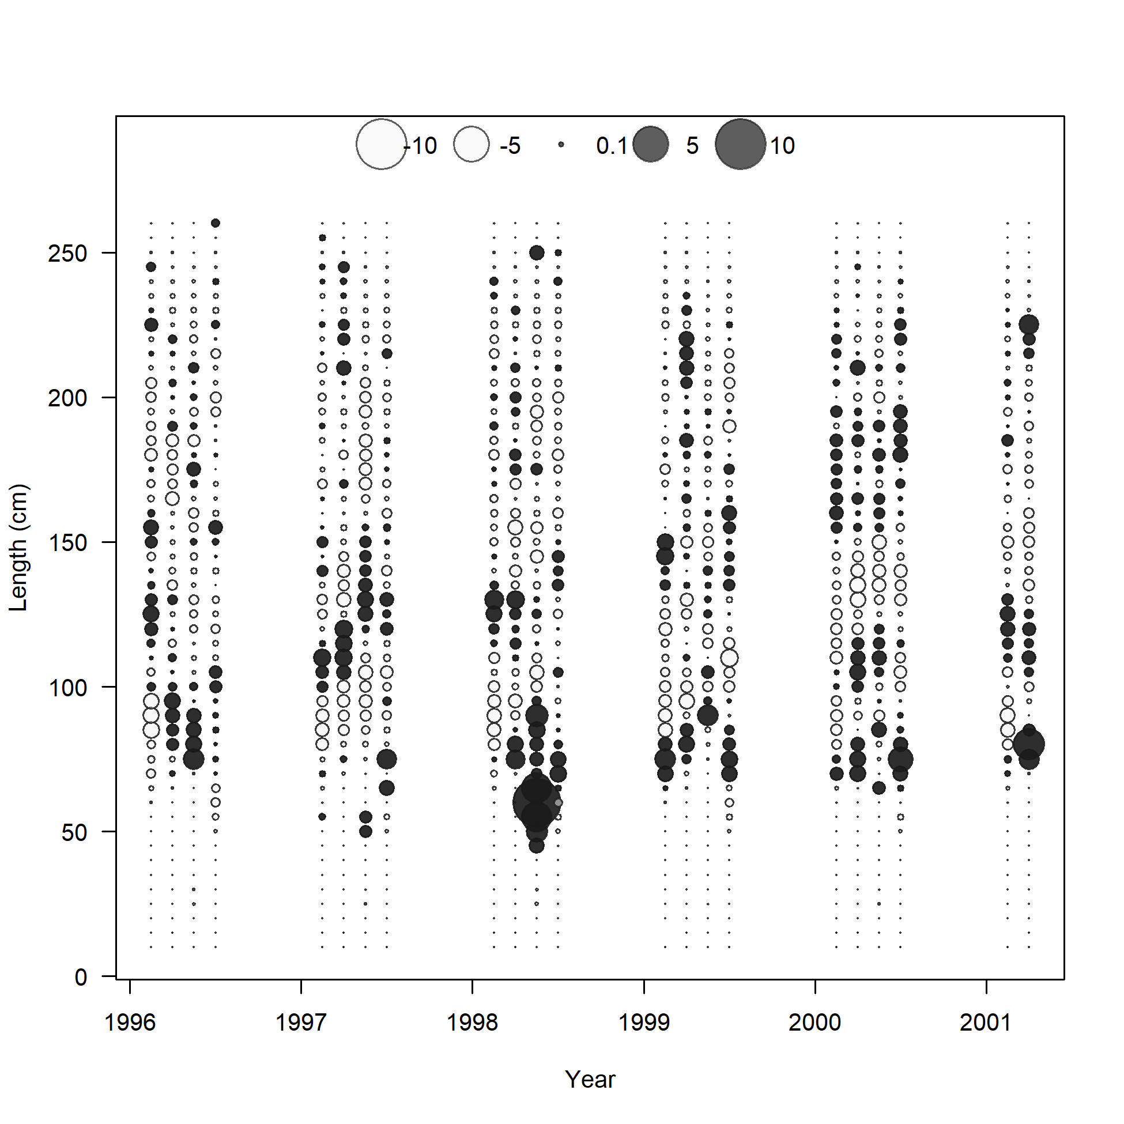

Fit to the Size Composition Data

Slide 43

Length Hindcast cross-validation

Slide 44




Sensitivity Analyses on Life History Parameters
Model 1: High M
Model 2: Low M
Model 3: Steepness = 0.7
Model 4: Steepness = 0.81
Model 5: Steepness = 0.99

Slide 45




Sensitivity Analyses on Life History Parameters
Model 6: Large Amax
Model 7: Sun et al., 2007 Growth
Model 8: High Maturity L₅₀
Model 9: Low Maturity L₅₀
Model 10: Wang et al., 2003 maturity

Slide 46




Sensitivity Analyses on Model Decisions
Model 11: Drop all Vanuatu and Chinese Catch
Model 12: Use all NP SWO Catch
Model 13: Include Orphan Catch
Model 14: Change Amin to 1
Model 15: Don’t fit to S6
Model 16: TWN size comp selectivity to double normal
Model 17: Include F9 size data

Slide 47


Sensitivity Analyses on CPUE Decisions
Model 18a: S1 and S2
Model 18b: S3 and S4
Model 18c: S5 Only
Model 18d: S7 only
Model 18e: S8 only
Model 18f: S7 and S8
Model 19: All CPUE

