Slide 1
3. Requests for further analysis and information by Scientific Services Provider (Rev.01*)
TTMW3
Online, June 2023
* Current Requests table updated as of 26 June 2023

Slide 2
Introduction
Key TT CMM area – high seas PS and key LL (Tables 2 and 3)
SPC analyses focus on:
  The PS/LL fishery as a whole > impacts on stocks
  Examine how changes in high seas PS/key LL levels influence BET/YFT/SKJ v objectives of the TT CMM
    E.g. if levels increase by 10% relative to recent levels, how does an increase in this component influence overall PS/LL impacts and hence stock status v objectives?
  Specific allocation between CCMs
    Can provide data to support allocation options
  Additional data analysis requests

Slide 3
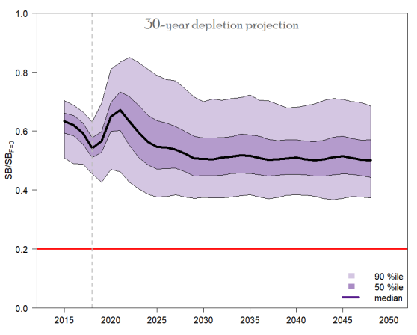
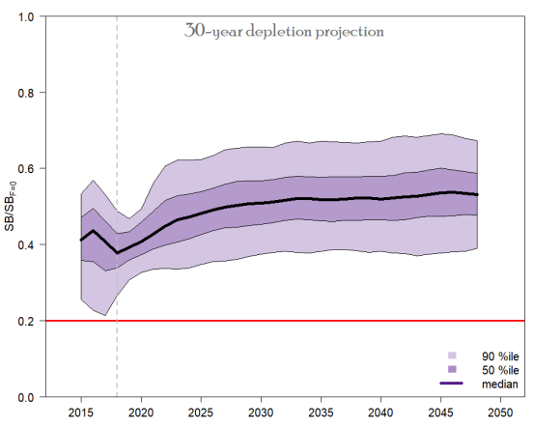
Projections – specific future conditions
Yellowfin
Bigeye [recent recruitment assumption]

Slide 4
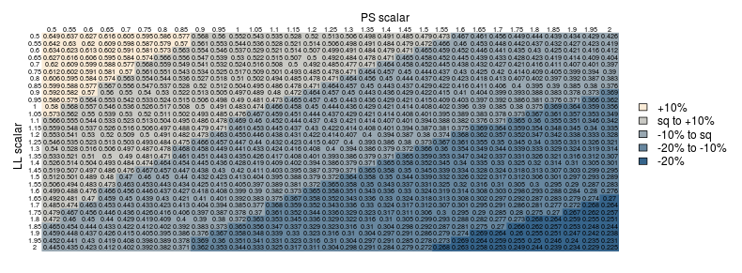
Evaluate the trade off between future ps and LL effort/catch levels
WCPFC-TTMW2-2021-IP11
1
1
‘Nuclear grid’ for BET
NOTE: likely AVERAGE (long term) stock status
Risk stock < LRP also provided
RECENT recruitment assumed

Slide 5
Evaluate the trade off between future ps and LL effort/catch levels
WCPFC-TTMW2-2021-IP11
1
1
NOTE: likely AVERAGE stock status
Risk stock < LRP also provided
Where ‘sq’=2012-15 avg (37%SB_{F=0})
RECENT recruitment assumed

Slide 6
Evaluate the trade off between future ps and LL effort/catch levels
WCPFC-TTMW2-2021-IP11

Slide 7
Process?
This meeting – prioritised CMM evaluation requests of SSP
August SC – new BET and YFT assessments agreed & mgmt. advice
  Basis for CMM option evaluations
  Will SC advice be = 2012-2015 avg depletion levels? Unknown…
August SC – SKJ management procedure run
  Defines overall level of purse seine effort in the WCPO
  MP assumes a 3mth FAD closure

Slide 8
Process?
Assuming SC advice => TT CMM objectives…
October meeting – presentation of evaluation results
Pre-Commission – complete any outstanding CMM evaluation requests in priority order, defined by time available

Slide 9
implications
Other PS ‘lever’ – FAD closure period – replacement axis?
Where ‘sq’ ~ SC advice

Slide 10
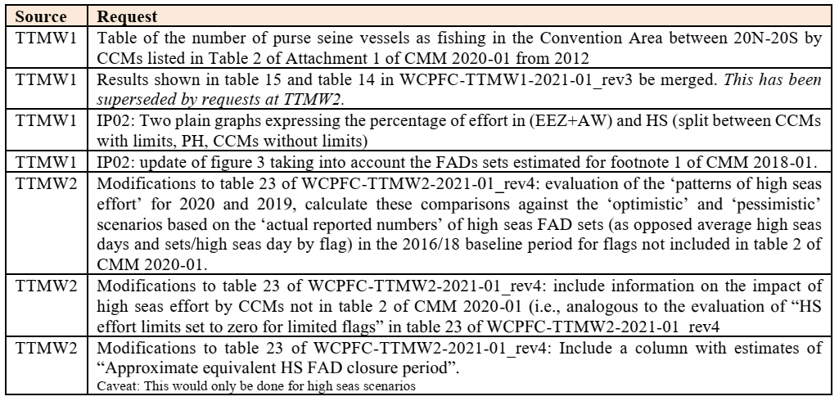
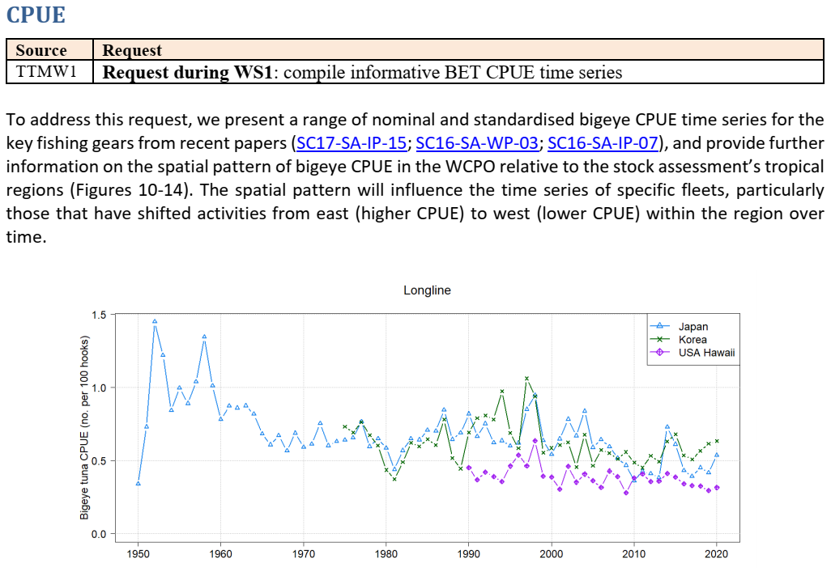
Other requests
Nearer term work (around SC prep):
  Other fishery data-based requests
  [Work using 2022 SKJ assessment (largely defined by SKJ MP outcomes)]

Slide 11
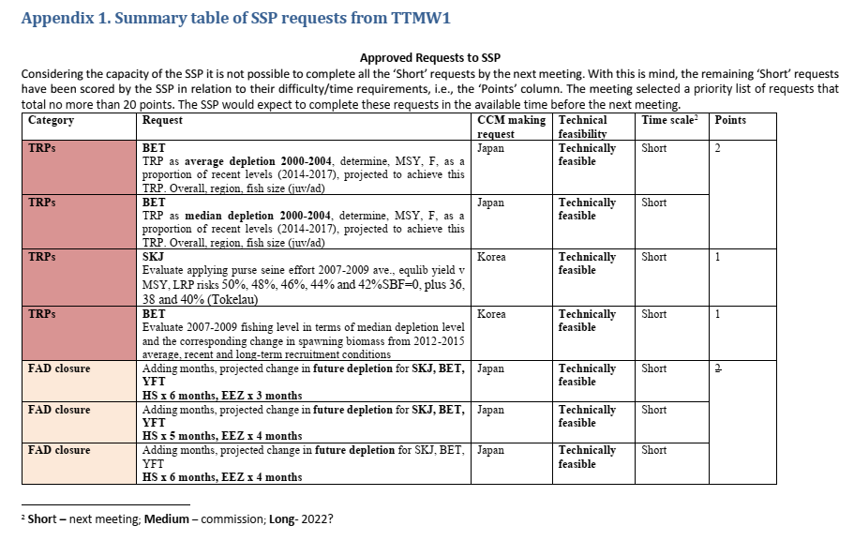
WCPFC-TTMW2-2021-01_rev4

Slide 12
Current requests (26/06)
Request to SPC | CCM/ Observer | Technical feasibility | Time scale | Points
Provide an updated analysis on the potential level of high seas purse seine effort based on the SKJ TRP. | FFA Members | Feasible
PS&PL effort/LL catch combinations. Limits for PS and PL effort could be provided by the upper limit deriving from the SKJ MP starting from the status quo [recent] conditions. Regarding the LL we suggest exploring combinations of PS/PL effort and LL [BET] catch to see the outcome in terms of depletion and interim objectives as in CMM2021-01 and SKJ TRP. Outcomes for all three tropical tuna spp (including 2 x BET recruitment combinations) | EU | Feasible
Update of data summaries as in SC18-MI-IP-08 – LL catch and PS effort by area (AW, EEZ, HSP, other HS) and HS v flag | EU | Feasible
Trade off between FAD closure period (EEZ/HS), and LL catch. Cf EEZ vs HS FAD closure, FAD closure and LL catch (table 9 of WCPFC-TTMW2-2021-01_rev4) | EU | Feasible
Table with future purse seine scalars under current conditions, without footnote 1 exemptions, without paragraph 15 exemptions (previous paragraph 17), without HS effort by CCMs in table 2, without HS effort by CCMs not in table 2 | EU | Feasible
Updated figures with PS effort in waters under national jurisdiction (EEZs and AWs), in the HS by CCMs in table 2 of CMM, in the HS by the Philippines, in the HS by Pacific island fleets fishing in high seas adjacent to their home waters during the HS closures, in the HS by CCMs not listed in table 2 (not including the effort already included in the previous item). | EU | Feasible

Slide 13
Current requests (26/06)
Request to SPC | CCM/ Observer | Technical feasibility | Time scale | Points
Include stock projections for different scenarios of reduced FAD closure (e.g. 10%, 20%, 30% reduction, etc.) in their analyses to be presented to SC19. | Korea | Feasible
What is the impact to juvenile BET and YFT from decreasing the FAD closure period? | US | Feasible (clarification)
Produce the usual depletion/risk matrices (nuclear grid) for BET and YFT based on LL and PS scalers using the 2023 assessment grids. | US | Feasible
Identify the biomass depletion levels associated with various candidate TRPs (i.e., 2012-2015 depletion, 2004 depletion, depletion associated with a risk level), and the LL/PS scalars that achieve those biomass depletion levels. | US | Feasible
Develop methods to convert between purse seine effort and longline catch. What does a day of fishing and sets of fishing equate to in terms of catch - both on the high seas and inside EEZs. | US | Feasible
What is the breakdown between LL fishing for BET in the high seas and in-zone? | US | Feasible
What is the breakdown of BET LL catch in the ‘core tropical area’ and outside the core tropical area (and by what fleets)? | US | Feasible
Note – what can be delivered will be influenced by both ‘timescale’ and period between SC and TTMW4 deadline

